Slide 1
Photos Of Beautiful Women From Around The World
But what is beauty?

Slide 2
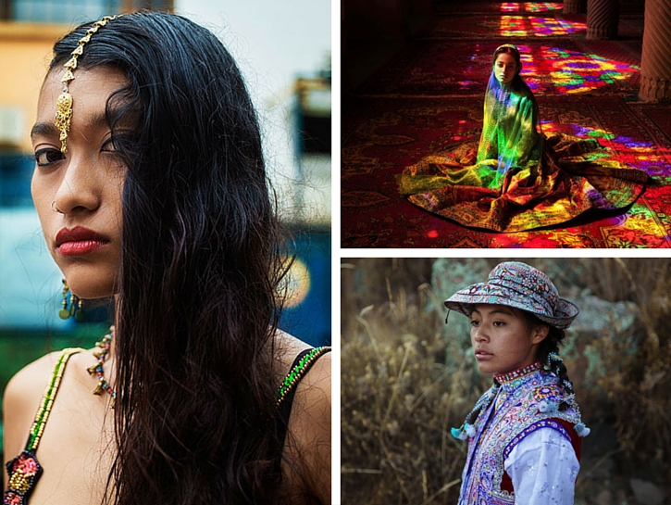

Slide 3
Cultural Bias?
After viewing these slides, do you notice that the photographer showed a cultural bias in the photos selected?

Slide 4
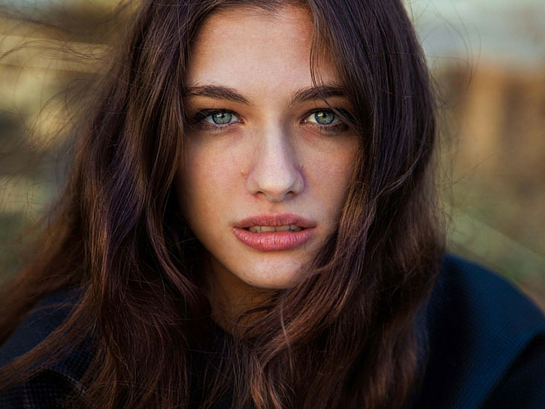
Tbilisi, Georgia

Slide 5
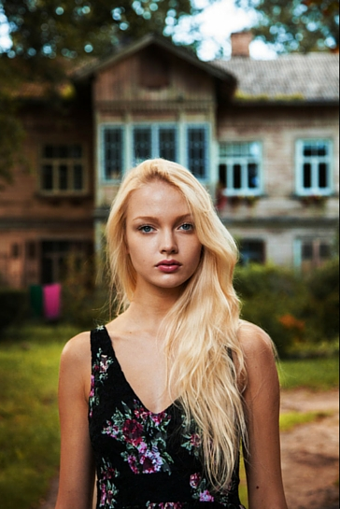
Riga, Latvia

Slide 6
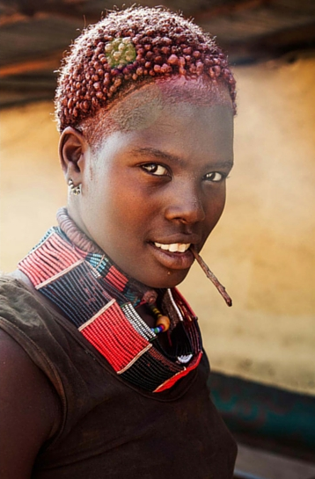
Omo Valley, Ethiopia

Slide 7
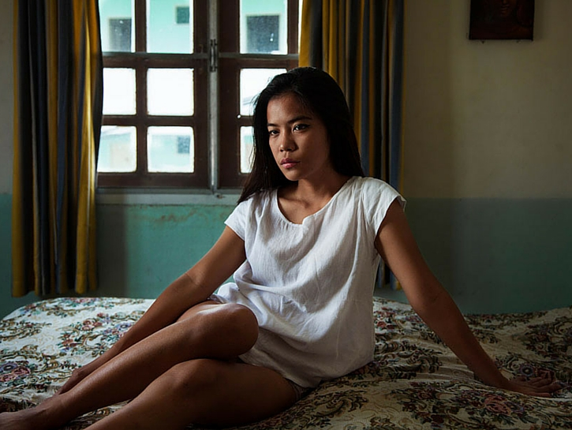
Chang Mai, Thailand

Slide 8
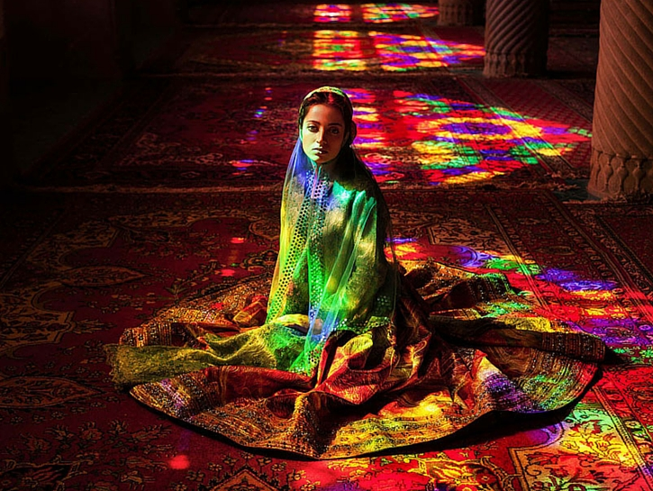
Nasir al-Mulk, Iran

Slide 9
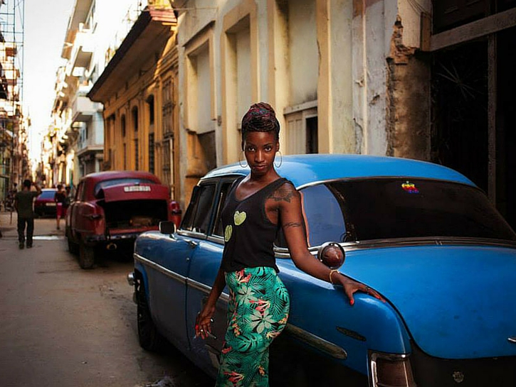
Havana, Cuba

Slide 10
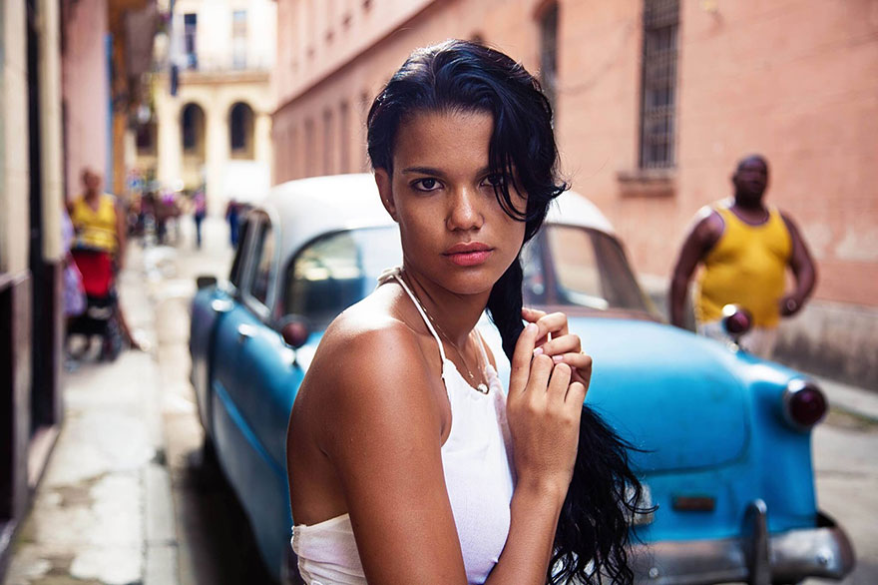
Havana, Cuba

Slide 11
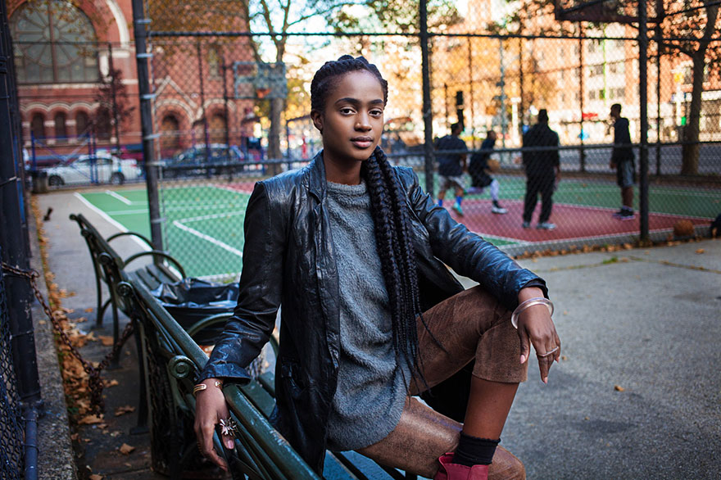
Harlem, New York City, USA

Slide 12
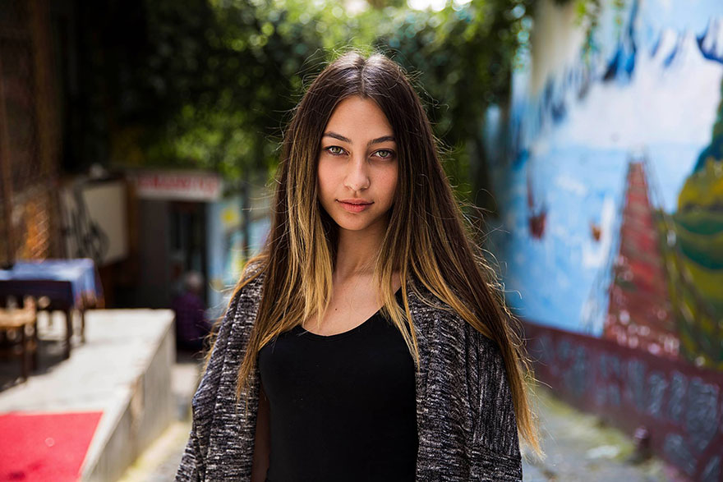
Turkish Cypriot

Slide 13
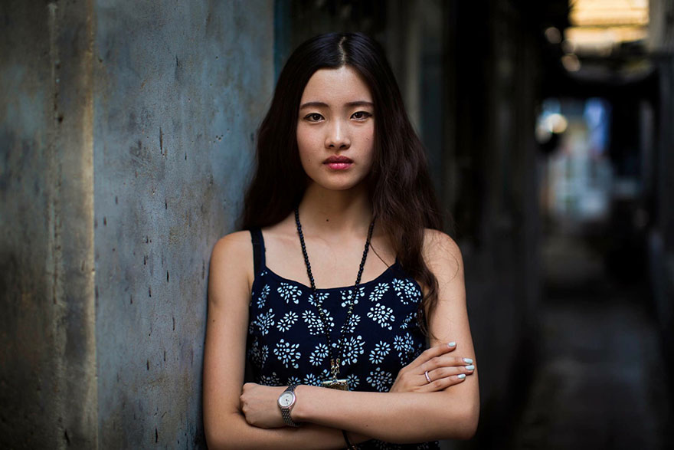
Beijing, China

Slide 14
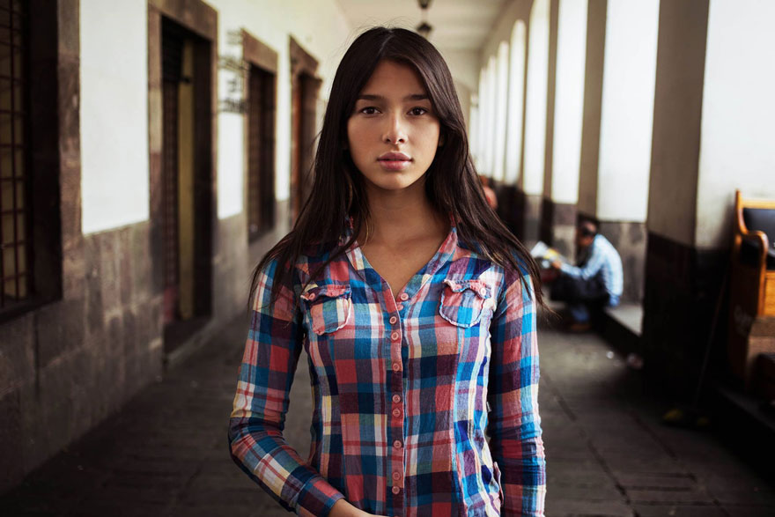
Colombian in Ecuador

Slide 15
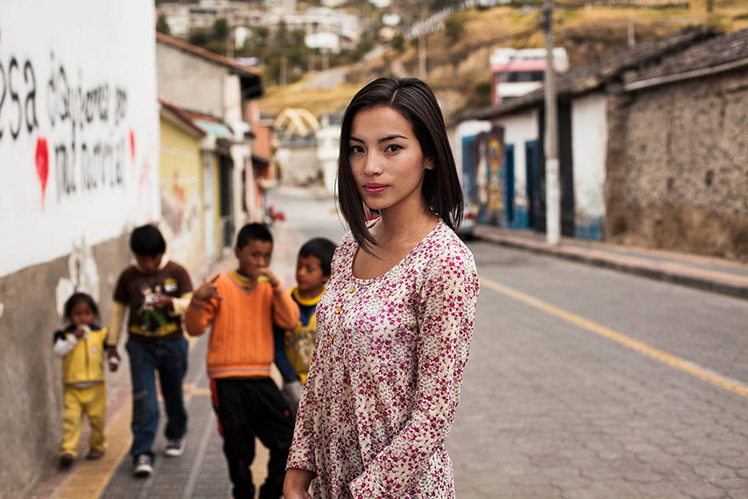
Colombian in Ecuador

Slide 16
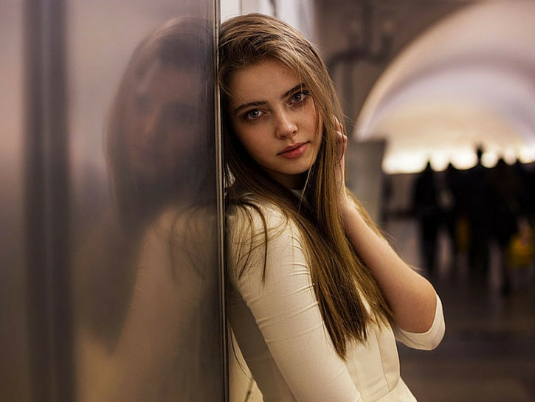
Moscow, Russia

Slide 17
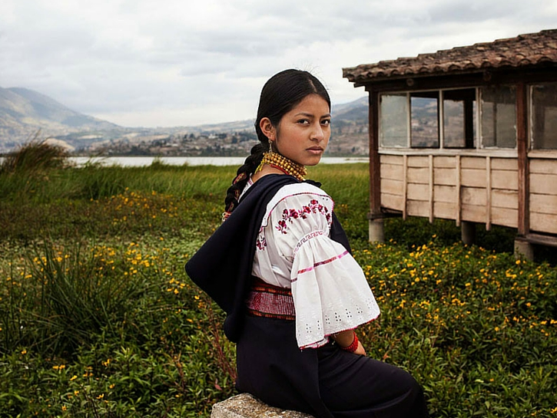
Otavalo, Ecuador

Slide 18
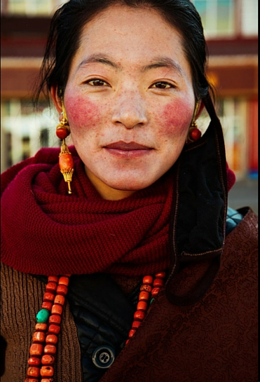
Tibetan Plateau, China

Slide 19
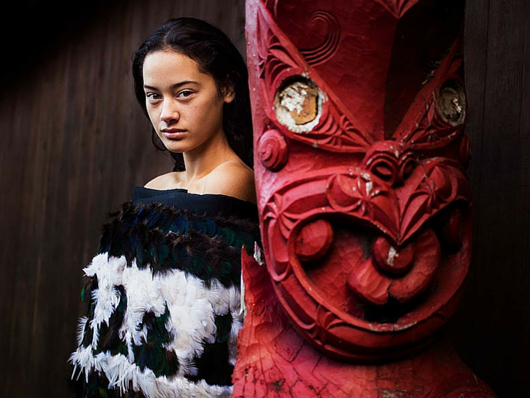
Maori Temple, New Zealand

Slide 20
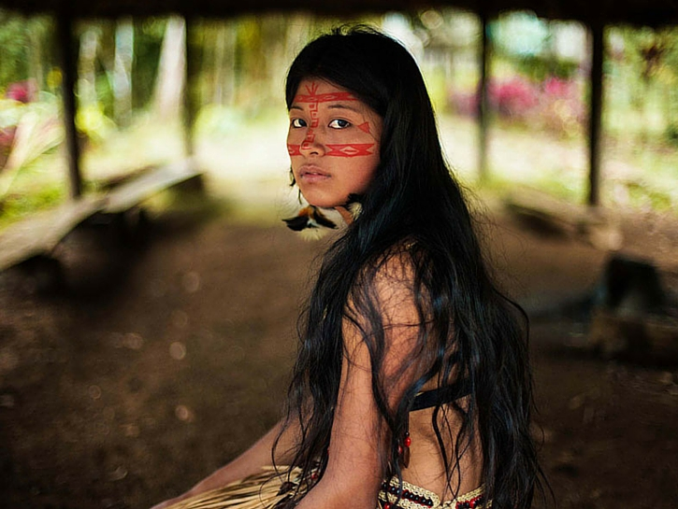
Amazon Rainforest

Slide 21
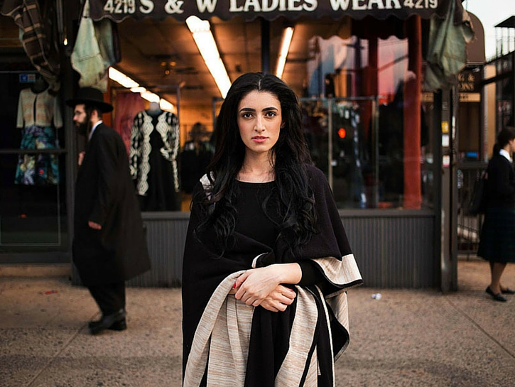
New York City, USA

Slide 22
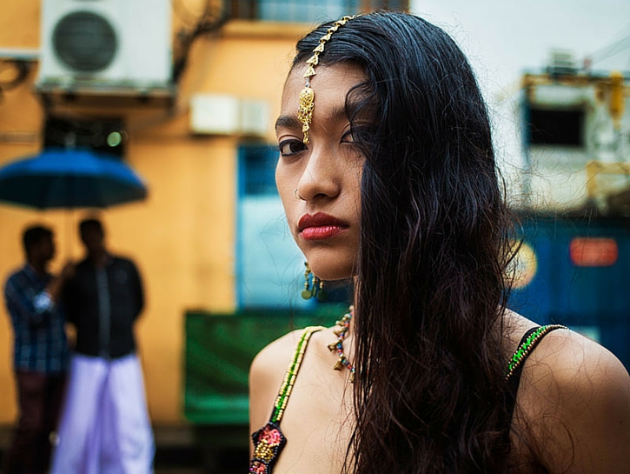
Little India, Singapore

Slide 23
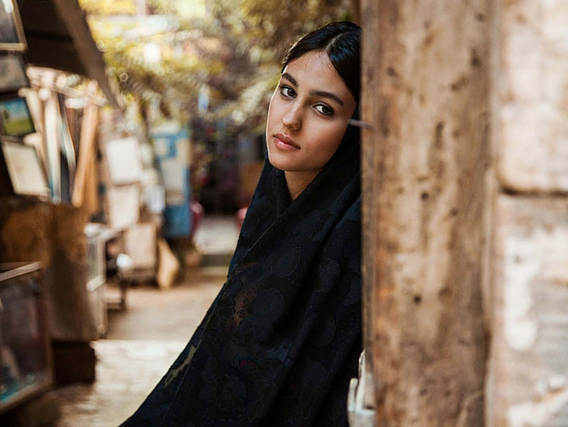
Shiraz, Iran

Slide 24
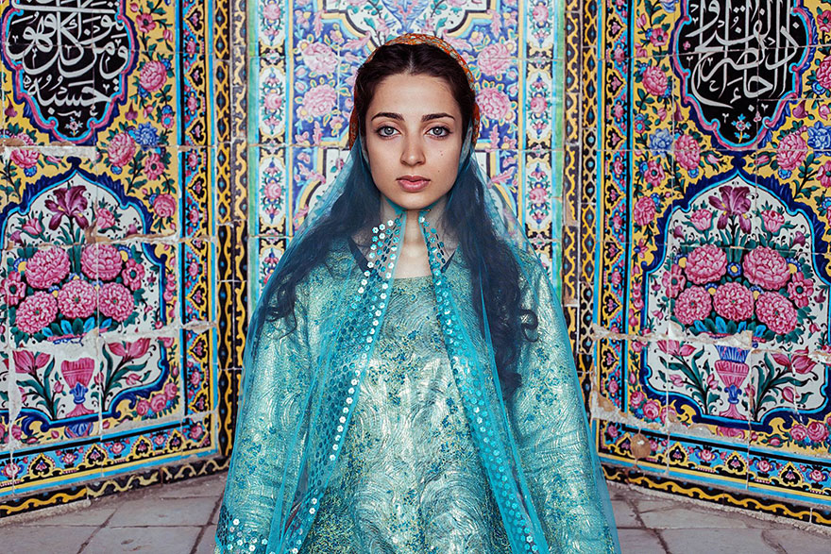
Shiraz, Iran

Slide 25
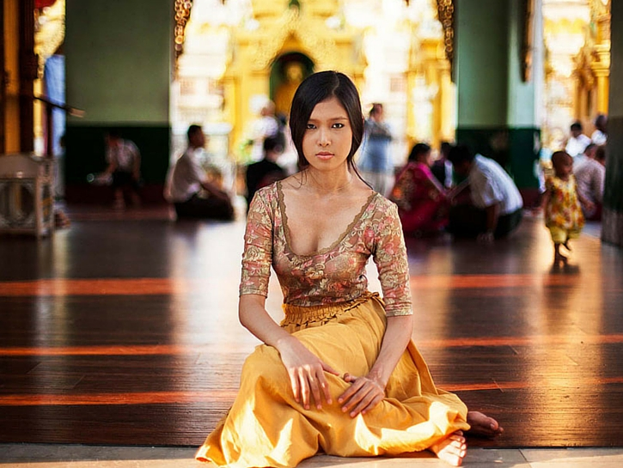
Yangon, Myanmar

Slide 26
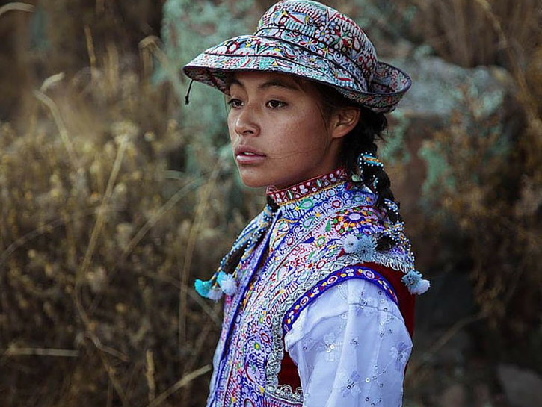
Colca Valley, Peru

Slide 27
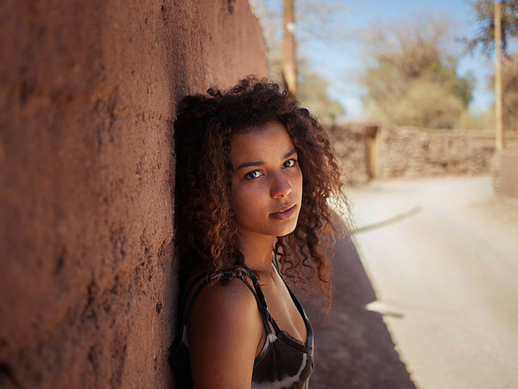
San Pedro de Atacama, Chile

Slide 28
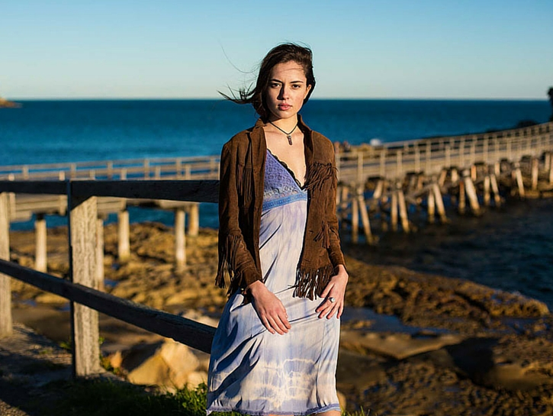
Sydney, Australia

Slide 29
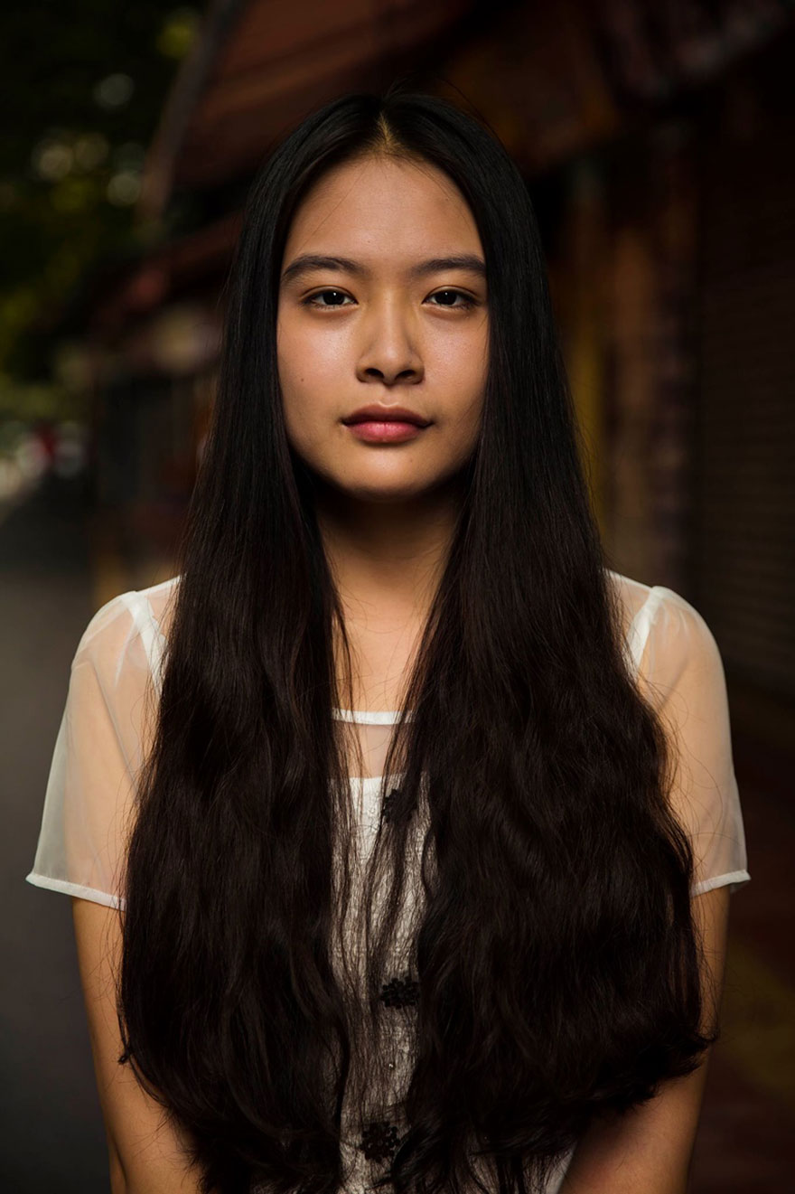
Guangzhou, China

Slide 30
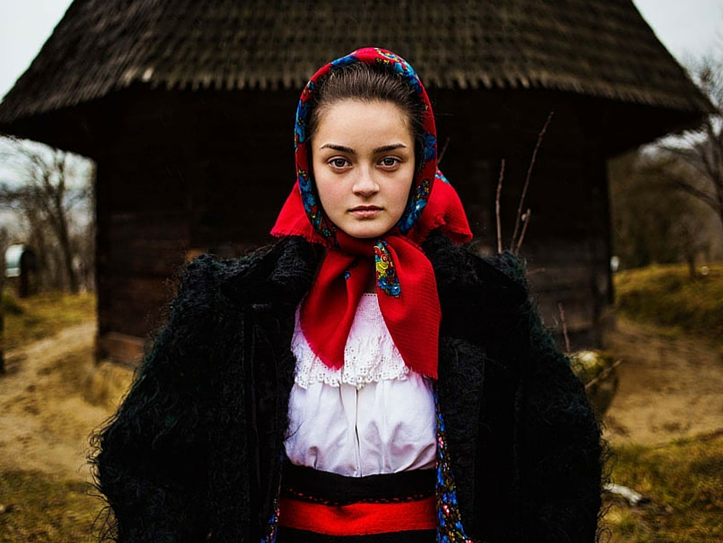
Maramures, Romania

Slide 31
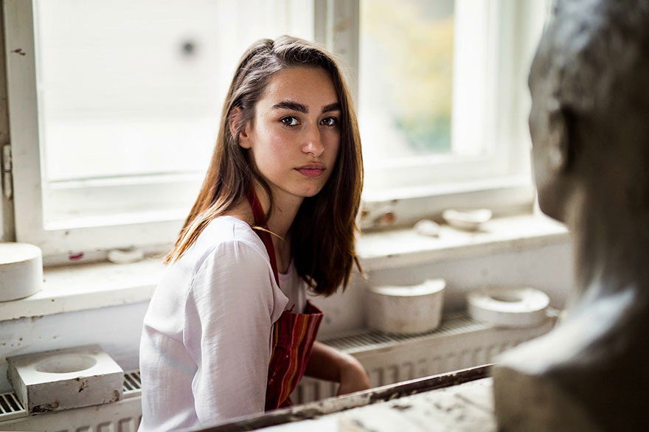
Cluj, Romania

Slide 32
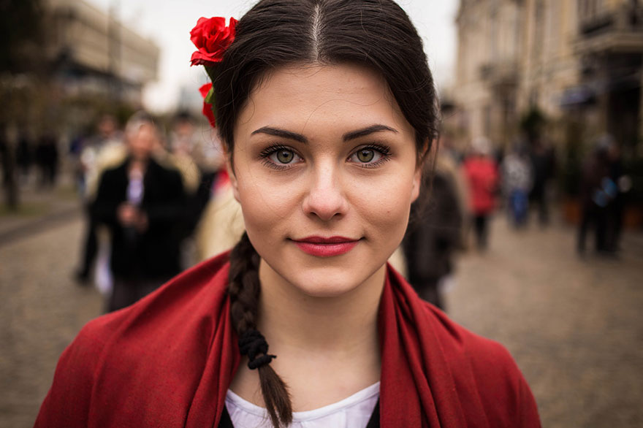
Moldova

Slide 33
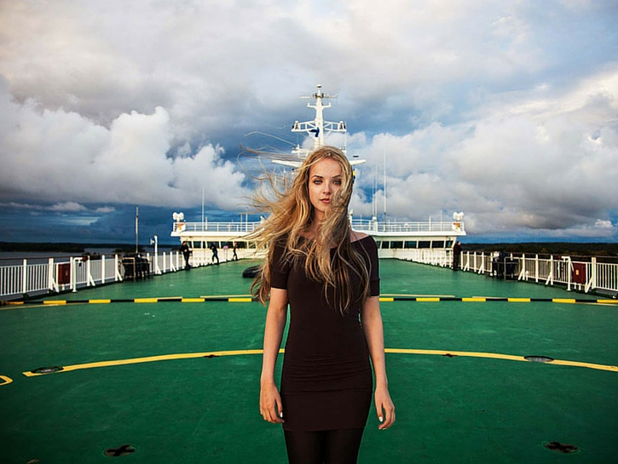
Baltic Sea, Finland

Slide 34
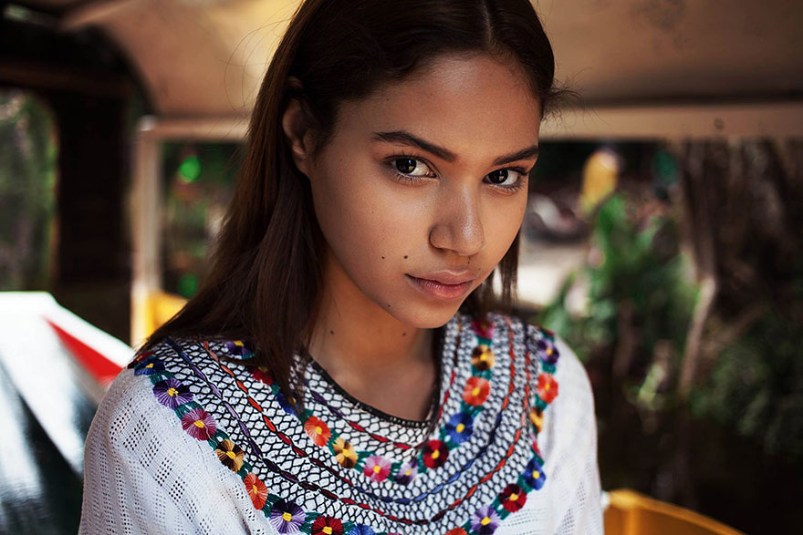
Mexico City, Mexico

Slide 35
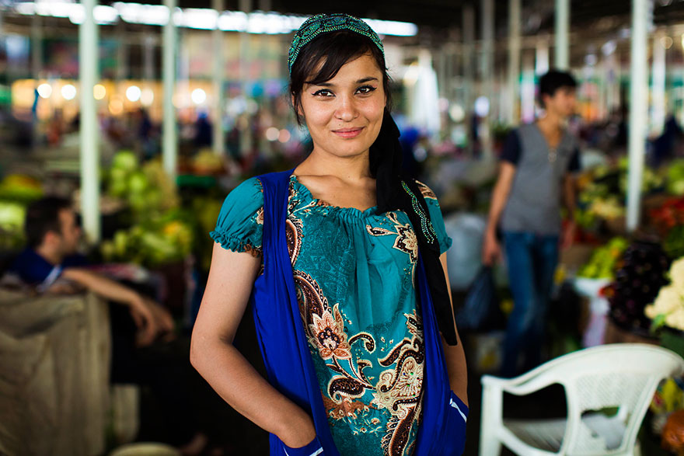
Dushanbe, Tajikistan

Slide 36
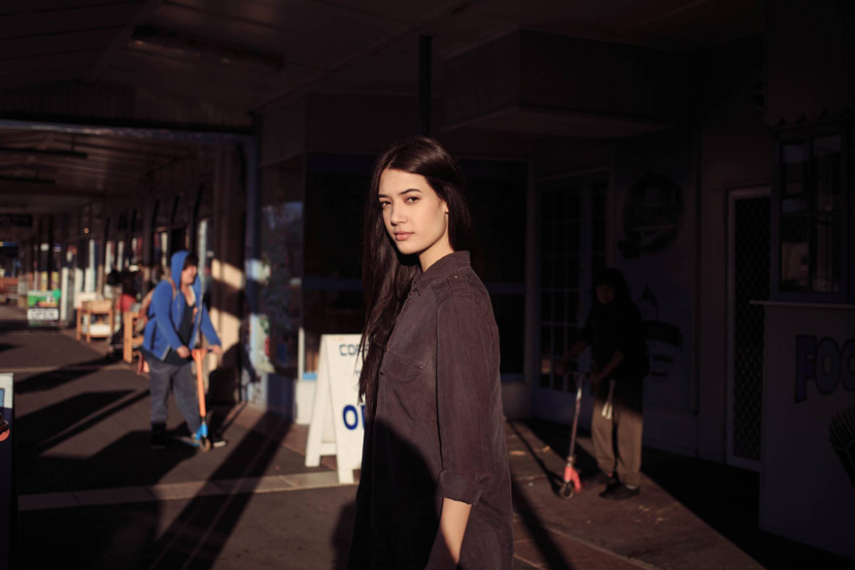
Woodville, New Zealaned

Slide 37
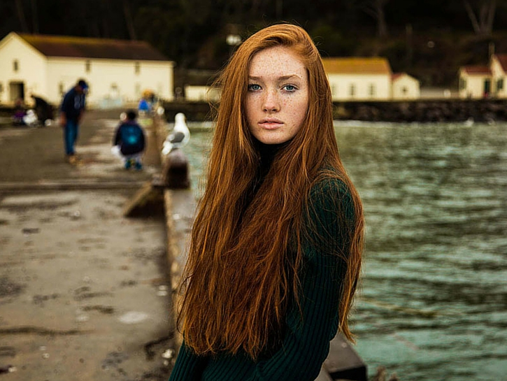
San Francisco, USA

Slide 38
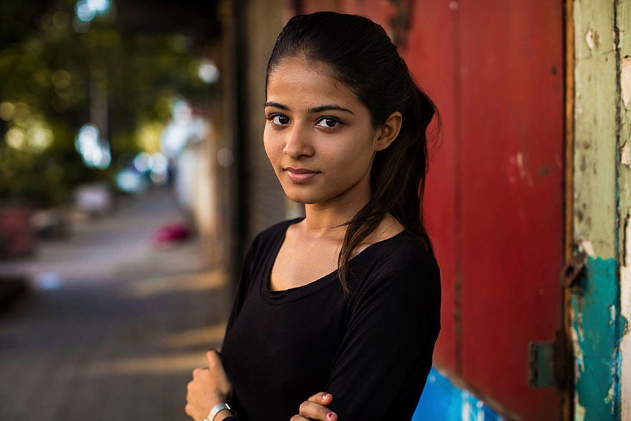
Mumbai, India

Slide 39
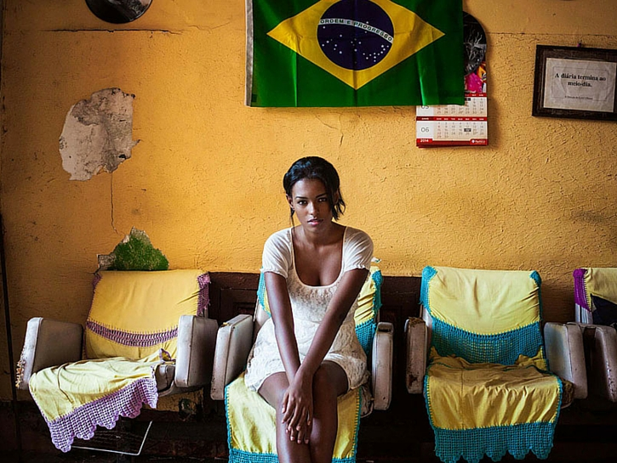
Rio de Janeiro, Brazil

Slide 40
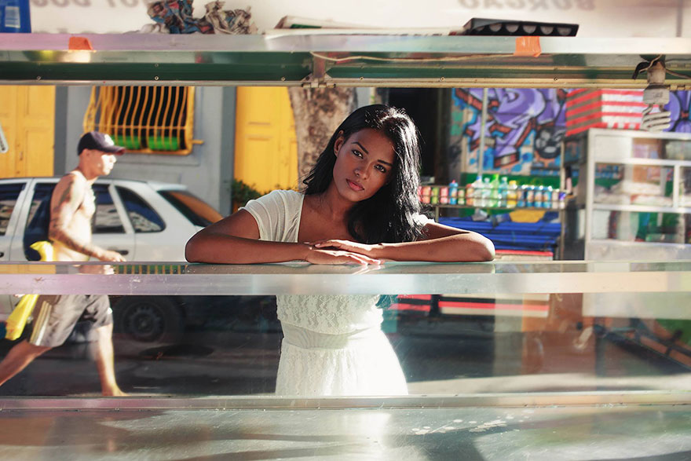
Rio de Janeiro, Brazil

Slide 41
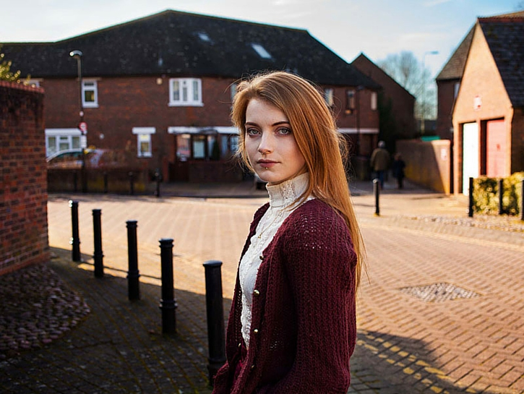
Oxford, UK

Slide 42
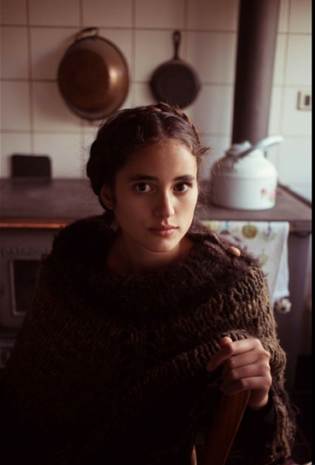
El Paico, Chile

Slide 43
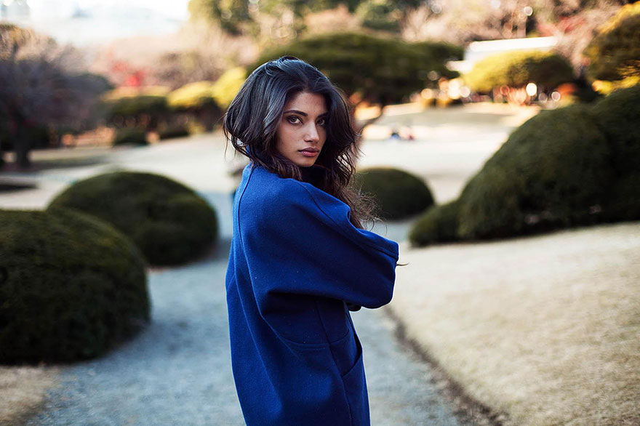
Indian in Japan

Slide 44
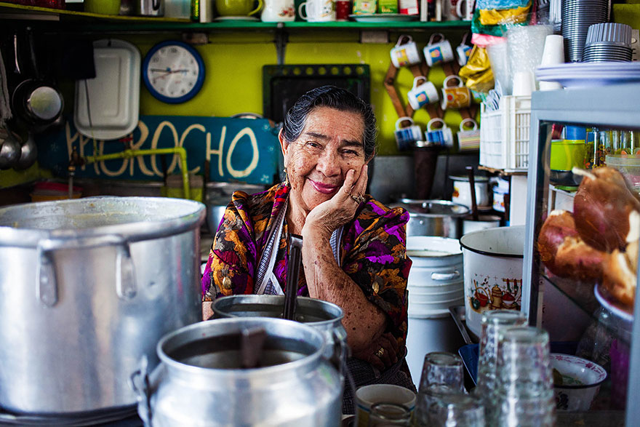
Ecuador

Slide 45
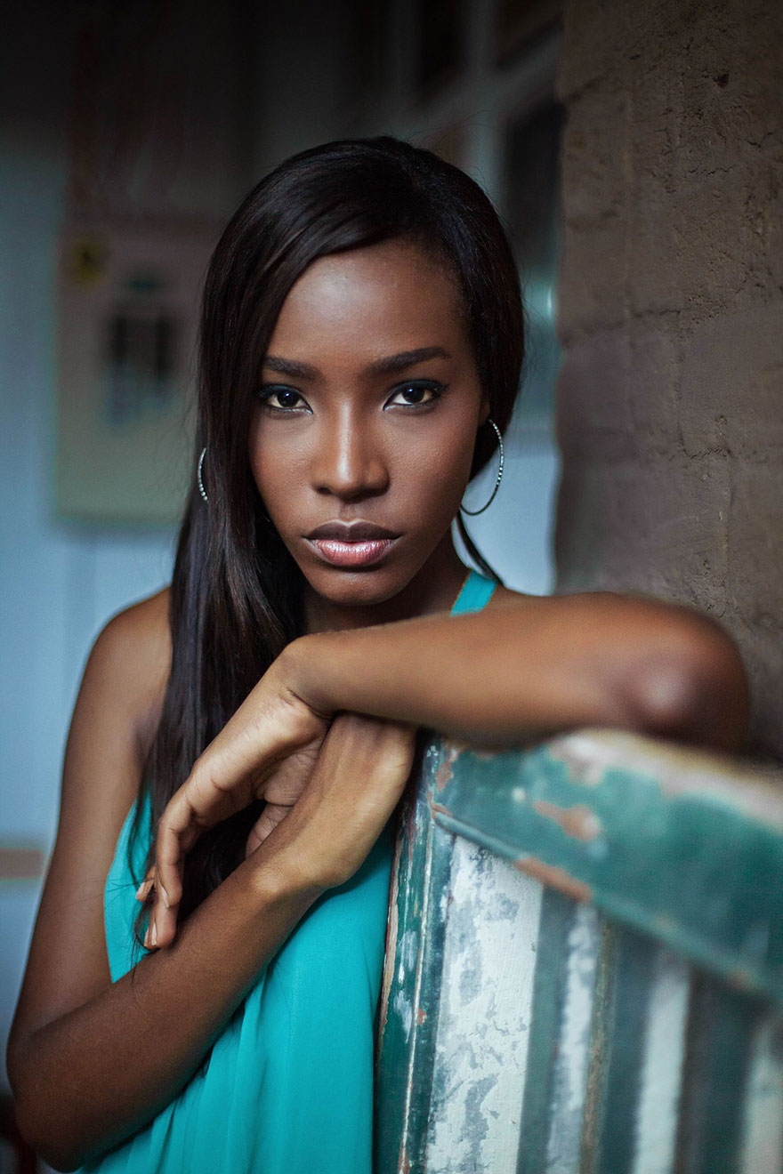
Cali, Colombia

Slide 46
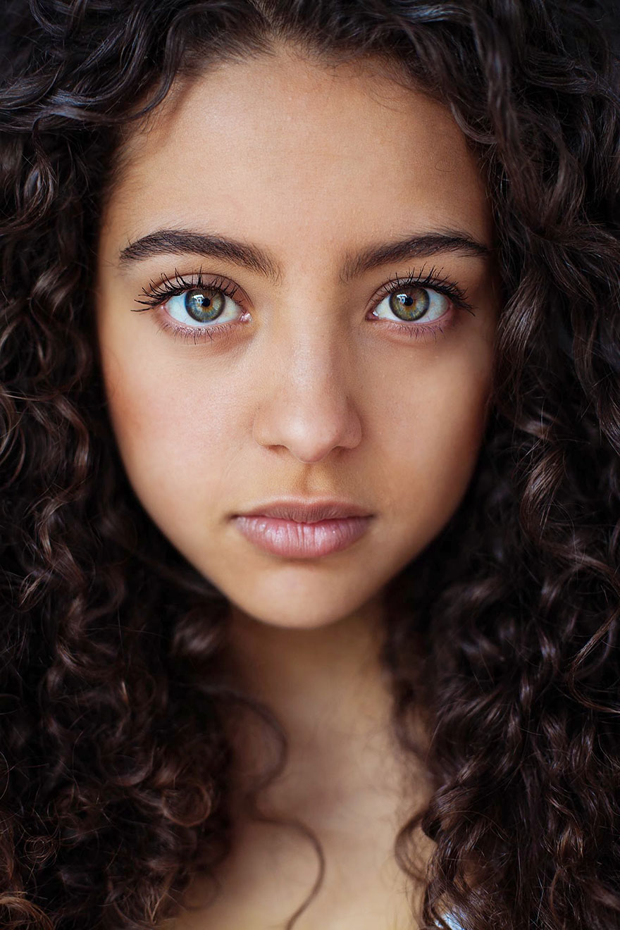
Medellin, Colombia

Slide 47
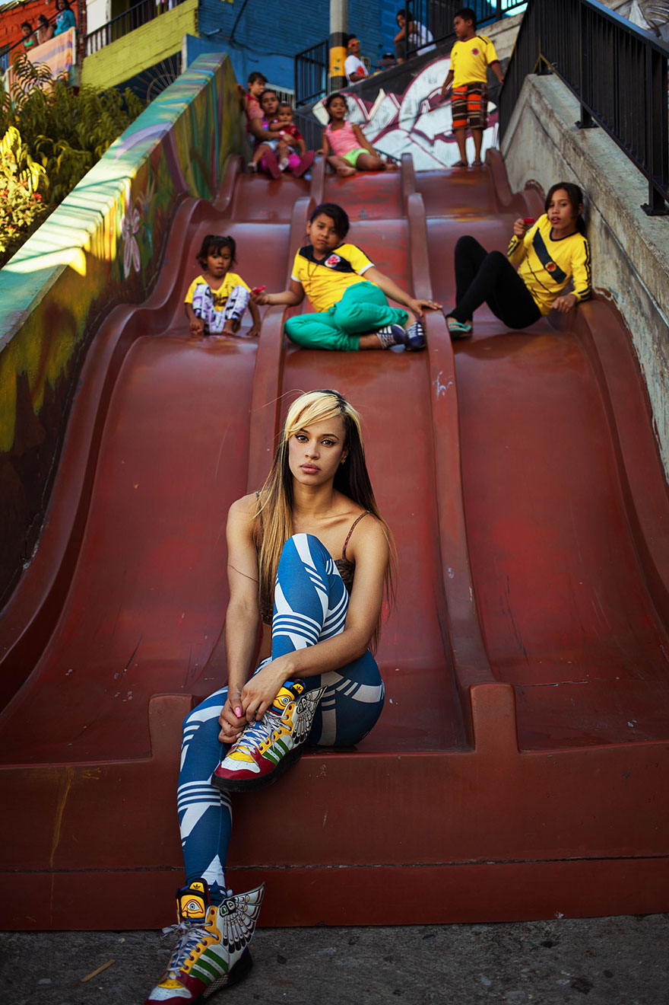
Medellin, Colombia

Slide 48
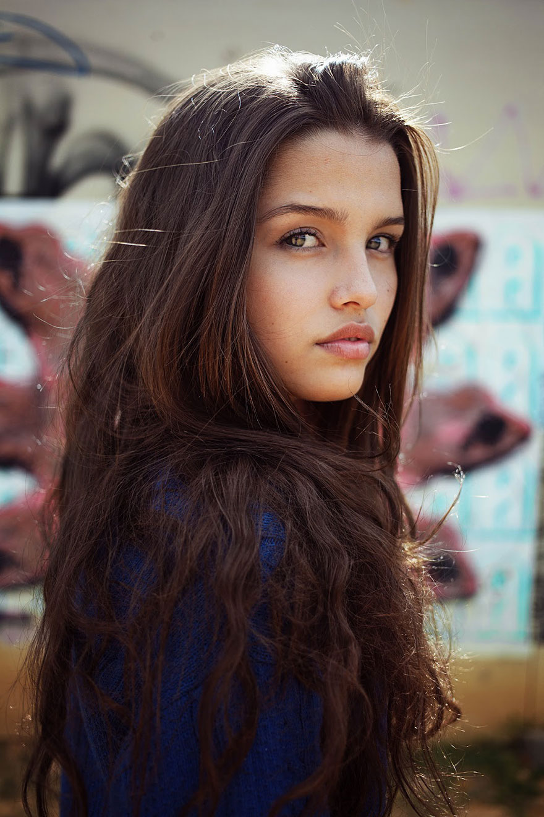
Medellin, Colombia

Slide 49
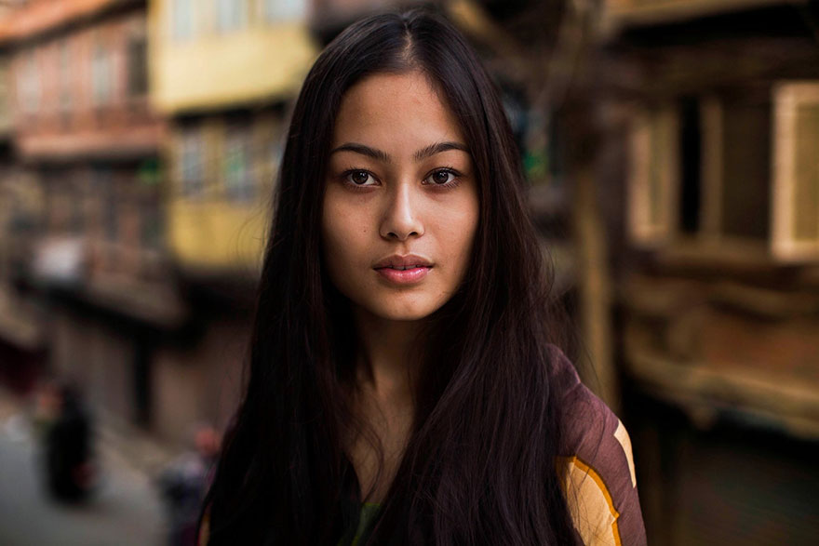
Kathmandu, Nepal

Slide 50
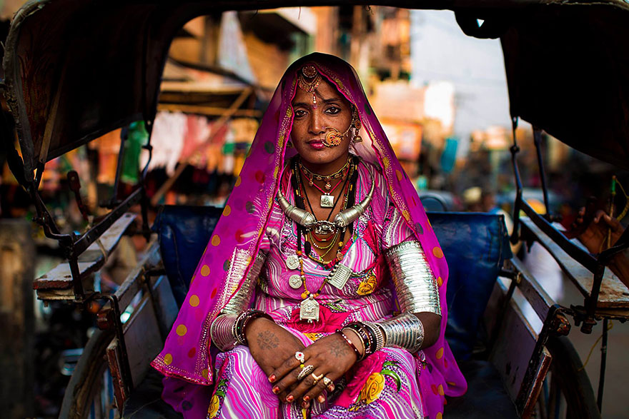
Jodhpur, India

Slide 51
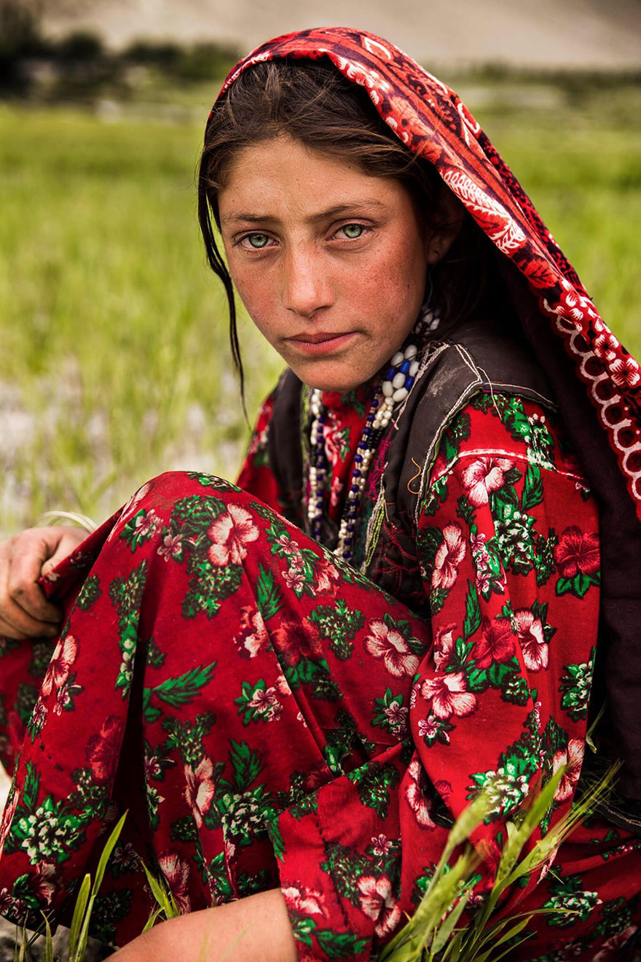
Wakhan Corridor, Afghanistan

Slide 52
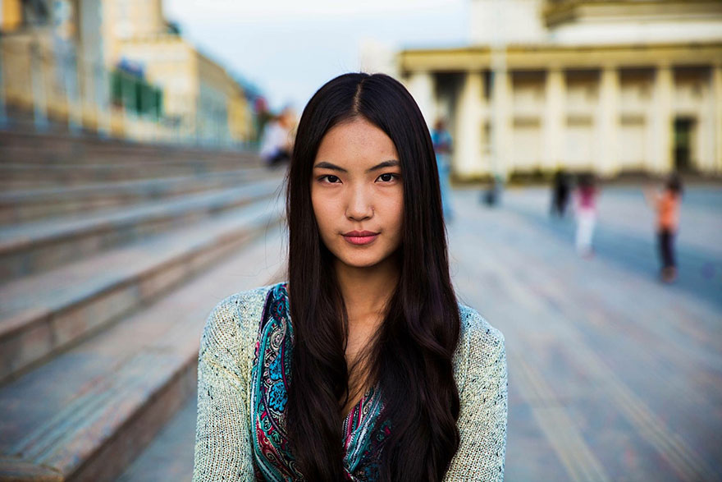
Ulaanbaatar, Mongolia

Slide 53

Amazon Forest

Slide 54

Australia

Slide 55

Bishkek, Krygyzstan

Slide 56

Arequipa, Peru

Slide 57
Well, did you detect a bias?
Who or what was over represented in the selection?
Who or what was under represented in the selection?
Where do you think the photographer’s homeland is?

Slide 58

Why were women like these included?

Slide 59

Maasai

Slide 60

San woman (Bushman)

Slide 61

Tamil woman

Slide 62

Australian Aboriginal Woman

Slide 63

Cherokee woman, USA

Slide 64

Alaska Native Women

Slide 65

Swazi woman

Slide 66

Tutsi woman

Slide 67

Samoan woman, USA

Slide 68

Mayan woman

