Slide 1
Wonderful Hindu Temples abroad

Slide 2
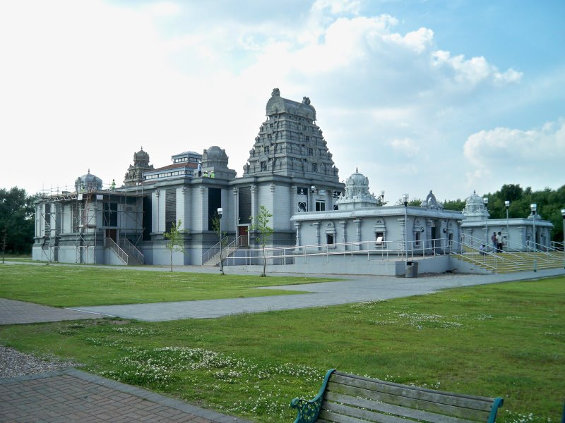
Lord Venkateshwara Temple, Birmingham, United Kingdom

Slide 3
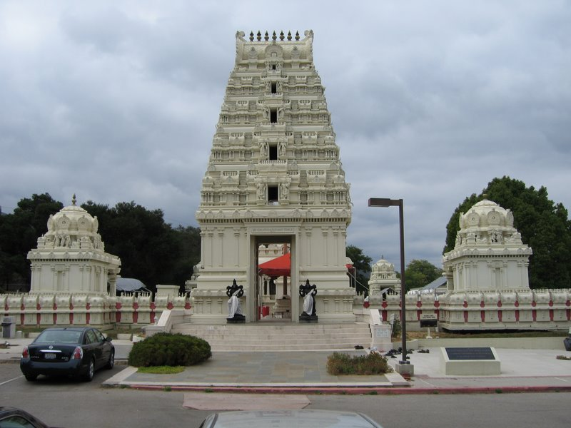
Malibu Hindu Temple, Malibu, California, US

Slide 4
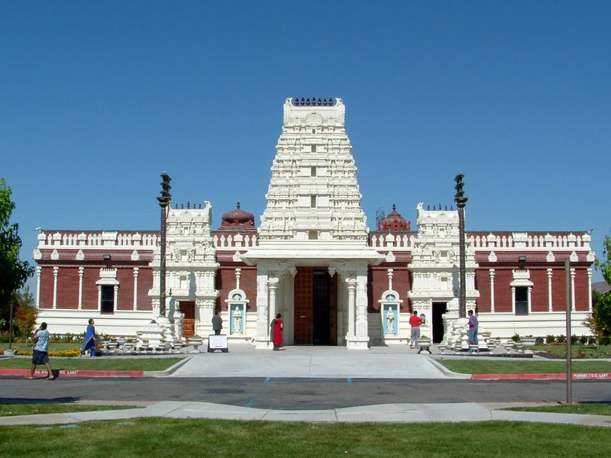
Shiva-Vishnu Temple, Livermore, California, US

Slide 5
Lord Vishnu Temple, Angkor, Cambodia
The largest temple of the world, raised during the reign of Suryavarman-II in 12th century, is, in fact, located in Angkor, a major archaeological site of Cambodia. It is dedicated to Lord Vishnu. It is also one of the two temples intact in Angkor, Cambodia. The other is a Buddhist Temple. The largest temple of Lord Vishnu in Angkor is built according to Khmer architecture, original to Cambodia.
Picture on next slide

Slide 6
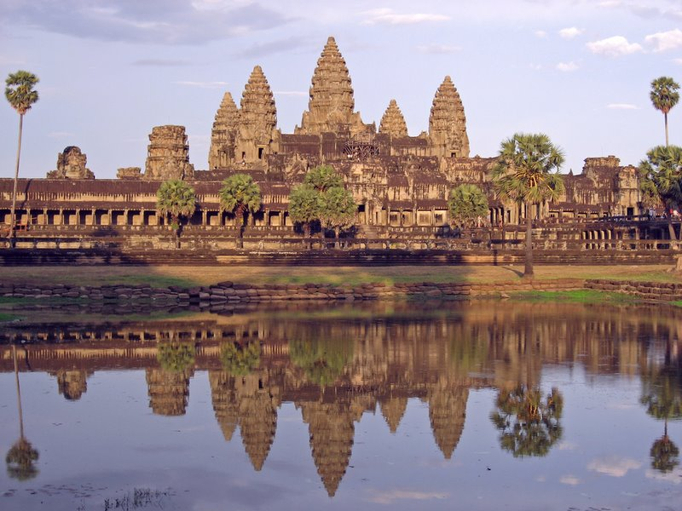

Slide 7
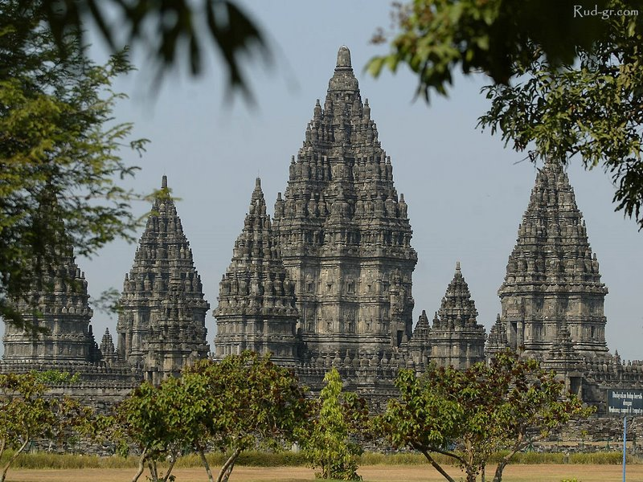
Prambanan Shiva Temple, Central Java, Indonesia

Slide 8
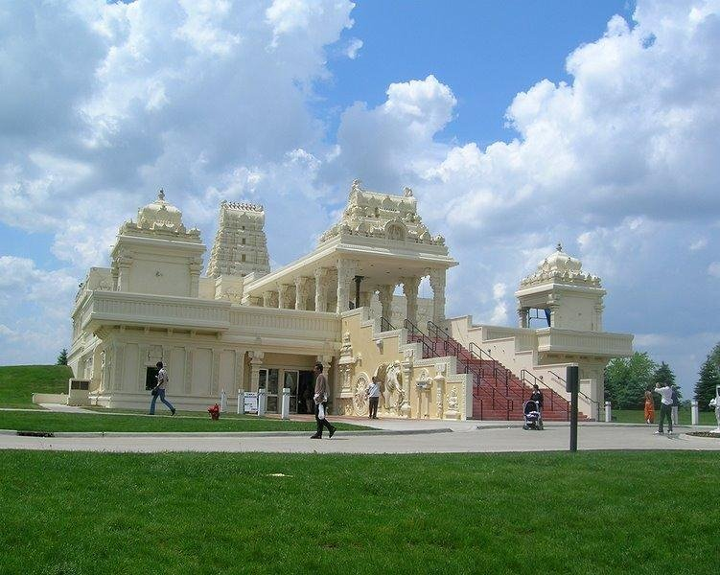
Sri Venkateswara Swami Temple of Greater Chicago - Aurora, Illinois, United States

Slide 9
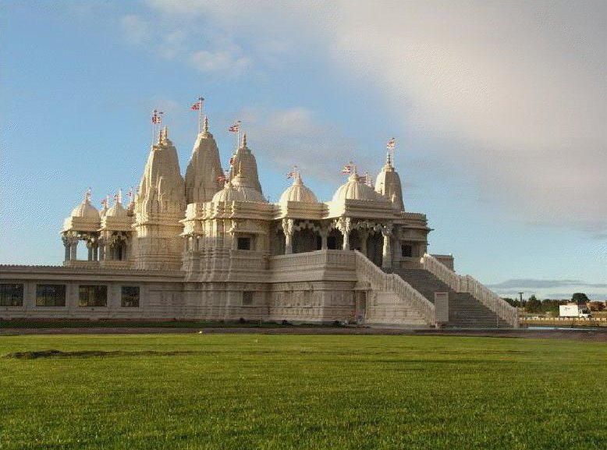
BAPS Shri Swaminarayan Mandir - Toronto, Canada

Slide 10
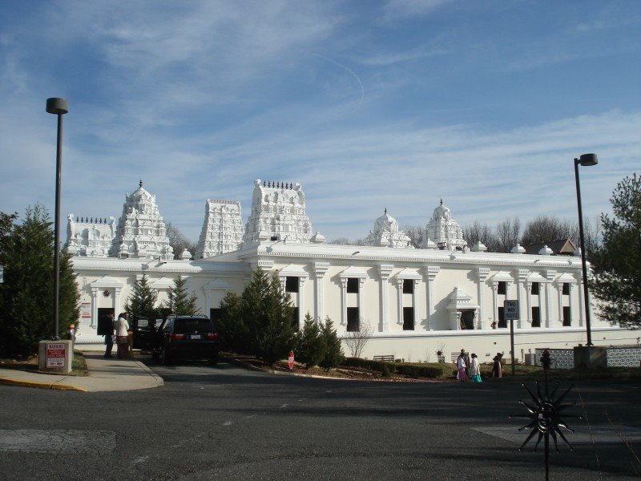
Sri Siva Vishnu Temple, Washington DC, United States

Slide 11
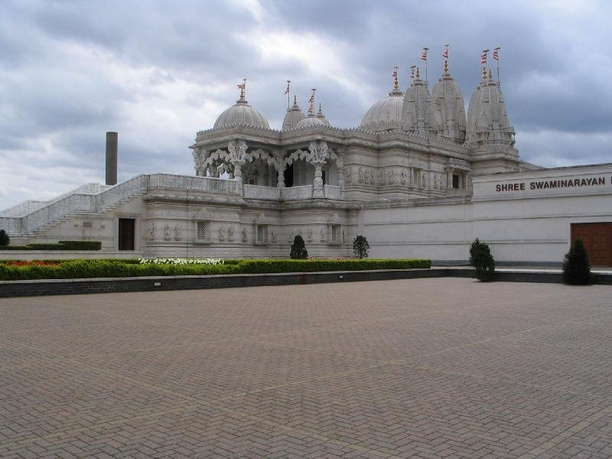
BAPS Shri Swaminarayan Mandir, London (Neasden Temple), United States

Slide 12
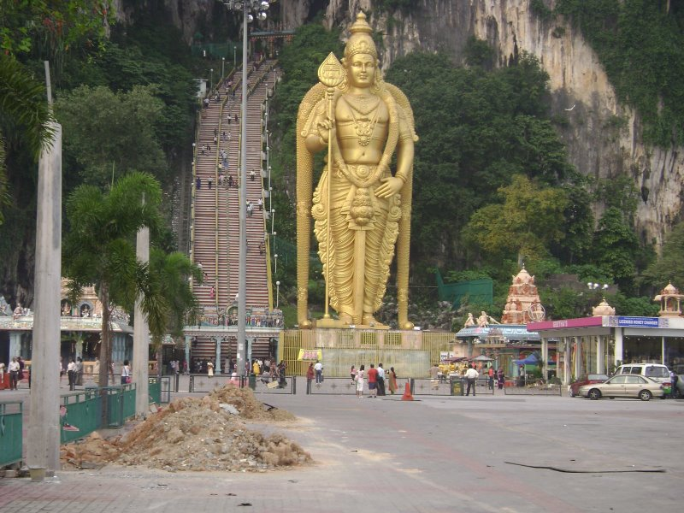
Sri Murugan Temple “Batu Caves”, Penang, Malaysia

Slide 13
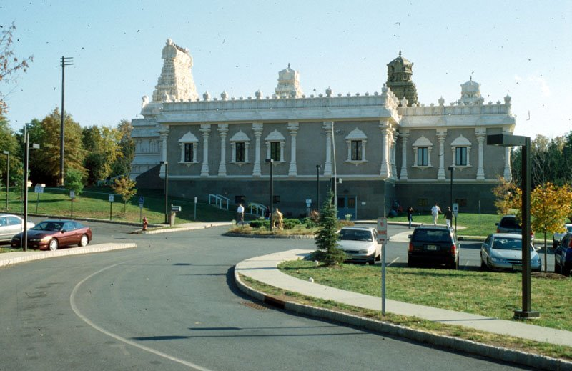
Sri Venkateswara Temple, Bridgewater, NJ, US

Slide 14
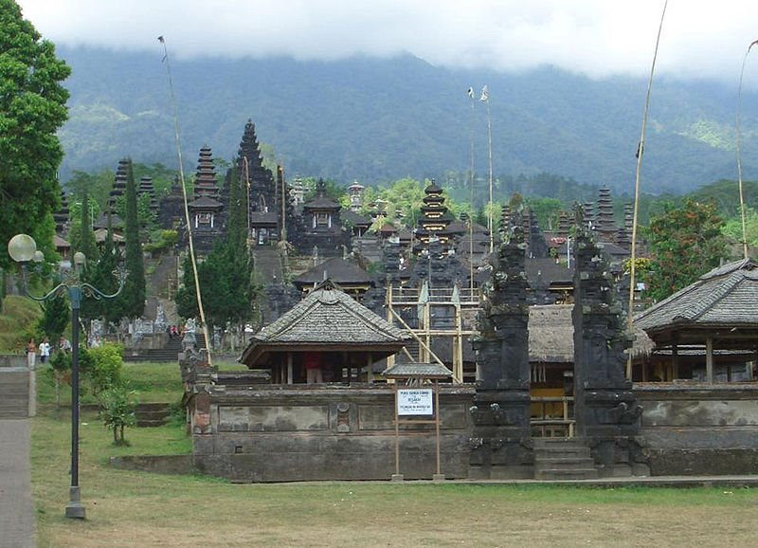
Mother Temple of Besakih, Bali, Indonesia

Slide 15
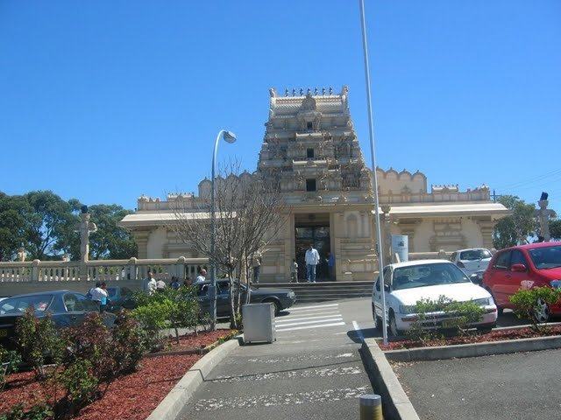
Murugan Temple, Sydney, Australia

Slide 16
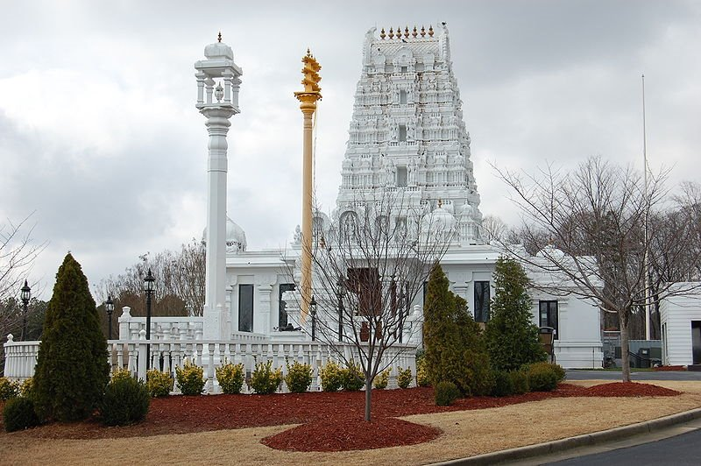
Venkateswara Swami temple, Riverdale near Atlanta, Georgia, US

Slide 17
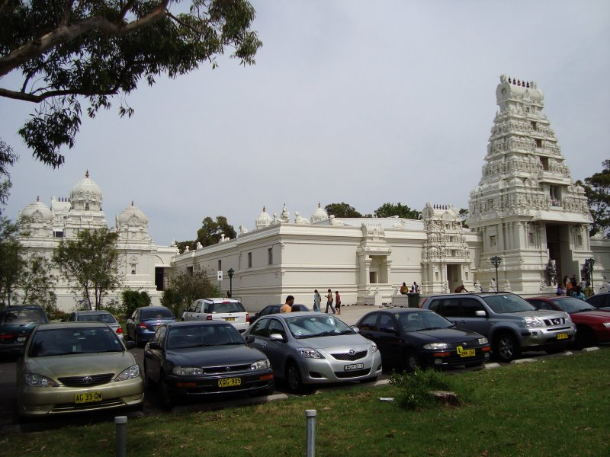
Sri Venkateswara Swami Temple, Helensburgh, Sydney, Australia

Slide 18
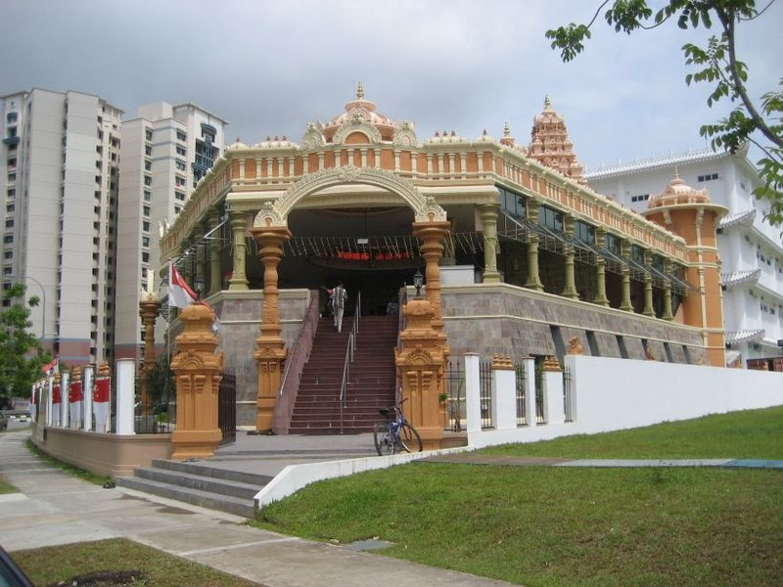
Velmurugan Gnana Muneeswarar Temple, Rivervale Crescent Sengkang, Singapore

Slide 19
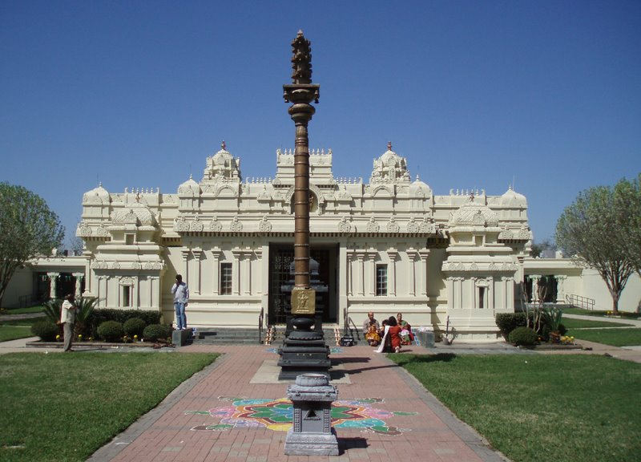
Sri Meenakshi Devasthanam - Pearland, Texas, US

Slide 20
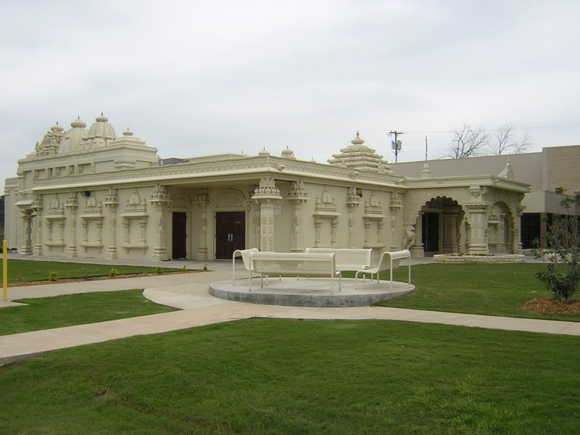
Ekta Mandir, Irving, Texas, US

Slide 21
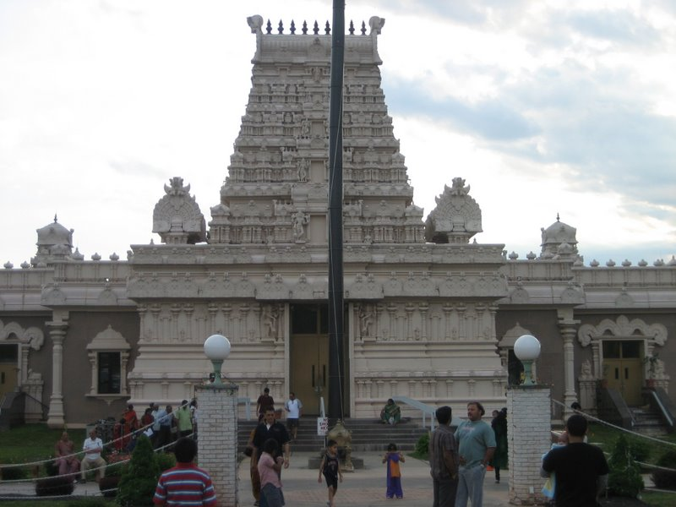
Sri Venkateshwara Temple - New Jersey, US

Slide 22
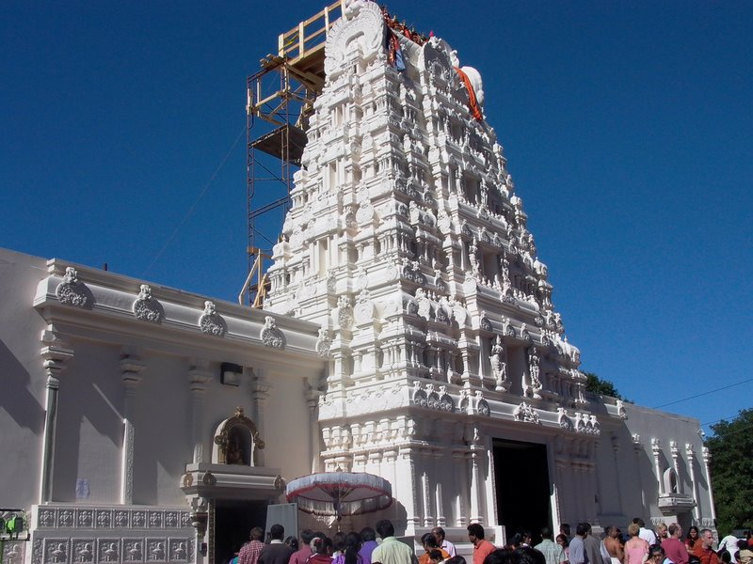
Sri Lakshmi Temple - Ashland, MA, US

Slide 23
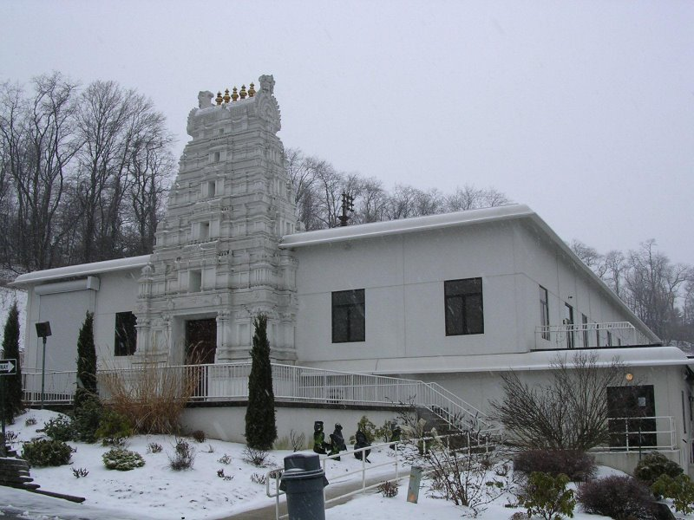
Sri Venkateswara Swami Temple, Pittsburgh, US

Slide 24
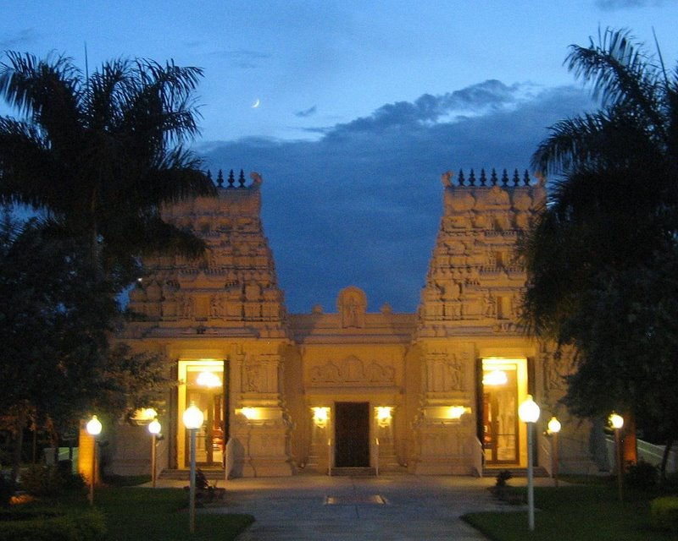
Shiva Vishnu Temple of South Florida Inc, FL, US

Slide 25
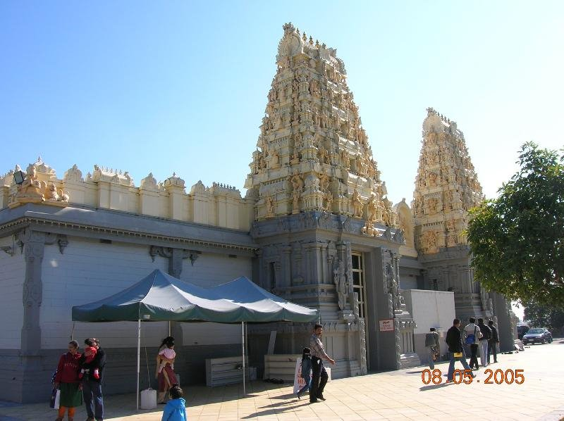
Shiva - Vishnu Temple of Melbourne, Melbourne, Australia

Slide 26
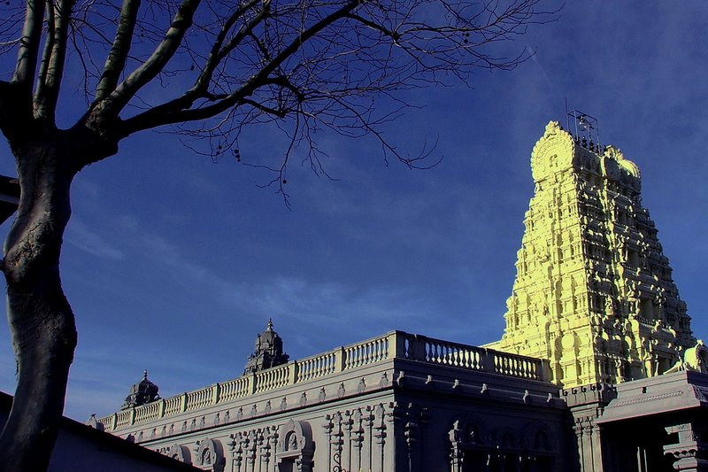
Sri Murugan Temple, London, UK

Slide 27
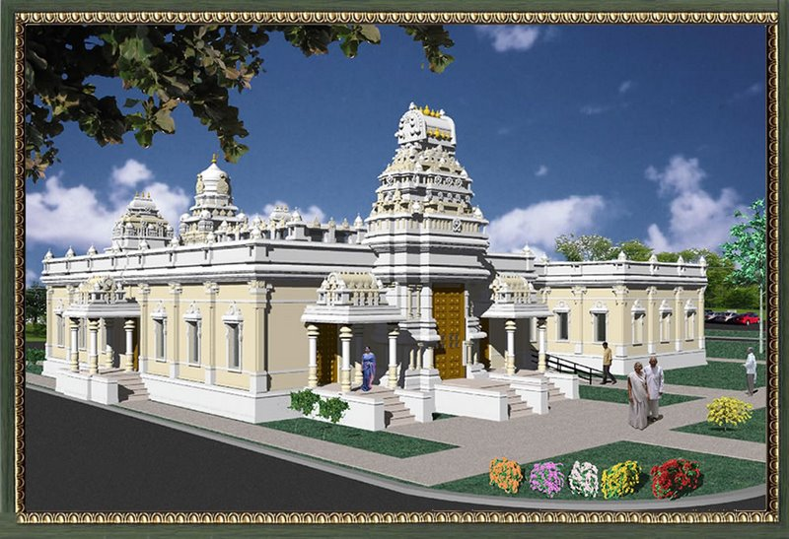
Quad City Hindu Temple , Rock Island, IL, US

Slide 28
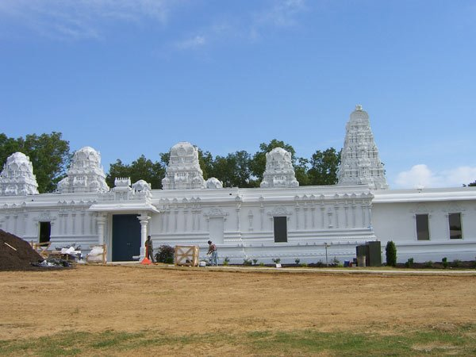
Sri Prasanna Venkateswara Swami Temple, Memphis, Tennessee, US

Slide 29
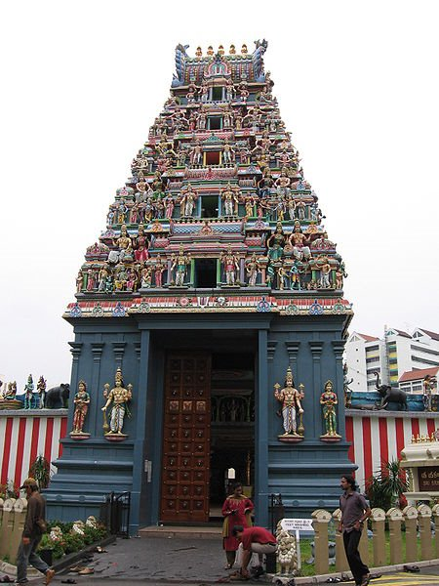
Sri Srinivasa Perumal Temple or Sri Perumal Temple, Little India, Serangoon Road, Singapore

Slide 30
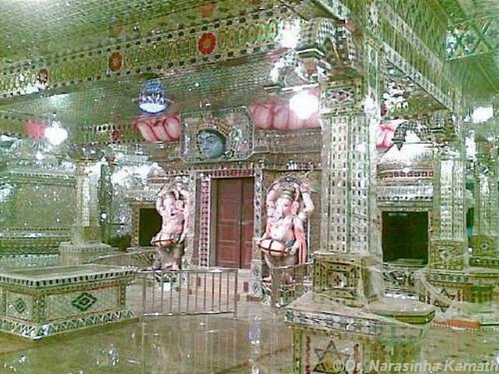
Arulmigu Sri Raja Kaliamman Temple, Johor Baru, Malaysia - The only Hindu Glass Temple abroad

