Slide 1
What The Perfect Body Looks Like In Different Countries
What a variety of beauty!

Slide 2
As we all know beauty is subjective to those who view it, but in this day and age, it’s easy for brains to be brainwashed with magazine covers and models of what “the perfect woman” should look like. A UK online pharmacy called Superdrug Online Doctors wanted to see if the ideal woman’s body was more or less the same around the world. They took a woman’s photo and sent it to 17 different designers in 17 different countries to photoshop her as that countries’ ideal image. Their press release states that “The goal of this project is to better understand potentially unrealistic standards of beauty and to see how such pressures vary around the world.” The results could not be more different.

Slide 3
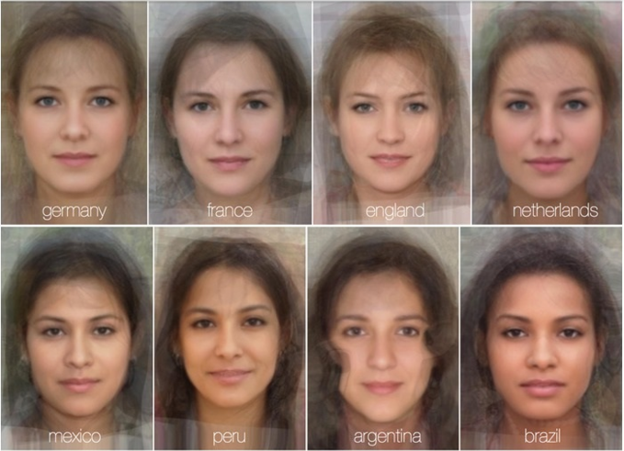

Slide 4
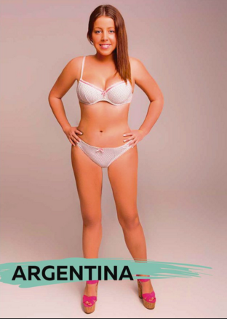
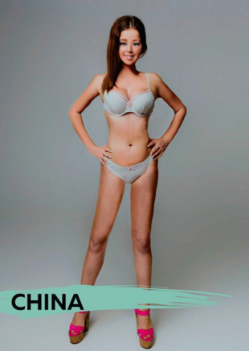

Slide 5
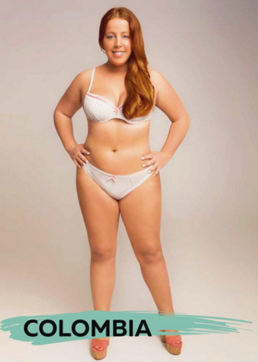
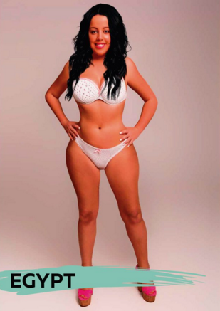

Slide 6
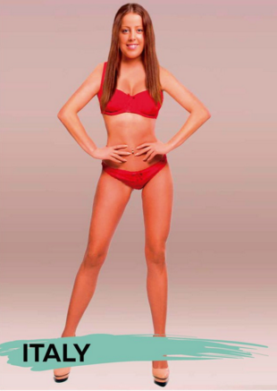
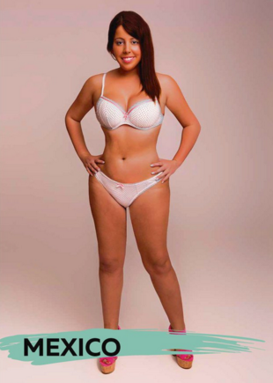

Slide 7
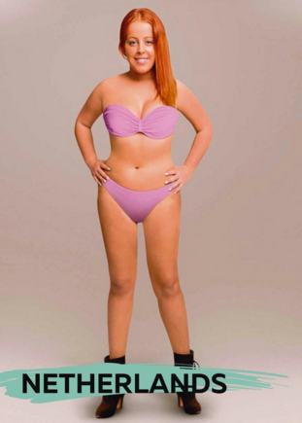
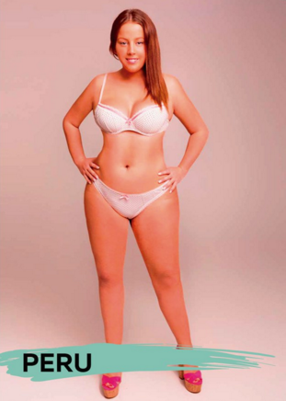

Slide 8
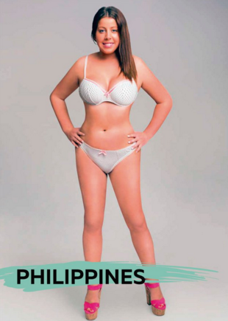
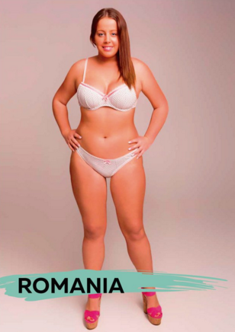

Slide 9
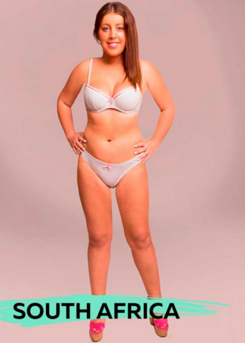
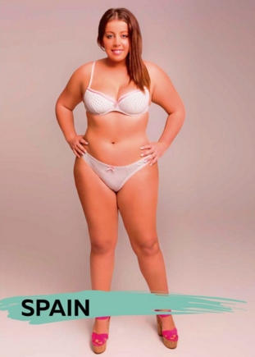

Slide 10
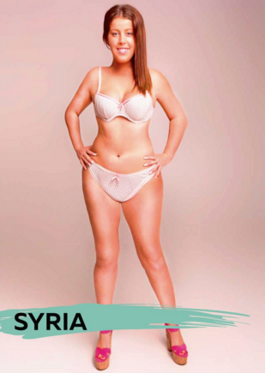
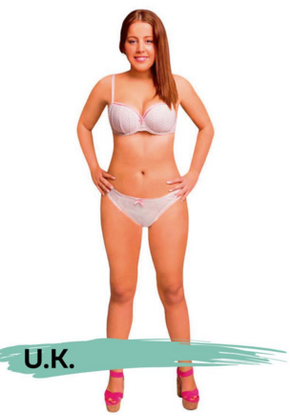

Slide 11
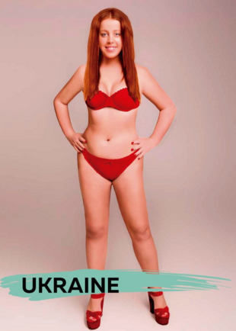
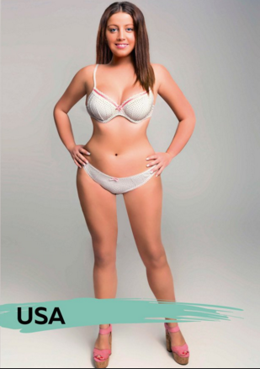

Slide 12
