Slide 1
What Makes Someone a Christian?
Subtitle

Slide 2
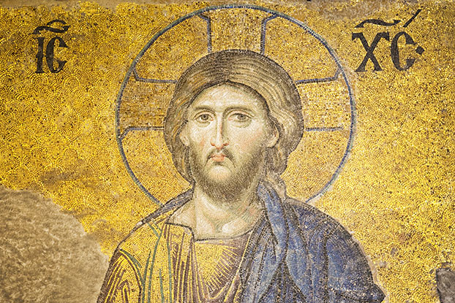
Like most religions, Christianity is defined differently by different people. Here are some of the ways it has been defined traditionally, and some of alternativesthe modern. Things change around slide 10, and slide 16 will surprise you.

Slide 3
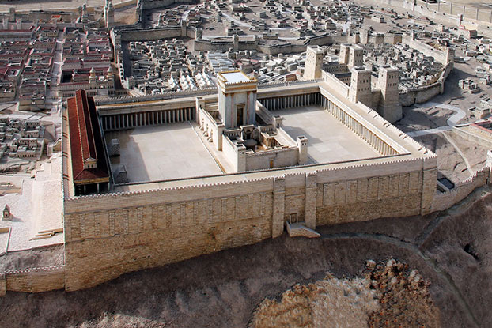
Most agree that Christianity developed in the context of first-century Judaism. The faith of Christians is centered on Jesus, a Jewish rabbi who, after three years of teaching, died in c. 33 C.E. at the hands of the Romans, but what happens next?

Slide 4
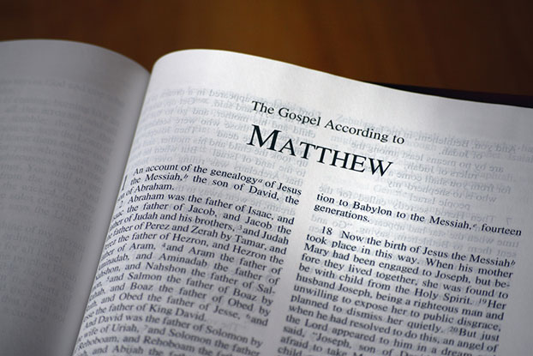
Over the centuries, most Christians agreed that the four Gospels—Matthew, Mark, Luke, and John—were the authoritative accounts of Jesus' life, death, and, most importantly for Christians, what happened after his death. What did Christians conclude about the Jesus story?

Slide 5
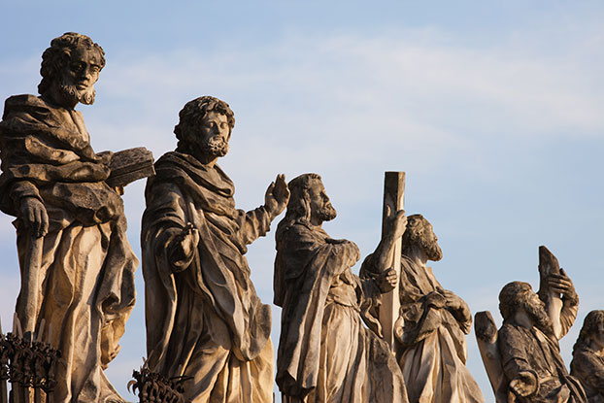
In the early centuries, most Christian leaders agreed on a handful of central documents that expressed the core of their faith. These are called creeds, and they include most importantly the Apostles' Creed and the Nicene Creed.

Slide 6
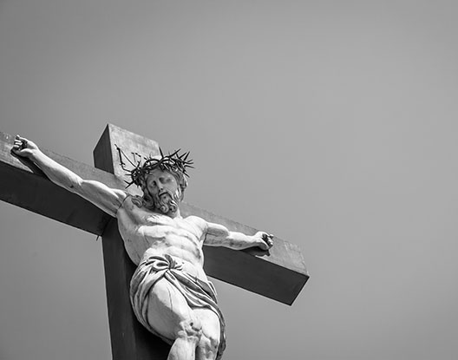
The creeds declared that Jesus was the Son of God who, being born of a virgin, lived a human life that culminated in a short ministry of teaching, miraculous healings, and finally crucifixion. The story doesn't end there though...

Slide 7
Jesus' followers insisted that God raised Jesus from the dead and that his death-resurrection had decisively changed the nature of human relationships with God.

Slide 8
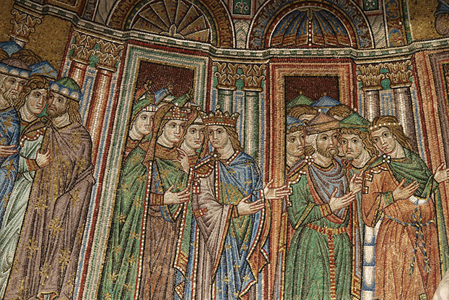
The creeds, the books of scripture (including ancient Jewish texts, the Gospels, and the early church writings by the apostles), and key leaders/writers/thinkers shaped Christian communities called the Church.

Slide 9
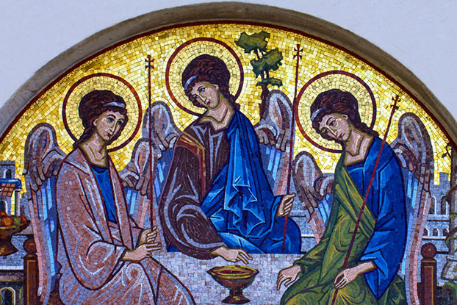
In thinking about who Jesus was and how he talked about his relationship with God, Christians began to teach that the One God had three persons—the Father, the Son, and the Holy Spirit. They called this the Trinity.

Slide 10

Traditional Christians believe that humanity has a fundamental problem, called sin, that shatters relationships with God and with one another.

Slide 11
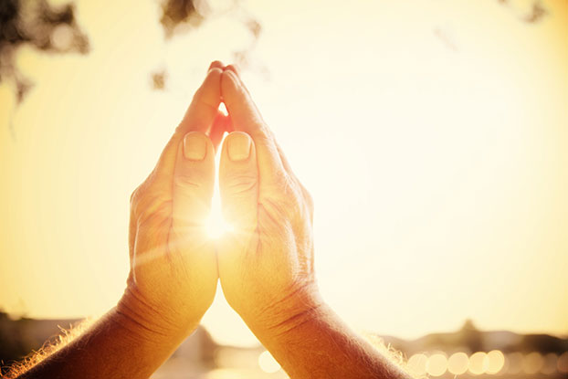
Traditional Christians teach that God offers both forgiveness and a remedy for this sin-problem through faith in Jesus Christ.

Slide 12
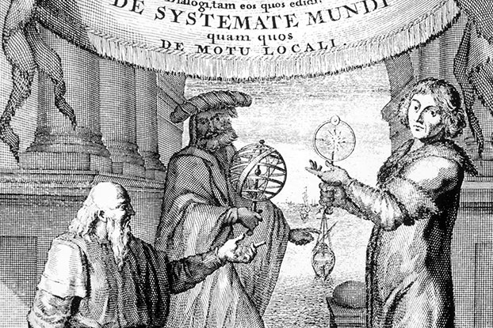
Over the past five centuries, many of these Christian teachings have been disputed. The rise of modern science and the influence of Enlightenment thought, along with various other social and cultural developments, have redefined Christianity for many people. Find out how...

Slide 13
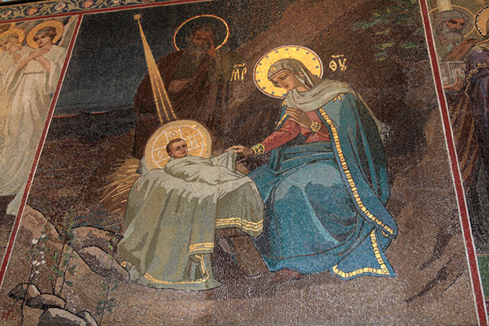
Some Christians today do not believe in the miraculous stories of the Gospels, including the virgin birth or the resurrection.

Slide 14
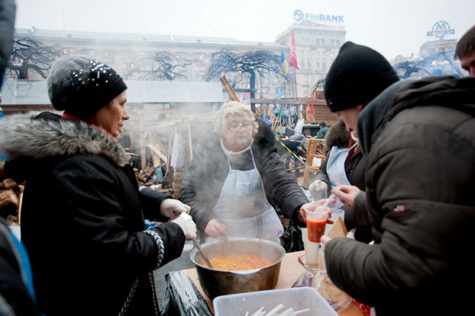
For some, being a Christian means following the teachings of Jesus, which should lead to social justice, but not necessarily believing certain things about him.

Slide 15

Some Christians today argue that the creeds and teachings of the Church have misled people about the nature of God and the meaning of Jesus.

Slide 16
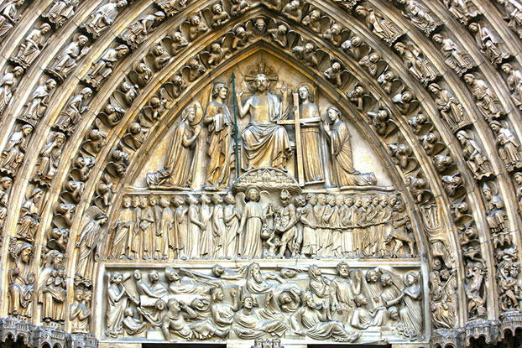
Some Christians dispute the gravity of sin, the need for divine forgiveness, and the possibilities of judgment.

Slide 17
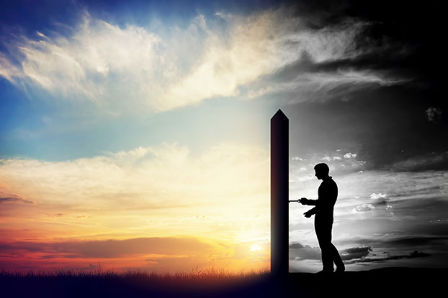
Some Christians believe the Bible is more of a human perspective than a divine revelation.

Slide 18
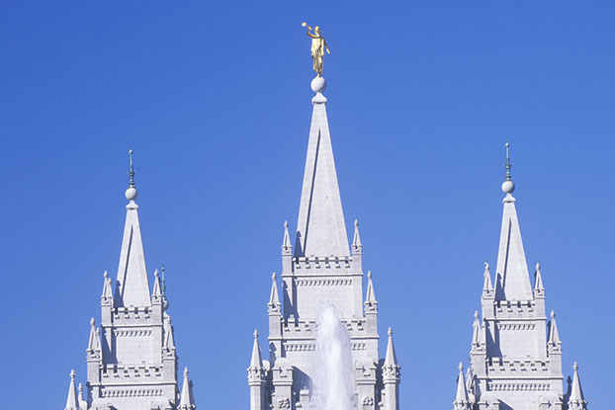
Others—like Mormons, Christian Scientists, and Jehovah's Witnesses—say they too are Christian though they have some very different doctrines than traditional Christianity.

Slide 19
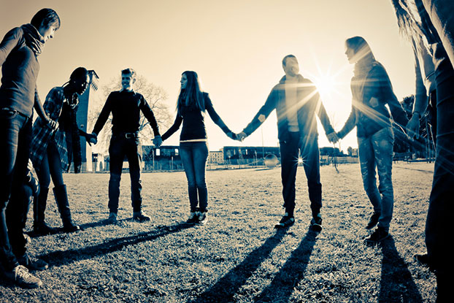
If you are a Christian, where do you fit?

