Slide 1
What Immigrant Life Looked Like In Early 20th Century America

Slide 2
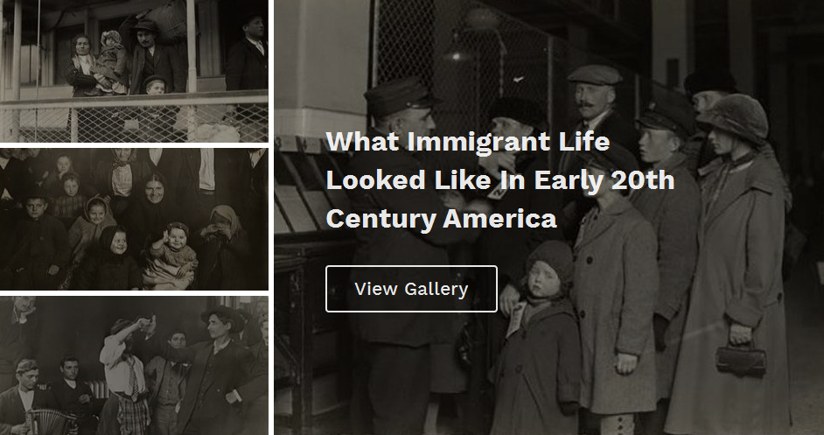

Slide 3
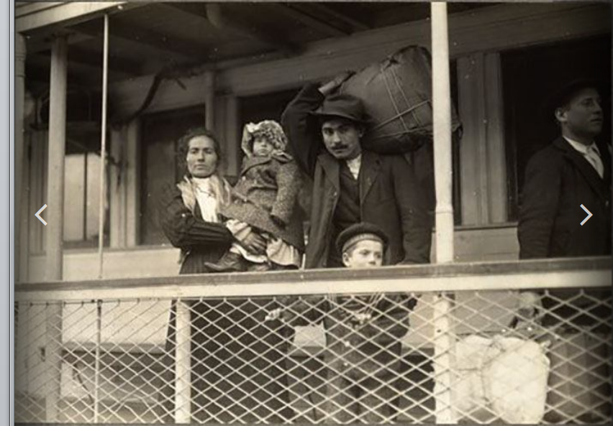

Slide 4
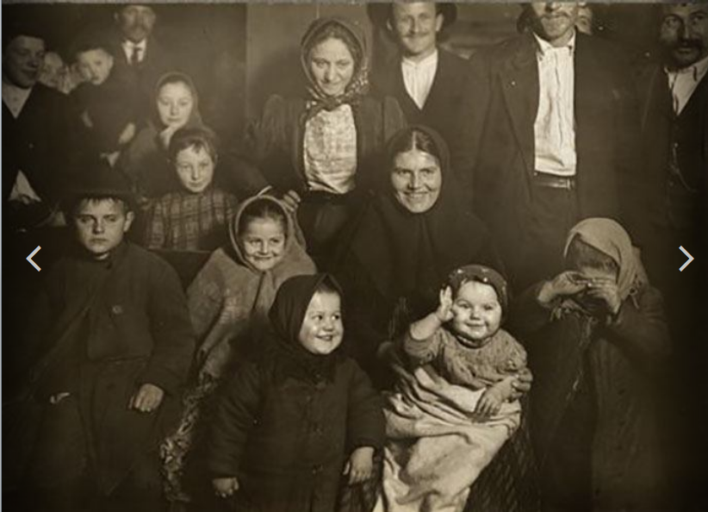

Slide 5
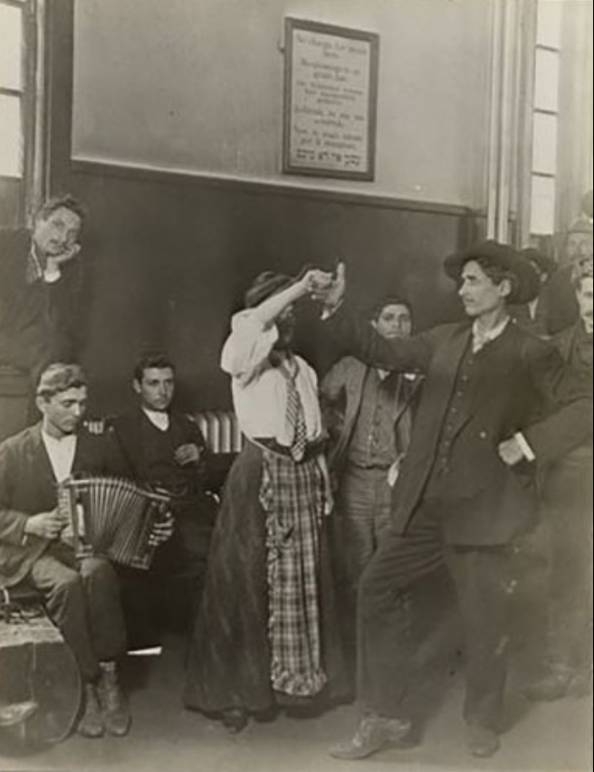
Waiting on Ellis Island

Slide 6
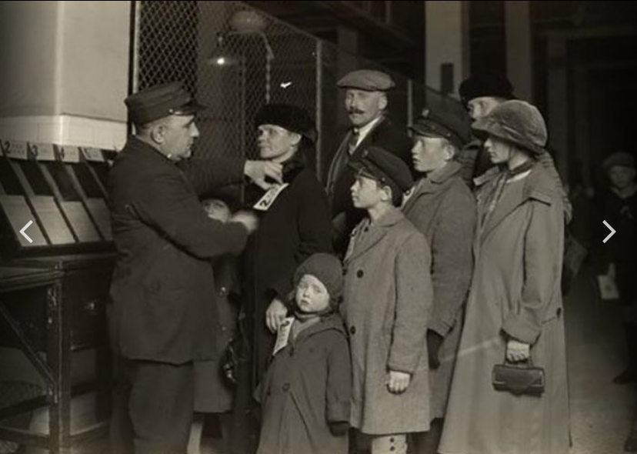
Large families

Slide 7
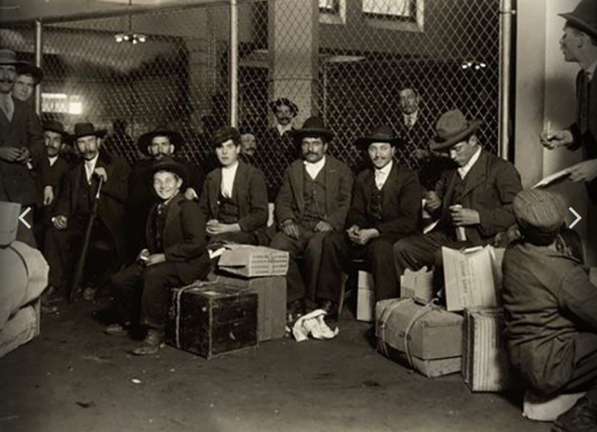
Italians

Slide 8
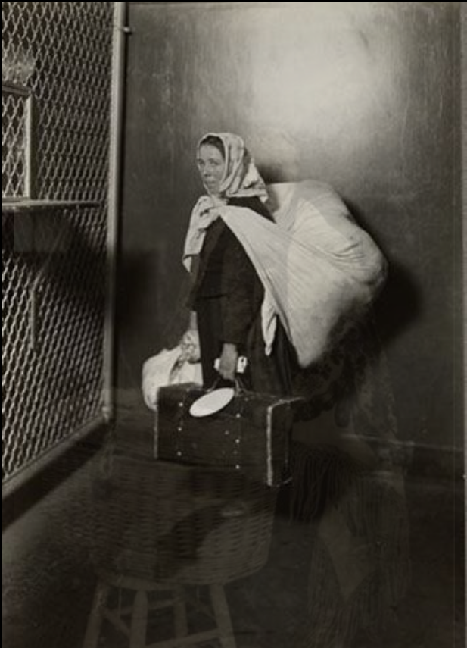
Immigrant woman with all her possessions

Slide 9
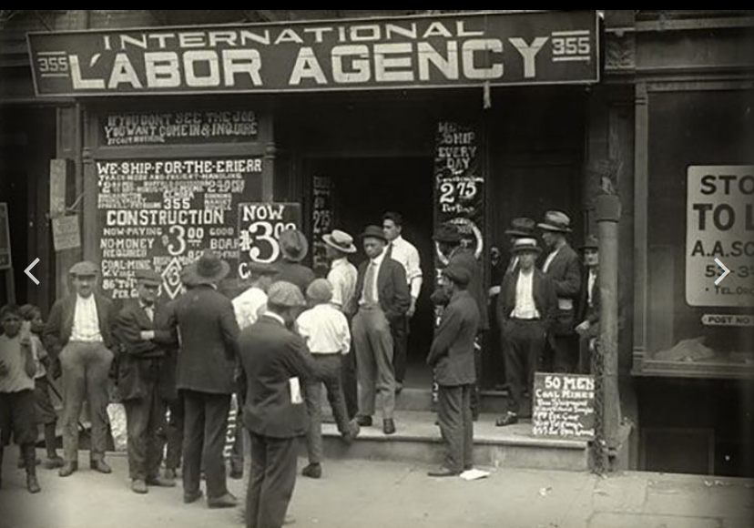
Men waiting at a Labor Agency

Slide 10
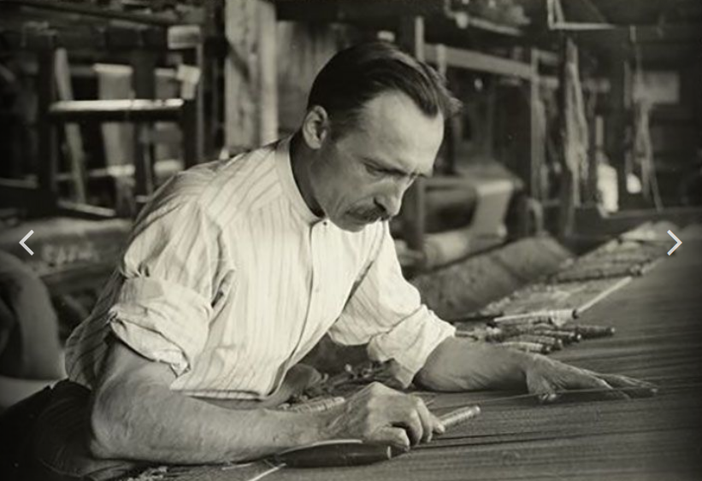
French tapestry worker

Slide 11
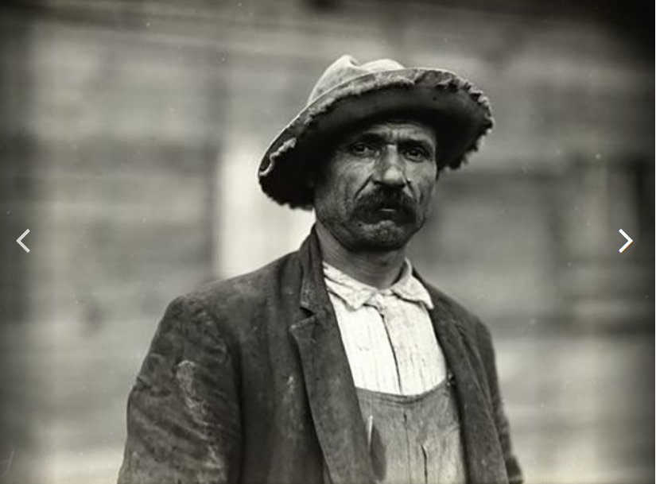
Italian barge worker

Slide 12
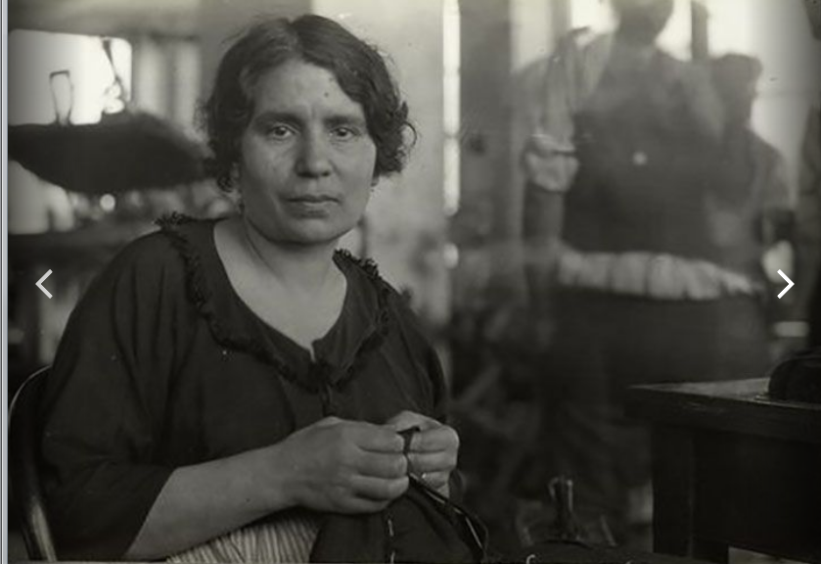
Italian seamstress

Slide 13
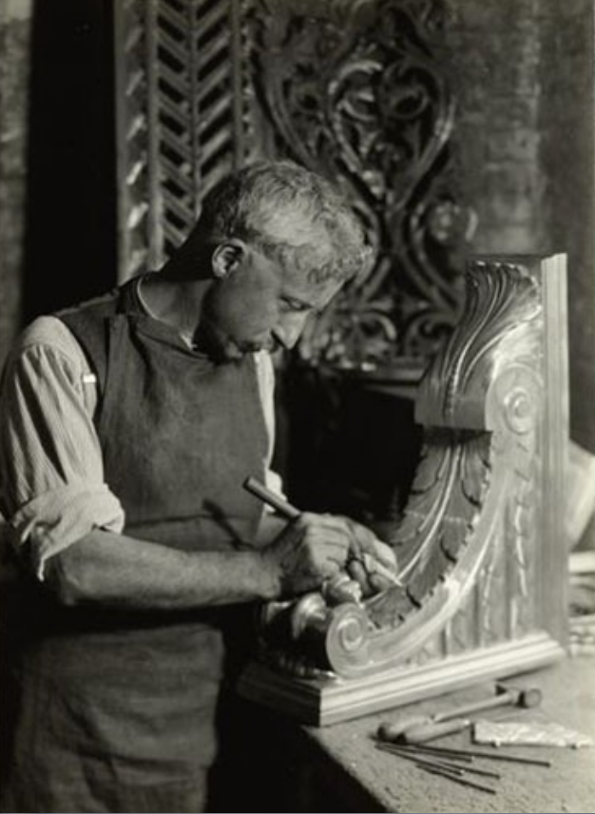
Italian skilled craftsman

Slide 14
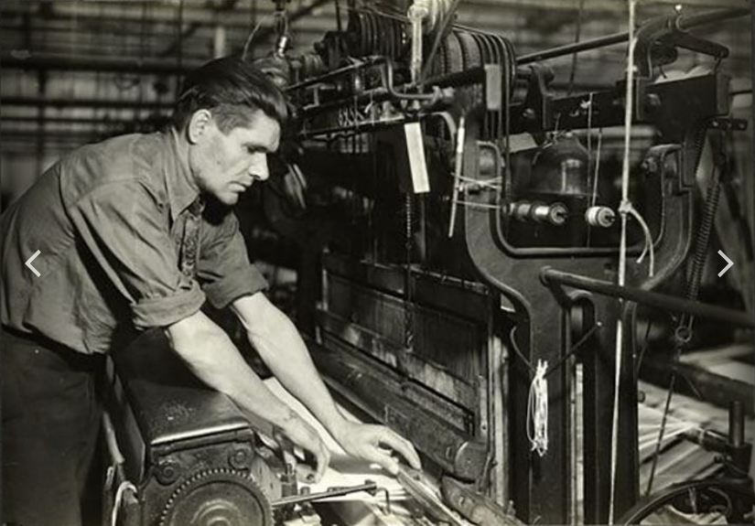
Slavic textile worker

Slide 15
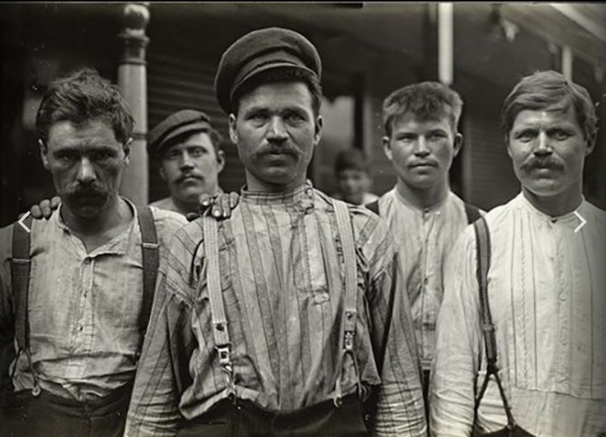
Single Russian men stay at a boarding house

Slide 16
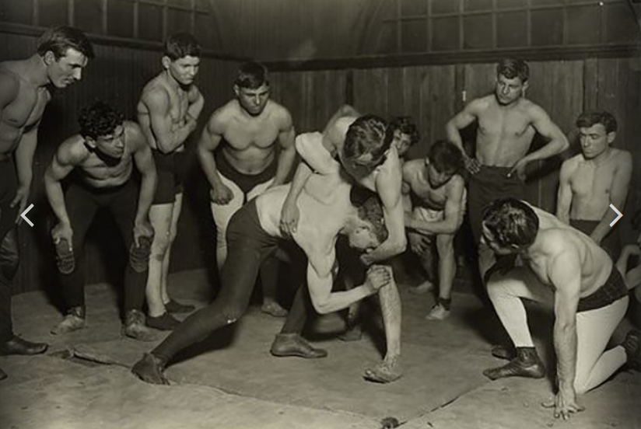
Greek wrestling club

Slide 17
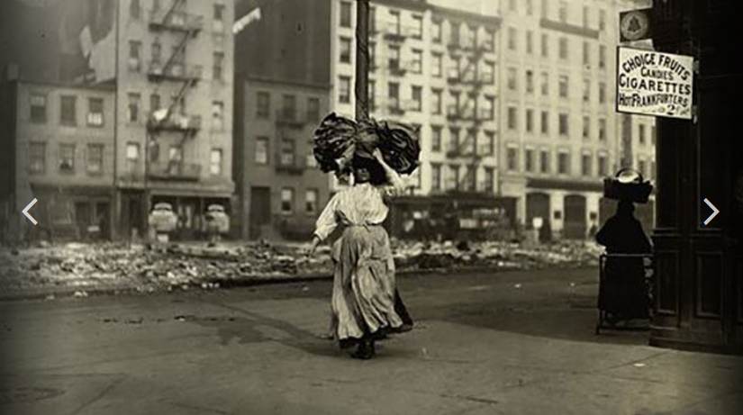
Taking clothing home to be finished there, possibly by underage children.

Slide 18
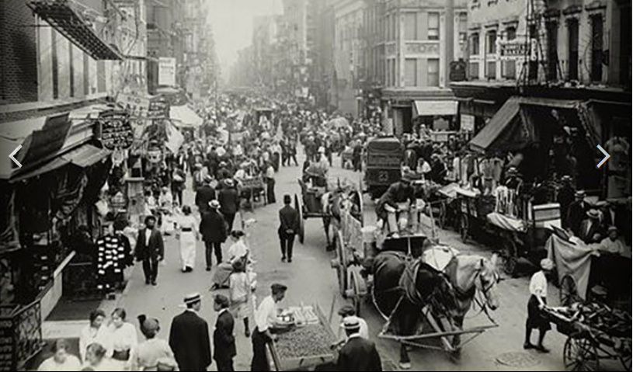
Market day in the Jewish quarter

Slide 19
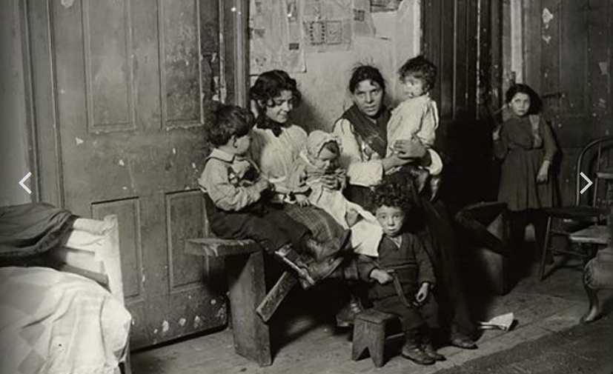
Italian family in Chicago

Slide 20
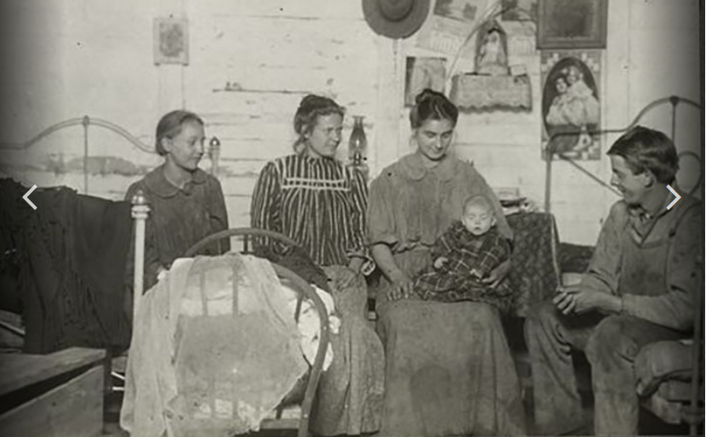
Slavic family living in a shack in the cannery community.

Slide 21
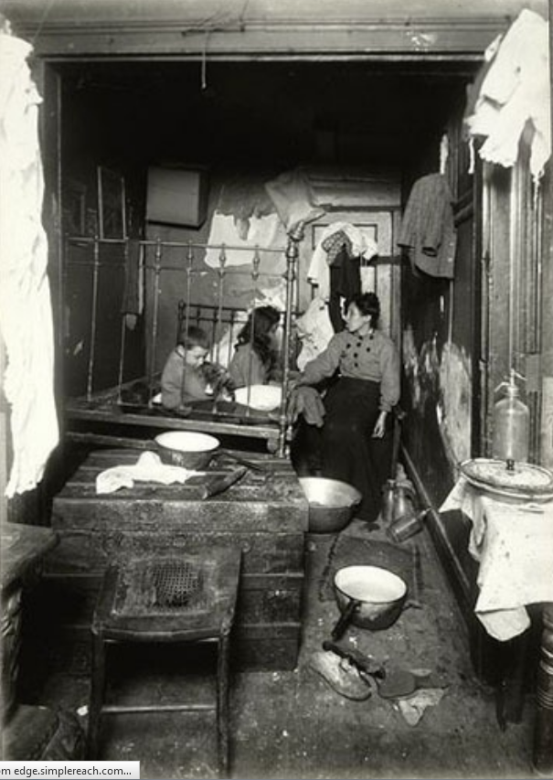
Italian family’s bedroom

Slide 22
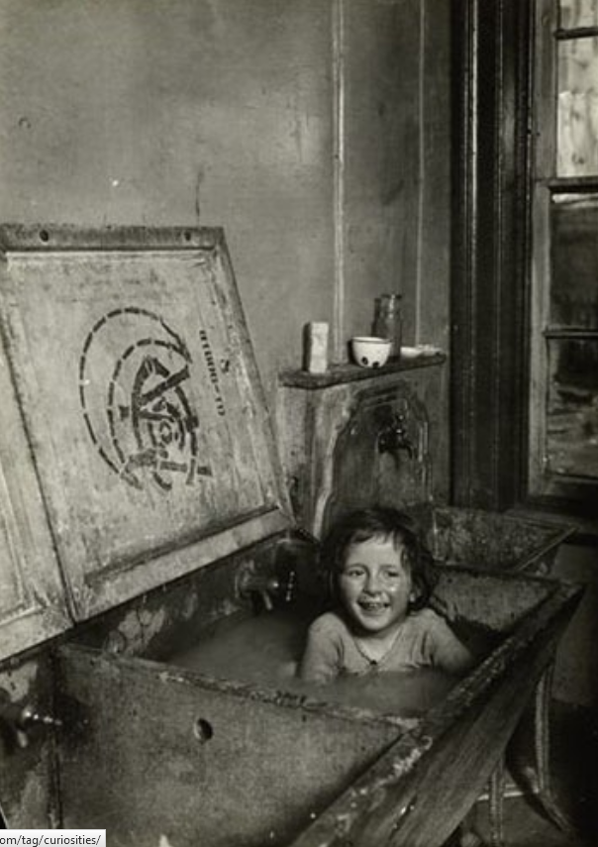
Bath time

Slide 23
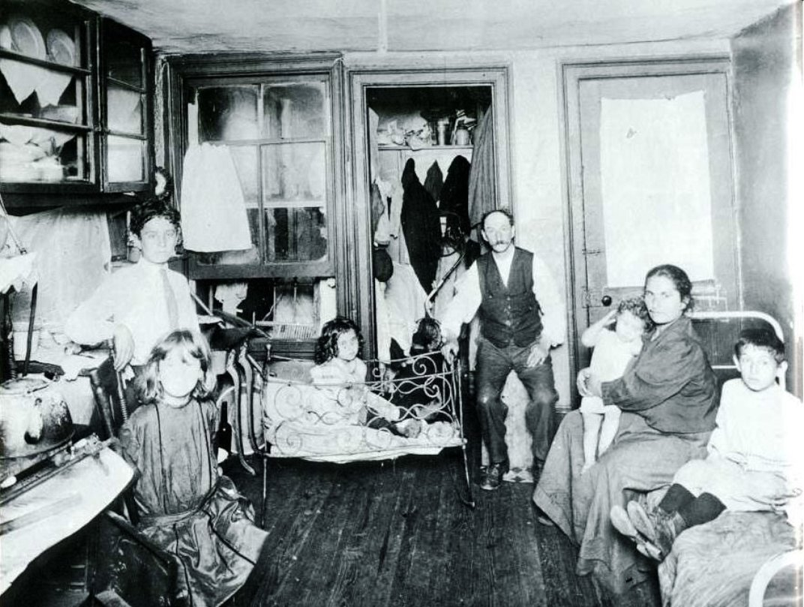
Tenement appartment

Slide 24
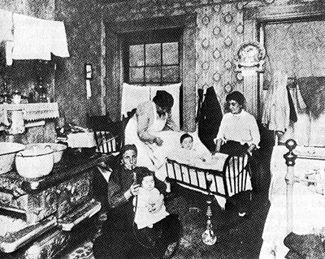

Slide 25
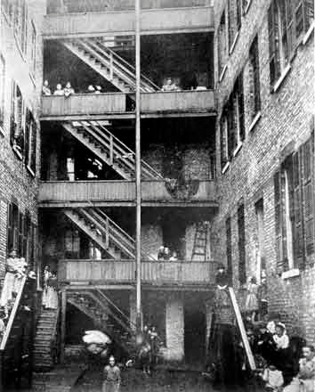
Back of a tenement building

Slide 26
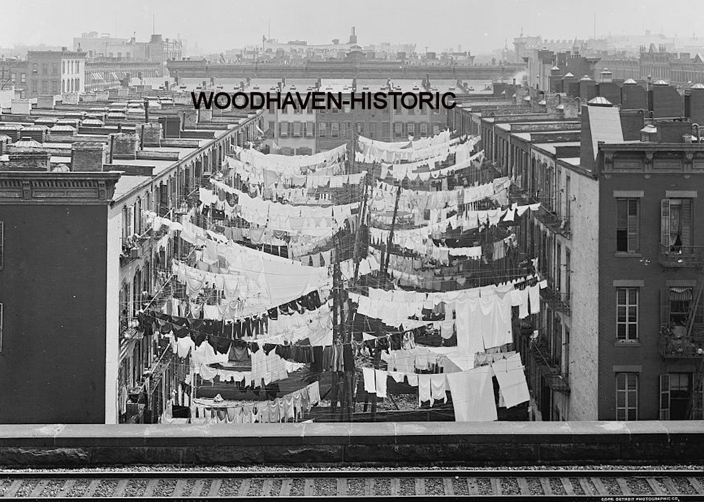
Laundry day in tenements

Slide 27
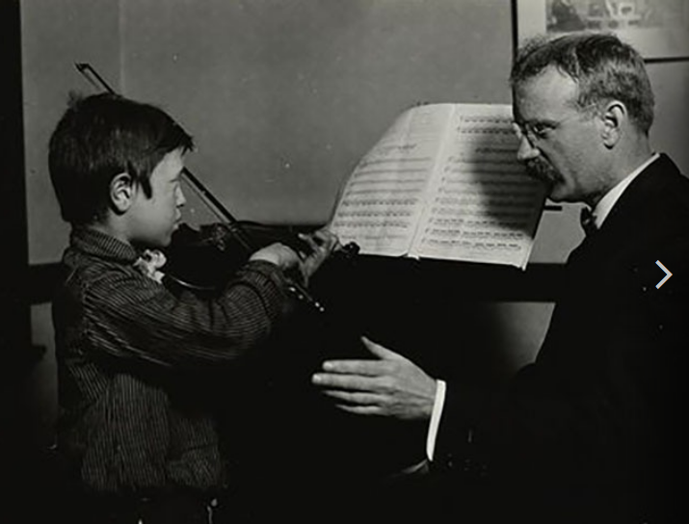
Musically talented boy gets instruction at Hull House

Slide 28
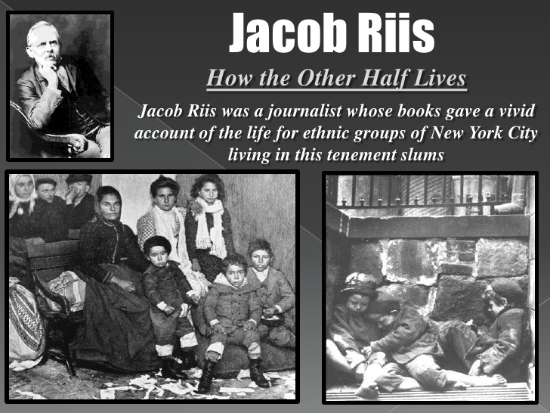

Slide 29


Slide 30
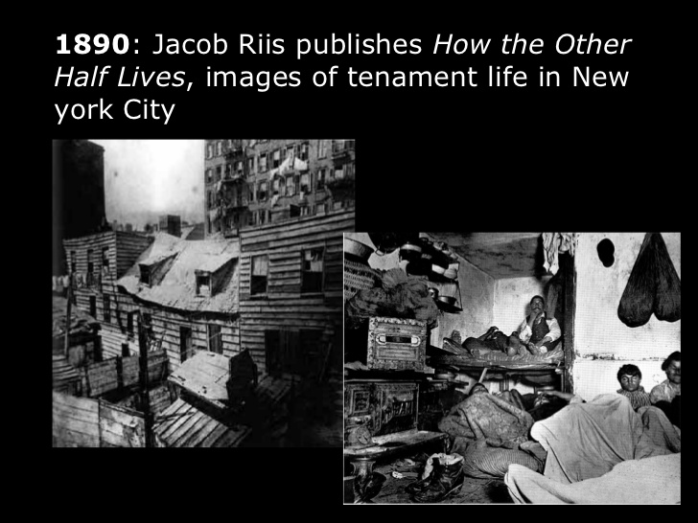

Slide 31
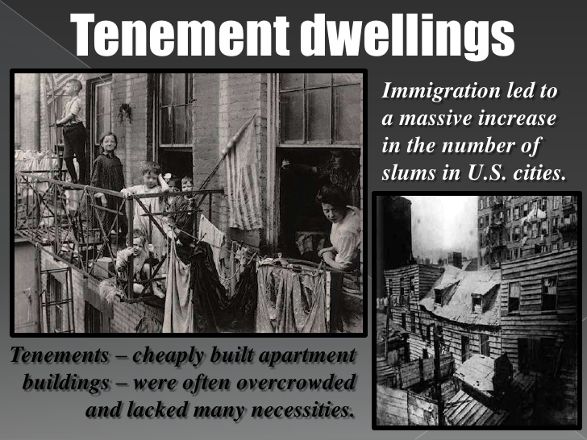

Slide 32
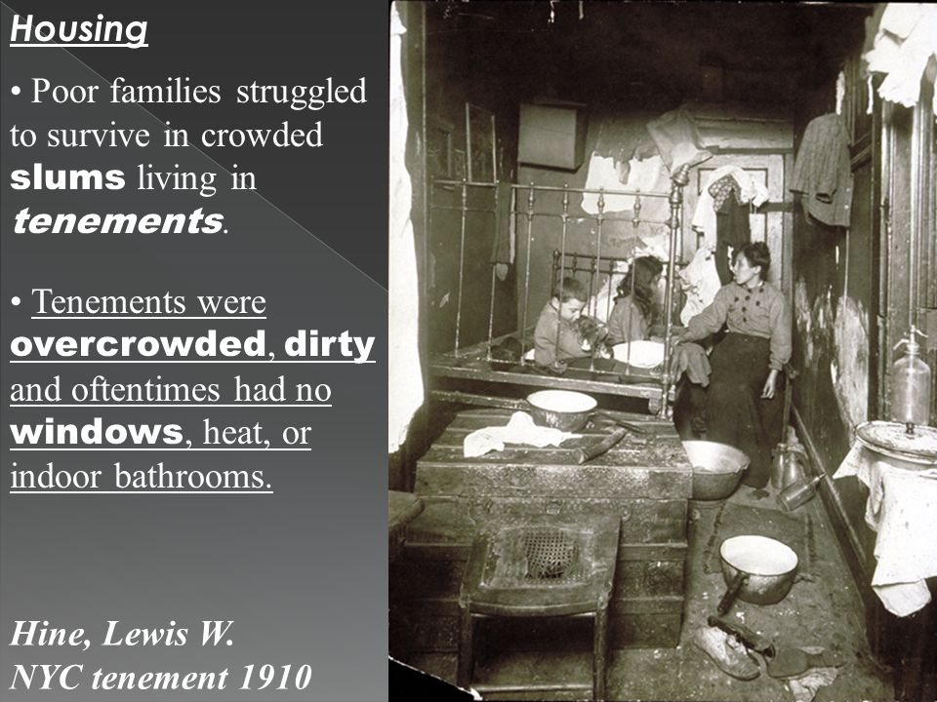

Slide 33
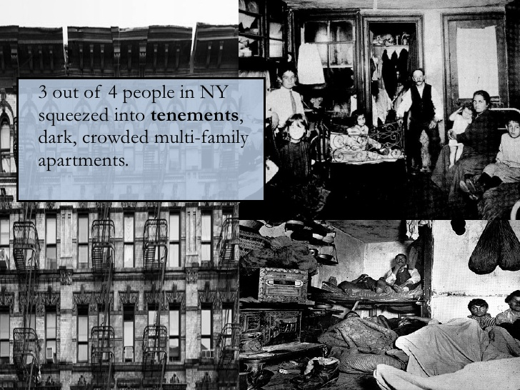

Slide 34
