Slide 1
Wedding Attire around the world

Slide 2
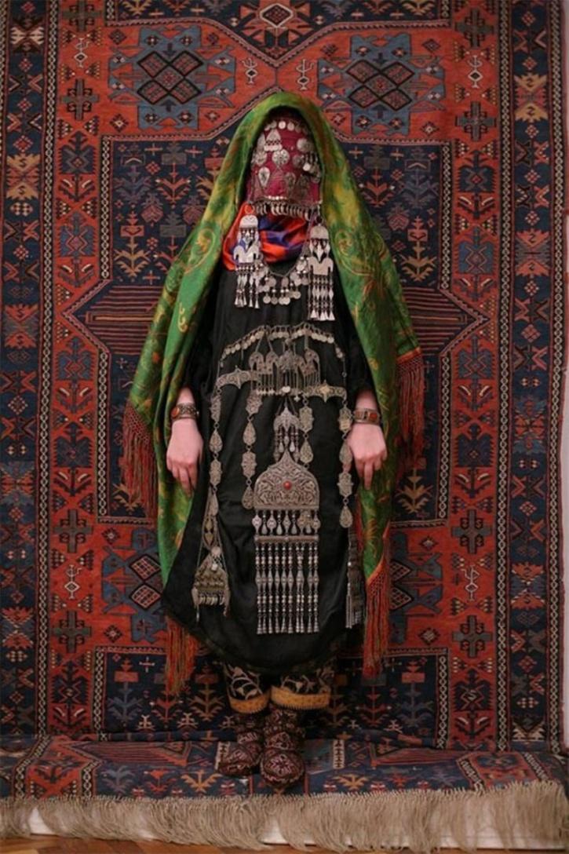
1. The Avar bride, a Caucasus native ethnic group living in the Russian republic of Dagestan

Slide 3
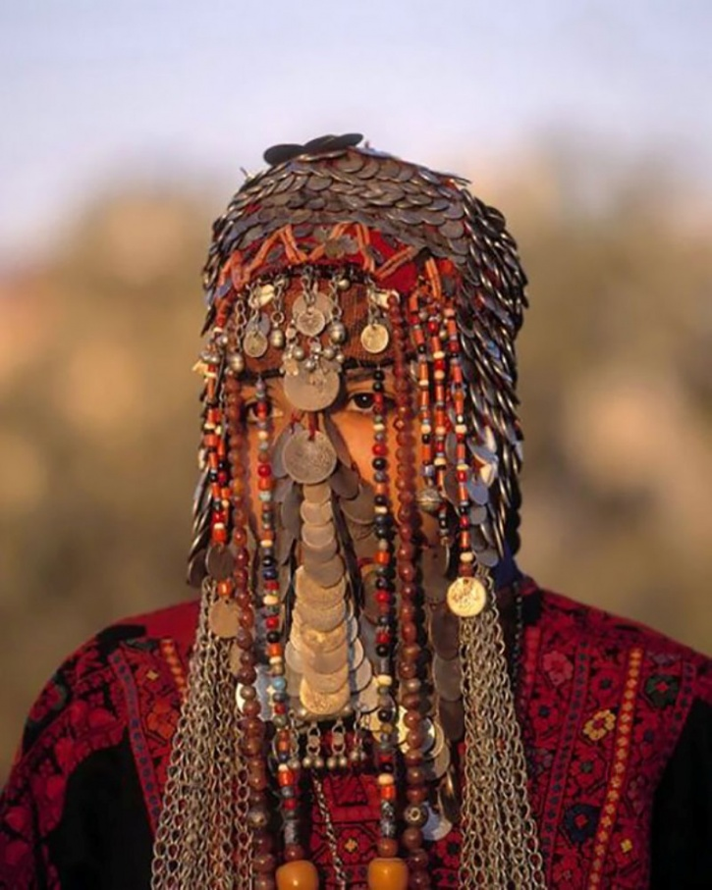
2. The Bedouin wedding veil in Israel

Slide 4
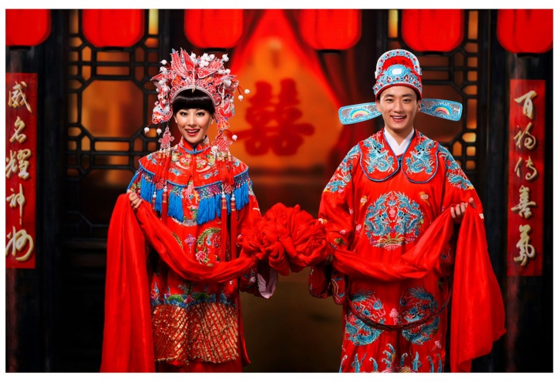
3. Traditional Chinese wedding attire

Slide 5
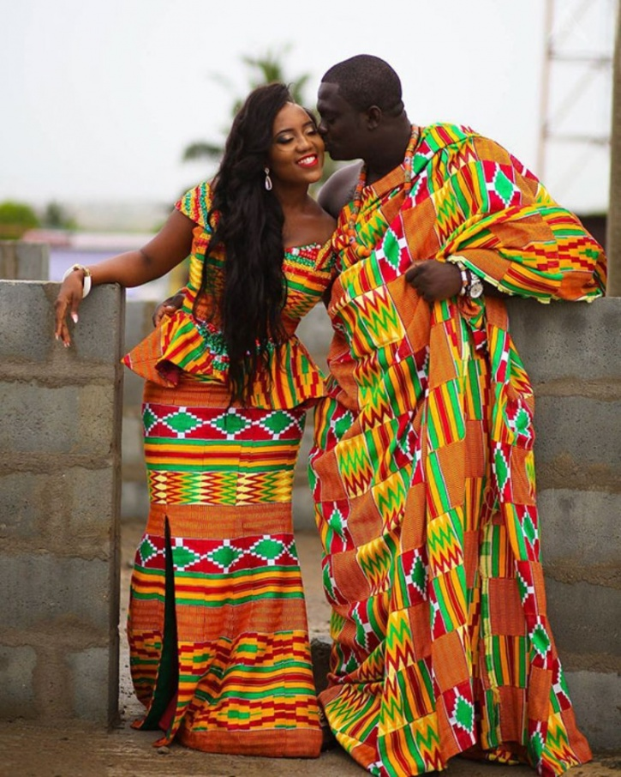
4. A wonderfully colourful couple from a wedding in Ghana

Slide 6
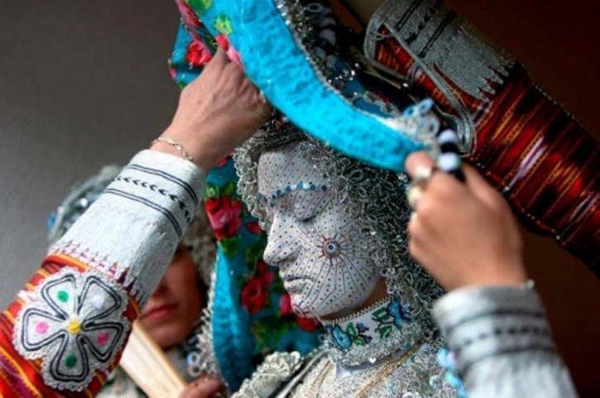
5. A bride from the Gora region between Kosovo and Macedonia. Just look how intricate that artwork is!

Slide 7
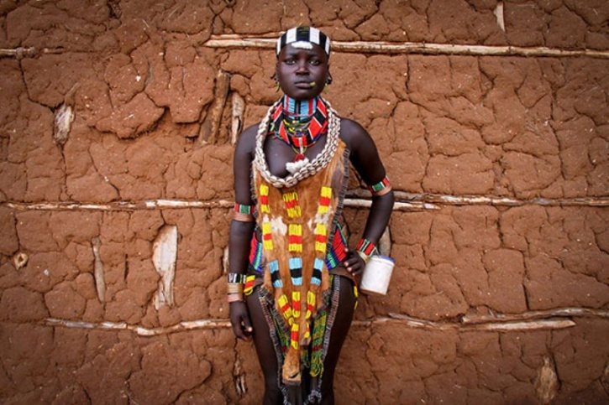
6. A Hamar woman from Ethiopia, although she doesn't seem too pleased

Slide 8
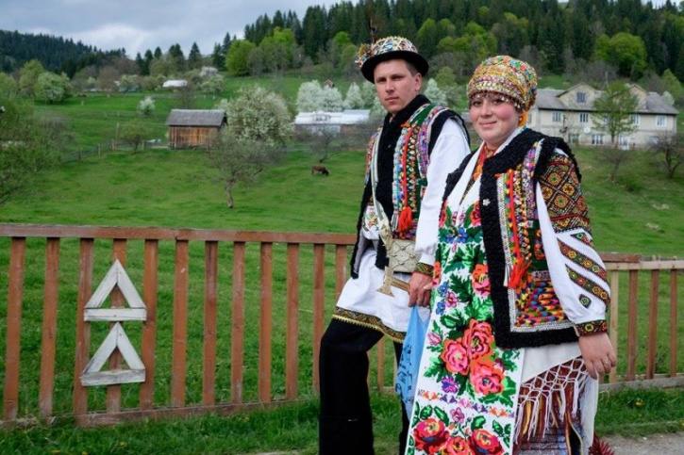
7. The Hutsuls from the Carpathian mountains in Ukraine

Slide 9
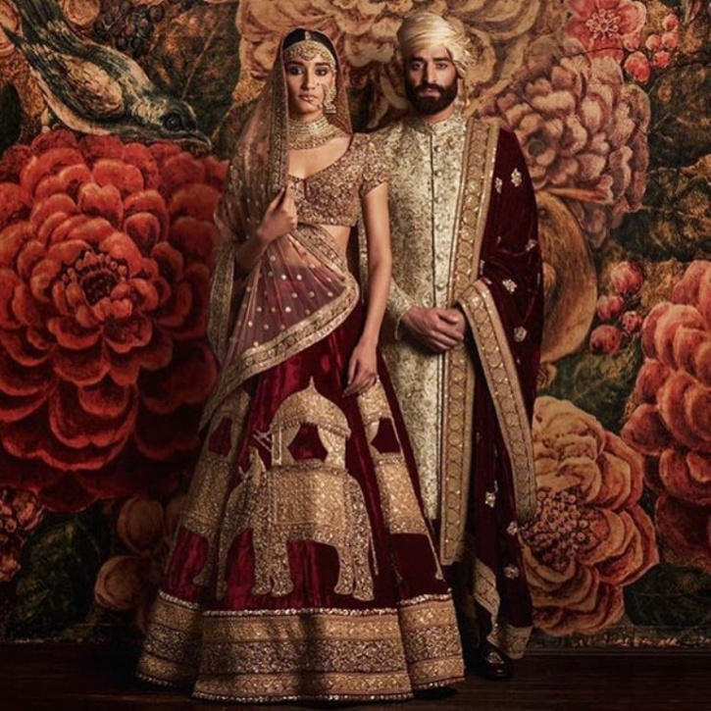
8. You recognise this one quite well, don't you? A traditional Indian wedding

Slide 10
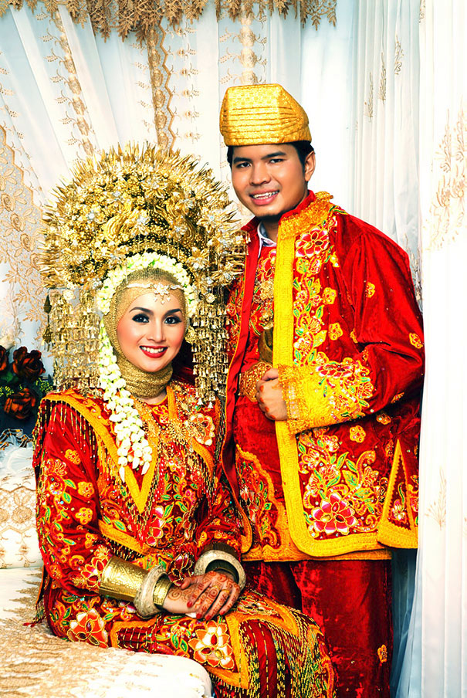
Indonesia has over 17,000 islands and so weddings here vary greatly depending on where people live and which of the 300+ ethnic groups they belong to.

Slide 11
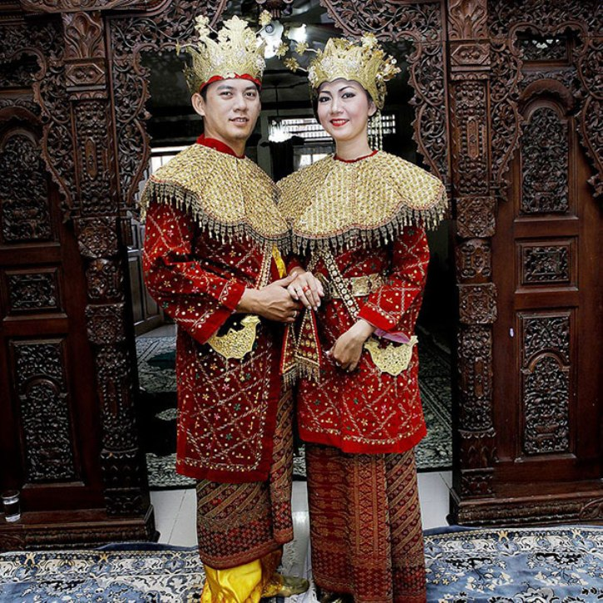
9. Indonesians have a number of different cultures and a number of ways to celebrate, just like India. This one from Jakarta is one of our favorites.

Slide 12
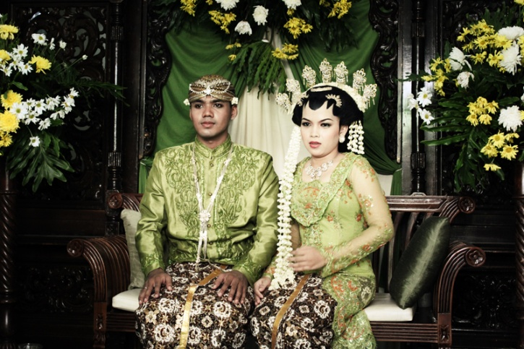
11. A Javanese wedding that reminds you a bit of Sindhi weddings. Their love for the colour gold is common, isn't it?

Slide 13
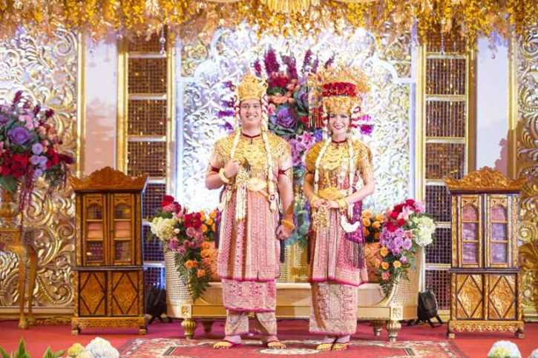
18. A Palembang wedding from Indonesia is an extravagant affair

Slide 14
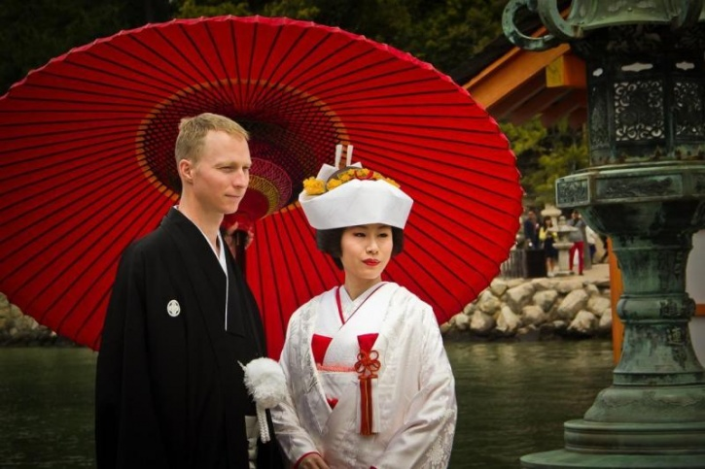
10. A traditional Japanese wedding with the bride in white, symbolizing purity

Slide 15
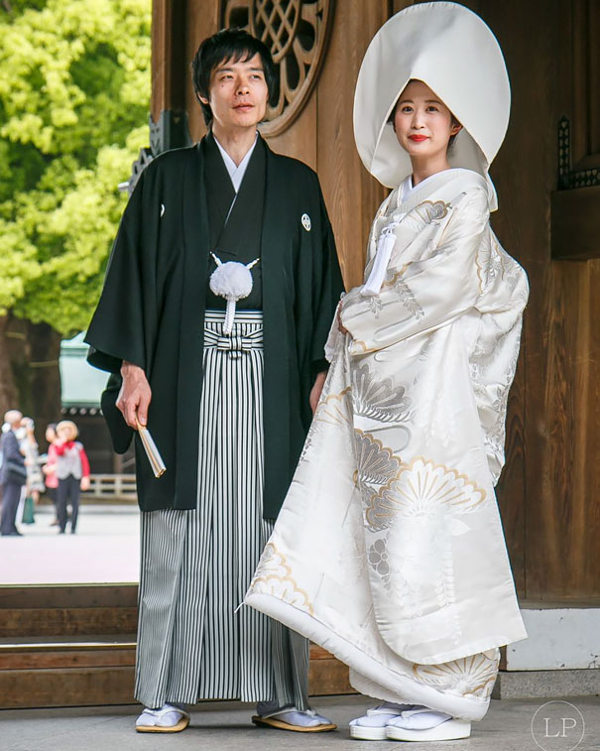
For a traditional Japanese wedding, the bride often wears a pure white kimono for the formal ceremony, which symbolizes purity and maidenhood. After the ceremony the bride may then change into a red kimono to symbolize good luck.

Slide 16
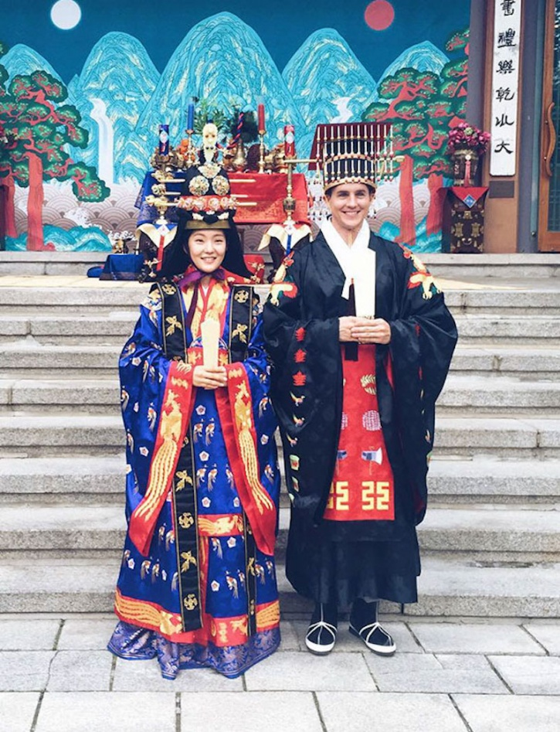
12. A traditional Korean royal wedding costume known as Hanbok

Slide 17
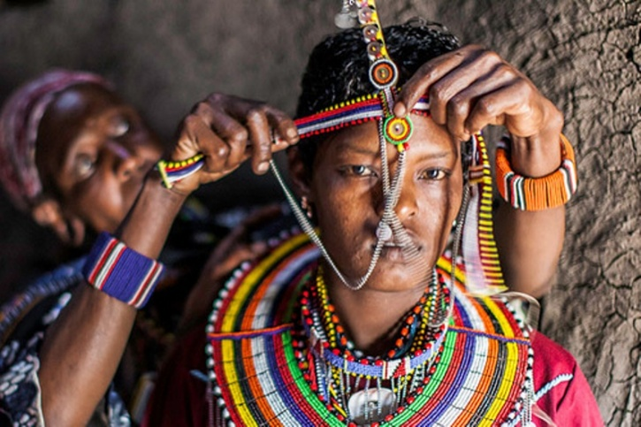
13. A Maasai wedding in Kenya where the bride is required to decorate her face and body with colourful shells and beads. It is during the wedding party where she lifts her veil and shows her beautiful self to the world

Slide 18
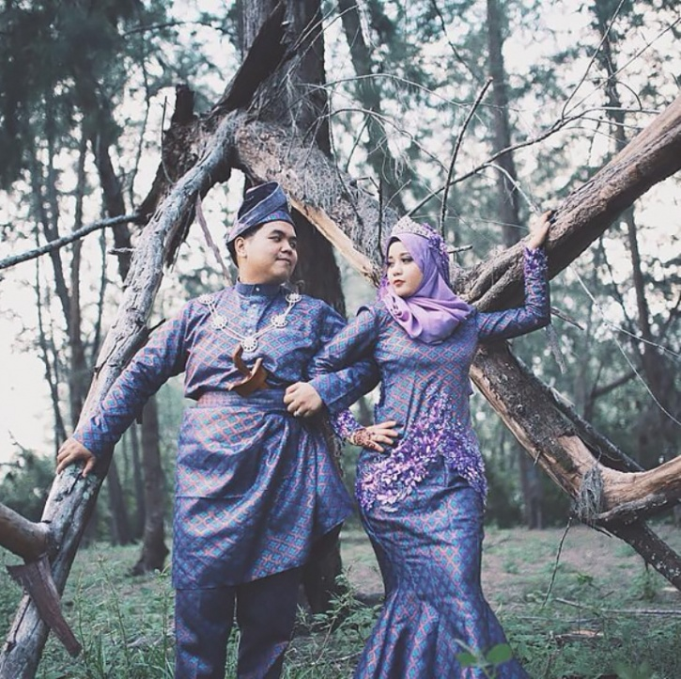
14. A Malay wedding held as per the Muslim tradition

Slide 19
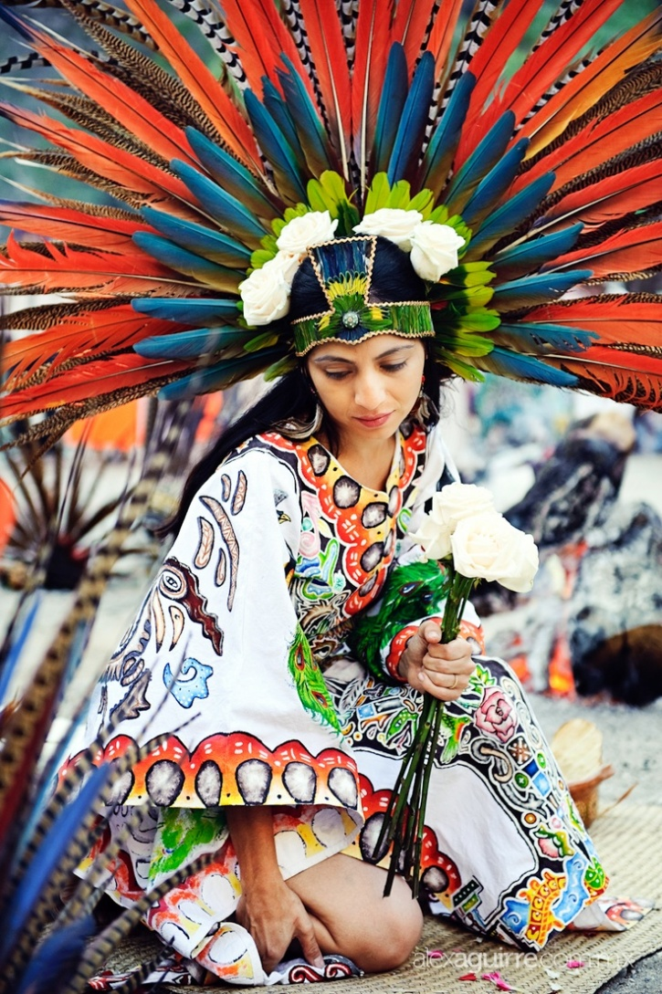
15. A gorgeous Mexican bride

Slide 20
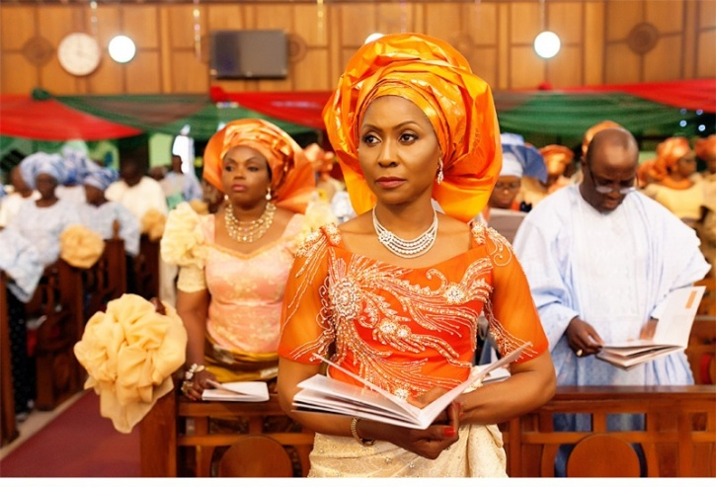
16. A Nigerian wedding ceremony would often have the women wearing a massive "head tie" known as Gele

Slide 21
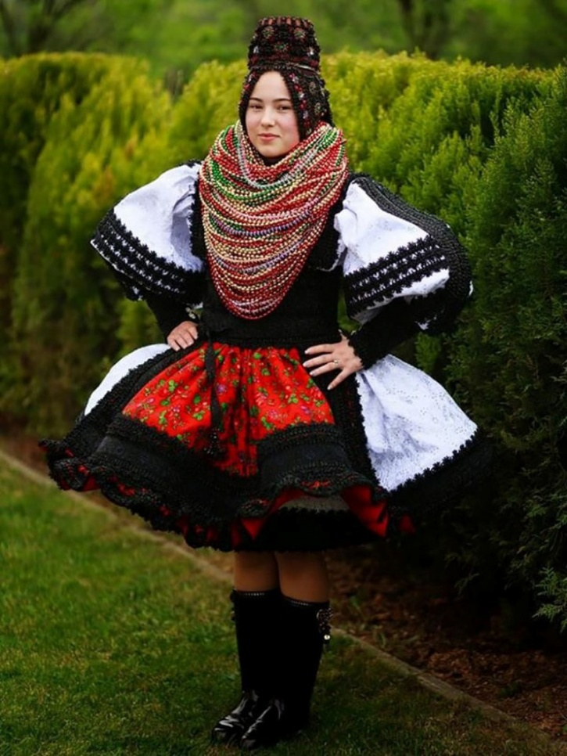
17. A Romanian bride from the Oas region

Slide 22
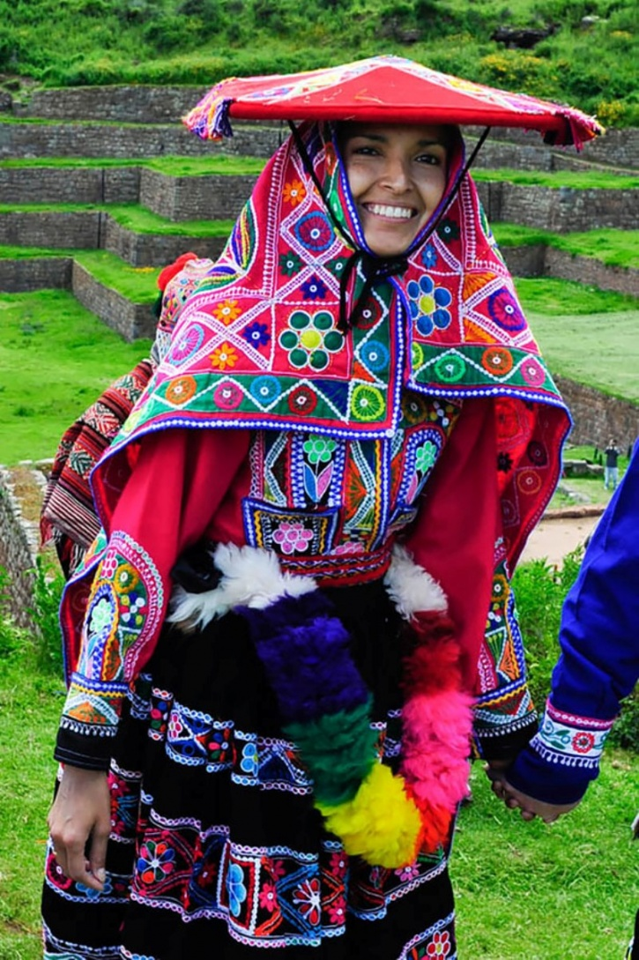
19. A traditional Peruvian bride in a valley near Cuzco, Peru

Slide 23
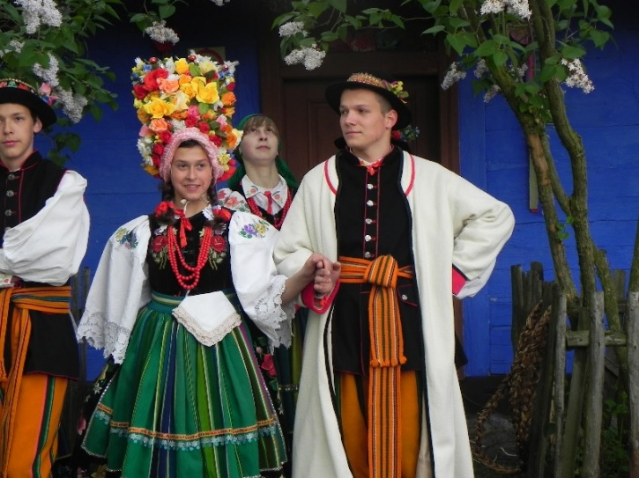
20. A Polish wedding with lots of ponchos and many more flowers

Slide 24
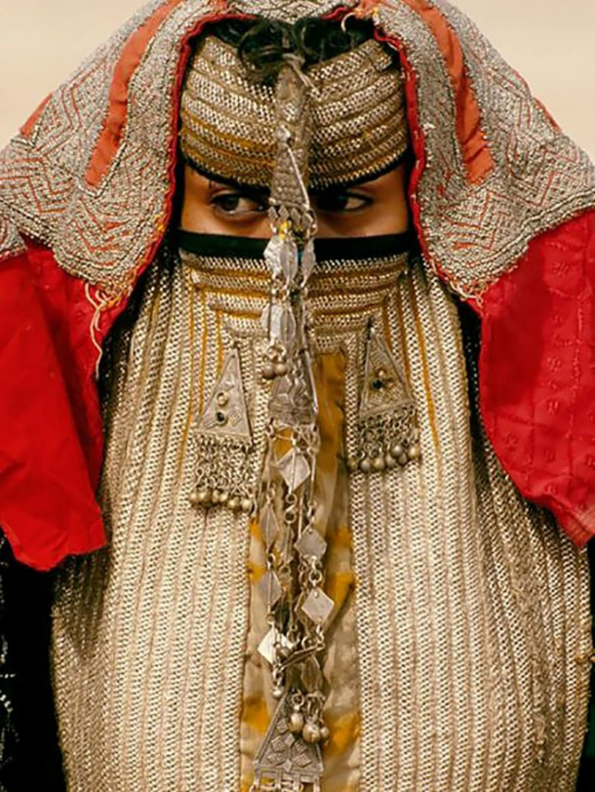
21. A Rashaida bride from Eritrea and northeast Sudan

Slide 25
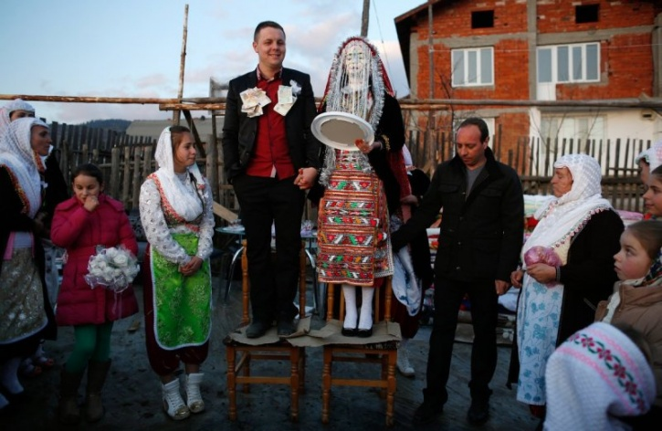
22. A traditional couple from the Ribnovo region in Southwest Bulgaria

Slide 26
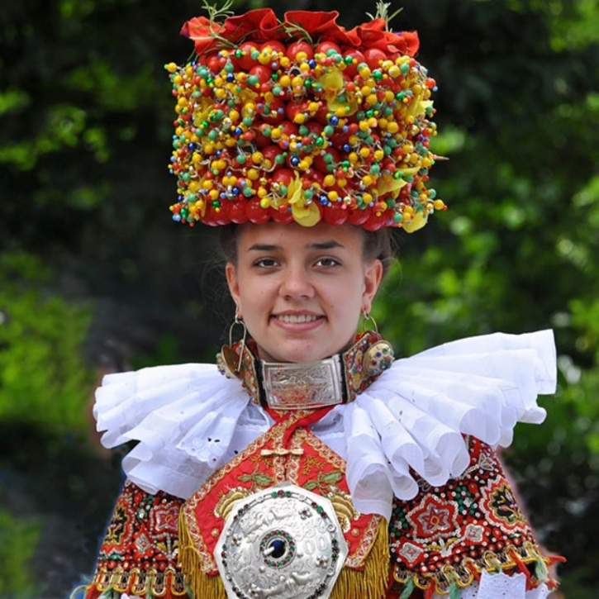
23. A fruit cake. Err, I mean a traditional bridal costume from Schaumburg-lippe, Germany

Slide 27
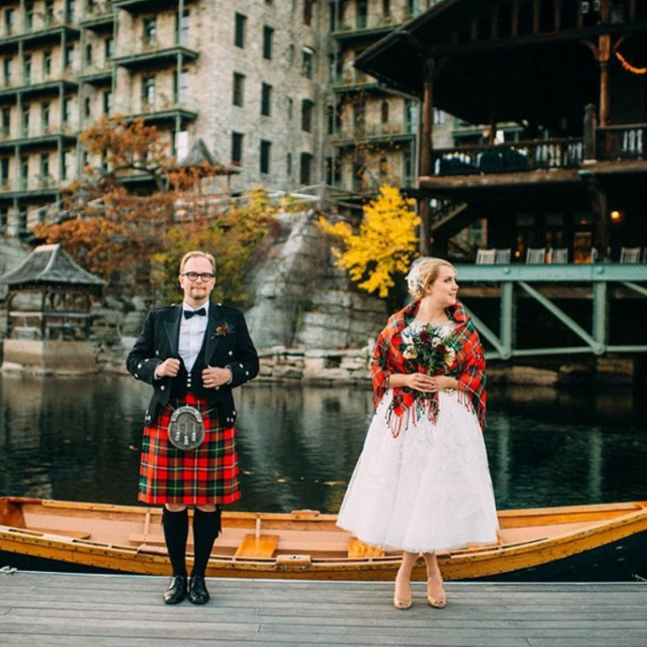
24. A lovely Scottish wedding where the groom is expected to show as much skin as the bride

Slide 28
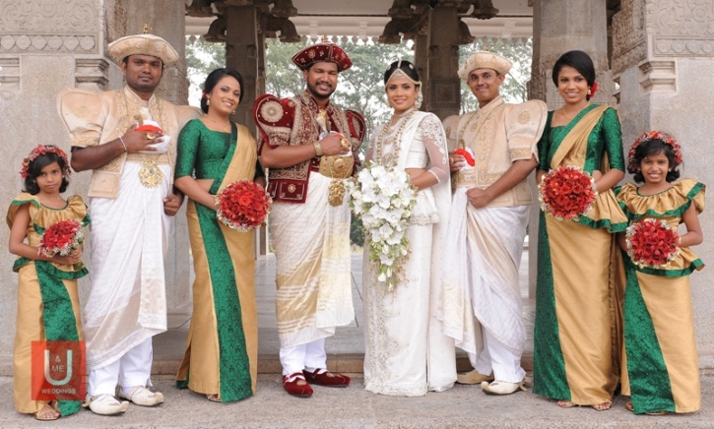
25. This is what a newly married Sri-Lankan couple look like

Slide 29
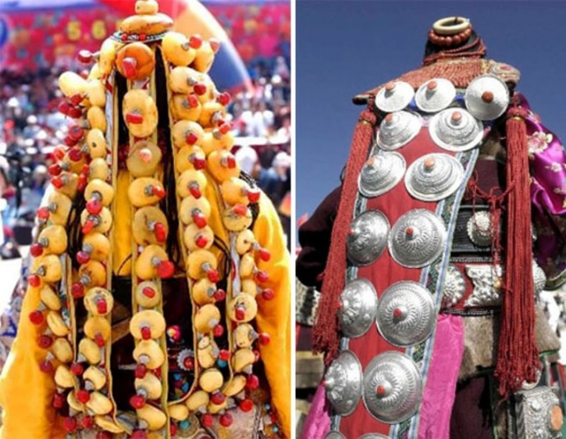
26. A traditional Tibetan bride, almost impossible to spot

Slide 30
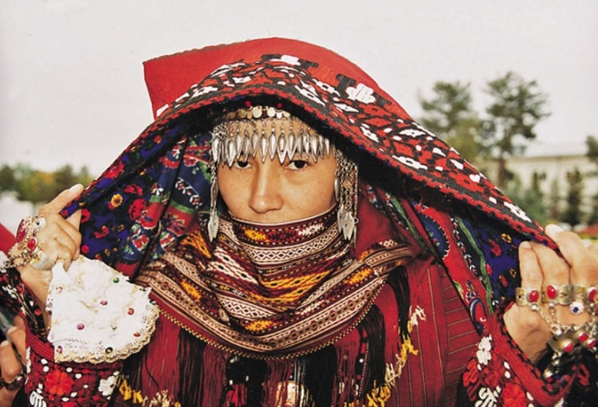
27. Beautiful wedding attire from Turkmenistan

Slide 31
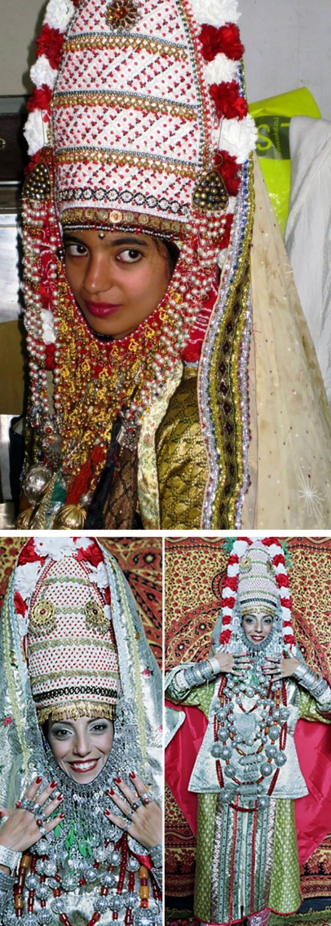
28. A traditional Yemenite bride wears some rather elaborate headgear to ward off evil

Slide 32
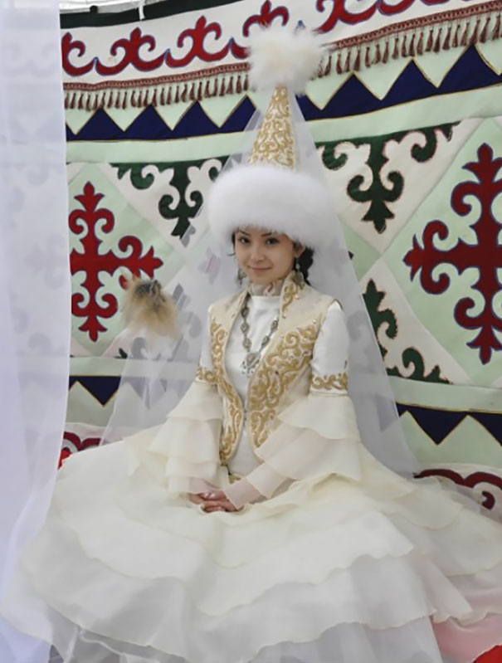
In a traditional Kazakh wedding, brides typically wear a headdress known as a "Saukele" as well as a facial veil. The Saukele is usually prepared long before the girls reach the age of marriage

Slide 33
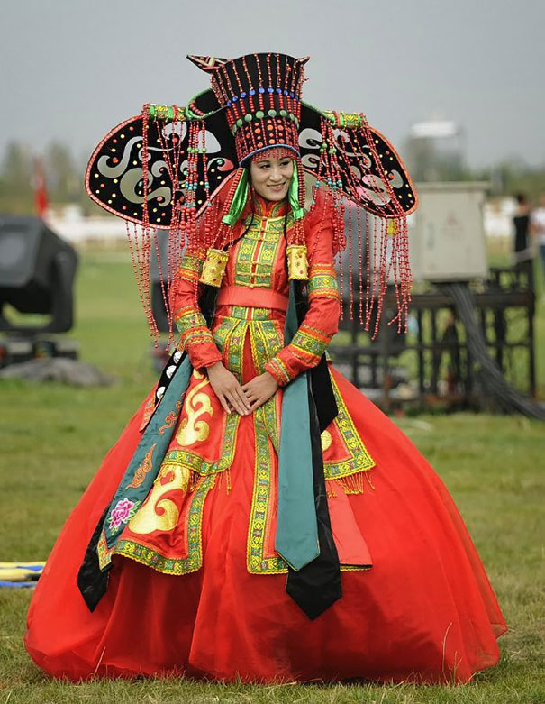
In a traditional Mongolian wedding ceremony, the bride and the groom each wear what's known as a Deel. A Deel is a form of patterned clothing that's been worn for centuries by Mongols and other nomadic tribes in Central Asia.

Slide 34
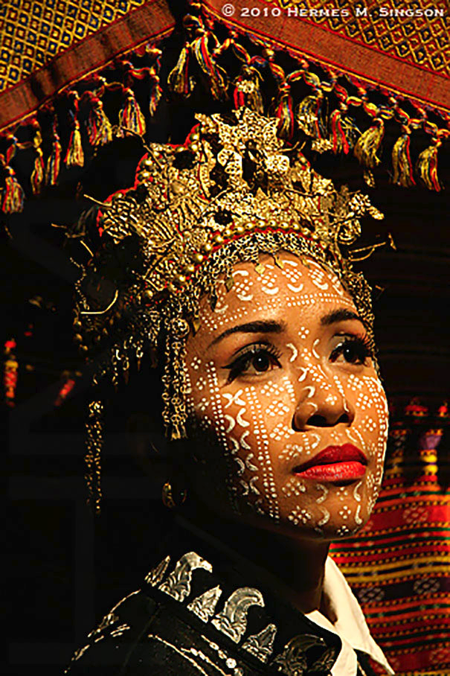
The Yakan are an ethno-linguistic group that mostly inhabit the island of Basilan in the Philippines. Traditional weddings usually consist of two ceremonies, an Islamic one and an older, pre-Islamic ritual. The weddings are arranged by the parents and both the bride and groom wear face paint for the ceremony.

Slide 35
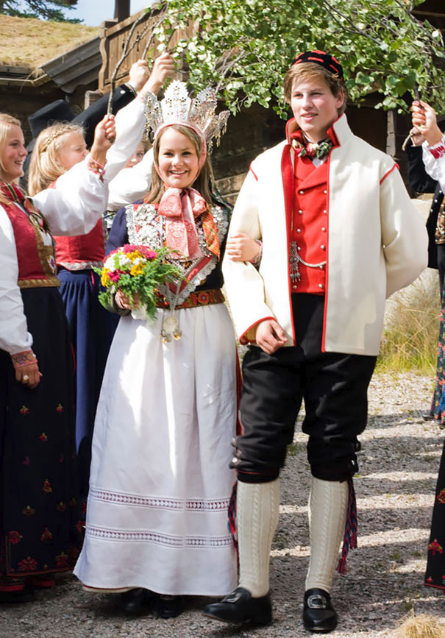
In Norway, the traditional wedding costume is called a Bunad. It can also be worn for other occasions such as christening parties.

Slide 36
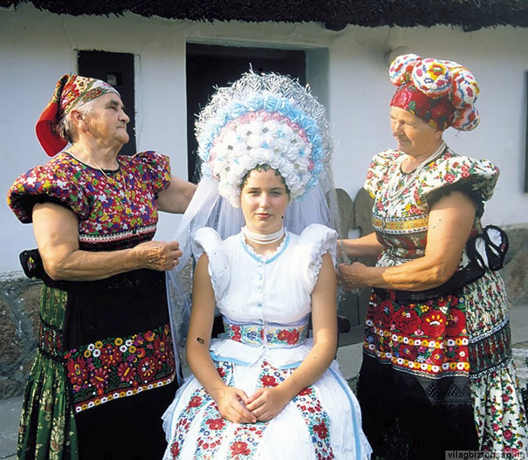
In traditional Hungarian weddings, a brides attire usually includes an embroidered dress with floral patterns and three bright colors. She often wears many underskirts as well as an elaborate head-dress with wheat woven into it.

Slide 37
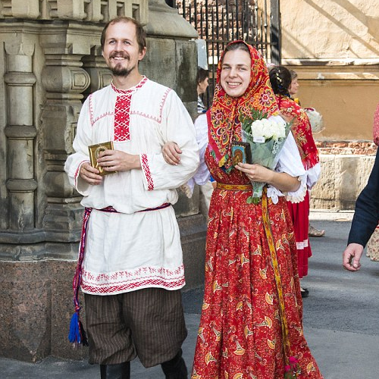
Because Russia is often so cold, faux fur or warm fabrics are a common choice for brides. The country as a whole has over 185 different ethnic groups, and many of these have their own separate wedding traditions.

