Slide 1
Traditions Of Ancient Greece
Culture

Slide 2
Traditions with longevity
Ancient Greece is incredibly old, so it’s only fitting they’d have some strange traditions, some of which are still practiced today.

Slide 3
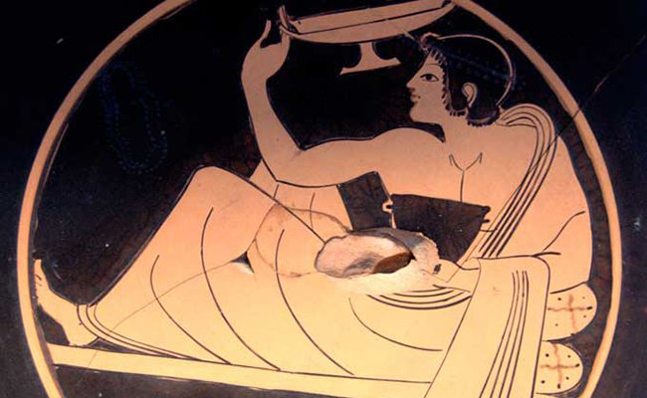
Bread
Ancient Greeks believed that bread was a gift from God. Before slicing it, older women would make the sign of the cross of a loaf of bread and they made sure that no bread was ever thrown away.

Slide 4
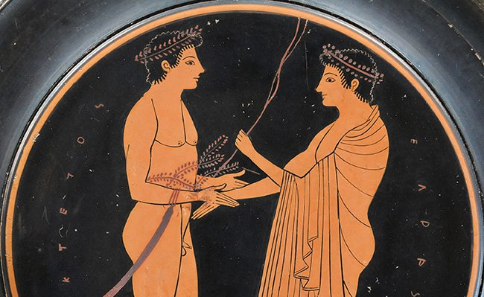
Men
Men would run the government in ancient Greece and would spend most of their time away from home. If they weren’t involved in politics then they would be in the fields, hunting or sailing. They would host parties to entertain their male friends, though women weren’t allowed in.

Slide 5
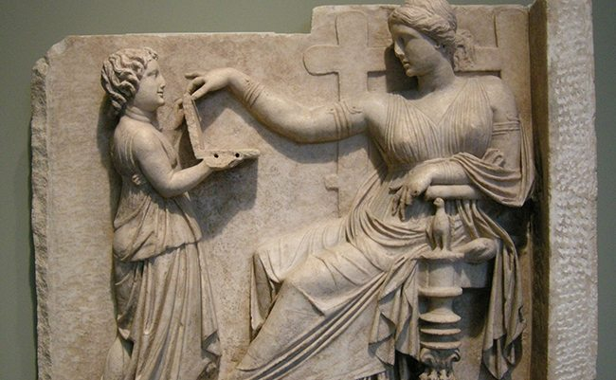
Women
Greek women didn’t have much freedom in ancient Greece. They could leave the house to visit friends for a short time and attend funerals or weddings but their job was to bear children and run the house.

Slide 6
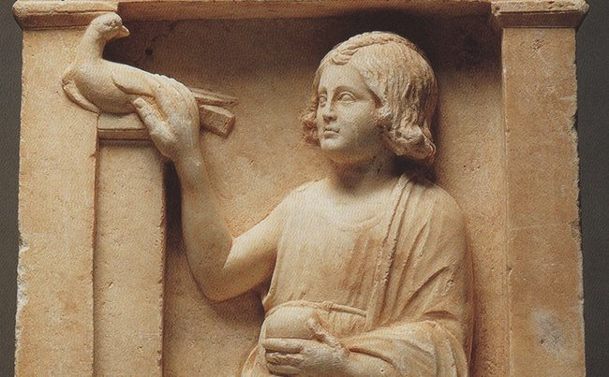
Children
The ancient Greeks considered people to be ‘youths’ until the age of 30. Whenever a child was born into a Greek family, a naked father would carry the child in a ritual dance around the house and friends and relatives would give the family gifts in celebration.

Slide 7
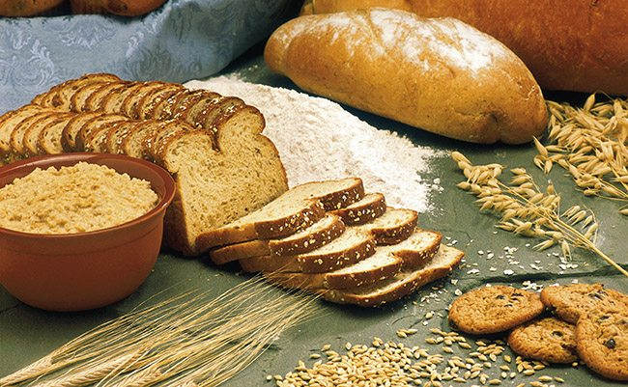
Food
Meals were often enjoyed outside of the home and their diets mostly consisted of grains, figs, wheat for bread, vegetables and cake. They also loved to eat grapes, seafood and enjoyed drinking wine.

Slide 8
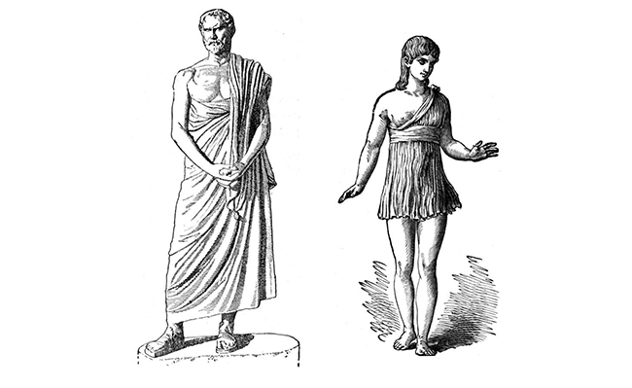
Clothing
Men and women would wear linen in the summer to help them cope with the weather while in the winter they would wear wool. Most families actually made their own clothing and were often dyed a bright colour or bleached white.

Slide 9
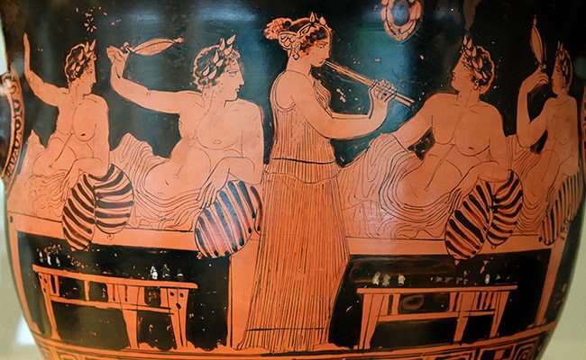
Dancing and Music
Dance and music was very important to ancient Greeks. They believed that dancing improved physical and emotional health but men and women rarely danced together.

Slide 10
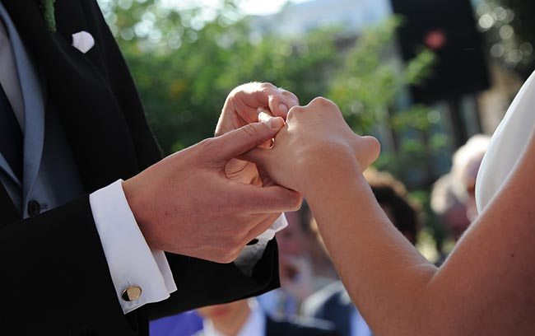
Weddings
In ancient Greece, wedding ceremonies started after dark and the veiled bride would travel from her home to her grooms while standing in a chariot. Her family would follow it on foot, carrying gifts.

Slide 11
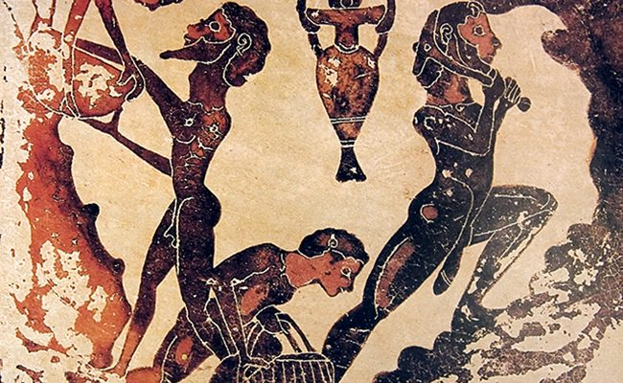
Slaves
The ancient Greeks had a lot of slaves. They were found everywhere and it’s been estimated that there were more slaves than free people in ancient Greece and they would serve as shopkeepers, farm workers and as ship’s crew members.

Slide 12
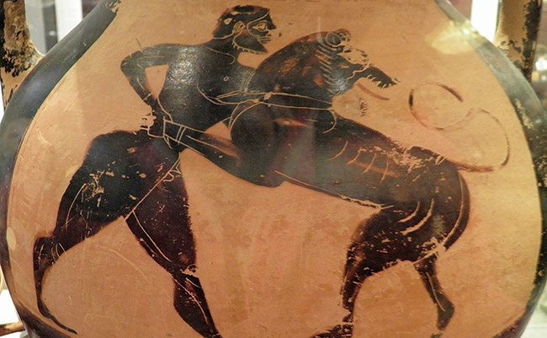
Animals
Ancient Greeks loved to keep pets and common ones include birds, goats, dogs and mice. However cats were not used as pets as they saw them as bad omens.

Slide 13

Cacti
Ancient Greeks would always have a cactus on their property near the entrance. It was thought that the plant would ward off the evil eye, an old superstition.

Slide 14
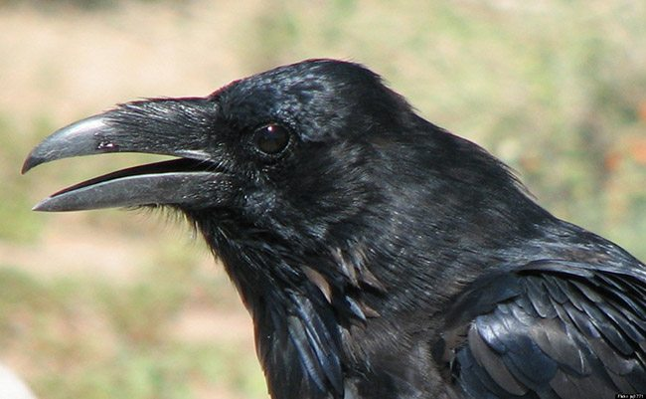
Crows
Crows were considered to be bad omens in ancient Greece. Whenever you would see or hear a crow, people would stop and say, “Sto Kalo… Sto Kalo… Kala Nea na me Feris” which translates to “Go well into the day and bring me good news.”

Slide 15

Garlic
Ancient Greeks believed that garlic would ward away evil spirits. People would often hand braids of garlic at entrances of shops, restaurants and even homes. Some people would also carry a clove of garlic in order to ward off the evil eye and other demons.

Slide 16
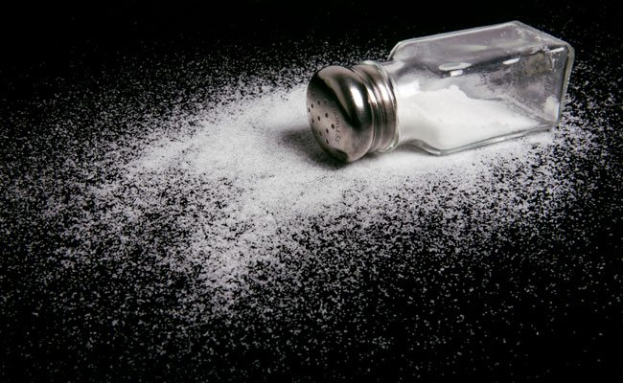
Salt
The ancient Greeks believed that salt had the power to get rid of unwanted human presences. All you had to do was sprinkle some salt behind them and it would chase them out. It was traditional to sprinkle salt in a new home to scare away any evil spirits.

Slide 17

Death
Death in ancient Greece was a journey and spirits would travel to the Underworld that involved crossing the river Styx on a boat and being judged on your actions, about where to go if you’ve been ‘bad’ or ‘good’.

Slide 18
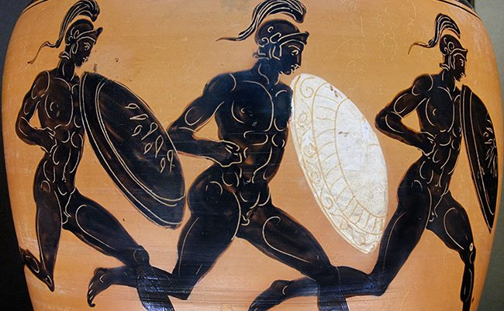
Games
Games were an important part of life in ancient Greece and was a central part of worshipping the gods and goddesses. Games normally involved sacrifices and competitions, hence the Olympic Games.

Slide 19
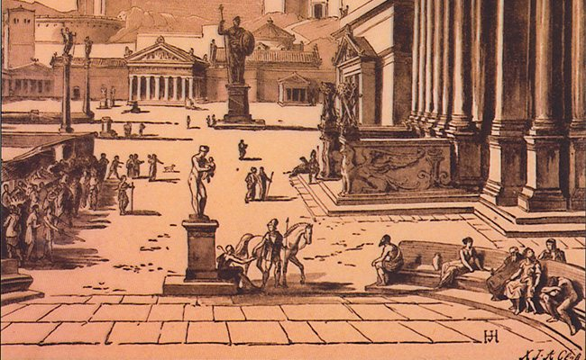
Sparta
Life in Sparta in ancient Greece was actually pretty different compared to other cities. Women were more active and slaves in Sparta belonged to the city rather than the individual families.

Slide 20
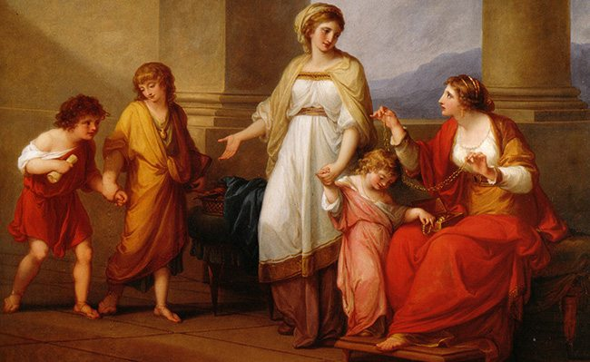
Education in Athens
Education in Athens was vastly different to that of Sparta’s. Athens’ goal was to produce citizens who were trained in both peace and war. They trained them in the arts but boys were also required to have two years of military training at 18.

Slide 21
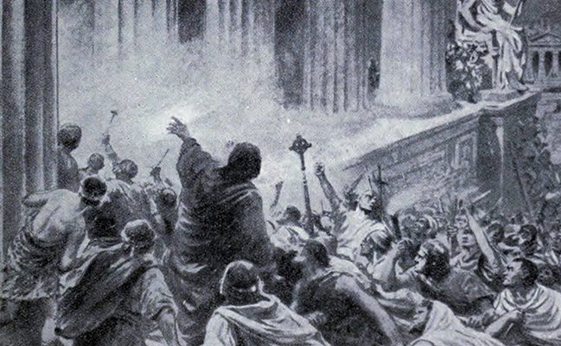
Education in Sparta
Education in Sparta was about producing solider-citizens. Citizens of Sparta believed in a life of discipline, self-denial and simplicity. Because of this, boys were very loyal to the city-state of Sparta.

Slide 22
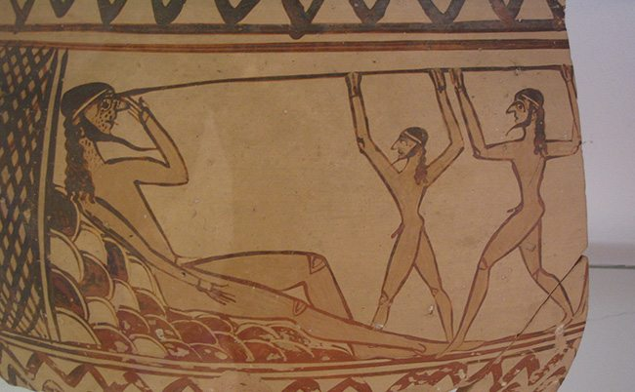
Stories
The ancient Greeks loved telling stories. They created a number of stories including Odysseus And The Terrible Sea and Circe. Parents would tell them to their children in the hope that when they grow up, they’ll follow the morals in the narratives.

Slide 23
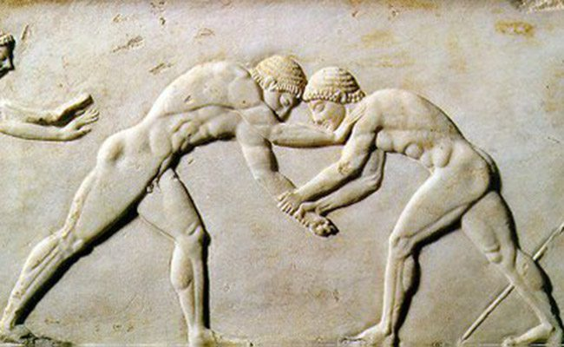
Olympic Wrestling
Ancient Olympic wrestling was a weird tradition, full of blood and gore! The goal was to destroy your opponent until they could no longer move…

Slide 24
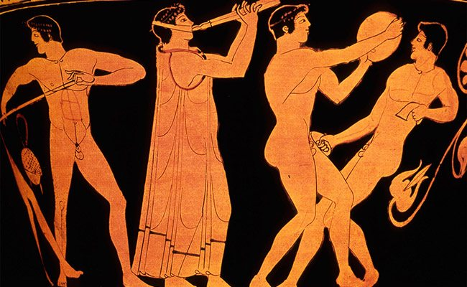
The Variety of Sports
The ‘variety’ sport was assembled of five different sports, all of which resulted in a lot of broken bones and torn limbs!

Slide 25
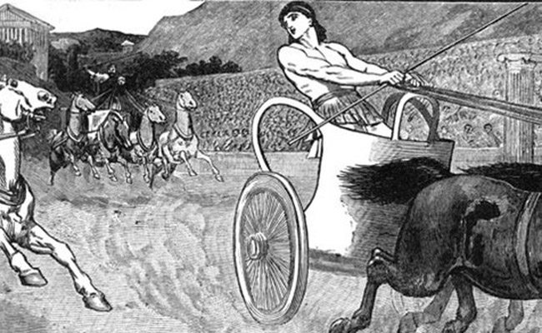
The Horse Carriage Hunt
This wacky sport pitted one opponent against another with the goal being to cross the finish line first. In between the start and finish line, however, violence was allowed!

Slide 26
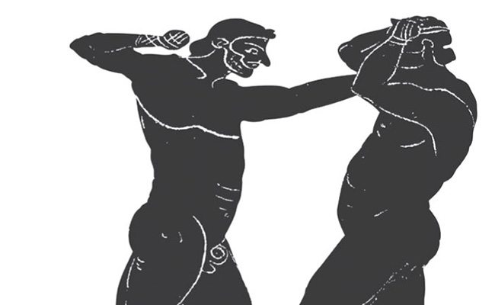
Knuckle Knuckle
Knuckle Knuckle was a brutal sport in which two opponents would stand in a small circle and hammer each other into submission!

Slide 27
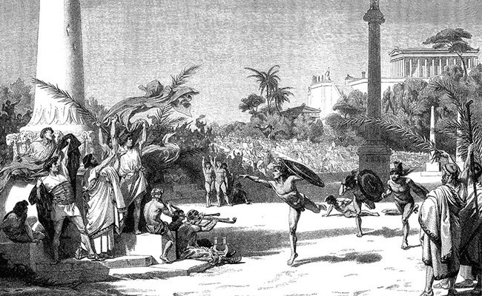
The Great Chase
In this sport, a designated thrower would launch a javelin-like object into the distance and two rival competitors would have to track it down first! Many bones were broken in the sport…

Slide 28
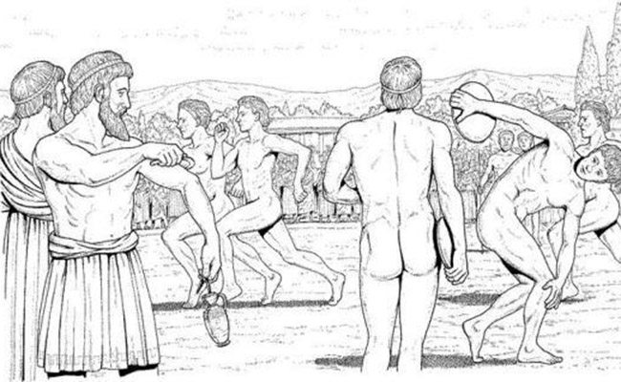
Ancient Discus
While in principle the discus discipline hasn’t changed much, it’s the added violence that made it more of a challenge in ancient Greece. Beaten contestants would often end up hurting their rivals! Sore losers much?

Slide 29
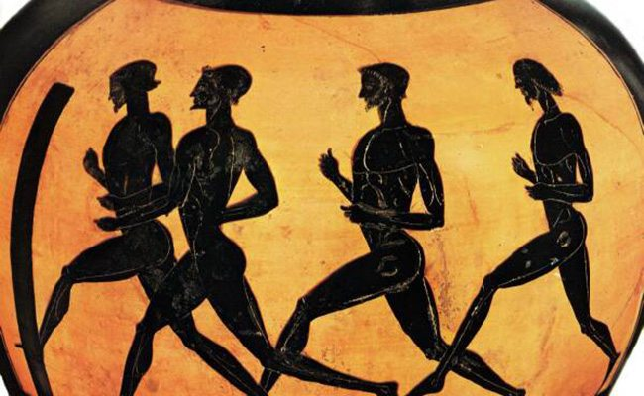
Naked Running
Performing running events whilst naked definitely adds a twist to proceedings, making weather conditions a lot harder to handle!

Slide 30
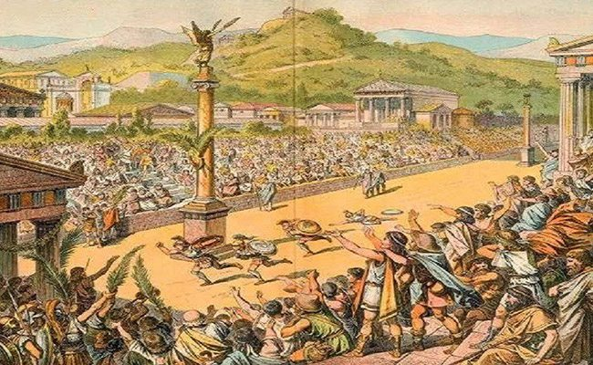
A Sprint With Major Consequences
Losing a sprint in ancient Greek times would often result in the losers killing themselves due to embarrassment!

Slide 31
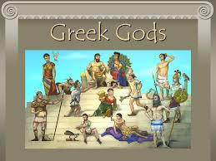
Religion and Gods

Slide 32

Mount Olympus
Olympus was notable in Greek mythology as the home of the Greek gods, on the Mytikas peak. Mount Olympus is also noted for its very rich flora with several species.

Slide 33
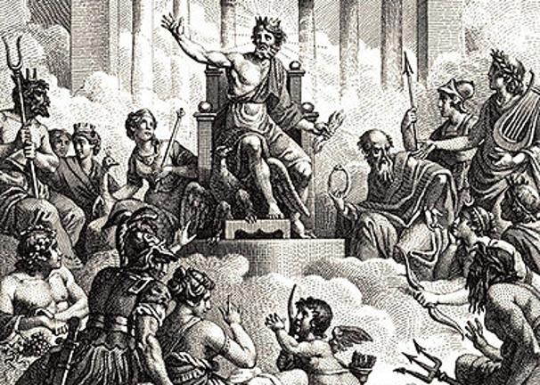
The gods at home on Olympus

Slide 34
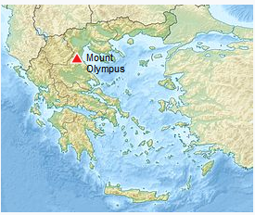

Slide 35
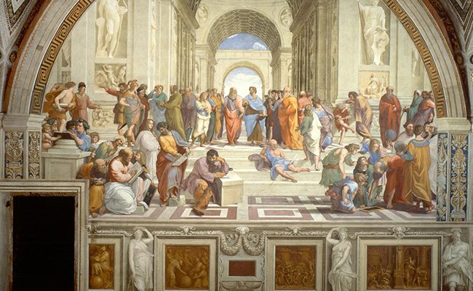
Religion
The ancient Greeks were very religious and worshipped a large number of gods who they believed appeared in human form and were gifted with superhuman strength. They also painted their gods and goddesses on vases, stones and more.

Slide 36
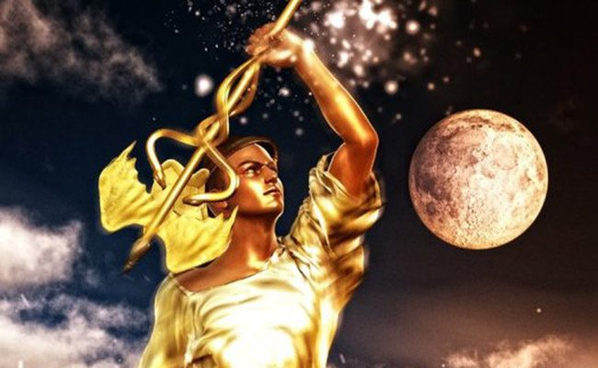
Hermes
Hermes in Greek mythology is the messenger god. A young intelligent man who was a good leader and traveled the world giving prosperity to those who crossed his path!

Slide 37
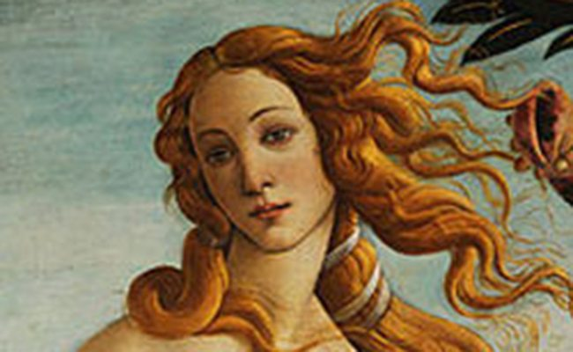
Aphrodite
Aphrodite had an unusual birth. She rose up from the sea one day as a beautiful woman who was the symbol of femininity and class!

Slide 38
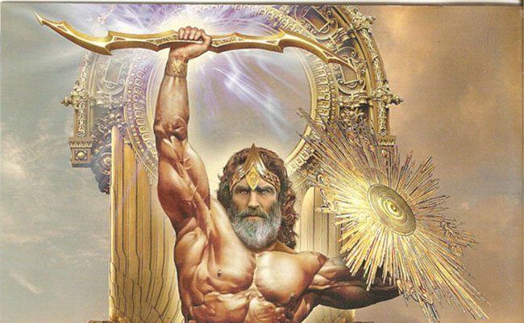
Zeus
Zeus was said to be the king of gods , a perfect being with the power to decide the fate of the world at his fingertips! He could also control lightning elements.

Slide 39
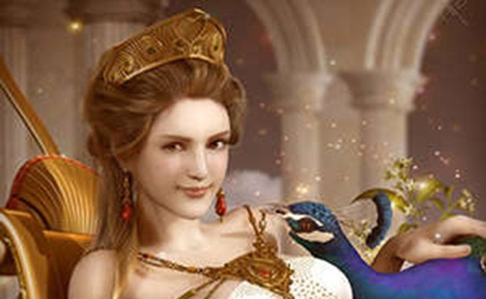
Hera
Hera was the queen of all gods and the protector of all women. She was said to be the original goddess, with deadly powers if angered!

Slide 40
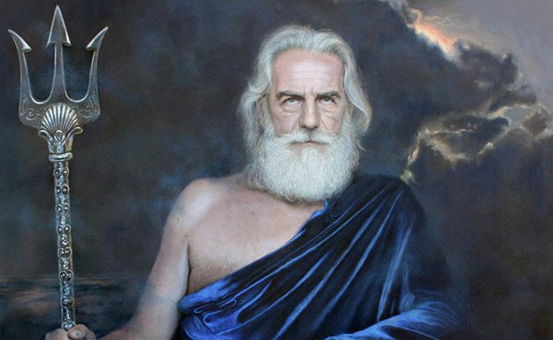
Poseidon
The brother of the great Zeus, Poseidon is the god of the sea and responsible for the many Aqua Man depictions in comic books and movies. He is able to manipulate sea creatures at will!

Slide 41
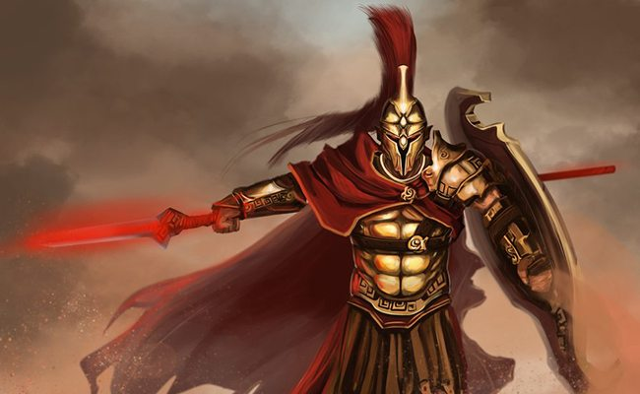
Ares
Ares is the god of war, a hardened soldier unbeatable in combat situations with a fiery temper! As far as physical strength goes, Ares is the strongest of all the gods!

Slide 42
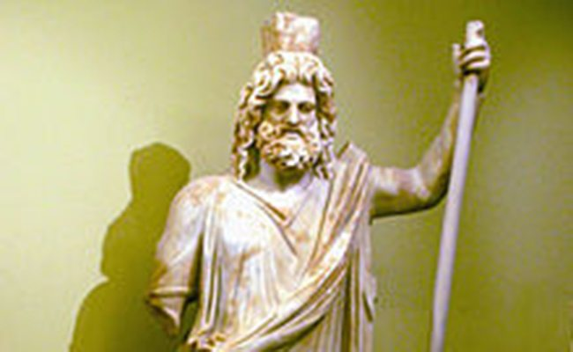
Hades
Hades is also the brother of Zeus and is seen as the most important god of all because of his insane levels of intelligence. He was able to come up with plans in testing situations!

Slide 43
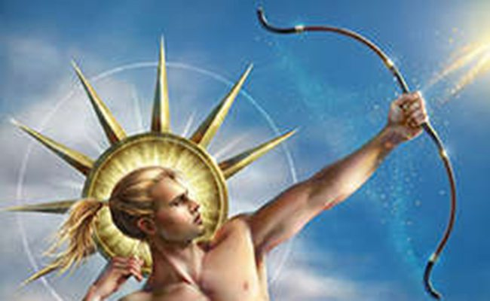
Apollo
Apollo was a master hunter who loved using his bow and arrow to take down enemies. He was seen as the most truthful of the gods and was later referred to as the god of prophecy!

Slide 44
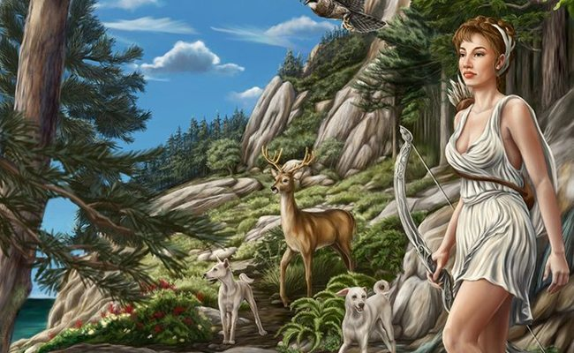
Artemis
Artemis is the twin sister of Apollo and she was also a master hunter who really excelled under moonlight! She became known as the goddess of the moon as a result!

Slide 45
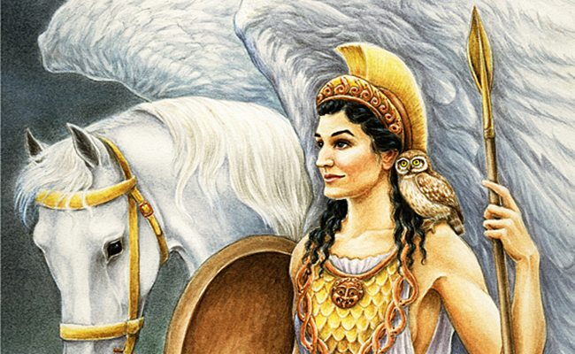
Athena
Athena was seen as the most graceful and elegant god around and she was the daughter of Zeus. She not only excelled in combat scenarios but also possessed wisdom beyond her years!

