Slide 1
Things I Found Weird As An International Student In The USA!

Slide 2
After almost 4 years in the great USA, I have made a list of things I've noticed that have been completely different from what I'm used to. These are all observations made in Oklahoma, and might not apply to all of the U.S. Also, some of the stuff might just be weird to me since I'm Norwegian and might not be weird to other foreigners

Slide 3
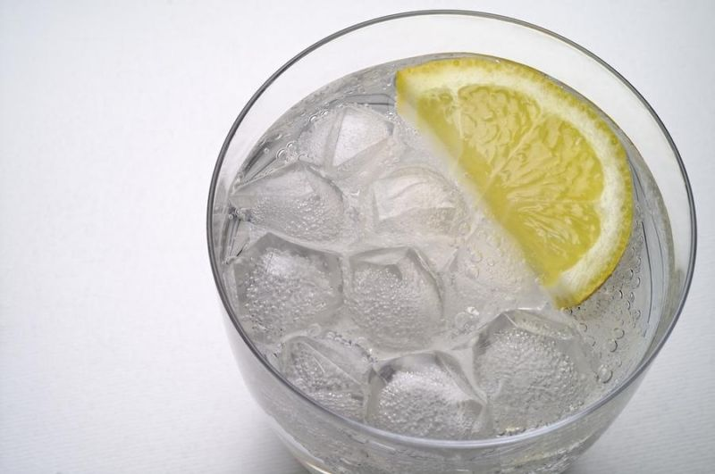
1. Ice in drinks. Sometimes there is more ice than drink.

Slide 4
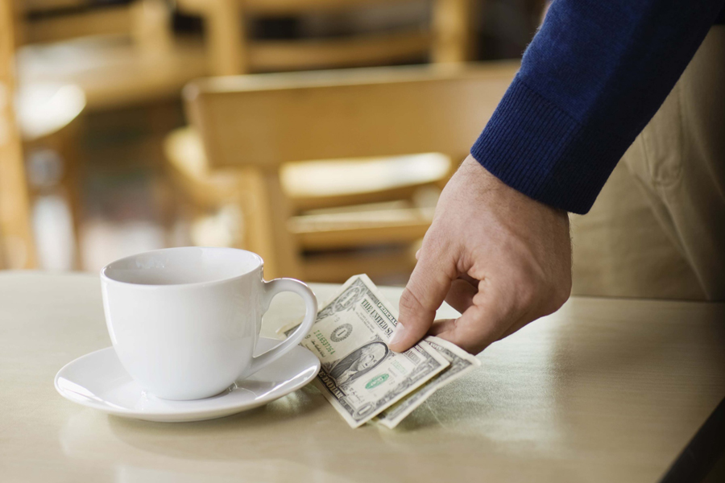
2. You have to tip the waiter. It's not a thing you do only if you actually liked the service you got.

Slide 5
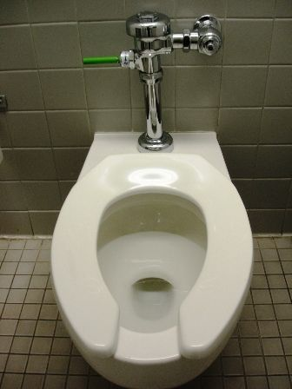
3. Public toilets. The toilet seat cuts off in the front.

Slide 6
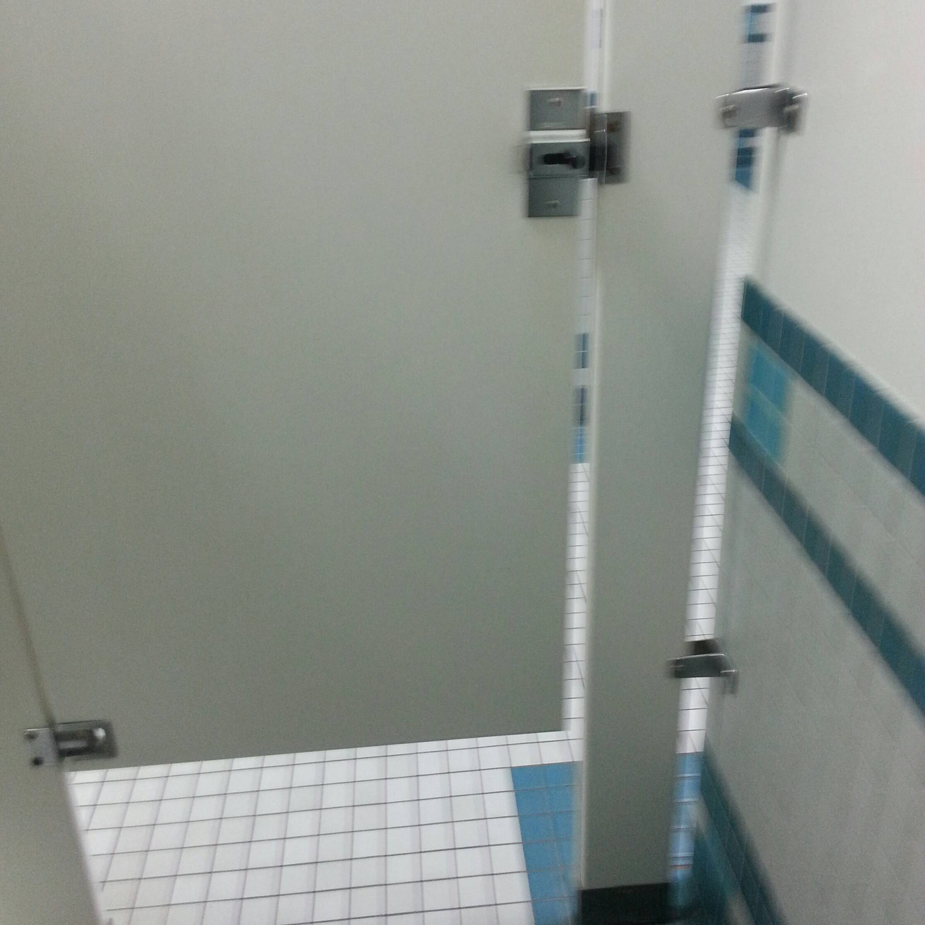
4. The gaps! I will never understand why anyone thought it was a good idea to put gaps between the door and the walls on public toilets. Let me pee in peace!

Slide 7
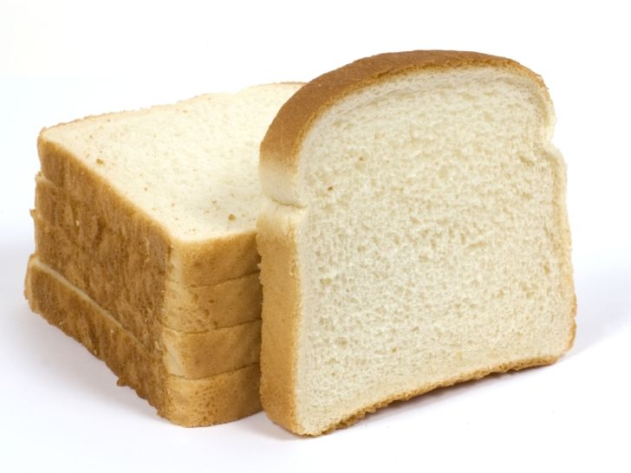
5. American bread is sooo sweet. The crust is also really weird. It's not crispy. It's soft. Like not crust, but still

Slide 8
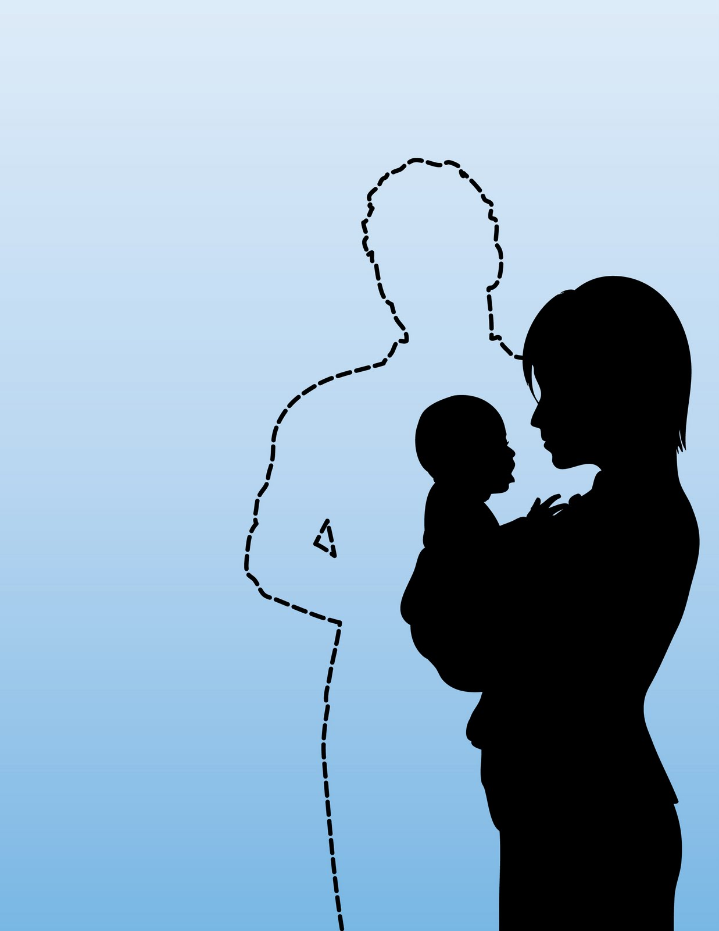
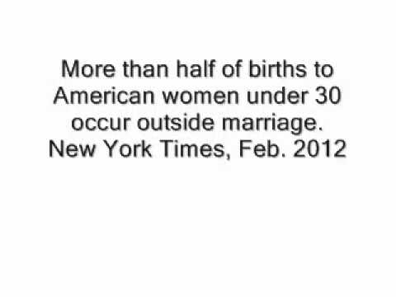
6. Being "born out of wedlock" is still a thing. To my now husband's distant relatives, I was known as the foreigner who gave birth to his child out of wedlock.

Slide 9
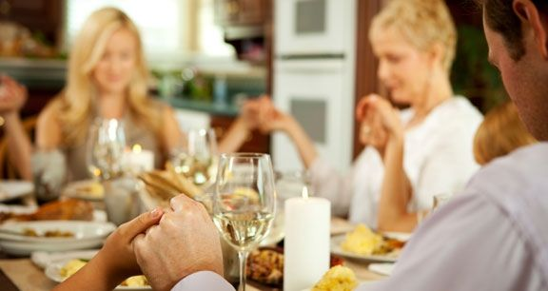
7. Praying before eating. This has made it a little awkward with the in-laws more than once, "saying grace" with my mouth full of food... Even when we eat at restaurants, they do the whole thing with holding hands etc.

Slide 10
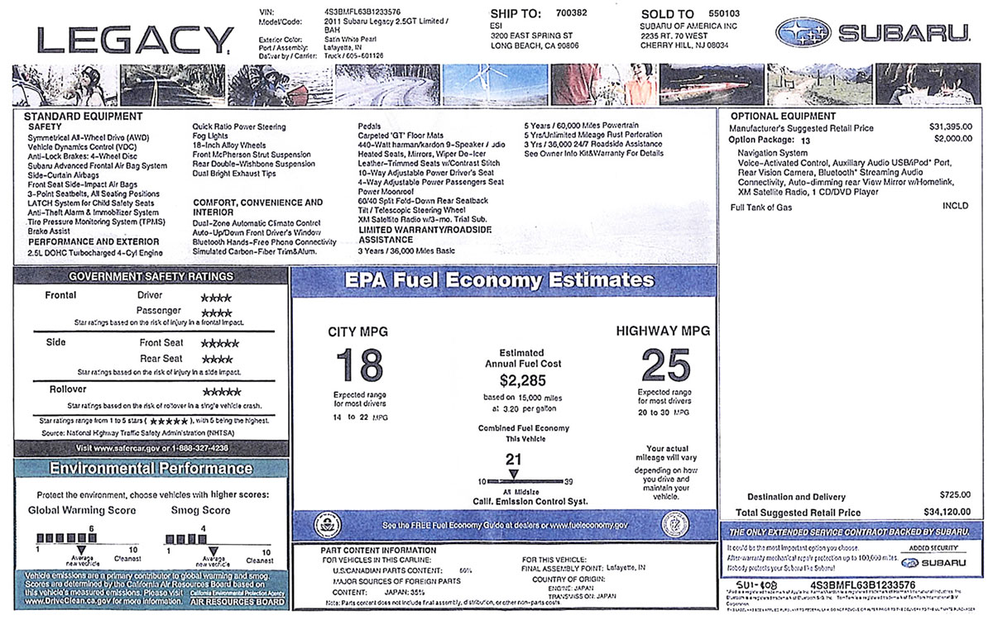
8. The price tag is not the actual price.

Slide 11
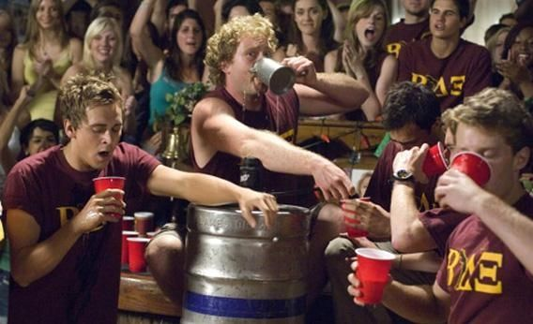
9. The host at a party provides the alcohol. In Norway, that's way too expensive, so everyone brings their own. Though, I know the hosts get happy if you pitch in of course!

Slide 12
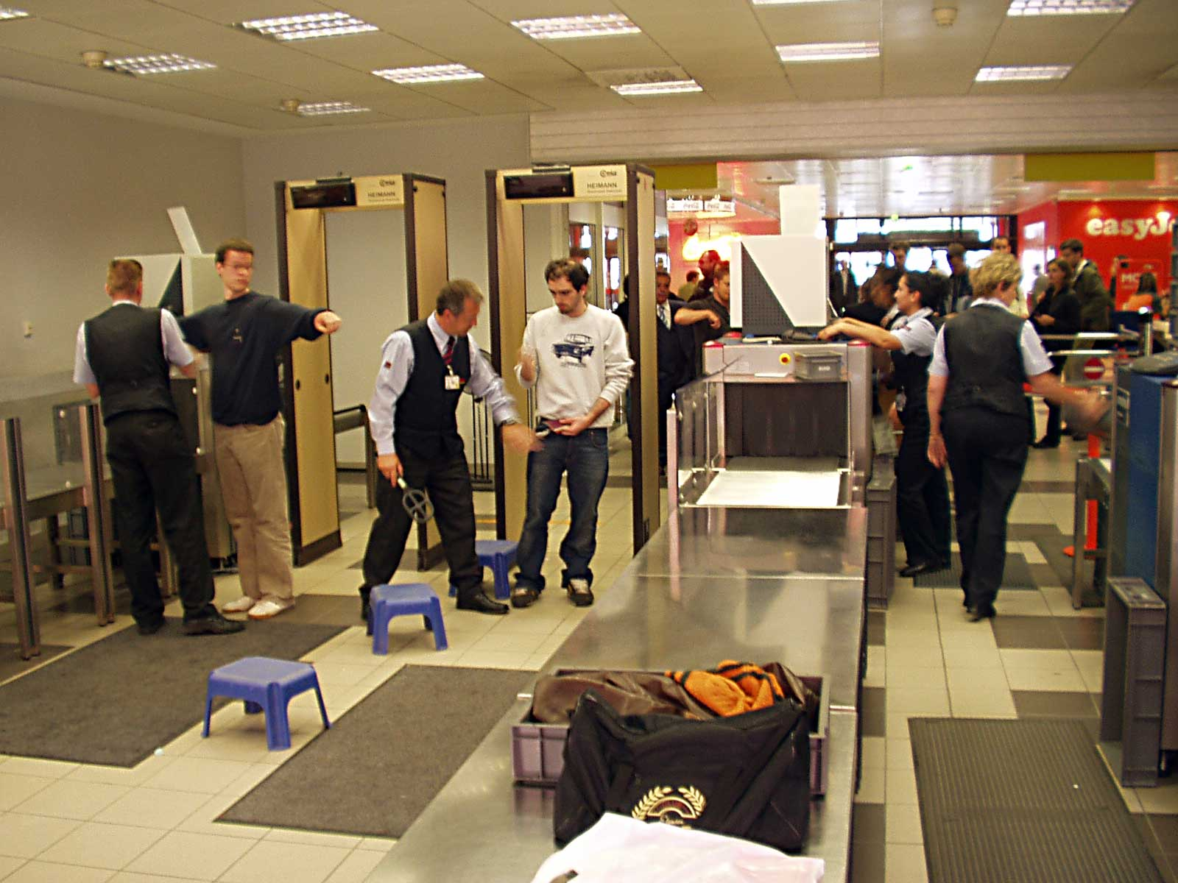
10. Before getting into the country, they actually ask you if you are a terrorist.

Slide 13
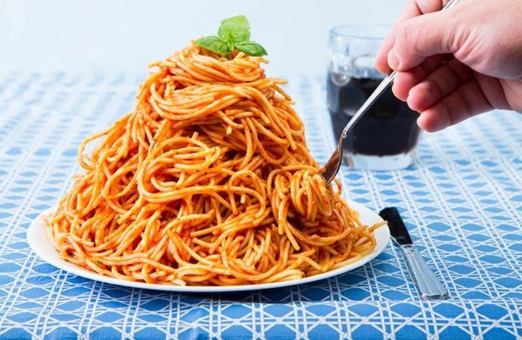
11. The food portions are huge!

Slide 14
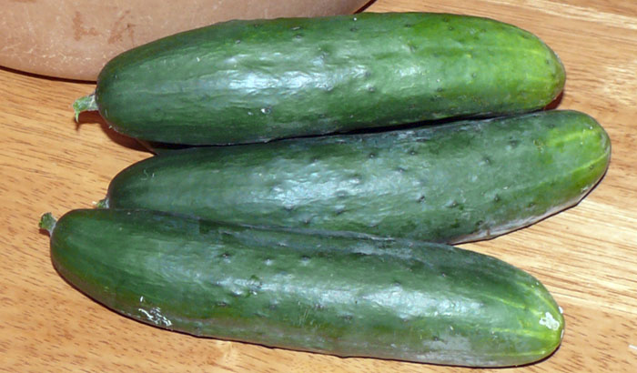
12. Your cucumbers are weird btw.

Slide 15
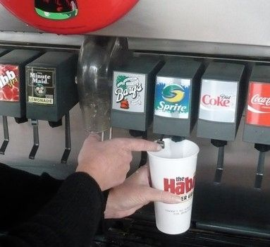
13. Free refills! It's awesome!

Slide 16
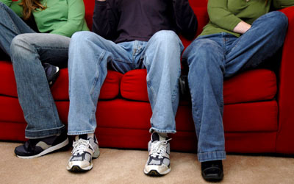
14. Some people wear shoes inside.

Slide 17
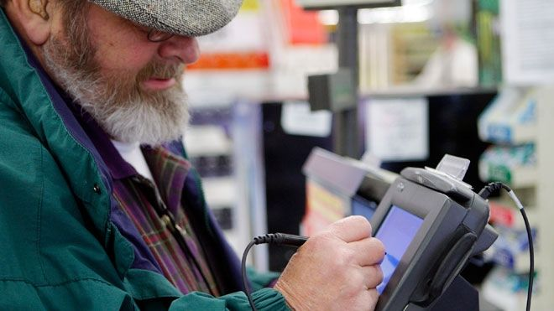
15. You can use your card without the pin code. Super secure!

Slide 18
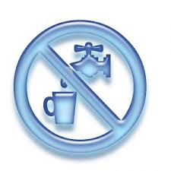
16. You can't drink tap water. At least not where I live.

Slide 19
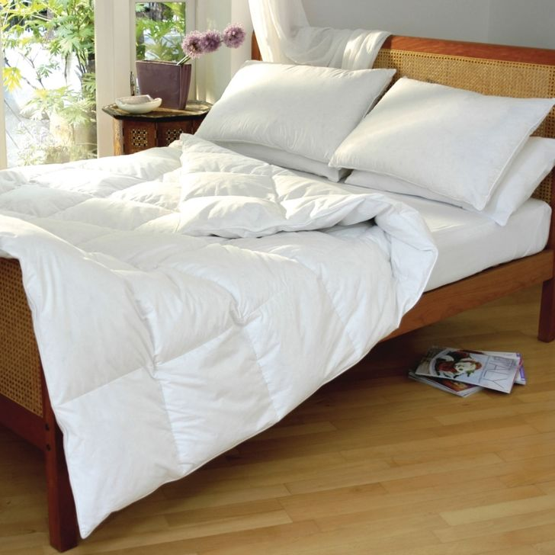
17. No one uses duvet covers for some reason.

Slide 20
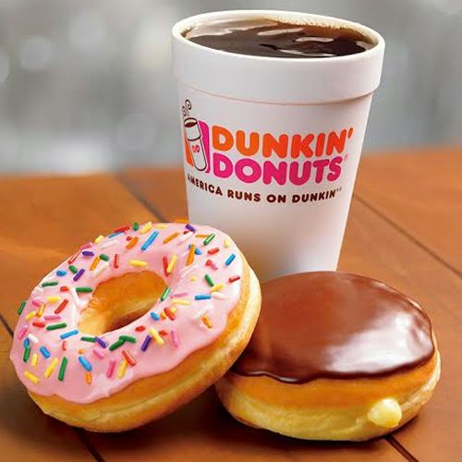
18. Some people (like my husband) consider donuts as a legit breakfast!

Slide 21
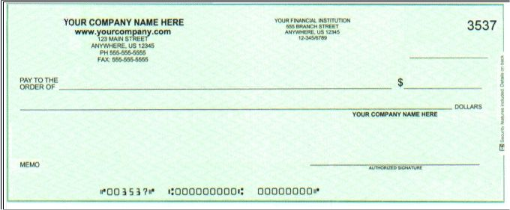
19. People still use checks.

Slide 22
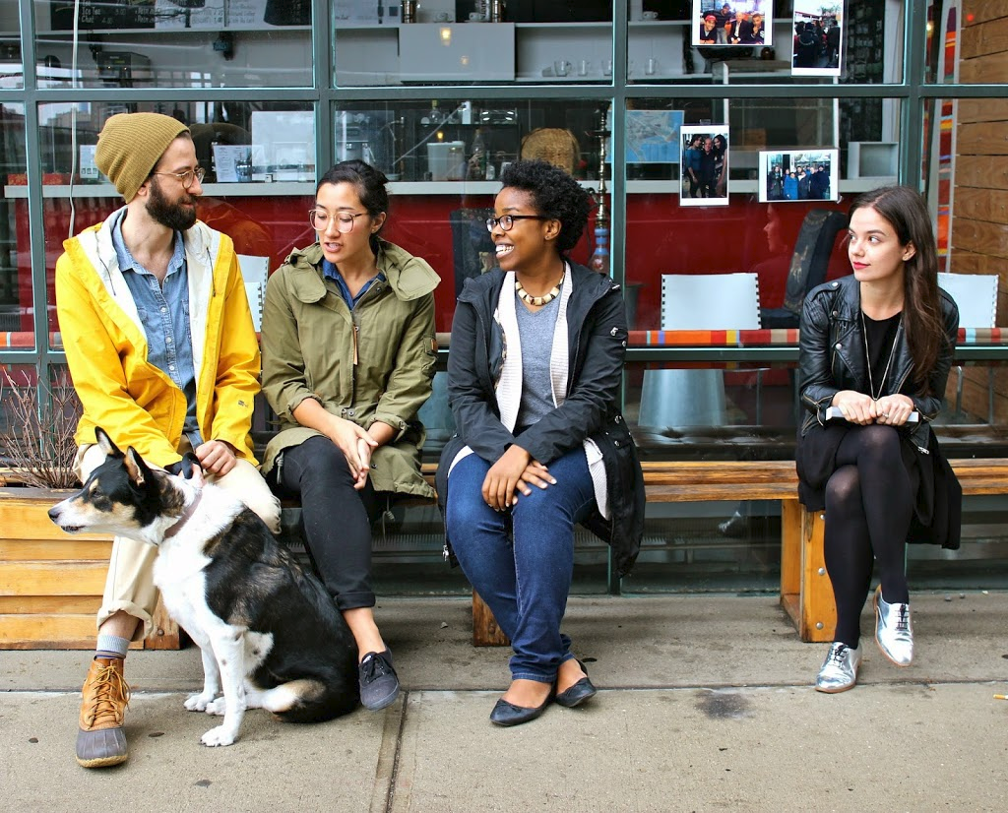
20. They will also give you random compliments, even strangers. In Norway, people will definitely think you're crazy if you talk to a stranger.

Slide 23
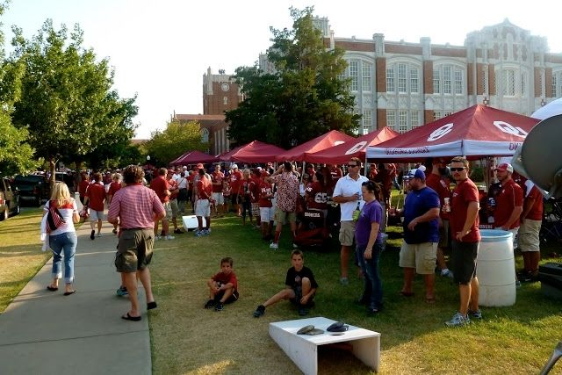
21. Tailgating. It has to be experienced.

Slide 24
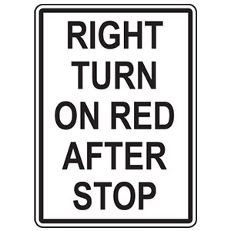
22. You can turn right on red! I had never even heard of that until I got to the U.S.

Slide 25
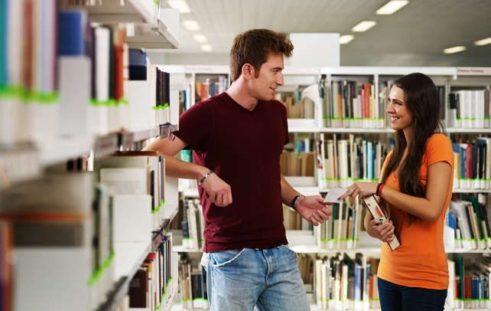
23. Random guys might ask you out in random places, and it's not considered too weird. I've been asked out by strangers in a staircase and a bookstore for no apparent reason.

Slide 26
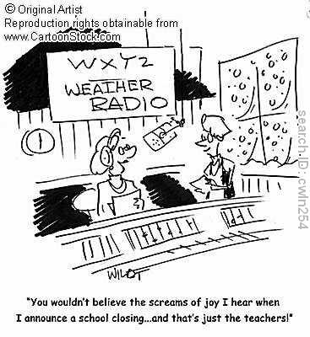
17. Snow days. Everyone freaks out when there is even 1 mm of snow and raid the grocery stores so they don't have to leave their houses. In Norway, we go to school in thigh high snow, because otherwise there wouldn't be school half of the year.

Slide 27
Some comments from other foreign visitors to the U.S.

Slide 28
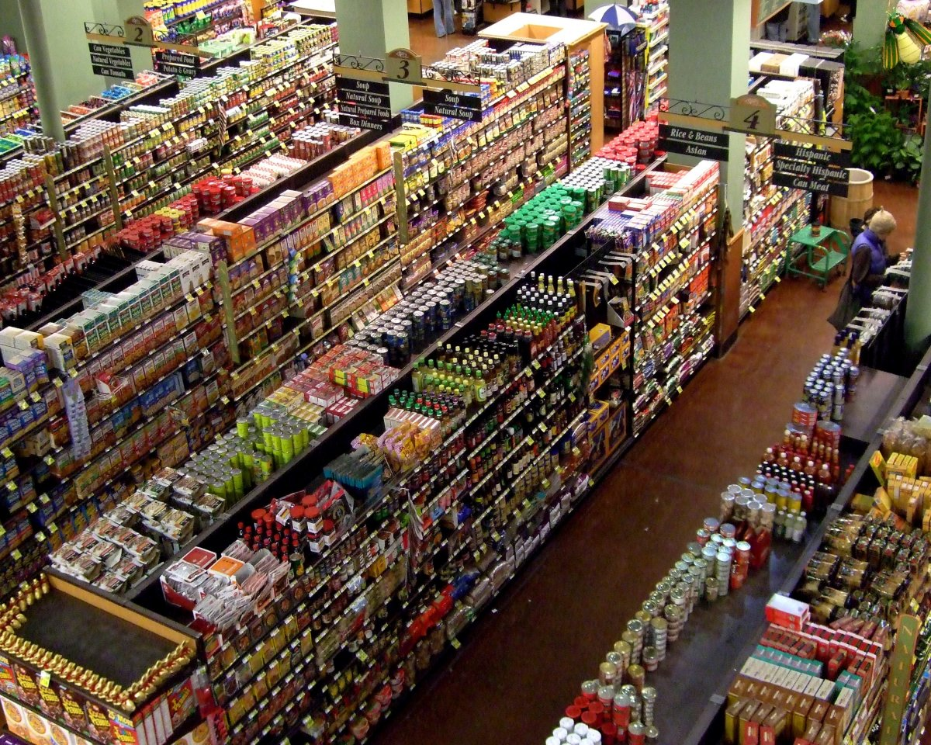
The insane range of options

Slide 29
Flags everywhere. EVERYWHERE.
Wearing the flag as a bikini.
Price tags without tax included. “How do you know how much you’re spending until you get to the cashier?”
Advertising for prescription drugs, as in “ask your doctor for brand x.” In the U.K., “your doctor tells you what drugs you should take, not the other way around.”
Everything being designed around cars.
The “sheer amount” and lack of quality of TV commercials.
Americans saying “oh, really?”, which to us is a way of saying “Interesting, can you elaborate?” In other parts of the world, that phrase is generally meant to imply that what they’re saying is being challenged.

Slide 30
Pickles given with everything.
College football players being treated as celebrities. They are “students that do an extra-curricular activity.”
Jaywalking is a crime.
Apparently we’re really loud but friendly!
Way too much water in toilet bowls.
The “creepy” Pledge of Allegiance sounds weird with children chanting it.
Lawyer advertisements everywhere.
According to the Japanese, our meals are “flat to the taste” and “sweet, high fat, high calories [sic] things.”
Nobody talks about grades here.

Slide 31
We are private about our accomplishments and failures.
The retail experience isn’t as fun as it is in India. They have personal shoppers because labor is cheap.
Students aren’t competitive with each other, but collaborative.
Strong ethics. Everyone has a lot of integrity, according to an Indian student, particularly in regards to schoolwork.
Rich people are thin and well-maintained while poor people are fat. Even the Indian student knows that this is because cheap food is fatty and it’s “expensive to be healthy in America.”
You receive better customer service if you are “well maintained.”
Girls aren’t as promiscuous as portrayed in Hollywood.

Slide 32
Everyone has access to basic food, clothing, water, and sanitation.
Dearth of African-Americans in tech fields.
We waste a lot of food.
Obsession with coffee.
The way we price our products makes “no apparent economic sense and is not linear at all.” Example: one Coke is $1 and 12 cans of Coke is $3.
You can “literally buy anything, including food, and return it within 90 days for a full refund” even without a specific reason for doing so.
The sheer volume of different varieties of pizza in the grocery stores.
Restaurants and supermarkets every couple of miles on interstate highways.
Fruit and vegetable prices are higher than those of junk food.

Slide 33
Putting last names first.
Restaurants take your plates away too soon.
We’re eager to please, particularly in restaurants.
The “relentlessly sincere cheer.”
The overzealous patriotism.
Treating pets like people.
Insisting that turkey is tasty.
Spelling words the wrong way, for example “colour” and using the letter “z” in place of “s” in some words.
Pretentious pronunciation. Examples cited included saying “erb” instead of “herb” and “fillet” instead of “fille” without the “t” sound.

Slide 34
Saying “panties, fanny, and bangs” seems to be “infantilizing and oversexualizing” at the same time.
Toilet handles instead of buttons on top.
Toilets get clogged a lot because of the weird shape (u-bend).
The light switches being “up for on and down for off.”
The showers “suck” because you can’t control the flow of the water, only the temperature.
All sinks have a little hole in them to prevent overflow.
The number of trucks — SUV’s, pickups, 4-wheelers.
Huge trees.
Lots of blinds and not so many curtains.

Slide 35
People talk to themselves a lot and no one notices.
We’re obsessed with the weather.
TV commercials are aimed at “the stupid.”
Excessive use of napkins.
Drinking alcoholic beverages by themselves, without eating.
Music is too loud in bars.
To Finlanders, a PB&J is gross.
So many ad breaks during TV shows.
We’re very eager to invite people to our homes.
The phrase “African-American” was weird to a Canadian. He said “no one here says “African-Canadian.”

Slide 36
“Endless, costly political campaigning” without spending limits.
The phrase “how are you” apparently isn’t often asked in other countries.
The sheer number of different churches and Christian denominations.
Public displays of affection in front of elders.
Sweet iced tea.
The lack of annual leave from work.
Not eating the national animal. The example cited was by an Australian, who said “kangaroos are bloody delicious.”
Canned laughter in TV shows.
Not getting paid maternity/paternity leave.
Personal responsibility is more valued that social responsibility.

Slide 37
Talking about work and asking what people do for a living in great detail at a social function.
Driving two hours for lunch.
Laws changing drastically between states.
Open carry of firearms.
Football is not what that game is.
The measurement systems are asinine.
You expect everyone to speak English perfectly.

Slide 38
24-hour stores
The legal drinking age
Peanut Butter
Root Beer
Wasteful
Chicken and Waffles
Frozen Meals

