Slide 1
Things Americans Are Surprised About European Culture

Slide 2
Cultural Differences
Undoubtedly the world we live in is an incredibly diverse place, and with 195 countries in existence today, it isn’t difficult to see why. For every culture has a history; some are longer and date back further than others, and many more are heavily influenced by the impact that older countries have had on their development; but, as a point of pride, each on is uniquely their own. However, whether you choose to attribute it to human nature and our incessant need to group and categorize things or not, we have put together many countries and nations that were born from European decent and labeled them the “Western World.”

Slide 3
Undoubtedly the world we live in is an incredibly diverse place, and with 195 countries in existence today, it isn’t difficult to see why. For every culture has a history; some are longer and date back further than others, and many more are heavily influenced by the impact that older countries have had on their development; but, as a point of pride, each on is uniquely their own. However, whether you choose to attribute it to human nature and our incessant need to group and categorize things or not, we have put together many countries and nations that were born from European decent and labeled them the “Western World.”
“How different could it be?” you might ask yourself, especially knowing that it was Europeans who came and settled here and are in a large part responsible for the country we know today. Although difficult to pinpoint when it happened, somewhere along the way, American culture diverged and began to adopt its own standards, beliefs, and practices, many of which today, are quite different from those found in Europe. In fact, you need only ask an American who was recently in Europe to learn how different it really is – so different, that many Americans are shocked by what they see on the other side of the pond.

Slide 4
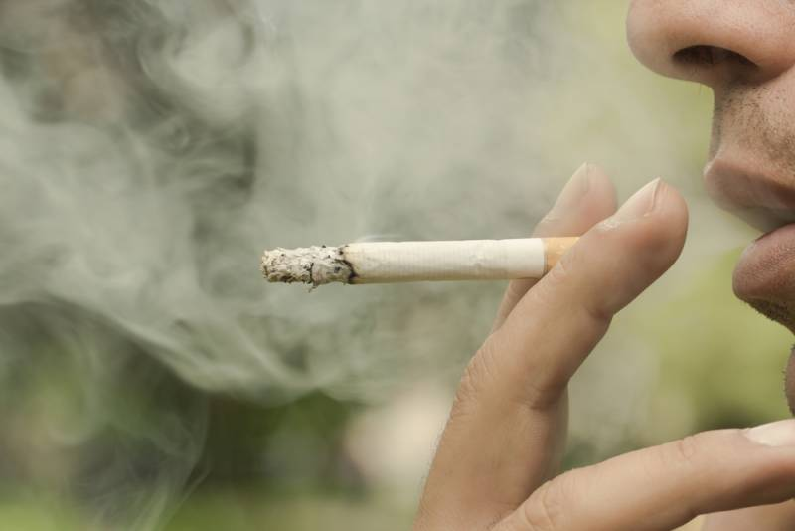
Smoking
Smoking is rampant in Europe with seemingly just about everyone doing it. And while many European countries have banned smoking indoors, as a result, terraces and patios are meccas for the populous. Many countries even have special rooms in airports and train stations for smoking so as not to bother those who don’t (which in our experience isn’t many).

Slide 5
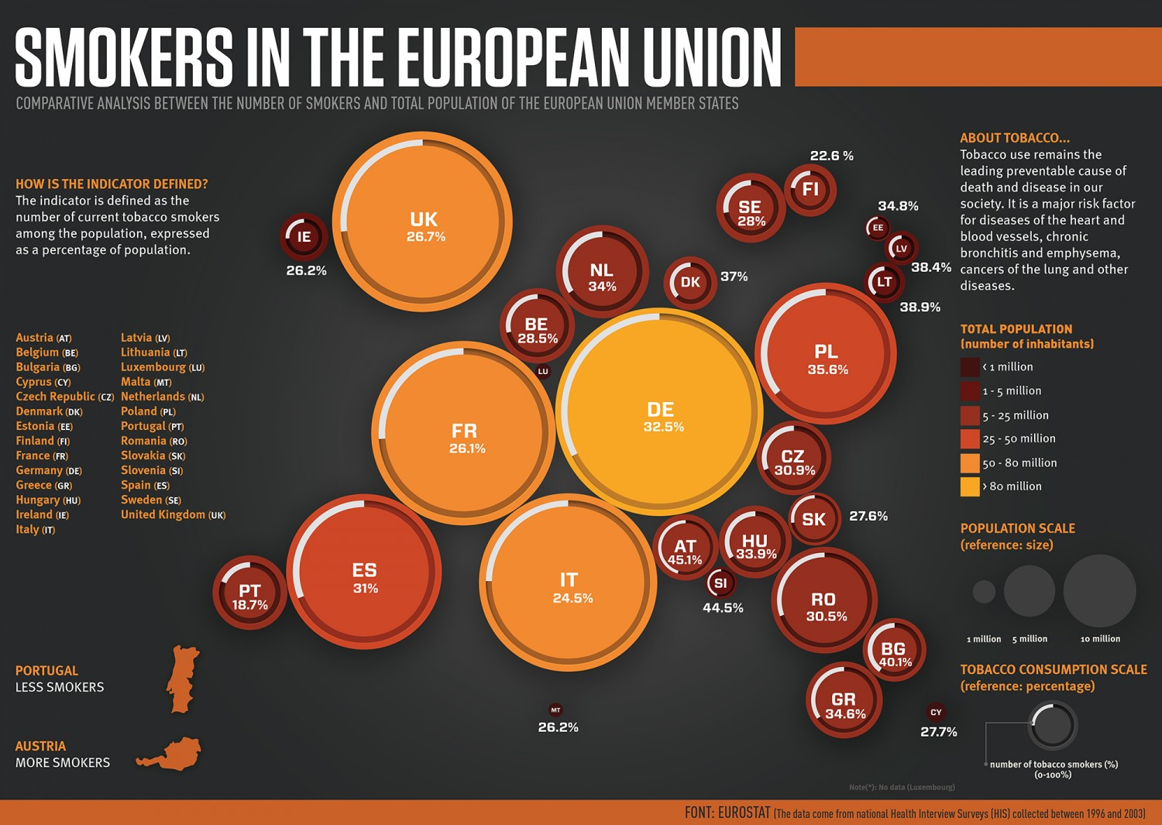

Slide 6
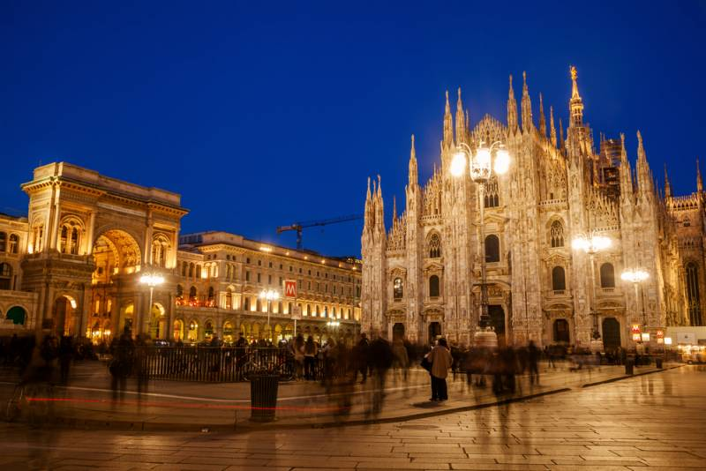
Everything is Old (Isn’t that why we go there as tourists?)
Houses, churches, castles, towers and roads, many of which are hundreds if not thousands of years old, have been used or walked on for a hundred generations and are still in fine working order today. Can the same be said for most of the structures that we have on this side of the pond? I don’t know about you, but many of the roads we drive on can barely make it through a winter let alone a dozen wars.

Slide 7
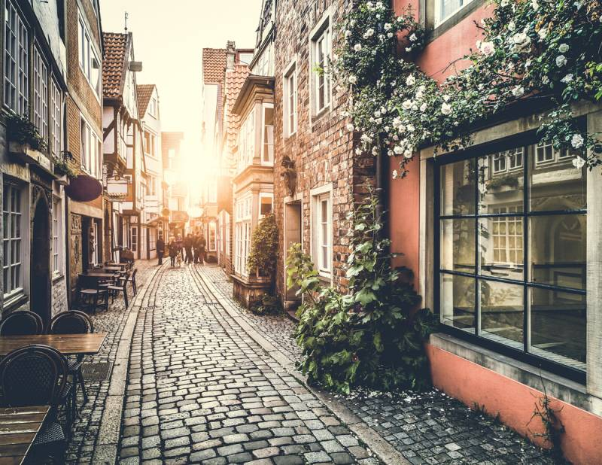
History is Everywhere
In terms of timelines, North America and the United States is relatively new in comparison to its older European counterparts. And while it can be nice to have new buildings, new designs and a modern infrastructure, there is a quiet, understated charm in being able to look back at the influences of years gone past by simply walking down the street.

Slide 8
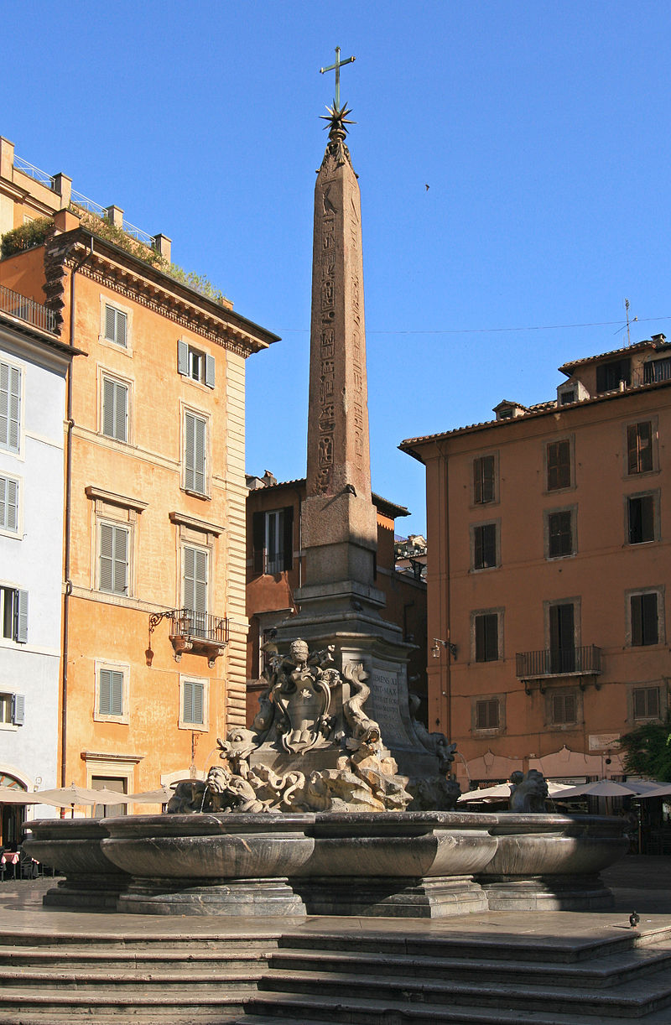
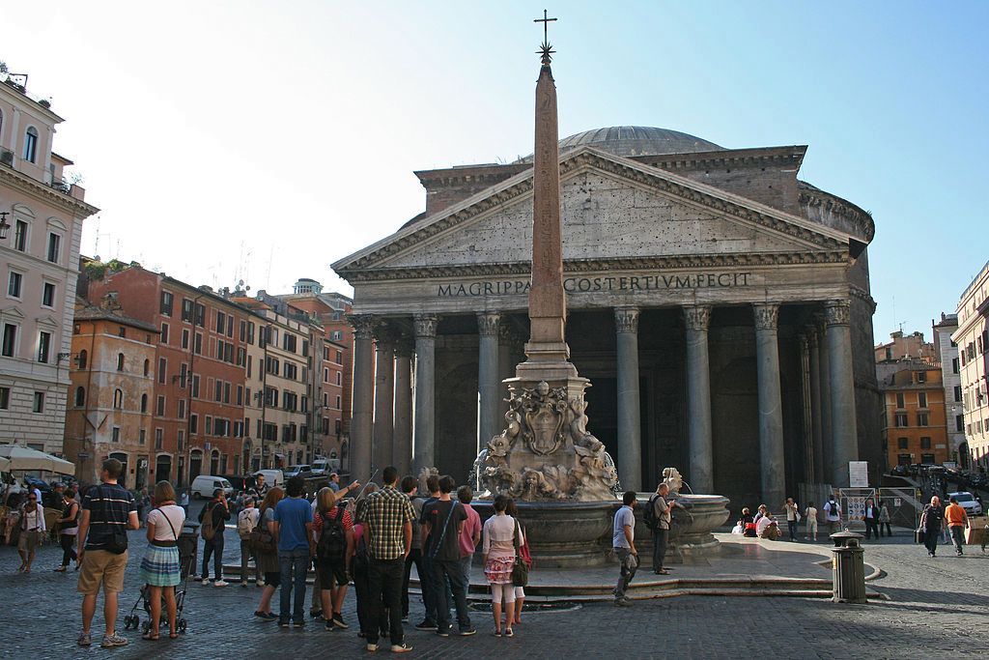
Our Last Visit to Rome (Joe & Mary Jane 2005)
We stayed in a condo in what had been ancient Rome. Our building had to be at least 500 years old. We could look out the window and across the piazza was the 2000-year-old Pantheon which had been a Roman temple, but today it is a Catholic Church. And in the middle of the piazza was a fountain made by the Renaissance artist Giacomo Della Porta in 1575 and sculpted out of marble by Leonardo Sormani.
Our window

Slide 9
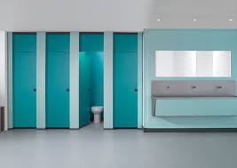
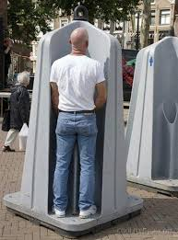
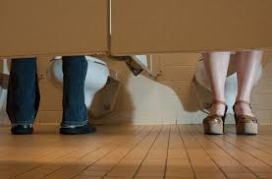
Bathrooms
Depending on where you are, a bathroom might not look or contain anything that you are used to. If you walk into a restroom and expect to see soap, water, towels and in some cases toilet paper, you might be in for a surprise. In fact, you might simply just find a hole in the ground. On top of that, most restrooms in Europe are gender neutral and in some countries, you might even have to pay to use a public facility.
Used by men and women

Slide 10
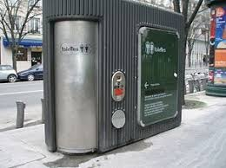
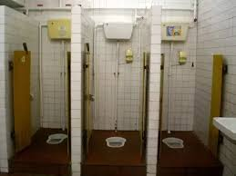
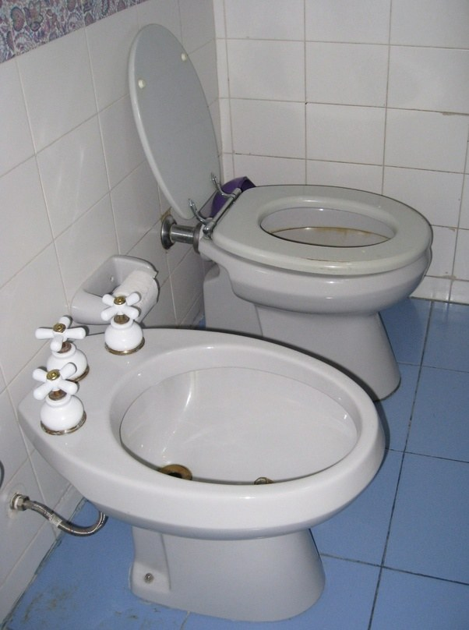
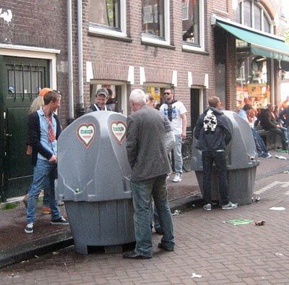
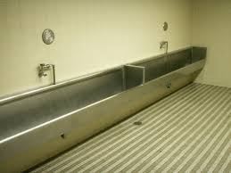
Other toilet possibilities
Multi-person urinal

Slide 11
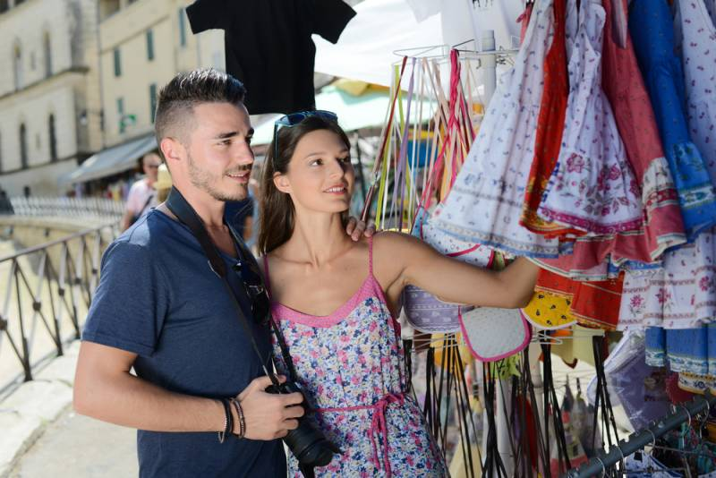
Hold Off on Pulling Out Your Wallet
In America, when you walk into a store, you will typically see a price tag and know exactly what you are expected to pay for such an item or service. In Europe, however, prices are much more fluid, meaning that oftentimes, there is potential to negotiate a better deal. Typically, this won’t happen in restaurants or at hotels, but if you enjoy the many outdoor markets and shops that are dotted across many great European cities, as long as you are willing to go outside your comfort zone and haggle a little bit, you will be surprised at how much money you can save.

Slide 12

Nobody is in a Rush
By comparison, there have been many studies done over the years that show Americans are significantly more stressed on than Europeans, and a large reason for that is that Europeans go through life in a much more relaxed, and ultimately slower pace. Allow us to explain. You are expected to sit down, be served by a waiter or waitress and enjoy your beverage at a table. And while this concept might be a little taboo to many Americans, you can’t argue with how relaxed most Europeans seem (and how they also seem to live longer on the whole than Americans do).

Slide 13
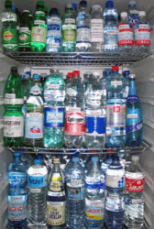
Water Might Not Be The Cheapest Option
While in America, a glass of water with a lemon is pretty standard anywhere you go (and free), in Europe, don’t expect the same type of accommodation. European restaurants will charge you for water, and that is pretty much constant across the board. And while you can ask for tap water (although we wouldn’t recommend it), there are many places that will refuse to serve you anything other than a paid bottle of water. Couple this fact with the lack of customer services and you might be in trouble if you don’t know what to expect before you make the trip. (Note: a change in water source, even “safe” water, can cause some people gastrointestinal distress – less likely with bottle water.

Slide 14
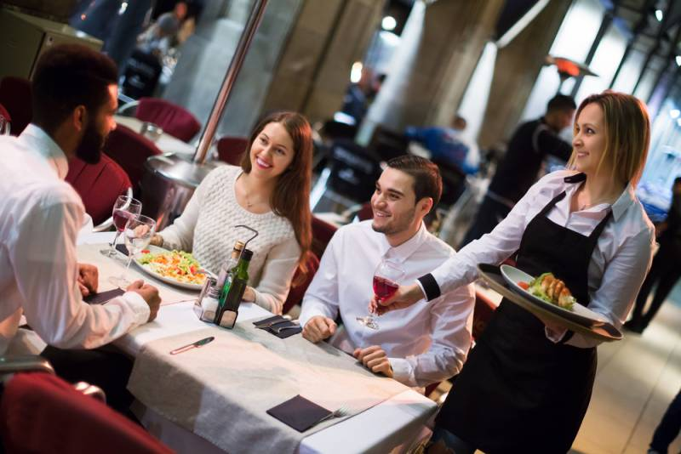
Customer Service- Lack There Of
If you walk into a restaurant feeling entitled, chances are you are going to get the exact opposite of customer service. That's because in America, waiters and waitresses are so conditioned to exemplify good customer service since their tips (which make up the bulk of their earnings) are so heavily influenced by it. In Europe, tipping isn’t really a thing as service staff is paid a living wage. So remember, if your meal takes 30 minutes to come out, just bite your tongue, for unlike in America, you likely won’t get your meal on the house, instead, just worse customer service in proportion to the entitlement you exude.
It might be a good idea to have a guide to tipping in Europe booklet so that you practice what is expected in that country for that kind of service. Also friendly smiles, patience, and an attempt to use some of the local language (even a few words) can greatly improve the service and attention you get in stores and restaurants.

Slide 15
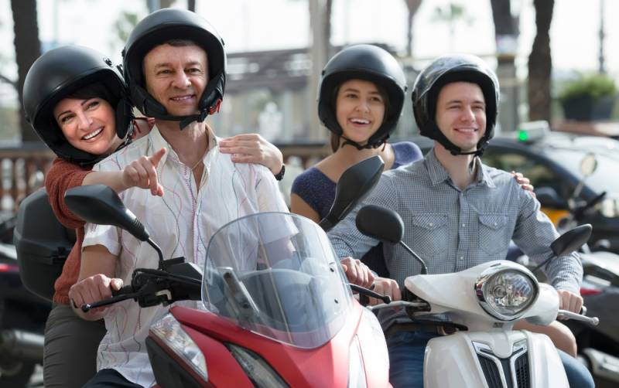
People Look Like People
In America, there is a huge (no pun intended) problem with obesity. And oddly enough, on the opposite end of the spectrum, it is quite common to run into people who like they spend 20 hours a day in the gym and are frighteningly muscular. While we are not here to body shame anyone, the fact remains that the people of Europe are generally smaller, leaner and have what would typically be considered a healthy physique. And while arguably there is better food in Europe, it does leave you to wonder what the differences in our cultures help to propagate this fact.
The older parts of the cities really are not automobile friendly, so people who live and work there do more walking. After dinner (around 8:30 p.m.) people are more likely to take a stroll around the neighborhood.

Slide 16
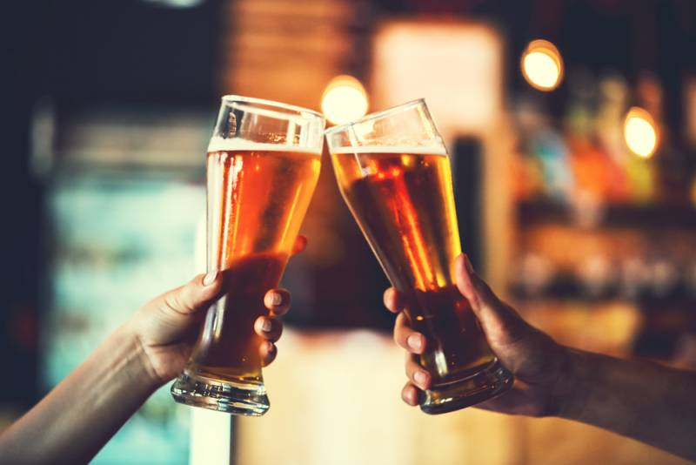
Alcohol
In Europe, they regard alcohol as something that shouldn’t be restricted to just a few places, for in Europe, you can drink alcohol just about anywhere. If you are going to the movies, you can enjoy a glass of wine at the theater. Going to a museum, you can have a beer while you look at the masterpieces. In fact, a majority of fast food restaurants, some of which are familiar in North America, actually serve alcohol. Is this a testament to the European ability to not drink to excess or is it simply an archaic lack of judgment? Well, we will let you decide, but we’ll just leave the fact that in comparison to Americans, Europeans have a much lower rate of alcohol related incidences.
For many centuries, drinking water caused many illnesses. Alcoholic beverages lacked the harmful organisms because the alcohol killed them. When water was used in cooking, the organisms were killed by heat.

Slide 17
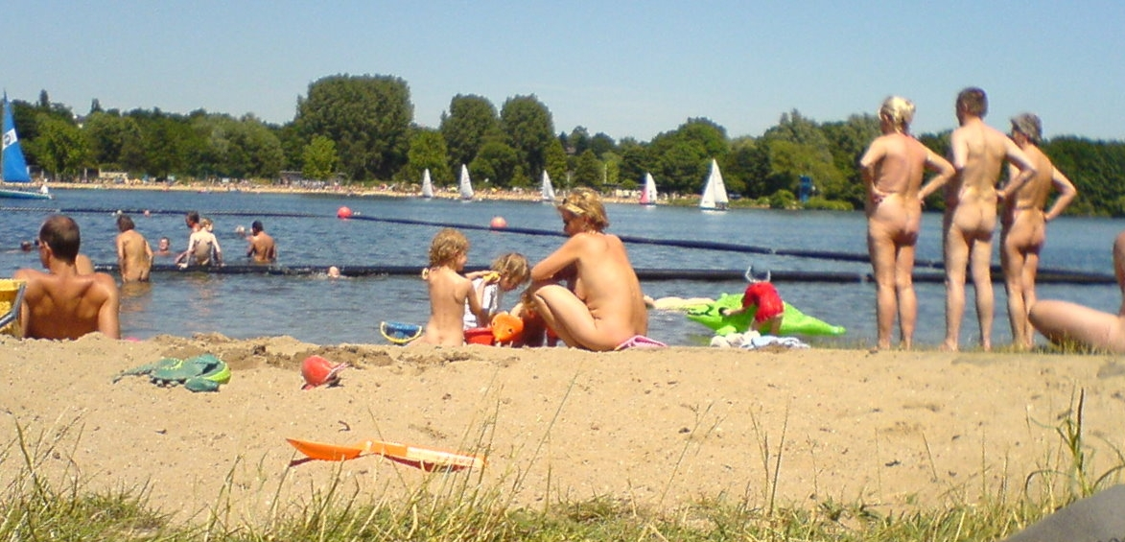
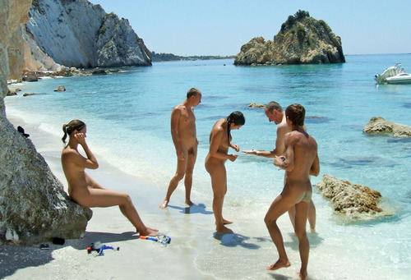
Nudity
In the US, in order for a person to see nudity they usually have to purchase a risqué magazine, watch an adult movie, or go to a strip club (not including your own personal adventures). However, in Europe, it is very common to see men and women naked on television, in newspapers and magazines (that you don’t need to be 18 years old to buy), on billboards and in some countries, even dancing in shop windows. And if you are planning on going to the beach while in Europe, be sure to remember that just about every beach is potentially a nude beach. Just remember not to stare.

Slide 18
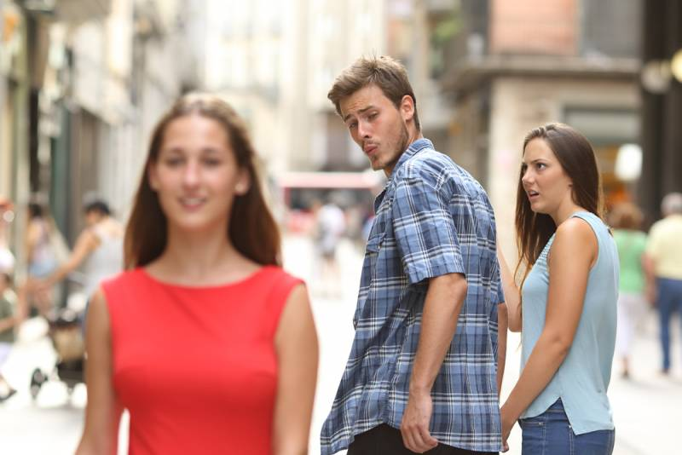
It's OK to Stare
In America, men are typically taught that it is rude to stare at women, especially long, lingering, border line creepy stares. However in Europe, looking at women seems to be par for the course, and this can often be unnerving for first-time female travelers. Here, when a man stares at a woman, they will often do so as casual as possible, and if they are noticed, they will quickly turn away and act like they hadn’t done anything. In Europe, men seem quite content to leer at the opposite sex and women, well, I don’t want to say that they enjoy it, but they do seem to be used to it. Perhaps that is why Parisian women have such a reputation for never smiling or making eye contact - and who could blame them.

Slide 19
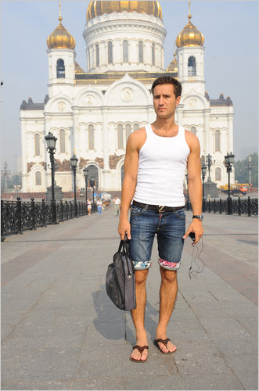
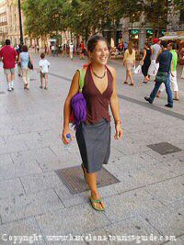
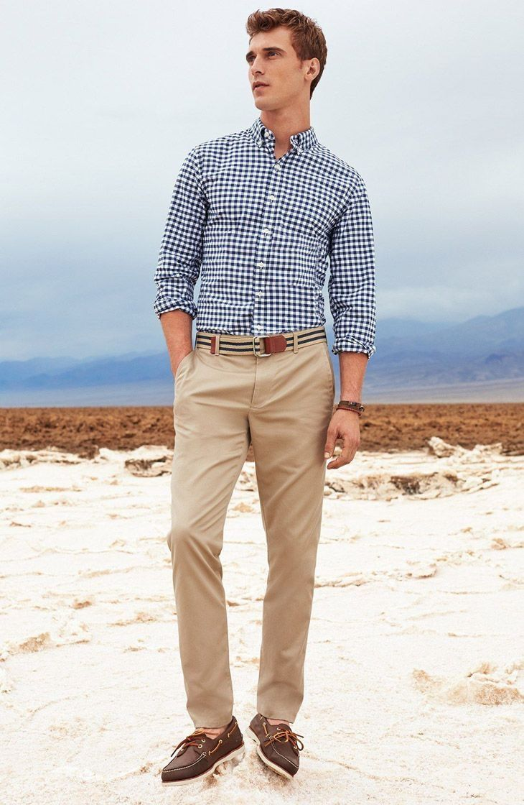
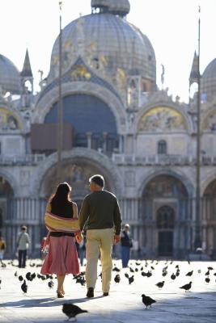
Dress for visiting churches
Most European cities are filled with churches of architectural or historic importance. Even though church attendance is Europe is quite low, they do have dress expectations for visitors. Some have “enforcers” to send inappropriately dressed persons outside. It is simple -- covered shoulders, covered knees. And probably nothing in between should show either. Short sleeves work, shorts do not. Do keep in mind that you are going into a church and need to show respect for that regardless of your faith or beliefs. The "enforcers" are just doing their job

