Slide 1
The Most Beautiful Bonsai Trees Ever
One aspect of Japanese culture.

Slide 2
Bonsai trees are awesome. Just ask Mr Miyagi. They look beautiful, they fit in your house, they encourage patience and dedication, they relieve stress, and they help to purify the air. What's not to like? People have been caring for Bonsai trees for over a thousand years. The ancient horticultural practice originated in China, where it was known as "penzai", and was later redeveloped under the influence of Japanese Zen Buddhism. The plants are kept small due to growth-restricting techniques such as pinching buds, pruning and wiring branches and restricting the use of fertilizer. It's a delicate and time-consuming process, but as you can from this list compiled by Bored Panda, those who persevere are rewarded with something amazing. Do you have a Bonsai tree? Then add your pictures to the list below and don't forget to vote for your favorite! It's what Mr. Miyagi would have wanted.

Slide 3
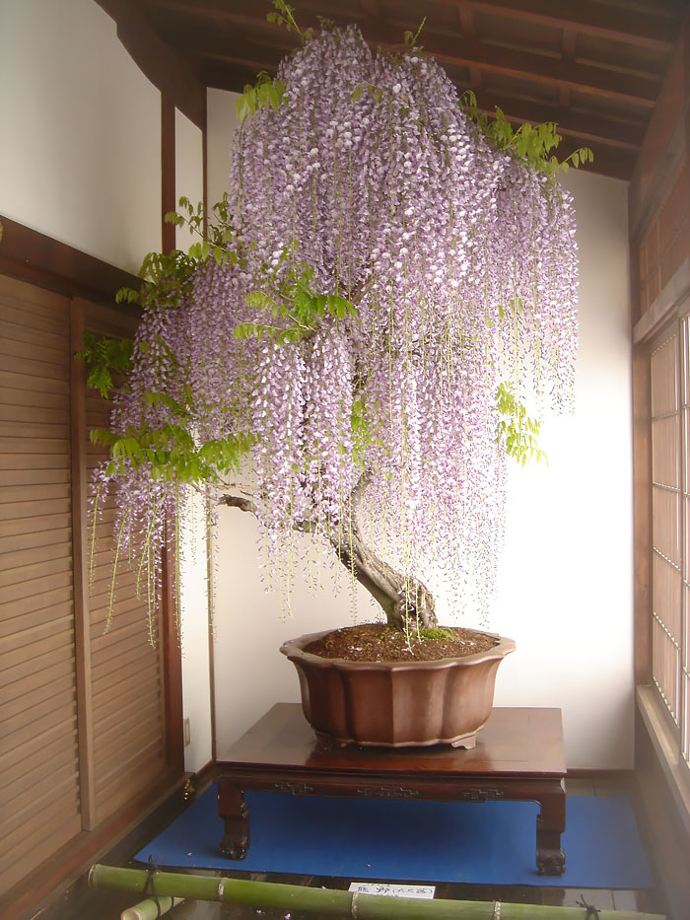
#1 Wisteria

Slide 4
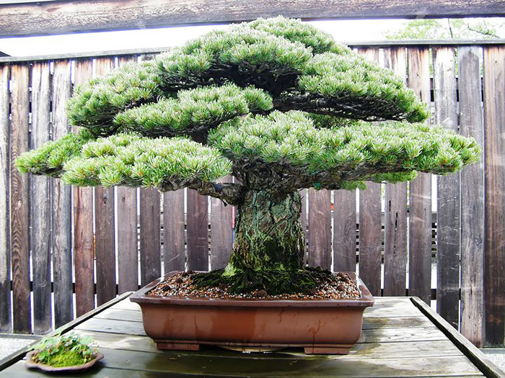
#2 This 390 Year-old Bonsai Tree Survived Hiroshima

Slide 5
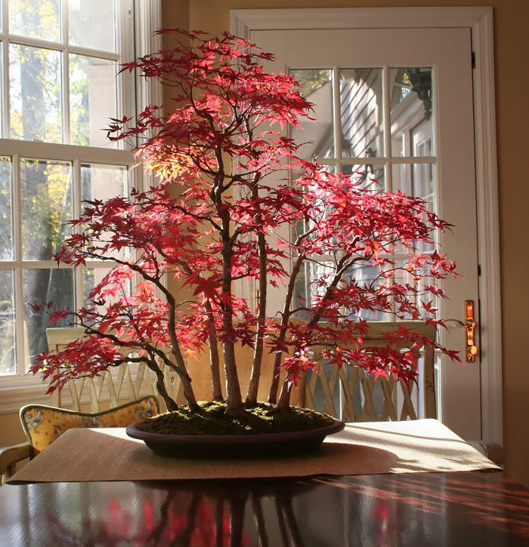
#3 Bonsai Maple Forest In Autumn

Slide 6
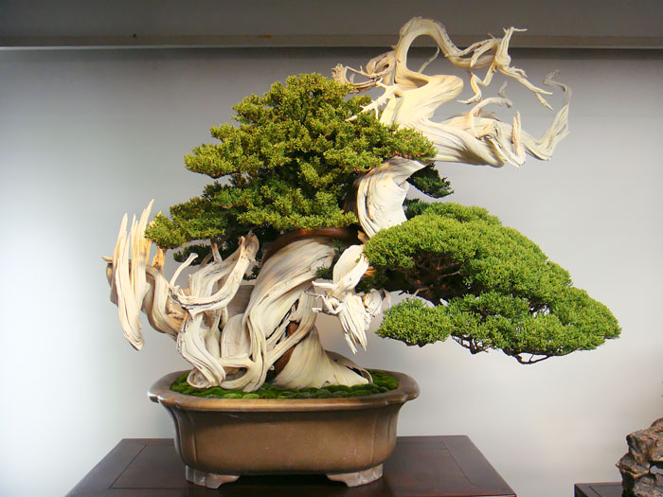
#4 This Bonsai Tree Is Over 800 Year Old

Slide 7
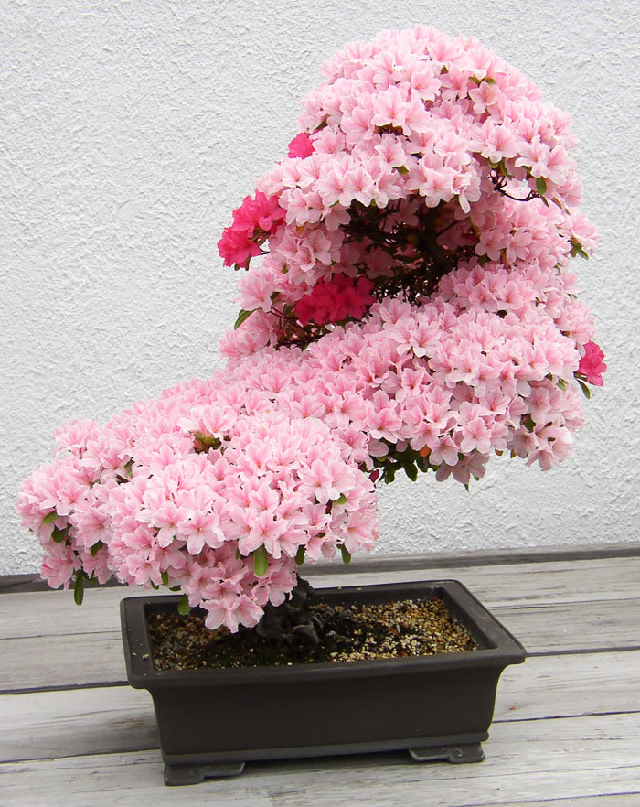
#5 Azalea

Slide 8
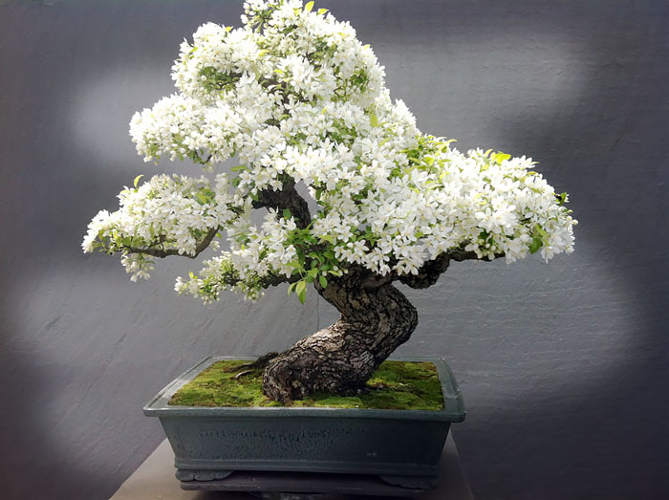
#6 Apple Tree

Slide 9
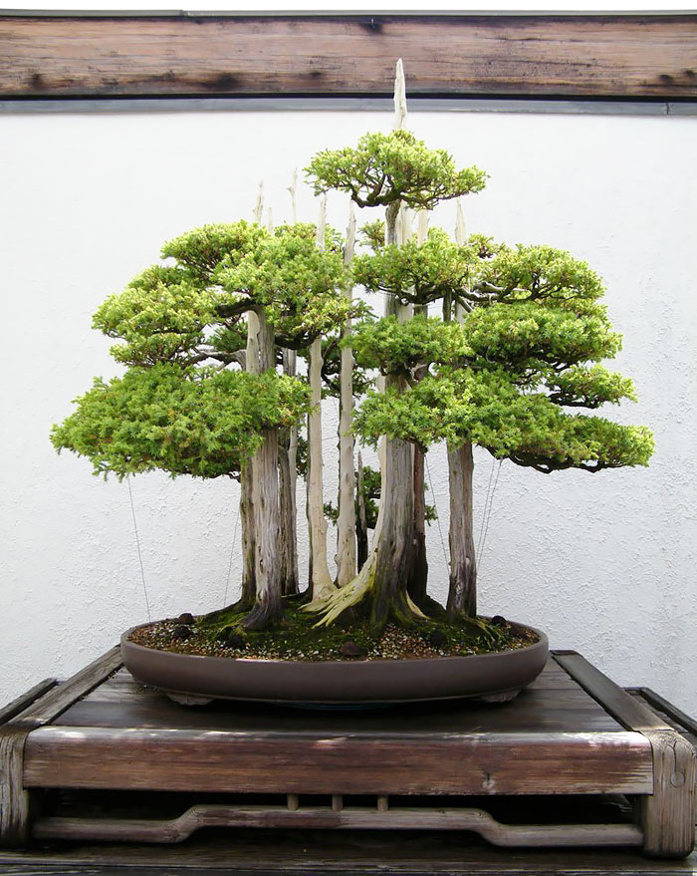
#7 Bonsai Forest

Slide 10
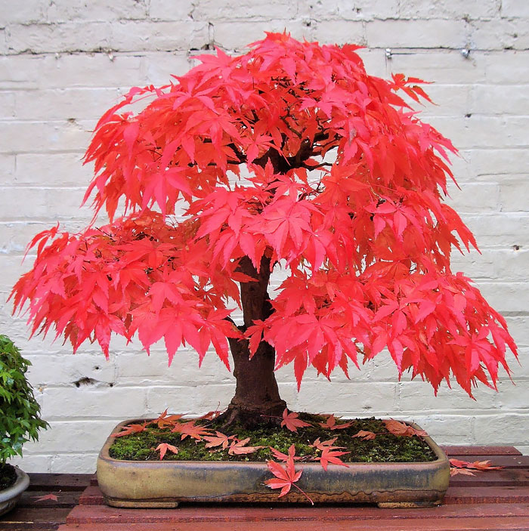
#8 Japanese Red Maple

Slide 11
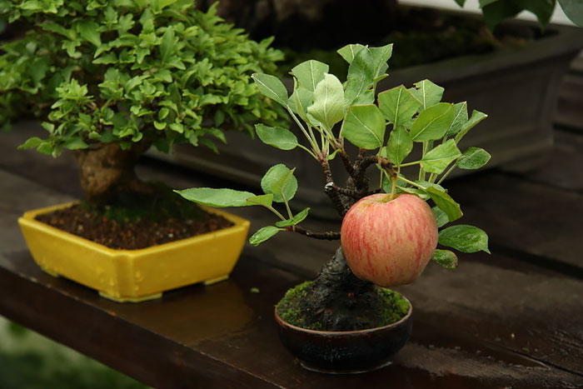
#9 Apple Tree

Slide 12
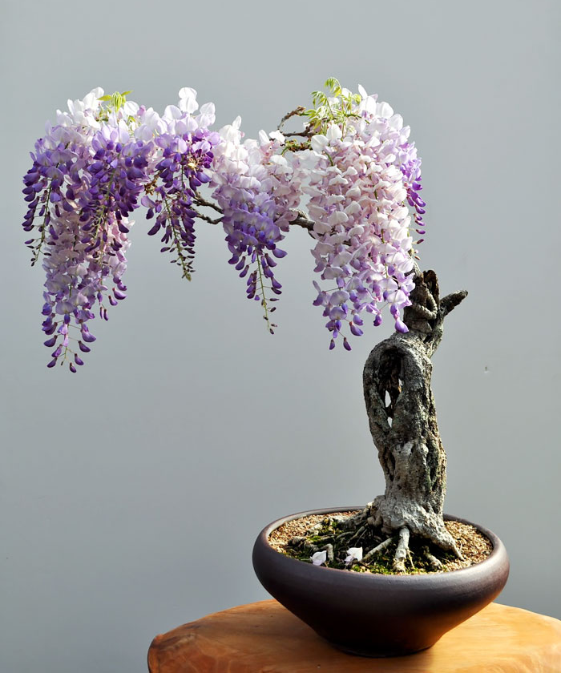
#10 Wisteria

Slide 13
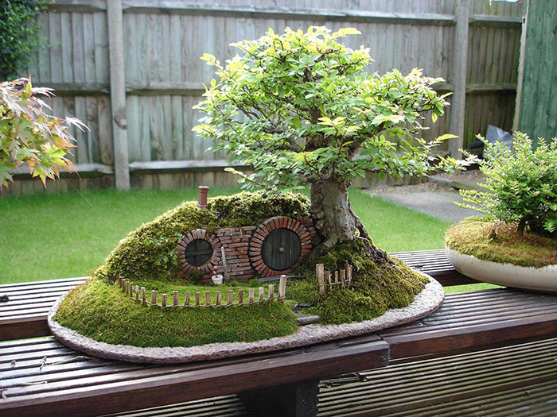
#11 Bonsai Hobbit Hole

Slide 14
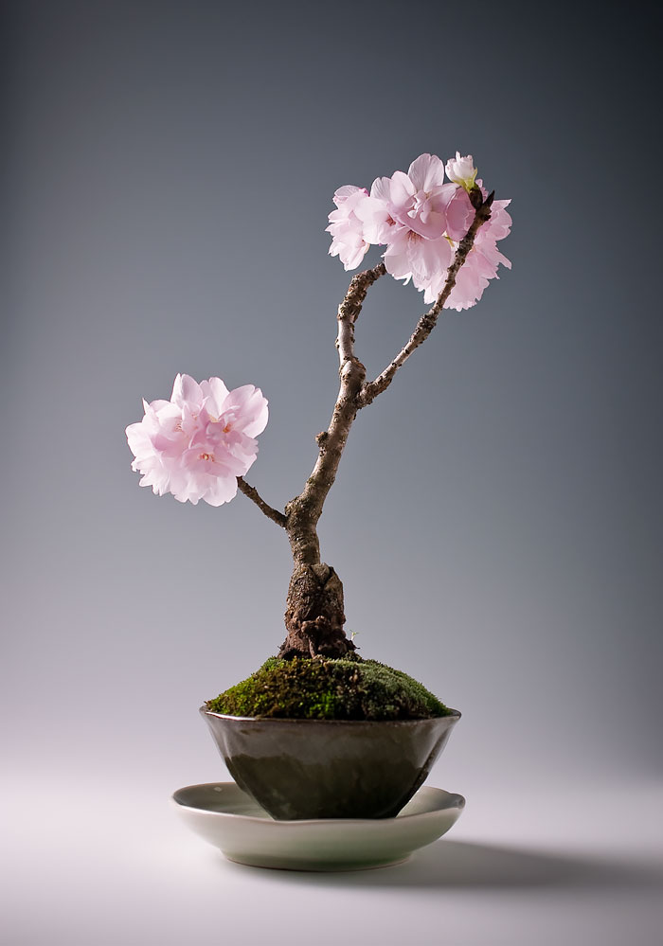
#12 Sakura

Slide 15
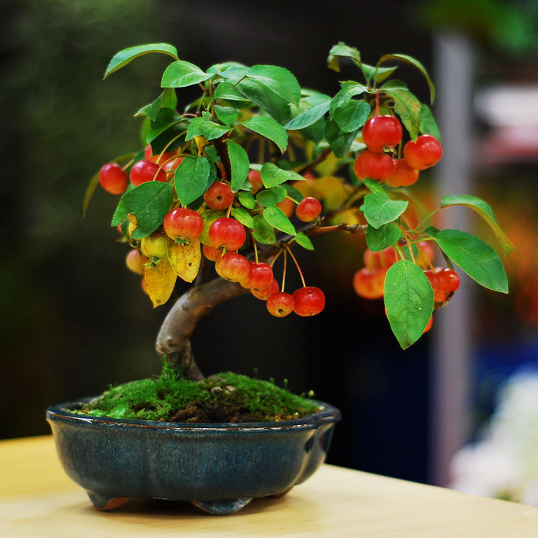
#13 Apple

Slide 16
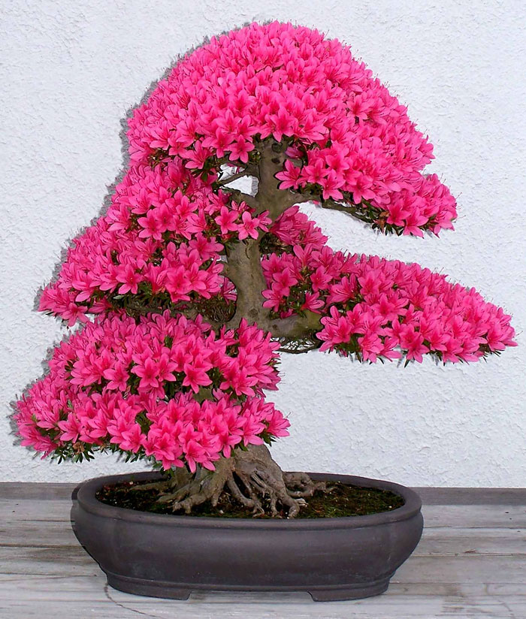
#14 Azalea

Slide 17
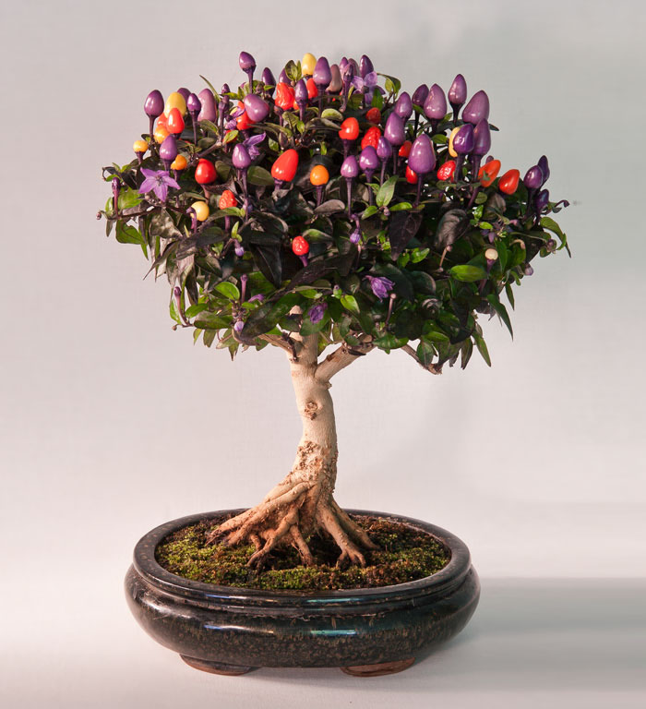
#15 Bonsai Chile Tree

Slide 18
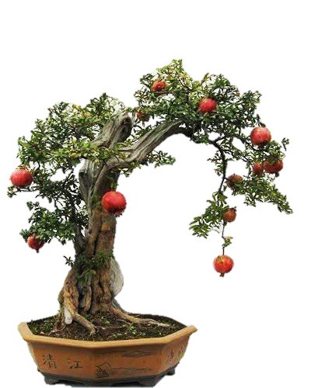
Other examples

Slide 19
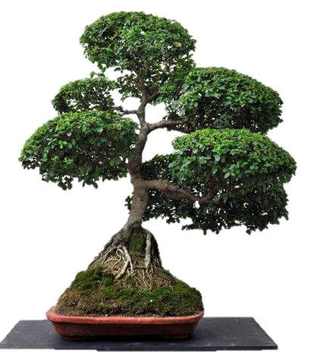

Slide 20
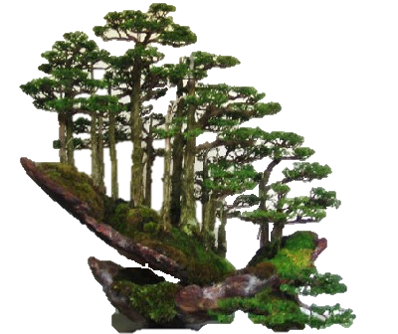

Slide 21
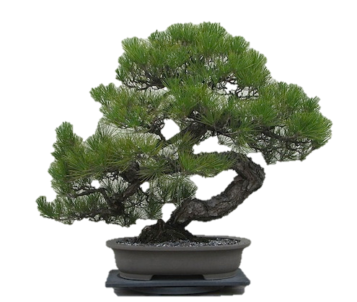

Slide 22
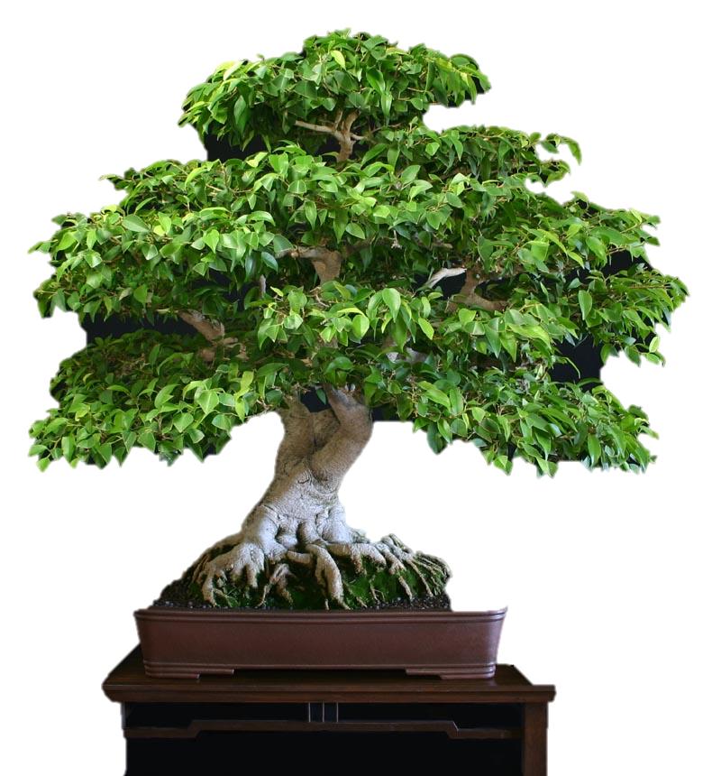

Slide 23
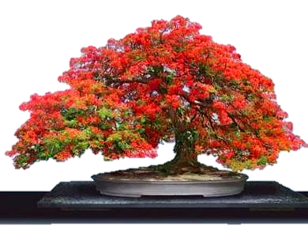

Slide 24
