Slide 1

The Colorful Diversity Of People and Places
NOTE:
To change images on this slide, select a picture and delete it. Then click the Insert Picture icon
in the placeholder to insert your own image.
By​ Pascal Mannaerts

Slide 2
Pascal Mannaerts
For over ten years, I have been travelling around the world with my camera. Here is a collection of portraits I have assembled to give you a little appetizer of my global work that is presented on my website.
Sit down and savor some of the pure beauty that our world is here to offer us!
More info: parcheminsdailleurs.com

Slide 3
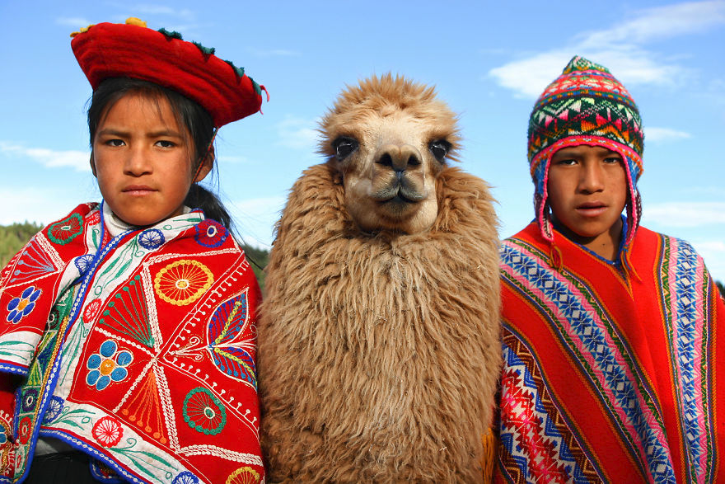
Kids Are Posing With Their Lama In Cuzco, Peru.

Slide 4
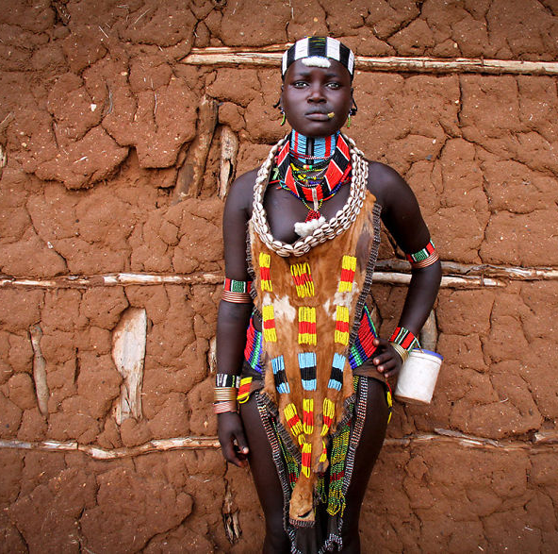
Full Of Grace – Some People You’ll Meet Will Just Make You Speechless. Here Is
A Hamar Women In Southern Ethiopia

Slide 5
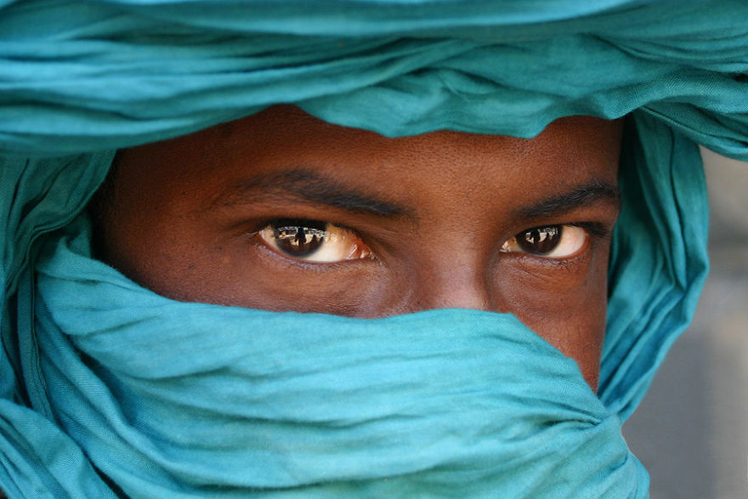
“The Violence Of The Wind Does Not Remove The Spots Of The Leopard,” African Proverb

Slide 6
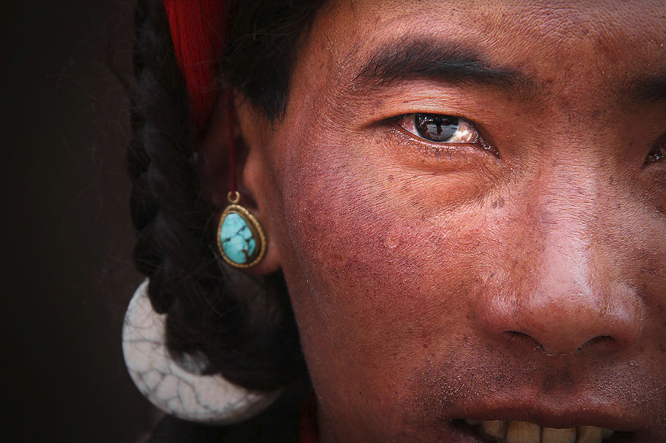
"Life Is A Journey And Not A Destination," Buddhist Quote

Slide 7
Being happy right here and now, anywhere we are. Travelling around the world made me enjoy every single second spent on these roads and has given me the chance to feel inspired by so many different people, cultures and places. And this is priceless.

Slide 8
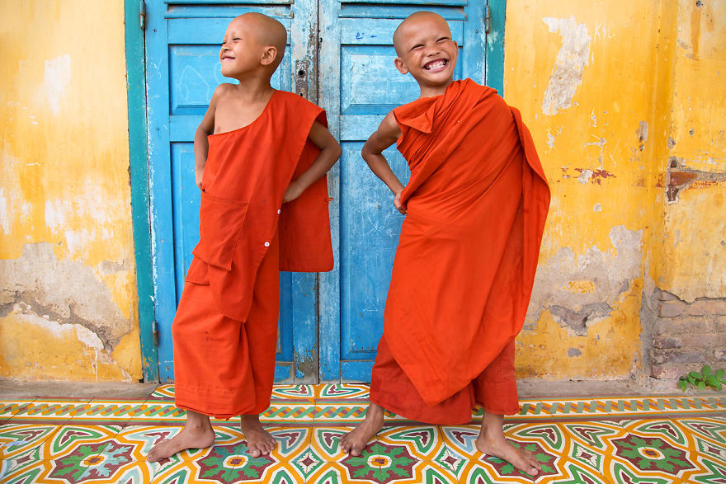
Strike A Pose At The Monastery – Young Monks Are Having Fun Posing In Battambang, Cambodia

Slide 9
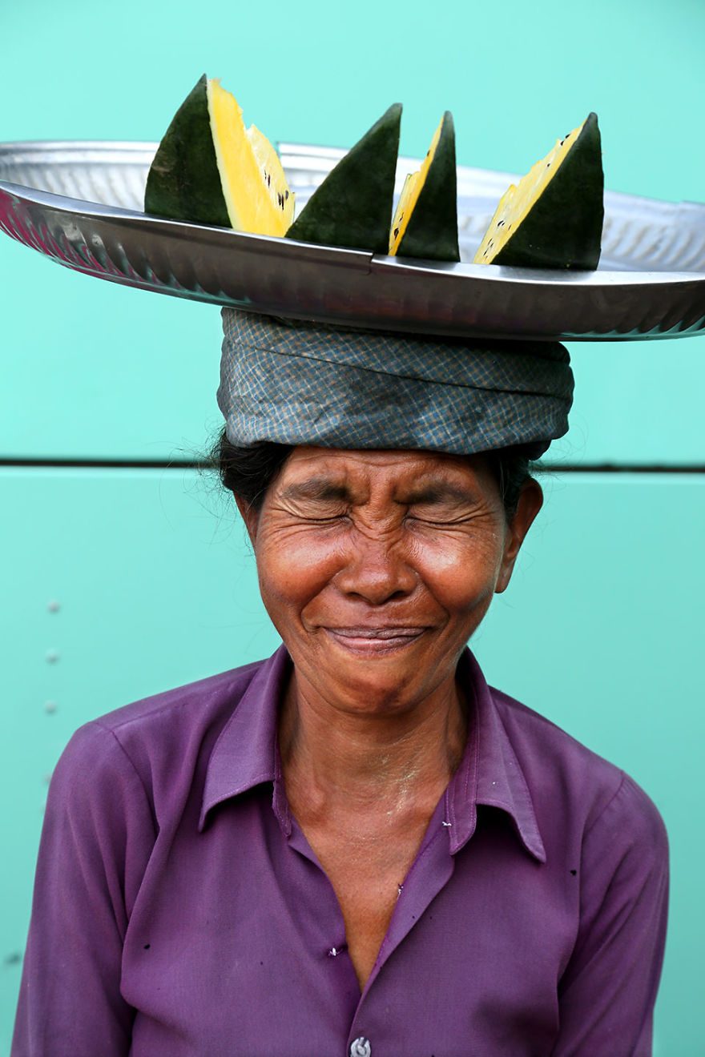
Never Take Things Too Seriously! Portrait Of A Woman In The Yangon Market, Myanmar

Slide 10
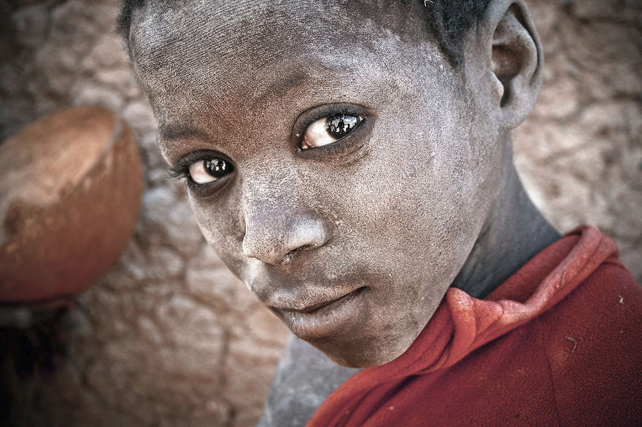
Child Of Djenné, Mali
"Listen to the ancestors, to the spirits, the trees and the animals. Listen to all these inspirations who come to talk to us," Sobonfu Somé.

Slide 11
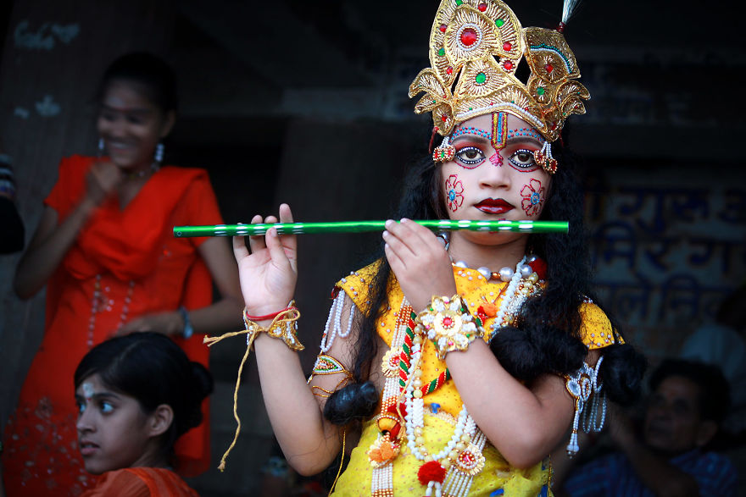
A Boy Dressed Up In Krishna. Varanasi, India
"Blind are the people who want to see the world in the light of reason," Kabir.

Slide 12
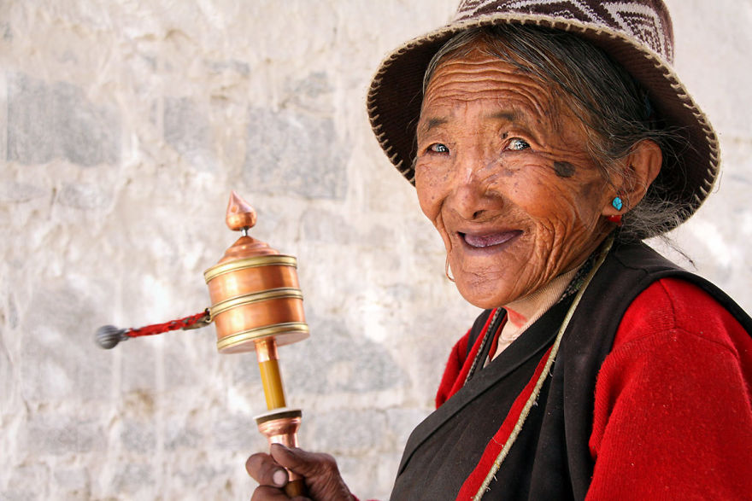
"True Happiness Doesn't Depend On Any Outside Ingredient, It Depends Only On Ourselves," Tibetan Proverb

Slide 13
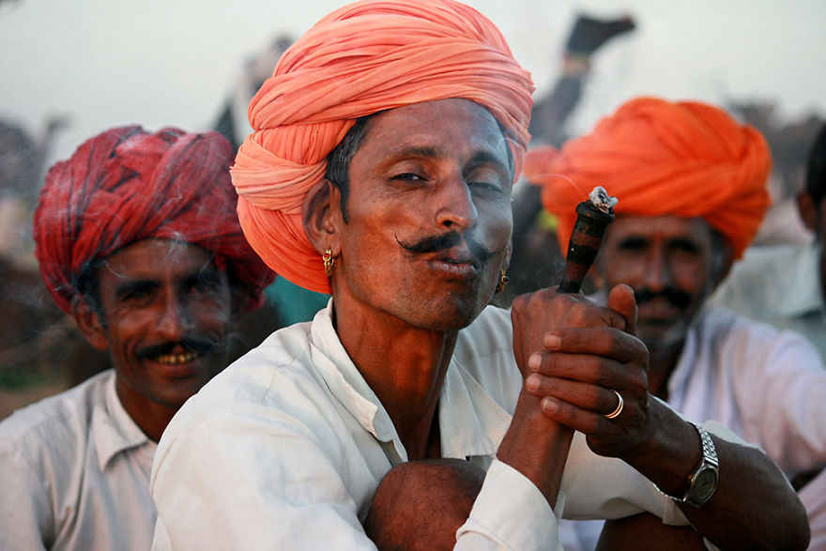
Rajasthani Elegance, India

Slide 14
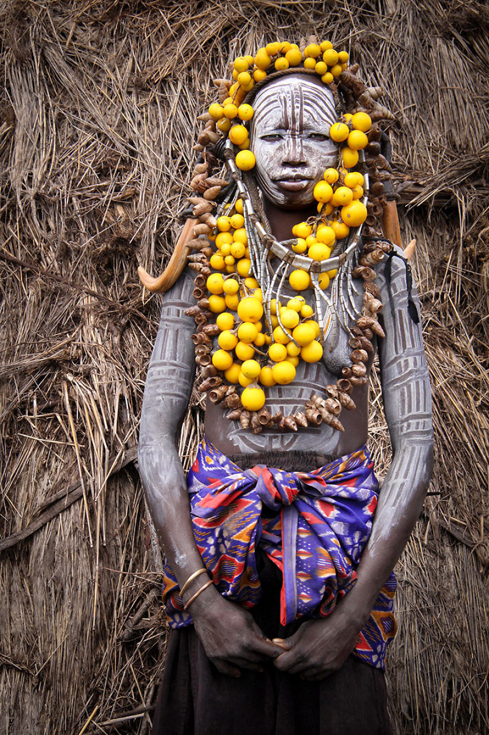
Mursi Woman In The Omo Valley, Ethiopia

Slide 15
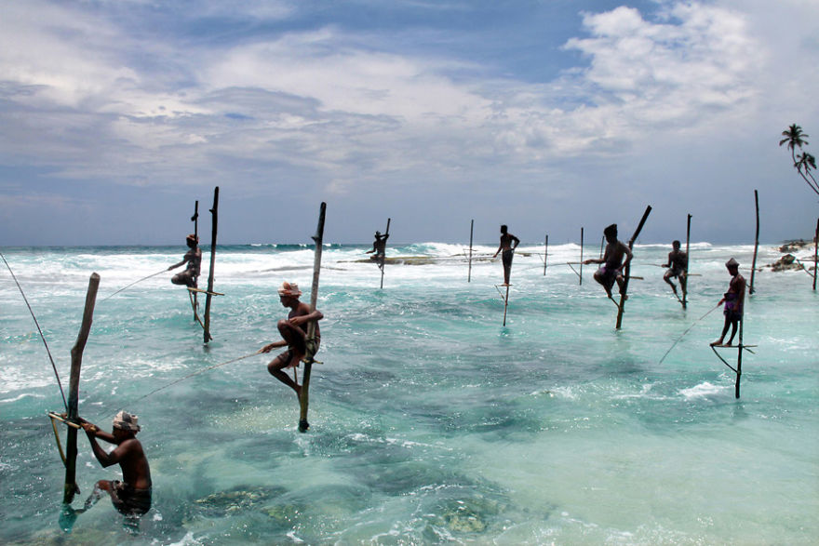
Stilt Fishing Is Practised By Several Fishermen Families In Sri Lanka (Here In Ahangama)

Slide 16
Stilt Fishing
It is transmitted from generation to generation, and no one knows exactly when this fishing technique was invented. Some say that it would have begun in the middle of the last century. This tradition disappeared shortly after the 2004 tsunami, but things returned to normal. Twice a day, fishermen go to roost on these two-meter high stilts and wait patiently, making constant movement in the water to attract fish.

Slide 17
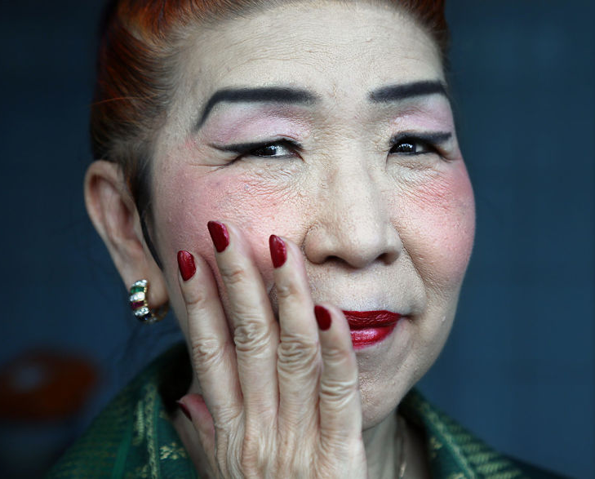
Picture Of A Fortune-Teller In Rangoon, Myanmar
“Be happy for this moment. This moment is your life,” Omar Khayyam.

Slide 18
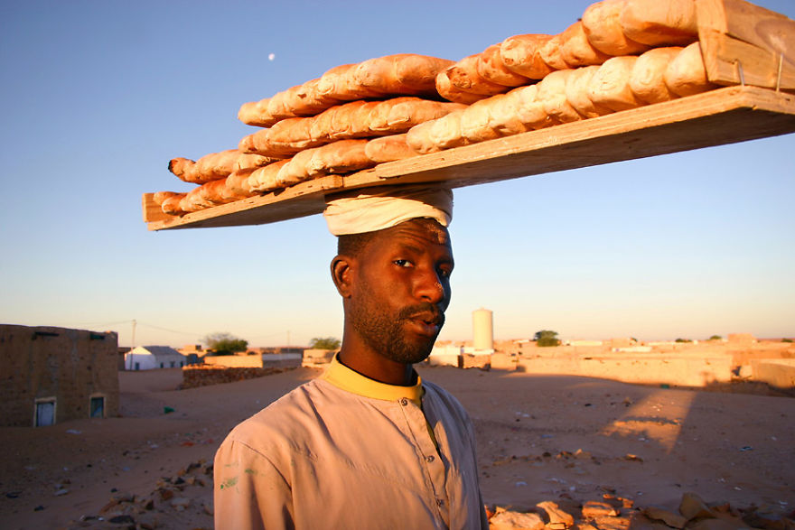
Portrait, Chinguetti

Slide 19
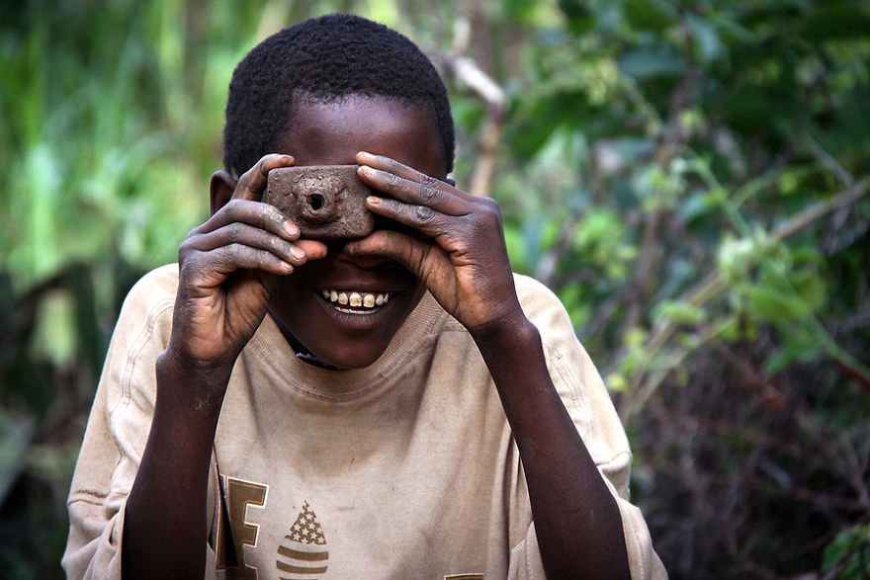
Smile! You're On Camera!

Slide 20
Africa

Slide 21
Travels by Continent and Country

Slide 22
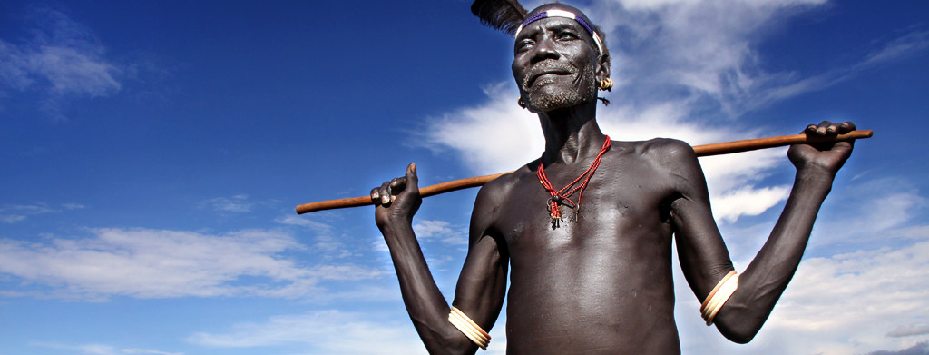
Ethiopia
Ethiopia is truly a world apart, a country I had read about in my teenage years and that had been on my bucket list a very long time. I will always remember the night we landed in Addis Ababa. It was like a dream come true. All that we had imagined for years was coming to life around us, even in just the capital city.

Slide 23
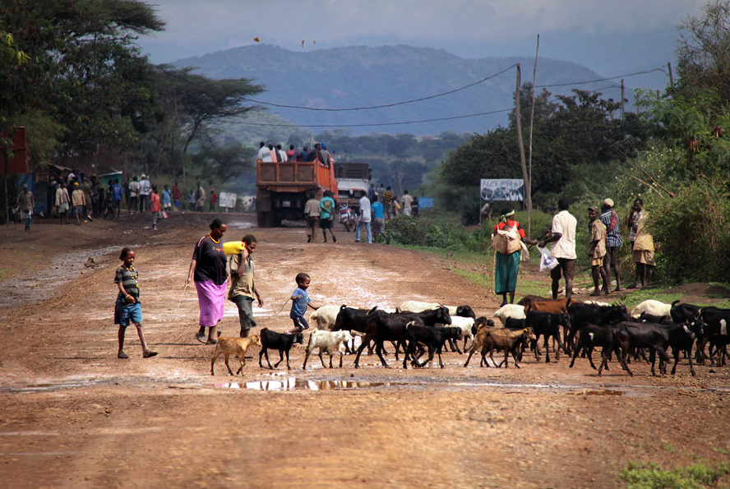
«The sun does not ignore a village because it is small.» African proverb

Slide 24
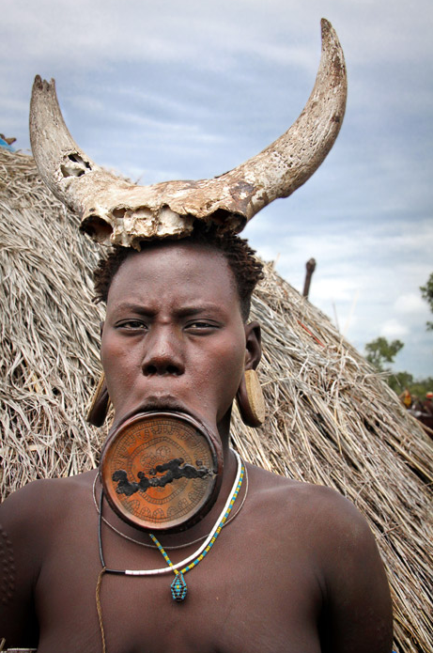
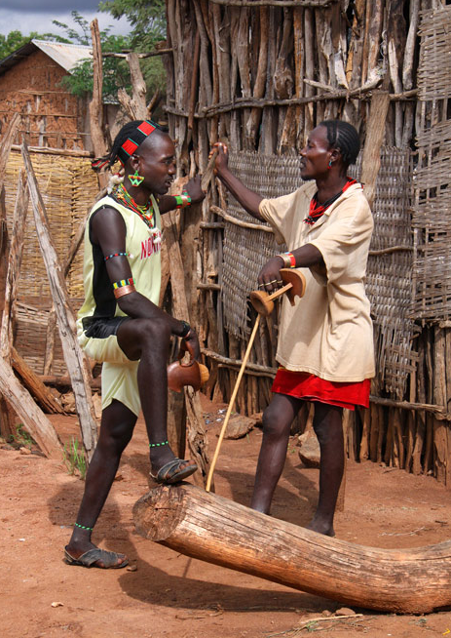
Men on market day

Slide 25
For the Mursi women, the setting up of the lower lip ornament (called «Dheba») occurs before the age of 10 years, after extraction of the lower incisors. The lip is perforated and a wooden peg is placed. The opening is enlarged from year to year by the introduction of a larger and larger cylinder, until establishment of a large disk of clay, decorated with engravings. We do not know the exact origin and function of the practice. Some anthropologists argue that this lip mutilation was to make women ugly to protect slave raids. Today, the function is only symbolic since only high-caste women are entitled to wear them. The size of the plateau is a measure of the dowry demanded by the family of marriageable girls, dowry consisting of a cattle of goats and a gun.

Slide 26
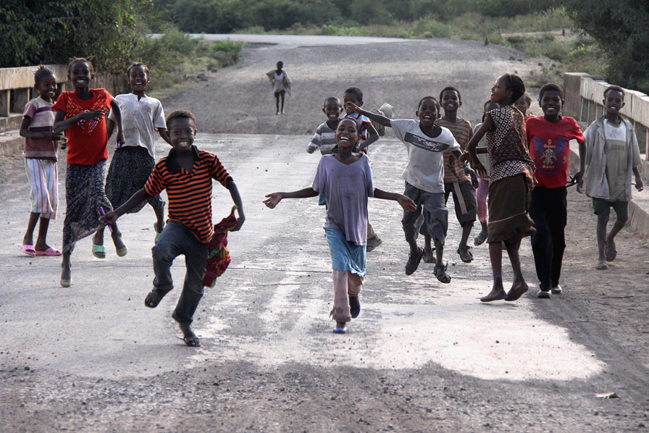
«A child needs a whole village to grow.» African proverb

Slide 27
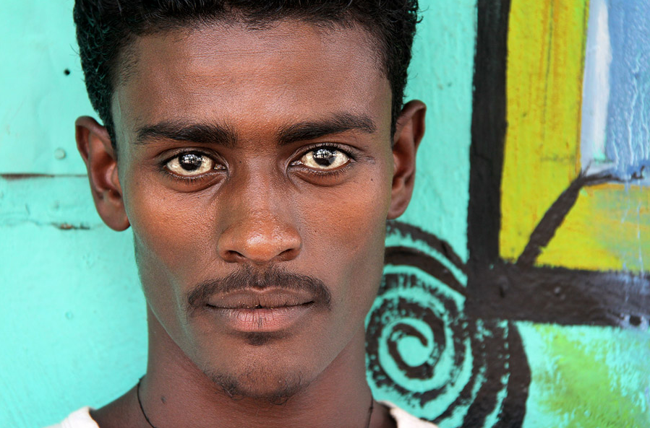
Handsome young man

Slide 28
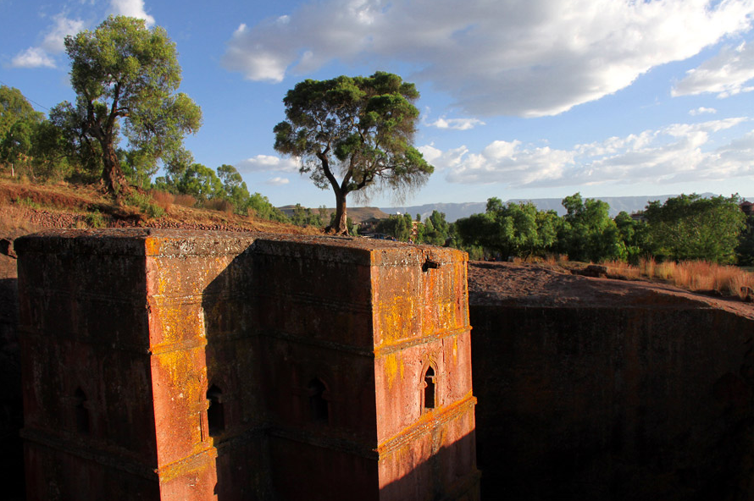
St. George Church in Lalibela

Slide 29
St. George Church in Lalibela. Lalibela is a monastic city located 2630 meters above sea level on the southwest flank of the mountains of the former province of Lasta, in the present Amhara region in Ethiopia. Holy city of Orthodox Christians in Ethiopia, it is famous for its eleven medieval monolithic cave churches carved into the rock. The most famous is Bete Giyorgis (St. George's Church), eight centuries old.

Slide 30
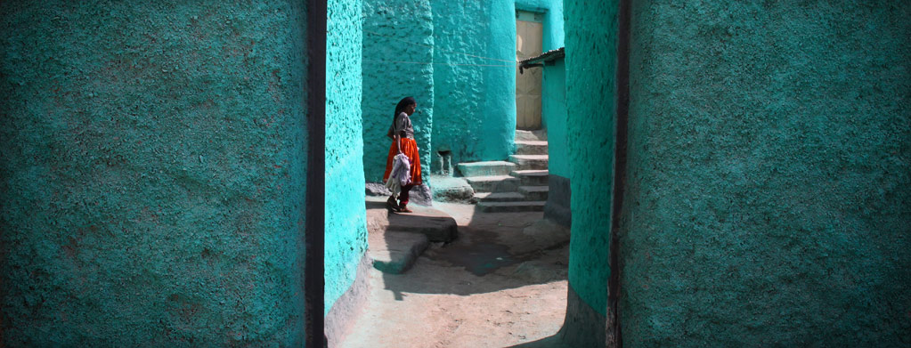
HARAR
World Heritage-listed Harar, in the east of Ethiopia, is a place apart. With its 368 alleyways squeezed into just one square kilometer, it's more reminiscent of Fez in Morocco than any other city in the Horn of Africa. Its countless mosques and shrines, animated markets, crumbling walls and charming people will make you feel as if you've floated right out of the 21st century.

Slide 31
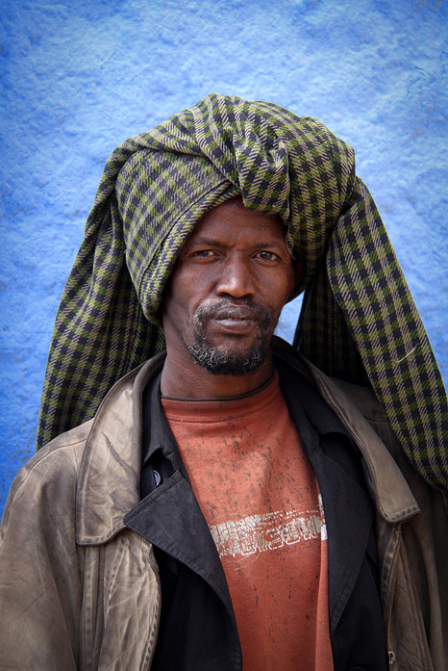
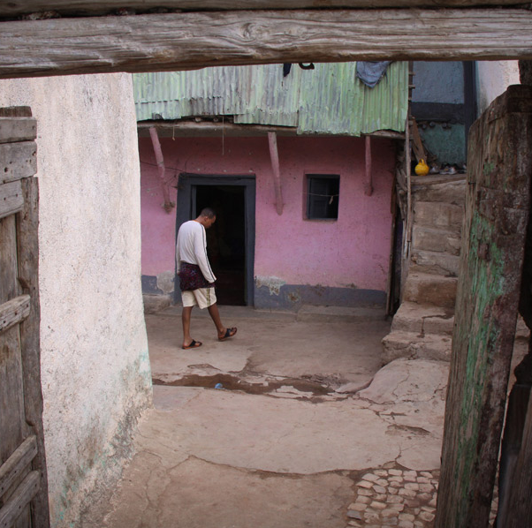
The old town & an inhabitant of the old town

Slide 32
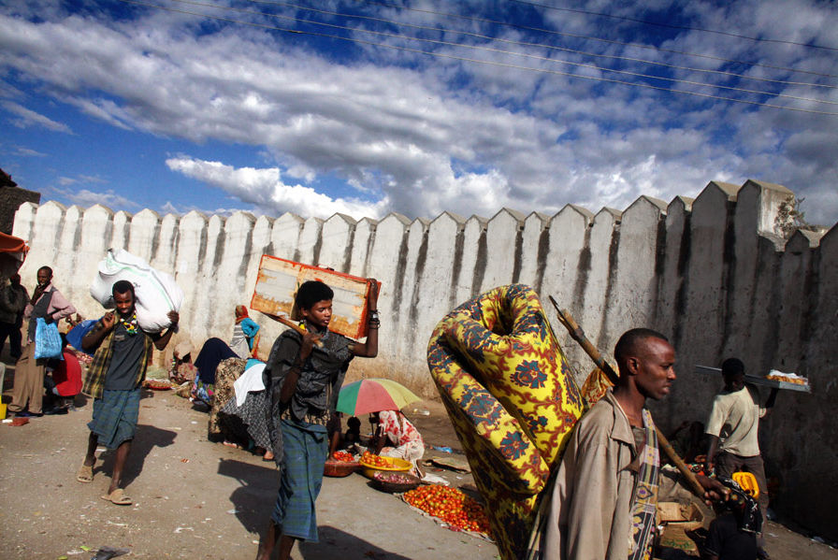
The main square is the hub of Harar.

Slide 33
The main square is the hub of Harar. From here start the five largest arteries of the city, after which stand the five doors. Smugglers sell Western liquors, probably adulterated, and blond American tobacco, made in Djibouti. We can also buy the tala, the local alcoholic drink, especially qat, the leaves of a plant with slightly euphoric properties, cultivated in the vicinity of Harar, which is one of the main sources of wealth in the region.

Slide 34
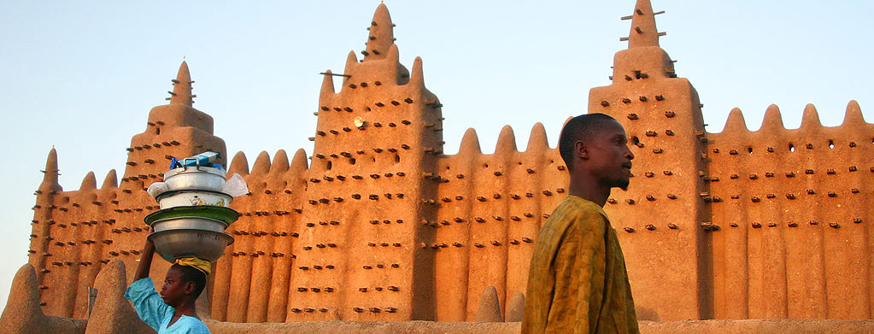
Mali
Mali occupies the heart of a territory that once supported Africa's greatest empires and is rich with historical resonance. This history bequeathed to Mali some of its most dramatic attractions – the legendary city of Timbuktu (Tombouctou), whose name has never lost its allure for travelers, the gloriously improbable mosque at Djenné and the bustling river port of Mopti are simply three among many. Mali's history has always been a story of its deserts and rivers. The lucrative trade routes of the Sahara once made the region among the world's richest, and the Niger, one of the grand old rivers of Africa, is still the lifeblood of the country; to journey along the Niger River route is one of the continent's great adventures. But all of Mali is alive with a fascinating cultural mix of peoples, from the nomadic Tuareg people of the Sahara to the Niger fishing societies of the Bozo to the Dogon people clinging to the cliffs of the Falaise de Bandiagara.

Slide 35
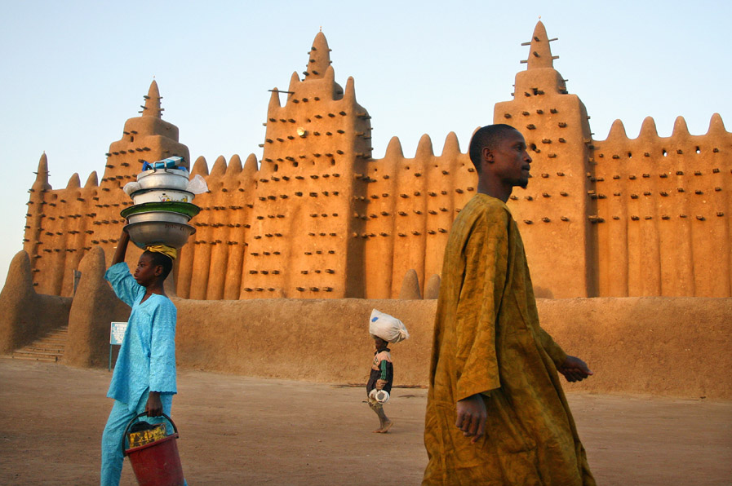
Djenné is undoubtedly the most beautiful city in Mali

Slide 36
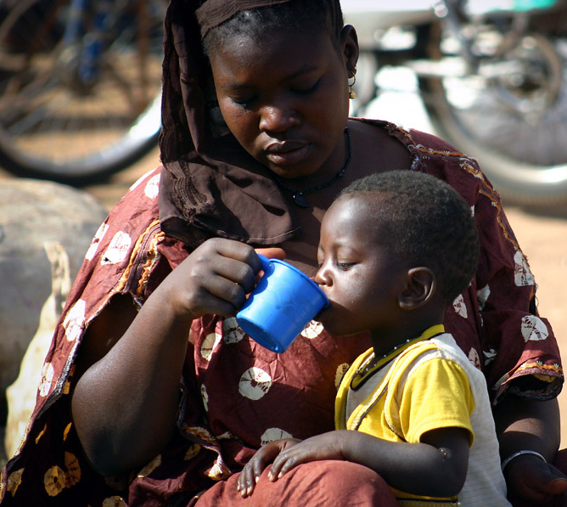
«To you, my dear child, I can tell you all about AIDS, but I can not protect you from HIV, I can tell you things, but I can not be responsible. I can advise you, but I can not decide for you, I can tell you about alcohol and drugs, but I can not say no to your place I can teach you kindness, but I can not give you morality, I can teach you respect, but I can not make you honorable, I'll pass on values, but I can not give you morality. I can give you love, but I can not give you an inner beauty. I gave you life, but I can not live in your place.» Abner Xoagub

Slide 37
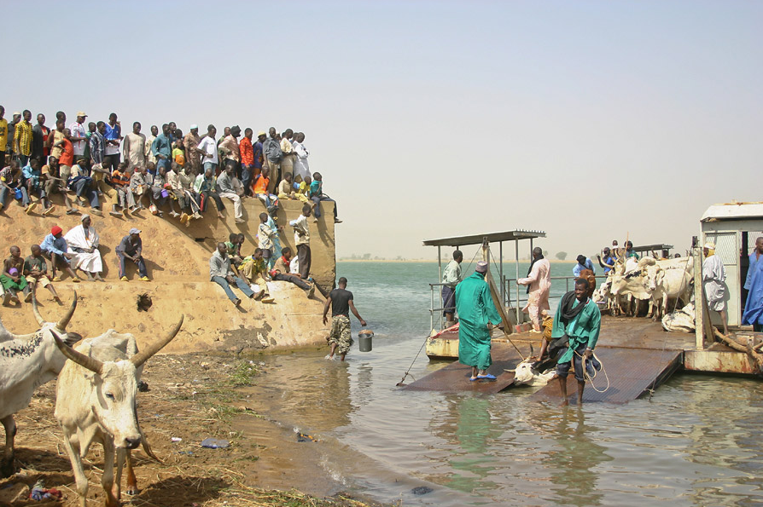
Delivery of cattle on the banks of the Niger river, Segou

Slide 38
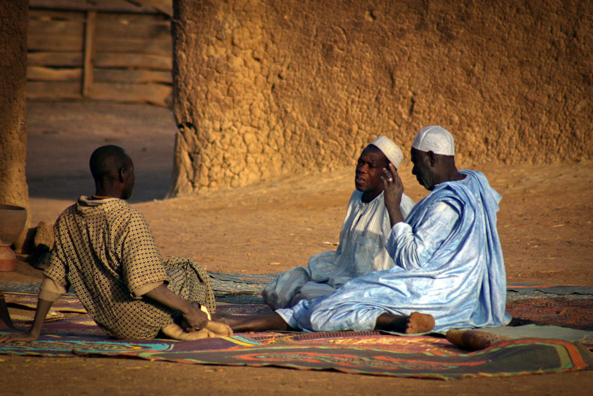
«There is no greater joy than the arrival of a host in peace and friendship.» African proverb

Slide 39
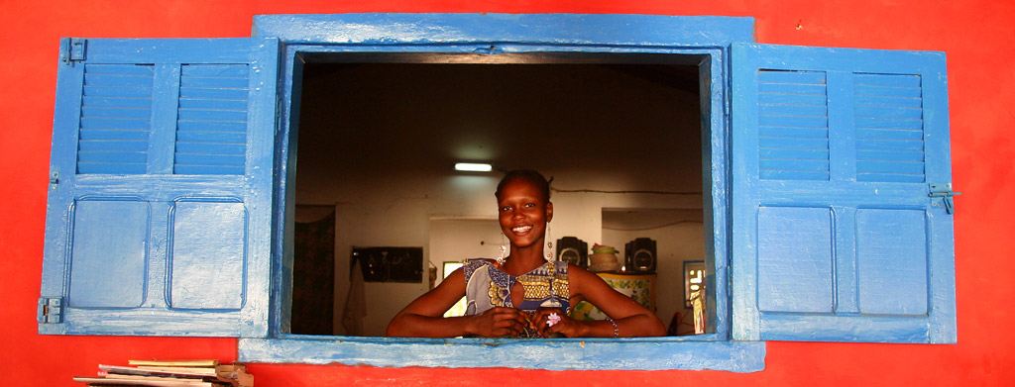
Senegal
Couched between the arid desert lands in Northern Senegal and lush tropical forests in the south, Senegal boasts a stunning array of sights, sounds and flavours. The capital Dakar alone hands you the country in a capsule. Perched on the tip of a beach-lined peninsula, this dizzying city is composed elegance and street hustle all rolled into one. The busy streets, vibrant markets and glittering nightlife will easily draw you into their relentless rhythm, but the escape route is always open – be it to the meditative calm of the historical Île de Gorée or the golden sands of Yoff and N'Gor. And if Dakar's sensory overload really gets too much, architecturally beautiful Saint-Louis, the first French settlement in West Africa, boasts a vibrant urban culture without the inner-city bustle.

Slide 40
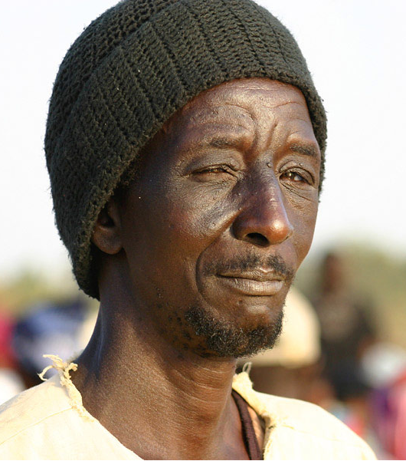
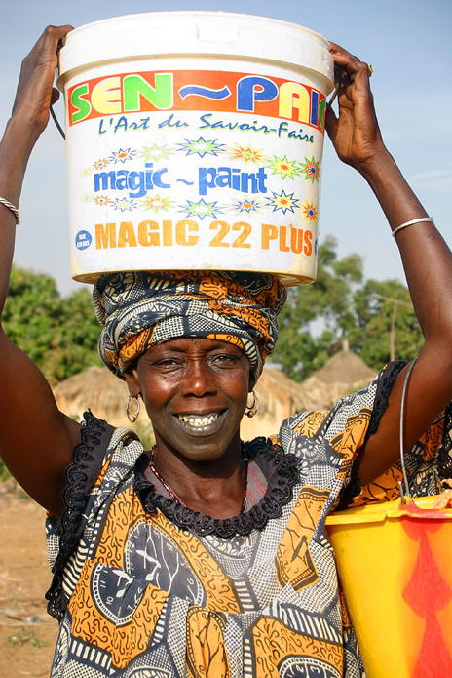
Portrait, Mar Lodj
«He who asks to be repeated, is not necessarily deaf.» Nigerian proverb

Slide 41
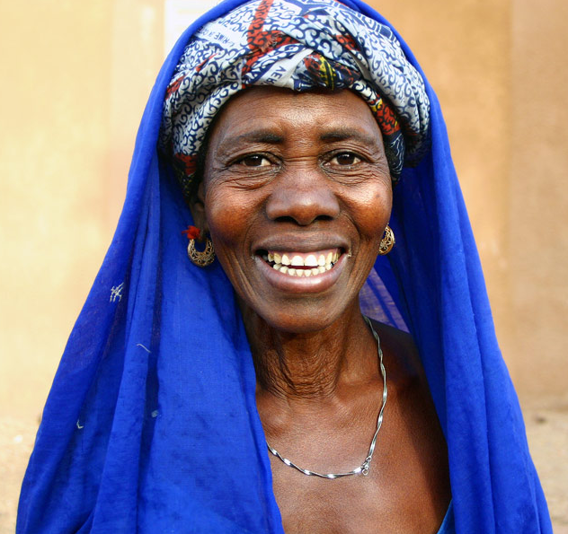
Senegalese women, despite the predominantly Muslim religion, has an independence and autonomy that many women in industrialized countries would envy. Present in all economic fields, many of them have reached the highest positions in the country. Seductive, extrovert, they are appreciated by all Africans. As such, they fully intend to represent all African women in their struggles to improve the life of the continent. Fight against female circumcision, against polygamy etc ... you can not see it on national television. The evening news, presented every other day by a woman shows how they have emerged in recent years as full citizens.

Slide 42
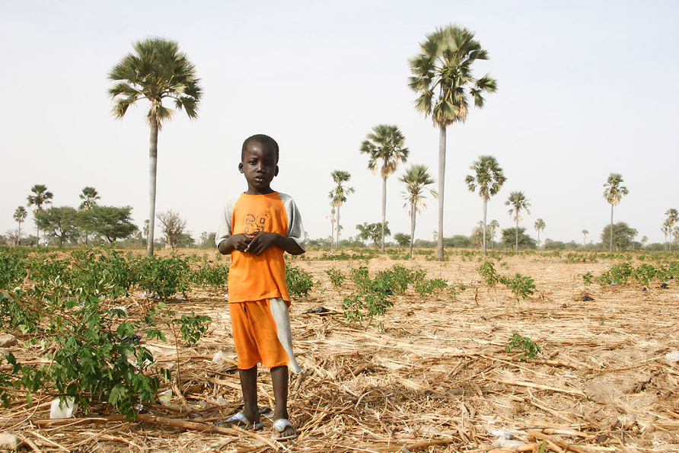
The future
«If you go hunting for elephants and you meet a snail, take it.» Mbed proverb

Slide 43
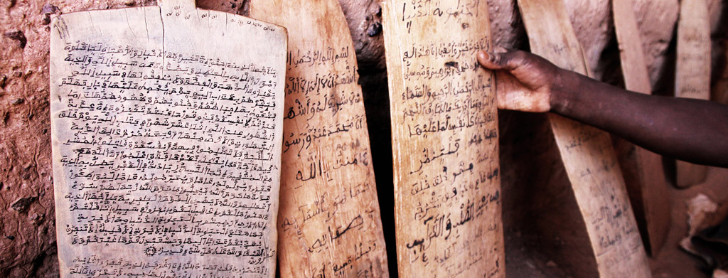
Benin
This club-shaped country, on the western edge of Nigeria, was once one of the most powerful empires in Africa – the Dahomey kingdom. The ruins of the Dahomeyans' palaces and temples can be seen in Abomey, while Ouidah is a poignant reminder of where their riches came from: the slave trade. The Route des Esclaves in Ouidah was the last walk on African soil for slaves bound for Brazil and the Caribbean. Museums here and in Porto Novo, Benin's lagoon-side capital, examine the resultant Afro-Brazilian society and culture. Cotonou, on the other hand, is urban Africa at its most frazzling and polluted - but is not without its own charms, a lively nightlife and good shopping being a couple of them. Benin is the birthplace of voodoo, the country's national religion.

Slide 44
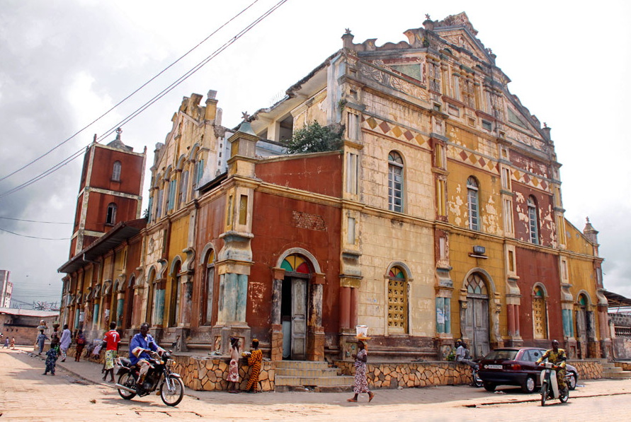
The old mosque, Porto Novo (originally a church)

Slide 45
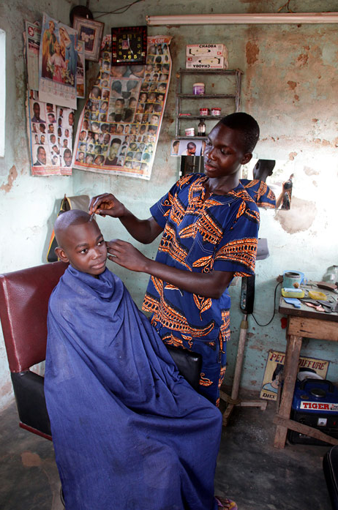
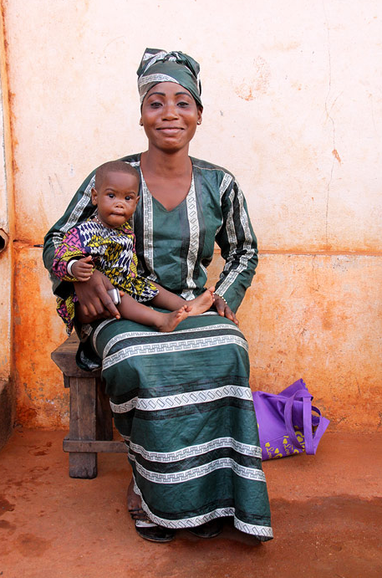
«Every mother is a river.» African proverb
Downtown Porto-Novo

Slide 46
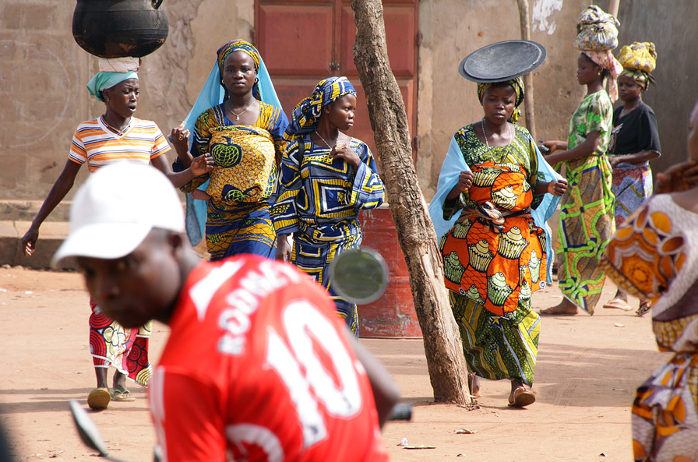
In Adjara

Slide 47
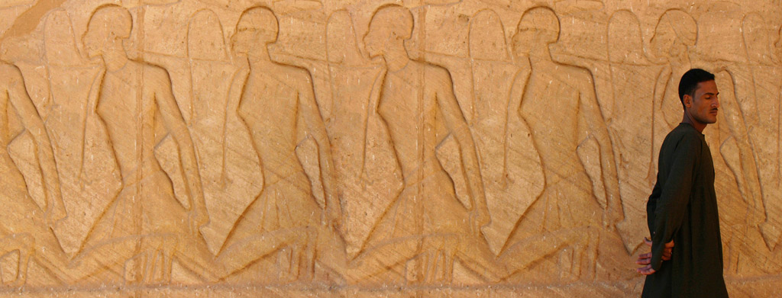
Egypt
Egypt is the oldest tourist destination on earth. Ancient Greeks and Romans started the trend, coming to goggle at the cyclopean scale of the Pyramids and the Colossi of Thebes. Today, the most popular places to visit are not only the monuments of the Nile Valley and the souks, mosques and madrassas of Islamic Cairo, but also fantastic coral reefs and tropical fish, dunes, ancient fortresses, monasteries and prehistoric rock art. The land itself is a freak of nature, its lifeblood the River Nile. From the Sudanese border to the shores of the Mediterranean, the Nile Valley and its Delta are flanked by arid wastes, the latter as empty as the former are teeming with people. This stark duality between fertility and desolation is fundamental to Egypt's character and has shaped its development since prehistoric times, imparting continuity to diverse cultures and peoples over seven millennia.

Slide 48
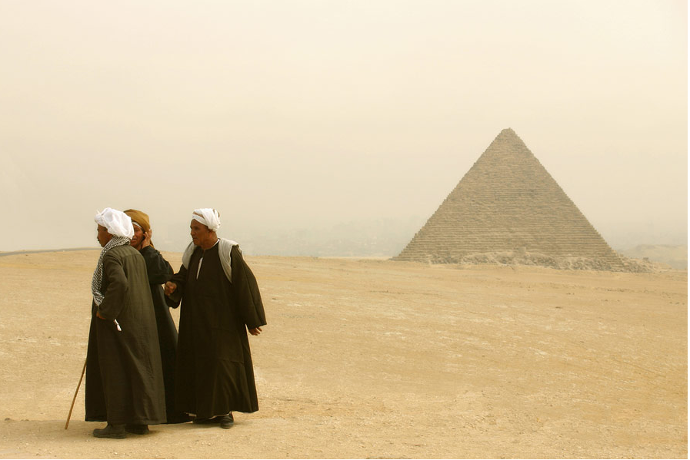
Bedouins on the Giza plateau. Of all the monumental ruins that we have inherited from the Egyptians ancient, the pyramids, including the three pyramids of Giza, are both the most impressive and most emblematic of this civilization. Tombs of kings, queens and great people of the state, the pyramid-shaped stone hosts one or more internal chambers, connected by corridors. The Great Pyramid of Giza, built by Khufu, is one of the seven wonders of the ancient world.

Slide 49
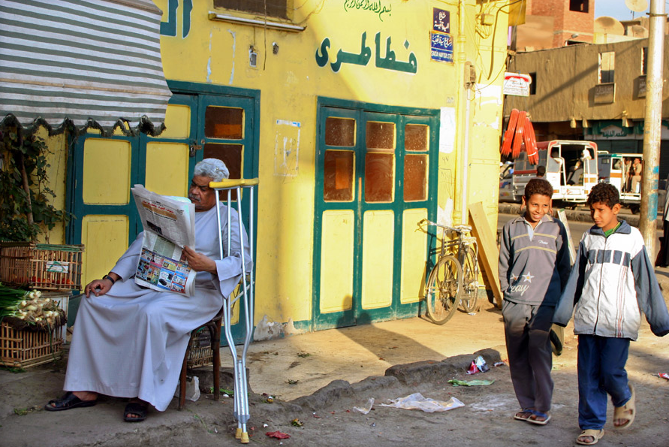
Streets of Aswan

Slide 50
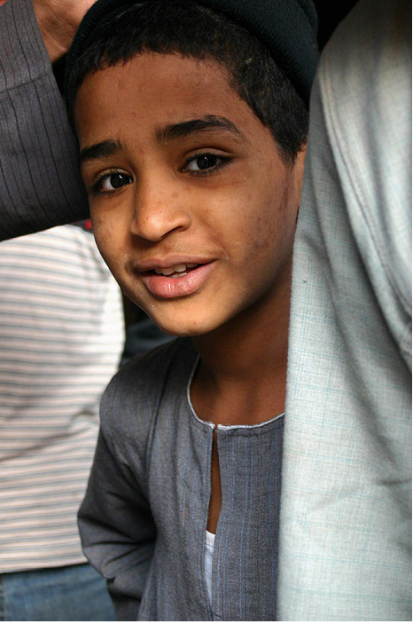
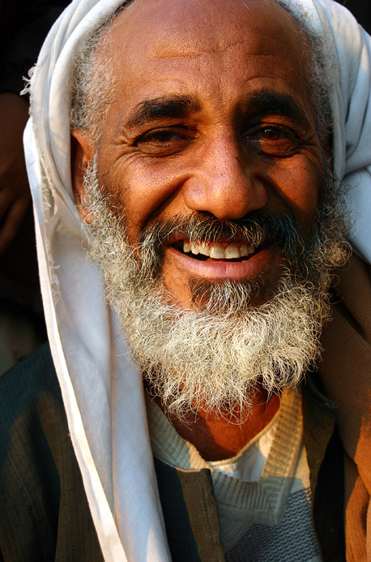
«You'll see in the temple of your sky a light face, your face, my brother, my sister, glittering among the human stardust. You're a star. Do not forget it. Look!» Irénée Guilane Dioh

Slide 51
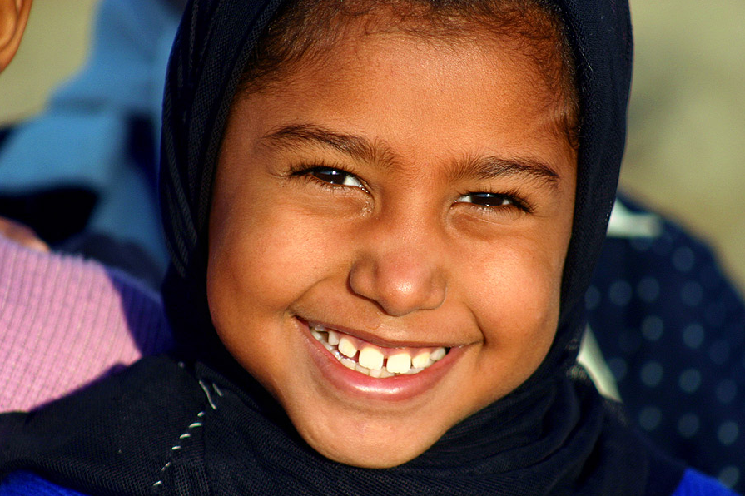

Slide 52
The young ones are the future!
Urban at 44%, with two cities with more than one million inhabitants (Cairo, 12 million, Alexandria, 4 million), Egypt's population is predominantly young: 54% of Egyptians are younger than twenty years, 36% under twelve. How many are there? More than 38 million at last count in 1976, and more than 62 million at present, against 6 million a century ago. The rate of population growth-about 1.2 million individuals per year-putting, as can be expected, dramatic problems in a country where the average density in relation to arable land is close to 2000 inhabitants per square kilometer (...).

Slide 53
India
After so many years, I am always amazed at how so many people that we meet in India generally seem to have preserved their own inner light, regardless of their life circumstances or life paths. It is their spontaneity, their gaze piercing the depths of their eyes, the bright smiles they offer you and that you can not help to give back immediately . An impression, seeing them, that they belong to a greater Whole, even though we know that this is not the case and that the modus operandi of their society can be especially cruel. New Delhi, March 2010

Slide 54
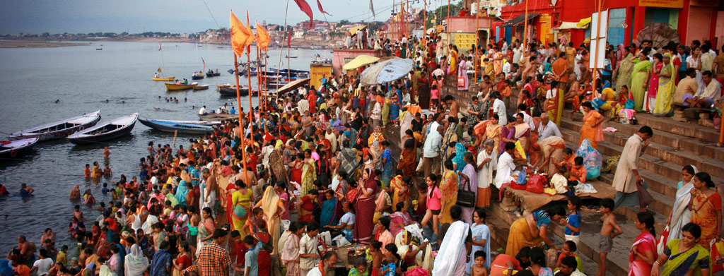
VARANASI
Imagine yourself at dawn, lost in a maze of alleys, almost a chiaroscuro of a medieval city. You wander around in narrow, winding streets, asking yourself what may lay behind these dozens of nameless and half-open doors that lead to the heart of houses dating back hundreds of years. Mysterious silhouettes move here and there, draped in silk or wrapped in a white sheet. They walk in silence, all in the same direction. You follow them. Sounds of bells ring out in the distance, the sacred Ganges is flowing somewhere below. It is 5 a.m. and Hindus start preparing to bathe or do their ritual ablutions. One night on a noisy and uncomfortable train has driven you near to exhaustion, but you almost don’t feel it as you realize that you finally got here, in the holiest of all Hindu cities : Varanasi.

Slide 55
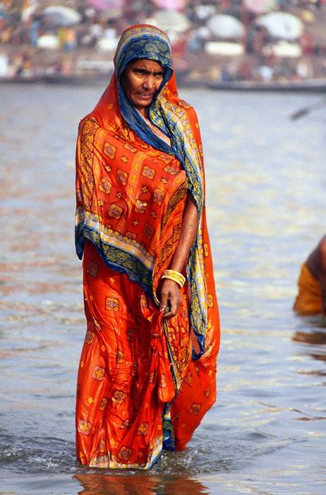
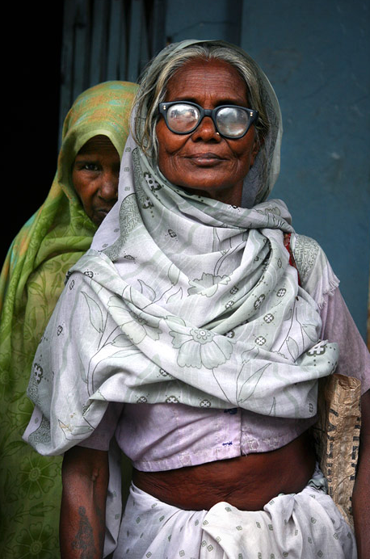
«There is an efficiency based on love, which goes much further and is much larger than the efficiency of ambition.» Jiddu Krishnamurti

Slide 56


Student of a Sanskrit school
«Is it appropriate to live as an ascetic? In Couple? As a scientist? What to do, we do not know.» Bhartrihari

Slide 57

Sunrise on the banks of Ganges, December 2008

Slide 58


Slide 59


Slide 60

Pilgrims from Andhra Presh have been photographed on the banks of the holy Ganges. A priceless souvenir they will take back home.

Slide 61

North India
After ten trips to India, having a chaï in front of the New Delhi railway station this morning by sunrise, I left everything around me for a while and I lost myself in my thoughts, without being able to control anything. I looked around, I smiled and I realized that, after so much time of my life I have already spent in India, this country and its people still fascinate me as much as on that very first day I came here, some 15 years ago. During all these years, I have moved to so many places around the world, but I have always come back to India, sooner or later. India is an endless path. It's like a never ending book, a magic box where you can always find something new. I could travel on its roads forever. As a travel through India feels also like being a journey within, inside our deepest mysteries.

Slide 62


Woman selling flowers for the puja, Jaipur

Slide 63


Slide 64


«Ahimsa means infinite love, which means an infinite capacity for suffering. Who else but the woman, the mother of man, shows more of that capacity?» Mahatma Gandhi

Slide 65


The turban, so typical attribute of Rajasthani male, is supposed to be 9 meters long. Careflly Wrapped each morning on the head, it allows connoisseurs to distinguish cast or the origin of the person. Men wear kohl and small earrings with flower shapes, gold and set with small pink and green stones that shine in the sun. This is the final touch to their sumptuous portrait

Slide 66
«Imagine yourself in a sand desert ... Only a few withered bushes break the monotony of the scenery. The heat is stifling. An endless tar slices the horizon in two parts. There is no sign of life around except a few vehicles that you cross in the opposite direction. Occasionally, we see some villages in the distance. Their houses are made of mud, the roofs are thatched, conical. They seem to have been abandoned of men and gods long ago, but the dazzling sari of a Bishnoi woman, waving in the wind, suddenly makes you think otherwise. This figure wanders from one house to another, like a ghost, a mirage. This woman wears a huge jar on her head. When you pay attention, you can hear songs coming from the villages, the zither and female voices. Or maybe it is this heat that starts disturbing your senses. After long hours, it is hard to believe the form of a fortress marks the end of the road. It rises amid the sands, as goddess against the powerful sun. It looks as if straight out of a time passed irrevocably, as a dip for hundreds of years back, back to the time when men crossed the desert on camels. We are in Jaisalmer, on the edge of the Thar Desert, in the heart of Rajasthan, India...» March 4, 2008

Slide 67

South India
There is a virus that will not let go. As soon as it enters us, it leaves us no more. It regularly comes back to our memories, making us want to go back on the road again as soon as possible. This virus is the journey. It’s the syndrome of the traveler. And the call of India is one of the most powerful.
Here is a collection of pictures I took during my journeys through South India, to Maharashtra, Kerala, Karnataka, Tamil Nadu and Andhra Pradesh.

Slide 68


«We would be happy to make millions of things we can not do. The will is there, but we can not achieve the desire. When we feel a desire, as soon as we have no way to achieve it, we get a reaction called suffering. Which is the cause of this desire? Me, myself. Accordingly, I am myself the cause of all the sufferings.» Swami Vivekananda

Slide 69


«We live, in fact, in a world starved for solitude, silence, and privacy: and therefore starved for meditation and true friendship.» CS Lewis

Slide 70


Slide 71


Slide 72


Slide 73

Globalization

Slide 74

Ayappa pilgrims, Tanjore

Slide 75

Brihadeeswara Temple, Tanjore

