Slide 1
The Circus
Subtitle

Slide 2
The Circus as an Element of Culture
It has been claimed that the circus originated in ancient Rome.
Circuses of some sort or other have existed all around the world for several centuries.
The traveling circus became a very important element in towns across Britain, Europe, and the Americas.
“In the day,” the day when the circus came to town was probably the most exciting day of the year, particularly for the youngsters, particularly in the days before radio, T.V., and streaming videos . . .

Slide 3
In 1825 Joshuah Purdy Brown was the first circus owner to use a large canvas tent for the circus performance. Circus pioneer Dan Rice was probably the most famous circus and clown pre-Civil War, popularizing such expressions as "The One-Horse Show" and "Hey, Rube!". The American circus was revolutionized by P. T. Barnum and William Cameron Coup, who launched P. T. Barnum's Museum, Menagerie & Circus, a travelling combination of animal and human oddities, the exhibition of humans as a freak show or sideshow was thus an American invention. Coup was also the first circus entrepreneur to use circus trains to transport the circus from town to town; a practice that continues today and introduced the first multiple ringed circuses.

Slide 4
Now enjoy some vintage photos from circuses back “in the day.”
Type content here

Slide 5
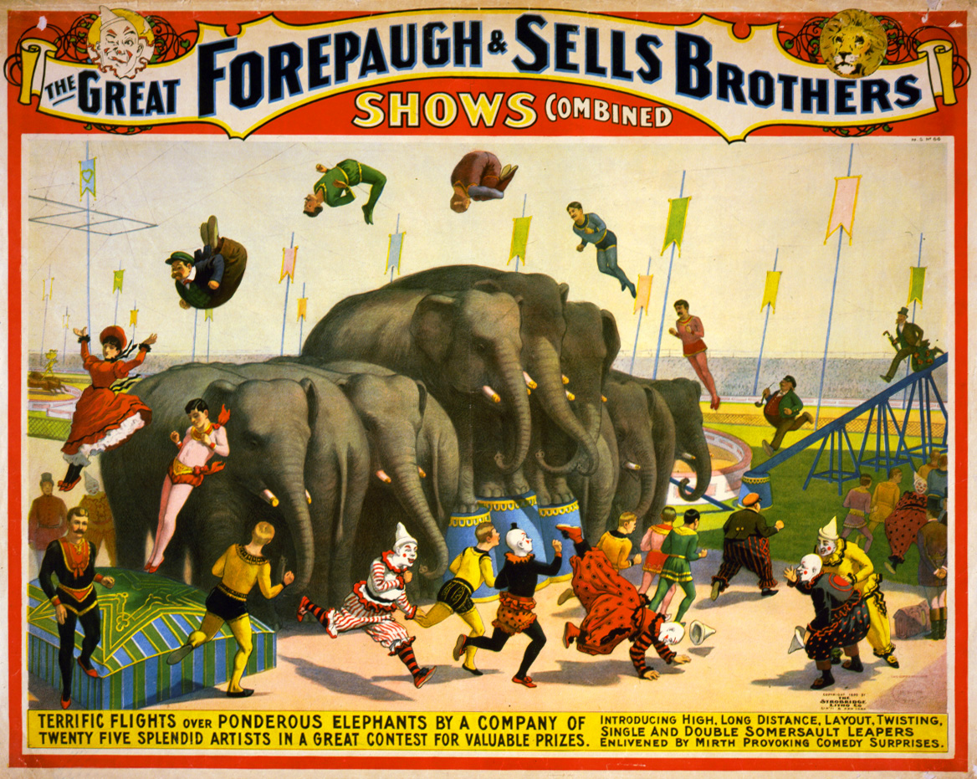

Slide 6
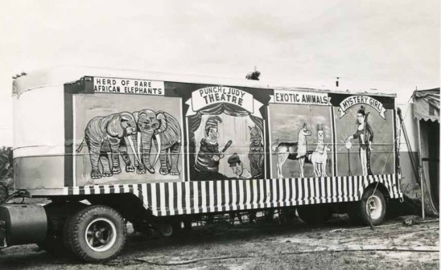

Slide 7
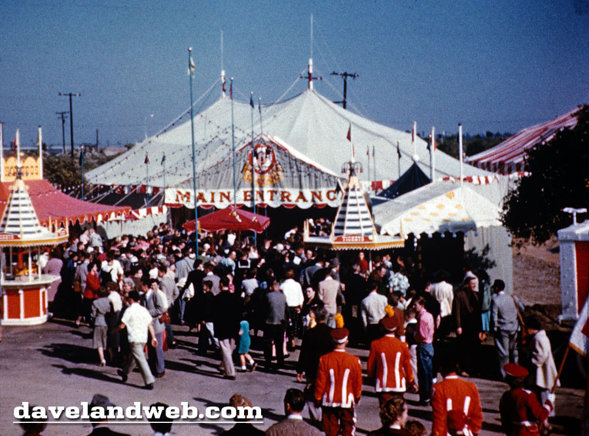

Slide 8
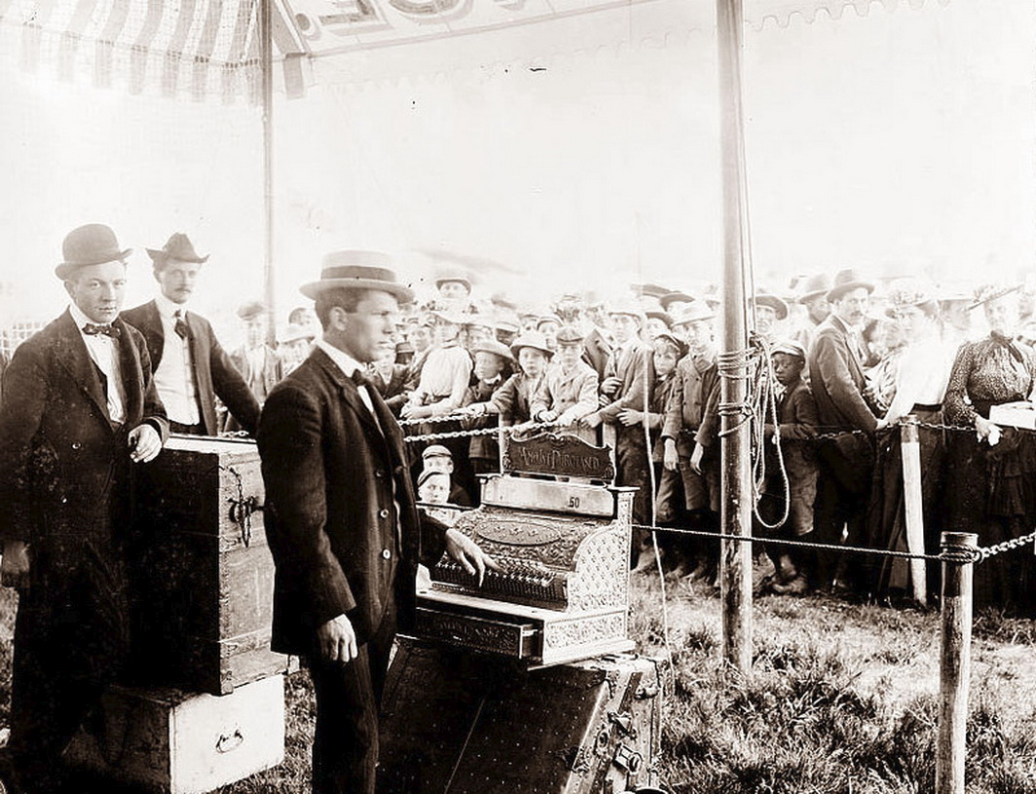

Slide 9
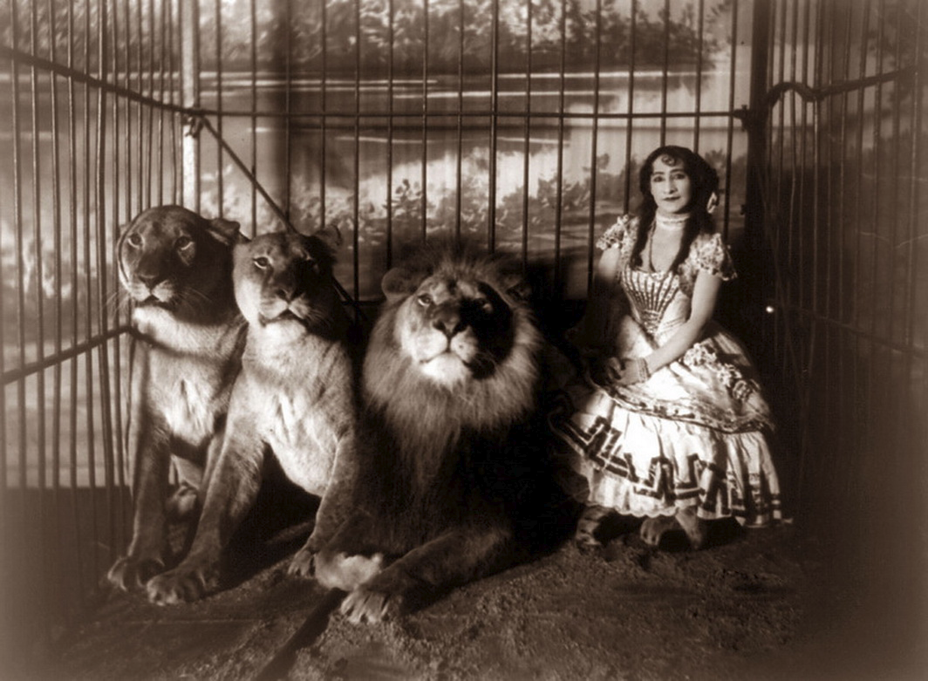

Slide 10
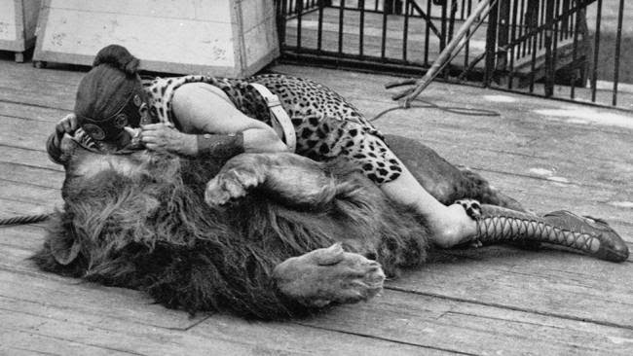

Slide 11
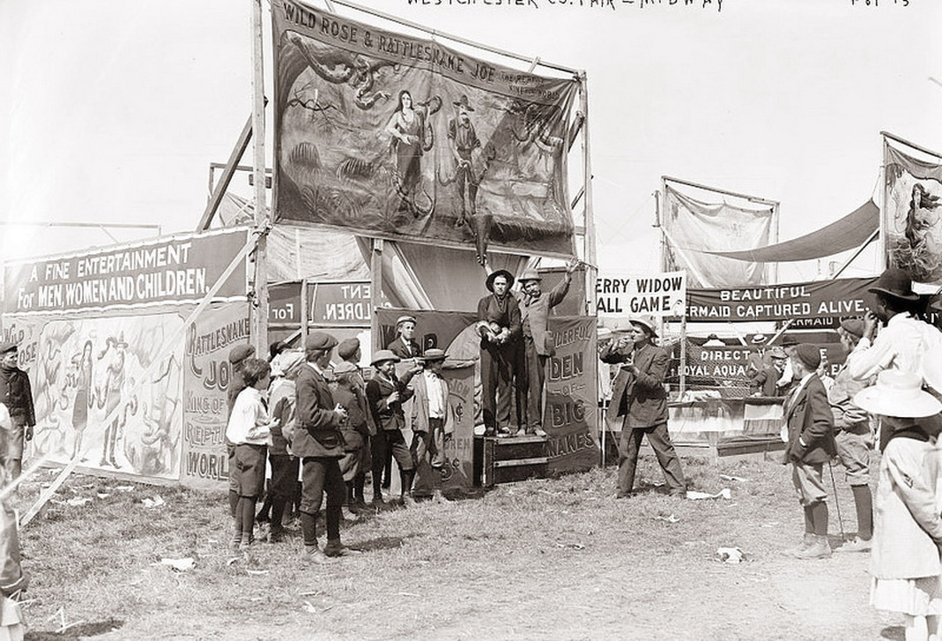

Slide 12
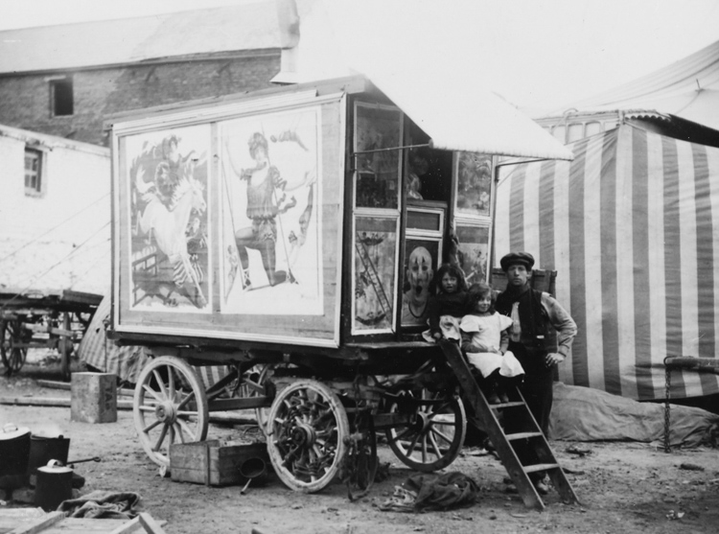

Slide 13
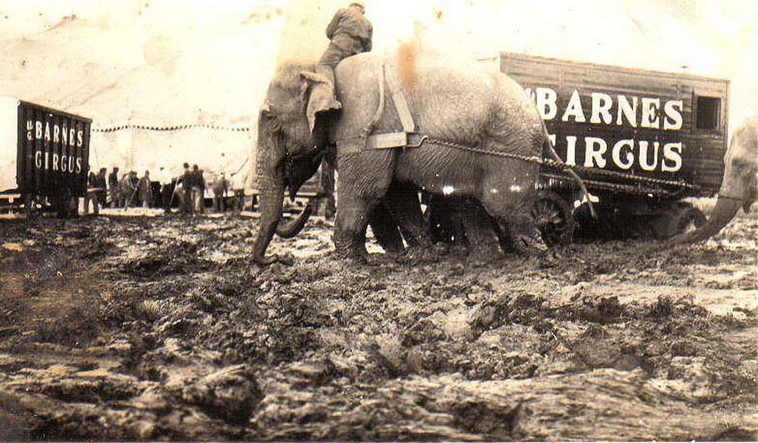

Slide 14
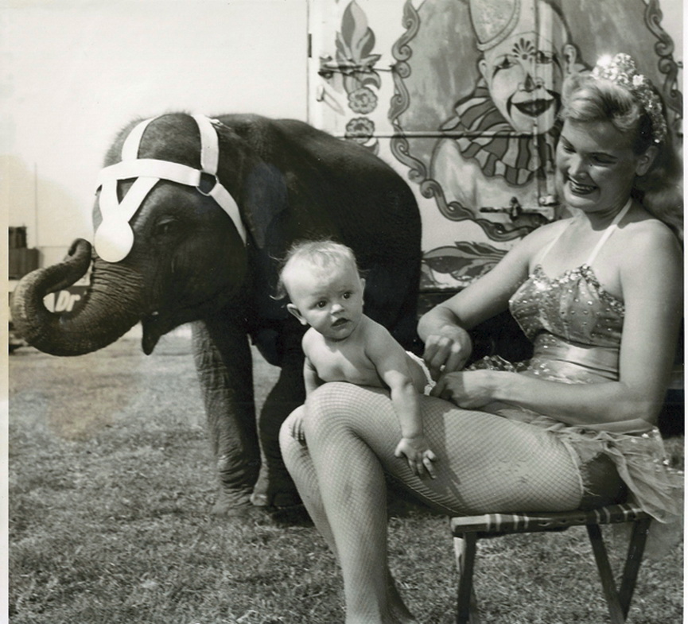

Slide 15
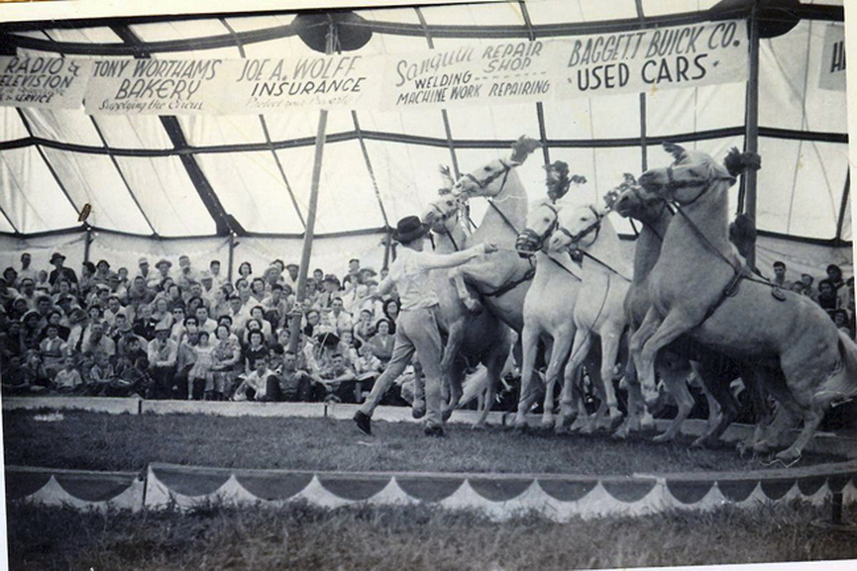

Slide 16
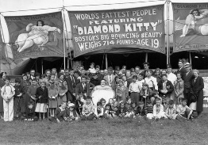

Slide 17
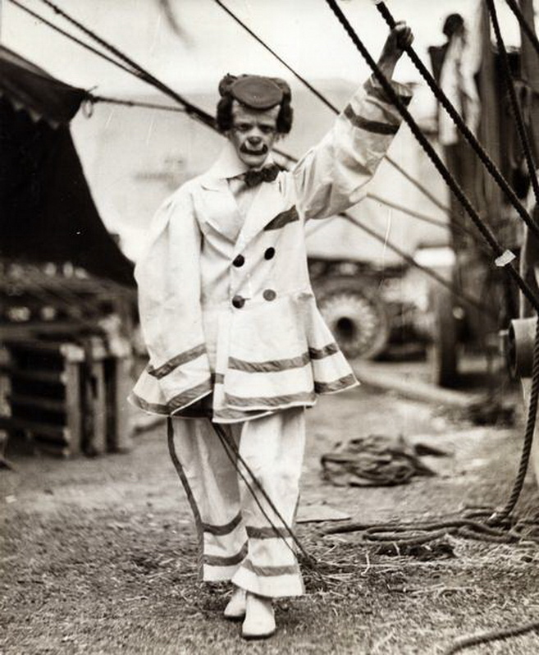

Slide 18
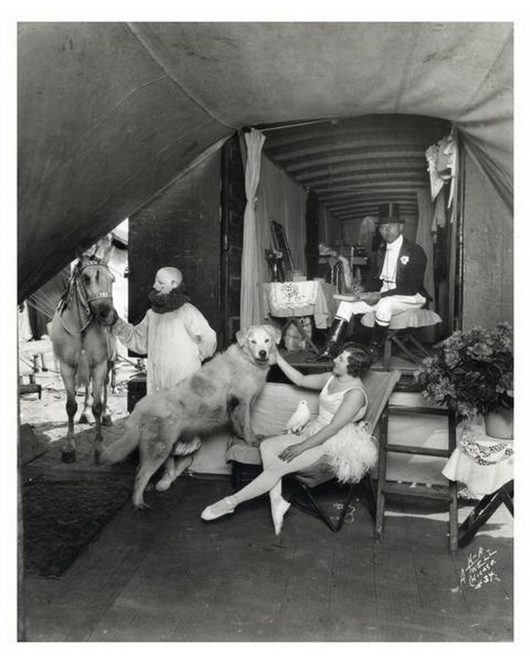

Slide 19
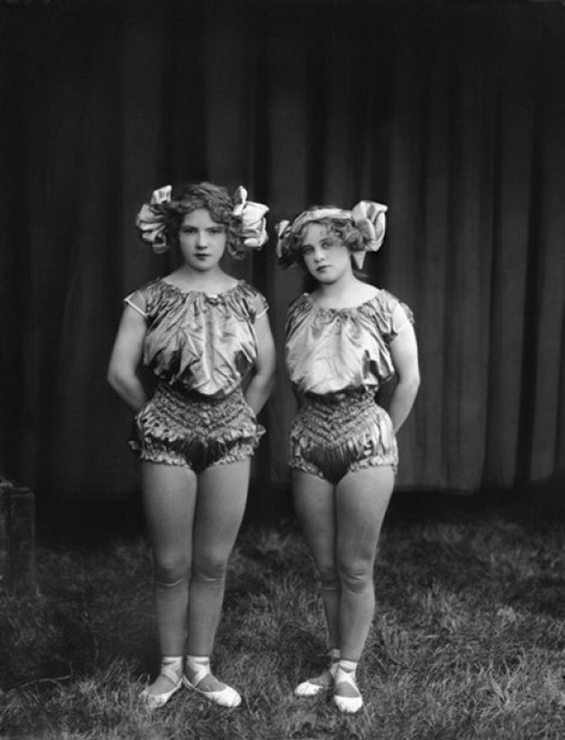

Slide 20
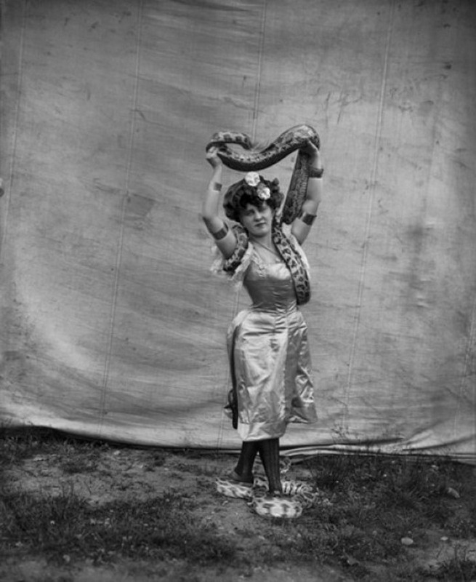

Slide 21
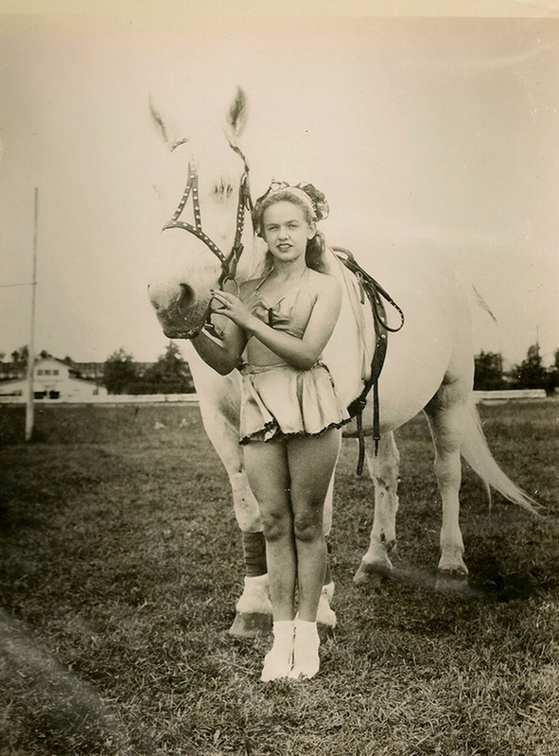

Slide 22
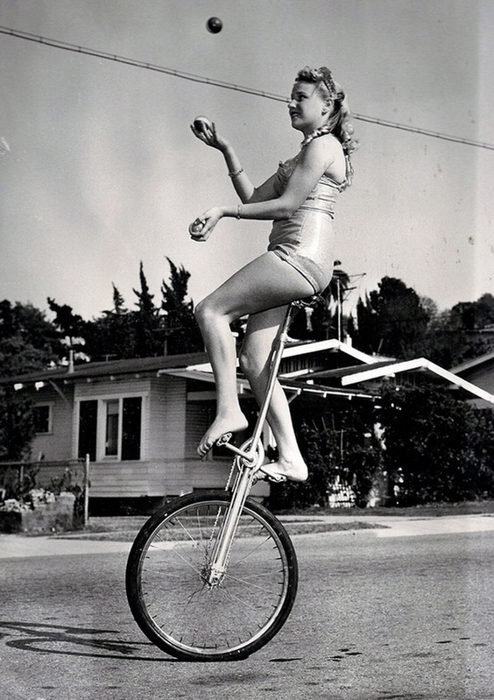

Slide 23
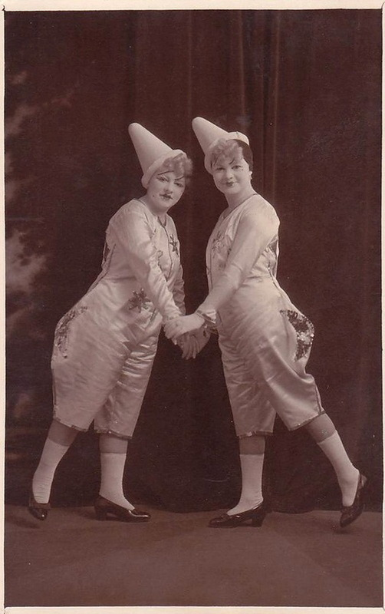
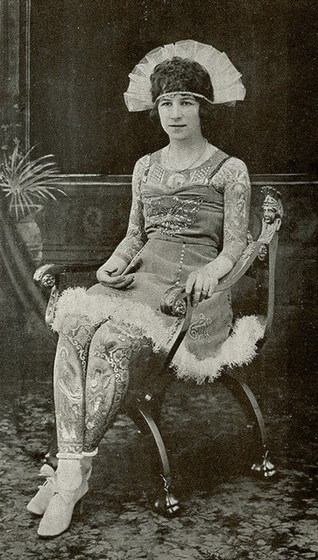

Slide 24
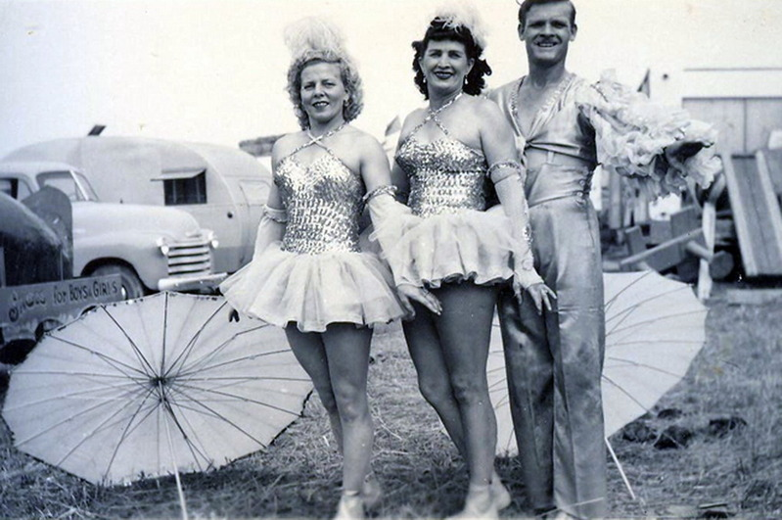

Slide 25
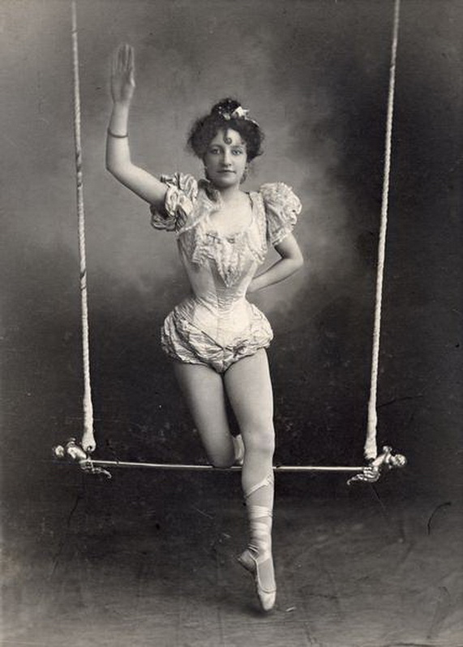
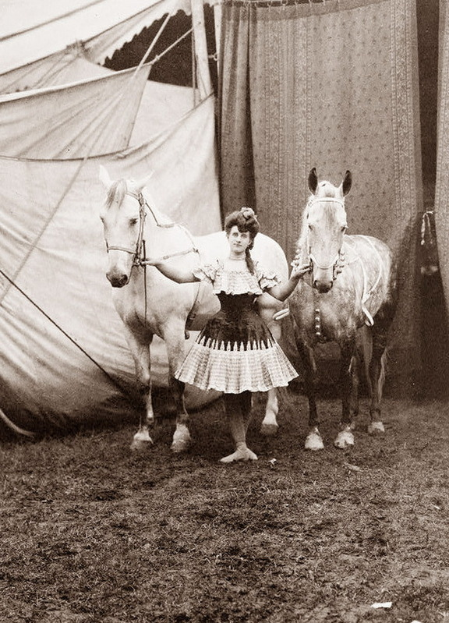

Slide 26
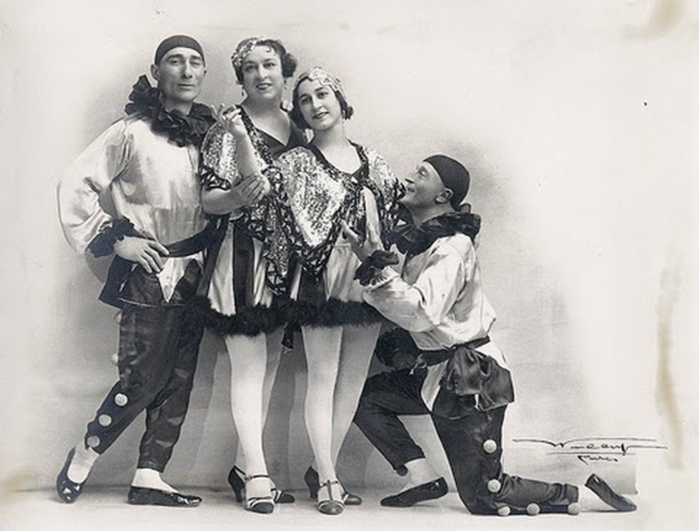

Slide 27
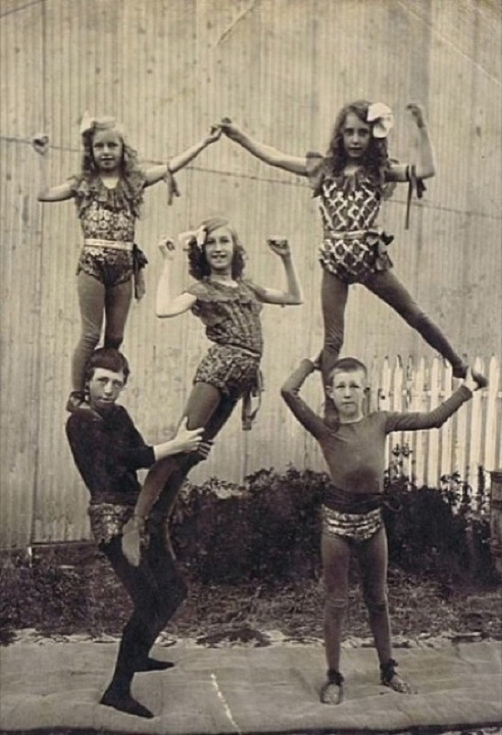
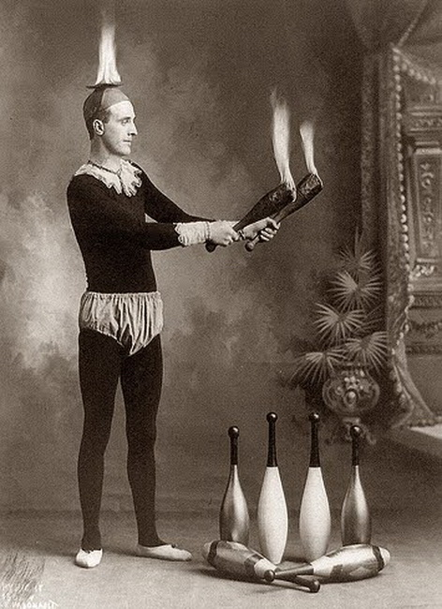

Slide 28
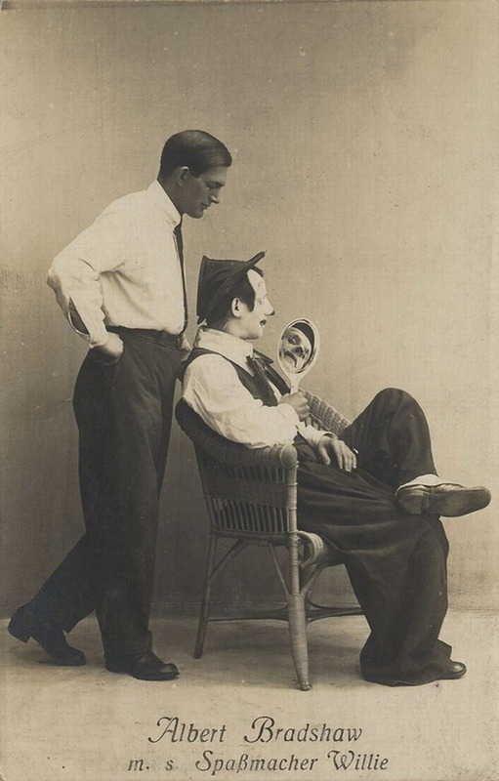
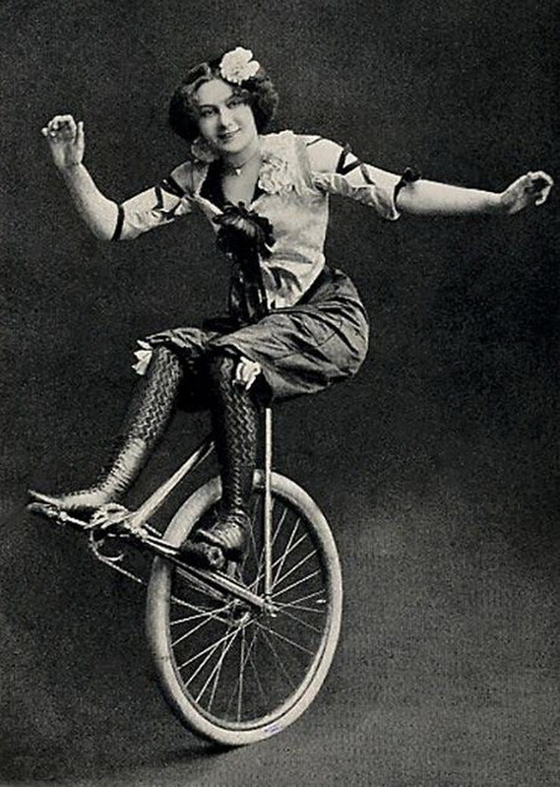

Slide 29
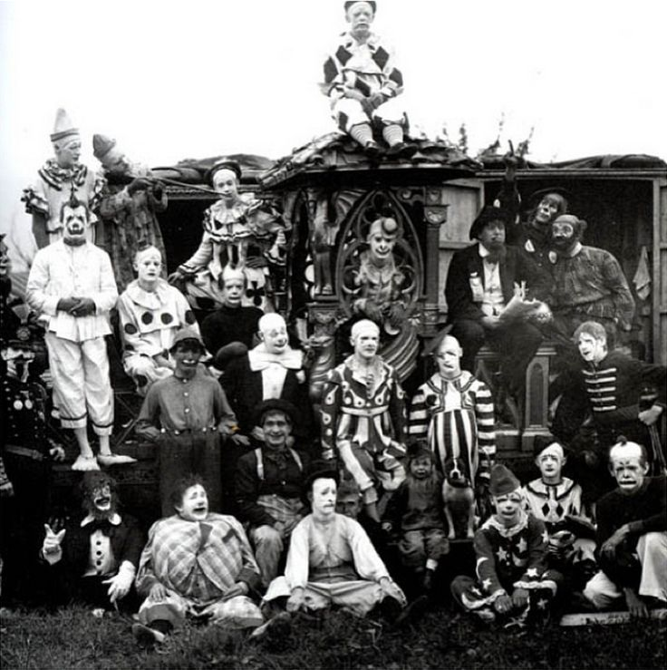

Slide 30
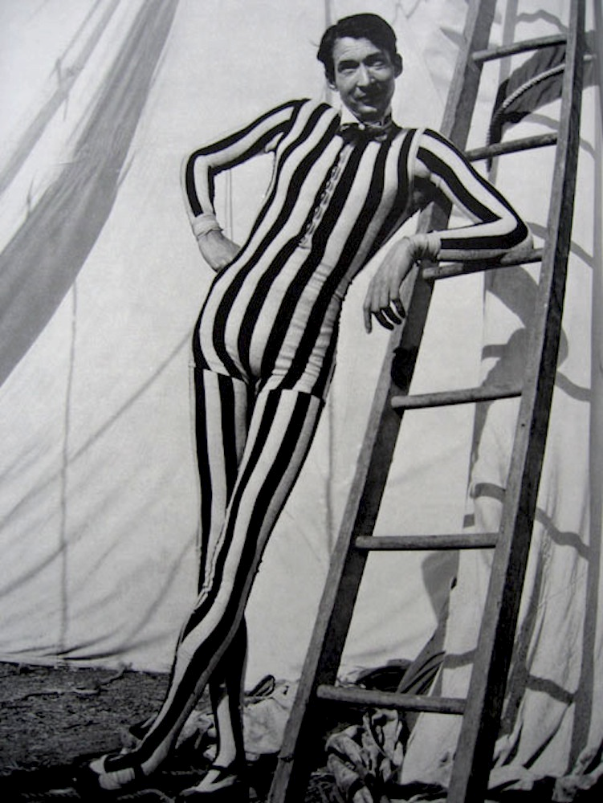
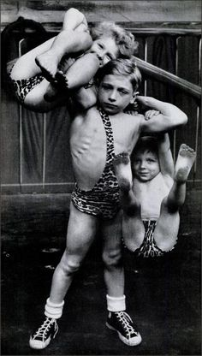

Slide 31
The Circus Side Show
people with birth defects and deformities were treated as "freaks" and exploited as main attractions traveling with the local circus from town to town. In many cases, this was the only way adults could make a living and support themselves. In the case of children, they were terribly exploited – often by their own families.

Slide 32
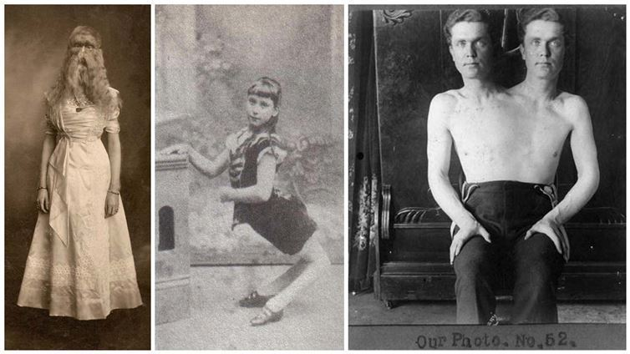

Slide 33
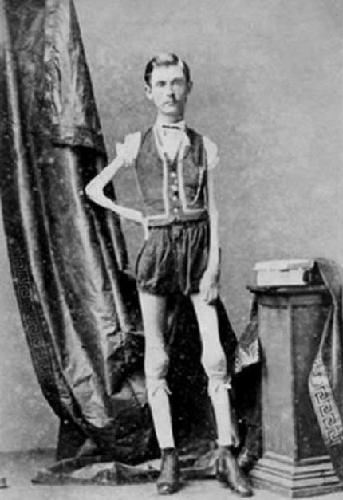
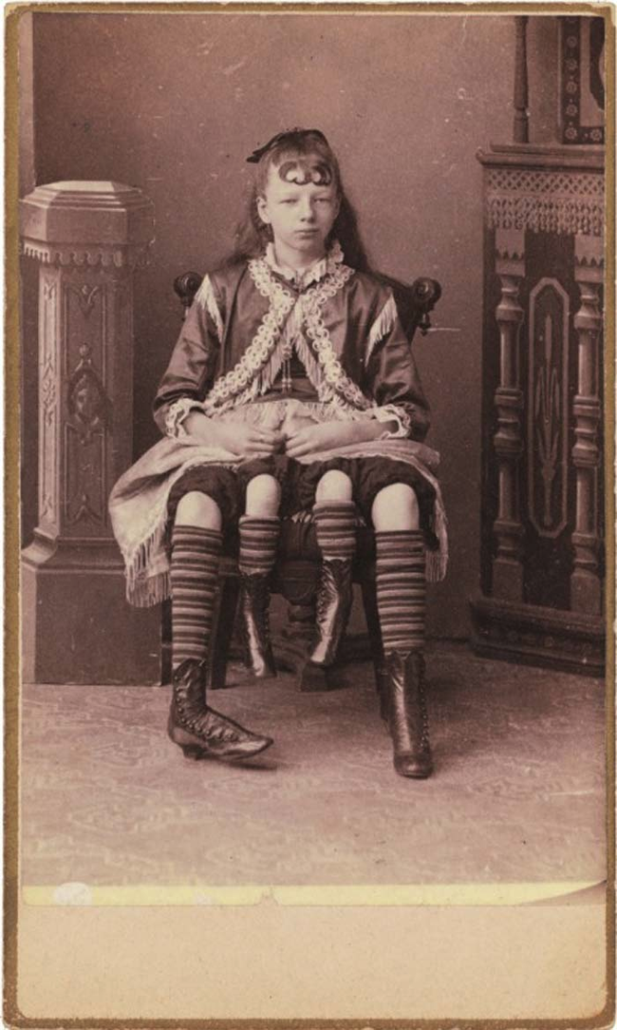

Slide 34
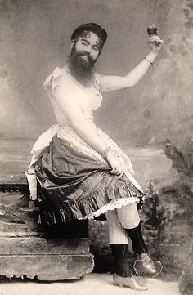
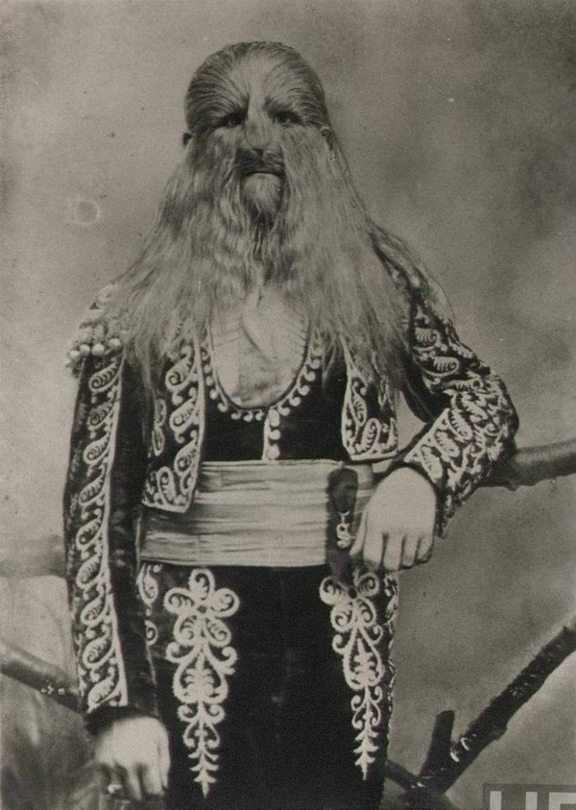

Slide 35
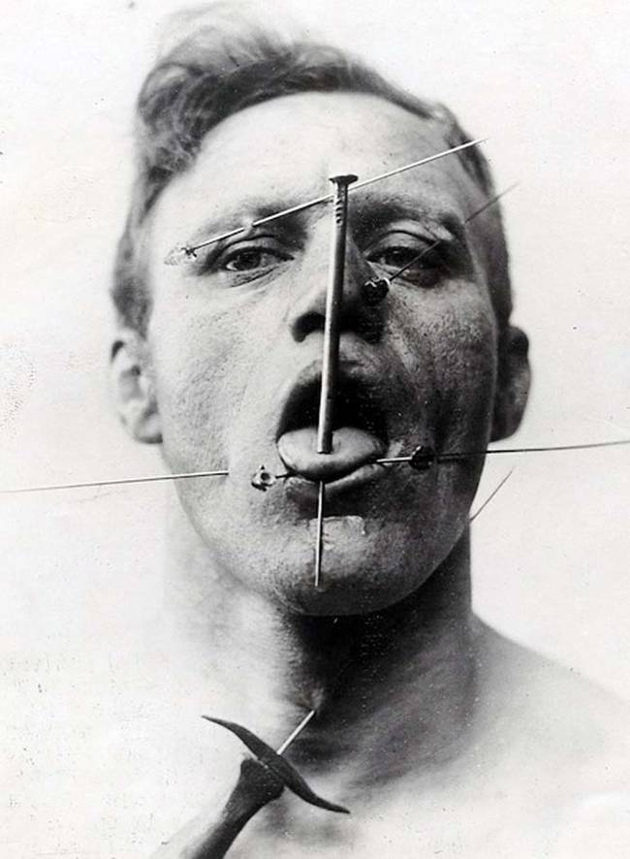
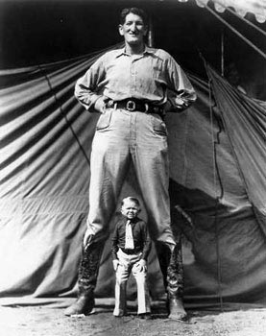

Slide 36
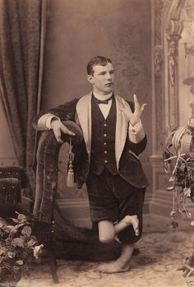
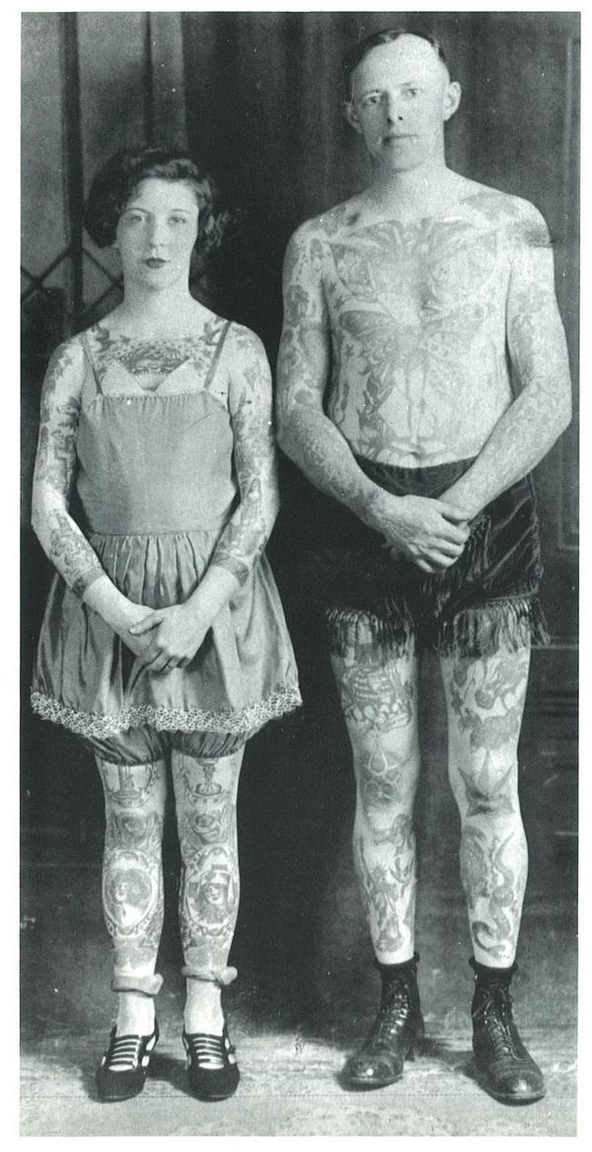

Slide 37
