Slide 1
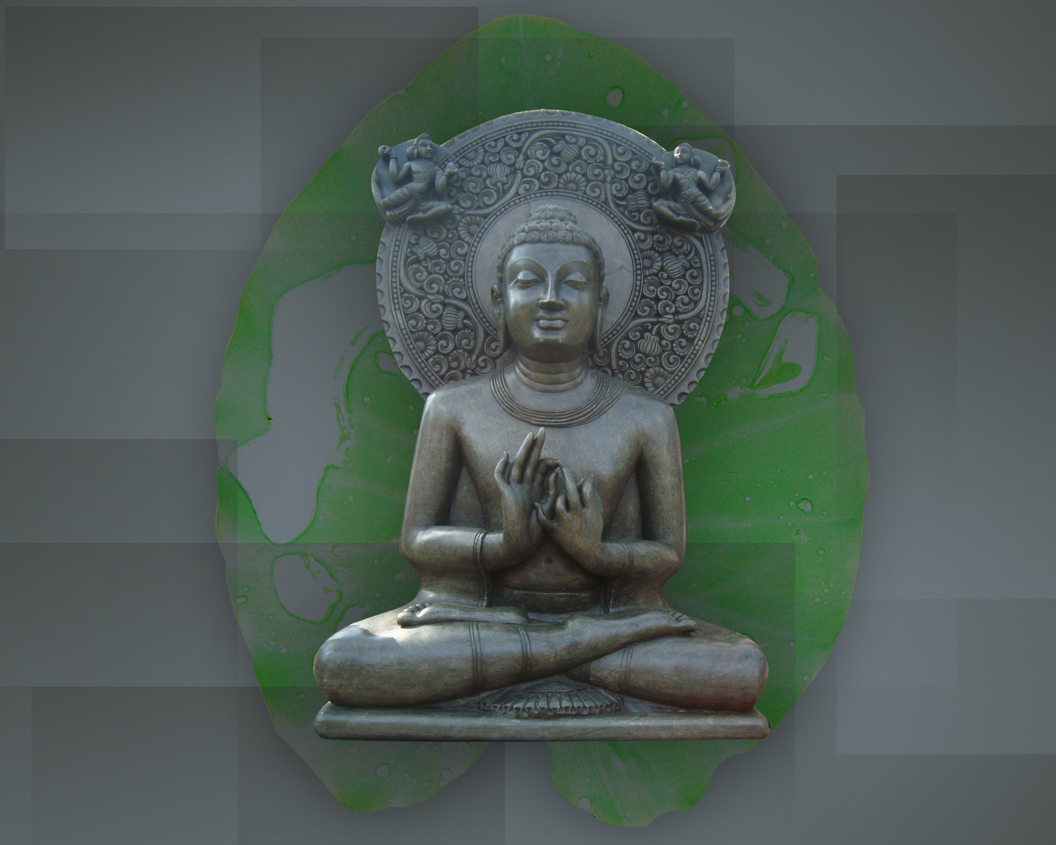
The Basics of Buddhism

Slide 2
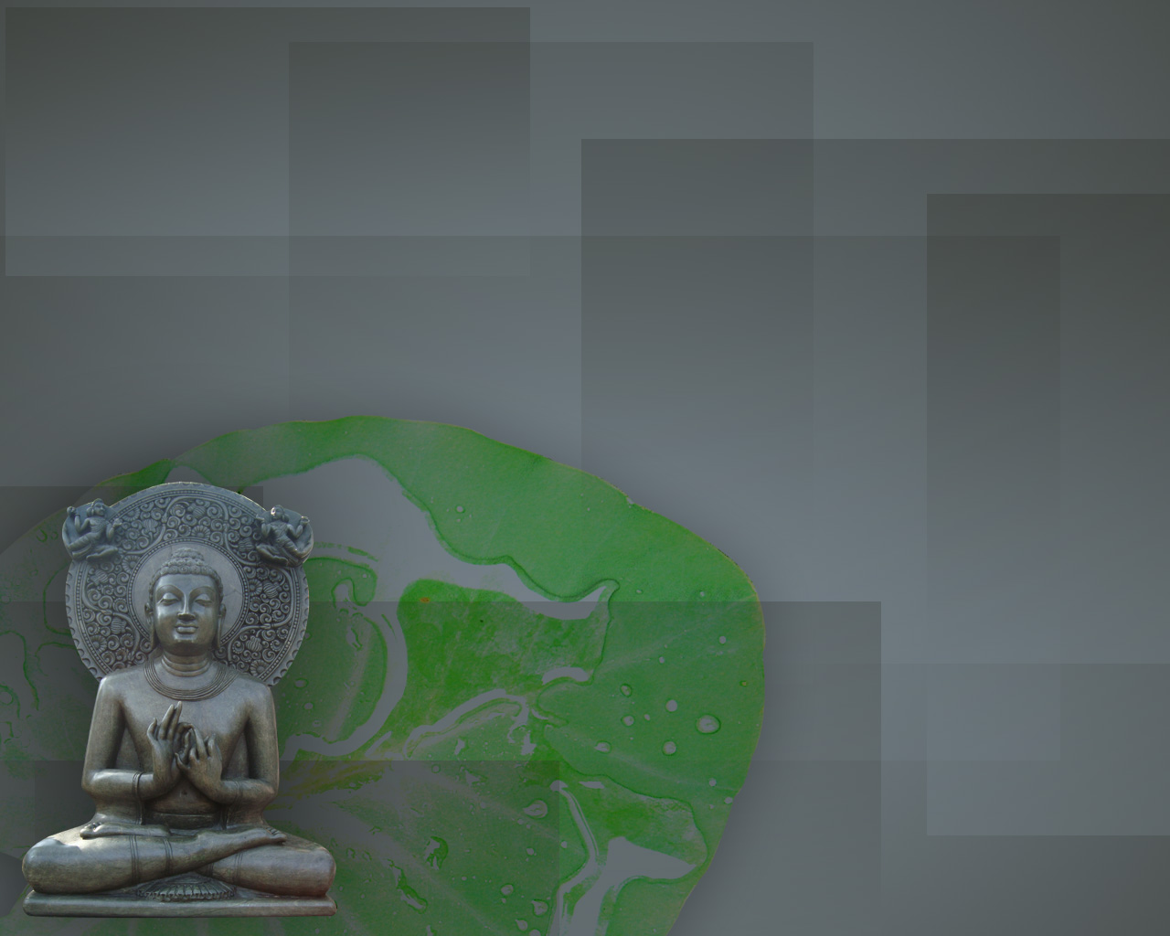
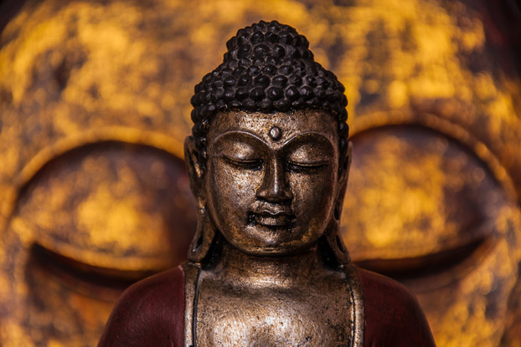
A simple introduction to the fundamental teachings of Buddhism and the core practices of this spiritual path.

Slide 3

1. Buddhism originated in northern India in the 5th century B.C.E. The tradition traces its origin to Siddhartha Gautama, who is referred to as the Buddha (the "Awakened" or "Enlightened One").

Slide 4
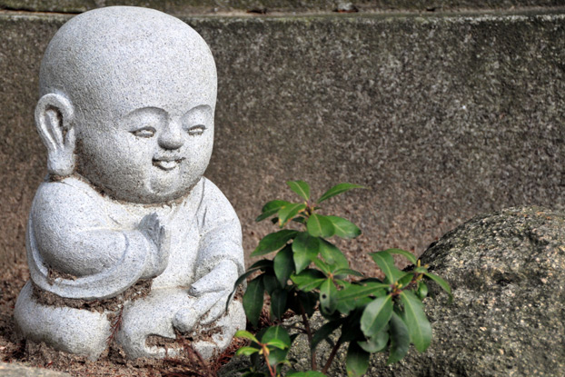
2. Born a wealthy prince, Gautama realized his material possessions and social benefits provided only temporary happiness. He gave up riches and royalty to take on a life of extreme deprivation as he wandered in search of the meaning and purpose of human existence.

Slide 5
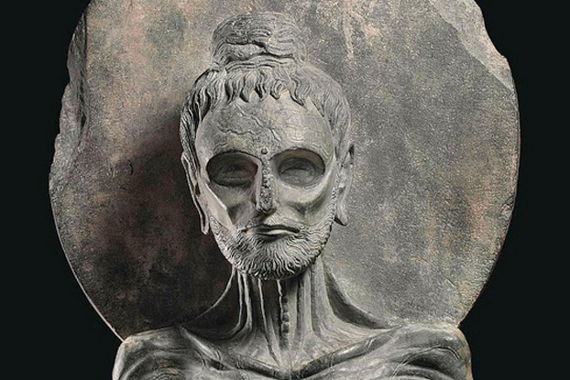
3. A life of scarcity (in which he almost fasted to starvation) didn’t lead him to the answers he sought. He discovered what Buddhists call the Middle Way, a path of moderation between self indulgence and self-mortification. He believed this was the path of wisdom.

Slide 6
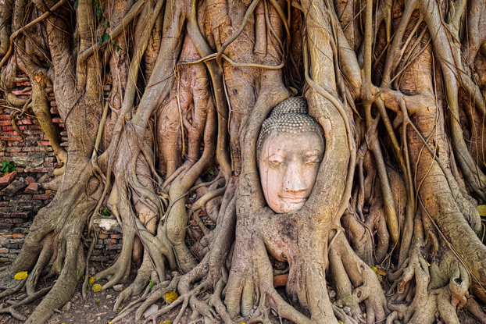
4. After a reputed 49 days of meditation under a Bodhi tree, at 35, Gautama attained Enlightenment and became the Buddha, realizing complete insight into the cause of suffering and the steps necessary to eliminate it. Anyone can become a Buddha, but it's a difficult path.

Slide 7

5. The Buddha taught that people end their suffering through the elimination of ignorance and craving, which is accomplished through the direct understanding and perception of dependent origination and the Four Noble Truths.

Slide 8
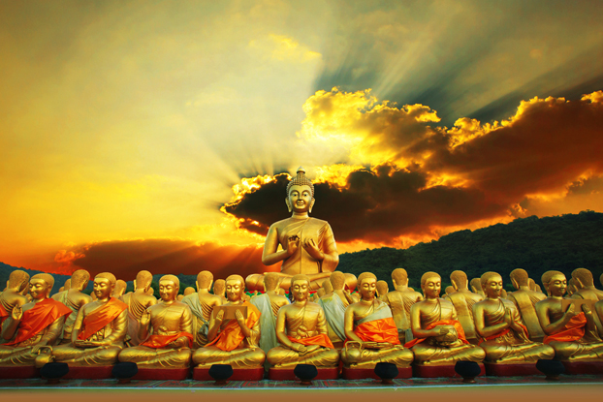
6. In his first sermon, he outlined the Four Noble Truths: 1) Suffering is characteristic of human existence; 2) Suffering is caused by longing for (craving) pleasure and avoidance of pain; 3) It is not necessary to suffer; and 4) There is a path to end suffering.

Slide 9
The Four Noble Truths
The teachings on the Four Noble Truths are regarded as central to the teachings of Buddhism, and are said to provide a conceptual framework for Buddhist thought. These four truths explain the nature of dukkha (suffering, anxiety, unsatisfactoriness), its causes, and how it can be overcome. The four truths are:
The truth of dukkha (suffering, anxiety, unsatisfactoriness)
The truth of the origin of dukkha (craving)
The truth of the cessation of dukkha (cease craving)
The truth of the path leading to the cessation of dukkha (the 8-fold path)

Slide 10

7. In addition, the Buddha taught the Noble Eight Fold Path, which is seen as a set of guidelines for moral behavior that lead its practitioner toward self-awakening and liberation.

Slide 11
Eight-Fold Path
The Noble Eightfold Path (also known as the Middle Way)—the fourth of the Buddha's Noble Truths—consists of a set of eight interconnected factors or conditions, that when developed together, lead to the cessation of dukkha. These eight factors are: [1] Right View (or Right Understanding), [2] Right Intention (or Right Thought), [3] Right Speech, [4] Right Action, [5] Right Livelihood, [6] Right Effort, [7] Right Mindfulness, and [8] Right Concentration.

Slide 12
Division | Eightfold factor | Description
Wisdom | 1. Right view | Viewing reality as it is, not just as it appears to be
 | 2. Right intention | Intention of renunciation, freedom and harmlessness
Ethical conduct | 3. Right speech | Speaking in a truthful and non-hurtful way
 | 4. Right action | Acting in a non-harmful way
 | 5. Right livelihood | A non-harmful livelihood
Concentration | 6. Right effort | Making an effort to improve
 | 7. Right mindfulness | Awareness to see things for what they are with clear consciousness; being aware of the present reality within oneself, without any craving or aversion
 | 8. Right concentration | Correct meditation or concentration, explained as the first four jhānas

Slide 13
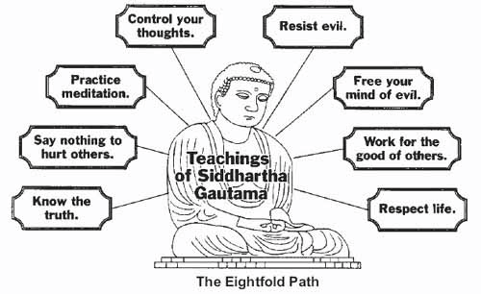

Slide 14

8. The law of dependent origination is another important teaching of the Buddha. Nothing exists in isolation, independent of other life. All things and individuals are mutually supportive, related, and form a single living whole.

Slide 15

9. The Buddhist interpretation of karma does not refer to preordained fate. Rather, it refers to the good or bad actions a person makes during his or her lifetime and how they bring on happiness or unhappiness in the long run.

Slide 16
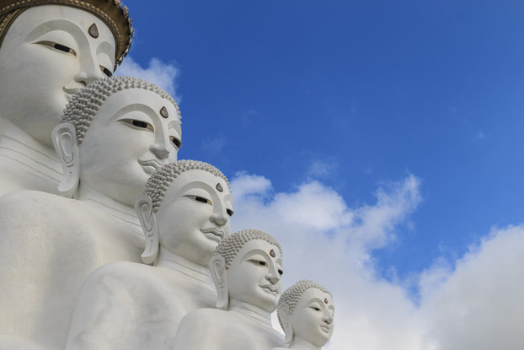
10. On a larger scale, karma determines where a person will be reborn and their status in their next life. Buddhists don’t believe in a permanent, intrinsically existing soul. Rebirth is an endless cycle involving the passing on of consciousness from one life to the next.

Slide 17

11. However, the aim of Buddhism is to eventually escape the cycle of rebirth altogether by reaching Nirvana—the state one reaches after ridding themselves of all karma that constitutes who they are.

Slide 18

12. Buddhism's transformations and cultural interpretations have led to the emergence of different schools of thought. Three major sects are Mahayana ("great vehicle"), Theravada ("school of the elder monks"), and Vajrayana (tantric Buddhism).

Slide 19
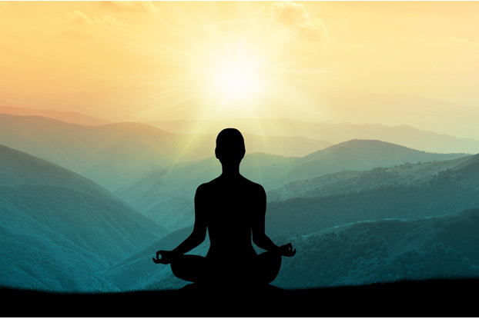
13. Meditation is important in nearly all forms of Buddhism, and it derives directly from the Buddha's experiences and teachings. It's the central focus of Zen Buddhism and the only way to liberation in Theravada Buddhism.

Slide 20
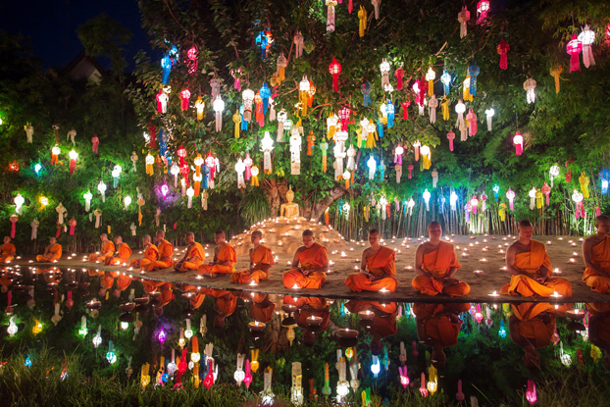
14. Chanting helps Buddhists learn texts, focus the mind, and internalize key Buddhist ideas. Buddhism is unique in that it does not consider chanting to be prayer.

Slide 21
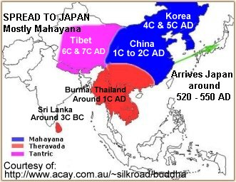

Slide 22
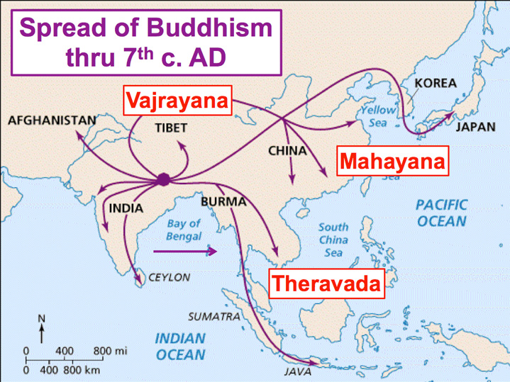

Slide 23
Theravada Buddhism
In Theravada Buddhism ("The School of the Elders“), the ultimate goal is the attainment of the sublime state of Nirvana, achieved by practicing the Noble Eightfold Path (also known as the Middle Way), thus escaping what is seen as a cycle of suffering and rebirth.
Males usually spend at least a small part of their lives as monks – a minority of them spend a lifetime as monks.

Slide 24
Mahayana Buddhism
Mahayana Buddhism instead aspires to Buddhahood via the bodhisattva path, a state wherein one remains in this cycle to help other beings reach awakening. Mahayana includes the traditions of Pure Land, Zen, Nichiren Buddhism, Shingon, and Tiantai (Tendai) and is found throughout East Asia.

Slide 25
Bodhisattva
In Mahayana Buddhism, bodhisattva is the Sanskrit term for anyone who, motivated by great compassion, has generated bodhicitta, which is a spontaneous wish to attain buddhahood for the benefit of all sentient beings.
Somewhat like a Saint, mentor, guide, etc.

Slide 26
Tantric Buddhism
Tibetan Buddhism, which preserves the Vajrayana teachings of eighth century India, is practiced in regions surrounding the Himalayas, Mongolia and Kalmykia. Vajrayana, a body of teachings attributed to Indian siddhas, may be viewed as a third branch or merely a part of Mahayana. Tantric Buddhism is largely concerned with ritual and meditative practices.

Slide 27
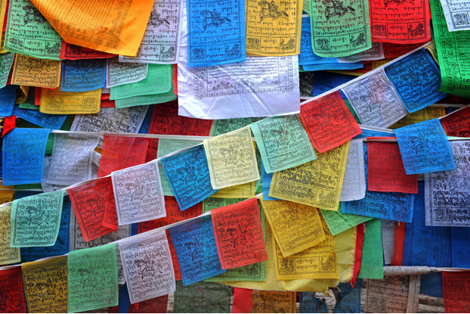
15. That said, Buddhists do pray. Instead of praying to a creator, as Buddhism doesn’t recognize a God (not even the Buddha), Buddhists pray to cultivate loving-kindness and strengthen their desire to see beings flourish and be free from suffering.

Slide 28
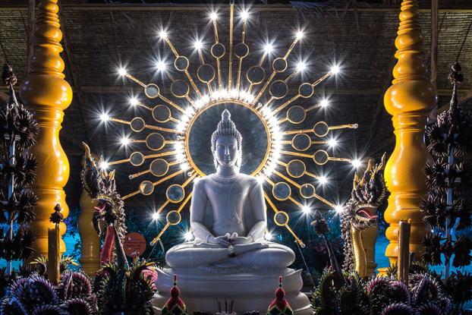
16. Buddhists pay respect to images of the Buddha, but not during worship or to ask for favors. A statue of the Buddha, with hands rested gently in his lap and a compassionate smile, reminds us to strive to develop peace and love within ourselves.

Slide 29
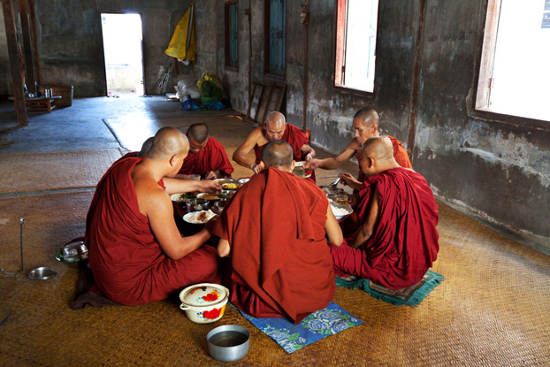
17. Some Buddhists are vegetarian, although the Theravada view is that the Buddha did not prohibit eating meat. Mahayana schools generally believe Buddhists should not eat the flesh of any sentient being.

Slide 30
18. The minimum moral obligations of a practicing lay Buddhist are: 1) Not to take the life of anything living, 2) Not to take anything not freely given, 3) Abstain from sexual misconduct and sensual overindulgence, 4) Refrain from untrue speech, 5) Avoid intoxication.

Slide 31
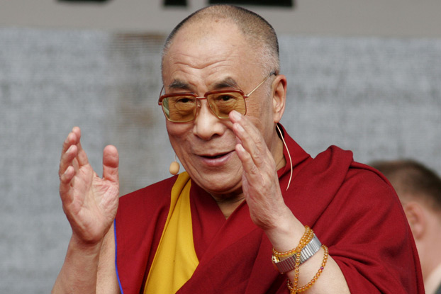
19. Monks and nuns are responsible for the preservation and sharing of the Buddha's teaching. The Dalai Lama is the spiritual leader of the four major schools of Tibetan Buddhism, but not the many other schools.

Slide 32
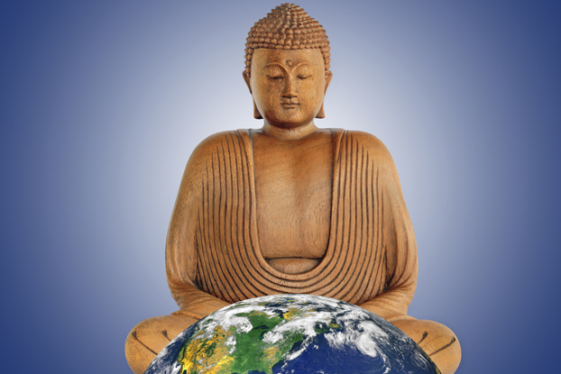
20. Buddhism has spread to every corner of the world, with 350 million followers. It's a distinct religious tradition, but many Westerners have adopted philosophical and practical aspects of Buddhism—there are "Buddhist Christians," "Buddhist Jews," and "Buddhist Atheists."

Slide 33
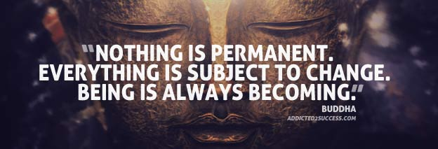
Thoughts to ponder

Slide 34
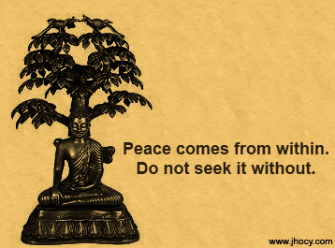

Slide 35
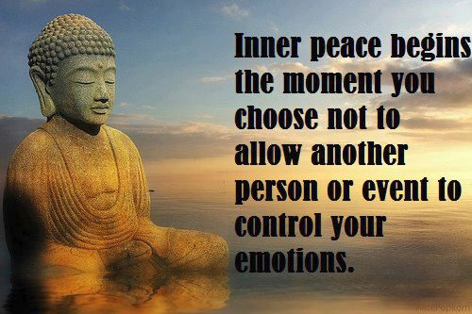

Slide 36
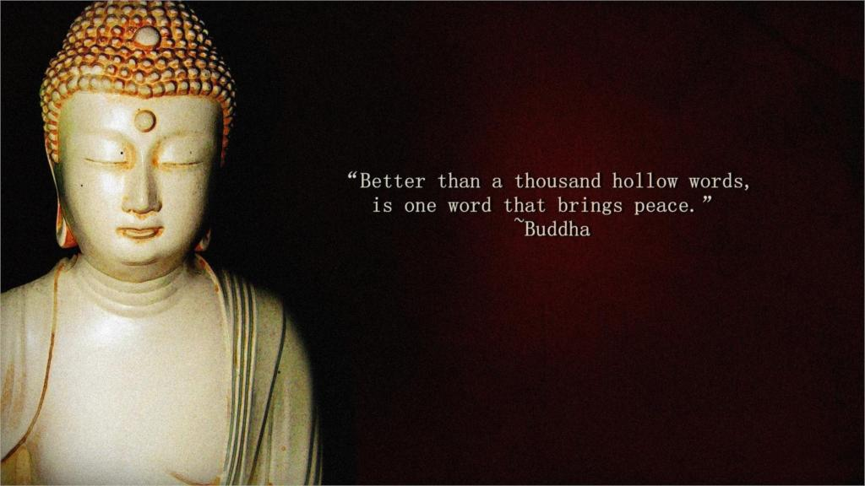

Slide 37
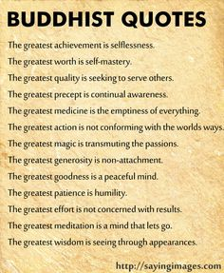

Slide 38
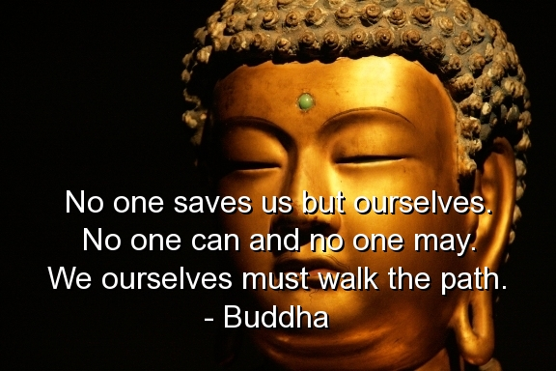

Slide 39
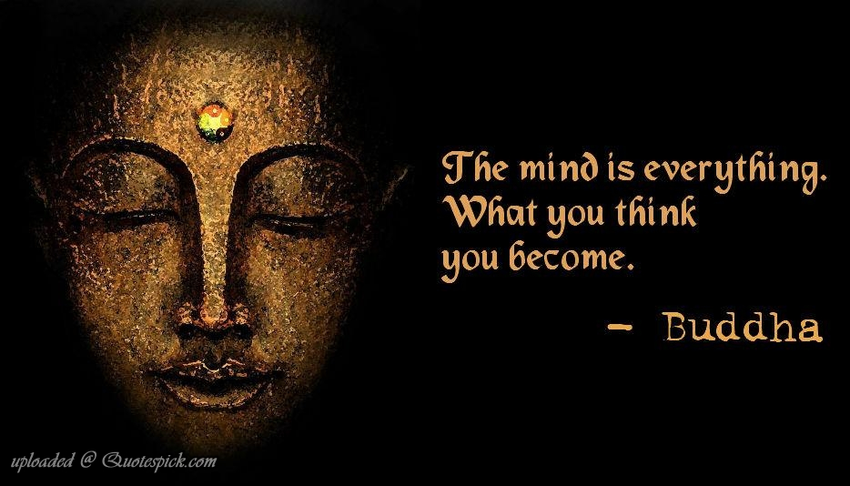

Slide 40
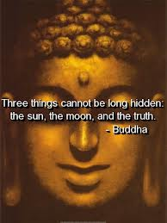

Slide 41
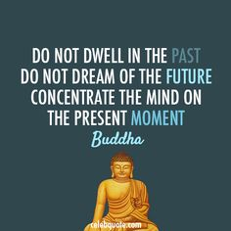

Slide 42
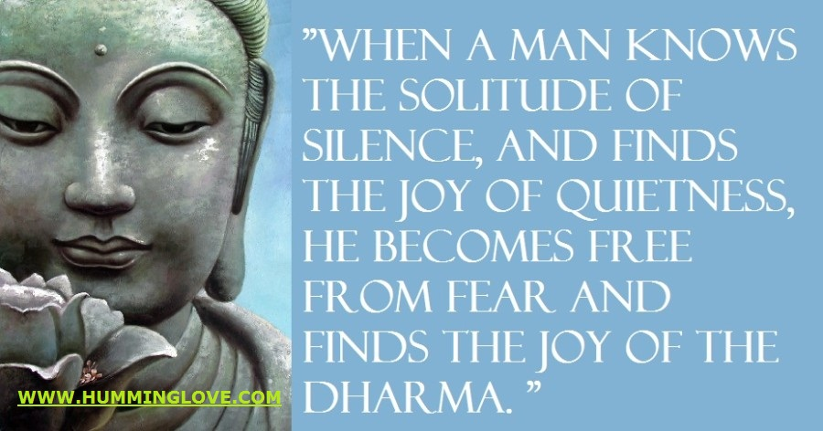

Slide 43
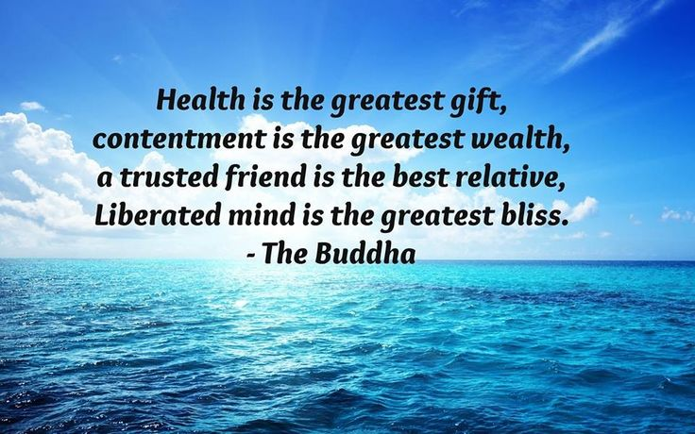

Slide 44


Slide 45


Slide 46
