Slide 1
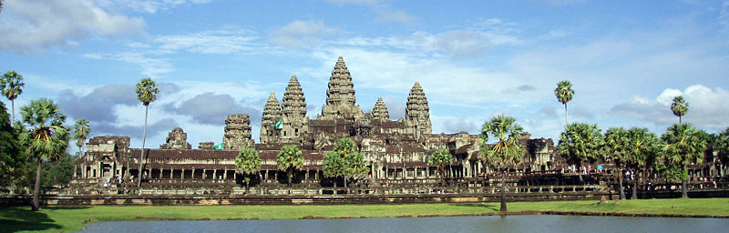
Temples of Angkor Wat and Thom
Cambodia

Slide 2
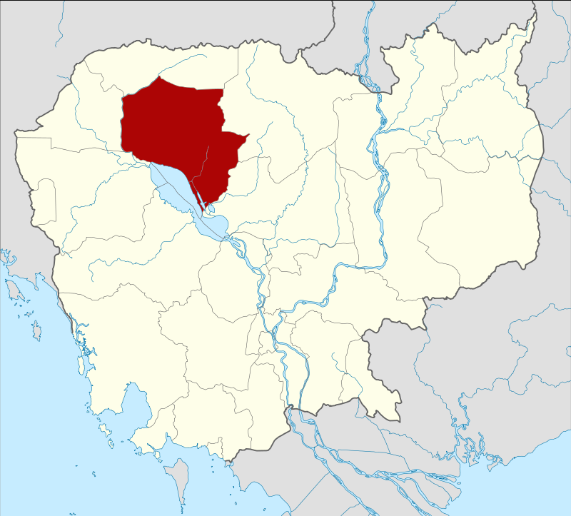
Location of Siem Reap Province

Slide 3
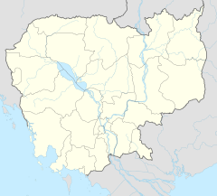
Located in a part of Cambodia that was once the seat of the famous Khmer Empire, Angkor (meaning 'capital city' in Khmer) was the heart of this civilization that thrived from the 9th to 15th centuries CE. There are over one thousand different temples in Angkor of different sizes and scales, all of which have been restored as a landmark of historic Khmer architecture. The entire site is preserved as a UNESCO World Heritage Site, but even if you can't make the journey to Cambodia, here is a tour of Angkor's highlights.

Slide 4
Angkor Wat ("Capital Temple") is a temple complex in Cambodia and the largest religious monument in the world, with the site measuring 162.6 hectares (1,626,000 m2; 402 acres). It was originally constructed as a Hindu temple of god Vishnu for the Khmer Empire, gradually transforming into a Buddhist temple toward the end of the 12th century. It was built by the Khmer King Suryavarman II in the early 12th century in Yaśodharapura, the capital of the Khmer Empire, as his state temple and eventual mausoleum. Breaking from the Shaiva tradition of previous kings, Angkor Wat was instead dedicated to Vishnu. As the best-preserved temple at the site, it is the only one to have remained a significant religious center since its foundation. The temple is at the top of the high classical style of Khmer architecture. It has become a symbol of Cambodia, appearing on its national flag, and it is the country's prime attraction for visitors.

Slide 5
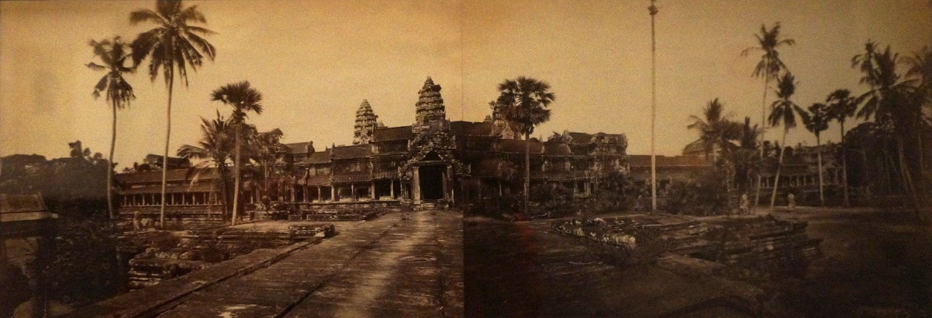
1870

Slide 6
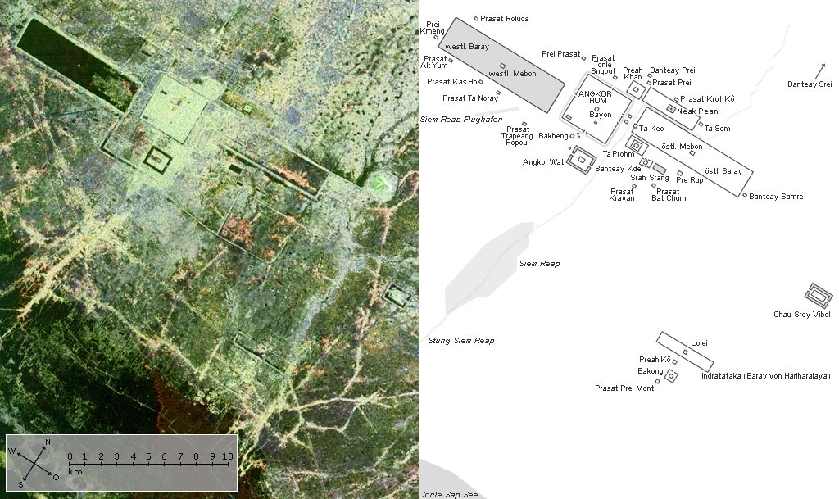

Slide 7
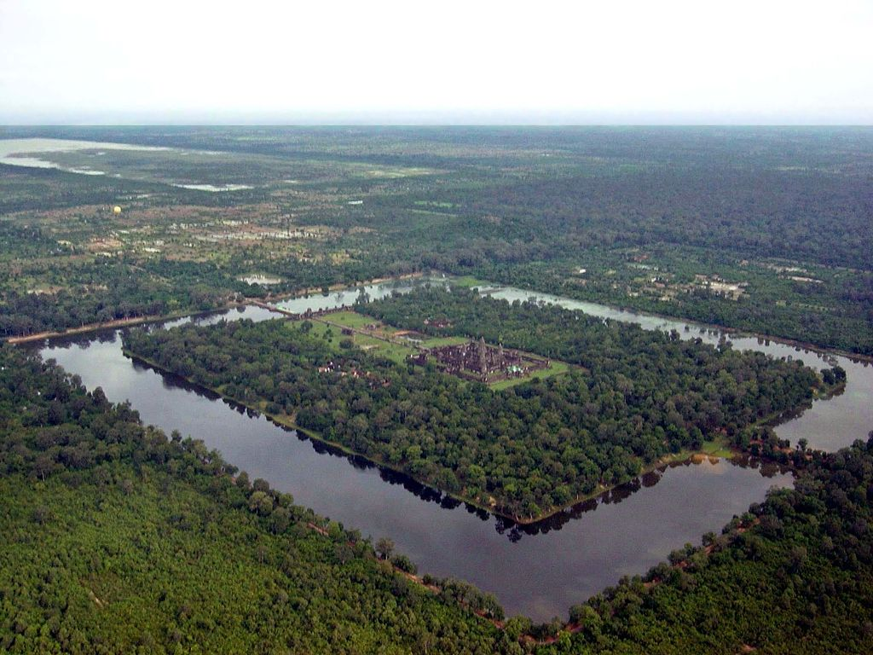

Slide 8
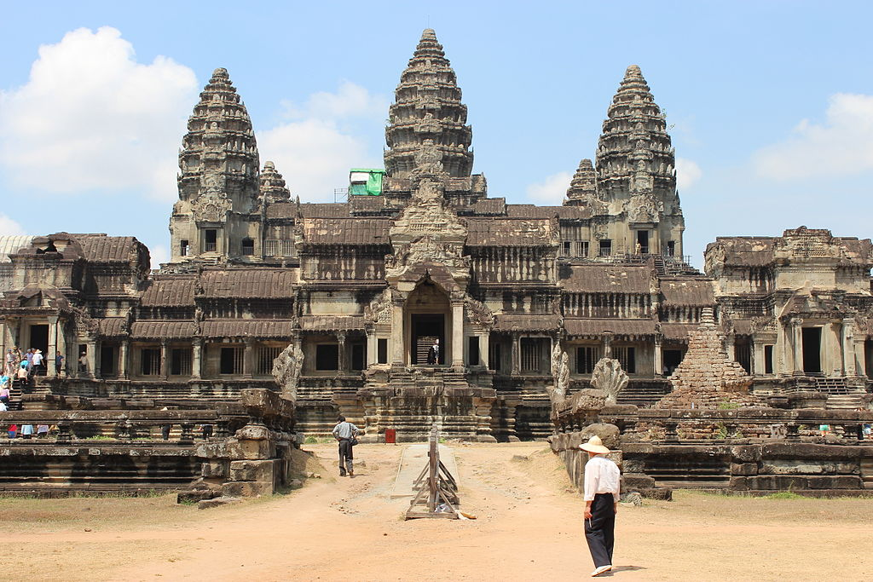
Viewed from the rear

Slide 9
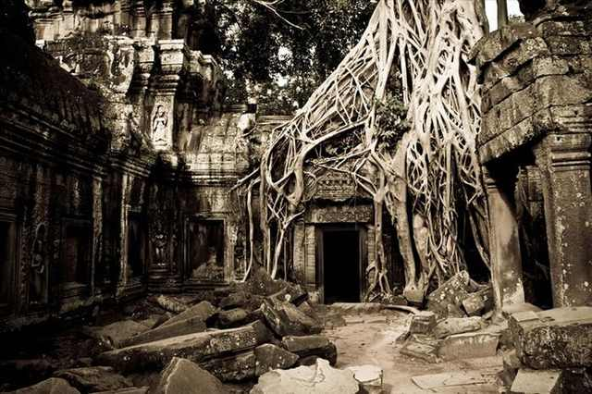

Slide 10
In 2007, a group of researchers concluded the Angkor had been the largest preindustrial city in the world, with an elaborate infrastructure system that connected at least 1,000 square kilometers (390 square miles) to the temples at its center. It is estimated that the Angkor area may have supported up to one million people.

Slide 11
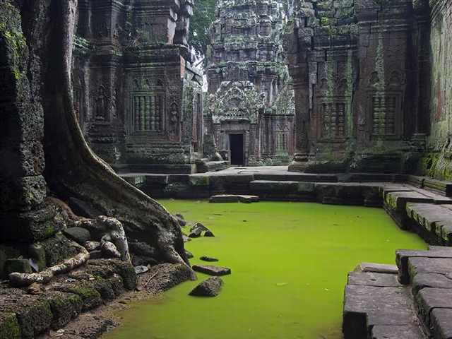

Slide 12
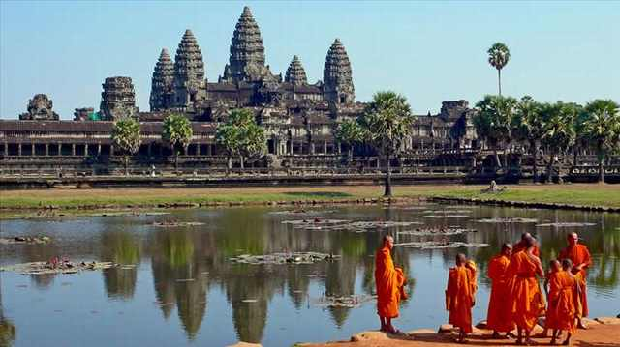

Slide 13
Referring to previous slide
Buddhist monks in front of the reflection pool at Angkor Wat, the site's best-known structure. Angkor Wat was built to represent the Hindu 'Mountain of the Gods' and served as a funerary temple. It was built between 1113 and 1150 by King Suryavarman II.

Slide 14
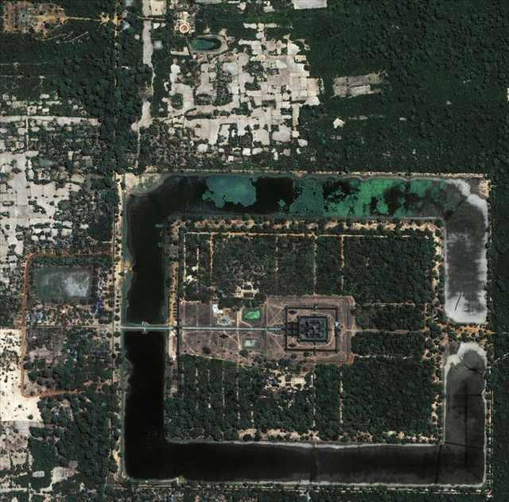
An aerial view of Angkor Wat, the temple dedicated to the Hindu god Vishnu and built as a representation of Mount Meru, the home of the gods and the center of the Hindu universe. Donned with pyramid architecture, the temple is also covered with intricate reliefs of Hindu gods and epics.

Slide 15
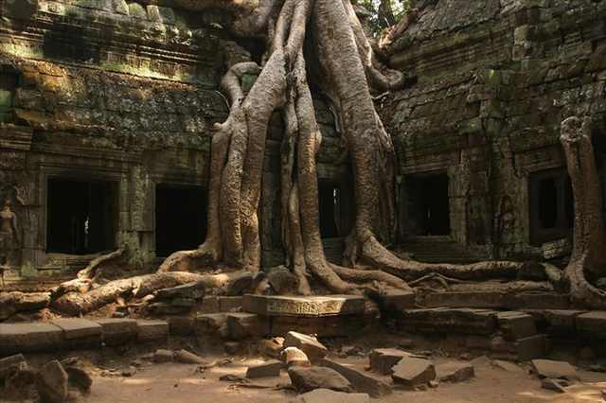
The iconic tree at Ta Prohm. This temple was built during the time of Jayavarman VII and is best known as the temple where trees have become intertwined and interwoven into the stone.

Slide 16
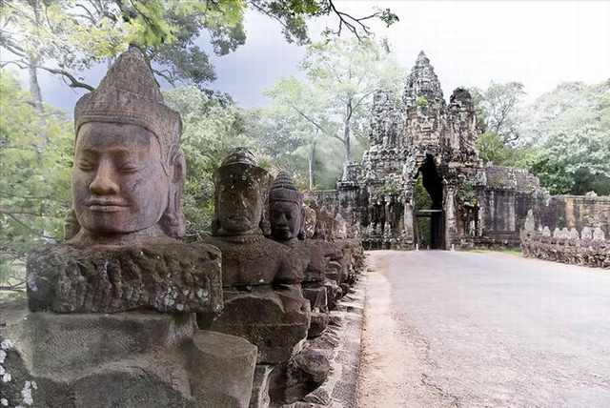

Slide 17
Referring to previous slide
Statues at the gateway to Angkor Thom, or 'The Great City'. These images represent the Hindu myth of creation, called the Churning of the Sea of Milk. On one side of the path, there are 54 guardian gods called devas and on the other side there are 54 images of demon gods called asuras.

Slide 18
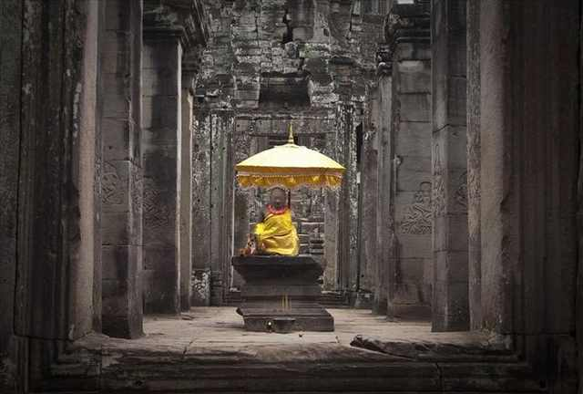
A statue of a Buddhist monk.

Slide 19
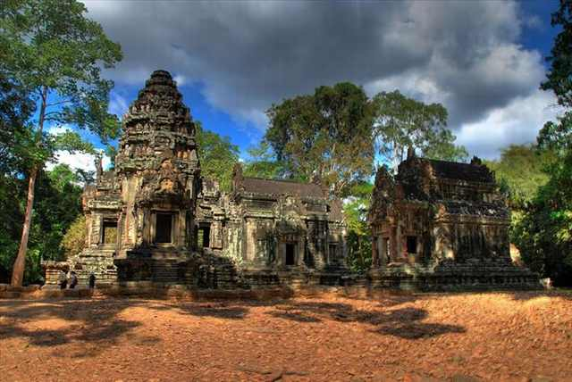
Chau Say Tevoda, another temple, built in the style of Angkor Wat in the 12 century before the construction of Angkor Thom and the Victory Way.

Slide 20
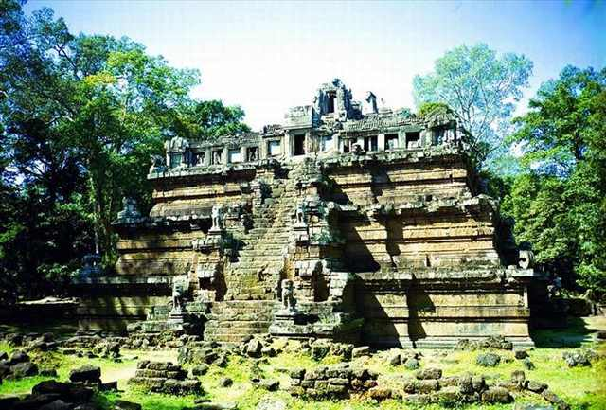
Phimeanakas was built towards the end of the 10th century during the reign of Rajendravarman and later rebuilt by Suryavarman II in the shape of a three-tiered pyramid. According to legend, there was once a tower at the top of the temple.

Slide 21
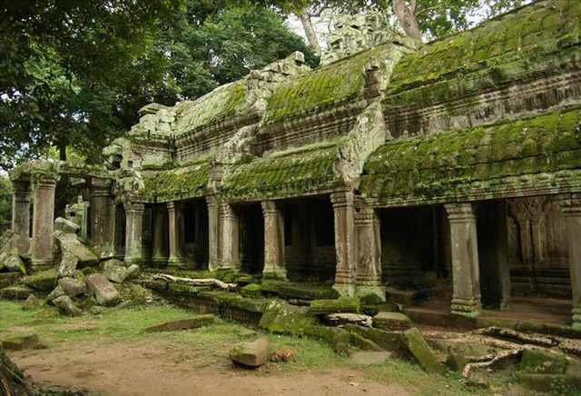
Fine carving at the ruins of the Buddhist temple of Angkor Ta Prohm. The temple dates back to the 12-13th century and was built by the famous Jayavarman VII.

Slide 22
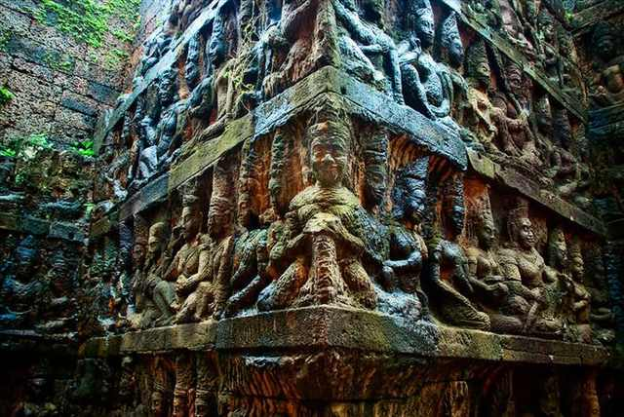
Detailed reliefs of the underworld, part of the Royal Square between the temples.

Slide 23
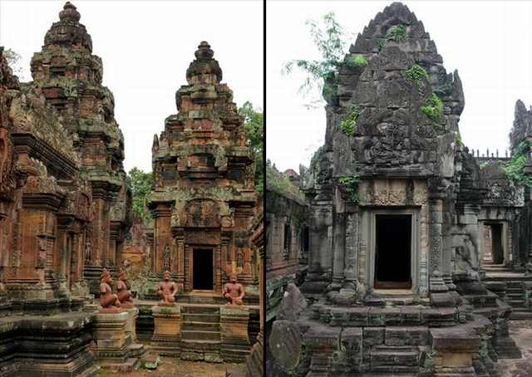
Banteay Srei was a temple built in the 10th century that was dedicated to the Hindu god Shiva. It is the only major temple built at Angkor that was not built by a monarch, but rather a courtier is accredited with the construction.

Slide 24
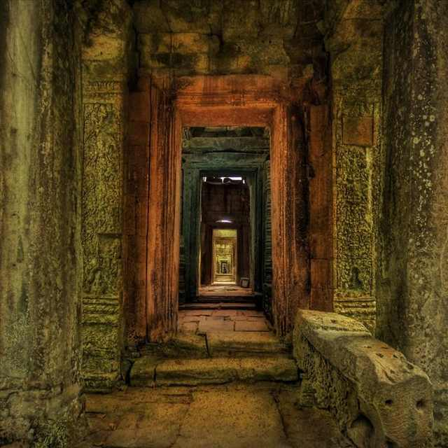
A secret passageway in one of the side temples.

Slide 25
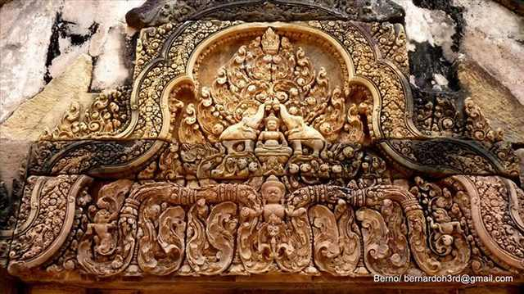

Slide 26
Refers to previous slide
The Banteay Srey temple dedicated to Shiva is so popular with tourists because it has been called 'the jewel of Khmer art', due to the untypically small size of the buildings.

Slide 27
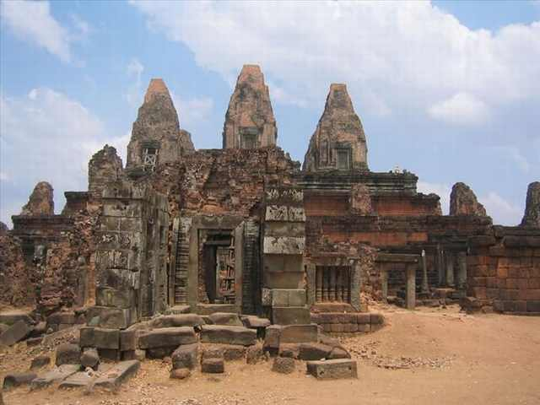
Pre Rup was originally built as the state temple of Khmer king Rajendravarman. It was dedicated in 961 or 962 and was built entirely of brick, laterite and sandstone.

Slide 28
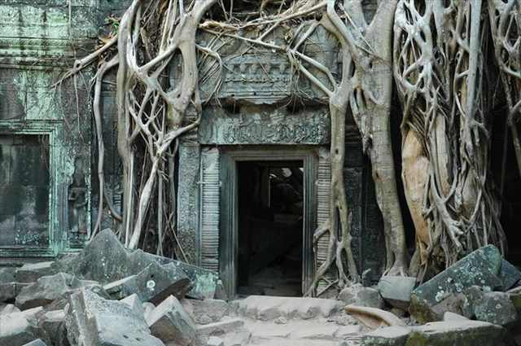
The famous empty doorway of Ta Prohm.

Slide 29
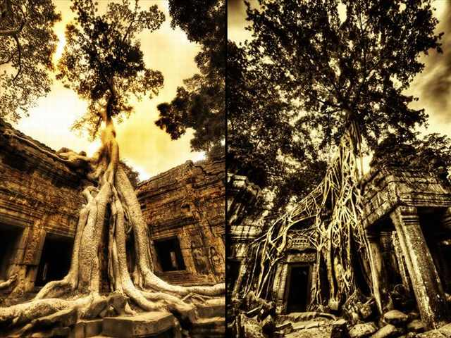

Slide 30
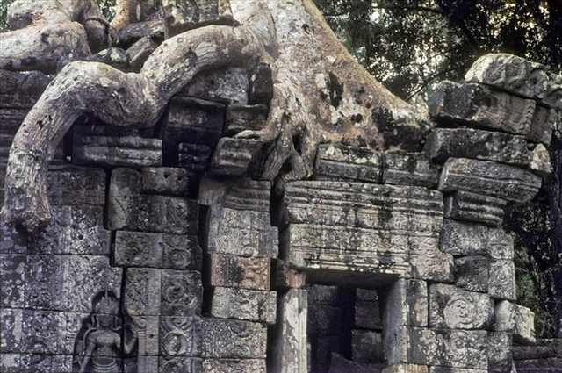
A photo of Angkor Wat taken in 1965 whence time was already taking its toll.

Slide 31
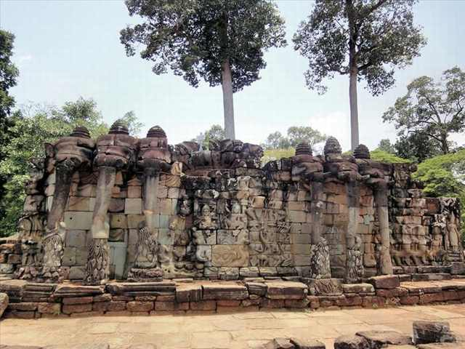
The Angkor Thom terrace of the Elephants named for the 350 meter long (1,148 ft) carvings of elephants on its face.

Slide 32
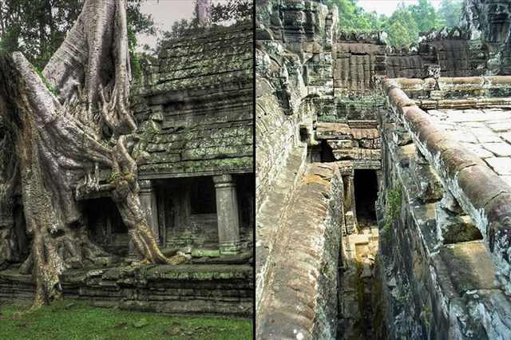

Slide 33
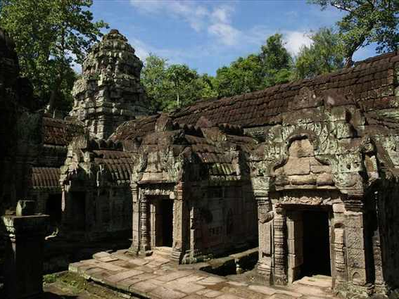
Preah Kham temple ruins, built by king Jayavarman the VII in the late 12th century and dedicated to his father Dharanindravarman II.

Slide 34
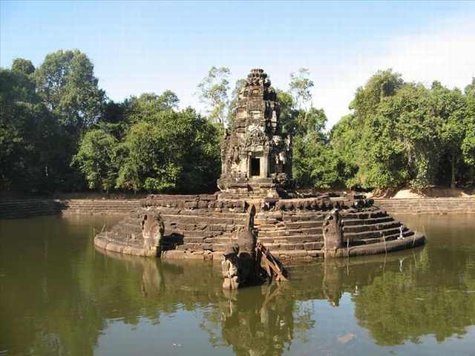
Neak Pean Temple is an artificial island with a Buddhist temple at its center. There are snakes or Naga that cover the bottom of the temple structure.

Slide 35
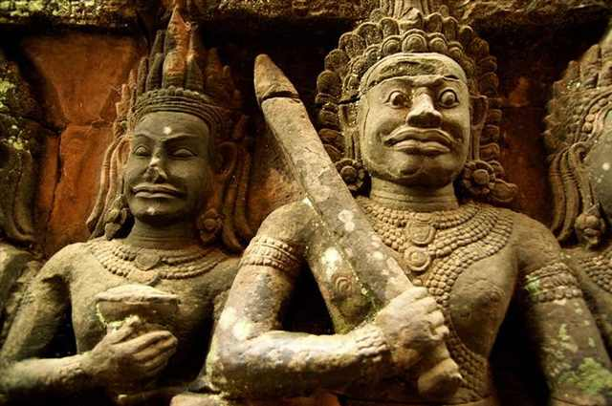
Terrace view of the Leper King in Angkor Thom.

Slide 36
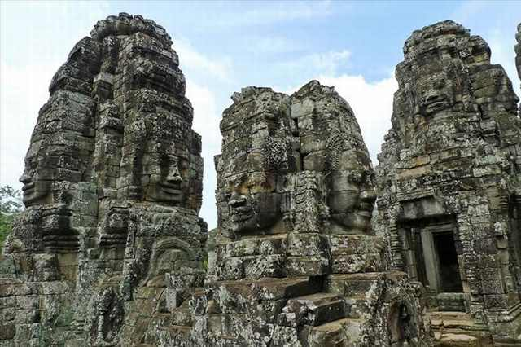
The stone faces of Bayonne.

Slide 37
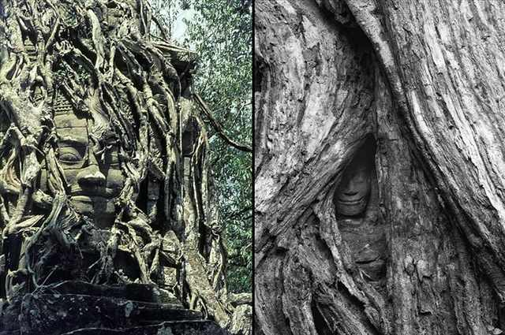
Buddha covered and embraced by the roots of nature.

Slide 38
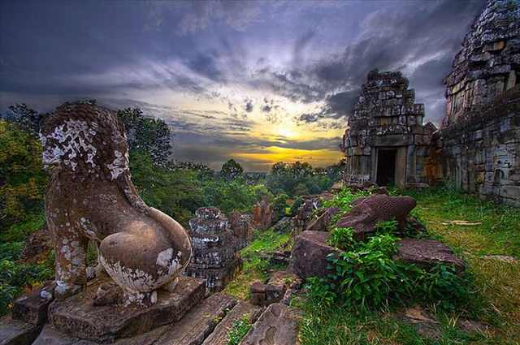
Phnom Bakheng.

Slide 39
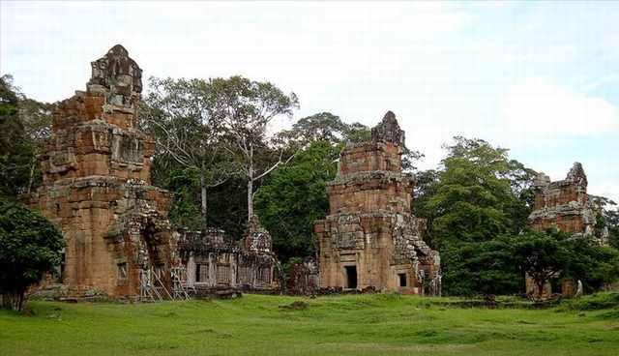
Prasat Suor Prat is a series of 12 towers at Angkor Thom.

Slide 40
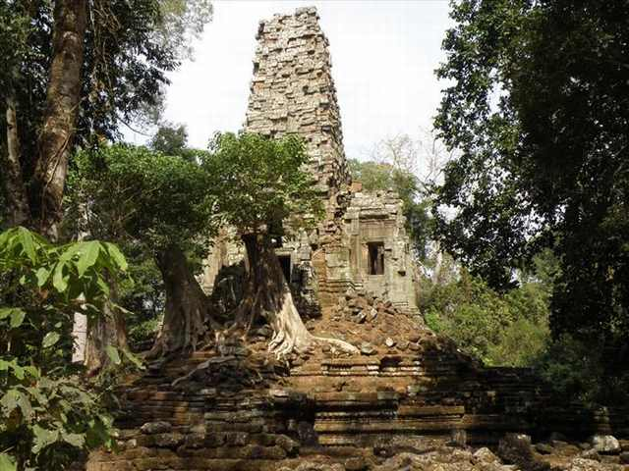
Prasat Preah Palilay. New research suggests that this entrance to a grid of canals was built as a shortcut for the ancient construction workers when building the Angkor Wat temple. This possibly explains how the temple was built in a mere 20 years.

Slide 41
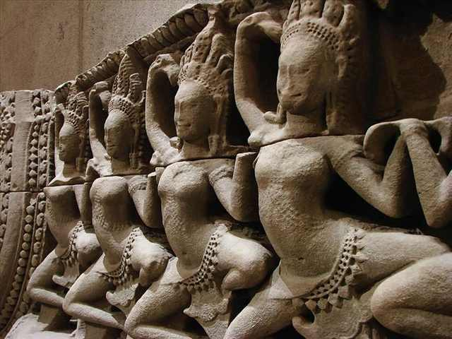
Apsaras from 12th-13th century sandstone.

Slide 42
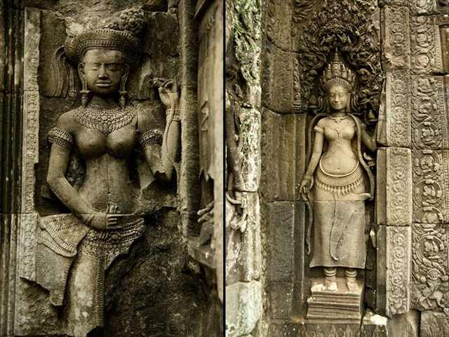
Statues at the Bayon temple.

Slide 43
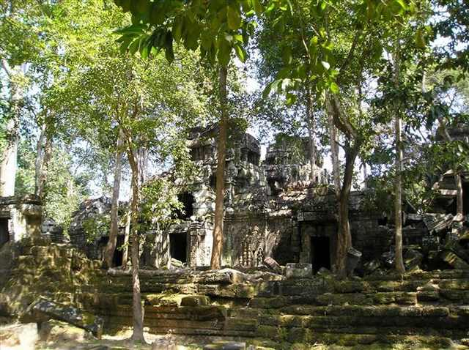

Slide 44
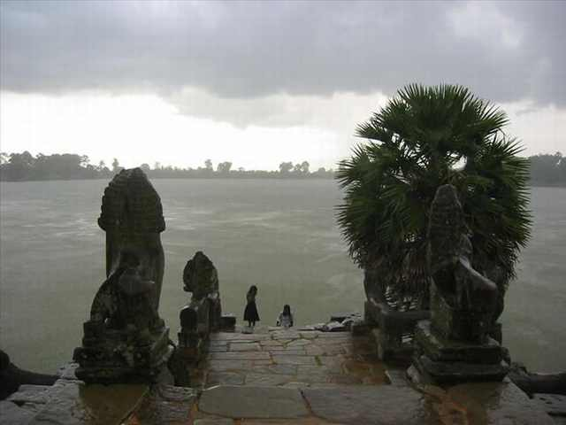
Srah Srang reservoir that was built during the mid-10th century. There are steps that lead down to the water guarded by two lions.

Slide 45
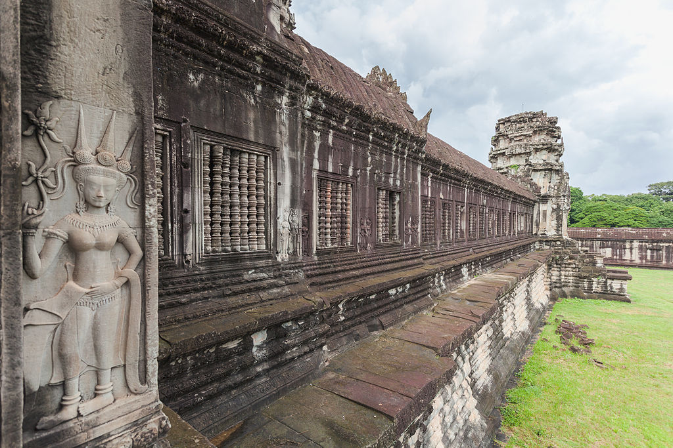

Slide 46
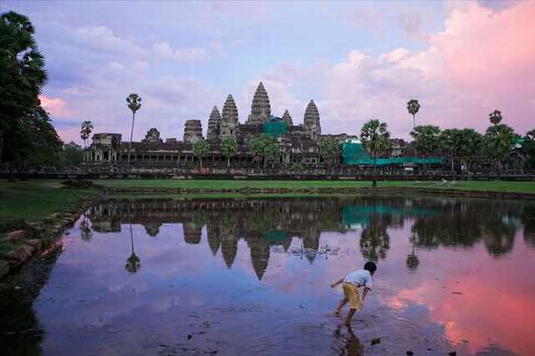

Slide 47
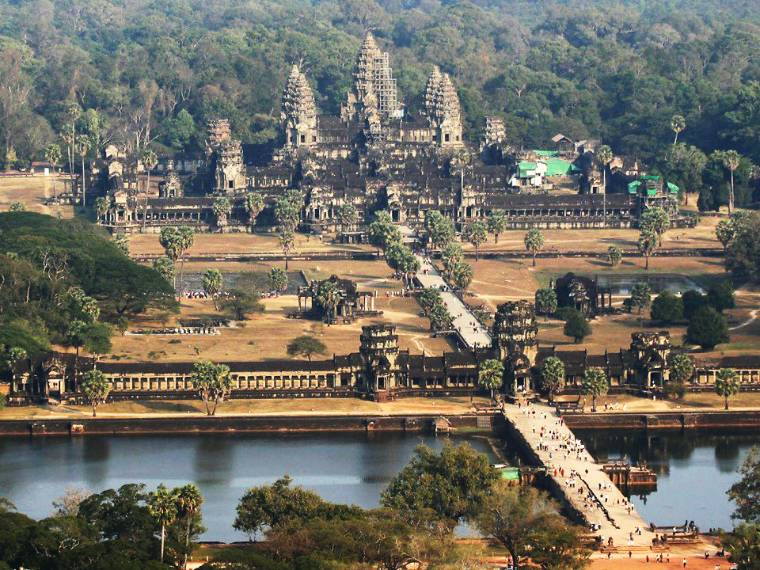

Slide 48
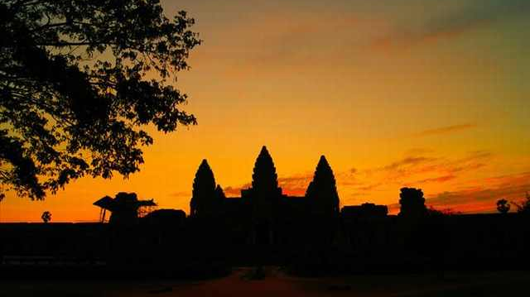
Sunset at Angkor Wat.

