Slide 1
Taboo Rituals Still Performed Today

Slide 2
What one may view as strange, may be very meaningful in another culture.
While some rituals can involve something as simple as a silent, individual prayer, others—especially those involving a larger group—can be extremely painful and violent. Here are some of the most unusual rituals from all over the world. Never ridicule rituals or beliefs from other cultures – keep in mind that some of our rituals and/or beliefs may seem just as strange or unusual to people from other cultures.

Slide 3
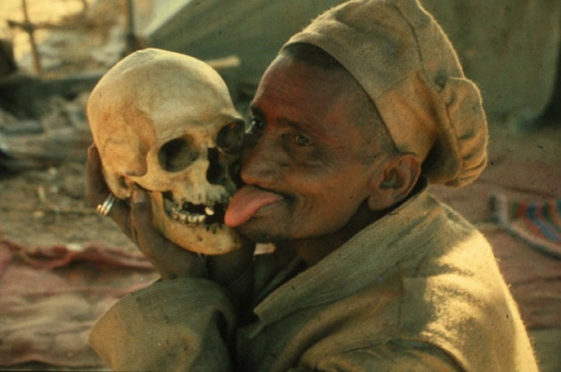
Cannibalism and Necrophagy

Slide 4
The Aghori Babas, who live in the city of Varanasi, India, are famous for eating the dead. They believe that the greatest fear human beings have is the fear of their own deaths, and that this fear is a barrier to spiritual enlightenment. So by confronting it, one can achieve enlightenment.There are five types of people who cannot be cremated according to Hinduism: holy men, children, pregnant or unmarried women, and people who have died of leprosy or snake bites. These people are set afloat down the Ganges, where the Aghori pull them from the water and ritually consume them.

Slide 5
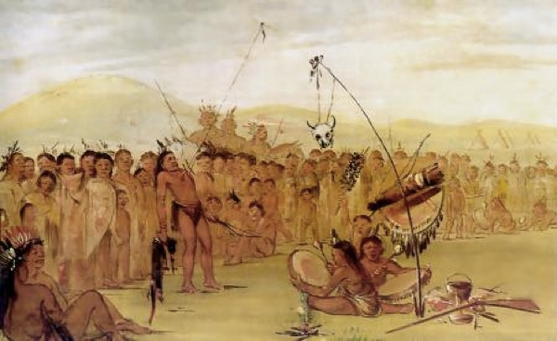
The Sun Dance

Slide 6
Native Americans are known to perform numerous rituals in honor of the Earth’s spirits. The rituals are a means of praying to the Great Spirit, and sacrificing oneself while retaining a direct contact with the Tree of Life. The skin on the chest of the participants is pierced with a skewer, and a rope connects the skewer to a pole which represents the Tree of Life. The participants then move back and forth to try and break free from the skewer—which, it bears repeating, is still lodged in their skin. This dance may take several hours before it is completed.

Slide 7
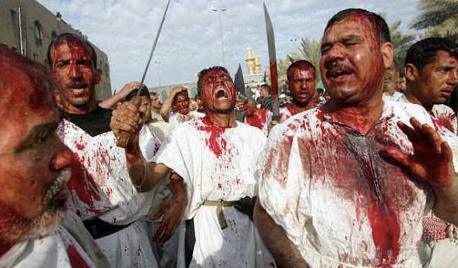
Self-Flagellation

Slide 8
Followers of the Shi’a sect of Islam carry out the ritual of mass self-flagellation every year during the Holy month of Muharram, in order to commemorate the martyrdom of Hussein, the grandson of Prophet Muhammad. In what can only be described as a gruesome display, the men whip their bodies with blades attached to chains. In their state of religious trance, they apparently do not feel the pain. In the Middle Ages, some Christian monks whipped themselves to assume some of the sufferings of Jesus. In the 20th century Pope John Paul II is said to have practiced this and some members of Opus Dei (a group on the conservative fringes of Catholicism).

Slide 9
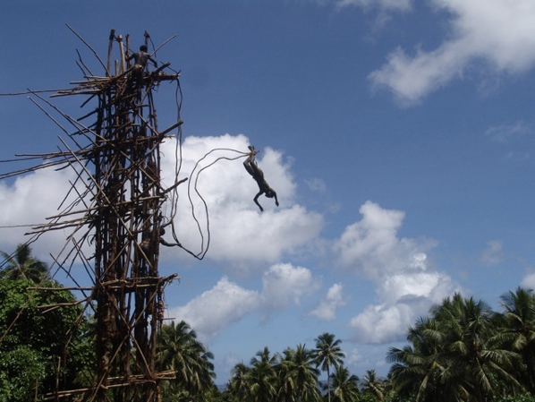
Vine Jumping

Slide 10
In the village of Bunlap, which lies on an island in the Pacific archipelago, a strange ritual is performed called Gkol, or land-diving—a kind of precursor to bungee jumping. The villagers sing and dance together, and some of them beat drums as men come forward to volunteer for the jump. They tie vines around their ankles, and jump from very high wooden towers constructed especially for this ritual.The participants, apparently heedless of the potential for broken bones, simply leap forward head-first. The fall is broken by the vines tied to the tower. It is said that a higher jump guarantees you a greater the blessing from the gods

Slide 11
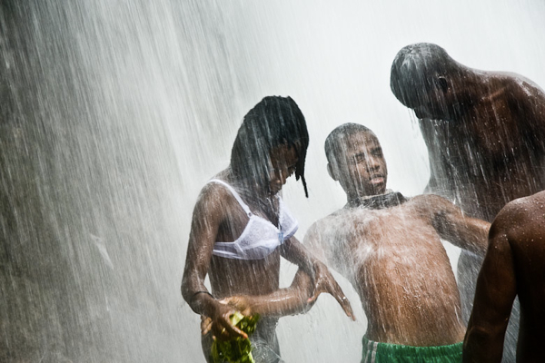
Voodoo and Spiritual Possession

Slide 12
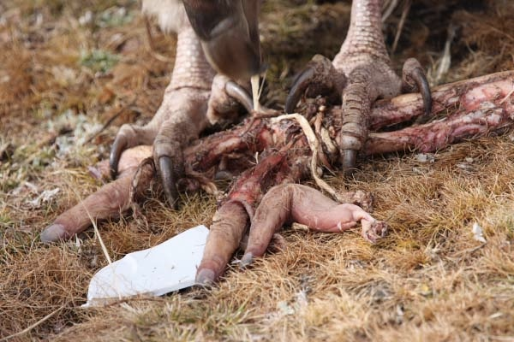
Sky Burials

Slide 13
In Tibet, Buddhists practice a strange sacred ritual called Jhator, or sky burial. Buddhists believe in a cycle of rebirth, which means that there is no need to preserve a body after death, since the soul has moved on to another realm. The bodies of the dead are therefore taken to open grounds—usually at very high altitudes—and then left as alms for scavengers such as vultures. In order to dispose of the body as quickly as possible, a specialist cuts the corpse into pieces, and spreads it around to be devoured.

Slide 14
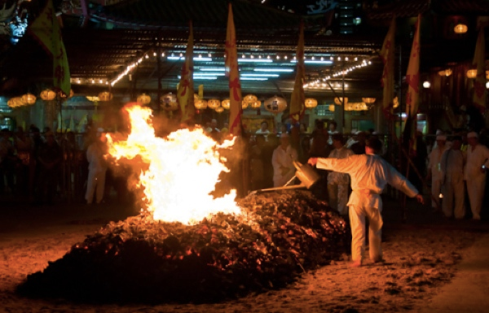
Fire Walking

Slide 15
The Nine Emperor Gods Festival is a Taoist celebration carried out in Penang, Malaysia. One of the purification rituals involves walking barefoot on burning embers. Fire is believed to overcome impurity and repel evil influences—so walking over the fire signifies a man’s strength, and his resolve to free himself from evil. Hundreds of devotees walk over the fire, sometimes carrying deities across in a brave display.

Slide 16
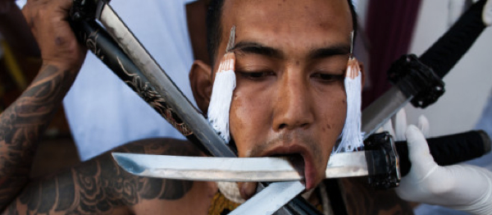
Impaling

Slide 17
The annual Vegetarian Festival in Phuket, Thailand, is host to a most extreme ritual. This intensely masochistic event requires the participants to push spears, knives, swords, hooks, and even guns through their cheeks. It is believed that gods enter their bodies during the ritual, protecting them from evil and bringing good luck to the community.

Slide 18
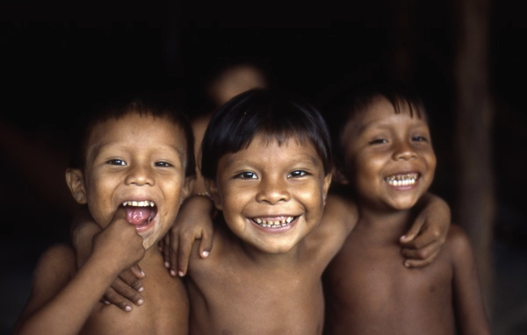
Death Rites

Slide 19
The Amazonian tribe of Yanomami is one of the most primitive in the world. In their view, death is not a natural phenomenon. The corpse is cremated, and the resulting ashes mixed with fermented banana. This mixture is then consumed by the tribespeople, as a way of making sure that the spirit of the deceased member continues to live among them.

Slide 20
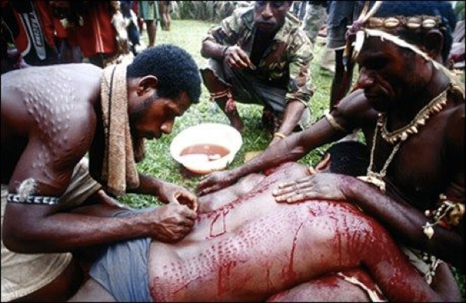
Scarification

Slide 21
A tribe in Papua New Guinea called Kaningara practices a bloody body-modification ritual that is intended to strengthen the spiritual connection between them and their environment.One of these ritual ceremonies is carried out in Haus Tambaran, or “The Spirit House.” The adolescents live in seclusion in Haus Tambaran for two months. After this period of isolation, they prepare for an initiation ceremony which recognizes their transition to manhood. An expert cutter marks their bodies with sharp pieces of bamboo. The resulting patterns resemble the skin of a crocodile; this is based on the notion that crocodiles are the creators of humans. The marks symbolize the tooth marks left by the spirit of the crocodile as it ate the young boy’s body and expelled him as a grown man.

Slide 22
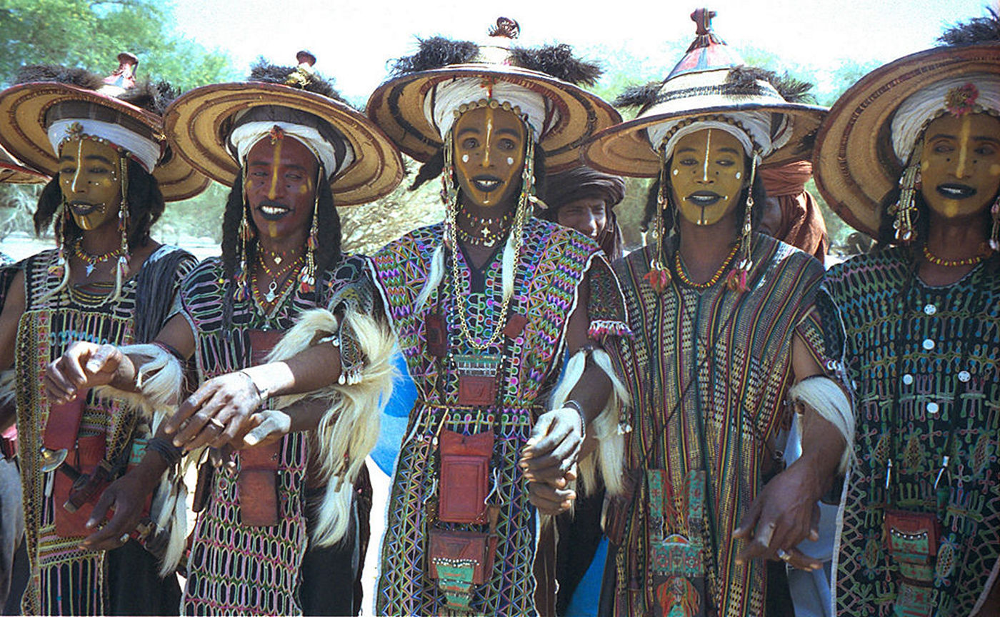
Men’s Beauty Pageant

Slide 23
In the African tribe of Wodaabe, it is the men who dress to impress. Men of this tribe value beauty, and often spend most of their days grooming and adorning themselves, in order to appear attractive to the women. The preening takes on epic proportions, especially during their annual courtship festival, called “Gerewol.” In this week-long festival, the men dress up and enter a dancing competition called the “Yaake.” The competitors form a single line and dance away, while being watched by a mostly-female audience. The judging panel usually consists of three women, who choose the winners based on their dancing skills and overall good looks. While it’s mostly fun and games for the women, the festival is no cakewalk for the men involved—the dance itself takes place in the sweltering heat, for several hours a day.

Slide 24
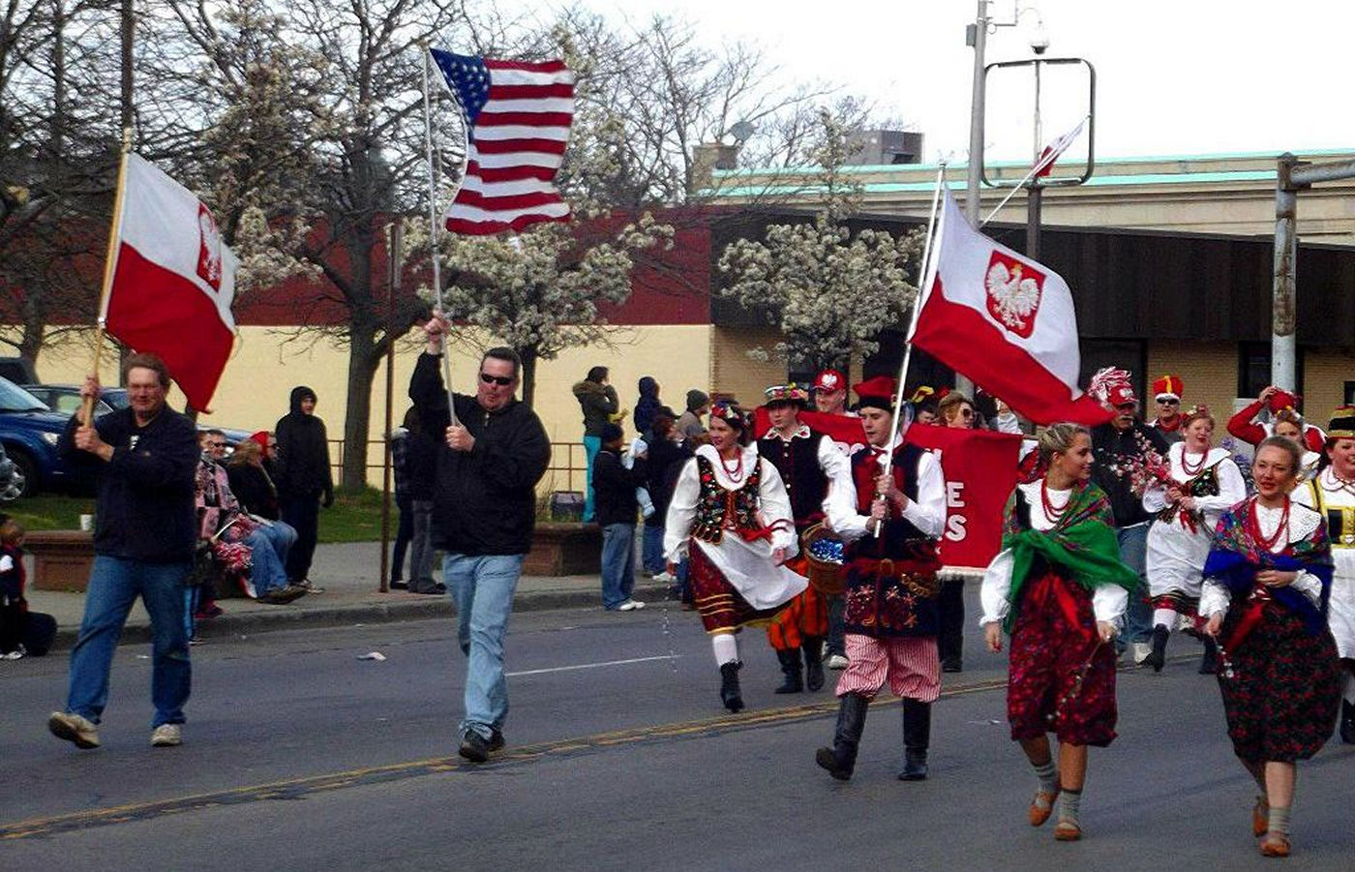
Dyngus Day

Slide 25
In this post-Lent festival, boys and girls douse those they liked with water or perfume. Aside from that, the boys also gently whip the girls they fancy with pussy willows. Roots of this Slavic festival can be traced back to pre-Christian times, where the dousing and whipping signified cleansing and renewal. Later on, the dousing came to be associated with the baptism of the first Christian leader of Poland, Mieszko I. Nowadays, Dyngus Day is celebrated in countries around the world with a large Polish population.

Slide 26
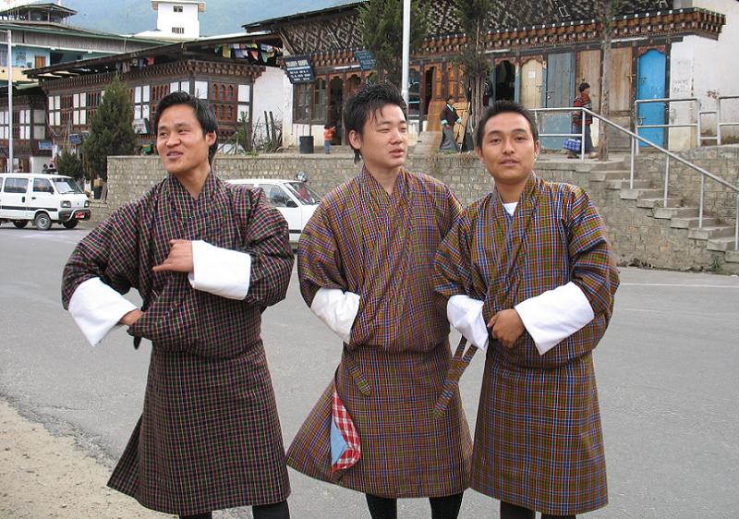
Bhutan’s Love Burglars

Slide 27
It’s late, the clubs have closed, and gangs of young men are out prowling the streets unsupervised. Passing a likely looking window, the gang pressures one of its own to climb up and break in, but be quiet about it; otherwise, you’ll wake the girl inside.In virtually any country on Earth, the above passage would be the opening words of the district attorney’s address to the jury in a rape trial. In Bhutan, it might be the best man’s toast at your wedding. Such is the case with Bomena, the traditional Bhutanese courtship ritual.

