Slide 1
Some Traditional Wedding Outfits Around The World

Slide 2
In western cultures, brides traditionally wear a white dress on their wedding day. Look beyond the west however and you'll find a wide variety of wedding attire according to different countries and cultures. Some brides adorn themselves in colorful garments, others paint their hands and faces in accordance with local traditions, and some hide their faces completely behind layers of jewelry or veils. Not everybody upholds these traditions of course, and many people wear what they want for their Big Day, but this list compiled by Bored Panda provides an interesting insight into the different ways that different people can celebrate the same occasion.

Slide 3
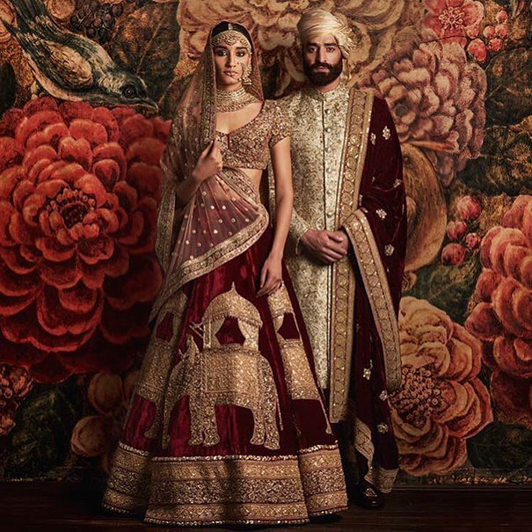
Indian Wedding
In Indian culture, pink or red wedding dresses are often the garment of choice for brides. Married woman in the north of the country can often be identified by a red dot in the middle of their forehead.

Slide 4
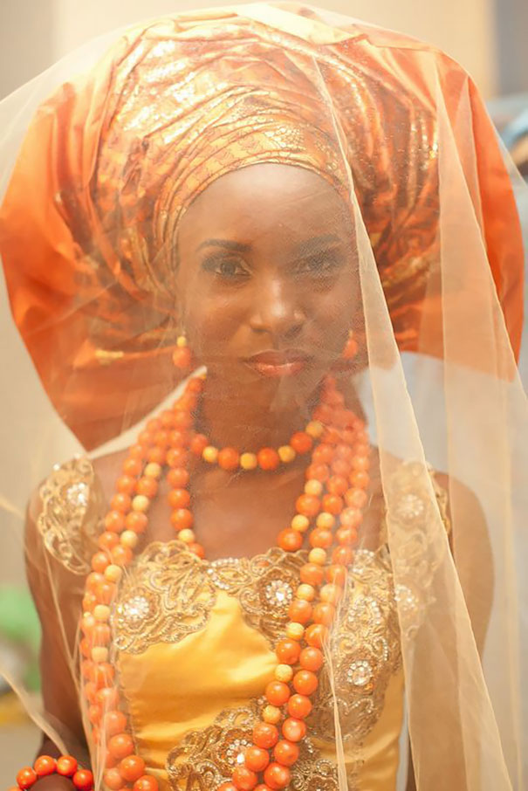
Nigerian Wedding
Nigeria is a big country with around 250 ethnic groups and over 500 languages. Wedding ceremonies therefore change according to region, religion and ethnic background. However, Nigerian brides often wear brightly colored wedding clothes. They also often wear a Nigerian head tie called a Gele.

Slide 5
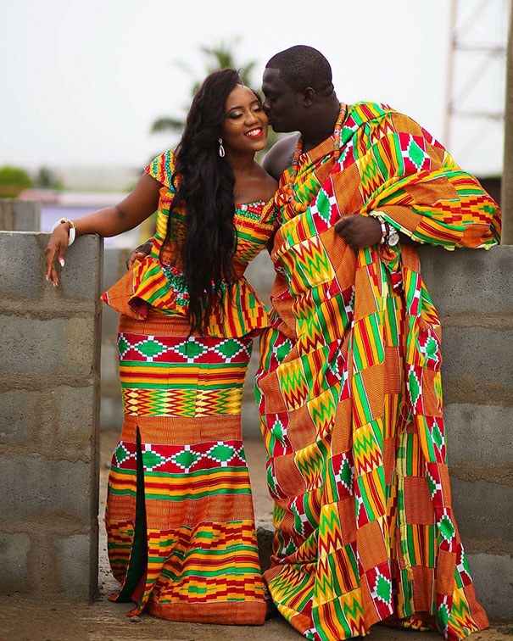
Ghanaian Wedding
Traditional weddings in Ghana are often very colorful, and each family has its own cloth pattern that features on the bride and groom's wedding outfits.

Slide 6
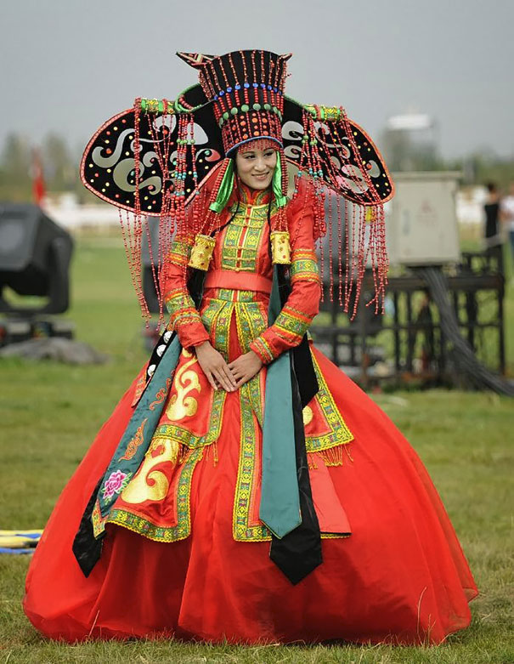
Mongolian Wedding
In a traditional Mongolian wedding ceremony, the bride and the groom each wear what's known as a Deel. A Deel is a form of patterned clothing that's been worn for centuries by Mongols and other nomadic tribes in Central Asia.

Slide 7
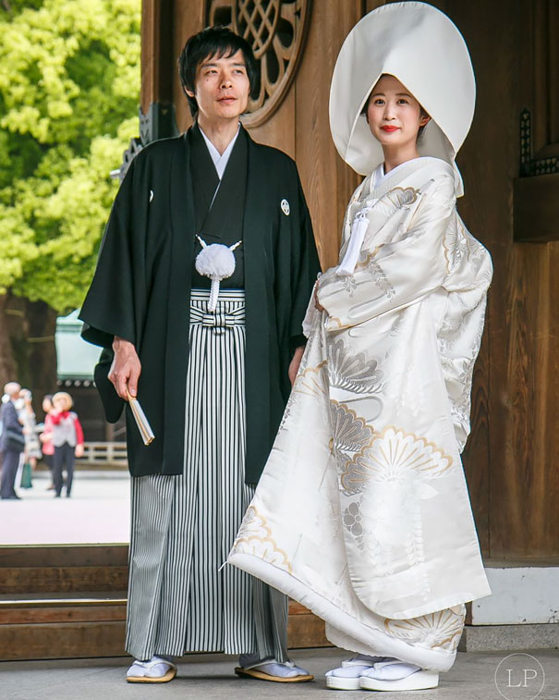
Japanese Wedding
For a traditional Japanese wedding, the bride often wears a pure white kimono for the formal ceremony, which symbolizes purity and maidenhood. After the ceremony the bride may then change into a red kimono to symbolize good luck.

Slide 8
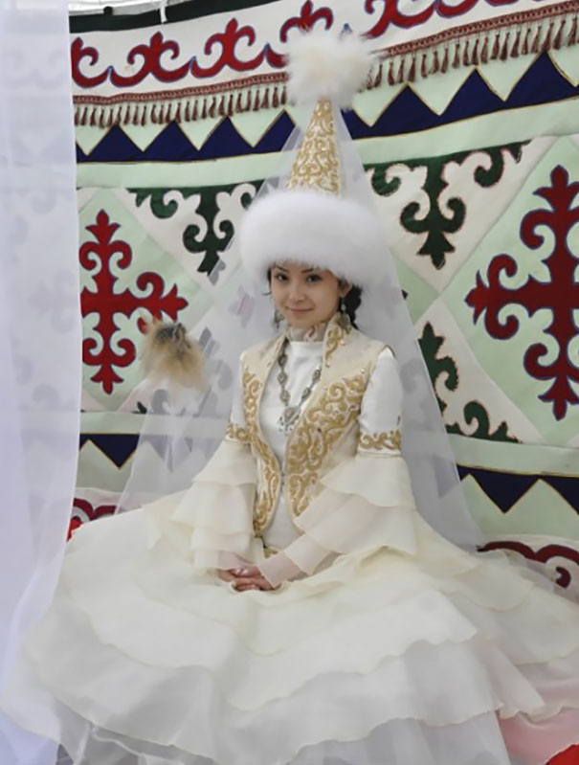
Kazakh Wedding
In a traditional Kazakh wedding, brides typically wear a headdress known as a "Saukele" as well as a facial veil. The Saukele is usually prepared long before the girls reach the age of marriage.

Slide 9
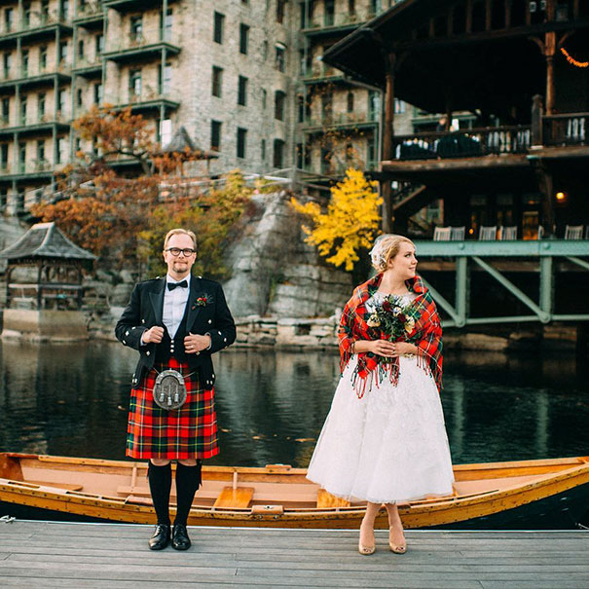
Scottish Wedding
Men in Scotland traditionally wear the kilt of his clan for his wedding. After the ceremony, the bride wears a shawl emblazoned with her new husband's clan colors to signify her transition into his family.

Slide 10
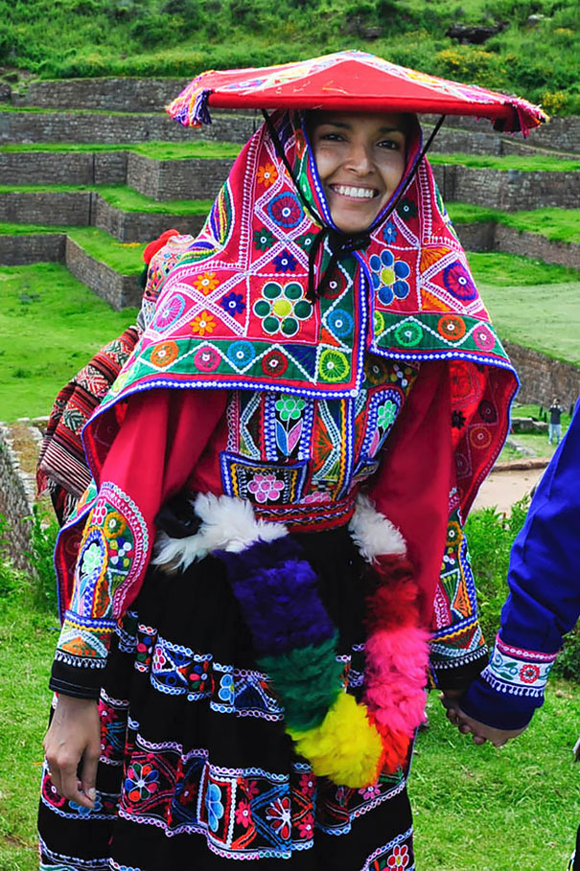
Peruvian Wedding
Traditional Andean wedding outfits are often bright and include woven cloaks and hats adorned with tassels and reflective material. A special skirt and poncho is made for the bride and groom's wedding day.

Slide 11
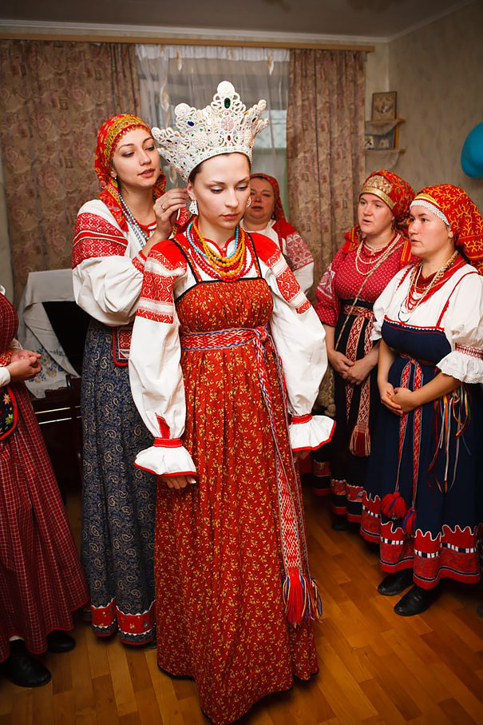
Wedding In Veliky Novgorod, Russia
Russia has over 185 different ethnic groups, and many of these have their own separate wedding traditions. However, many Russian weddings last for at least two days and some go on for as long as a week.

Slide 12
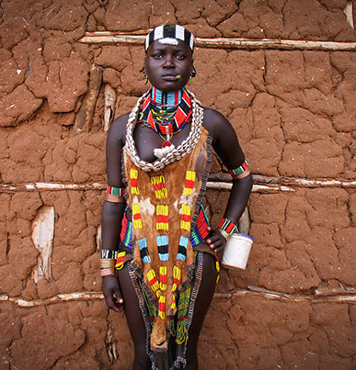
Hamar Wedding in Ethiopia
The Hamar people come from Ethiopia. Unmarried women wear large collars made of red, green, and black coloured beads, and married women wear two distinct metals collars. First wives also wear a leather band with a large visible disk attached.

Slide 13
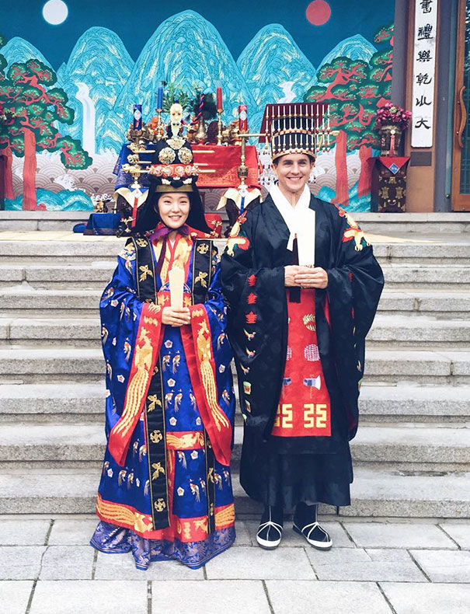
Korean Royal Wedding
The Korean national costume is called the Hanbok, and a variation of this can be worn at traditional weddings. According to ancient tradition in, the groom should carry his wife around the table on his back. This is so the bride knows that her husband is reliable.

Slide 14
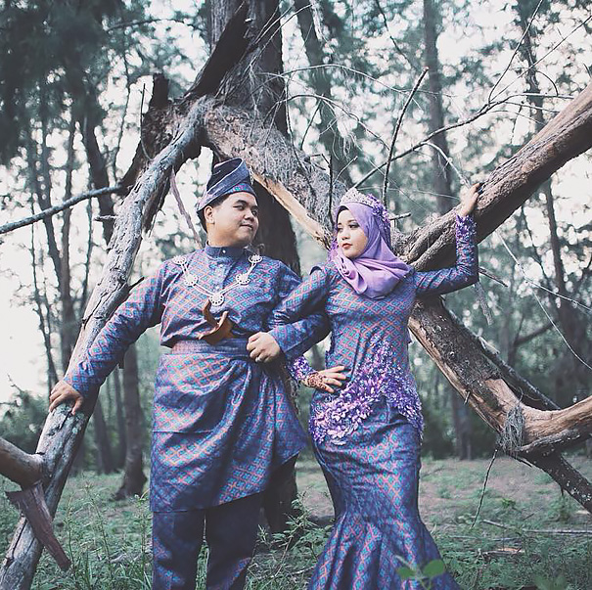
Malay Wedding
Most weddings in Malaysia are held according to the Muslim tradition. Brides often wear wedding dresses that include colors such as purple, violet, and cream.

Slide 15
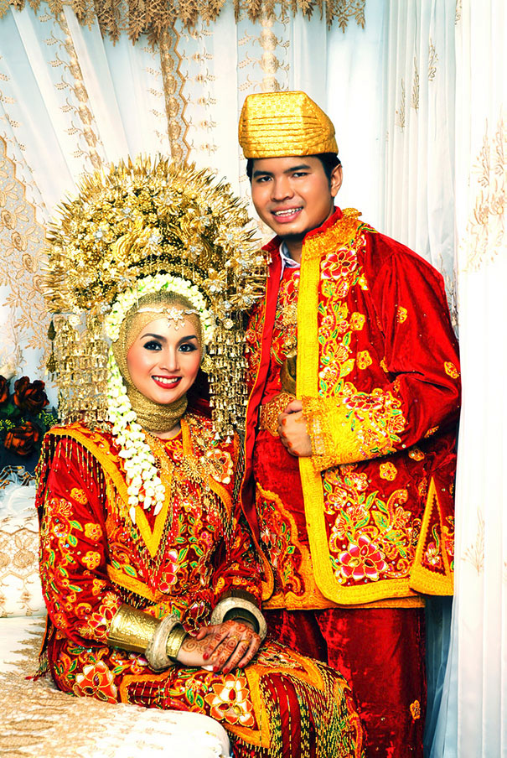
Indonesian Wedding
Indonesia has over 17,000 islands and so weddings here vary greatly depending on where people live and which of the 300+ ethnic groups they belong to.

Slide 16
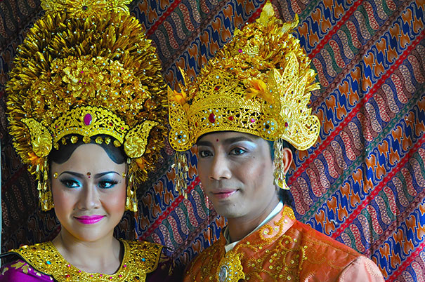
Balinese Wedding, Indonesia
Traditional Balinese wedding clothes are often vivid and richly decorated. The bride and the groom often wear crowns of gold on their heads during the ceremony.

Slide 17
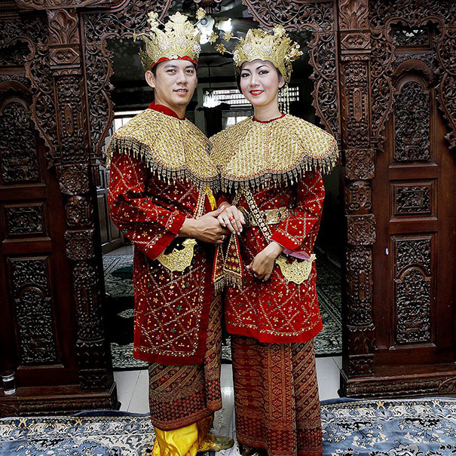
Weddings In Jakarta, Indonesia
As in other parts of Indonesia, traditional wedding attire in Jakarta includes plenty of gold, intricate patterns, striking colors and ornate head wear.

Slide 18
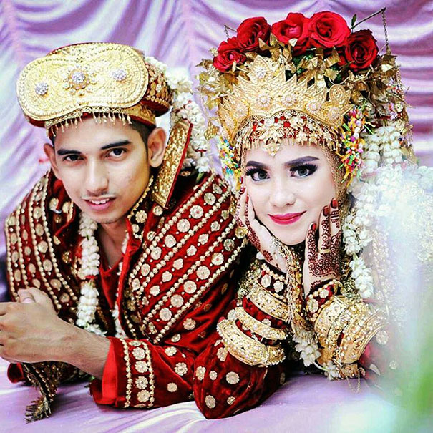
Palembang Wedding, Indonesia
Palembang is the second-largest city on Sumatra island in Indonesia. In traditional weddings brides wear what's called an Aesan Gede, which is a rich and striking costume that evokes the grandeur of the Srivijaya empire.

Slide 19
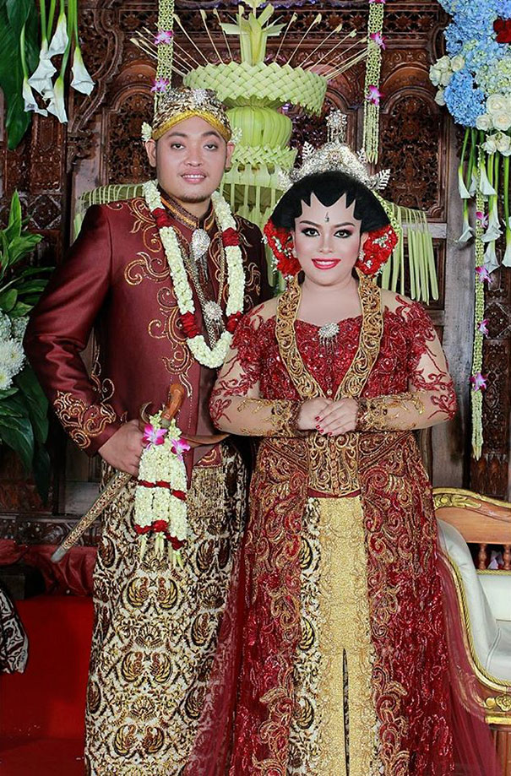
Javanese Wedding
Traditional Javanese wedding outfits generally include a sarong, a high-collared shirt, a jacket and a blangkon (a traditional Javanese headdress) for the groom, and a sarong, a kebaya (long-sleeved blouse), and a selendang for the bride. The woman's hair is often put in a flat bun called a Sanggul.

Slide 20
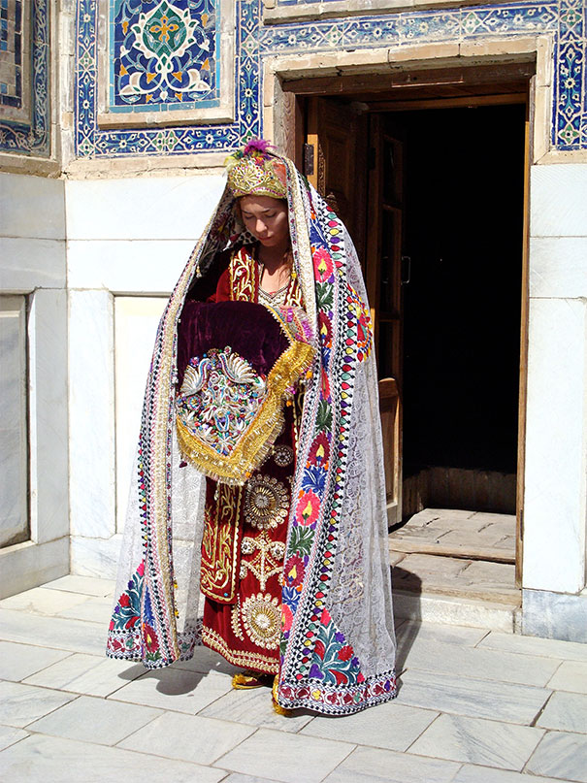
Uzbek Wedding
In traditional Uzbek weddings (Nikokh-Tui), the bride wears a colorful outfit hand embroidered with intricate patterns. The wedding ceremony plays an essential role in Uzbek life.

Slide 21
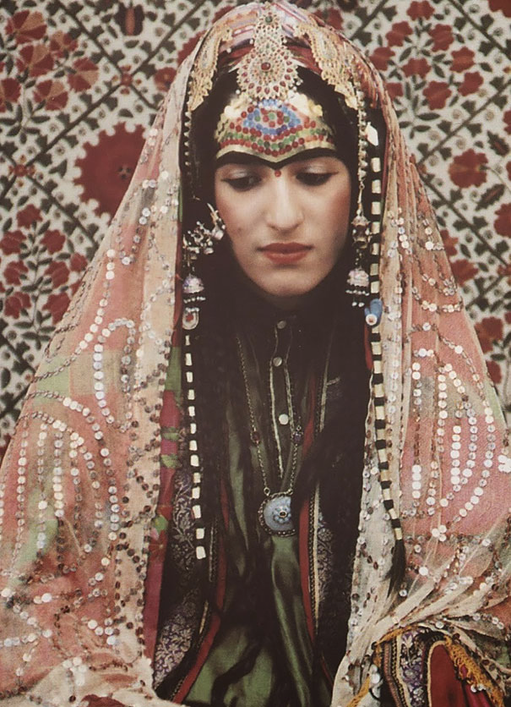
Afghani Jewish Bride
Jews are believed to have resided in Afghanistan for nearly 1,500 years. Now however there is only one Jew remaining in the country (Zablon Simintov, who was born in Herat in 1959). Traditional wedding ceremonies saw the brides covered with a veil and garments, and she also wore henna on her hands and feet and sequins on her forehead.

Slide 22
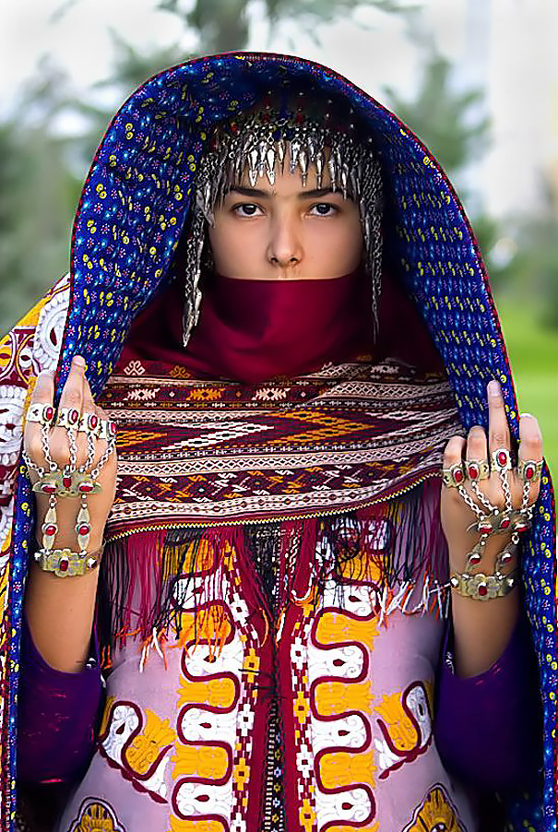
Turkmen Bride
In Turkmenistan, the traditional wedding ceremony sees the bride dressed up in a red dress made from silk homemade fabric studded with silver or gilded pendants.

Slide 23
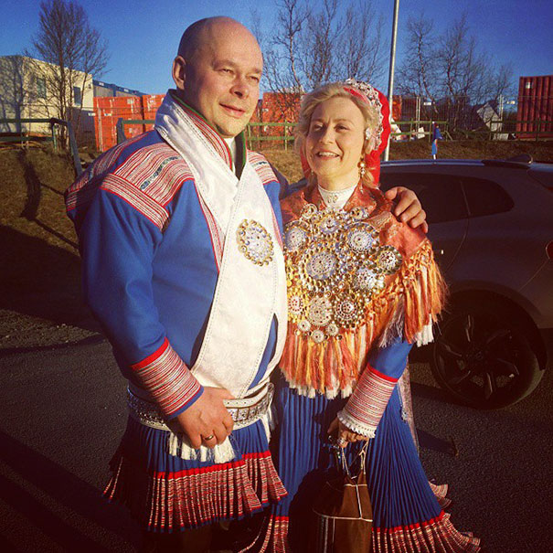
Sami Wedding
The Sami are the indigenous people living in the far north of Europe. The area is called Sápmi and it stretches across parts of Norway, Sweden, Finland and the Kola Peninsula. Their traditional dresses explain a lot about the wearer. For example, single people wear belts with circular buttons, while square buttons mean a person is married.

Slide 24
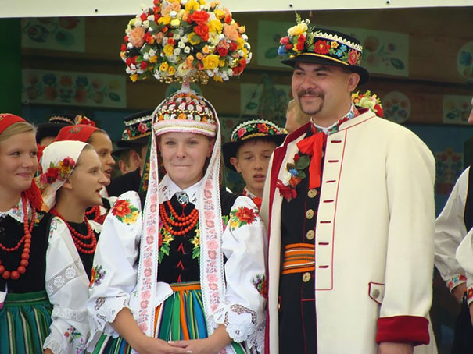
Polish Wedding From The Lowicz Area
A Polish bride will traditionally wear a white dress and a full veil (welon). The groom will often wear a buttonhole flower to match his bride's bouquet. If you notice a bride subtly moving a part of her wedding dress to cover the top of the groom's shoe, she may be following a traditional belief that this will give her a position of dominance in the relationship.

Slide 25
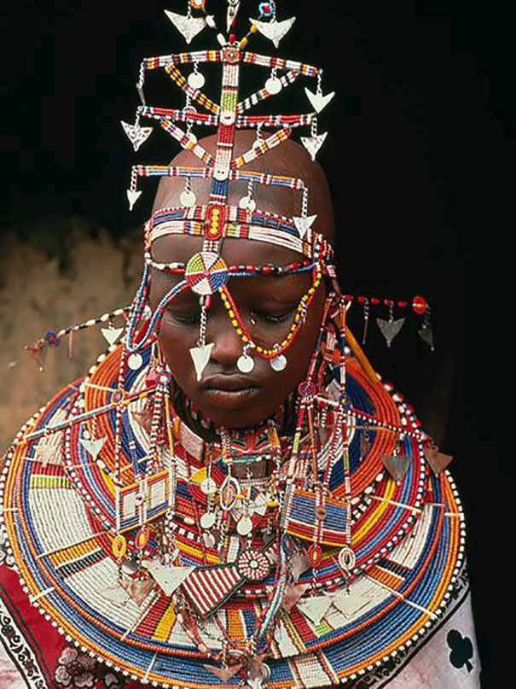
Maasai Wedding In Kenya
In a Maasai wedding, the bride is required to wear a bold and colorful necklace made of beads and shells. On the night of the wedding, a party called the "kupamba" takes place. During this party, the bride is allowed to take off her veil and show her hairstyle and jewels.

Slide 26
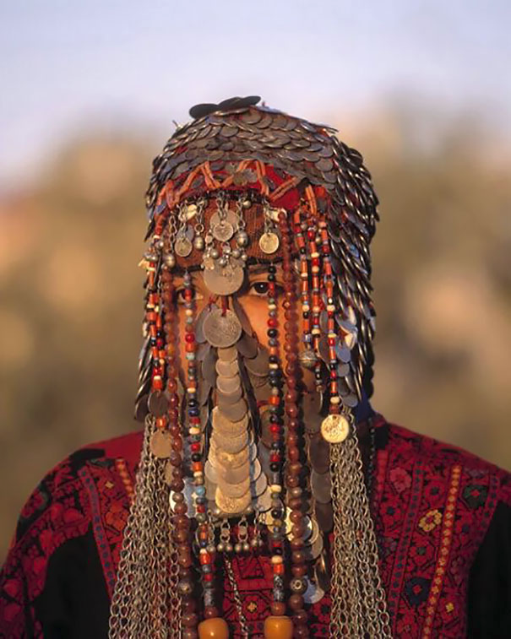
Bedouin Wedding Veil In Israel
In traditional Bedouin wedding ceremonies, Bedouin brides often wear a heavy and ornate face veil comprised of various jewelry.

Slide 27
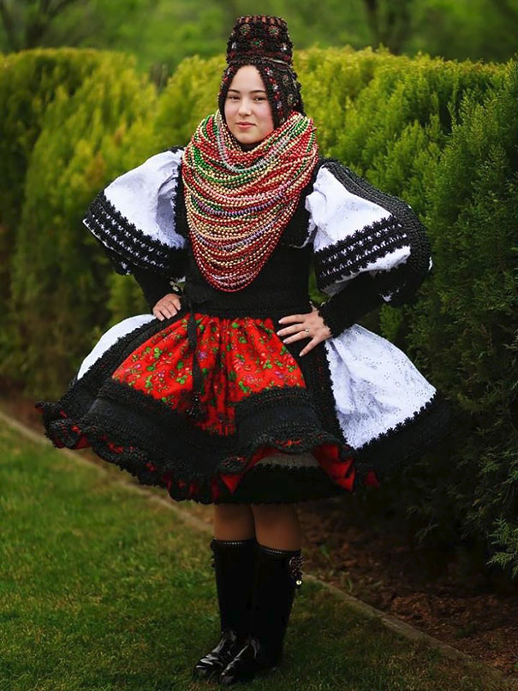
Romanian Bride From Oas Region
Weddings in Oas are an important event in the north-west part of Transylvania. The wedding is organized by the parents as well as the bride-and-groom-to-be and various different rituals are involved including the preparation of the dowry and the costumes, choosing the godparents, and preparing the wedding flag.

Slide 28
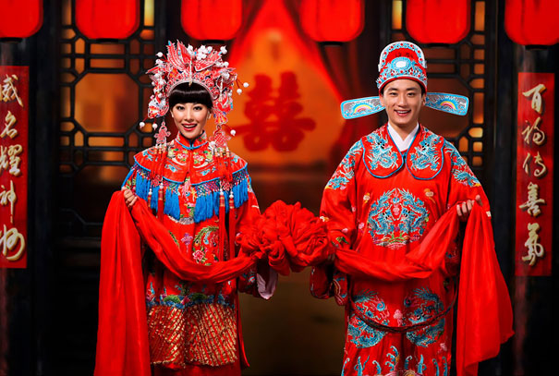
Chinese Wedding
In China the colour red is considered to symbolize good luck. The colour is also believed to keep away evil spirits. It's therefore no surprise that traditional Chinese wedding outfits almost always feature the colour red.

Slide 29
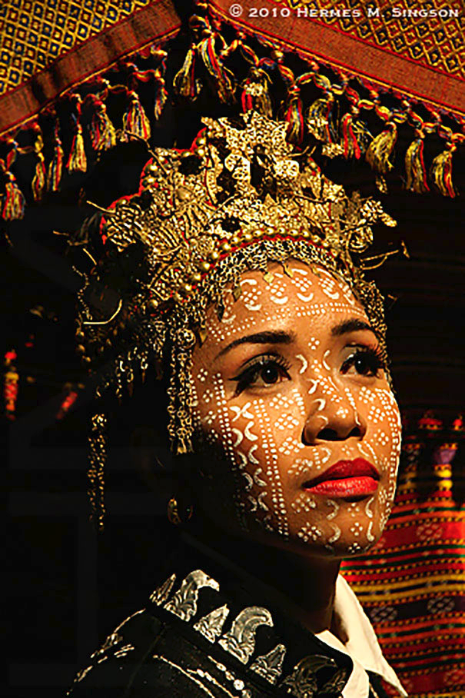
Yakan Bride
The Yakan are an ethno-linguistic group that mostly inhabit the island of Basilan in the Philippines. Traditional weddings usually consist of two ceremonies, an Islamic one and an older, pre-Islamic ritual. The weddings are arranged by the parents and both the bride and groom wear face paint for the ceremony.

Slide 30
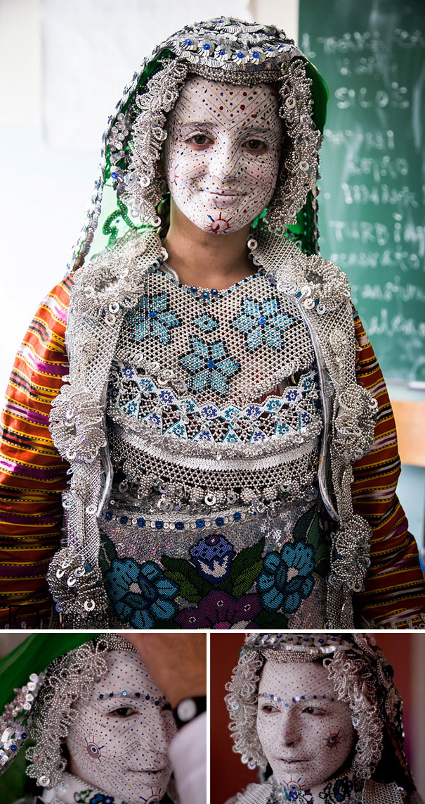
Bride In Gora Region Between Kosovo And Macedonia
The Gorani people are Muslims by faith, but their traditions and customs contain various pagan elements. The bride is carried on a white horse covered with a scarf and a specially decorated umbrella during wedding festivities, and she accompanies her family to the neighbour's house of her husband-to-be.

Slide 31
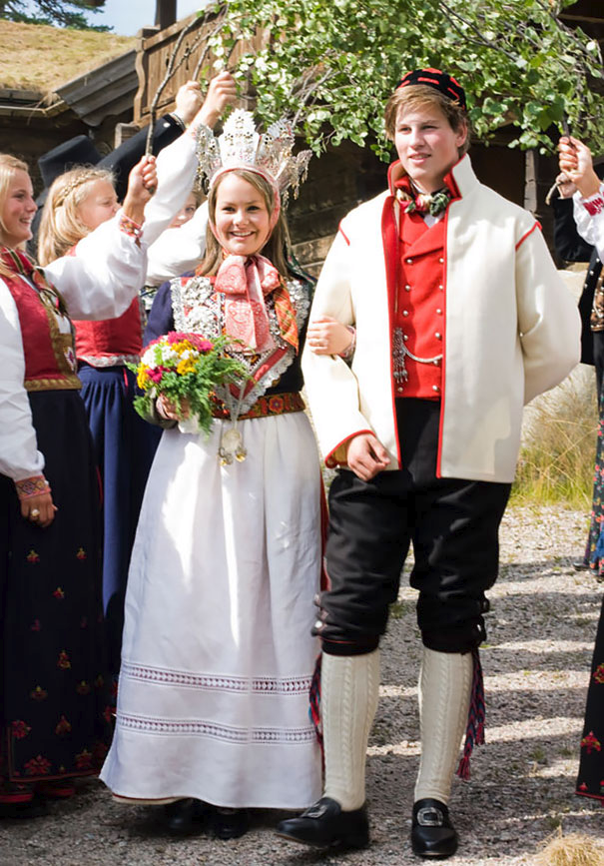
Norwegian Wedding
In Norway, the traditional wedding costume is called a Bunad. It can also be worn for other occasions such as christening parties.

Slide 32
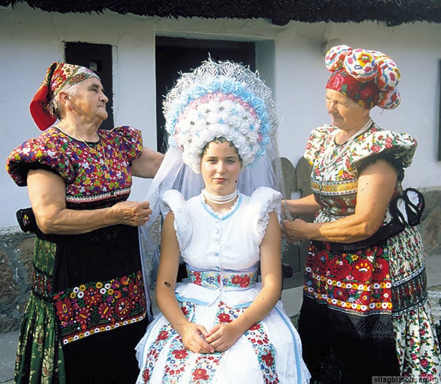
Matyo Bride From Hungary
In traditional Hungarian weddings, a brides attire usually includes an embroidered dress with floral patterns and three bright colors. She often wears many underskirts as well as an elaborate head-dress with wheat woven into it.

Slide 33
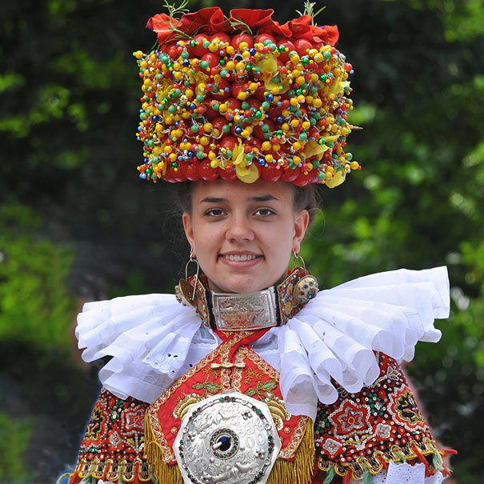
Schaumburg-lippe, Germany Wedding
In Germany, traditional bridal headdresses vary from region to region. In the Black Forest valley, the headdress is large and decorated with hundreds of beads and glass balls, while in Buckenburg the emphasis is more on flowers than beads.

Slide 34
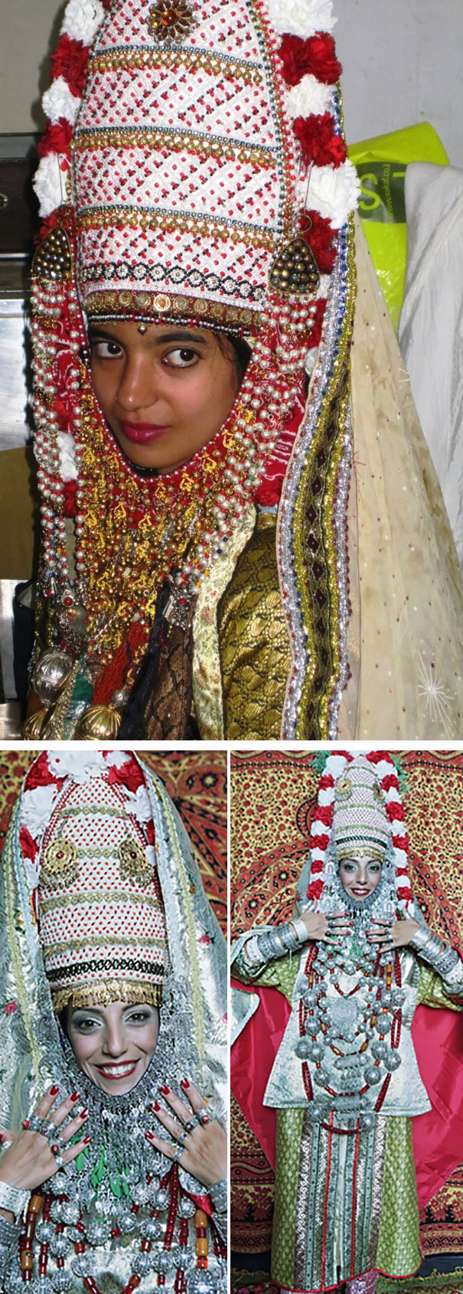
Yemenite Jewish Bride
In a traditional Yemenite Jewish wedding, the bride wears jewelry and an elaborate headdress decorated with flowers and leaves. These are believed to ward off evil. Gold threads are also woven into the fabric of her clothes and wedding celebrations traditionally last seven days.

Slide 35
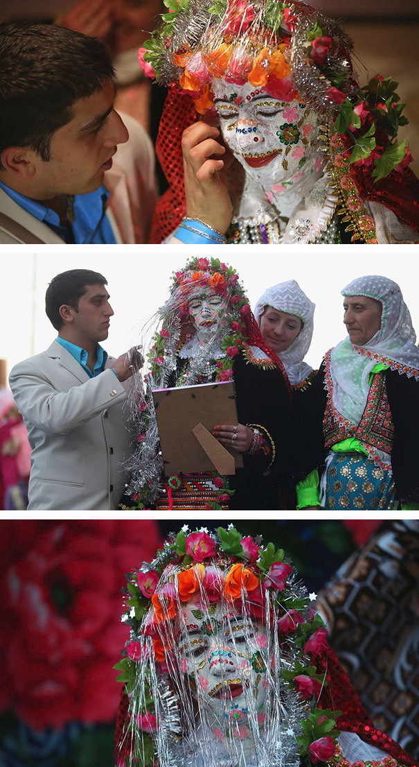
Bride In Ribnovo Region In Southwest Bulgaria
The wedding customs in Bulgaria's Ribnovo region are influenced by Islamic traditions. Festivities last for five days and include lots of singing and dancing. On the second day the bride's face is painted white and adorned with sequins.

Slide 36
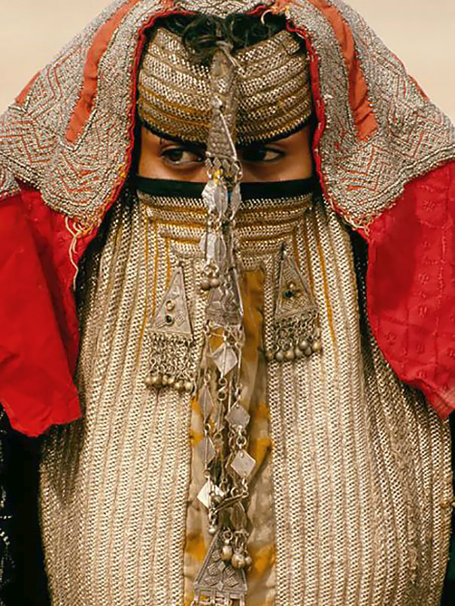
Bride In Eritrea
The Rashaida are a Muslim tribe populating Eritrea and northeast. When a Rashaida woman is to be marriedSudan, she stays in seclusion until her wedding, and the Rashaida only marry their own. A Rashaida bridal veil contains rows of metallic thread embroidery and pearls which are geometrically arranged.

Slide 37
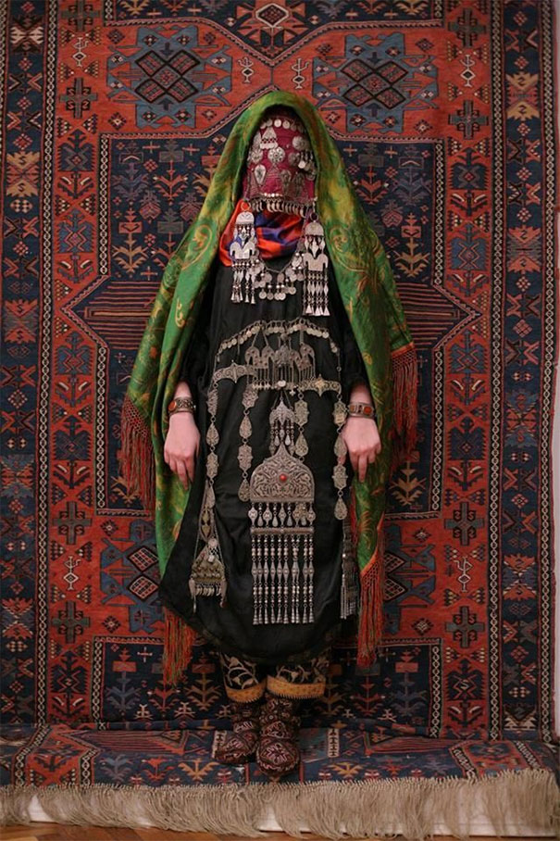
Avar Bride Wearing Traditional Costume
The Avar are a Caucasus native ethnic group living in the Russian republic of Dagestan. Much like their wedding outfits, their traditional wedding ceremonies are also quite elaborate and are generally accompanied by folk dances and music.

Slide 38
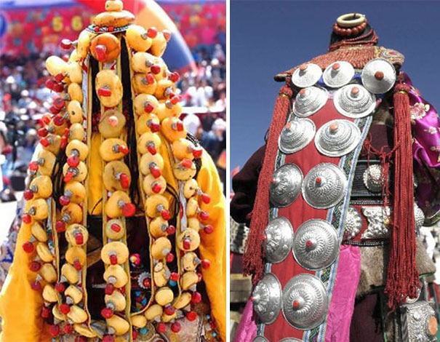
Tibetan Brides
For a traditional Tibetan wedding, the bride wears a white, woollen wedding dress which may be layered with brightly coloured aprons and robes. Often there are so many layers that it can sometimes be difficult to see the bride underneath!

Slide 39
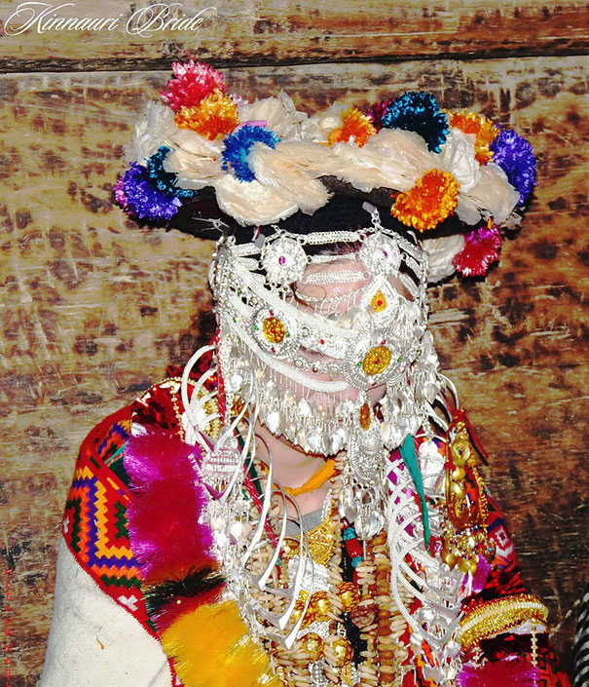
Kinnauri Bride
The Kinnauri people come from Kinnaur district in Himachal Pradesh, India. In traditional Kinnauri weddings, the bride wear a heavy layer of gold and silver ornaments and a handmade garland made from dry fruits. The bride also wears a hand woven dress with a brightly embroidered hand woven shawl to cover the shoulders.

Slide 40
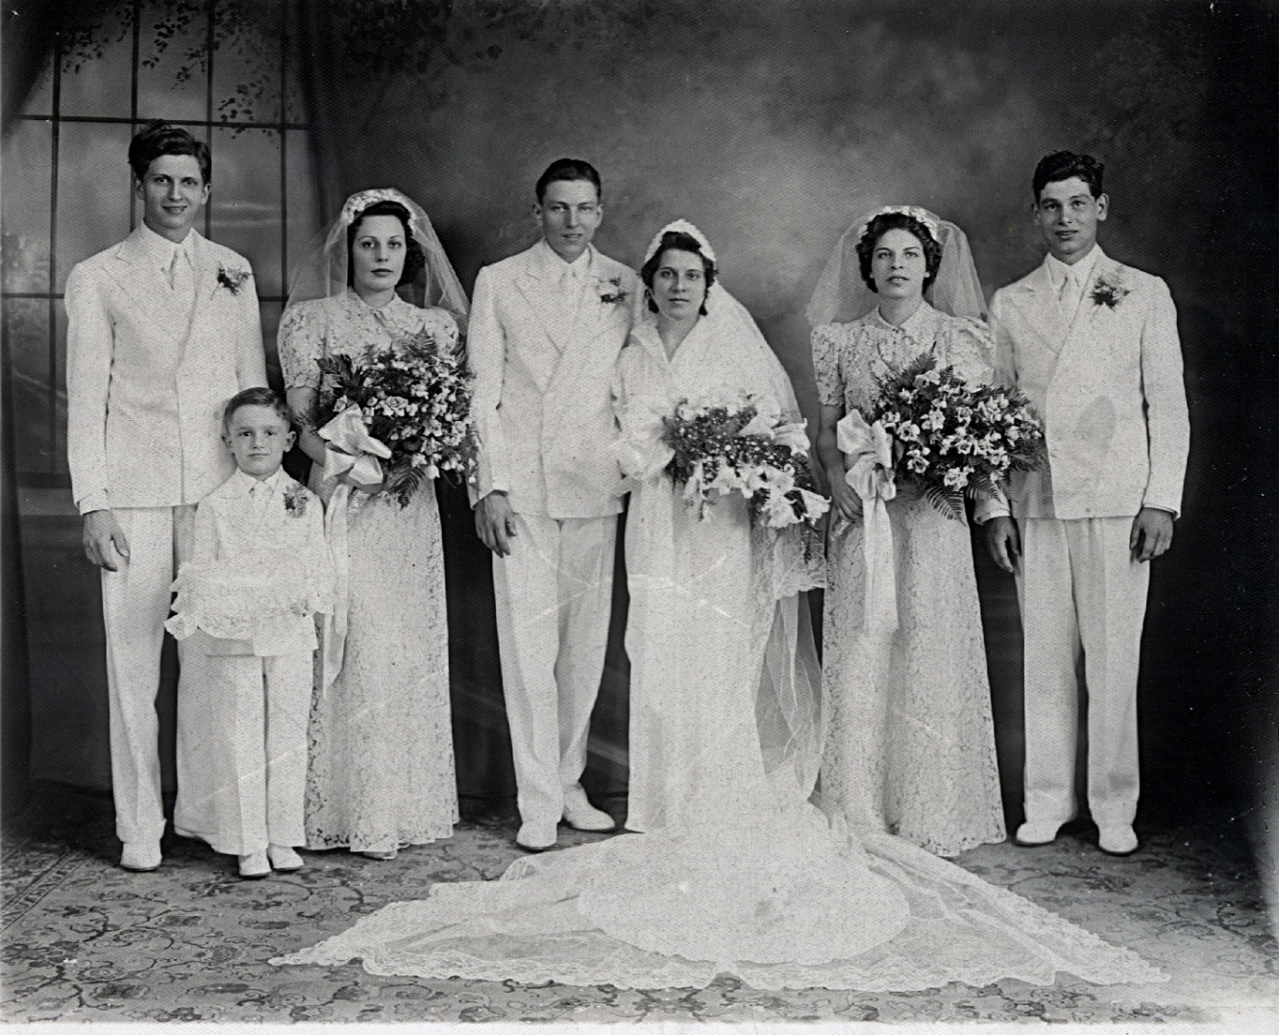
American Wedding C. 1937
Brides wore white and the men wore formal dress – Usually black tuxedoes The bride came down the isle with part of her veil covering her face. It was lifted back when she arrived at the front of the church and joined the groom. In the next slide, you will see that in a span of 29 years, the basic elements didn’t change.

Slide 41
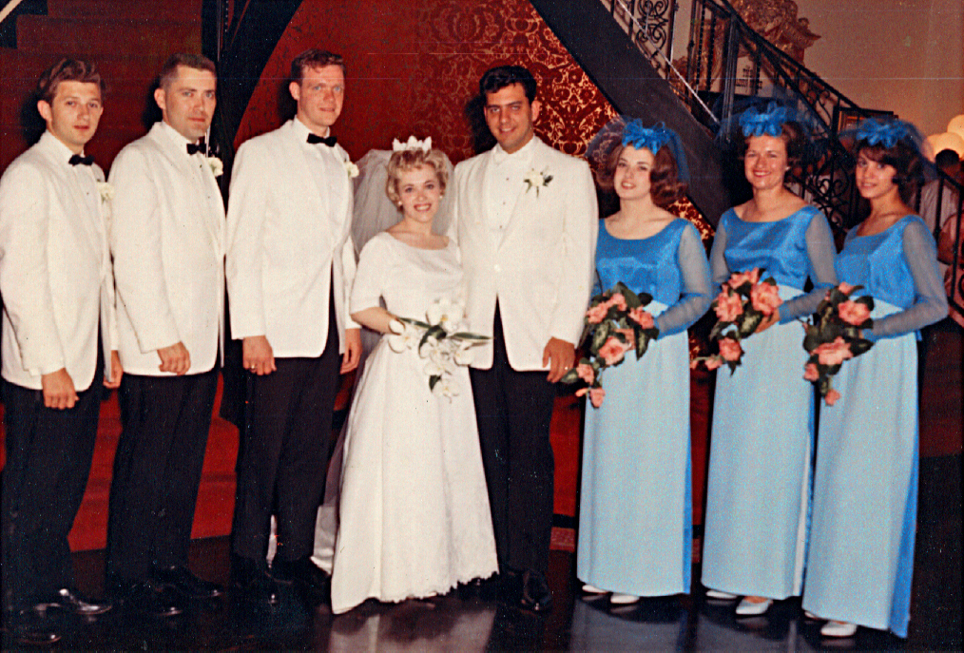
Rather Traditional American Weddings
Brides wore white dresses and the groom and groomsmen wore formal attire. The bride came down the isle with her veil covering her face. It was lifted back when she came to the minister and the groom. This was somewhat typical for 1966.

Slide 42
Today, American weddings are less traditional

Slide 43
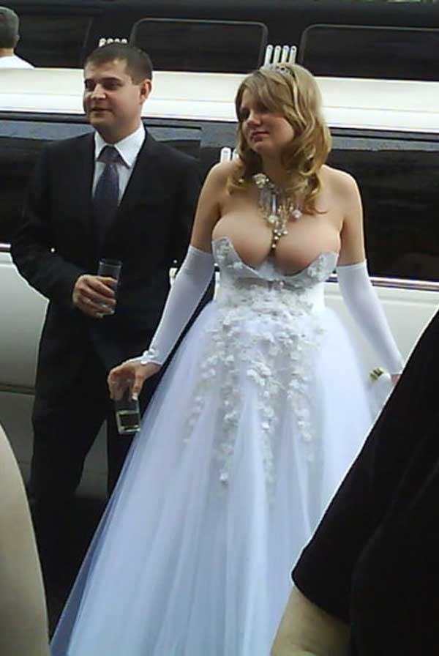
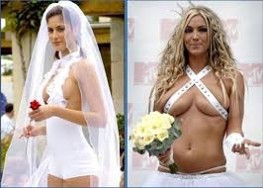
Slutty dresses

Slide 44
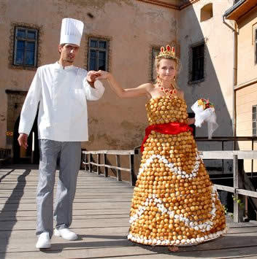
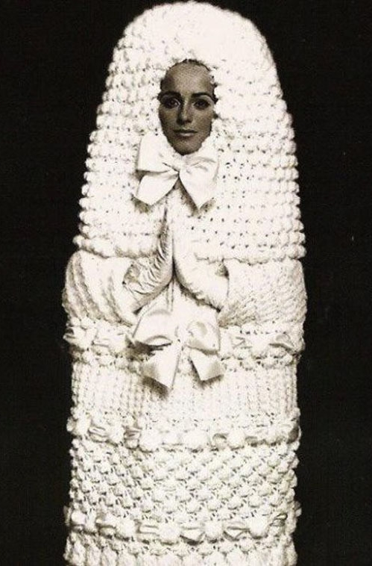
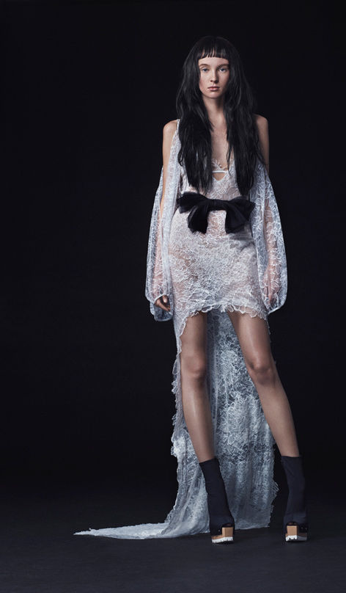
Poor taste for what is supposed to be a solemn occasion

Slide 45
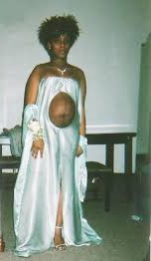
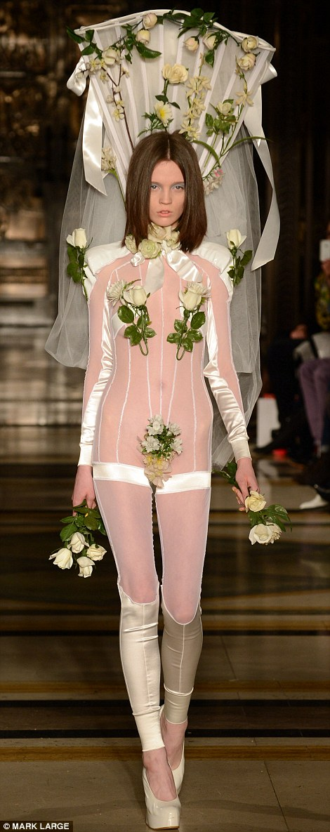
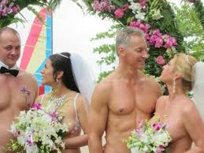
Revealing way too much

