Slide 1

Saint festival shows Orthodox strength in Romania

Slide 2
SLIDE TITLE
BUCHAREST, Romania – The feast of St. Dimitrie of Basarobov in Bucharest is an annual demonstration of the strength of Christianity in Romania, and the dominance of the Orthodox branch.
Catholics are 4.3 percent of Romania's population of 19 million, while about 85 percent are Orthodox believers.
The difference in sizes of the two churches was highlighted by the crowds: tens of thousands attended the weeklong Orthodox celebration in late October, while about 300 participated in the one-day Catholic event.
Both churches parade holy remains. The Catholics have a few drops of the blood of St. John Paul II; the Orthodox claim to have the remains of three saints including those of St. Dimitrie, the patron saint of Bucharest.

Slide 3
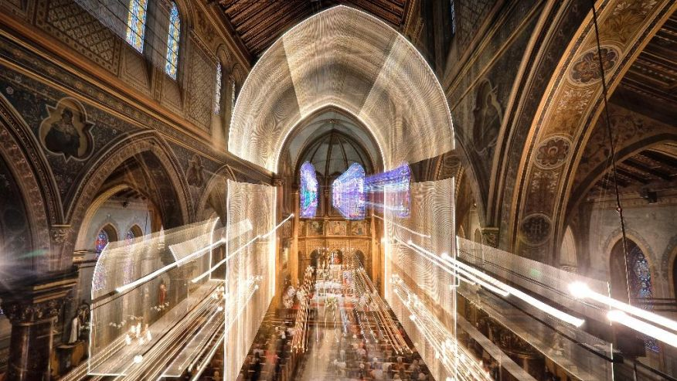

Slide 4
In this Sunday, Oct. 23, 2016 picture taken with a long exposure time, catholic priests sit inside the St. Joseph cathedral next to remains and an icon depicting Pope John Paul II during a pilgrimage, in Bucharest, Romania. The Romanian Orthodox and Catholic churches staged pilgrimages parading holy remains. A few drops of Pope John Paul II's blood were carried through the streets of the Romanian capital by the Catholics, the remains of three Orthodox saints, one Saint Dimitrie the patron of Bucharest, by the Orthodox. (AP Photo/Vadim Ghirda) (The Associated Press)

Slide 5
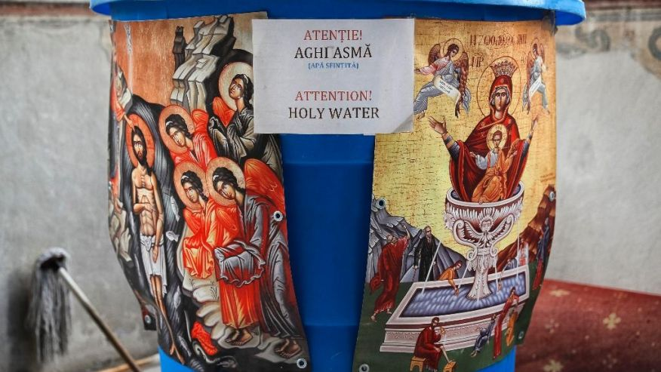

Slide 6
In this Saturday, Oct. 22, 2016 picture a container holding holy water is placed at the entrance of the orthodox patriarchal cathedral in Bucharest, Romania. The feast of St. Dimitrie of Basarobov in Bucharest is an annual demonstration of the strength of Christianity in Romania, and the dominance of the Orthodox branch. (AP Photo/Vadim Ghirda) (The Associated Press)

Slide 7
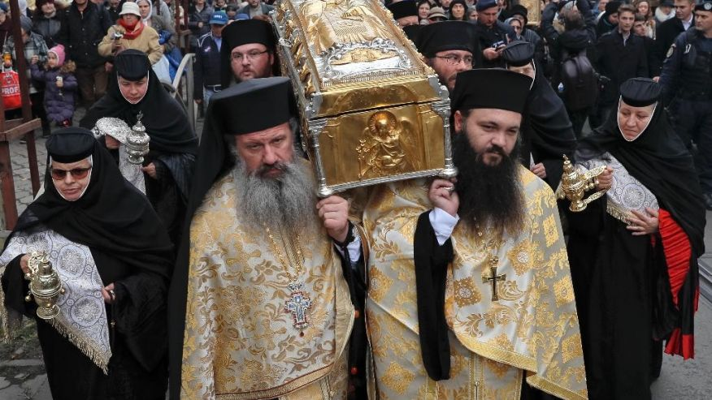

Slide 8
In this Saturday, Oct. 22, 2016 picture priests carry the remains of Saint Dimitrie Bassarabov, during a pilgrimage, in Bucharest, Romania. The Romanian Orthodox and Catholic churches staged pilgrimages parading holy remains. The Catholics have a few drops of the blood of Saint John Paul II; the Orthodox claim to have the remains of three saints including those of St. Dimitrie, the patron saint of Bucharest. (AP Photo/Vadim Ghirda) (The Associated Press)

Slide 9
Both churches parade holy remains. The Catholics have a few drops of the blood of St. John Paul II; the Orthodox claim to have the remains of three saints including those of St. Dimitrie, the patron saint of Bucharest.
Orthodox worshippers in the Romania's capital braved cold weather and rain as the waited long hours in lines throughout the pilgrimage to touch the shiny metal case said to contain Dimitrie's remains, which are normally kept in the Patriarchal Cathedral.

Slide 10
There is an important lucrative dimension of the five major annual Orthodox pilgrimages, which draw throngs of believers. The church has a monopoly on the production of beeswax candles used in celebrations as well as being involved in the sale of various religious items.
Dimitrie is said to be a monk of the 13th century (or later, according to some versions) who spent much of his life in a cave. His body was said to be lost for 300 years before being found in a river, where his remains were credited with miraculous healing powers.

