Slide 1

Respect for Women
Barak Obama
Good Examples
tips & tricks
Notes:
To use this title animation slide with a new image simply 1) move the top semi-transparent shape to the side, 2) delete placeholder image,
3) click on the picture icon to add a new picture, 4) Move semi-transparent shape back to original position, 5) Update text on slide.

Slide 2
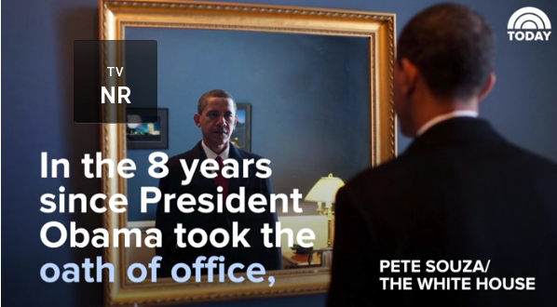

Slide 3
Pete Souza is known for his skillful art of criticizing President Trump with pictures, and his latest move is receiving attention for all the right reasons. Following Trump's verbal attacks on MSNBC's Morning Joe host Mika Brzezinski, in which he called her "dumb as a rock" and tweeted about her appearance, the former White House photographer decided to remind Trump what it looks like when a president treats women as equals. Souza uploaded a series of photos on his Instagram page, captioned "respect for women," that will remind you that Trump's bullying and sexism are not normal behavior from a president. Read on to relive all the times Barack Obama showed women the respect they deserve.

Slide 4
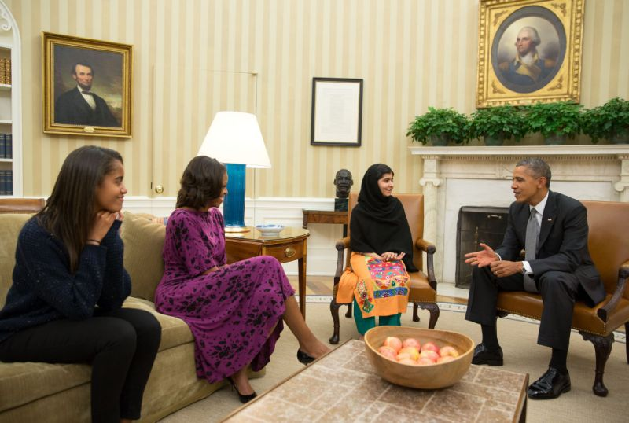
Family Time

Slide 5
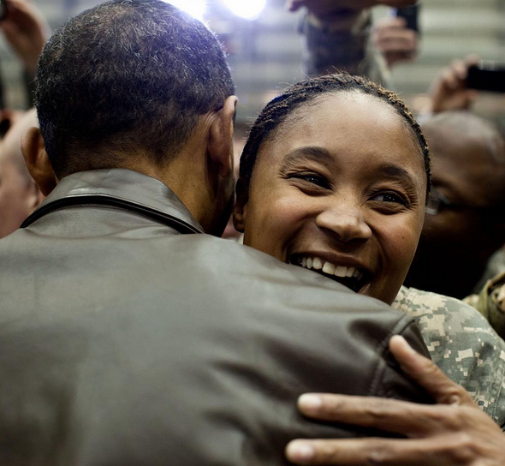
President Obama greets US troops after secret all-night flight to Afghanistan in 2010.

Slide 6
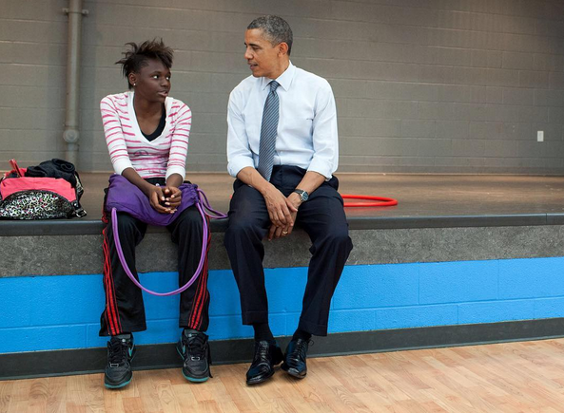
President Obama talks with a young woman during a stop at the Boys and Girls Club of Cleveland, Ohio in 2012.

Slide 7
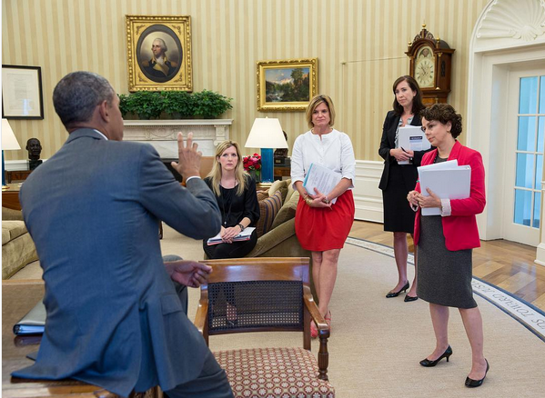
President Obama strategizes with from left, White House Counsel Kathy Ruemmler; Communications Director Jennifer Palmeiri; Katie Beirne Fallon, Deputy Communications Director; and Cecelia Munoz, Director of the Domestic Policy Council, in 2013.

Slide 8
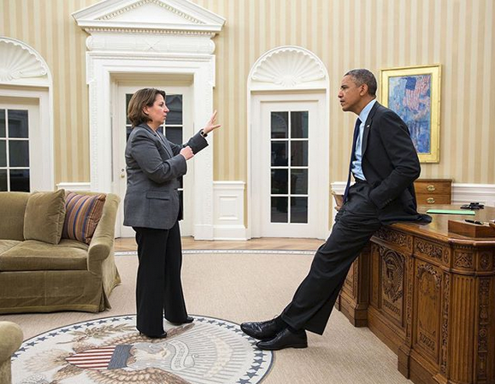
Homeland Security Advisor Lisa Monaco updates President Obama on the Boston Marathon bombing in 2013.

Slide 9
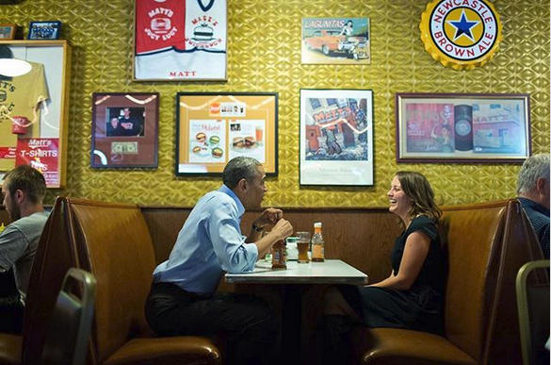
President Obama has lunch with Rebekah Erler, who had written him a letter in 2014 about the economic challenges of raising a family.

Slide 10
