Slide 1
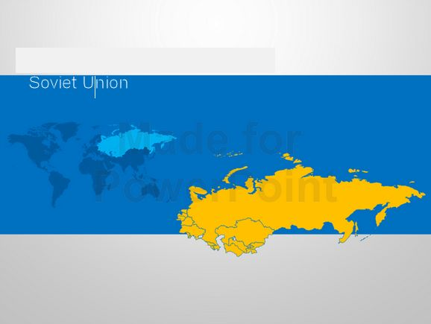
Reindeer herding in Russia's Arctic

Slide 2
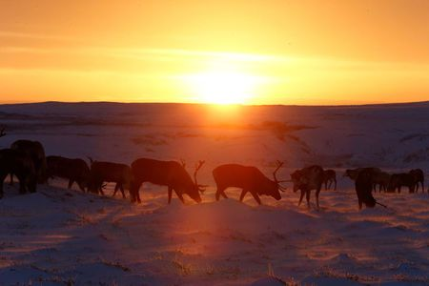
Reindeers graze in the tundra area in Nenets Autonomous District, Russia, November 26, 2016.

Slide 3
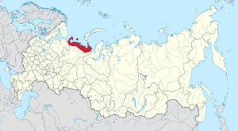
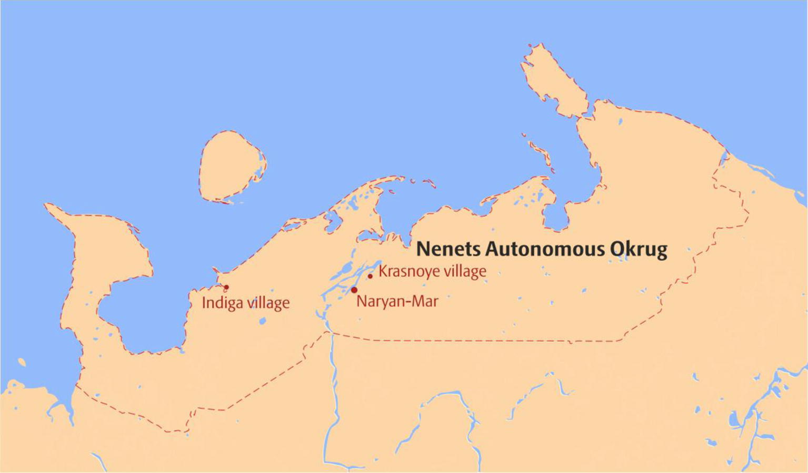

Slide 4
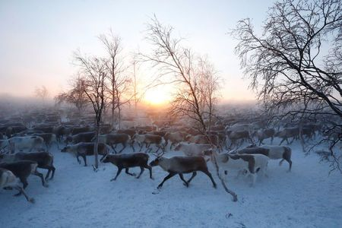
A herd of reindeers is seen inside an enclosure as herders select and sort them in the settlement of Krasnoye in Nenets Autonomous District, Russia,

Slide 5
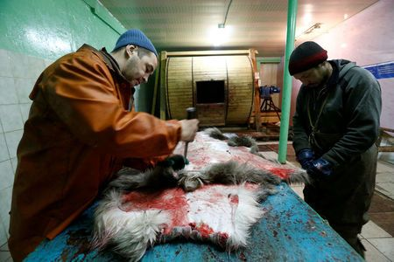
Farm employees process reindeer skin in the settlement of Krasnoye in Nenets Autonomous District, Russia, November 29, 2016. Picture taken November 29, 2016

Slide 6
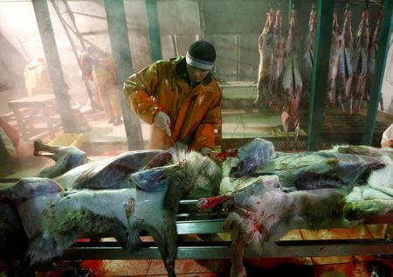

Slide 7
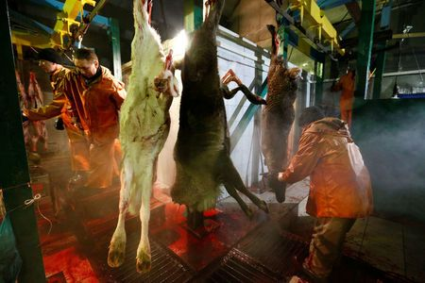

Slide 8
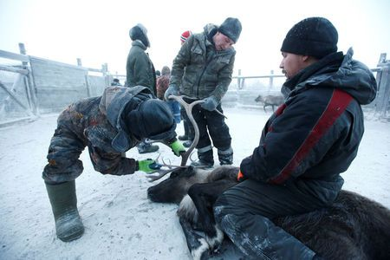
Herders cut off reindeer antlers inside the enclosure in the settlement of Krasnoye in Nenets Autonomous District, Russia, November 29, 2016.

Slide 9
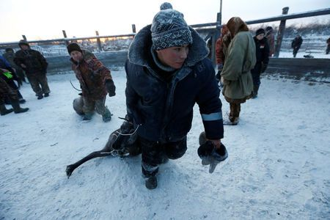

Slide 10
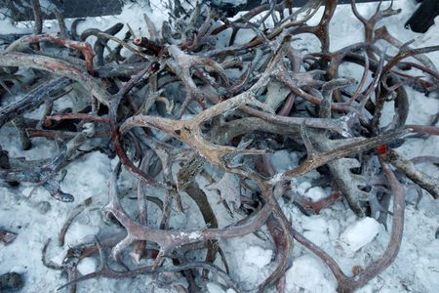
Reindeer antlers cut off by herders lie inside the enclosure in the settlement of Krasnoye in Nenets Autonomous District, Russia, November 29, 2016

Slide 11
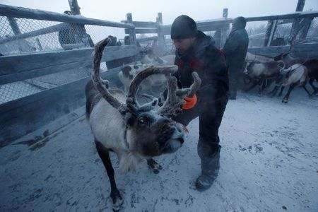
Herders select and sort reindeer inside the enclosure in the settlement of Krasnoye in Nenets Autonomous District, Russia, November 29, 2016

Slide 12
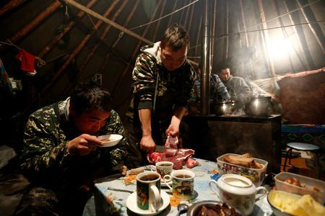
Reindeer herders cook and have a meal inside a tent in the tundra area in Nenets Autonomous District, Russia, November 27, 2016.

Slide 13
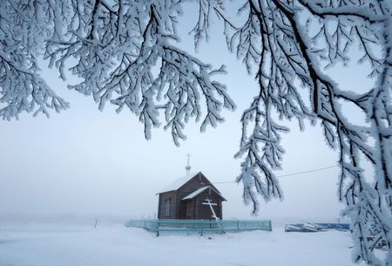
An Orthodox church is seen in the settlement of Krasnoye in Nenets Autonomous District, Russia, November 25, 2016.

Slide 14
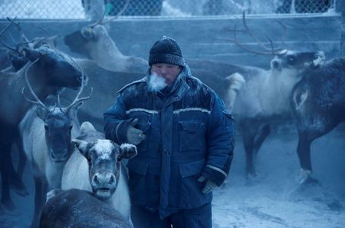
A herder smokes while selecting and sorting reindeer inside the enclosure in the settlement of Krasnoye

Slide 15
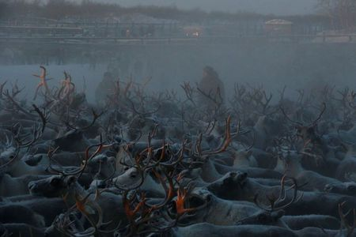
Reindeer in the enclosure

Slide 16
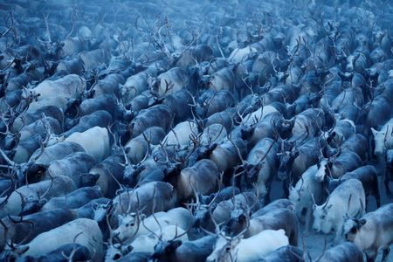

Slide 17
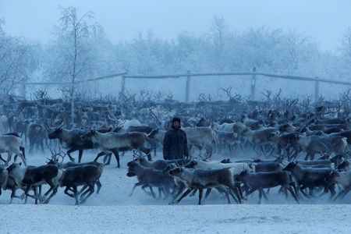

Slide 18
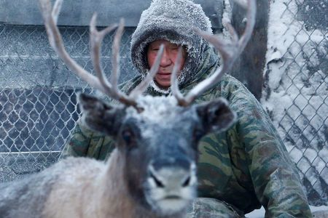
A herder sits inside the enclosure where they select and sort reindeer

Slide 19
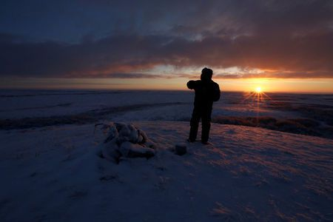
A man stands at a site, which is holy for local residents, during the sunrise in the tundra area in Nenets Autonomous District, Russia,

Slide 20
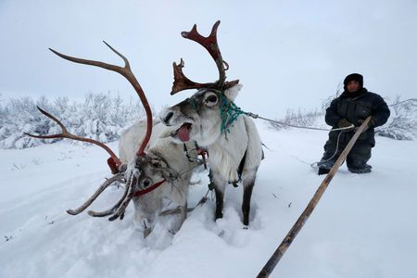
A herder stops for reindeers to have a rest while riding along the tundra area

Slide 21
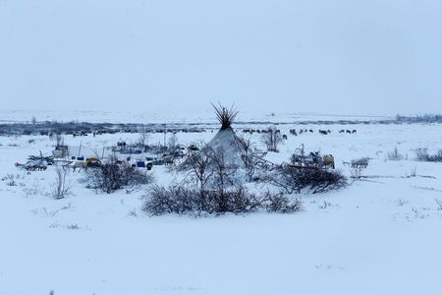
A view shows a tent belonging to reindeer herders in the tundra area in Nenets Autonomous District, Russia,

