Slide 1
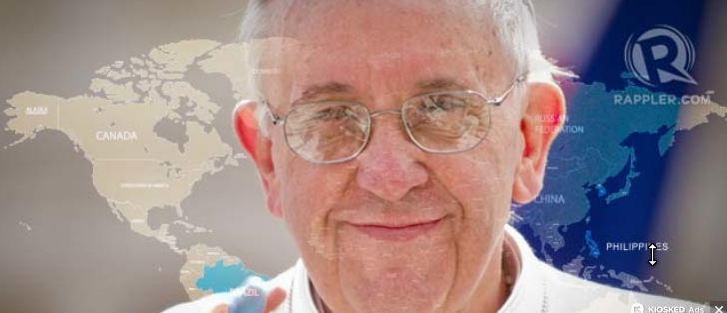
Pope Francis Building Bridges
Pope of the fringes: Francis as pilgrim-diplomat

Slide 2
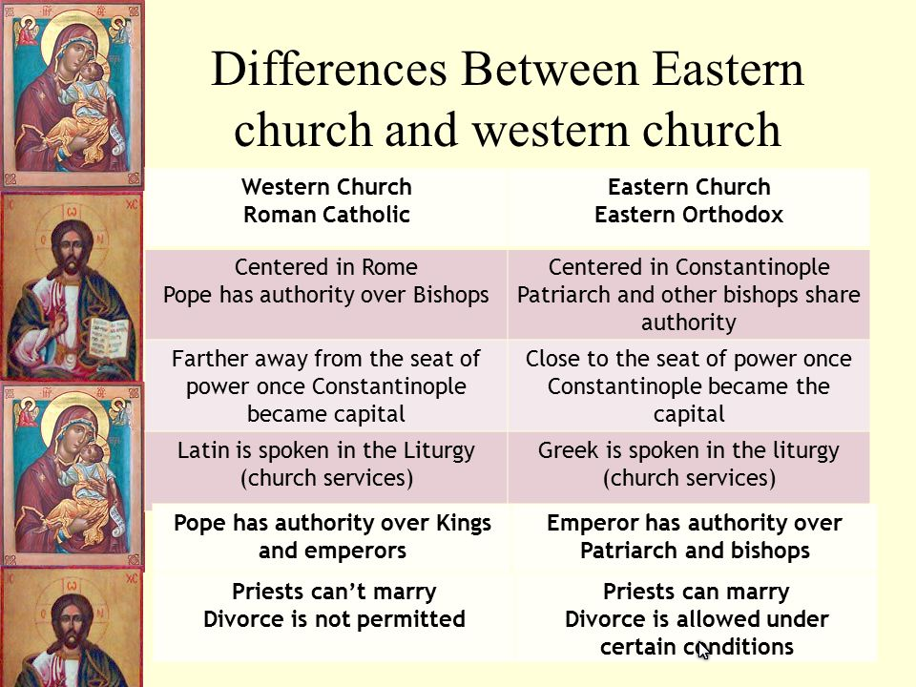
Positions around 1454 CE

Slide 3
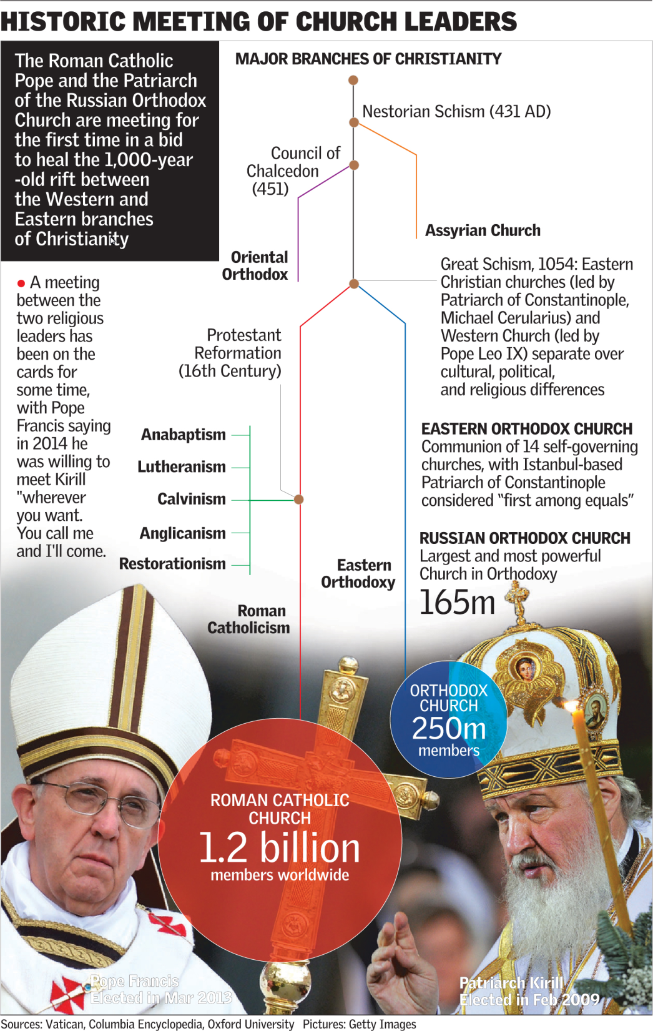

Slide 4
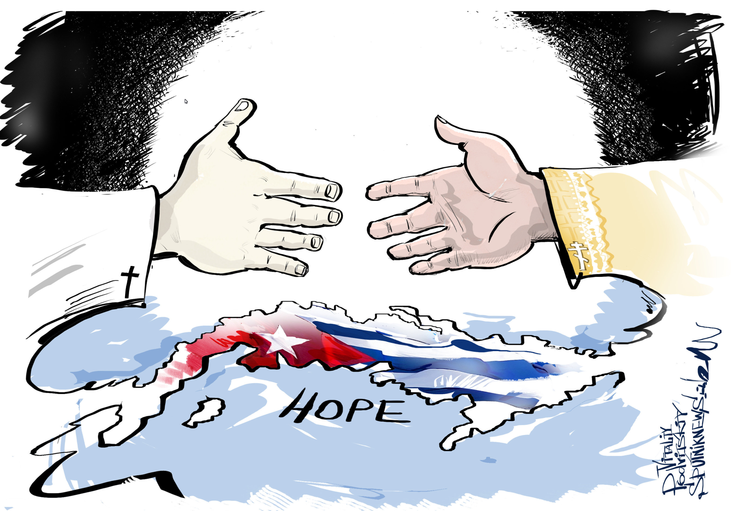

Slide 5
Building Bridges
Some type of workable accommodations could be made between the Roman Catholic and Orthodox churches. Remember that “church time” operates at a sail’s pace compared to real time.
Bringing the Anglican Communion into some type of unified structure is less likely, complicated by female priests and bishops and more liberal stands on gender issues in some members of the Anglican Communion (unity within is shaky)
Other Christians: Meeting them with respect and a willingness to work together is a great improvement over pre-1960 relations.
Other religions and secularists: Meeting them with respect and a willingness to work together is a great improvement over pre-1960 relations.
Pope Francis seems to be willing to work with whatever or whomever is available to at least start building footings and foundations for the bridges that will become funcional after he has passed.

Slide 6
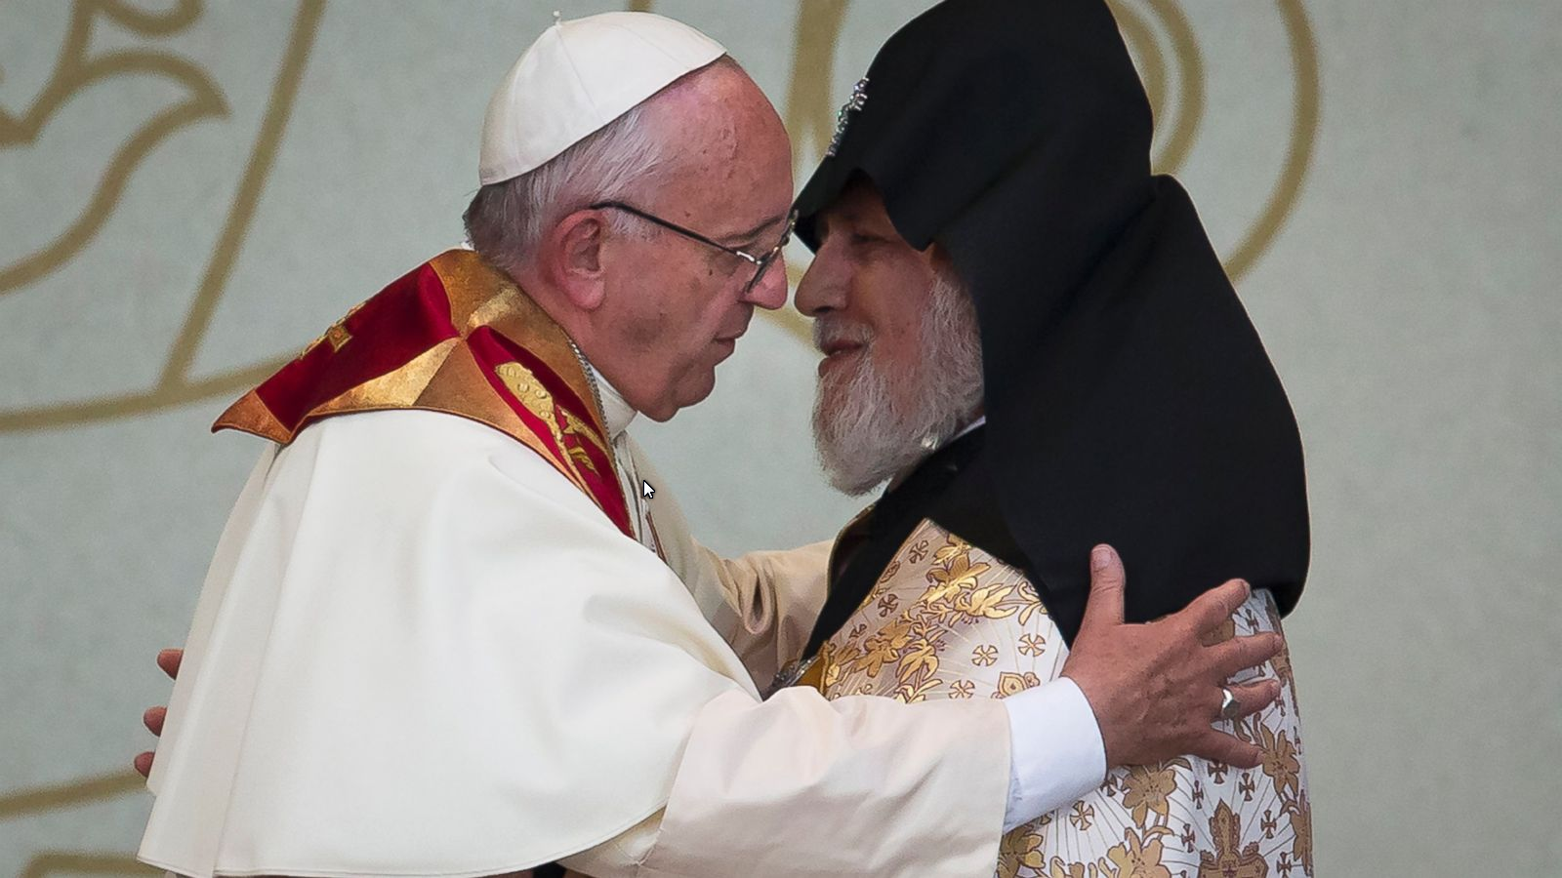
Pope Francis, left, embraces Catholicos Karekin II during an Ecumenical encounter and prayer for Peace at the Republic Square in Yereven, Armenia, Saturday, June 25, 2016

Slide 7
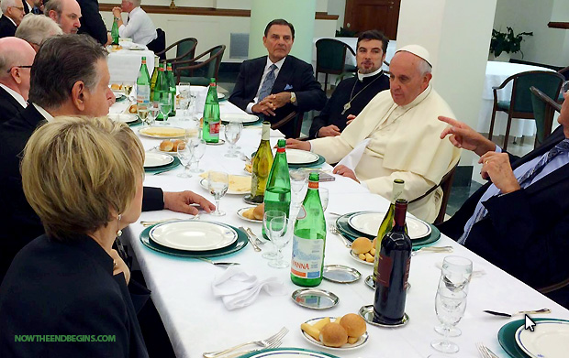
Meets with Charismatics

Slide 8
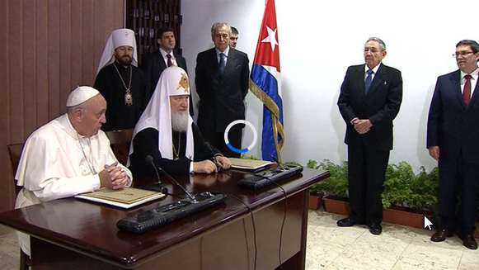
Meets Patriarch of Russian Orthodox Church

Slide 9
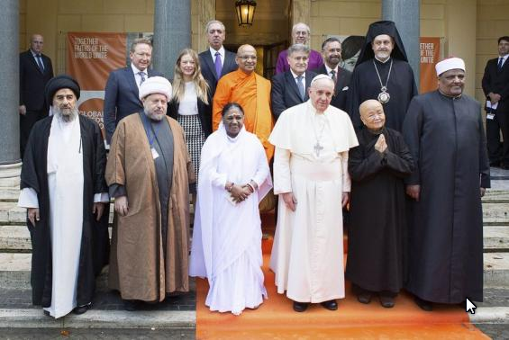
Pope Francis (front 3rd R) poses with religious leaders during a meeting at the Pontifical Academy of Sciences at the Vatican on 2 December 2014

Slide 10
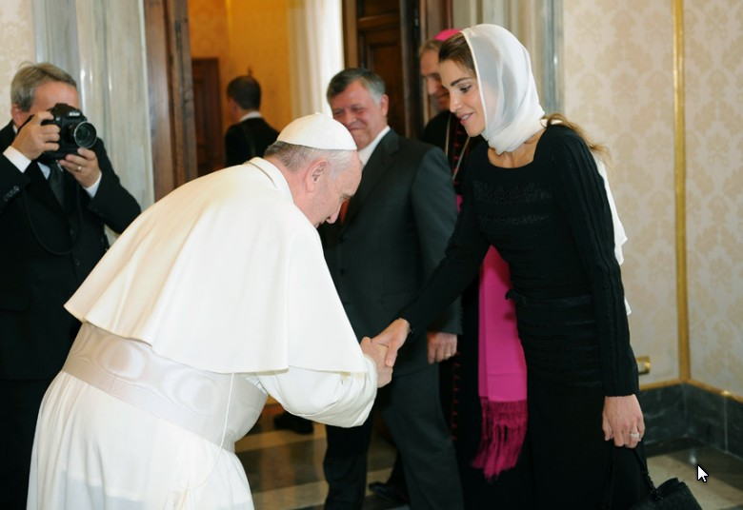
King of Jordan Abdullah II Ibn Hussein's wife Rania

Slide 11
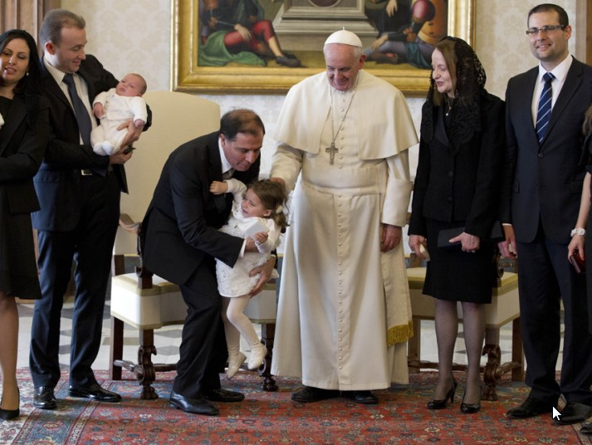
March 2014: Malta's President George Abela took his family to meet the Pope

Slide 12
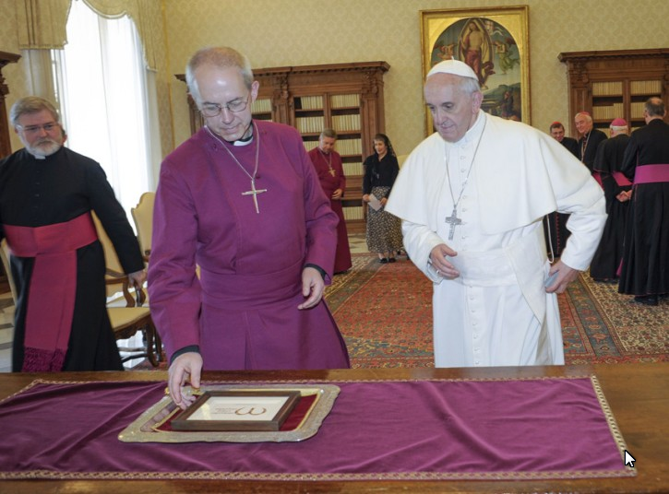
June 2013: Pope Francis with the Archbishop of Canterbury Justin Welby

Slide 13
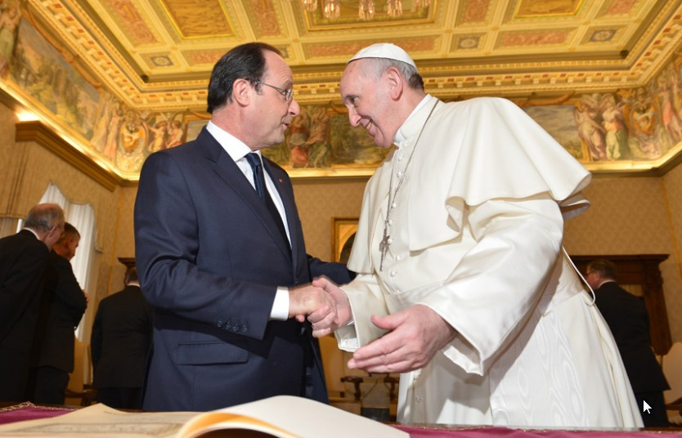
January 2014: French President Francois Hollande met Pope Francis

Slide 14
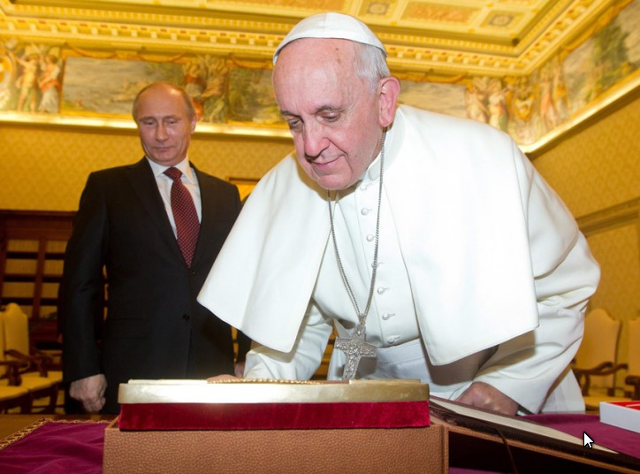
November 2013: Russian President Vladimir Putin

Slide 15
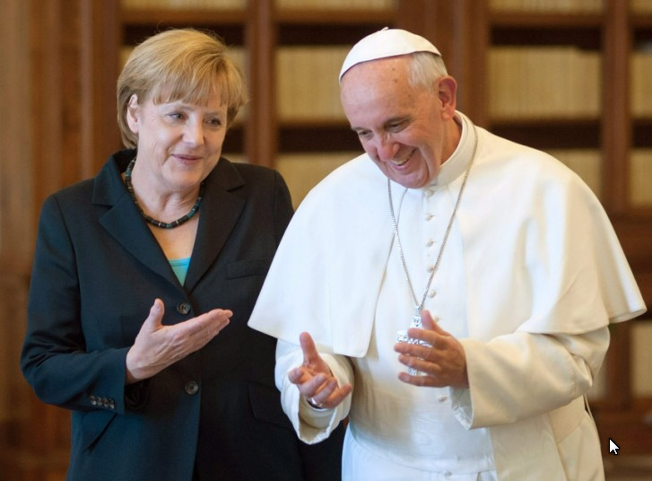
May 2013: German Chancellor Angela Merkel

Slide 16
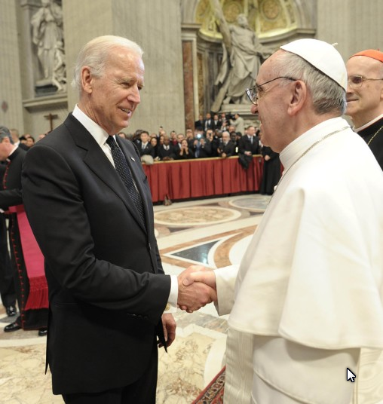
March 2013: Pope Francis with US Vice President Joe Biden

Slide 17
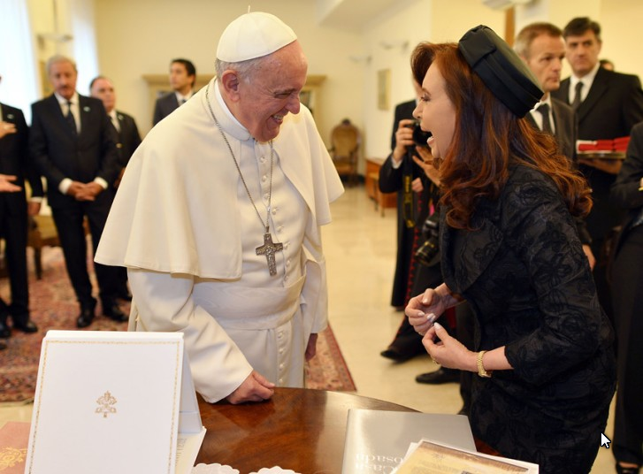
The Argentinian President paid the Pope a 2nd visit

Slide 18
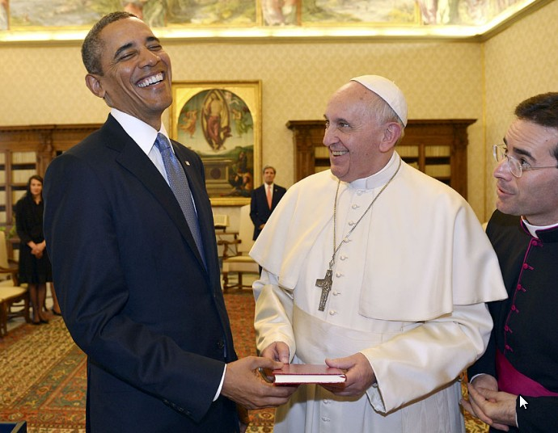
The US President has repeatedly praised the pope for his compassion and emphasis on helping the poor.

Slide 19
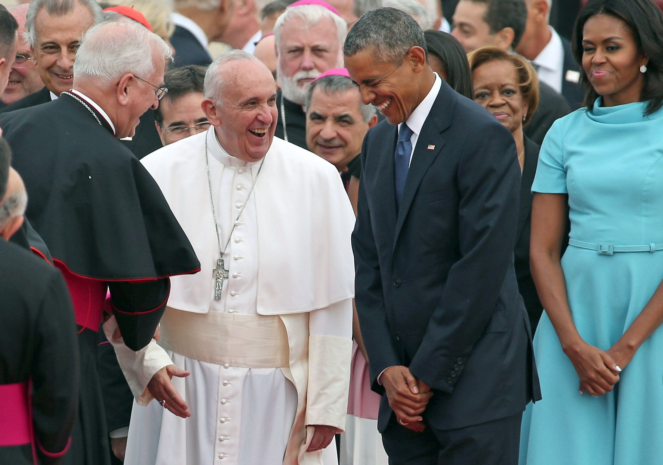

Slide 20
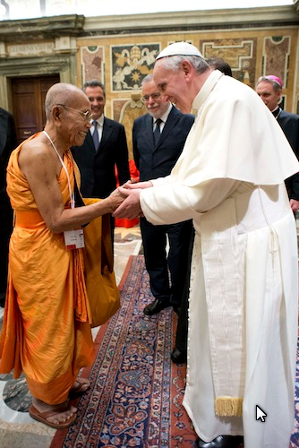
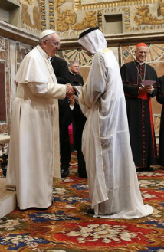

Slide 21
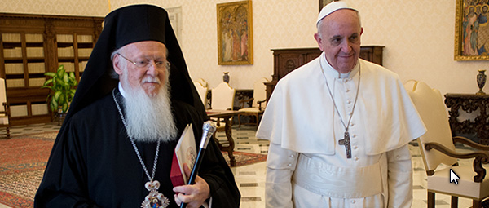
Pope Francis walks with Ecumenical Patriarch Bartholomew of Constantinople at Vatican

Slide 22
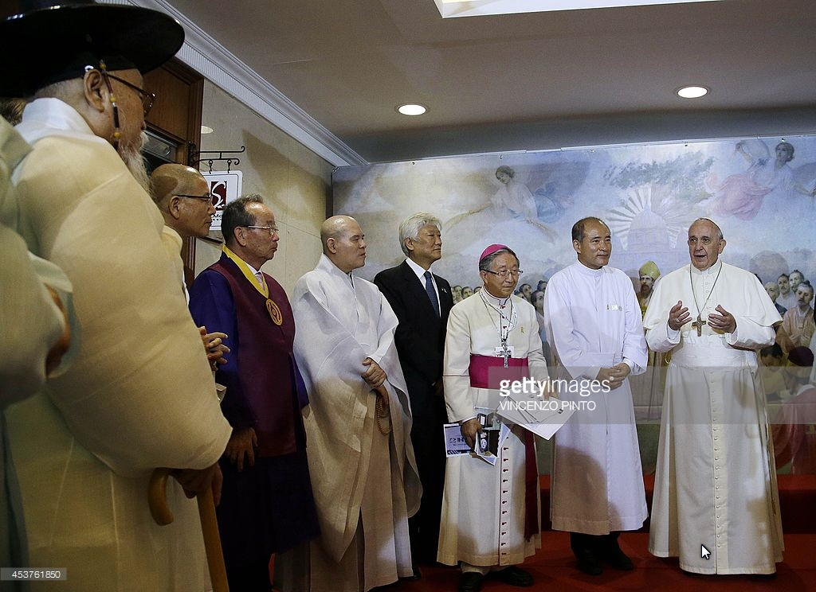

Slide 23
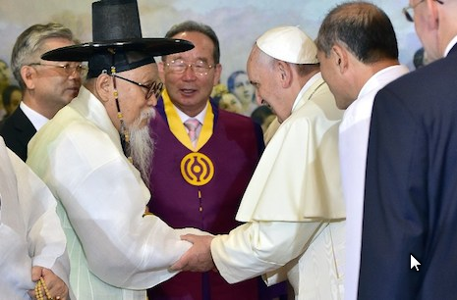

Slide 24
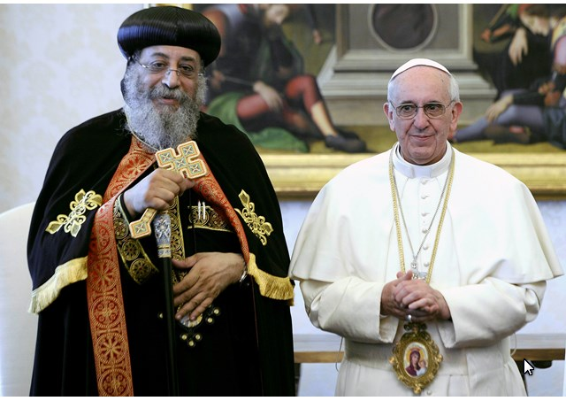
Pope Francis with the head of the Coptic Church of Egypt

Slide 25
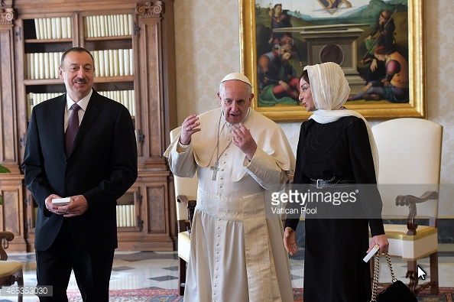
Pope Francis meets President of Azerbaijan Ilham Aliyev and his wife

Slide 26
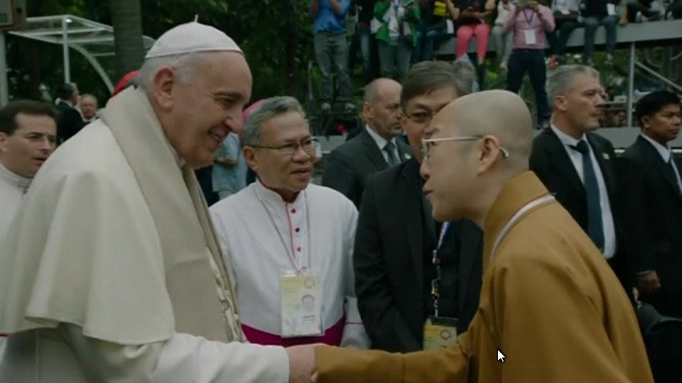

Slide 27
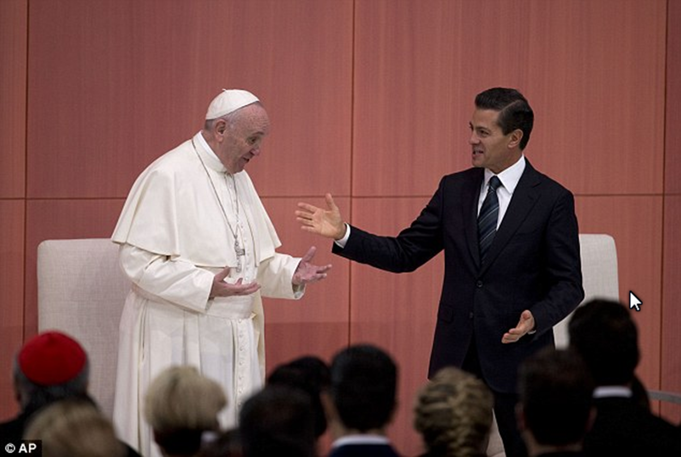
The Pope and President Nieto of Mexico

Slide 28
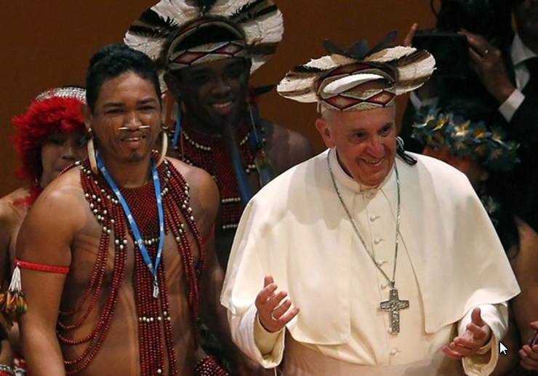
Pope Francis wears a colorful feather headgear in Brazil

Slide 29
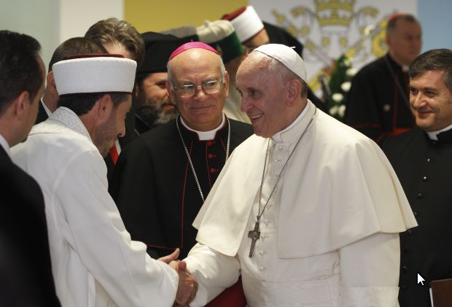

Slide 30
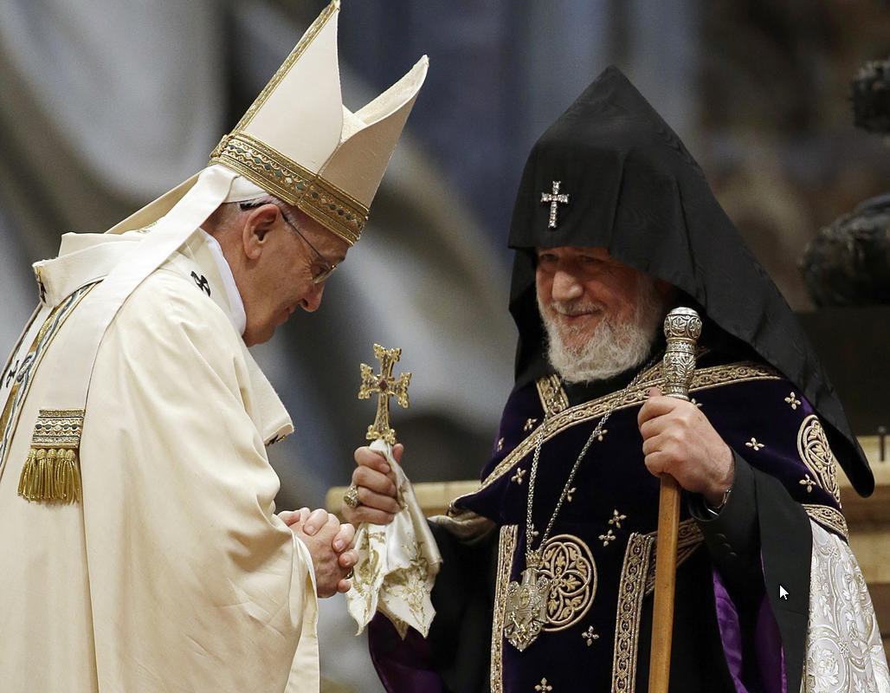

Slide 31
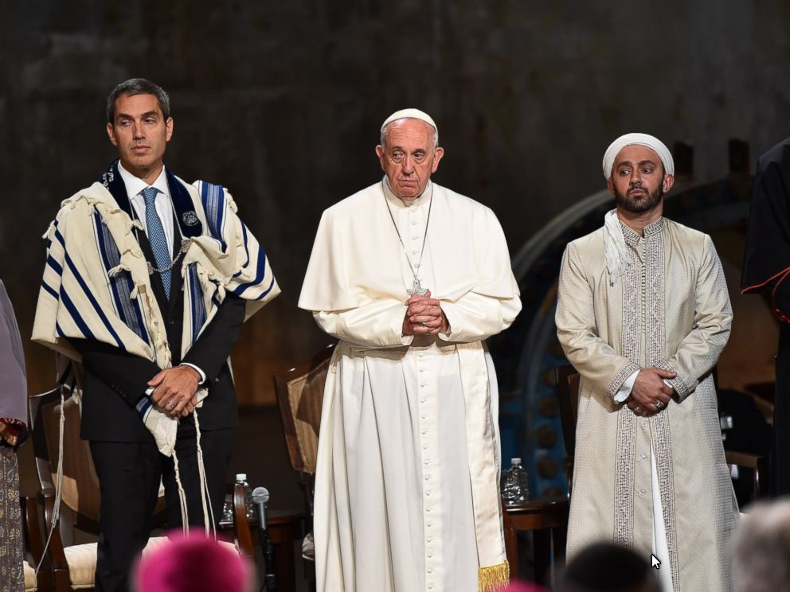

Slide 32
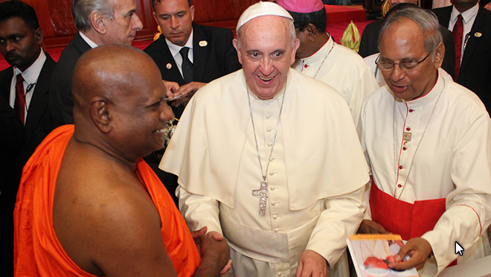
Pope Francis is greeted by a senior monk during a meeting with religious leaders at the Bandaranaike Memorial International Conference Hall in Colombo, Sri Lanka

Slide 33
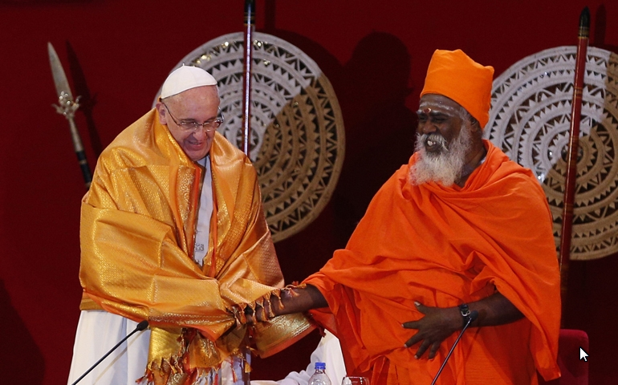
Pope Francis shakes hands with Hindu Kurukkal SivaSri T. Mahadeva

Slide 34
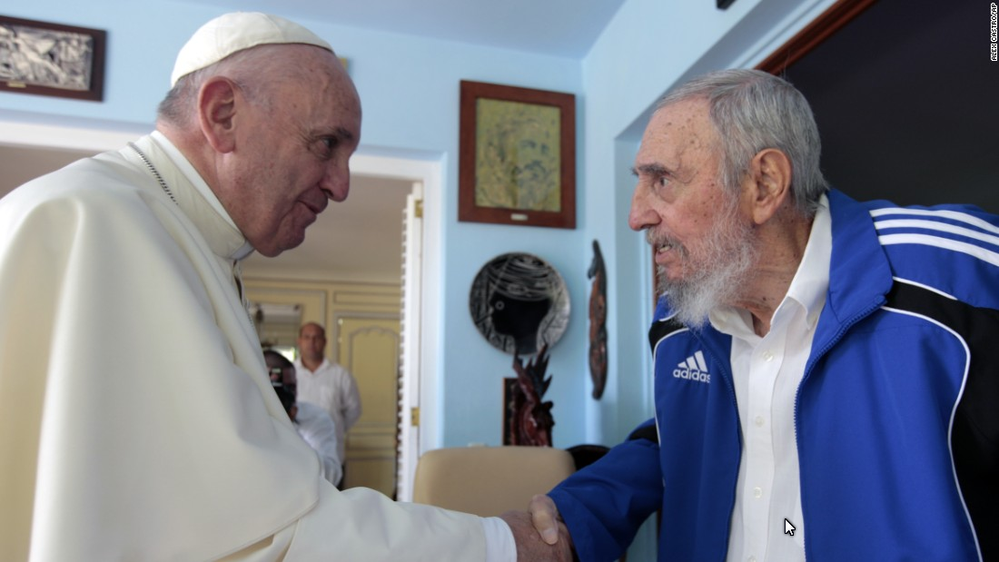
With Fidel Castro in Cuba

Slide 35
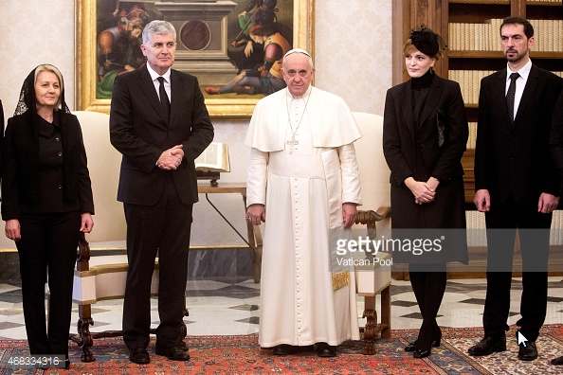
Pope Francis Meets Leader of the Croatia

Slide 36
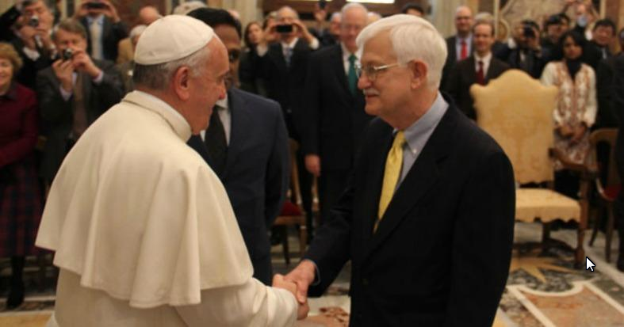
Pope Francis Meets with Georgetown Professors and Students

Slide 37
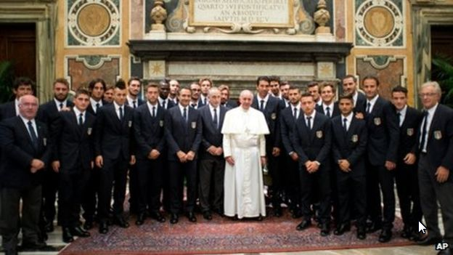
Italian football team

Slide 38
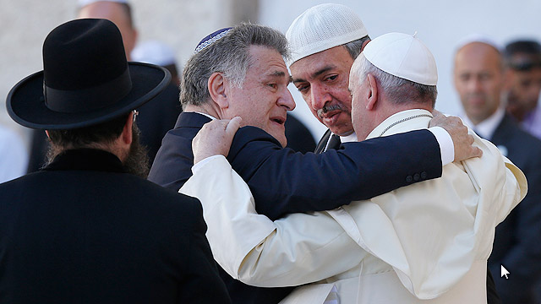
Pope Francis is embraced by Argentine Rabbi Abraham Skorka as he leaves after praying at the Western Wall in Jerusalem May 26. On the right is Omar Abboud, Muslim leader from Argentina. "We did it," Rabbi Skorka said he told the pope and Abboud

Slide 39
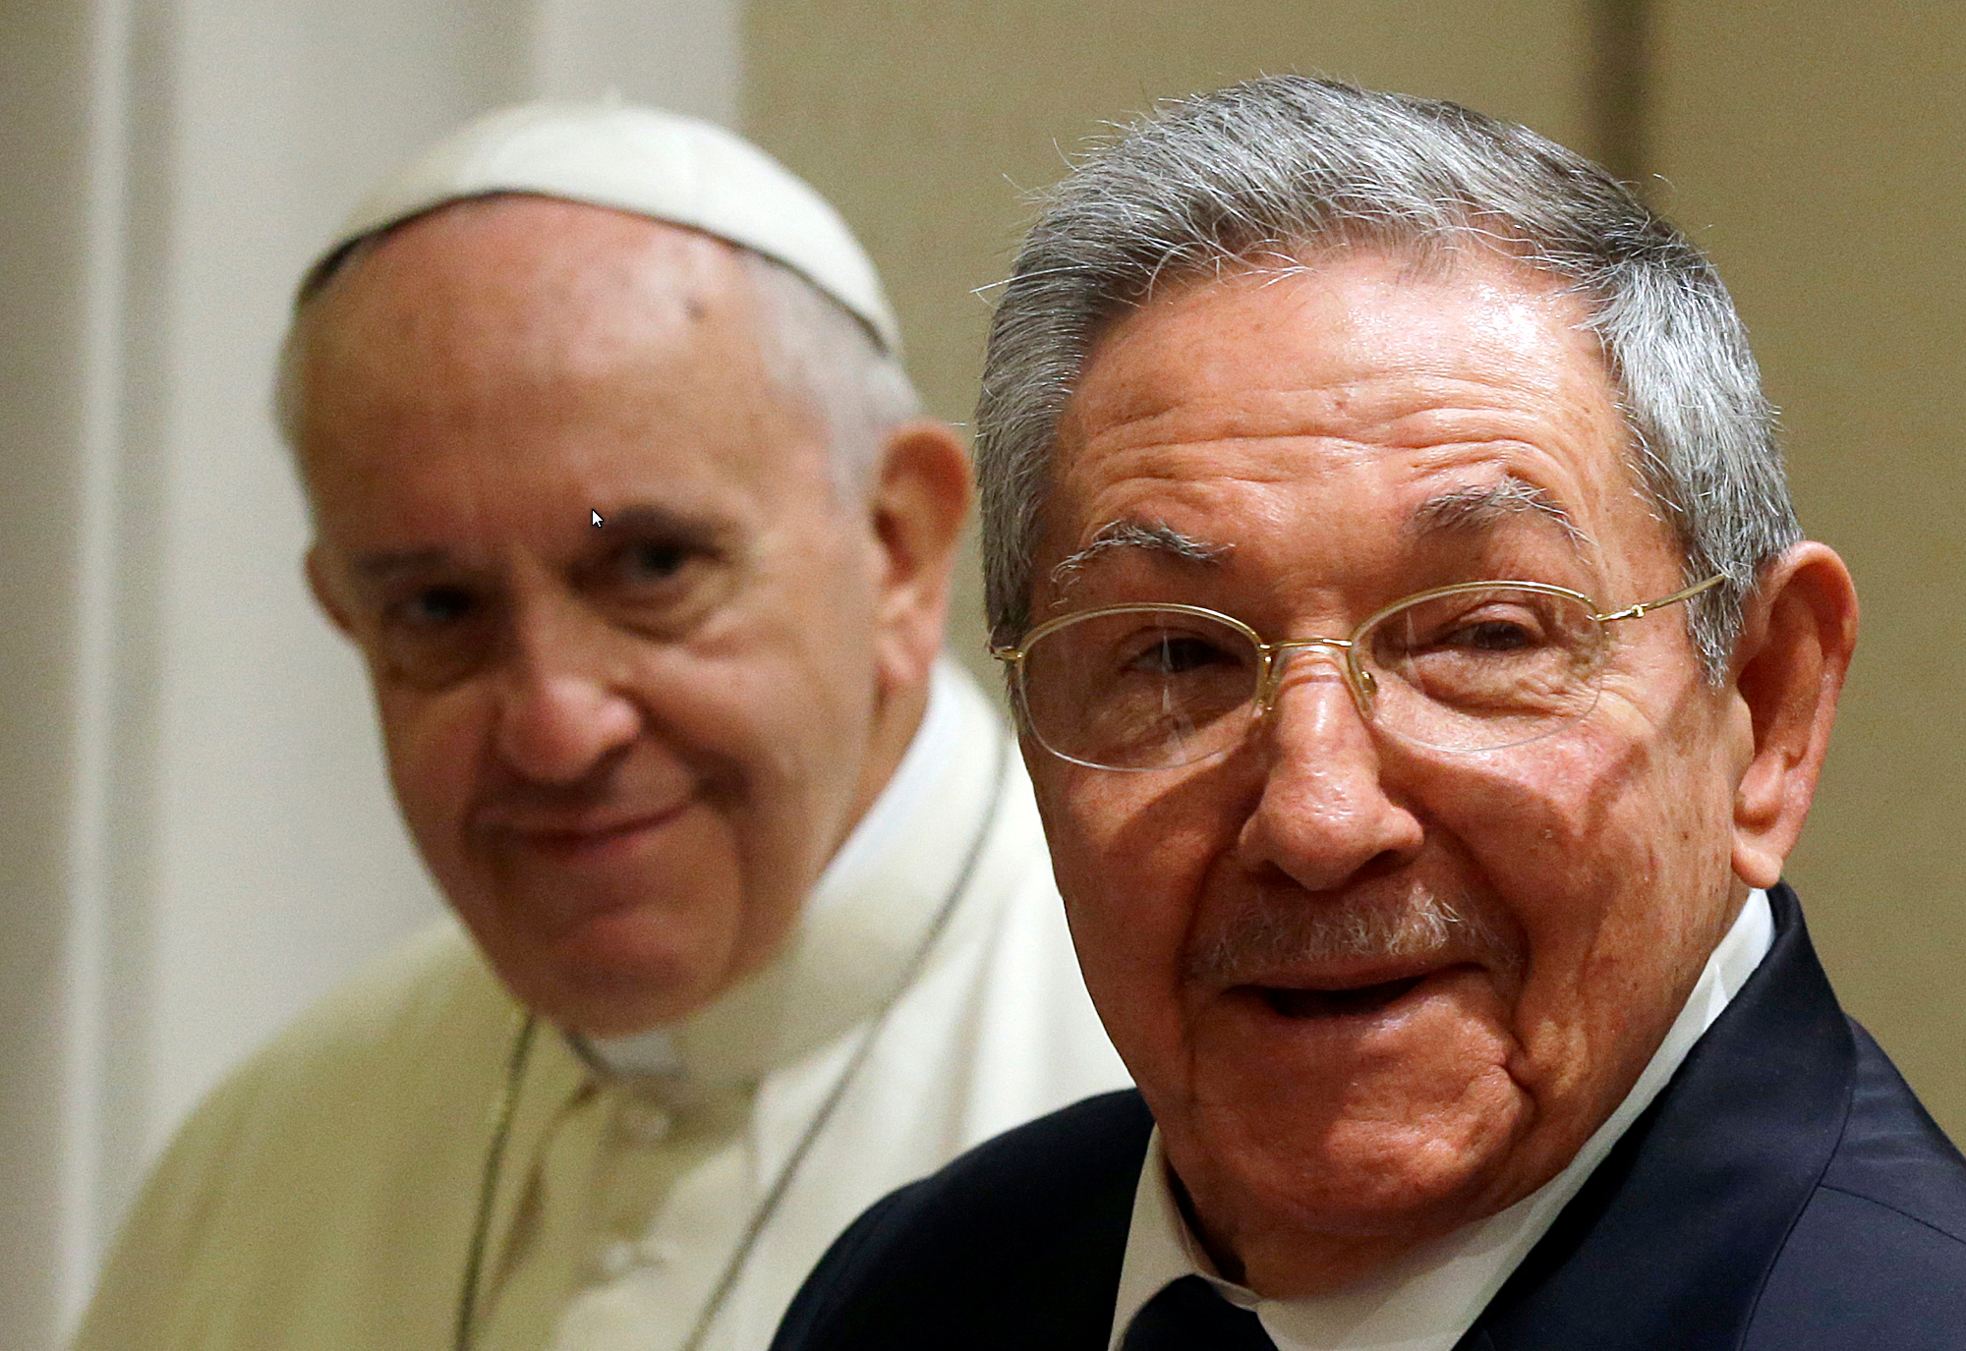
Cuban president Raul Castro

Slide 40
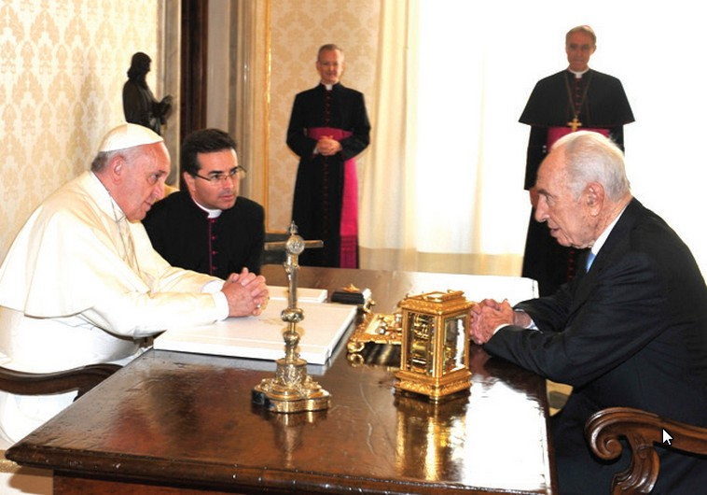
POPE FRANCIS and former president Shimon Peres chat

Slide 41
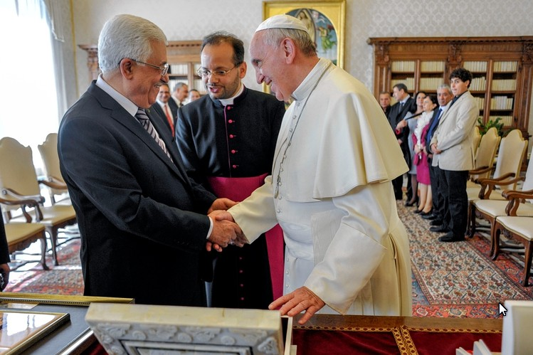
Pope Francis met Palestinian President Mahmud Abbas

Slide 42
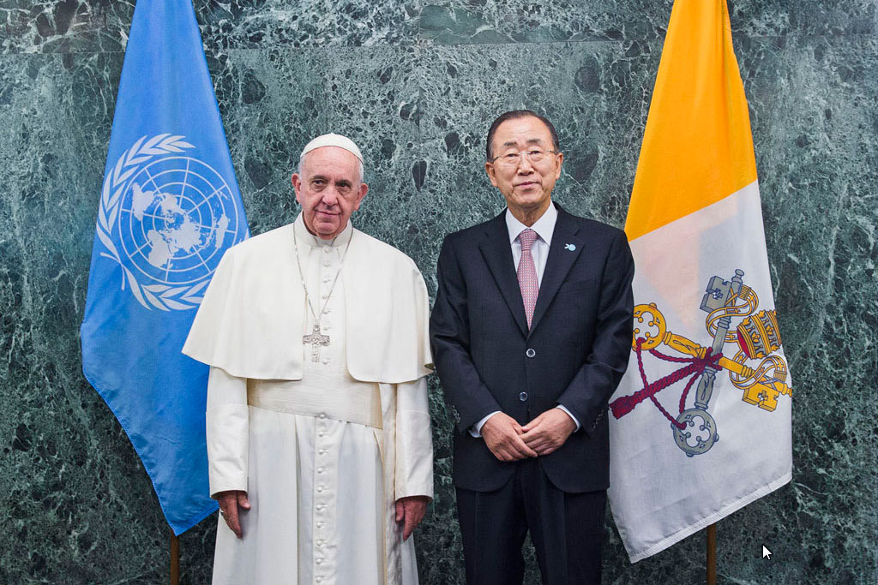

Slide 43
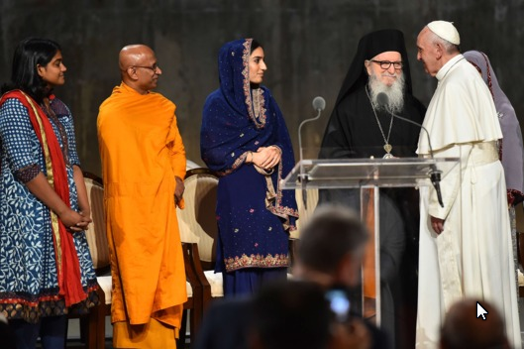

Slide 44
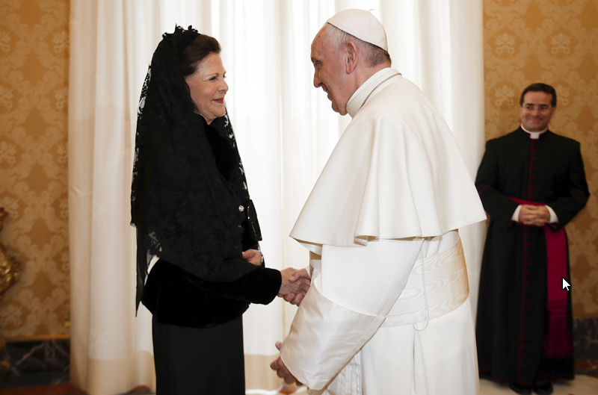
Pope Francis shakes hands with Sweden's Queen Silvia

Slide 45
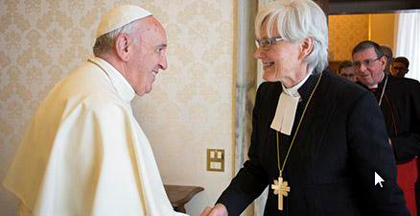
Meeting the head Luthern bishop

Slide 46
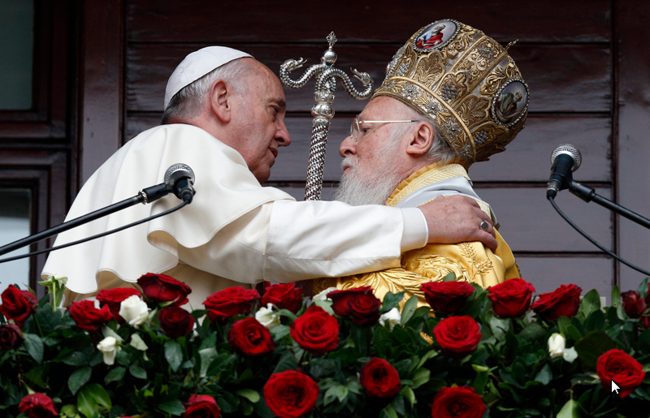
Pope Francis and Ecumenical Patriarch Bartholomew of Constantinople

Slide 47
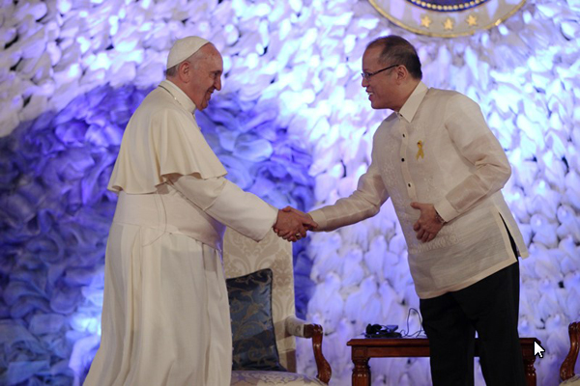
Pope Francis Thanks President Aquino

Slide 48
The Current World Situation:
Too many bigots and too much hatred
Too many bridge blockers
Too many wall builders
Too much violence
Too little understanding and respect

Slide 49
We need more bridge builders
Most of us won’t have the impact of Pope Francis, but that’s no reason to shirk our duty as good stewards of our world.
When dealing with our neighbors and with people of diverse ethnic, religious, racial, economic, and gender identities and preferences, we can:
Meet them with non-judgmental respect and a willingness to work together.
This simple approach, also taken by Pope Francis, can promote:
Harmony in the workplace or place of worship
Workable relations with neighbors
Building a client base for a retail business
Deescalate frictions within families or among relatives

