Slide 1
Photographer Uncovers 700-Year-Old Medieval Dwellings
Secrets In Hidden Places

Slide 2
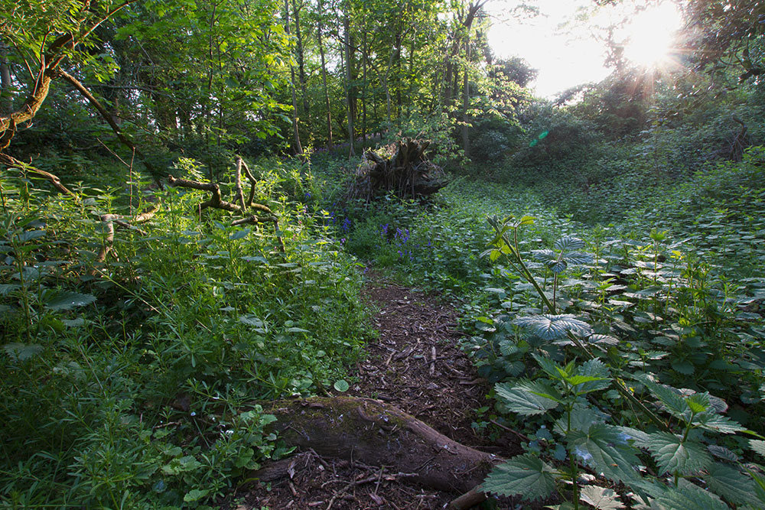

Slide 3

For all of the excavations and discoveries made over the centuries, planet Earth still has more than its fair share of ancient places just waiting to be uncovered by some eager adventurist. While most would assume that big discoveries reside in difficult-to-access places (like forgotten temples and crumbling ruins), sometimes it’s the places right underneath our feet that yield the most amazing finds.

Slide 4
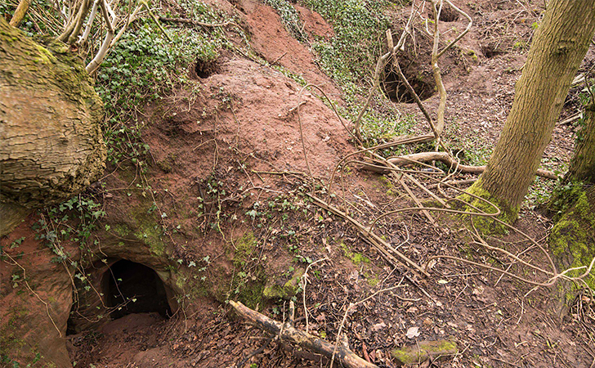
.

Slide 5

Just a Photographer
Michael Scott was a simple photographer who specialized in capturing the sultry and individual sides of people, though he also had a penchant for nature — as does pretty much every photographer. He was always on the lookout for the next great natural gem that he could capture in its most radiant beauty.

Slide 6

Whispers and Rumors
An England native, Michael frequented numerous pubs throughout his homeland. As he would visit pubs throughout Shropshire, though, he overheard talks on a couple occasions of some secret hidden beneath the earth. With Jules Verne-like curiosity, Michael inquired about this supposed secret.

Slide 7
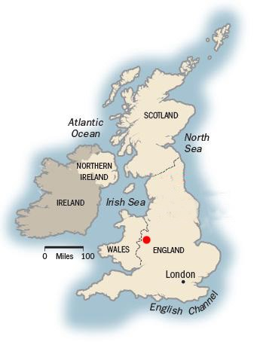
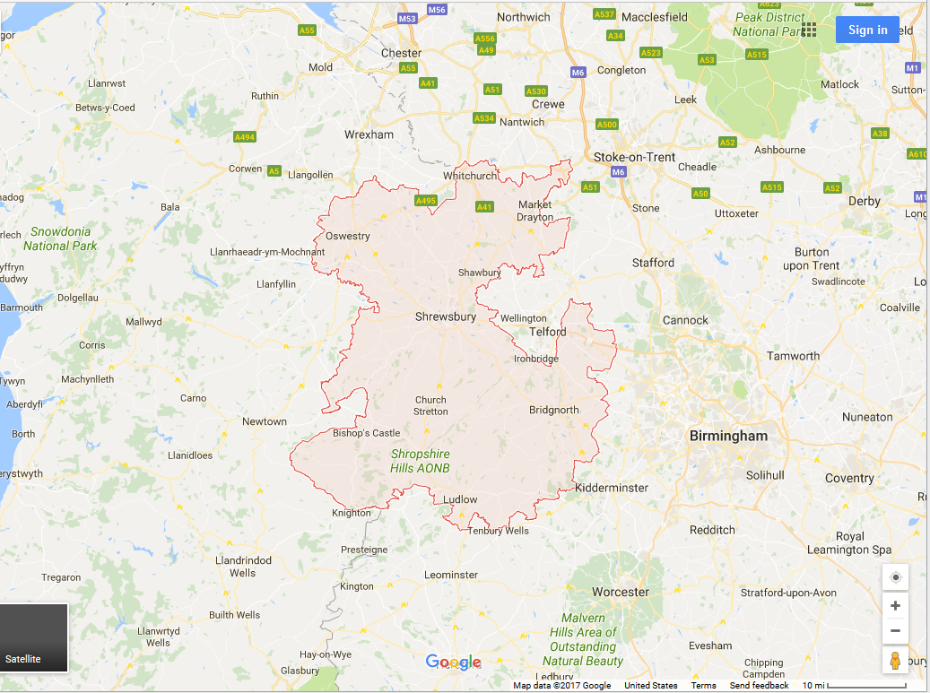
Shropshire

Slide 8
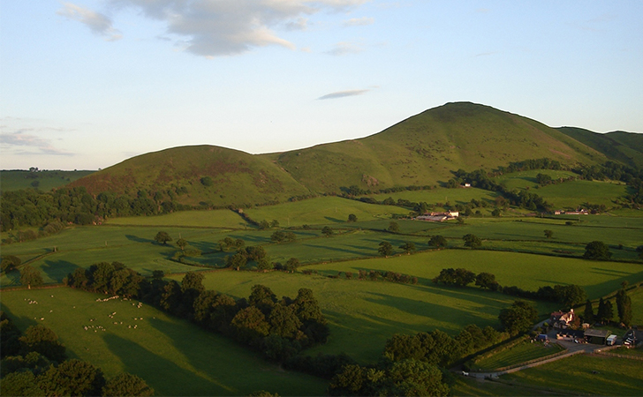
Hidden Caves
The pub patrons described to him a network of caves lurking somewhere underground. From the sound of it, the story seemed more like a legend passed down from generation to generation than something anyone had ever actually witnessed. Shropshire was a large area with many rolling hills. It wouldn’t be any simple task, but Michael was determined to find these caves and be the first to ever photograph them.

Slide 9
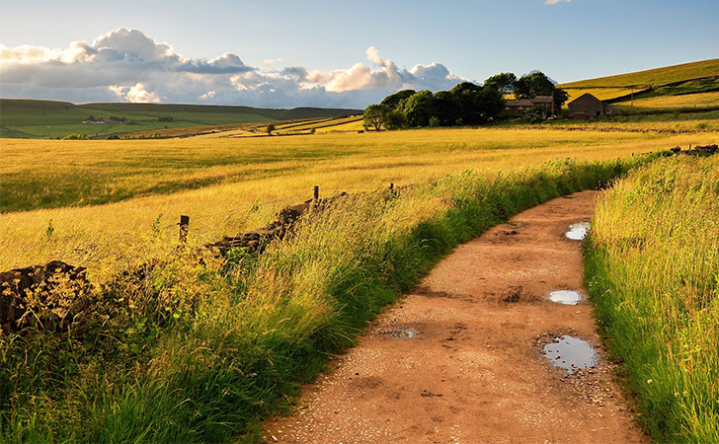
Through Hills and Fields
The only hint Michael had to go on was that the underground caves were used as burrowing grounds for rabbits. He’d have to find rabbit holes. After some research, Michael determined that rabbits stick closely to farm houses in remote locations, so search farm houses in remote locations he did.

Slide 10
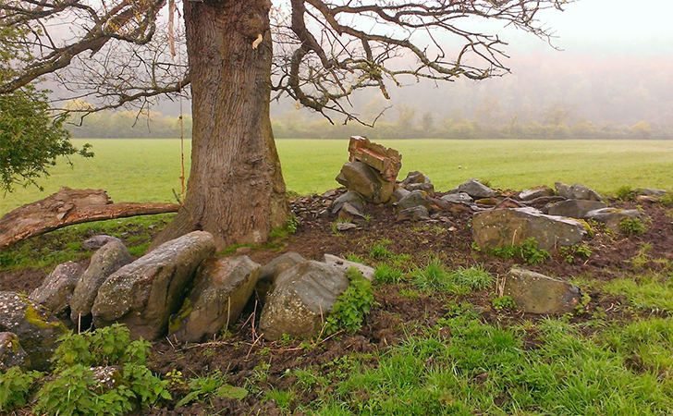
Narrowing It Down
After many grueling hours with nothing to show, Michael recalled another tidbit of information: rabbits tend to dig closer to trees, as the roots provide something of a safe haven for them. “I traipsed over a field to find it,” said Michael of his trek. “If you didn’t know it was there you would just walk right past it.”

Slide 11
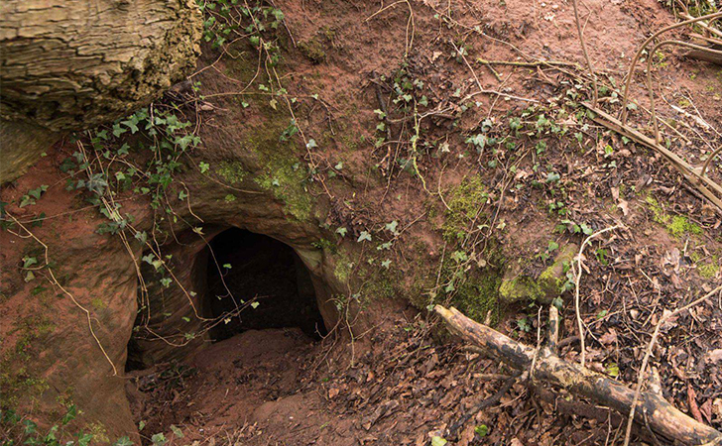
Eureka!
Finally, when he was about to give up and head home, Michael found the rabbit holes. They looked as typical as any rabbit hole could appear. But the photographer knew that there was a discovery lurking in those dark interiors. He had a gut feeling about this one.

Slide 12
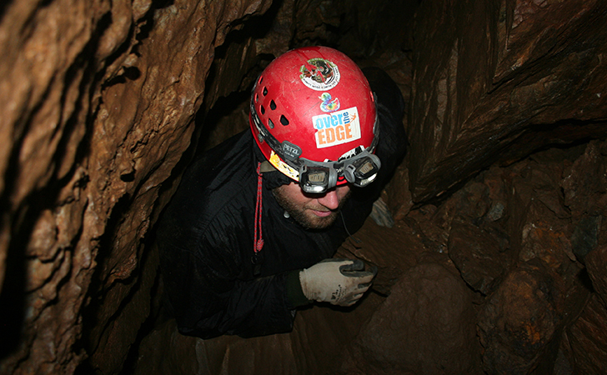
Coming Prepared
Michael was exceedingly grateful he came prepared for spelunking, because that’s essentially what he had to do after he crawled through the rabbit hole (after he widened it a bit). He knew he was in the right place when the dirt turned into hardened stone.

Slide 13
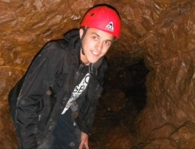

Slide 14
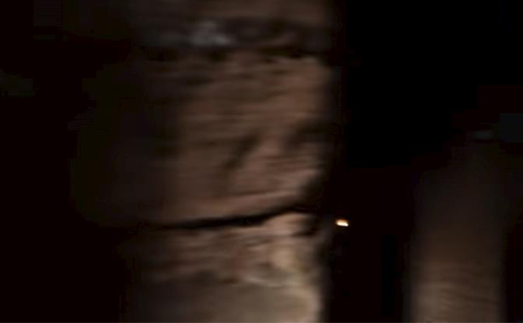
Cramped Spaces
With the natural light waning, it became harder for Michael to see. It didn’t help that rain had made the descent slippery. Things were finally made easier once the hole opened up into a large cavernous space. “I had to crouch down, and once I was in, it was completely silent,” he explained. “There were a few spiders in there but that was it.”

Slide 15
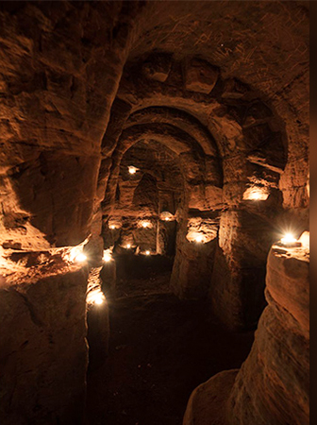
Opening Up
Michael came across a candle, then another, then another. He lit them as he went along, and by the 10th one he had illuminated a large section of a cave. The rumors were real! And they weren’t natural caves, either — there were carved out walkways and arches.

Slide 16
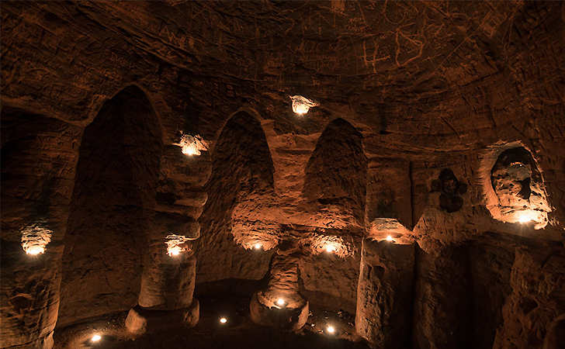
Magnificent Caverns
Michael wandered about in utter amazement at what he had found. Though they clearly hadn’t been touched in centuries, Michael wondered how long these caves had been sitting in darkness. This massive discovery would require some thorough research….

Slide 17
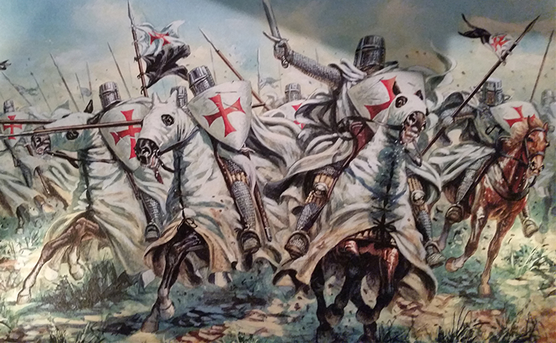
Some Fact Checking
If Michael’s research was correct, these caves were used by the Knights Templar following the fall of their order for initiations and prayer chambers. But who exactly were the Knights Templar, and who originally constructed the network of underground caves?

Slide 18
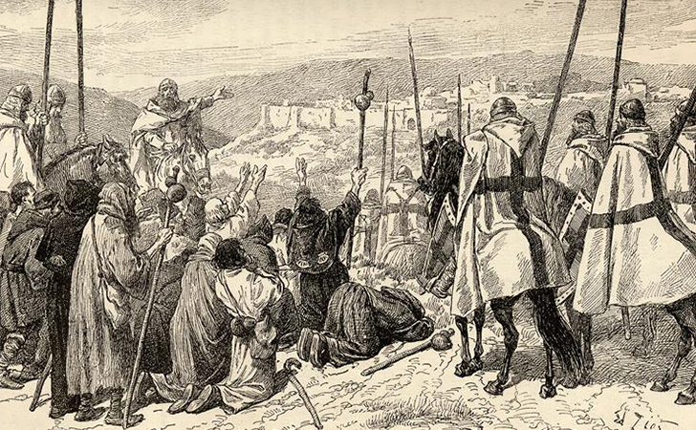
A Brief History
Founded in the 12th century, the Knights Templar were a military order formed by the Catholic church. Sworn and bound by oath, these knights were tasked with guarding and protecting travelers during their pilgrimage to the Holy Land of Jerusalem.

Slide 19
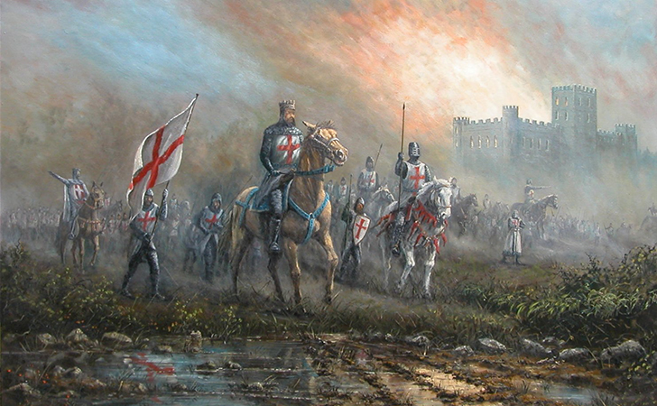
Immense Power
Backed directly by the most powerful religious organization in all of Christendom, the Templars were granted legal privileges. This lead to the rising of Europe’s most powerful and influential group of knights.

Slide 20

Wearing Their Pride On Their Sleeve
In honor of their religious roots, the Templars wore red crosses on their chests and shields — reminders that they were backed by the almighty Catholic church and granted special powers. Despite their grandiose appearance, however, the knights were vicious fighters and brilliant tacticians. They perfected many of the battle tactics famous today during their sieges on the city of Jerusalem — famously known as the Crusades.

Slide 21
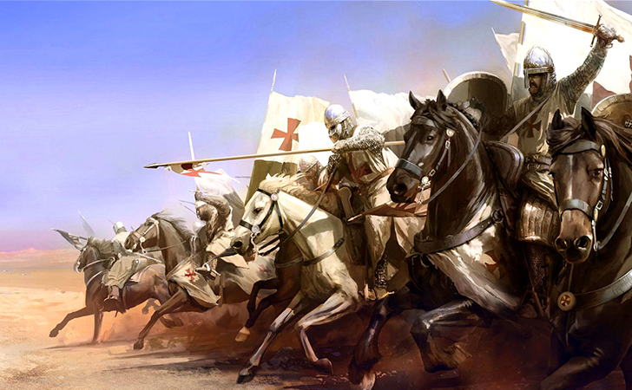
A Noble End
Once the Holy Land was lost, the Templars lost a large amount of support from European kings — particularly King Philip IV of France, who was very much in debt to the Templars and looked for any excuse to discredit them.

Slide 22

Burned at the Stake
It was in their moment of weakness that King Philip made his move. He issued a royal edict and had many members of the Knights Templar arrested and tortured into giving false confessions, after which most of them met their fate at the hot end of a fire.

Slide 23
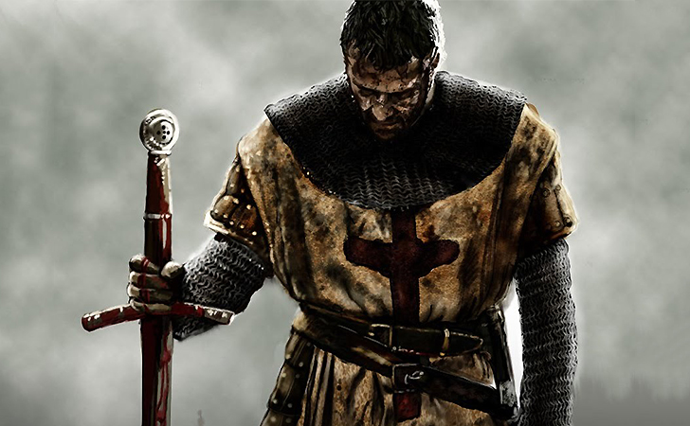
Going Into Hiding
Disgraced and dejected, the few remaining Knights Templar had no choice but to go underground….literally. Vast caverns were constructed in underground caves in the early 1300s where the Templars could carry out their order in secret.

Slide 24
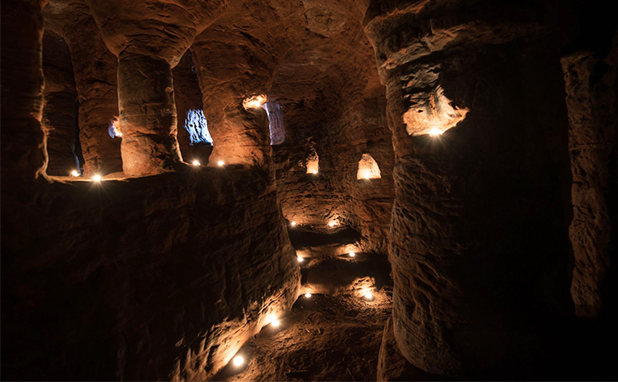
Significant Discovery
Once he had conducted the appropriate research, Michael Scott realized how amazingly significant this finding truly was. These weren’t just some random caves used by peasants to live in. These were caves used by the illustrious Knights Templar in their days of desperation to carry out their order in secret.

Slide 25
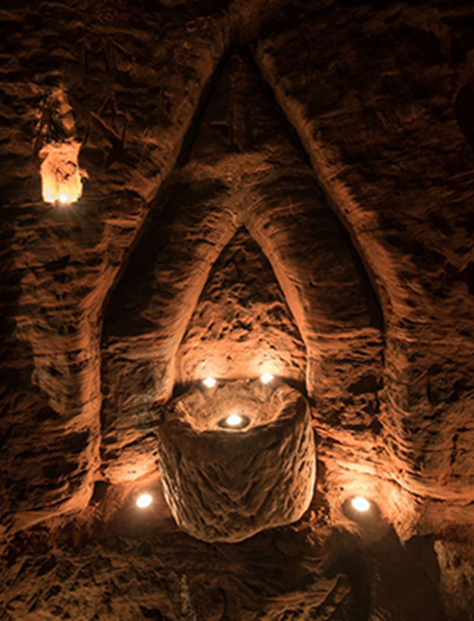
Shrouded In Mystery
The fact that these caves were used for initiations into the order or secret ceremonies hasn’t been definitely proven. This is certainly the logical explanation, though historians have agreed that this simply could be a sensationalized explanation of what they were really used for. Others still have an alternate theory….

Slide 26
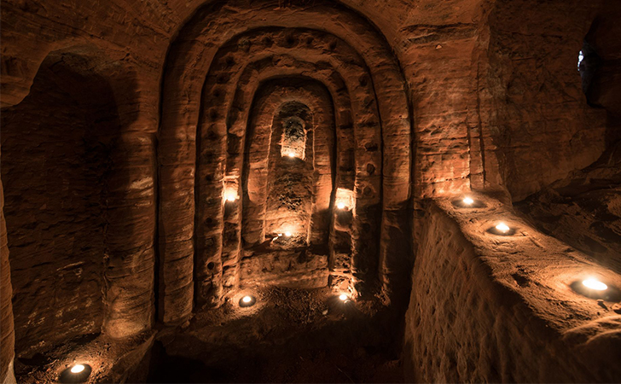
Used For Dark Magic
Some historians believe that the caves were built in the 18th or 19th century, several hundred years after the collapse of the Templar order. It’s speculated that these caves were used by modern-day pagans and witches as a sanctuary for ritualistic black magic.

Slide 27
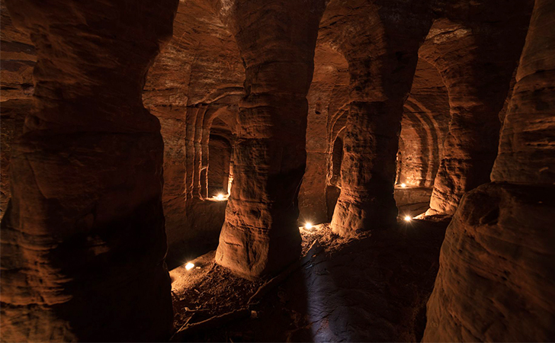
Monumental Discovery
Though it may never be revealed what precisely these caves were used for, they still serve as a reminder of centuries-old history that varied so vastly from our own modern history. Michael Scott lives everyday with the pride that he found and documented something that will be explored and researched for centuries more to come.

