Slide 1
Native Americans
Some cultural elements

Slide 2
The indigenous people of modern America will always be a staple of world history. Native Americans ruled the land before their tragic downfall when the colonies overtook their homelands. Composed of varying ethnic groups, bands and tribes, the American Indian history is rich. The little-known facts, stories and traditions of these people are fascinating, especially since there are tribes in America today as partially sovereign nations. Brush up on your Native American history skills with these little known facts.

Slide 3
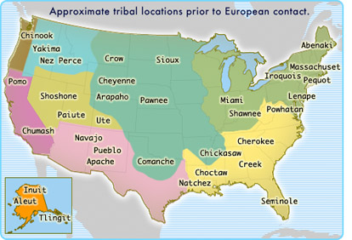
Few Generalizations Can Be Made
There are 566 federally recognized American Indian and Alaska Native tribes and villages in the United States, each with their own culture, language and history. Every tribe has unique traditions and distinct styles of housing, dress, and food.

Slide 4
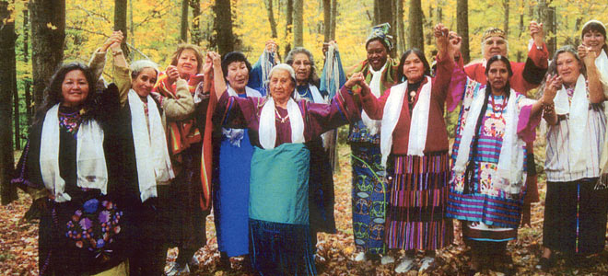
“Without your language or your land, you are not who you say you are.” Loretta Afraid of Bear, Oglala Lakota

Slide 5
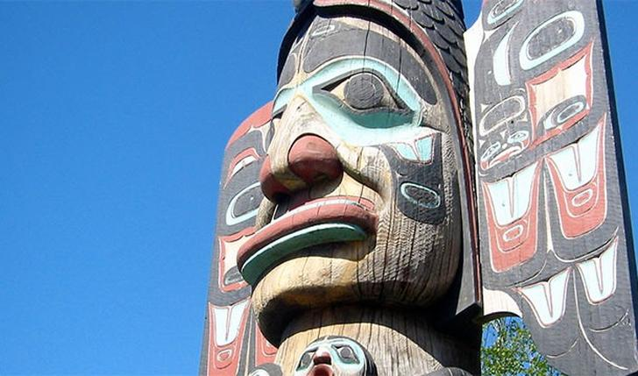
Totem Poles
Native Americans would build totem poles from scratch from poles or pillars. They include symbols and faces often describing the status of the family. Totem poles were typically made from red cedar. They were mostly built by Native Americans living in the Pacific Northwest regions.

Slide 6
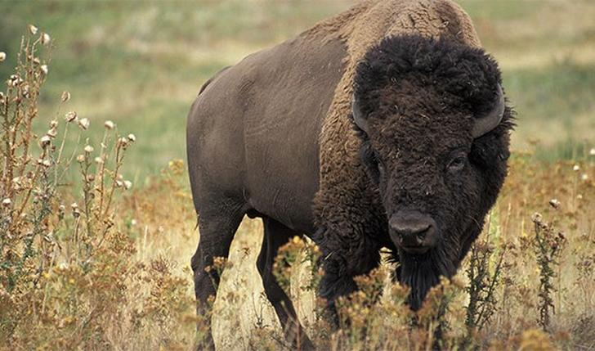
Native American Buffalo Ettiquette
Especially with the Plains Tribes, Native Americans hunting buffalo would use three methods: the impound, the buffalo jump, and the horse-mounted hunt. Buffalo was considered the real food of the land. When a Native American had his first buffalo kill, it was customary for the hunter to be offered the tongue to eat. However, it is expected that the hunter share with friends.

Slide 7
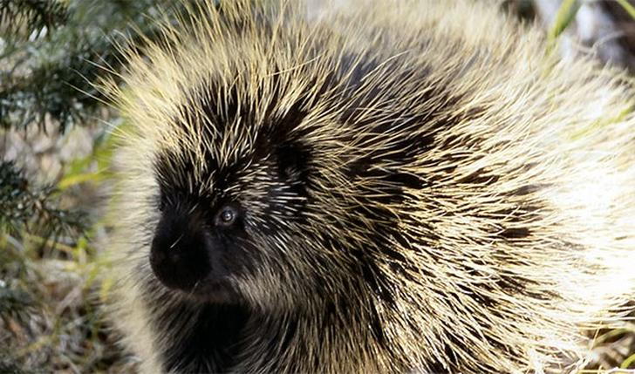
Porcupine Quill Uses
The quills of the porcupine were very useful for Native Americans. They would use them for hair brushes and other grooming. They would also master a practice that is still used today - - quillwork. Quillwork is an art form where porcupine quills are woven in different forms including loom and embroidery. The quills would be reshaped and dyed using natural plant-based dyes and used for multiple purposes, such as embellishing clothing.

Slide 8
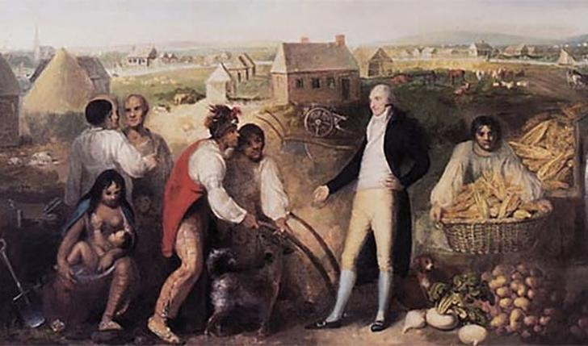
Civilization
Many tribes seemed to be so different from those of Europeans. However, a few tribes impressed them because of their planned farms and villages, showing a civilized social system. These tribes were the Cherokee, Choctow, Seminole, Creek and Chickasaw.

Slide 9
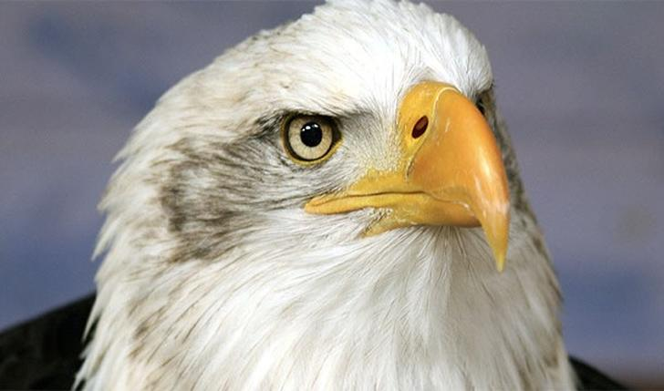
Iroquois Confederacy Bald Eagle
The Iroquois were a powerful part of the Native American Confederacy in the northeast. The totemite of all the Iroquois was the bald eagle. It represented peace and protection. Oddly enough, this influence may be what drove the decision to put the bald eagle on the US Shield.

Slide 10
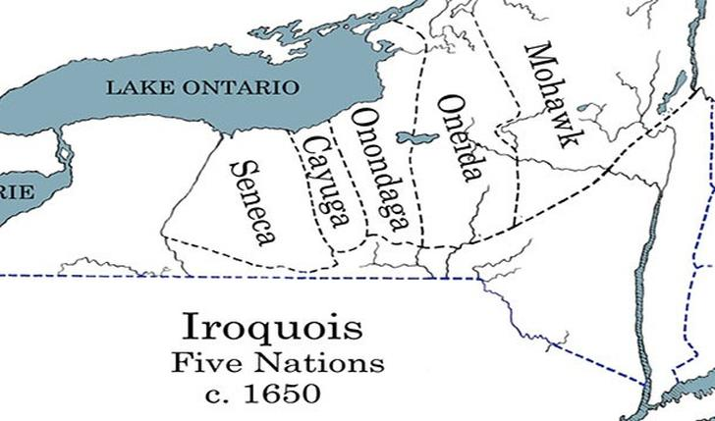
Five tribes of the Iroquois
Can't we all just get along? That's what the Haudenosaunee, also known as the Iroquois, did when prior enemies came together. The five original tribes in the 1600s, the Seneca, Cayuga, Onondaga, Oneida, and Mohawk, decided to create the Iroquois Confederacy to establish a strong and powerful peace within their land.

Slide 11
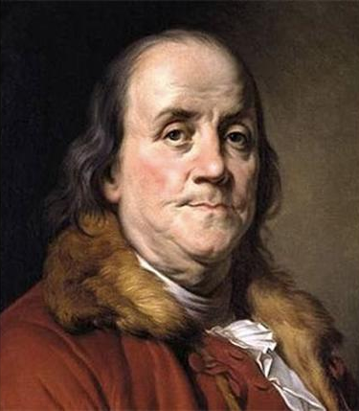
The Iroquois Impressed Benjamin Franklin
The Iroquois Confederacy impressed Ben Franklin. He saw the successful group as showing signs that their system worked. Franklin thought their government system was something the colonies could emulate.

Slide 12
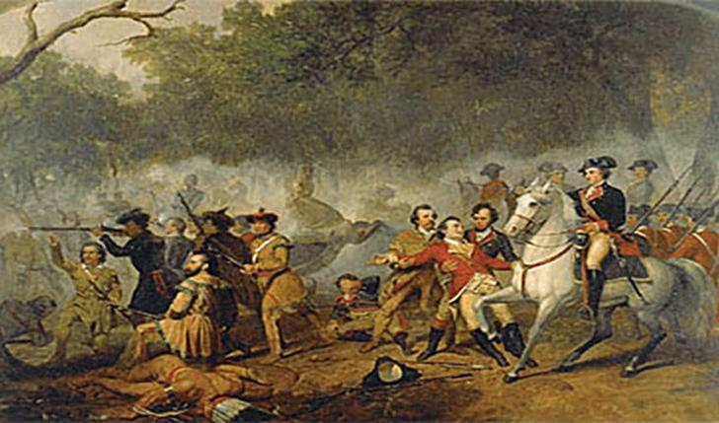
Taking Them Out
Governments and peoples in both Canada and the United States decided to go against the Native Americans. Forces purposefully tried and essentially succeeded in removing the Indian tribes from any rule and control. Eradicating native cultures by force was essentially common practice.

Slide 13
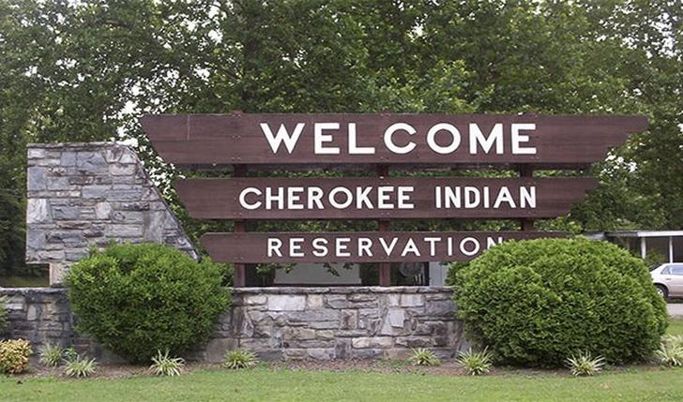
Reservations
The US Bureau of Indian Affairs made legal reservations to be run by Indian rule, without the infiltration of United States democracy. It is believed that out of the over 5 million Native Americans living in the US, 22% live on the reservations.

Slide 14
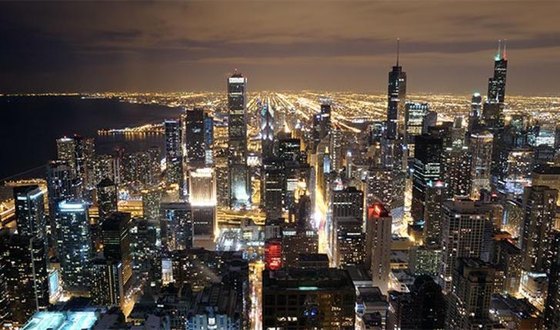
Big City Start
Many of the big US cities we know today actually started out as trading posts for Indian tribes. Detroit, Kansas City, Pittsburgh, and Chicago are all major cities which started out as Indian trade posts, forts and then cities.

Slide 15
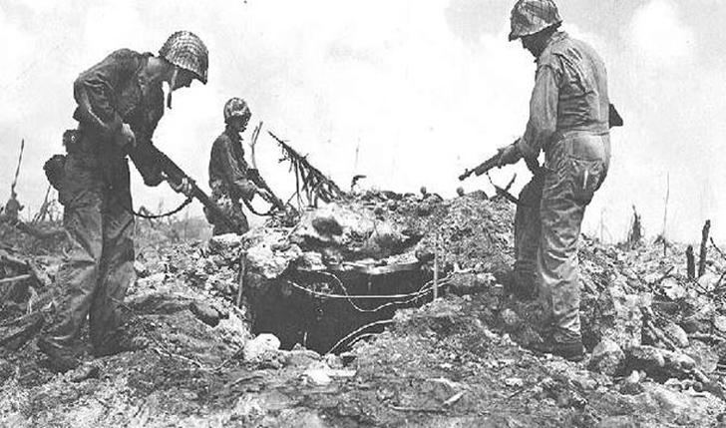
Devoted Native Americans
When World War I came about in 1914, members of the US government mandated the Native Americans to be drafted. It was confusing because the Natives were not citizens. It turns out, about 12,000 Native Americans volunteered to fight in World War I.

Slide 16
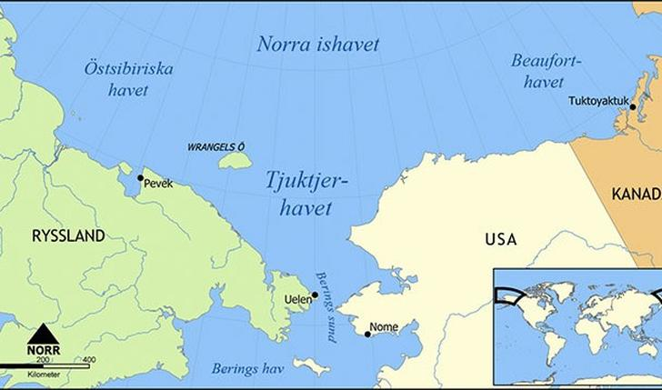
Diverse Languages
Although many original Native American languages are extinct today the almost 300 Native American languages vary across the US. It is too difficult to pin-point where each language came from. Instead, researchers believe the languages came from three regions of migration. Eskimo-Aleut, Na-Dene, and Amerind are the three distinct groupings, but many experts reject this idea.

Slide 17
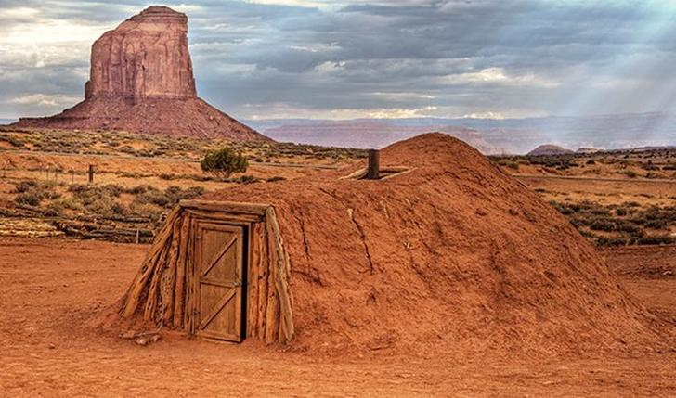
The Hogan Shelter
The Hogan shelter is a traditional Navajo home. They are still used today, especially in ceremonies. Hogan's are constructed of mud, bark, thick tree branches, and sometimes stone.

Slide 18
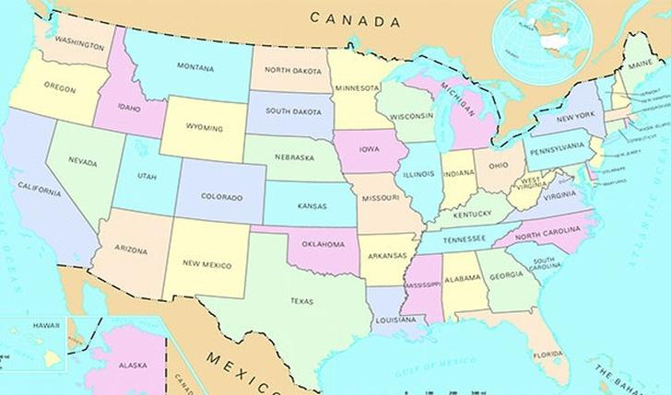
Some US States Are Named After Native Americans
There are 26 states named after Native Americans. Some are named after a tribe, such as Alabama (Alibamu tribe, meaning "clears the thickit"). Others are named after Native American language, such as Massachusetts (means "about the big hill).

Slide 19
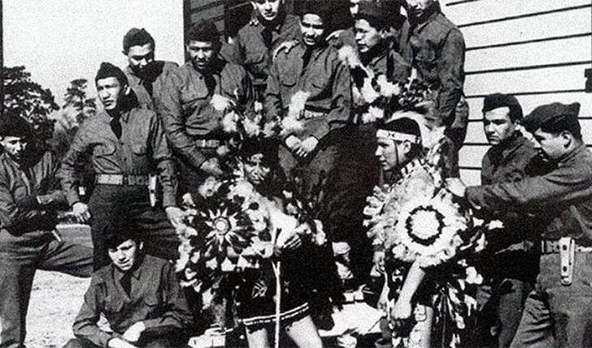
Navajo Language
The Navajo language is very complex. It is so complex, it is very difficult to learn and understand. During World War II, some Navajo Native Americans were used in the battle to "speak code" over the airwaves. Because of the Navajo language, enemies were unable to break the code, and Americans were successful.

Slide 20
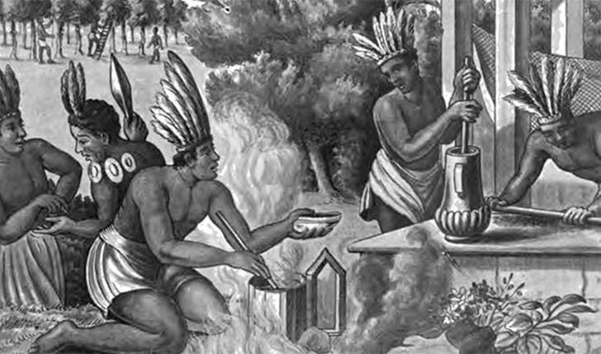
Cacao Chocolate Drink
Cocoa was popular among the Native Americans. They would grind the cocoa bean with stone into a fine powder. they would then mix the powder with boiling water and sometimes pepper. The drink would be cold in the summer and thick and warm in the winter months. The cocoa was often used as a clan symbol, and was even traded like currency.

Slide 21
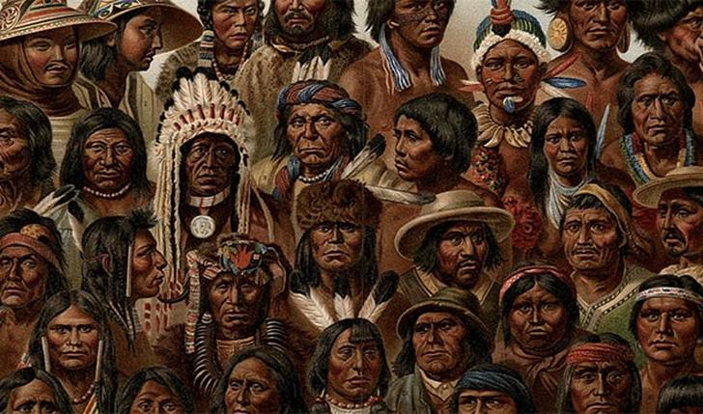
American Indian Removal
While some vain attempt to integrate Native Americans into society, such as bringing them to school and showing the ways of the white people, things didn't work out. Although courts ruled in favor of the Native Americans, they were still treated terribly and forced from their homelands. Tribes were removed and sent to other areas as settlers saw fit. Many Native Americans passed away and there was a great decline.

Slide 22
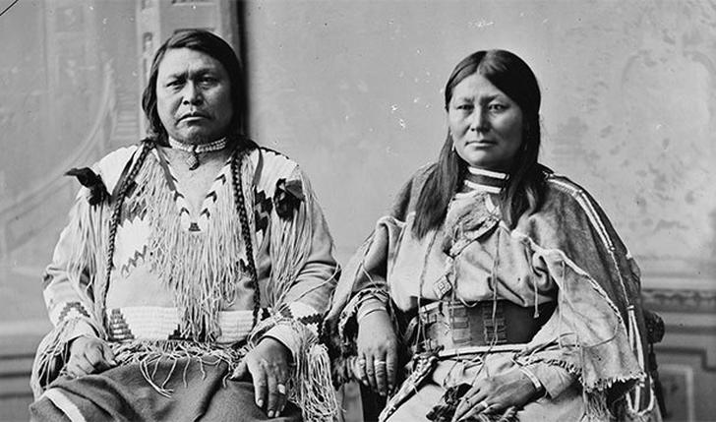
Chief Ouray and Chipeta
Ouray married Chipeta after his first wife died and his son was taken by the Sioux tribe during an attack. When Ouray's father passed, he became Chief of the Ute tribe. The couple was fluent in many languages, and became diplomats for the Native Americans. They spent their lives fighting for their original homeland, but they were denied and were continued to be forced out of their land. Despite this, Chief Ouray and Chipeta are respected as peaceful diplomats in Native American history.

Slide 23
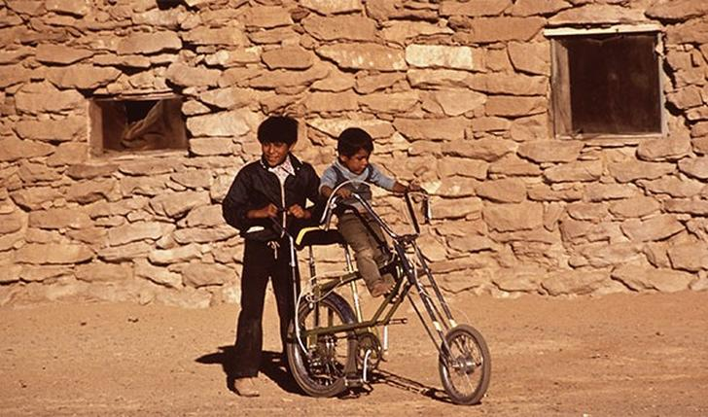
Native American Children on Reservations
Pictured are two children on a Hopi reservation in the 70s. Today, approximately 40% of children on reservations are under the poverty level. Housing conditions are poor and unstable, and there isn't enough food. Many of the reservations were forced on infertile soil, making it difficult to sustain crops. Jobs are scarce for Native Americans and college graduates are around 11%. Native Americans definitely need support and aide continually.

Slide 24
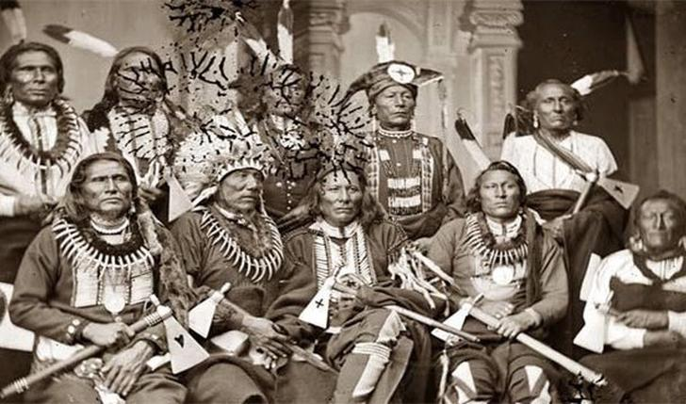
Native American Chiefs
Pictured is a group of Native American Chiefs posing for their picture. They are adorned in traditional garment and ornate, hand made ornaments. They also pose with their tomahawks. This photo was taken in 1865.

Slide 25
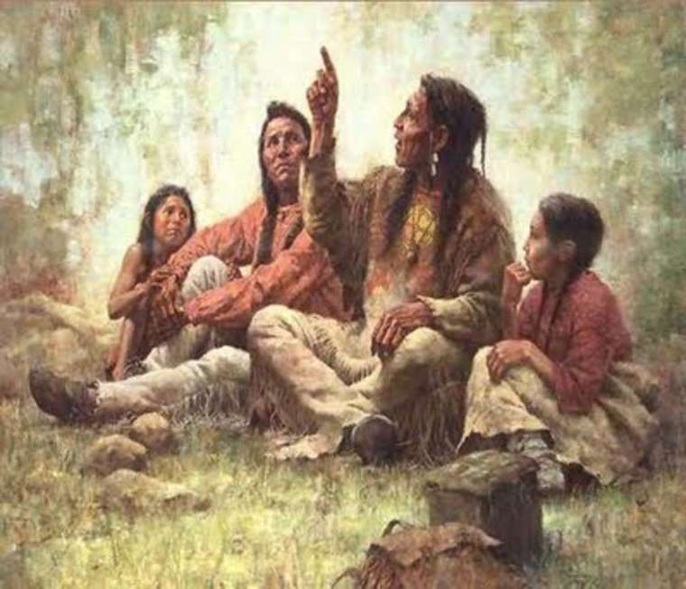
Native American Religions
Shamanism is the oldest documented spiritual belief system, dating back 40,000 years. It’s practiced in every indigenous culture across the planet. It is an open-source practice rooted in the presence, gratitude, and the inter-connectivity of all things. A “shaman” refers to a person who makes journeys to other realities or “worlds” in an altered state of consciousness. The journeys are intended to heal, get information, or do other things

Slide 26
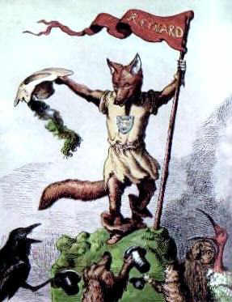
Trickster
What is a Trickster? A Trickster is a legendary supernatural creature that features in the stories, myths and legends of the different tribes of Native American Indians. Tricksters are mythical creatures that are mischievous supernatural beings who take the form of animals such as the coyote, spider, ram, hare and raven. The trickster, who is almost always male, represents uncertainty. The trickster disobeys normal rules and conventional behavior. The trickster loves to upset things and spread confusion. The Trickster can be fun, like a clown, but they can also have a cruel side. The Trickster can be a hero in one tale and a villain in the next tale. His outrageous and totally unconventional behaviour might include lying, cheating, tricking, and deceiving. These traits might be unconscious due to the Trickster being a fool lacking in intellect or may have the deliberate actions of a spiteful spoiler who lacks morality.

Slide 27
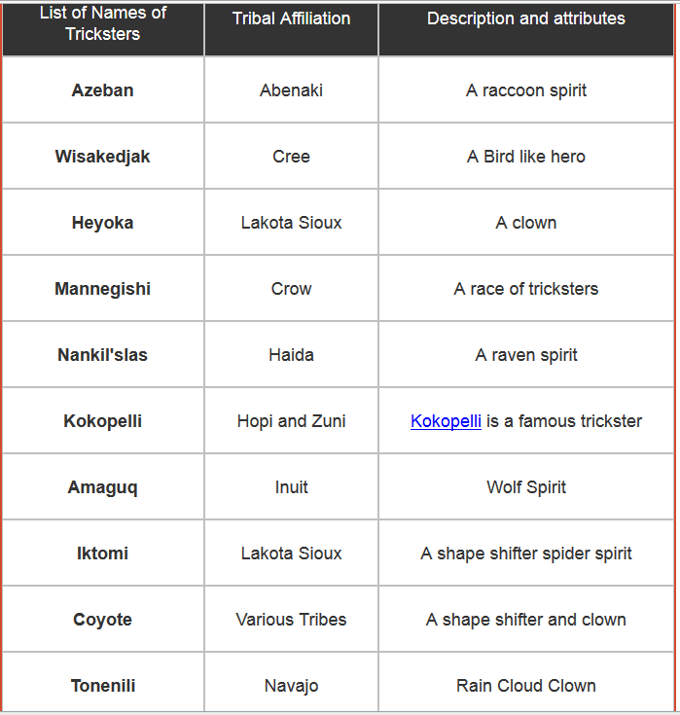
To learn more about Native American cultures:
Indian Tribes | Pictures of the Native Americans
History of Native Americans | Native American Indians
Native American Clothing | The Indian Wars
Native American Houses | Native American Indian Names
Native American Symbols | Native Indian Tribes Index
Native American Culture | Native Indian Weapons and Tools
Famous Native Americans | Native American Life
Native Indian Art | Native American Women

