Slide 1
Man builds low-cost tiny home with recycled materials for $500
Subtitle

Slide 2
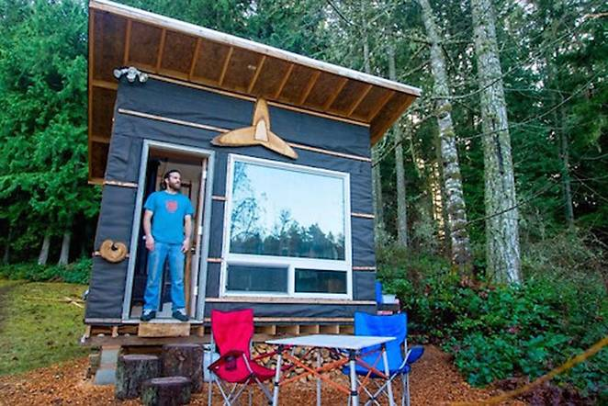

Slide 3
As we've seen with glamper microhomes and high-end, luxurious tiny homes (that come with their own high-end price tag), smaller spaces aren't always as affordable as one may think. However, using salvaged materials and gifted items will keep costs down, as Pacific Northwest resident Scott Brooks did with his tiny home, which he built for "well below" USD $500.

Slide 4
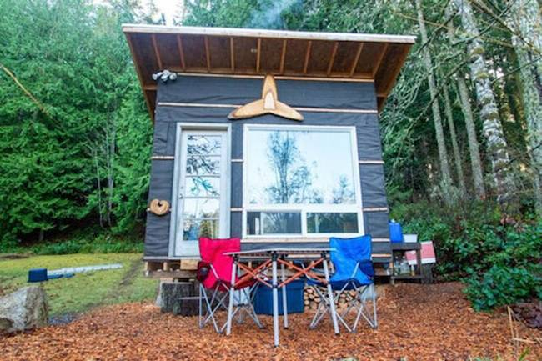

Slide 5
Seen over at Gizmag, Brooks' home is also tiny for a tiny home: measuring only 83 square feet, it sits on a 20-acre piece of land owned by a friend in Washington. Brooks, who constructed the house after a two-year-long journey around Africa, Thailand, India, Nepal, Montana and Alaska, moved back home to settle down a bit, while helping friends start an organic farm. He's dubbed his abode the "Transforming Tiny Home," and built out the interior, while his friend designed the structure.

Slide 6
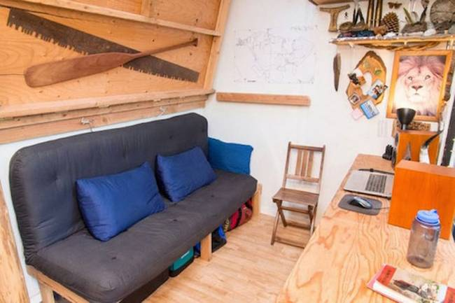

Slide 7
There are no fancy bells and whistles here, no silly, superfluous granite countertops, but the no-frills budget means compromises like no alternative energy options like photovoltaics, no plumbing, no refrigerator, and no cladding (yet) on the exterior. Brooks is connected to the main grid, heating is provided with a gifted woodstove and he uses a nearby outdoor shower and outhouse instead. But the basics are there, and the interior is efficient and compact with a sitting area, fold-down bed, a wall full of hooks and storage shelving, and a generous work surface that doubles as a kitchen, thanks to an awesome, ninja-style hood that hides a portable propane cooktop

Slide 8
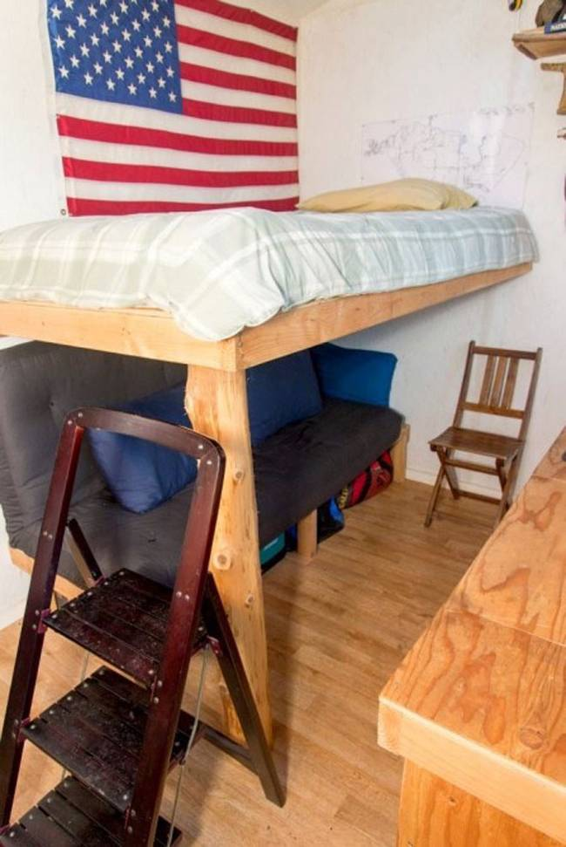
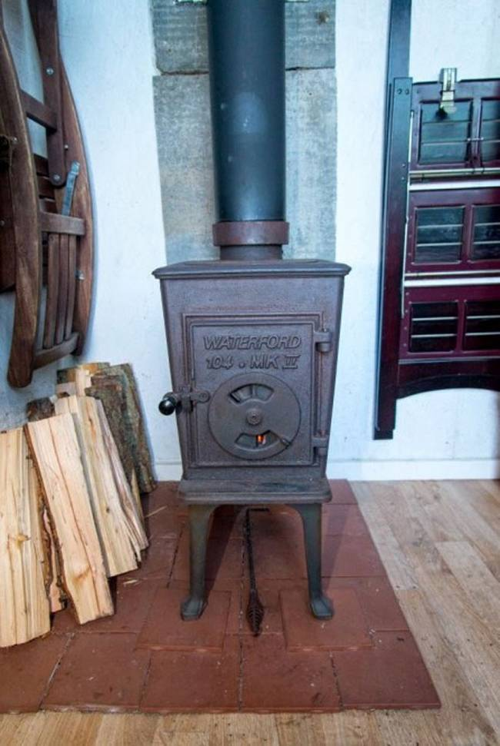

Slide 9
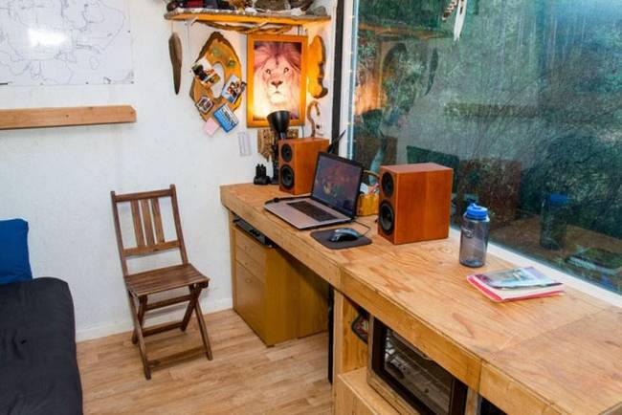

Slide 10
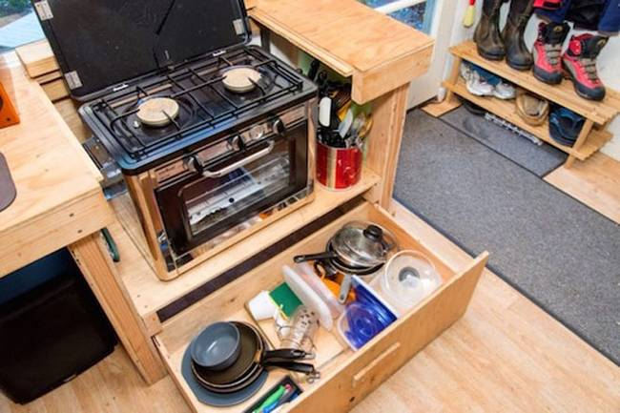

Slide 11
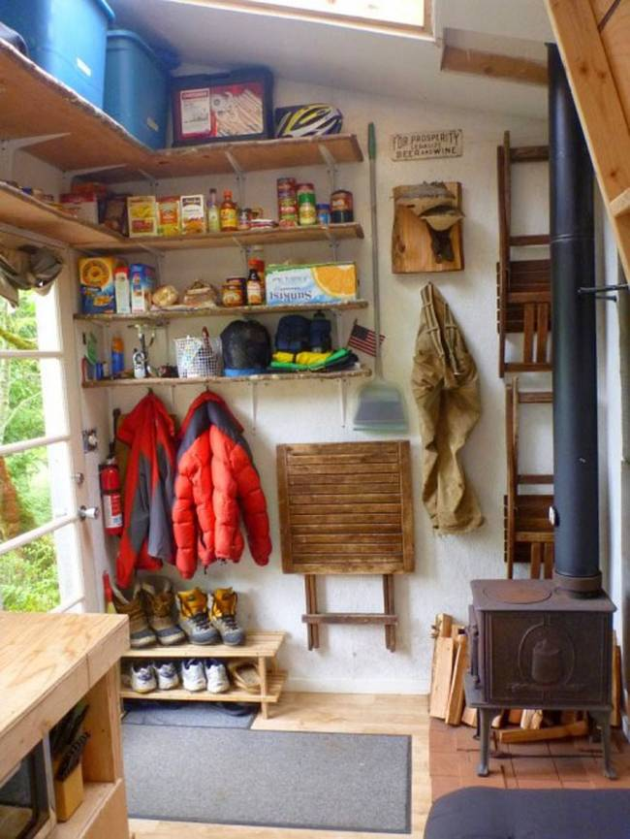
Even though the house is compact, it has a lot of natural daylighting, thanks to a recycled skylight window and a large front window.
It may be a small space, but Brooks makes good use of the wildly beautiful outdoors that is his front yard. With a cost of only $500, hand-built with hard work and made possible by friendship, it's an affordable tiny home to be proud of. More images over atGizmag and Scott Brooks' blog.

