Slide 1
Man Builds Tiny Log Cabin for $500
Subtitle

Slide 2
his man built a tiny log cabin with the help of friends for only $500 in the northern woods of Canada on a private plot of land.
He did it with no building codes because the land is privately owned and there are no permits required in his area for structures that are 10′ x 10′ or less.
The front door used to be a coffee table. This is his first log cabin build and he’s already working on his second one.

Slide 3
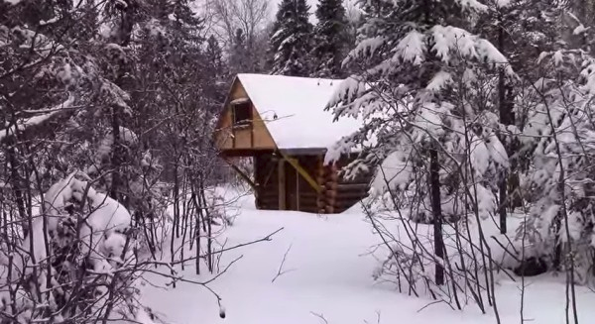

Slide 4
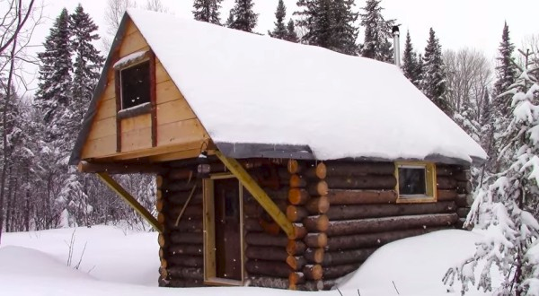

Slide 5
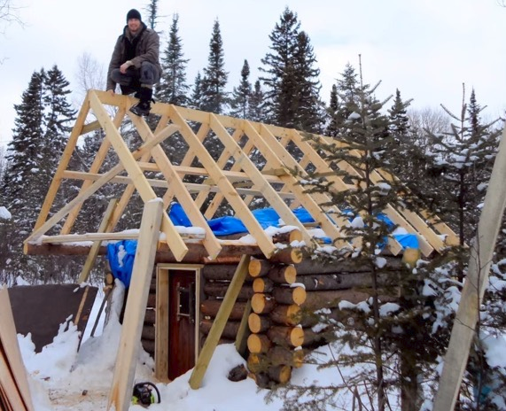

Slide 6
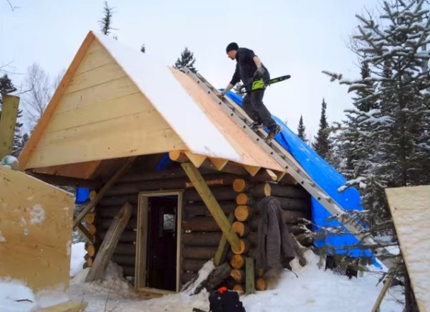

Slide 7
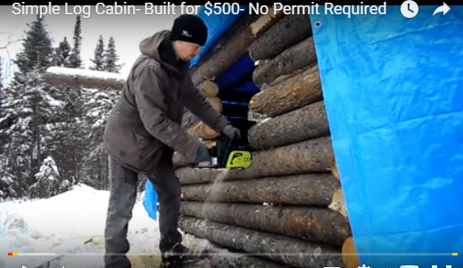

Slide 8
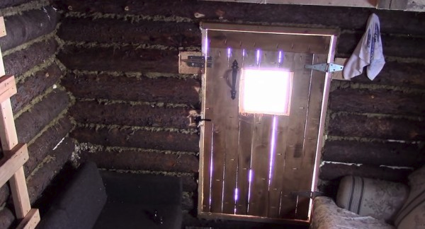

Slide 9
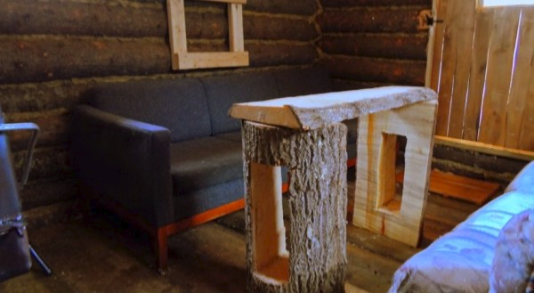

Slide 10
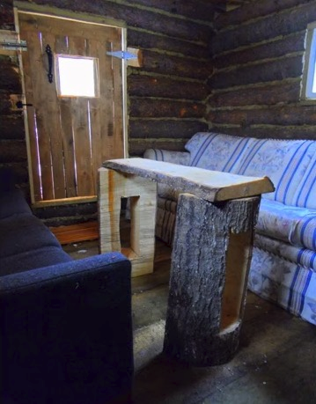

Slide 11
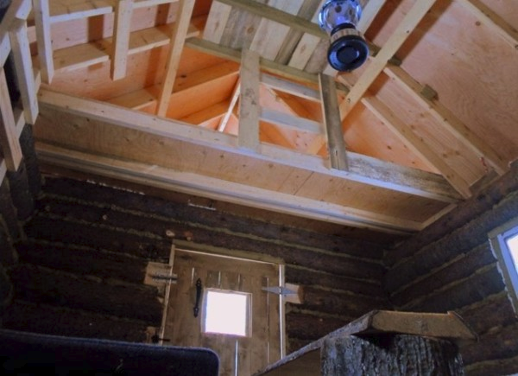

Slide 12
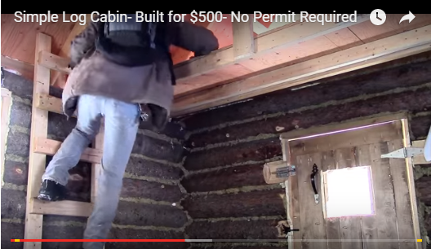

Slide 13



Slide 14
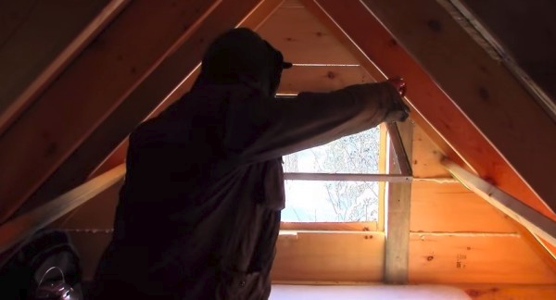

Slide 15
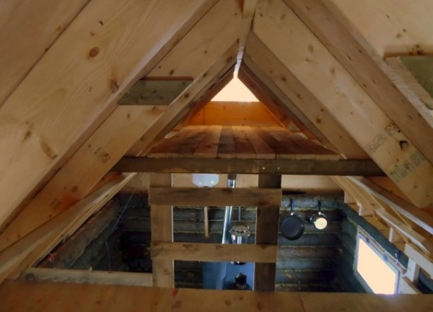

Slide 16
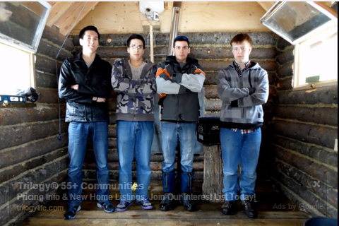

Slide 17
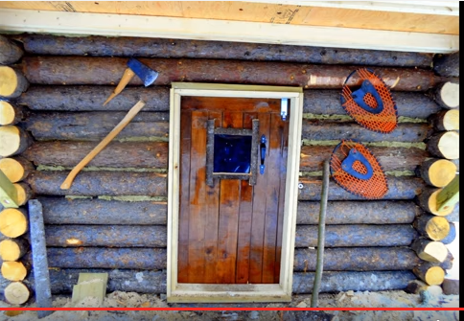

Slide 18
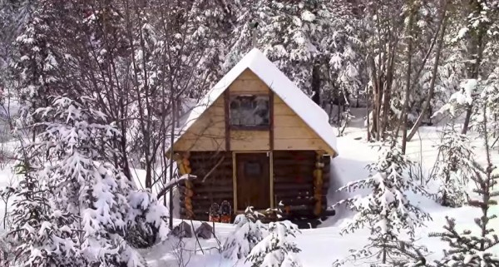

Slide 19
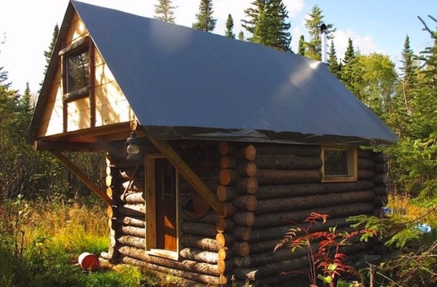

Slide 20
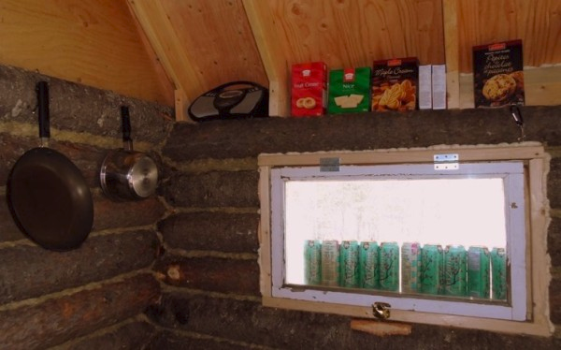

Slide 21
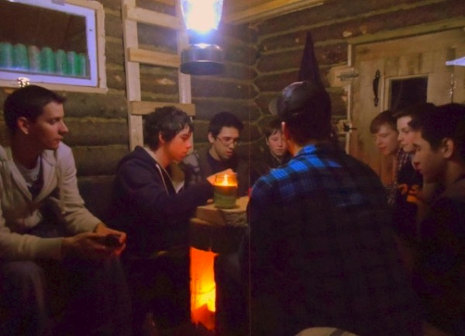

Slide 22
