Slide 1
Living small
This Tiny House Squeezes So Much Style Into 250 Square Feet

Slide 2
David Latimer, founder of New Frontier Tiny Homes in Nashville, Tennessee, and his team have really outdone themselves, packing an unprecedented level of upgrades into 250 square feet. This luxurious tiny home has got everything, down to the hammered copper details and matching Moscow Mule mugs.
As seen on HGTV, and probably every friend's tiny house Pinterest board, the original flagship design from New Frontier Tiny Homes, the Alpha, is one of the most-pinned tiny home designs on the site — and was featured in this inspirational profile on House Beautiful.

Slide 3
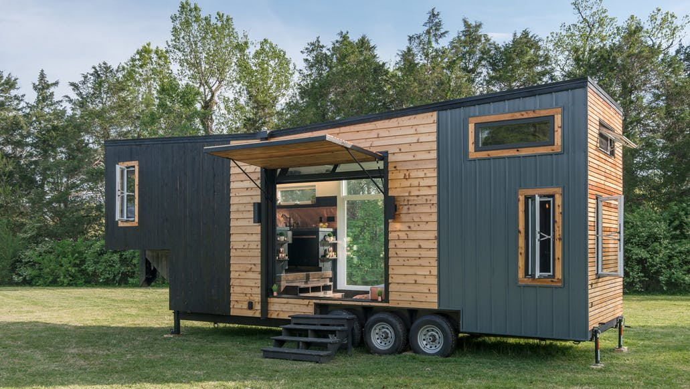

Slide 4
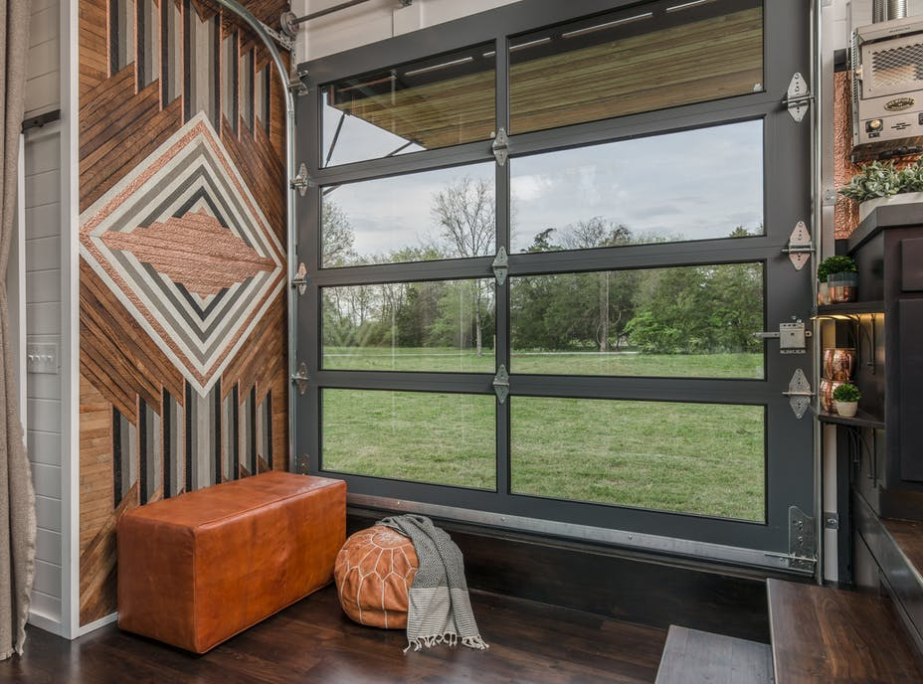

Slide 5
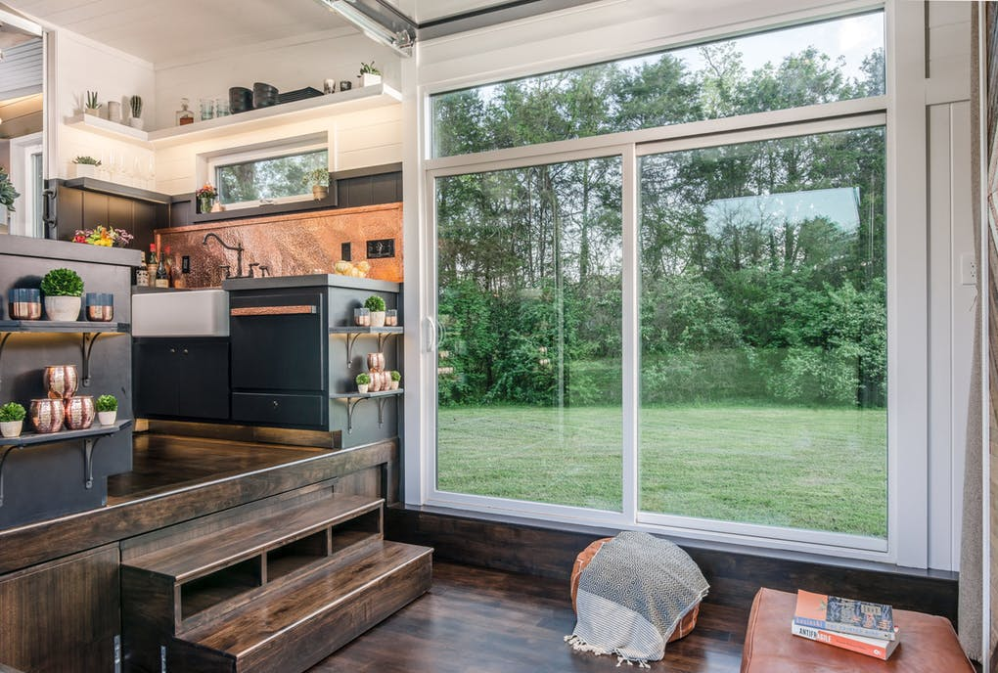

Slide 6
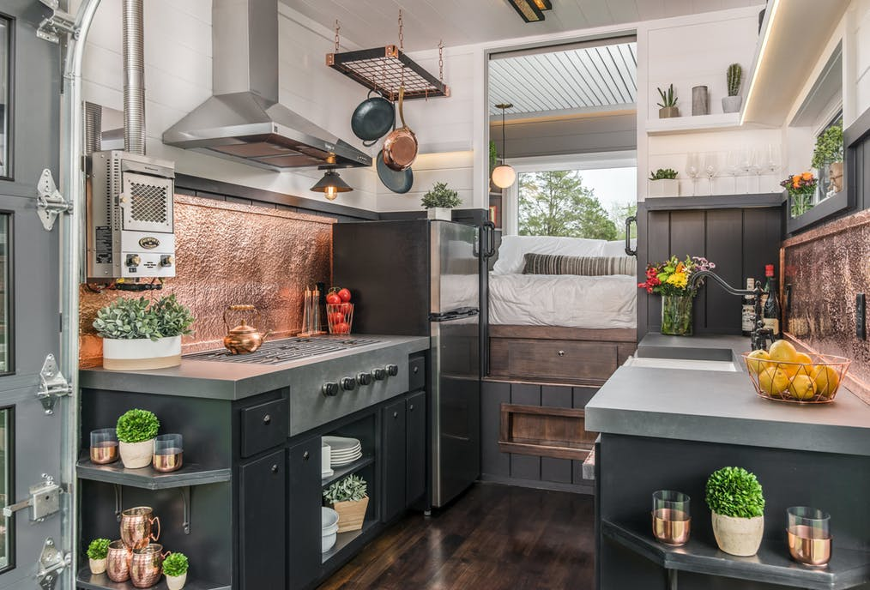

Slide 7
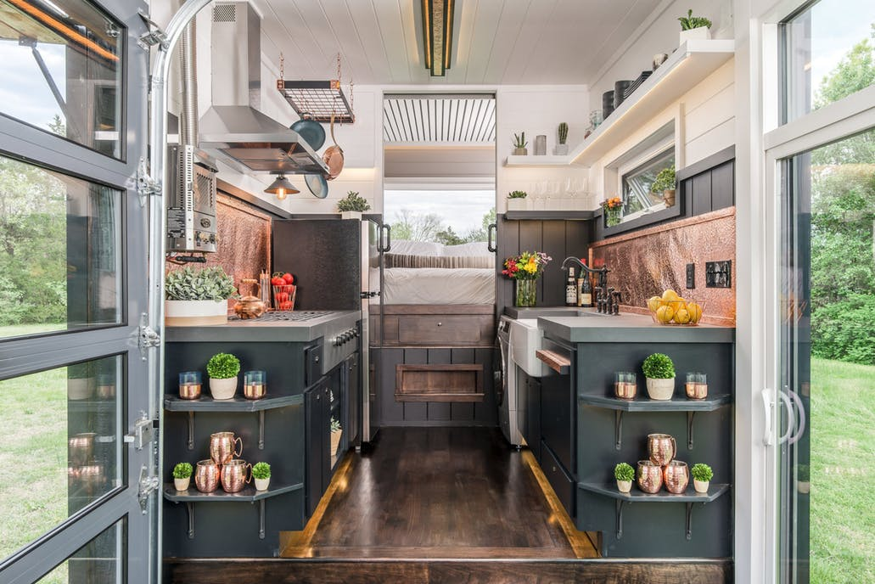

Slide 8
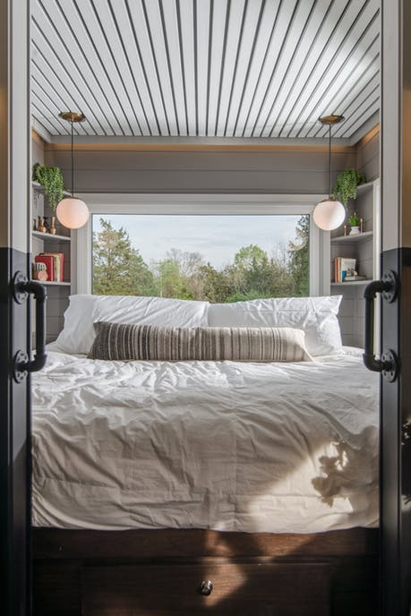
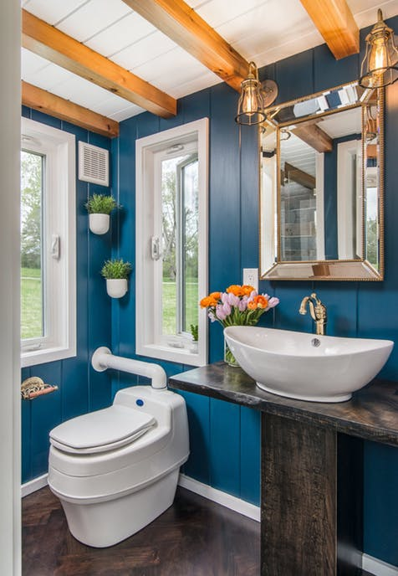

Slide 9
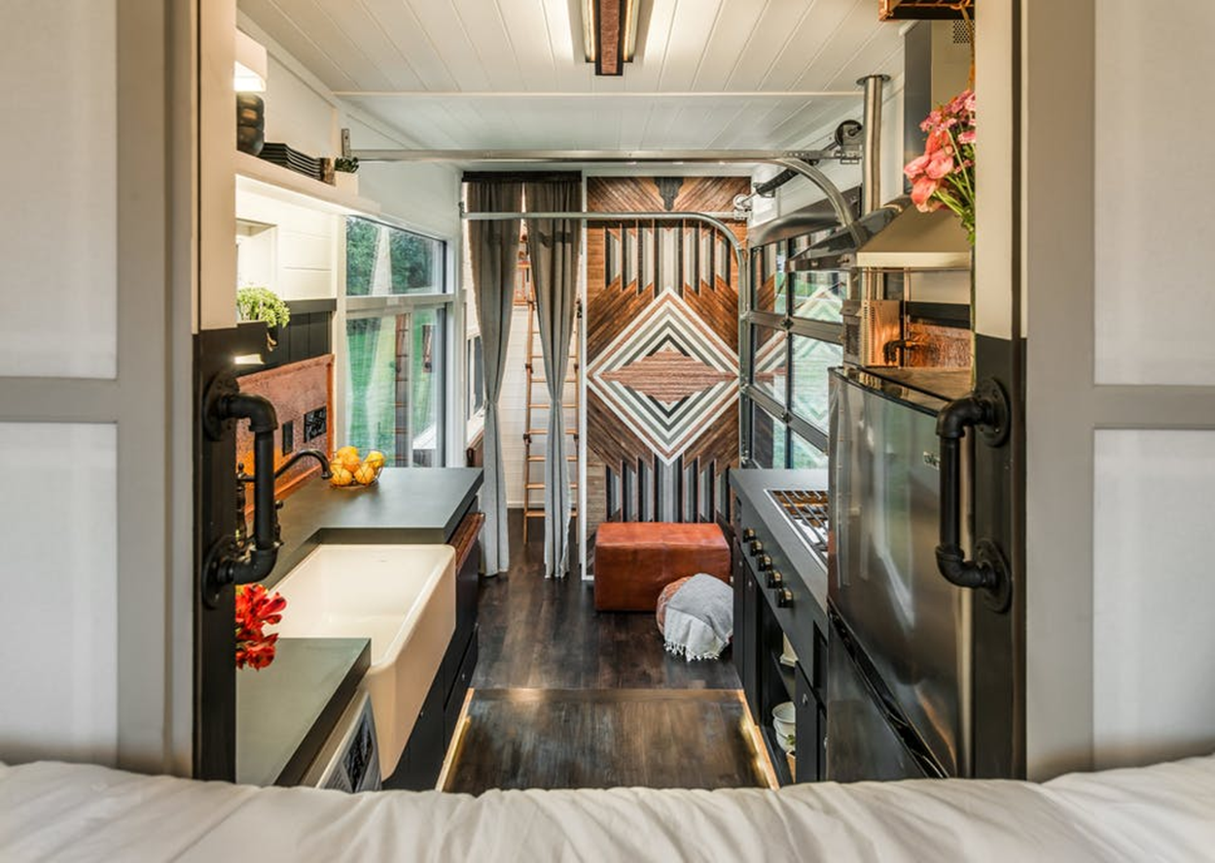

Slide 10
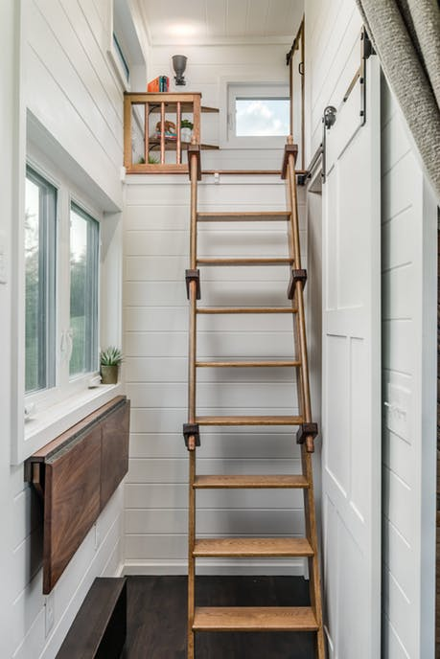
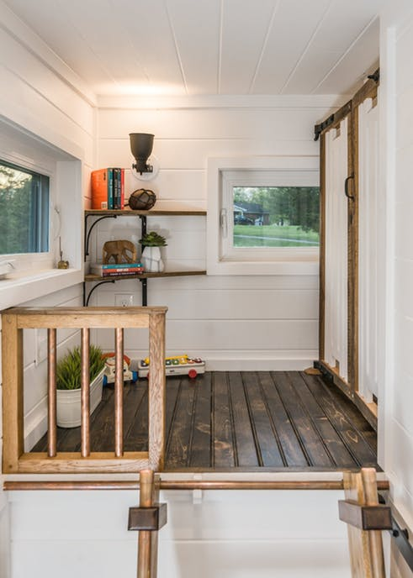

Slide 11
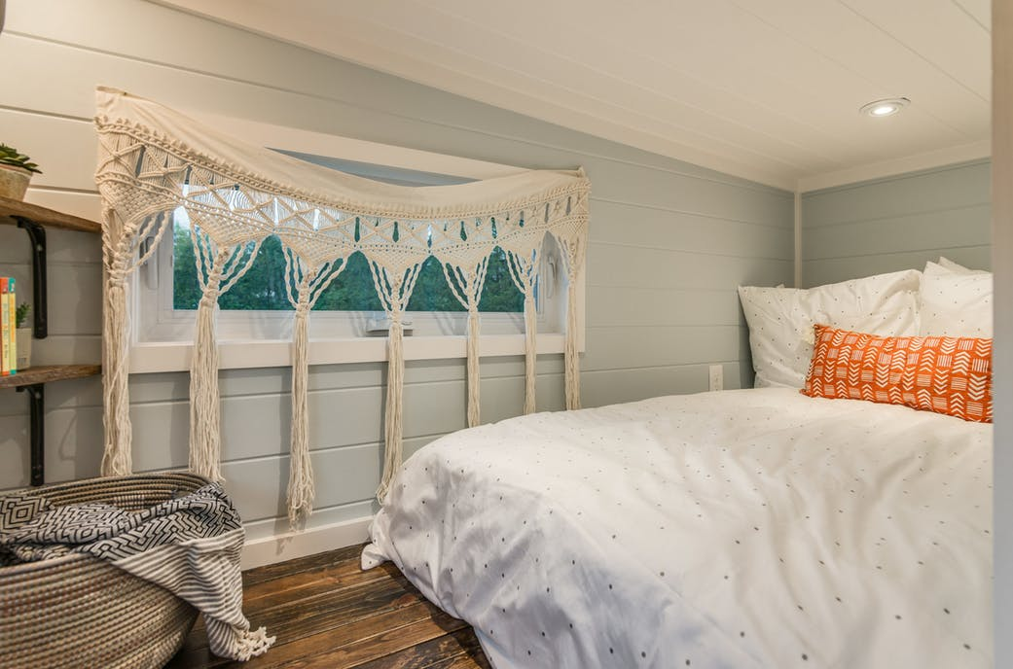

Slide 12
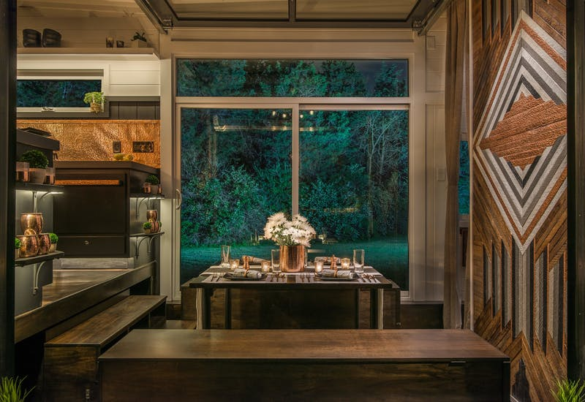

Slide 13
Who Says Every Living Room Needs a Coffee Table? Clever Substitutes in Small Living Rooms

Slide 14
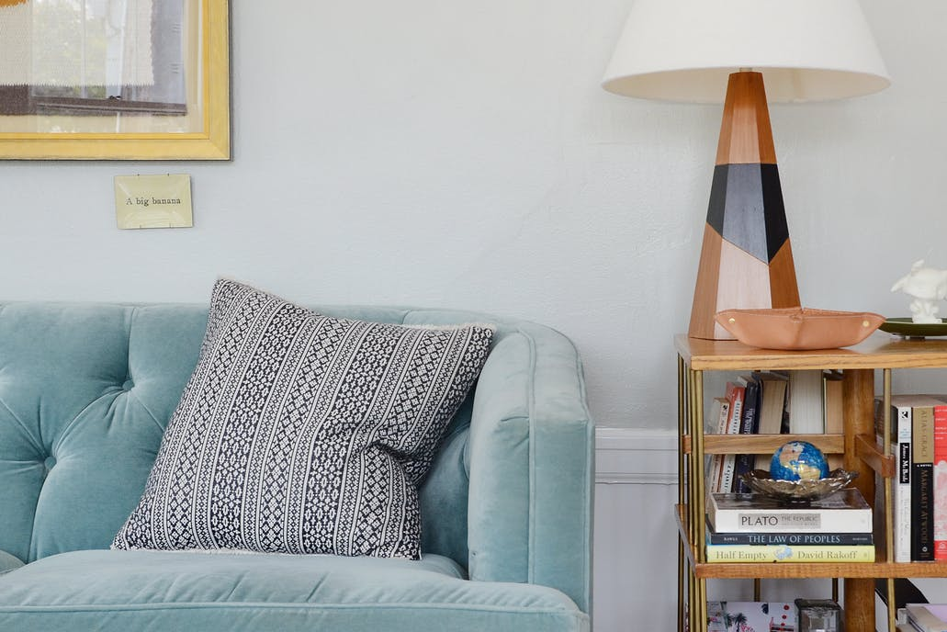

Slide 15
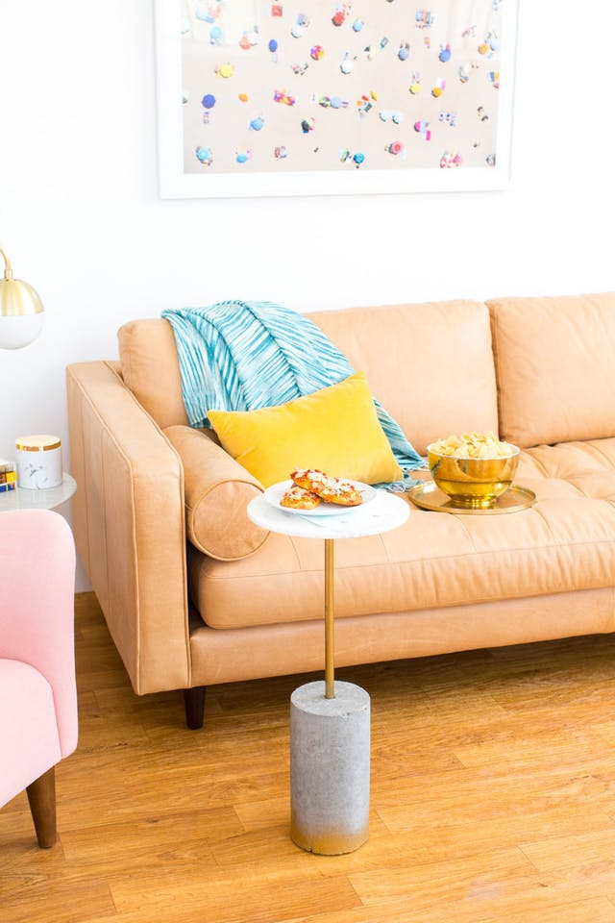
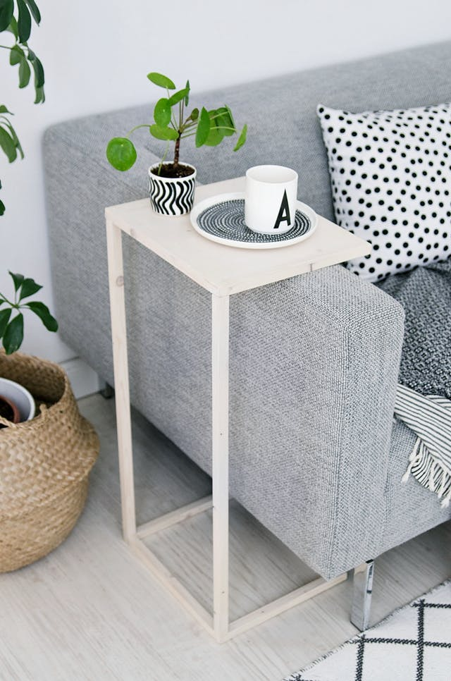

Slide 16
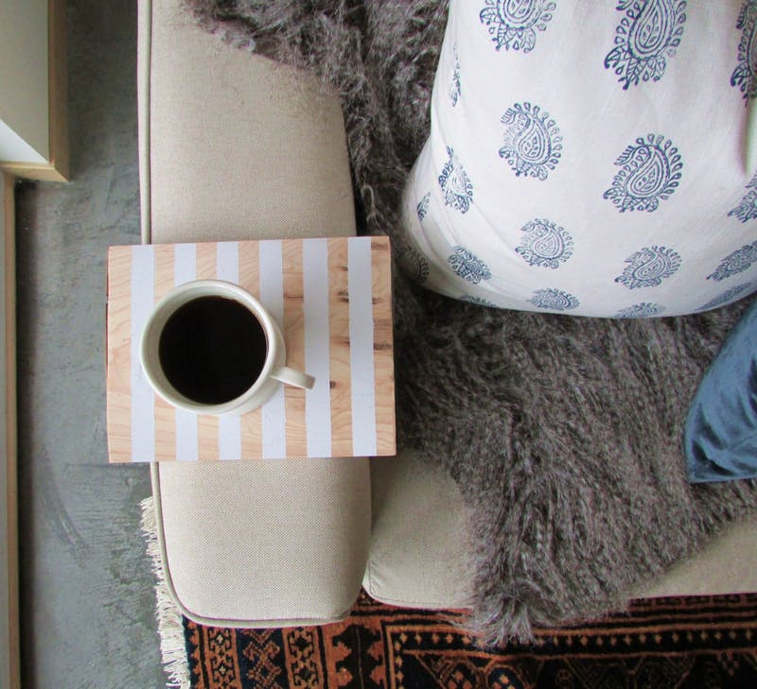

Slide 17
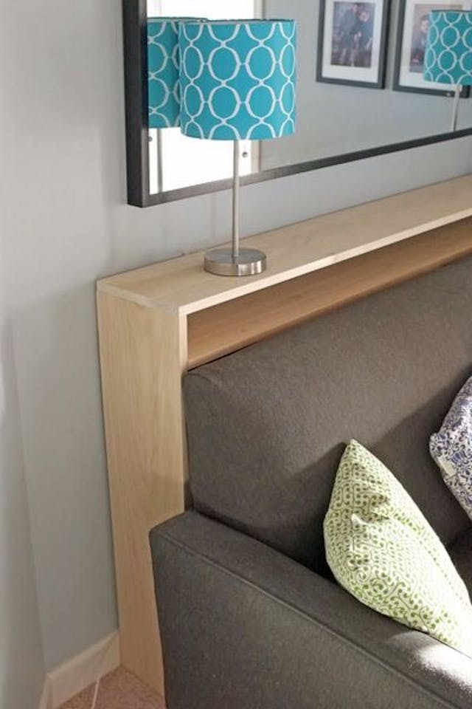
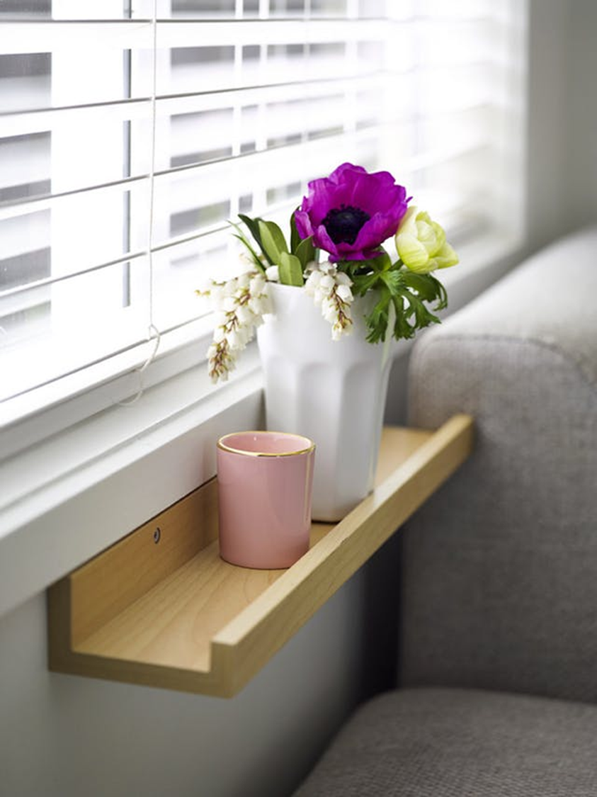

Slide 18
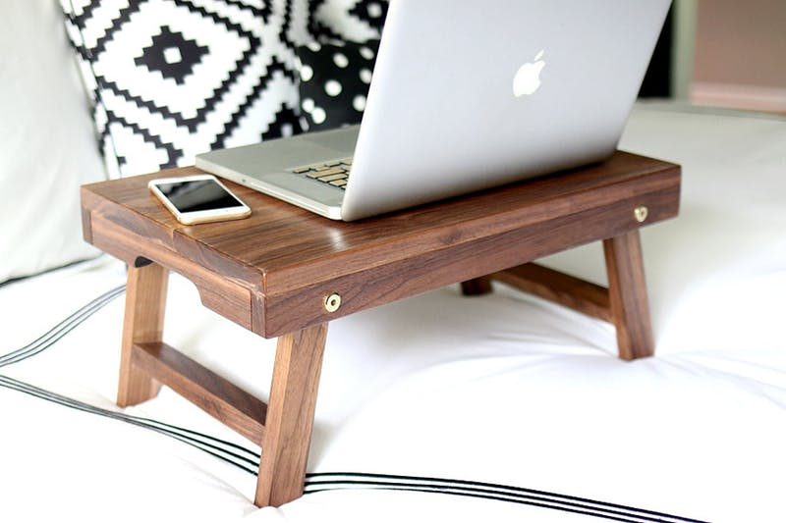
folding lap desk

Slide 19
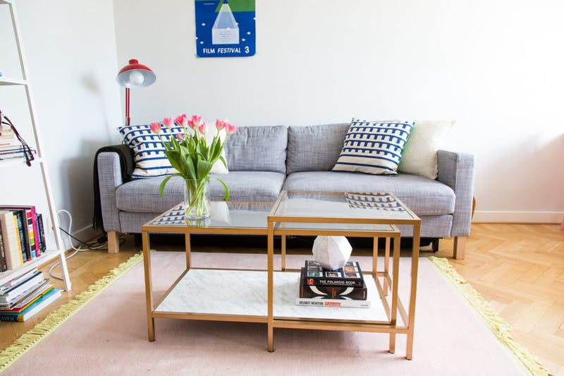
Nesting tables

Slide 20
Cool Repurposing

Slide 21
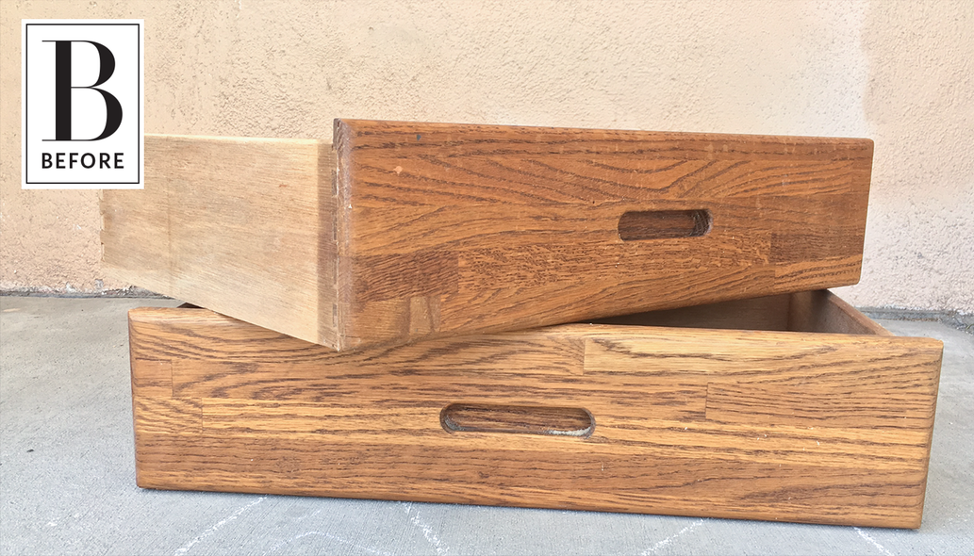
Old drawers found at the curbside

Slide 22
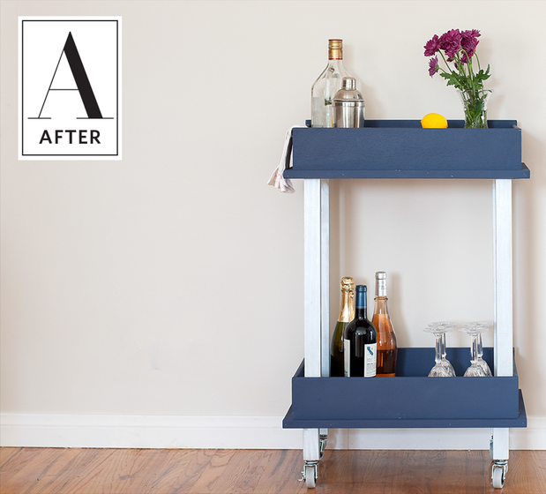
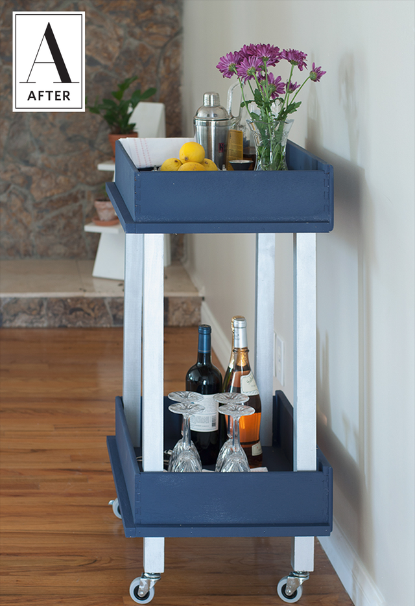

Slide 23
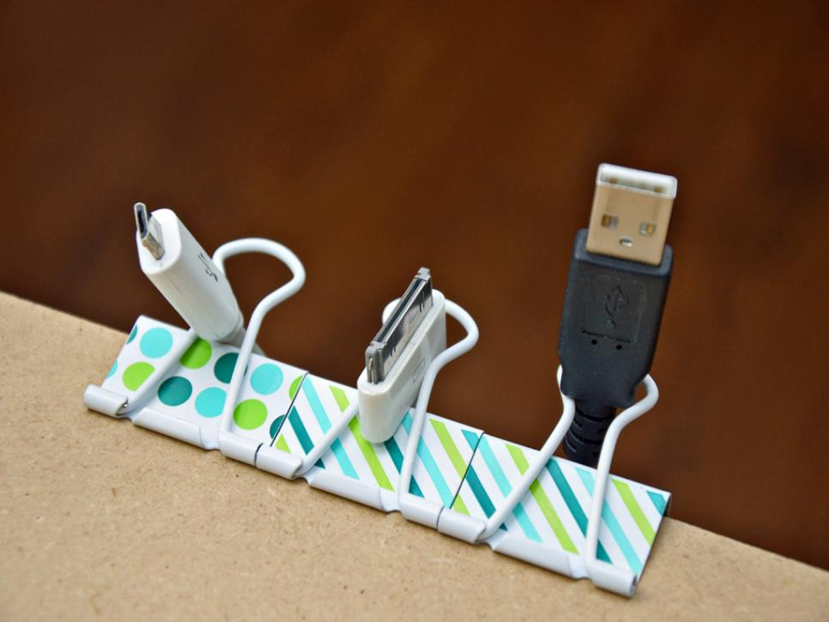
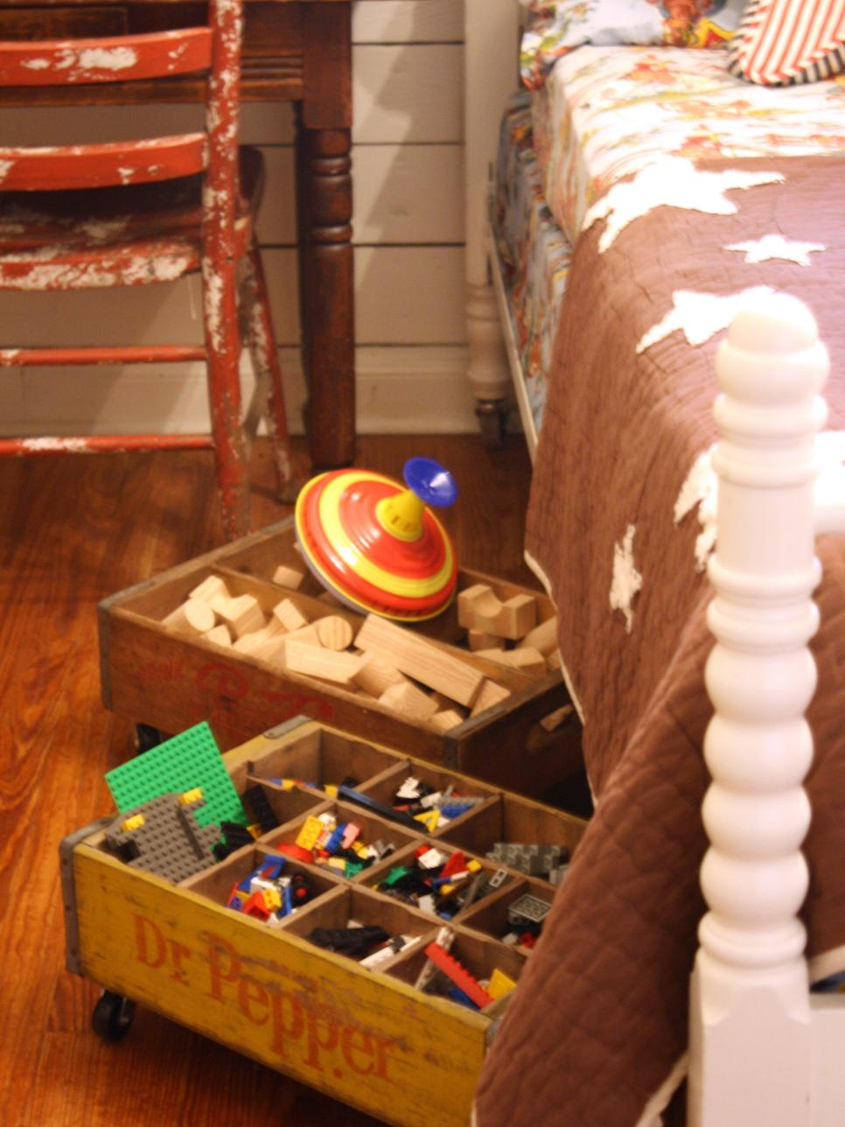
Binder-Clip Cord Organizer Soda-Crate Toy Storage

Slide 24

Dish-Rack Coloring Station

Slide 25
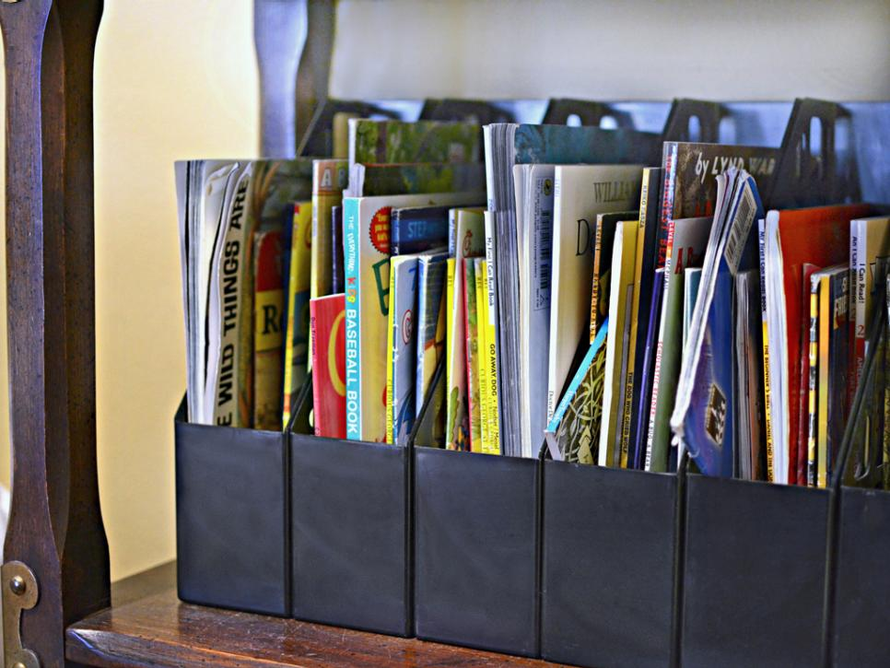
Magazine Holder Bookcase

Slide 26
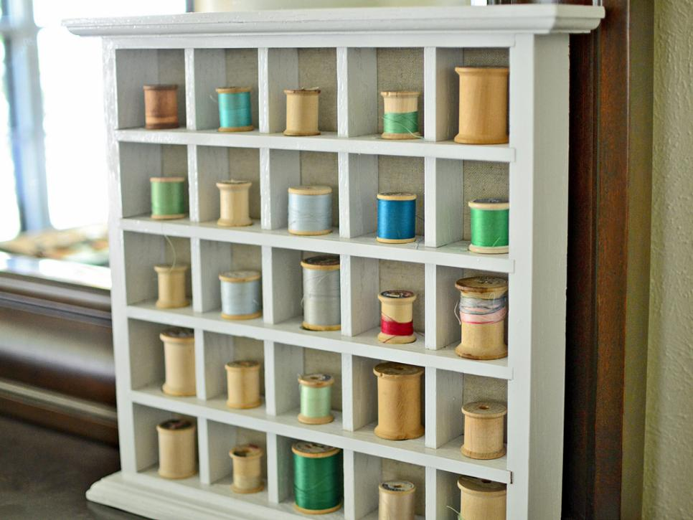
An old golf-ball holder makes the perfect thread holder

Slide 27
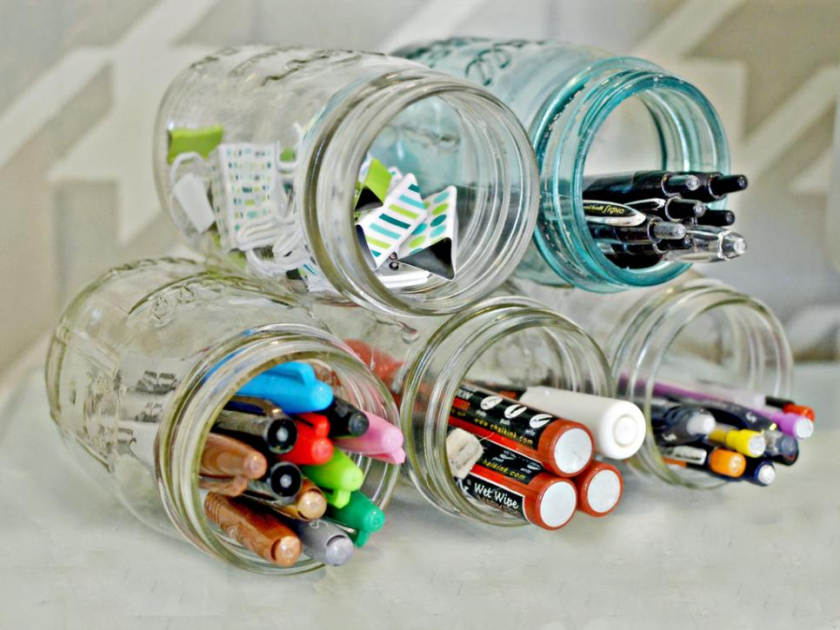
Office Supply Jar Holder
Mason jars super-glued together

Slide 28
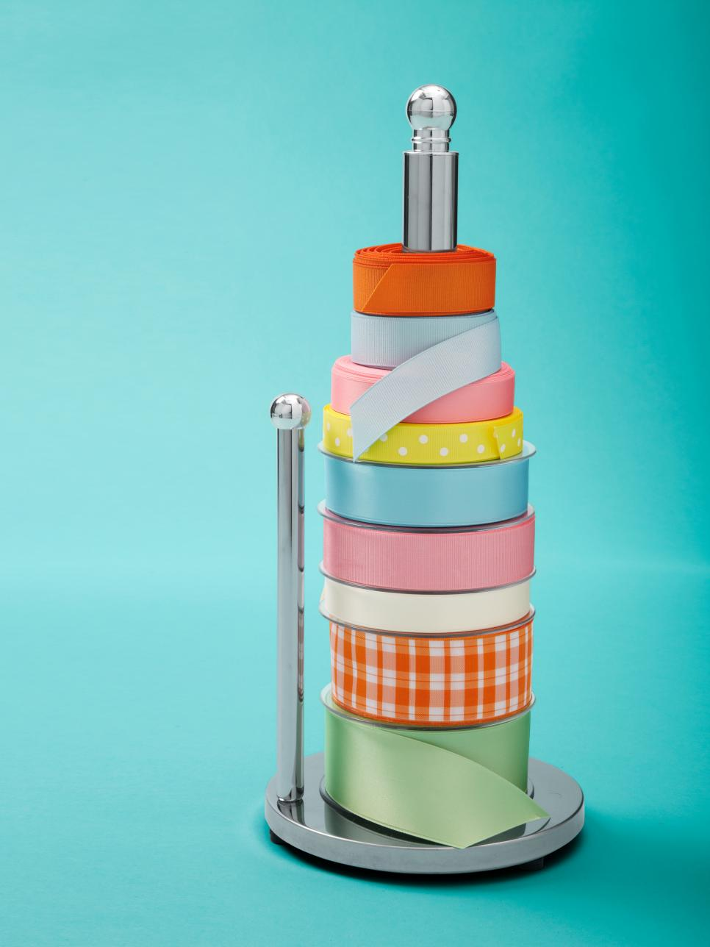
"I use a standing paper towel holder to organize my unruly ribbon

Slide 29
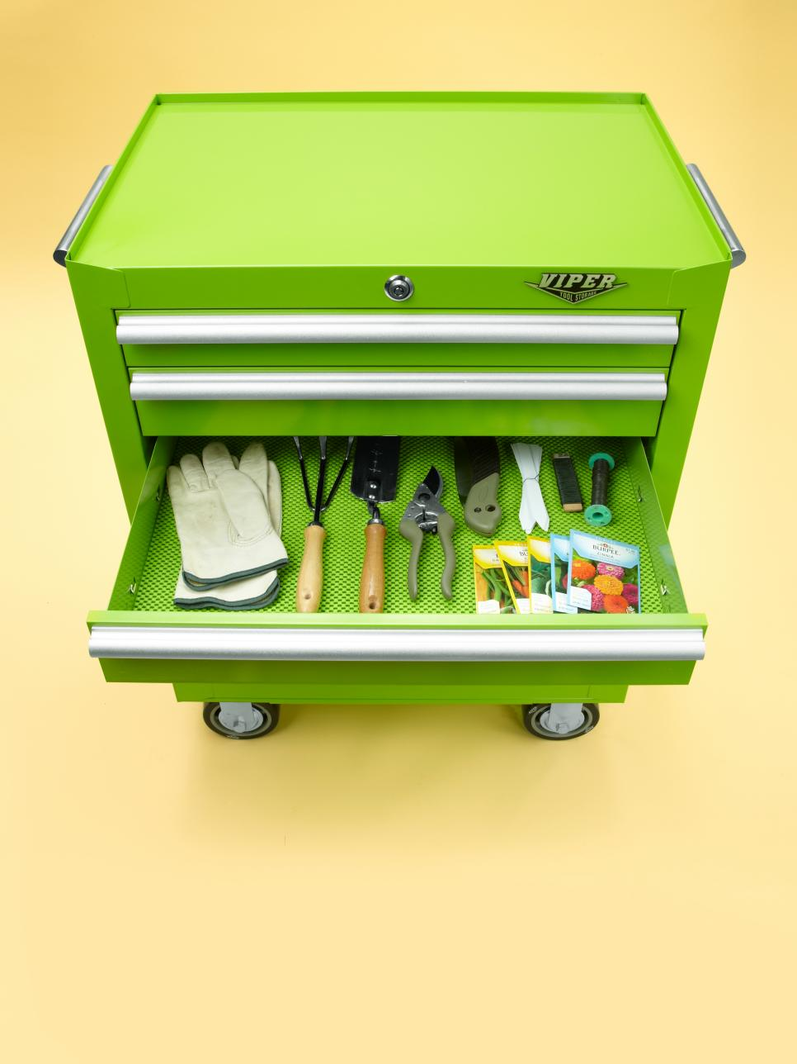
a rolling metal tool chest

Slide 30
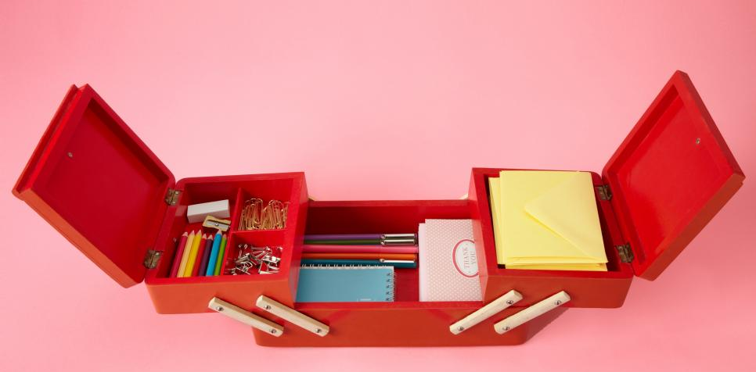
I use an old sewing box for desk supplies

Slide 31
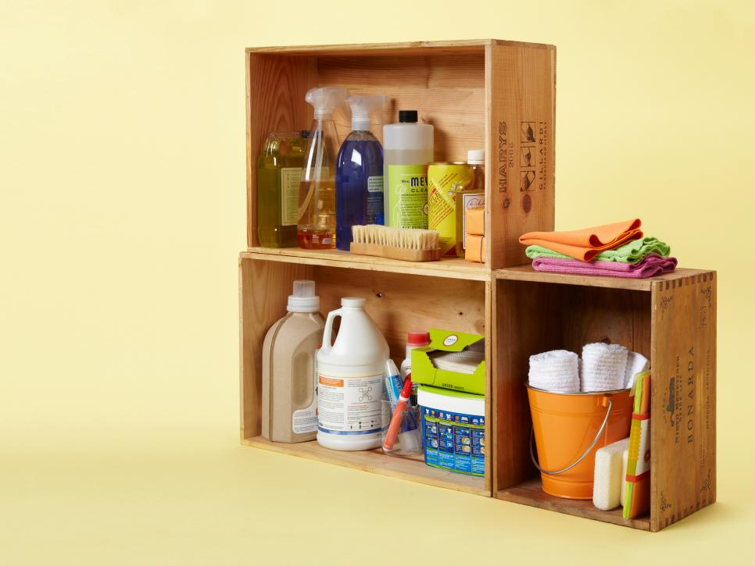
Wine shops usually toss their wood crates, so ask to take some off their hands and stack them to make charming insta-shelves.

