Slide 1
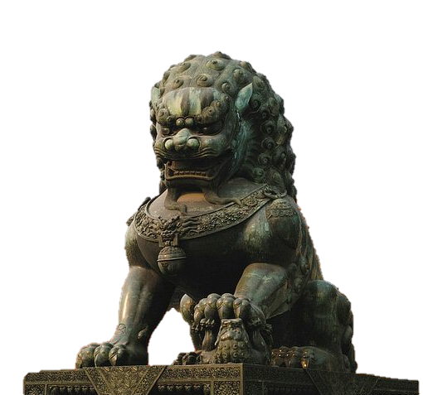
Lions in Chinese Traditional Architecture

Slide 2
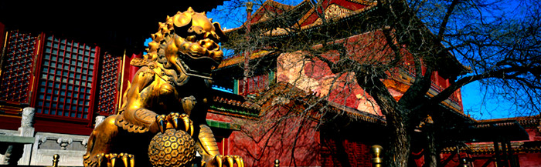
Chinese guardian lions or Imperial guardian lions
In China since ancient times the lion was the symbol of well-being, value, and credibility, so that in the construction of palaces, houses of important officials and ordinary people, lions were incorporated. Lions were also thought to protect from evil spirits and have always been placed about the Chinese mausoleums as well.
Traditionally known in Chinese simply as Shi (literally: "lion"), and often called "Foo Dogs" in the West, are a common representation of the lion in imperial China. The concept which originated and became popular in Chinese Buddhism, subsequently spread to other parts of Asia including, Japan, Korea, Tibet, Thailand, Burma, Vietnam, Sri Lanka, Nepal, Cambodia and Laos

Slide 3
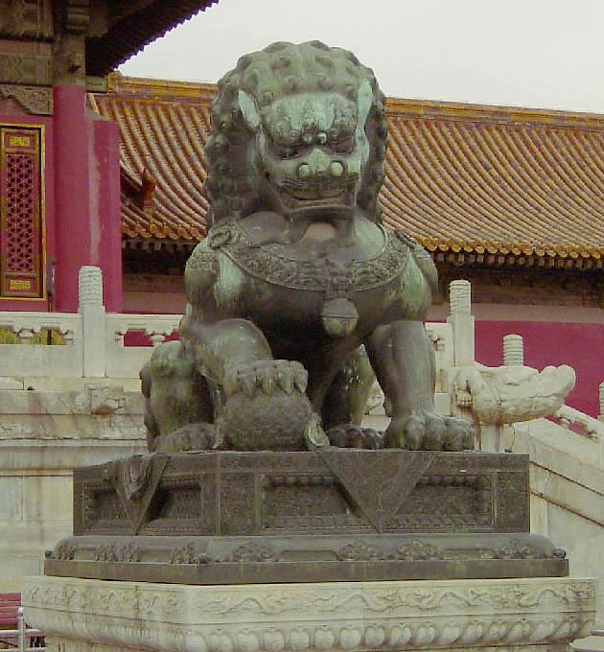

Slide 4
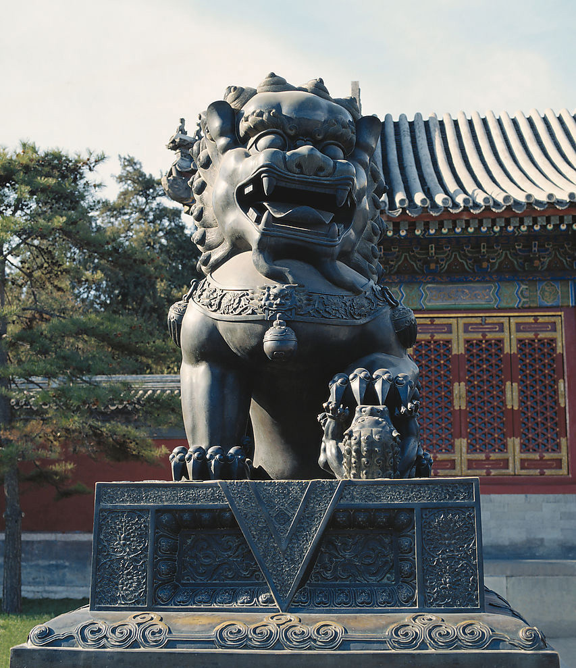
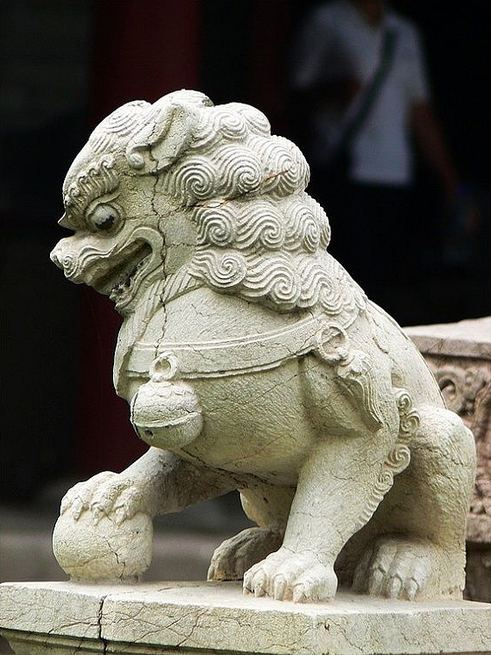

Slide 5
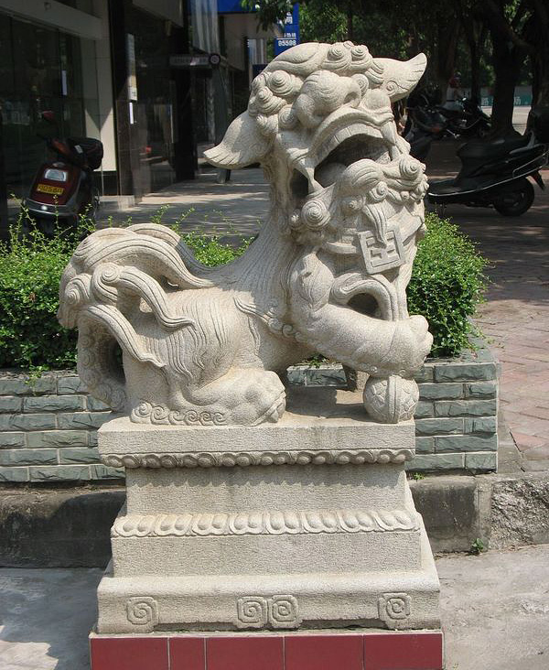

Slide 6
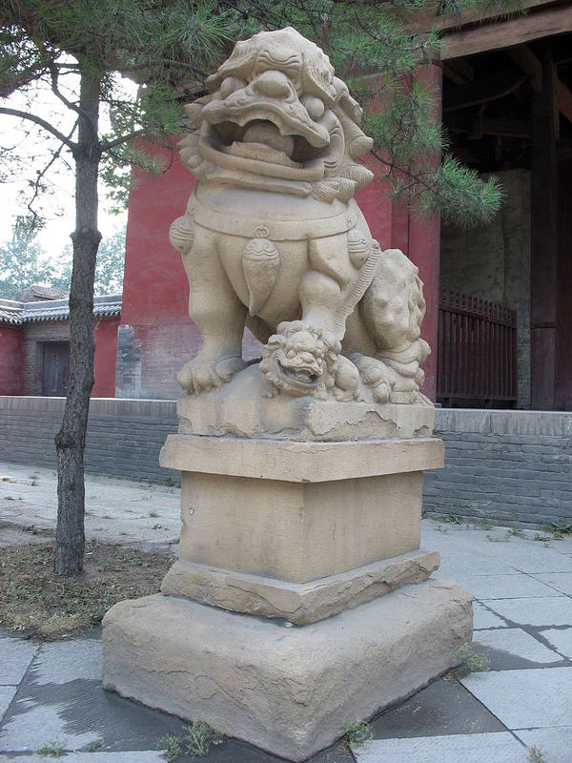

Slide 7
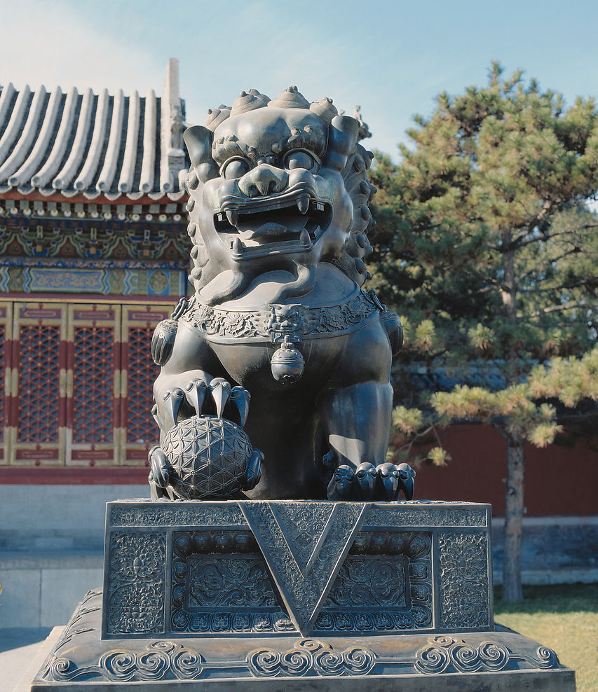

Slide 8
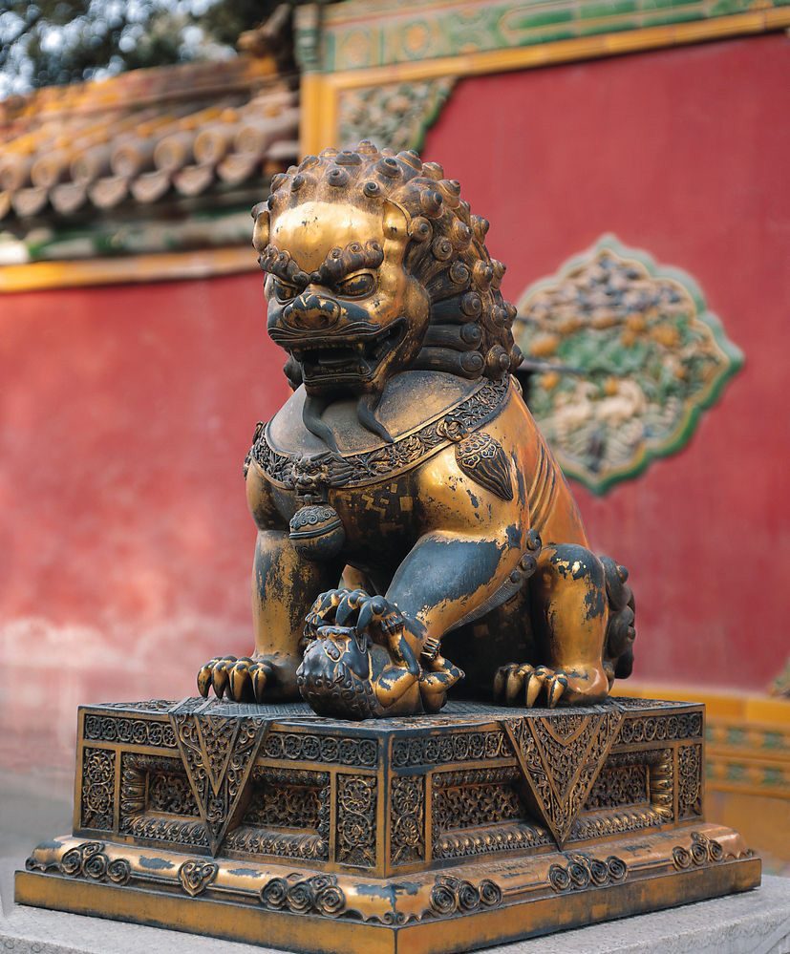

Slide 9
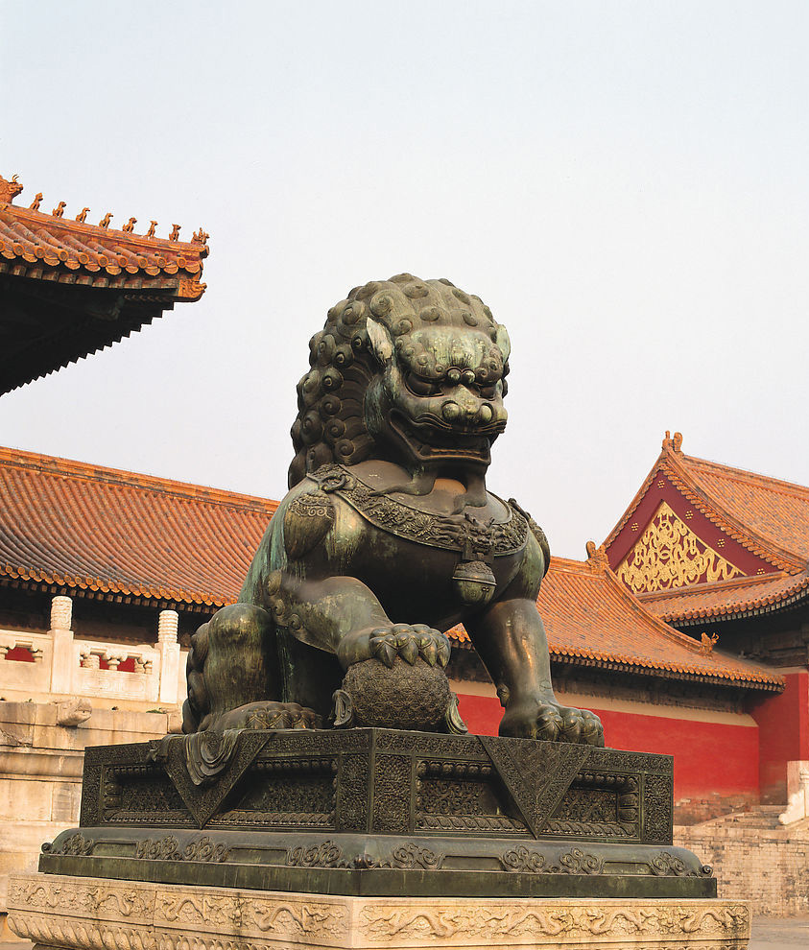

Slide 10
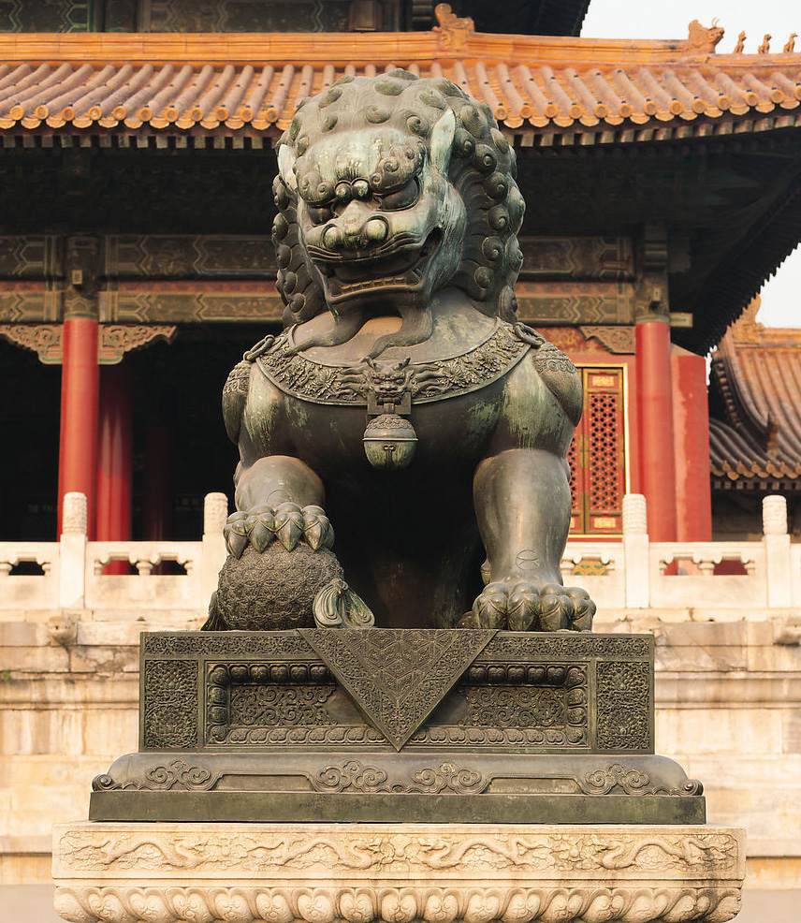

Slide 11
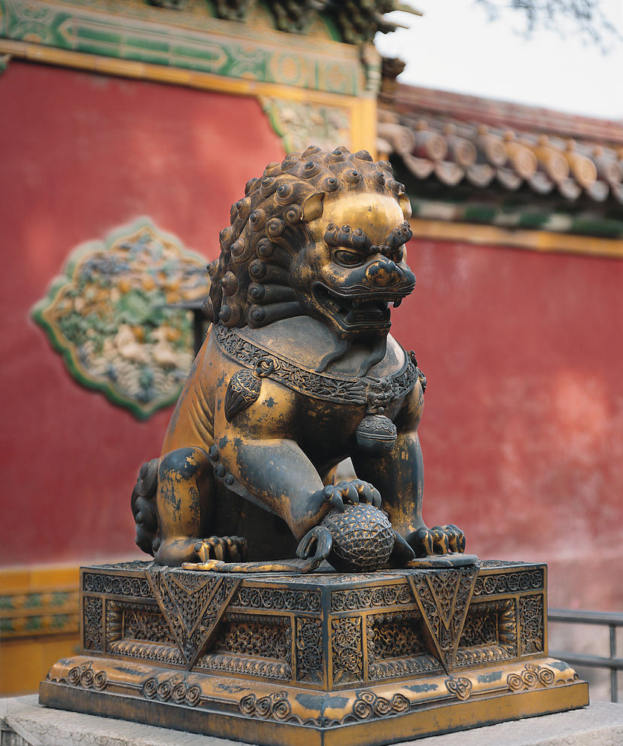

Slide 12
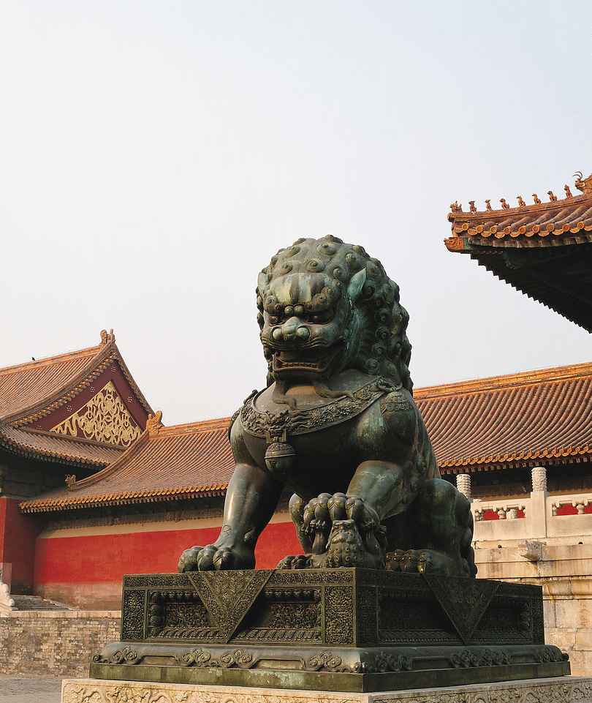

Slide 13
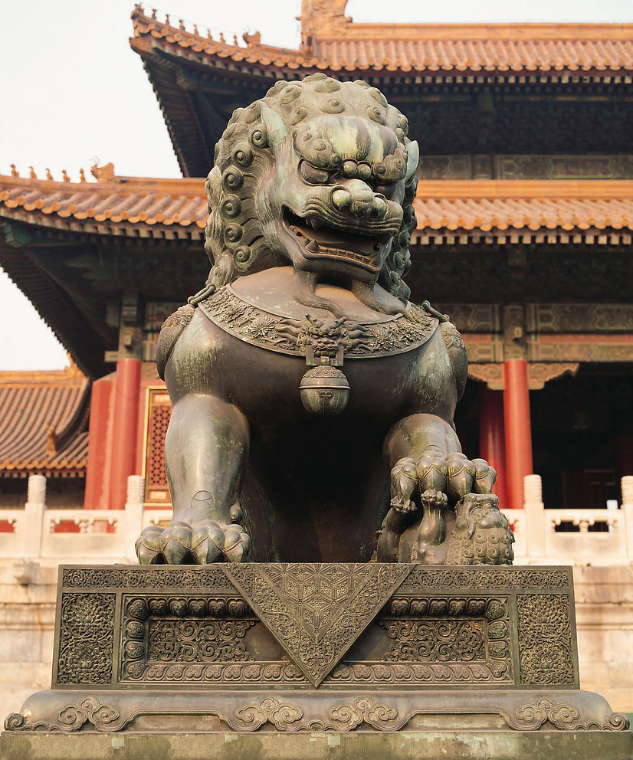

Slide 14
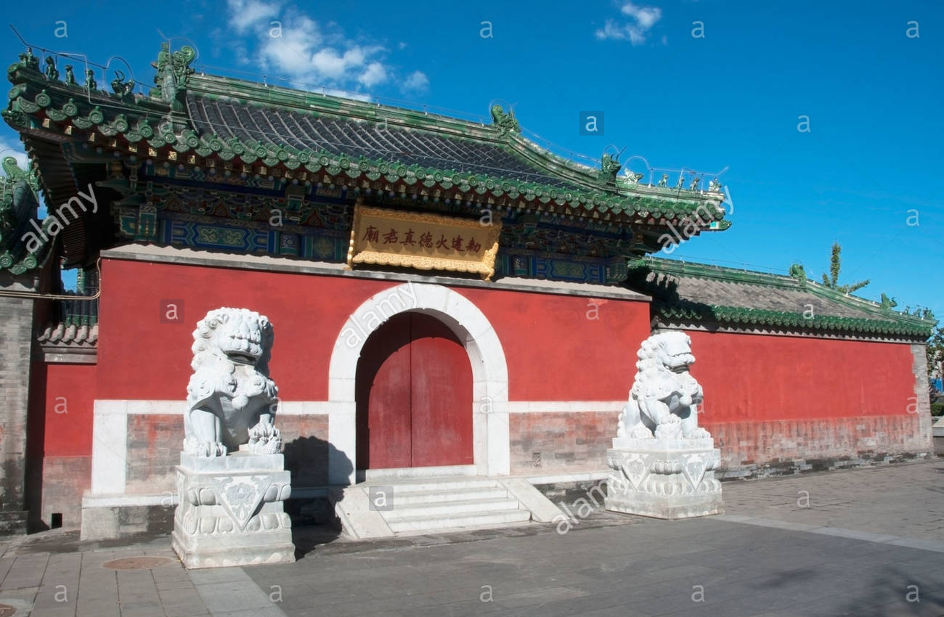

Slide 15
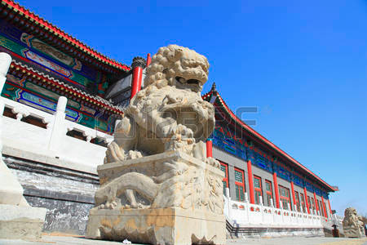

Slide 16
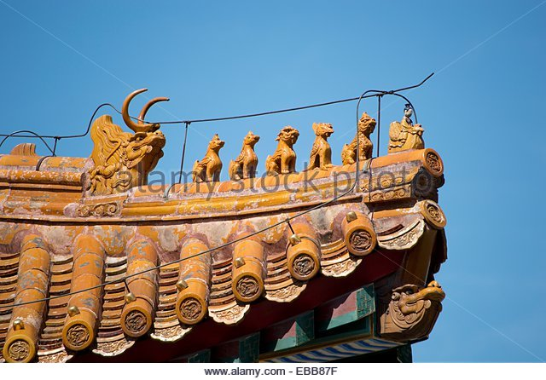

Slide 17
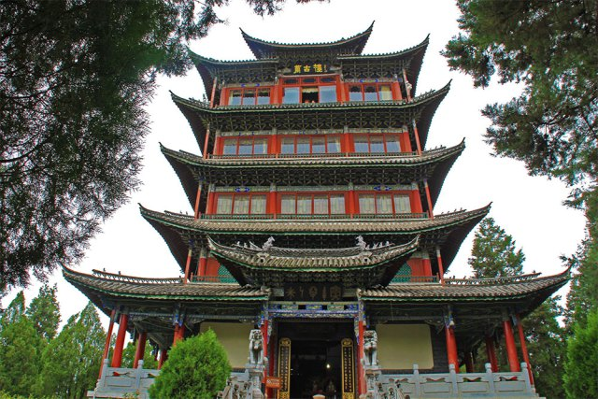

Slide 18
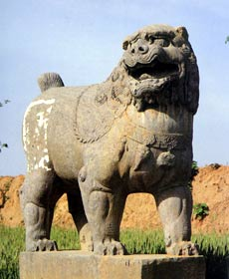
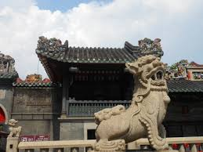

Slide 19
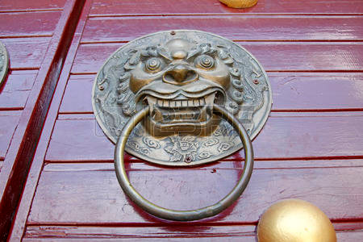

Slide 20
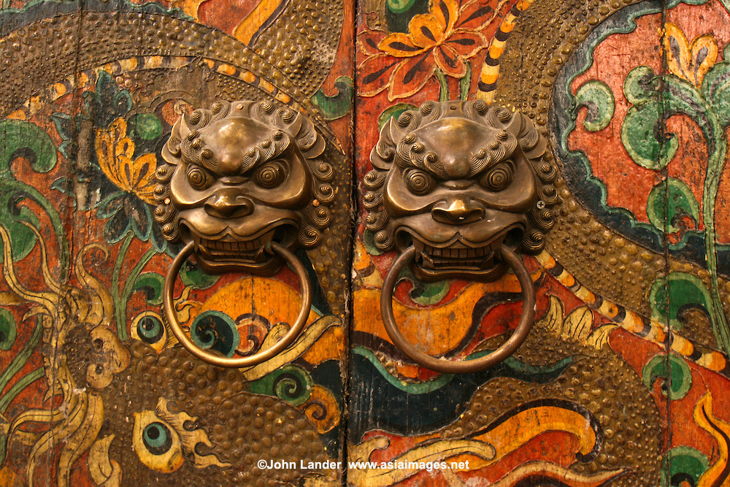

Slide 21
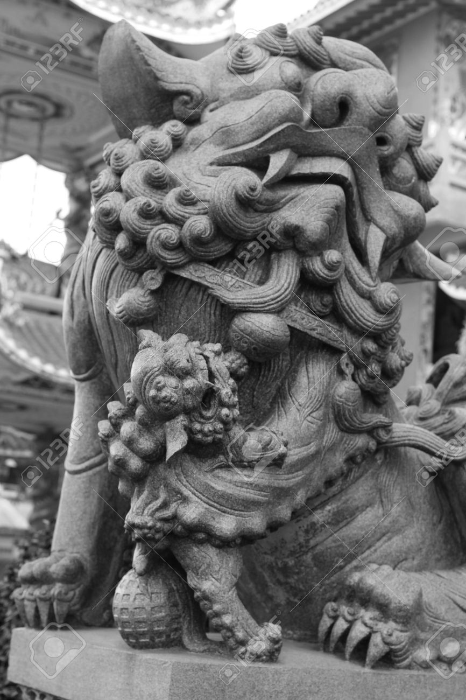

Slide 22
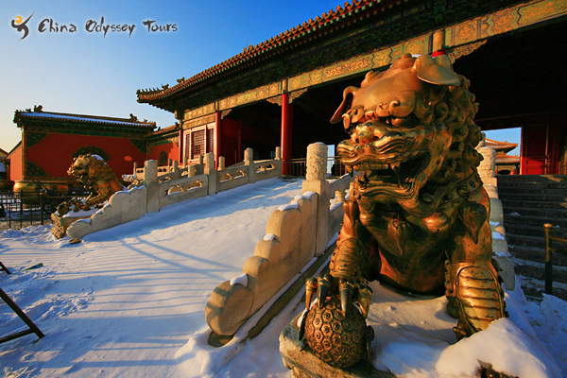

Slide 23
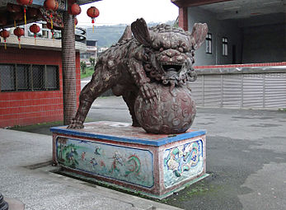

Slide 24
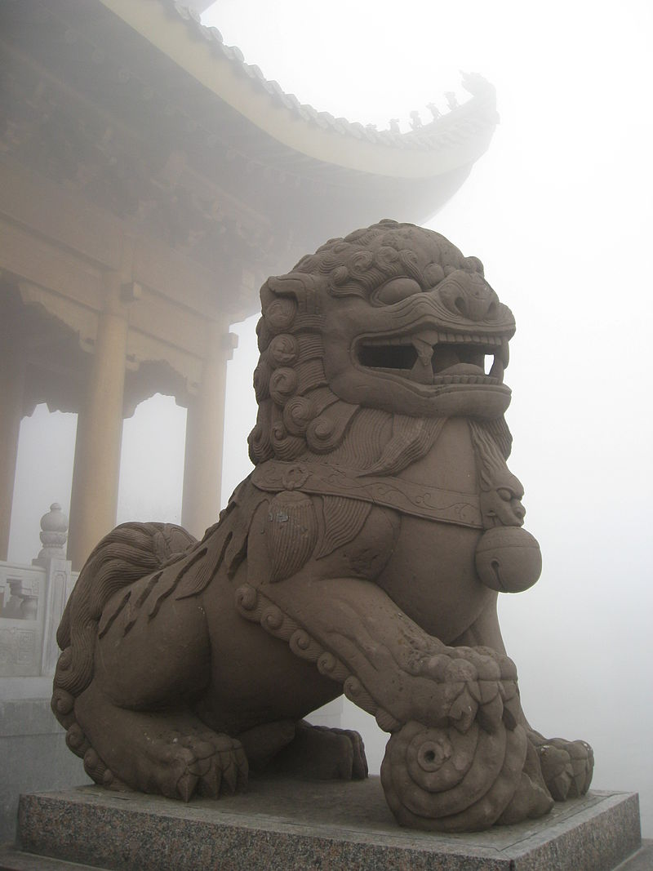
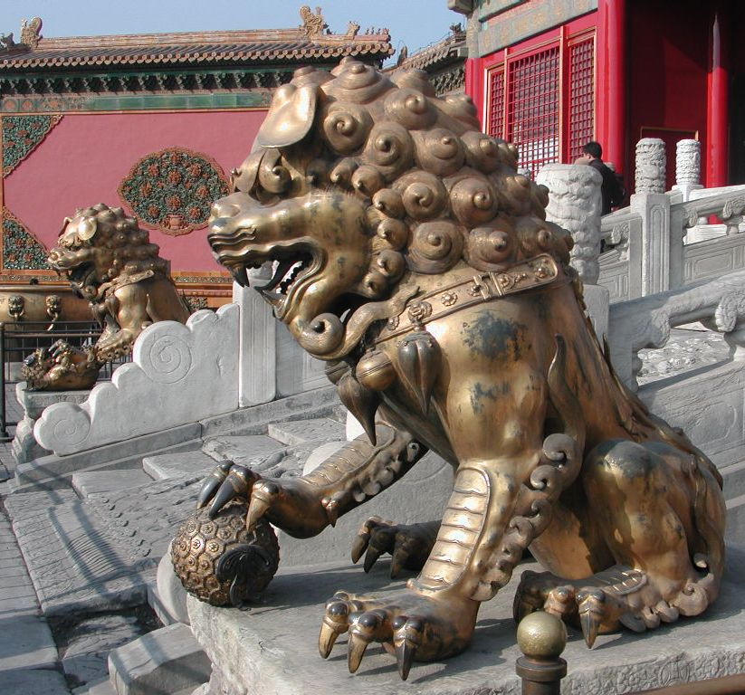

Slide 25
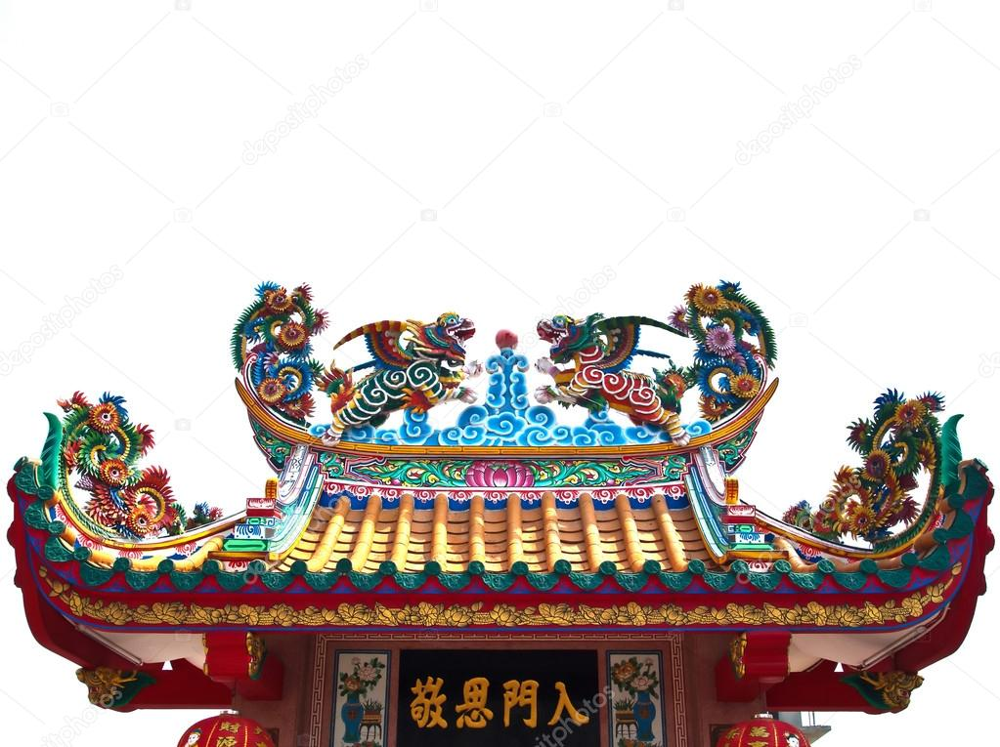

Slide 26
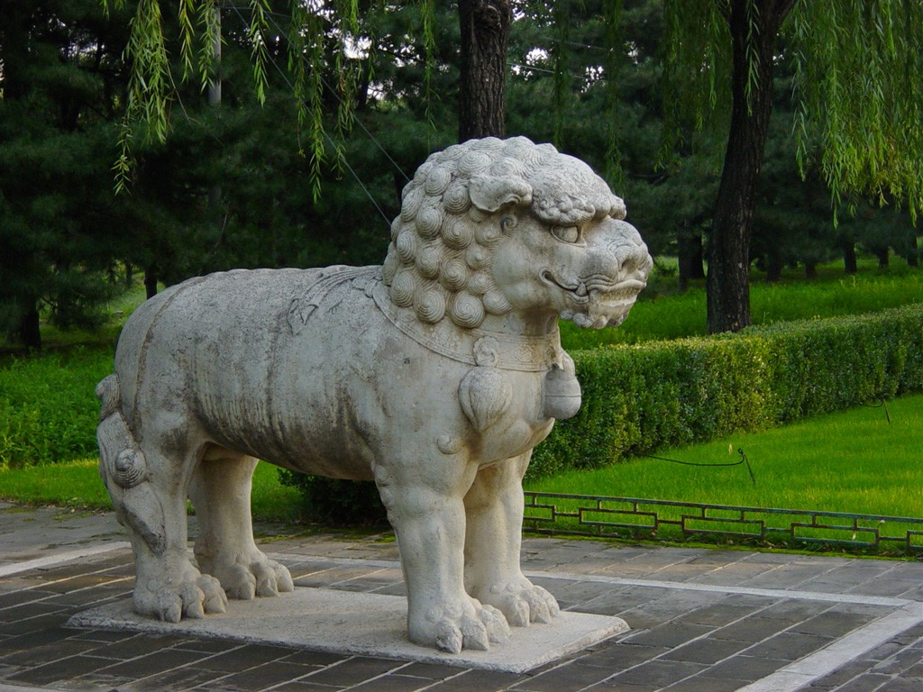

Slide 27
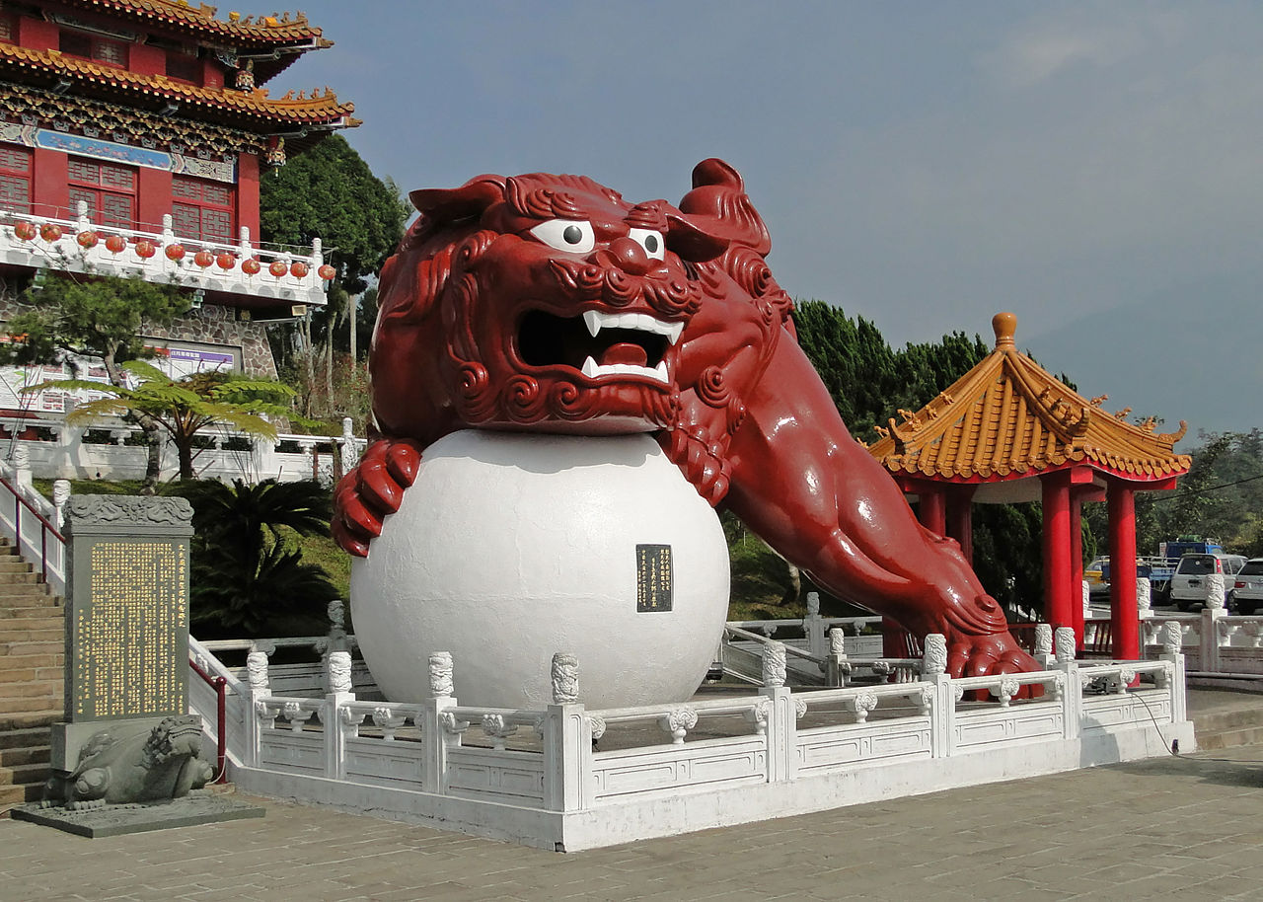

Slide 28
Continued in modern building

Slide 29
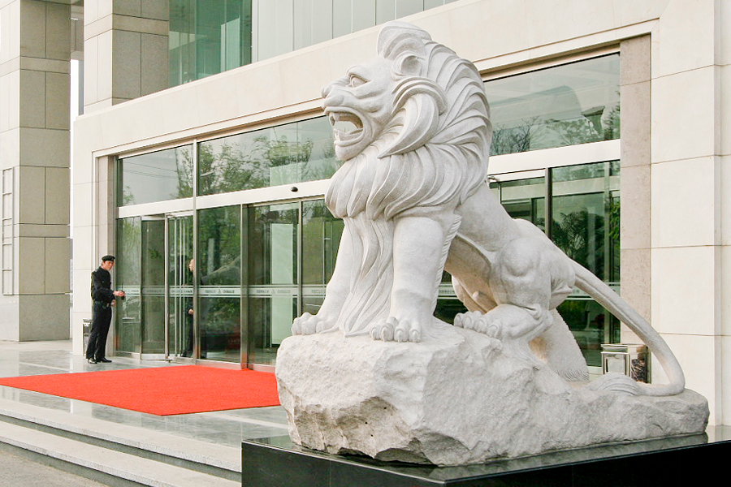
Skyscraper in Beijing, China

Slide 30
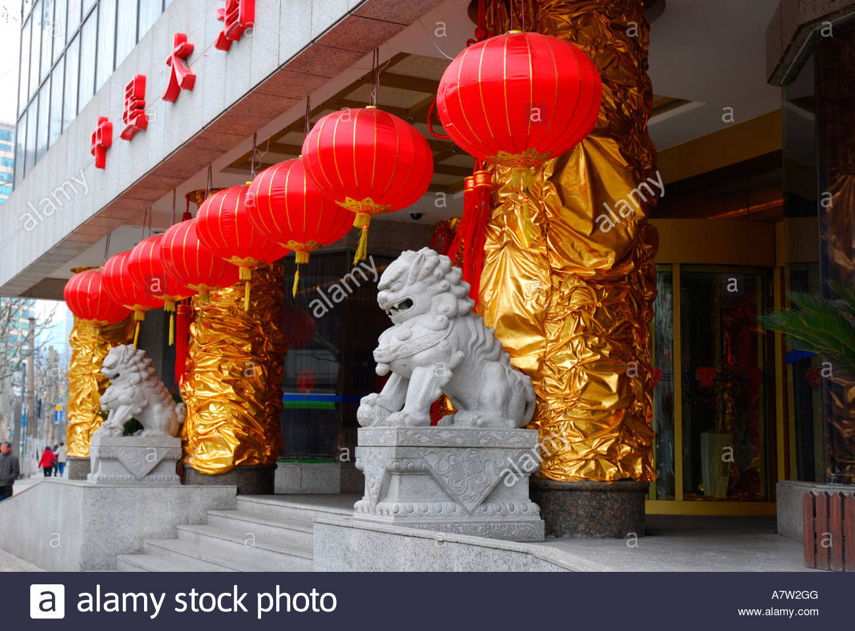
Shanghai hotel

Slide 31
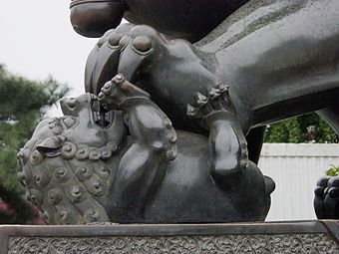
Non-traditional style

Slide 32
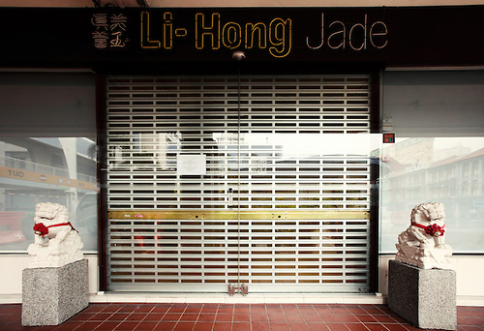
Modern commercial establishment

Slide 33
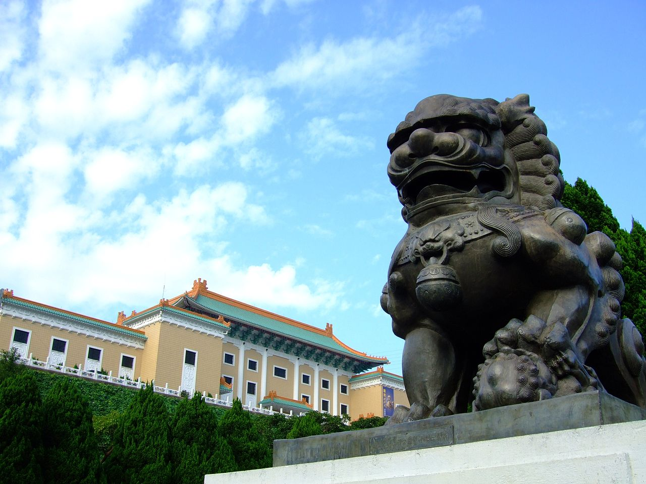
Guardian lion at the National Palace Museum in Taipei

Slide 34
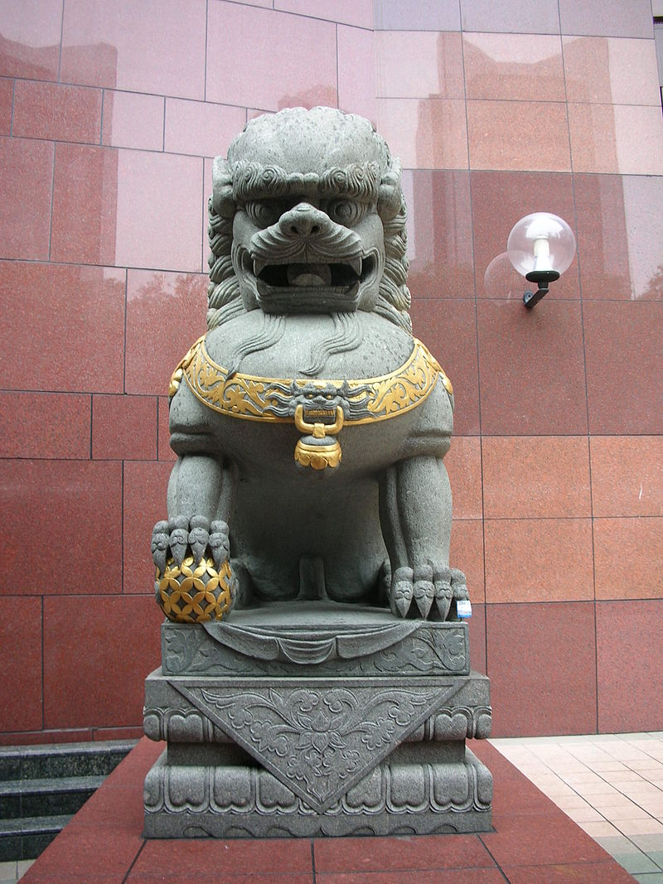
Imperial guardian lion outside Ngee Ann City in Singapore.

