Slide 1
Less known Facts About Christian History and the development of Christian beliefs and practicers
Subtitle

Slide 2
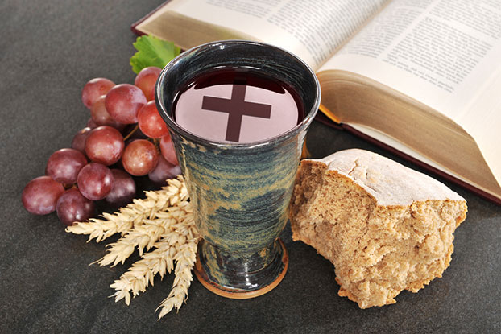
One of the most well-known belief systems in the western world, Roman Catholicism continues to exert influence in our daily lives. Even so, there are many aspects of this religion that remain a mystery. Here we present a select few of those mysteries for your eyes only—you won't believe #10.

Slide 3
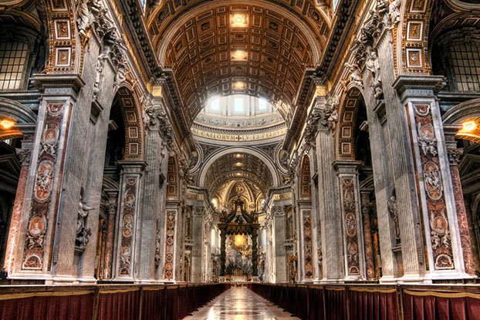
While the belief system recognized as Christianity was in place by the first century, scholars disagree on the exact date of the Roman Catholic Church's formation.

Slide 4
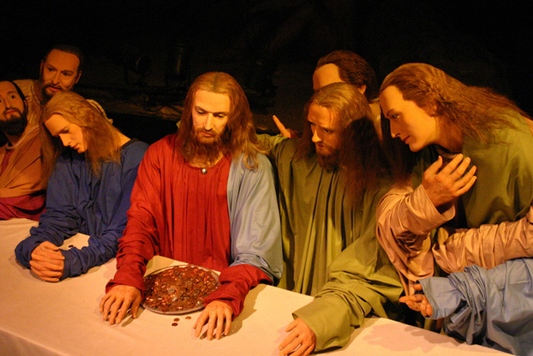
In the first centuries after Christ, there were many varieties of Christian belief. The term Catholic was used to identify the one most closely associated with the Apostles.

Slide 5
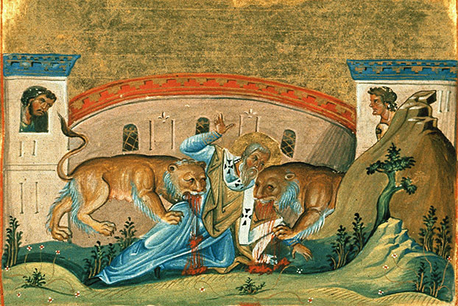
The word "Catholic" is derived from the Greek katholikos, meaning universal. Evidence of its first use comes from Ignatius of Antioch's Letter to the Smyrnaeans in A.D. 108—in which Ignatius defines the Catholic church in contrast to beliefs he thought heretical.
The Death of Ignatius of Antioch Licensed under Public Domain via Commons

Slide 6
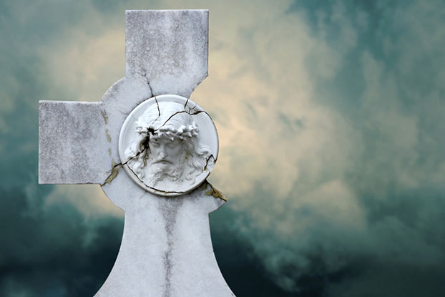
Many scholars point to the Great Schism in 1054, when Eastern and Western branches of the Church formalized their separation—the first large-scale division within Christendom—as a defining moment for both Roman Catholicism and Orthodoxy.

Slide 7
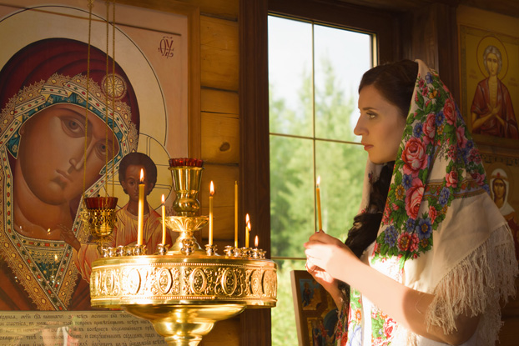
The Catholic and Orthodox churches split over several issues, some theological and some institutional, though they continue to have in common more than they divide over.

Slide 8
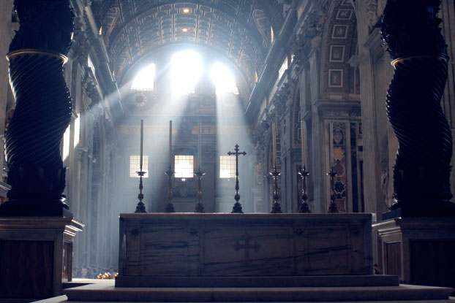
The term "Roman Catholic" was not generally used until the Protestant Reformation, and some historians view the Council of Trent (1545-1563) as the centralizing movement within Catholicism—a movement to enhance the authority of Rome.

Slide 9
Roman Catholic doctrine affirms seven sacraments enacted and entrusted to the Church by Christ. These sacraments are baptism, confirmation, the Eucharist, penance, the anointing of the sick, holy orders, and matrimony.

Slide 10
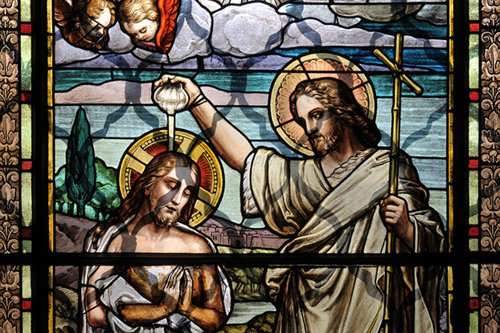
Baptism is the first of the sacraments, and is considered the rite of initiation. Catholics believe that baptism is necessary for salvation. In an emergency, baptisms can be performed by anyone. Almost all Christian denominations require baptism

Slide 11
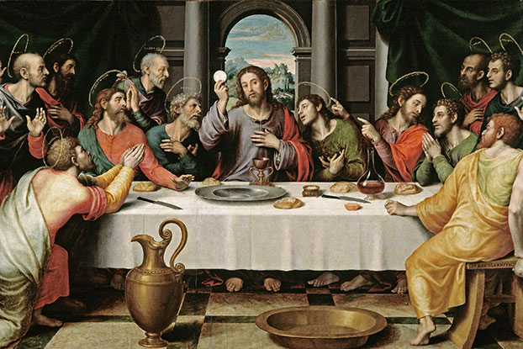
Catholics believe that in the sacrament of Eucharist, the bread and wine become the body and blood of Christ; the theological term for this is transubstantiation. Partaking of this physical presence of the divine is a point of mystery and wonder for believers. Some Protestant denominations believe there is a “real presence” in the blessed bead and wine and leave that rather vaguely defined.

Slide 12
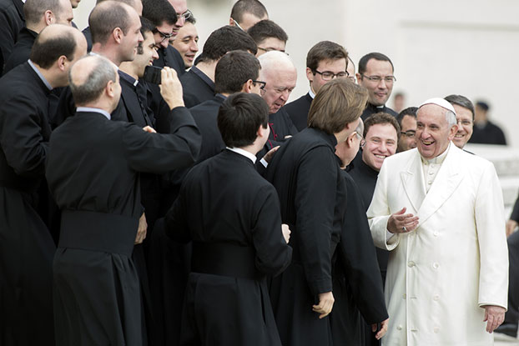
The Roman Catholic Church reserves the sacrament of holy orders to men. This means that women cannot be deacons, priests, or bishops. Some other denominations do ordain women, however, not all of them do.
Pope Francis has asked that the ordination of women deacons be discussed.

Slide 13
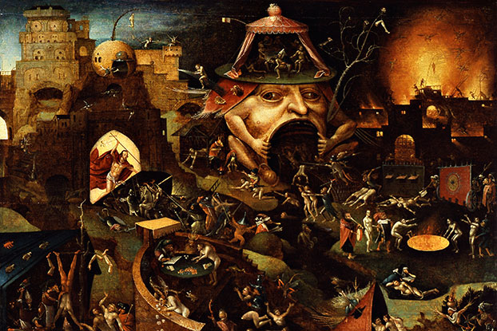
Catholics have long affirmed that there is no salvation outside the Church. Traditionally this has been interpreted as sure damnation for those who are not in communion with the Roman Catholic Church, though since Vatican II, this has been reinterpreted. After Vatican II, Catholics began calling Protestants separated brethren rather than heretics.

Slide 14
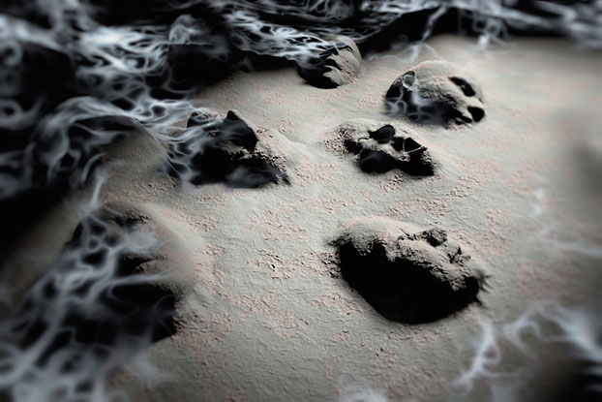
Roman Catholics generally believe that most souls are not cleansed enough of sin in this lifetime to be ready for heaven. Instead, most will enter an interim state called purgatory, a place of purgation, where humans are cleansed of sin and its ill effects. Protestants do not teach this.

Slide 15
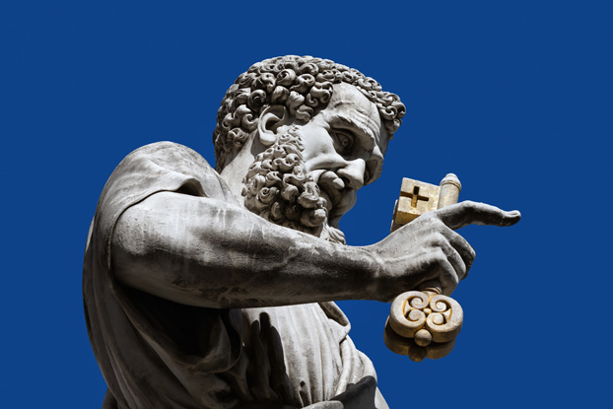
Catholics teach that St. Peter was the first pope. The authority of the papacy is part of what separates the Catholic, Protestant and Orthodox churches.

Slide 16
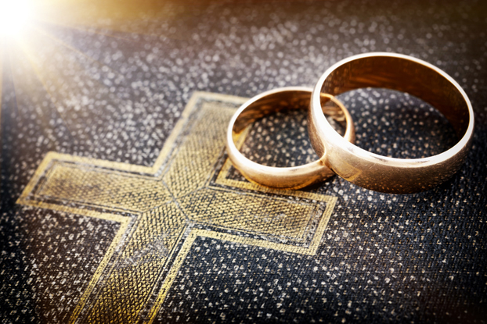
Despite the fact that Catholic priests, bishops, and popes are celibate, St. Peter was a married man. And priests and bishops could marry in the early church. Celibacy is a man-made rule.

Slide 17
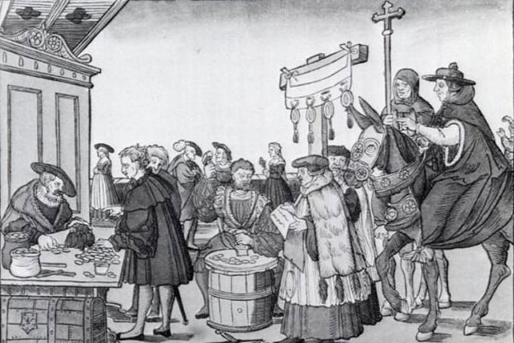
Roman Catholic doctrine holds that individuals can reduce their penance (and/or time spent in purgatory) through indulgences. Indulgences are granted for the performance of certain actions such as the repetition of prayers, pilgrimages, and/or good works. The abuse of this practice is one of the factors that led to the Protestant Reformation.

Slide 18
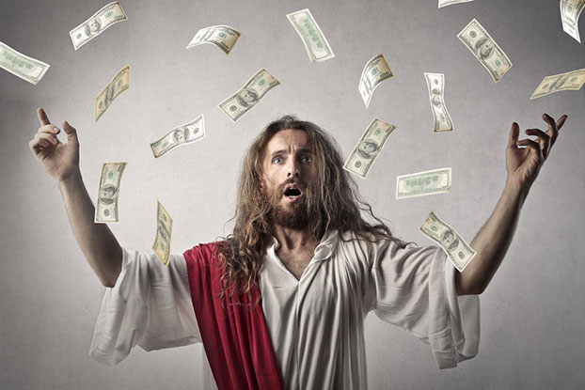
Abuse of indulgences in the Middle Ages, whereby corrupt clergy sold immunity from penance/purgatory for large sums of money, was a major criticism aimed at the Roman Catholic Church by early Protestants. Since then, the practice has been reformed to prevent corruption.

Slide 19
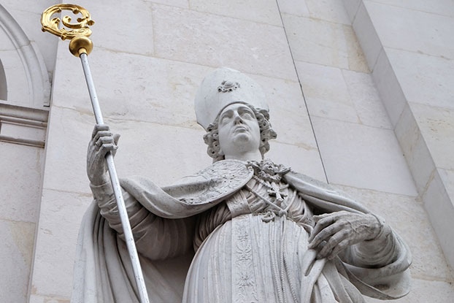
The Roman Catholic doctrine of papal infallibility allows the pope to declare dogmas that all Catholics are required to believe. There have only been two such statements made by the pope in the modern history of the Church.

Slide 20
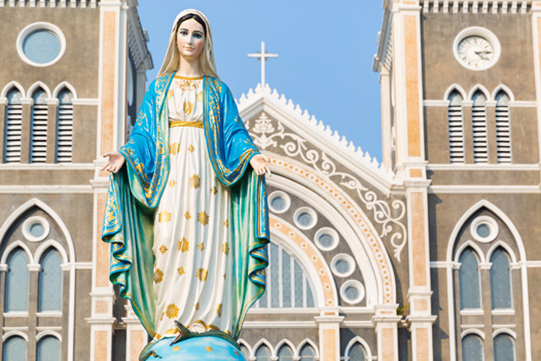
Both of these doctrines concerned Mary, the mother of Christ. Catholics deeply revere Mary as instrumental in the salvation of the world. Contrary to the belief of some non-Catholics, Catholics do not worship Mary. Most Christians do see her as model of faith.

Slide 21
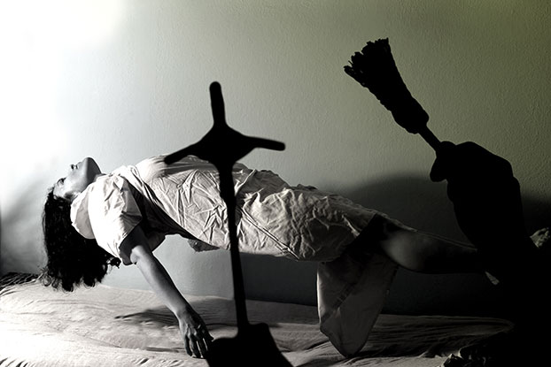
Though movies like The Exorcist and The Exorcism of Emily Rose have tied exorcism (the practice of casting out demons by the power of Christ) to the Roman Catholic Church, modern Catholic officials regard demonic possession as extremely rare.

Slide 22
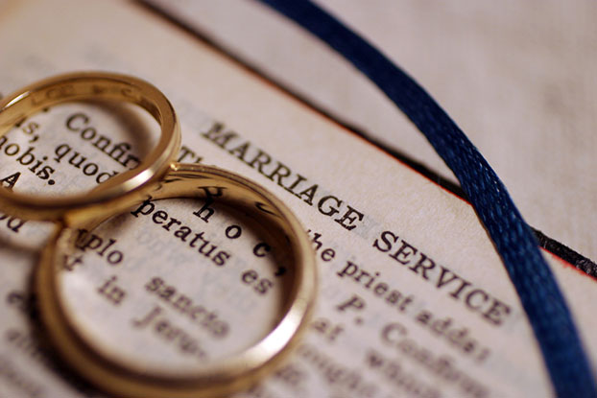
Vatican City is one of two countries—the second is the Philippines—that have no procedure for divorce. Annulment of marriage is allowed, but difficult to obtain. Most Protestant churches are more willing to accept divorced and remarried persons as full members of their congregation.

Slide 23
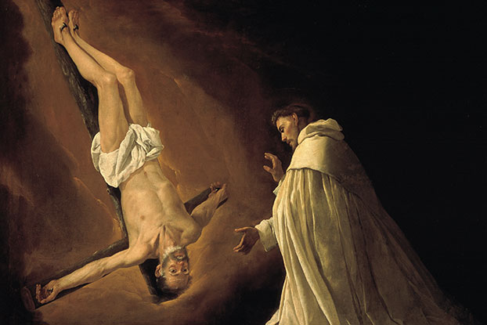
\
The upside down cross (seen as a Satanic symbol in popular culture) is actually the symbol of St. Peter—considered to be the first pope. According to the apocryphal Acts of Peter, St. Peter asked to be crucified head down as a statement of his unworthiness to die like his savior. It is possible that this may just be a myth.

Slide 24
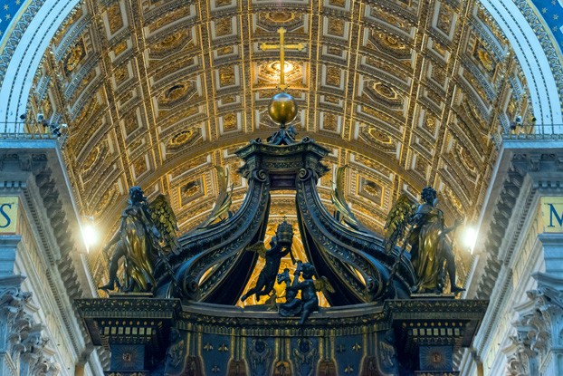
St. Peter is believed to be buried beneath the main altar in St. Peter's Basilica.

Slide 25
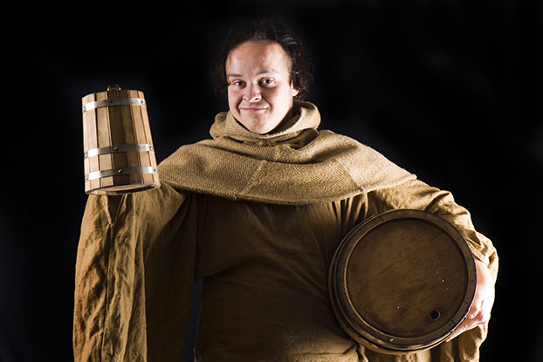
Catholicism's relationship to wine through the Eucharist was instrumental in creating most of the world's best alcoholic beverages. Benedictine friars invented champagne, and Trappist monks continue to make some of the best beer in the world, just to name a few. Some Protestants refuse to use wine for sacramental purposes.

