Slide 1
Land where humans first evolved 'Kumari Kandam' is now submerged in Indian Ocean!
An interesting theory – certainly worth considering

Slide 2
Consider this:
When I was in high school in the 1950s, our textbooks talked about the discovery of Peking Man and Java Man as pointing to where humans developed – no definite answer was given.
Then Dr. Leaky discovered the jawbone of Zinjanthropus in 1959. As more and more early humanoid remains were found in East Africa, scientists stated conclusively that that is where the human species developed.
Scientists and rational thinkers have to have minds open to new information and be willing to consider changing the currently agreed upon theories when compelling new information is brought to light.

Slide 3
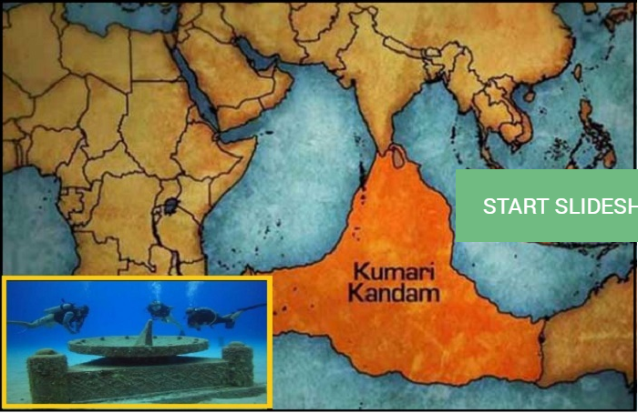
Let us begin . . .

Slide 4
Kumari Kandam- The lost continent
Over past few decades, explorers have found traces of the lost cities submerged deep in waters that once stood witness to legendary epics like Mahabharat.

Slide 5
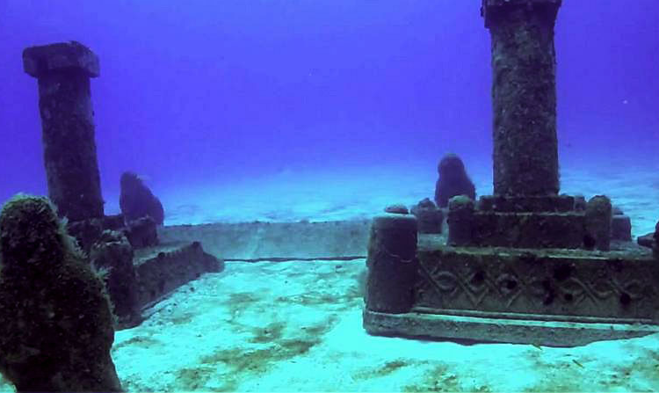

Slide 6
Atlantis and Dwaraka
With time, they found the lost city of Atlantis, and the city of Dwaraka. But, only recently they found evidence of a huge land mass submerged towards the south of today’s Indian peninsula.

Slide 7
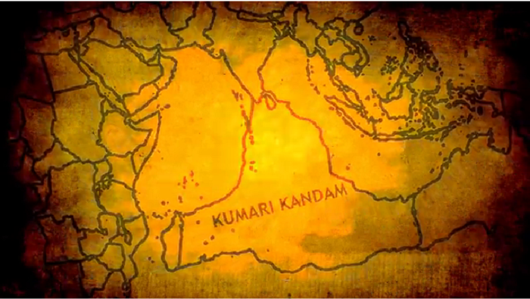
The region extended from Kanyakumari in the North, to the far west as Madagascar and nearing the East Coast of Australia.

Slide 8
First trace of human evolution
Over the time, scientists have agreed on backing claims, on how humans evolved from Africa (before migrating out into the rest of the world), based on evidence gathered.

Slide 9
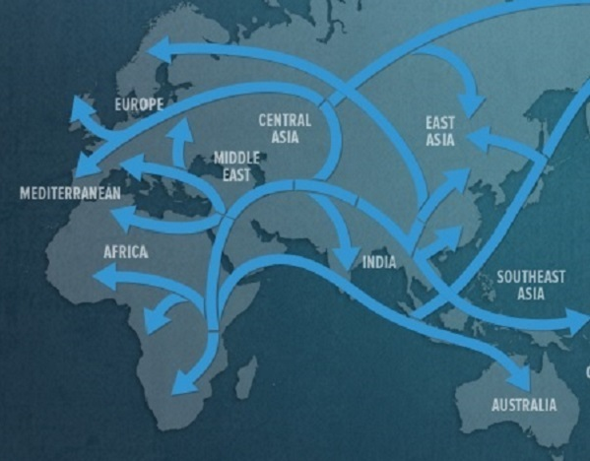
Current theory of migration
?

Slide 10
The Kumari Model by Vasudevan
But, going by the Kumari model, a result of the advanced study by A. R. Vasudevan, one would have to believe that humans never evolved in Africa. In fact, they originated on a continent in the Indian Ocean, which was known as Kumari land. Currently, scientists still believe it was in Africa. Unless enough new and compelling evidence is found beneath the Indian Ocean, this theory will be rejected. At this point it doesn’t hurt to keep an open mind.

Slide 11
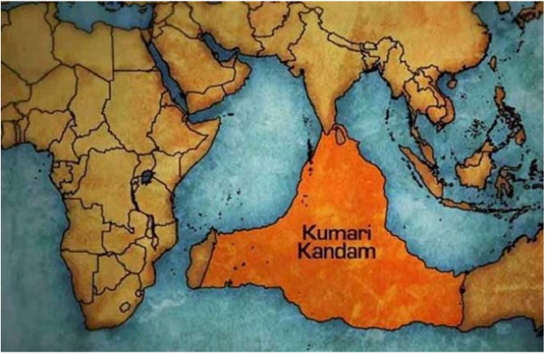
?

Slide 12
The ‘model’ on human origins argues that the Kumari land was claimed by the sea around 14,000 years ago, which was a region so huge that it connected India to Africa and extending southwards into the Antarctic.

Slide 13
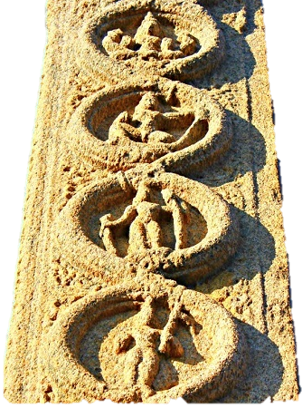
Migration of Homo Sapiens
A. R. Vasudevan in his work ‘Aryans: Who are they?’ ascertains that the evolved species of humans migrated out of Kumari land and populated the rest of the world; taking two routes, one West into Africa and East into India. And, those who kept voyaging into East, eventually moved out of India, settling in Europe and the rest of Asia.

Slide 14
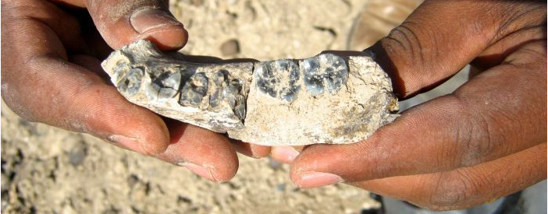
Hence proved?
He claimed that the Indian origin of Europeans, in turn lend the credence for the Kumari model, citing significant proofs. Most of which is directed of the Genographic Project by National Geographic, to trace how genes have moved around the world; further proving the evidence of Kumari model.

Slide 15
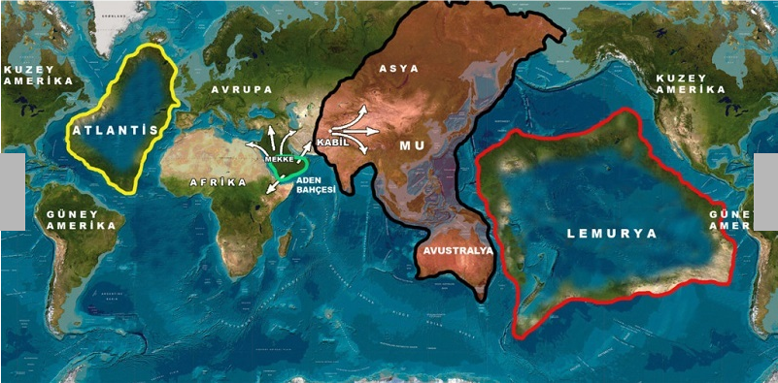
Interesting Map of Places That Might Have Been
This lost land according to Vasudevan, was called Kumari or the Lemuria continent.

Slide 16
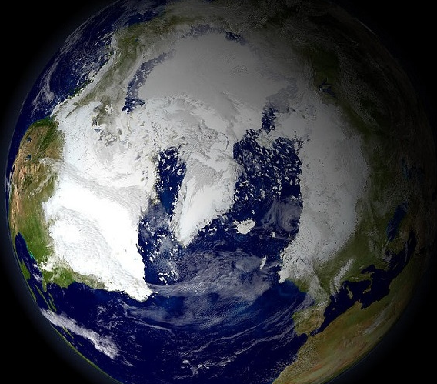
Ice Age
It is believed that around the last leg of Ice age, earth’s temperature was on rise, causing the large glaciers to melt; thus the sea levels rose.

Slide 17
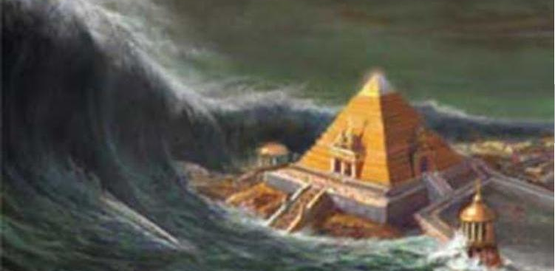
According to Oceanographic Researchers, sea levels around the Indian peninsula have seen a stark rise over 100 meters in past 14,500 years. And, it is claimed that during this period the Dravidian peninsula was engulfed into waters.

Slide 18
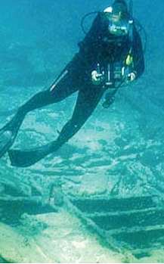
Rising Sea Levels?
And, these are not just tall claims made by these researchers; the proofs mentioned in the book, hint at three major episodes of sea level fluctuations, which further resulted in the submergence of Kumari Kandam.

Slide 19
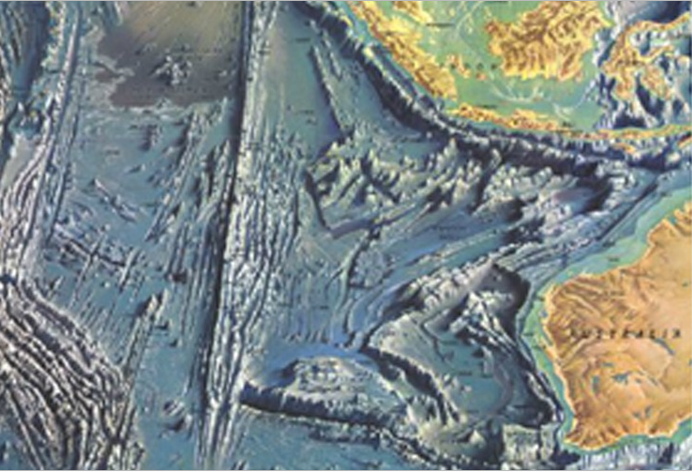
According to him, a huge landmass around 7000 miles, from the tip of Kanyakumari got sunken into sea; splitting Kumari Kandam into 49 territories.

Slide 20
Sadly, within a few years, entire Kumari Kandam got submerged in the Indian Ocean.
The speculation about the existence of a larger continent in Indian Ocean, surfaced when English geologist Philip Sclater found presence of lemur fossils in Madagascar and India but not in mainland Africa and the Middle East.
His article ‘The Mammals of Madagascar’, published in 1864 proposed that Madagascar and India, both were once part of a larger continent, and named this missing landmass ‘Lemuria’. This theory found, acknowledgment and support from the scientific community of that period, who agreed that lemurs could have migrated from Madagascar to India or vice versa in ancient times.

Slide 21
Interesting?
YES!
But, don’t throw away the east African theory yet. It will take quite a bit of evidence to displace that theory.

