Slide 1
Interesting Facts You May Have Not Known About Easter Island
By JJ Foster, Published on Jun 5, 2017

Slide 2
Let’s Start With The Heads
It’s “the island with a peculiar name,” or “the island with the heads.” But there is so much more to this mystical pacific gem. Here are some things you may have not known about Easter Island. The ancient stone heads, known as Moai, have baffled people for centuries. Archeologists have struggled to work out their origins and why exactly their construction stalled. A phenomenon shrouded in mystery, what’s even more perplexing is the location of the island…

Slide 3
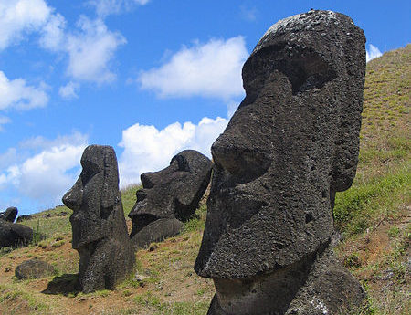

Slide 4
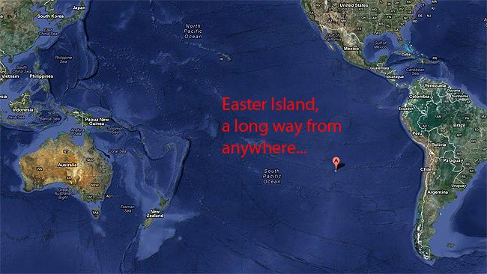
Location, Location, Location
Unsurprisingly, Easter Island is one of the most remote locations on the planet. Pitcairn, which is 1,200 miles to the west of the island, is its nearest inhabited neighbor. Its closest mainland is Chile, which is 2,300 miles away to the east. So the question remains: is Easter Island worth search a strenuous journey? Well it depends on how much you want to the visit the Moai. It is also a place of incredible natural beauty and a rich history.

Slide 5
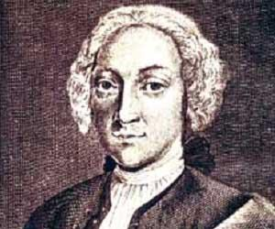
So Why Is It Called Easter Island?
The meaning behind the island’s name can be attributed to its discoverer, and more specifically, when he discovered it. Dutch explorer Jacob Roggeveen was the first European to reach the location, and he found it on Easter Sunday, April 5, 1722. Officially part of Chile, the official name of the island is Isla de Pascua, which also translates to “Easter Island.” Another name for the island is Rapa Nui, because of its resemblance to the Rapa island in the Bass Islands.

Slide 6
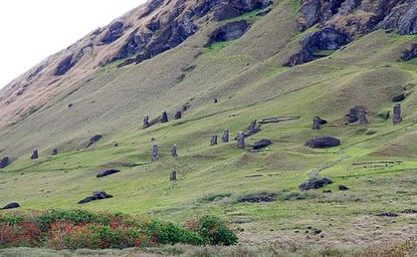
More To The Name
But before the European travellers gave the Pacific Island the name we’re most familiar with today, the location adopted other names long before. The oldest name in recorded memory is Te Pito o Te Henua, which literally means “The Center of the World.” Another name that inhabitants gave the island was Mata-Ki-Te-Rani, translating into the English “Eyes Looking at Heaven.” Eventually, Tahitian sailors called the island Rapa Nui in the 1860’s, and the rest was history.

Slide 7
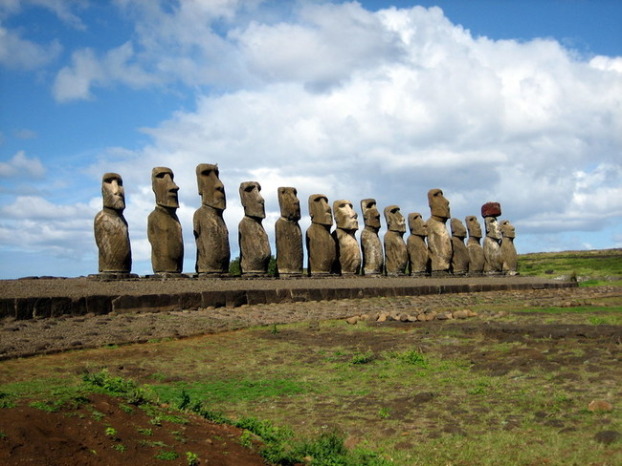
The Moai
There is a strong chance that you may have learned about Easter Island and its intriguing features in a geography lesson. The island is immersed with giant stone figures that resemble heads. Named after the Polynesian word for “head,” the statues are known as the Moai. And don’t be fooled, there’s a lot more heads on the island than just these ones. In total, there are a staggering 887 Moai on the island. And the Moai are more than just a bunch of heads…

Slide 8
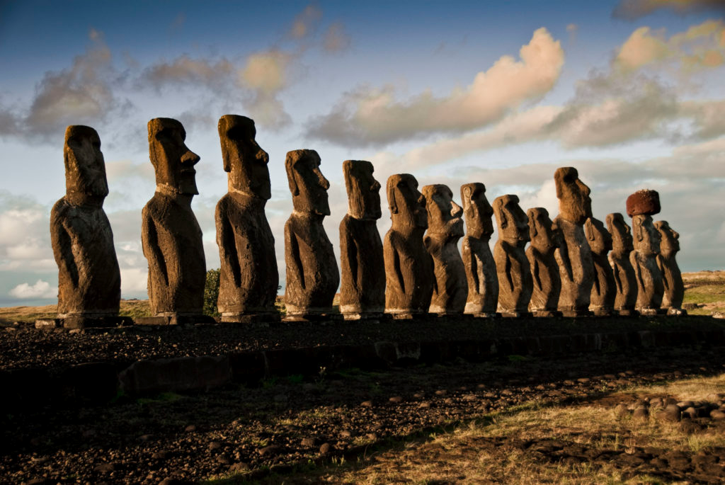
Moai Have Bodies
The statues also have complete bodies that have been buried deep into the ground. Sometimes, only their heads can be seen above the surface. It makes one wonder what else could be hiding under the Earth, waiting to be discovered. After extensive excavations lead by leading archeologists, it was revealed that the Moai’s bodies have heavily detailed tattoos. It is discoveries like these stone structures that go to show how there is a lot more to something than meets the eye.

Slide 9
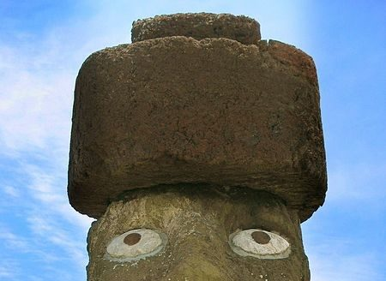
Head Coverings
Did you know that the Moai wore hats? The headgear, known as pukao in Rap Nui, actually represented hair. The islanders would tie the “hair” around the head like a ball. The same reason that chieftains would not cut their hair was attributed to this practice. It was believed that supernatural powers known as “mana” were connected to one’s hair. Men would take rocks, pile them up against the statue and then push the hat over the head.

Slide 10
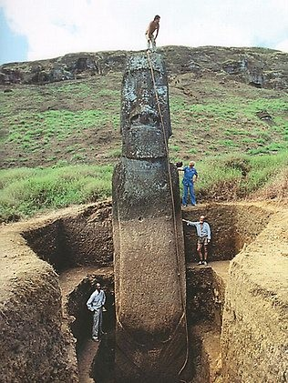
A Team Effort
Officially known as the Easter Island Statue Project, this team of archeologists put an incredible amount of effort in order to excavate a number of Rapa Nui’s statues. As you can see, the excavation made some stunning revelations about the Moai, giving researchers clues about the structures’ history and who may have built them. Within the structures was found large portions of red pigment. There is a strong chance that this substance may have been used to paint the Moai.

Slide 11
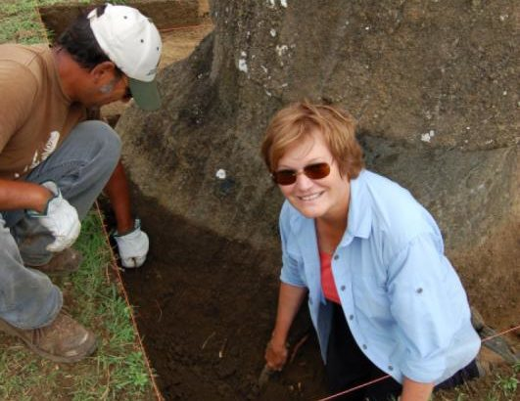
The Director
Jo Anne Van Tilburg is the director of the Easter Island Statue Project (EISP). After her team’s hardworking endeavors to unveil the mysteries of the Moai, she released a statement on the company’s website. She said, “Our EISP excavations recently exposed the torsos of two 7m tall statues. Hundreds, perhaps thousands, of visitors to the island have been astonished to see that, indeed, Easter Island statues have bodies! More important, however, we discovered a great deal about the Rapa Nui techniques of ancient engineering.”

Slide 12
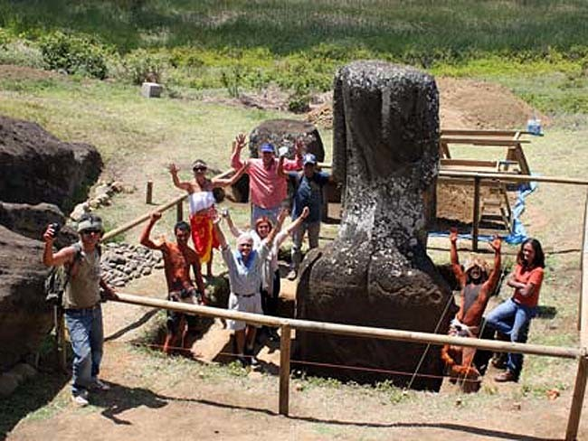
Addressing Misconceptions
Van Tilburg felt that it was important to squash the misconceptions surrounding the Moai. She made this clear by saying that “the reason people think they are [only] heads is there are about 150 statues buried up to the shoulders on the slope of a volcano, and these are the most famous, most beautiful and most photographed of all the Easter Island statues. This suggested to people who had not seen photos of [other unearthed statues] that they are heads only.”

Slide 13
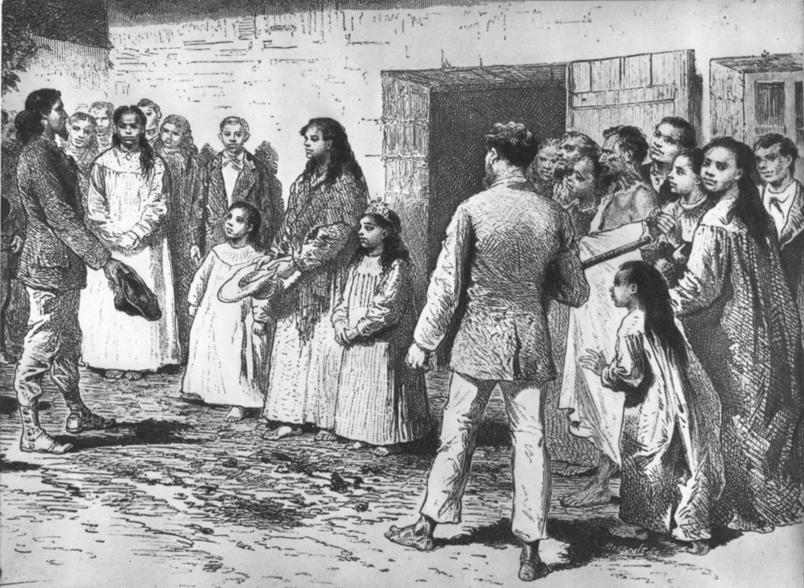
The Original Settlers
In the 20th Century, a popular theory surrounding Easter Island was that Indians from the South American coast were the original settlers of the island. However, after detailed research from archeologists and linguists, this theory has since been unanimously debunked. Nowadays, the general consensus is that the first people to discover the island were of Polynesian descent. These people most likely hailed from the Marquesas or the Society islands, arriving as early as 318 AD.

Slide 14
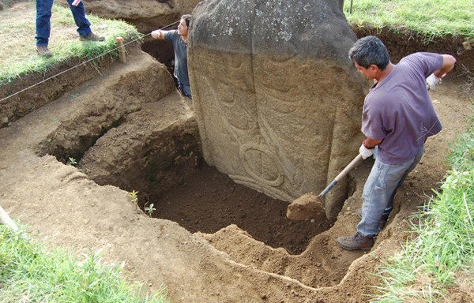
Mysterious Markings
Some of the discoveries that the EISP are absolutely jaw-dropping. Under one of the statues, Van Tilburg’s team found a particularly interesting relic. The stone had a crescent shape carved into its surfaces. According to researchers, it was believed to symbolize a canoe, or a vaka. The statues that this stone was found within have petroglyphs written on its sides. The team made the conclusion that the designs, together with the petroglyphs strongly hinted at the people responsible for the statue’s construction.

Slide 15
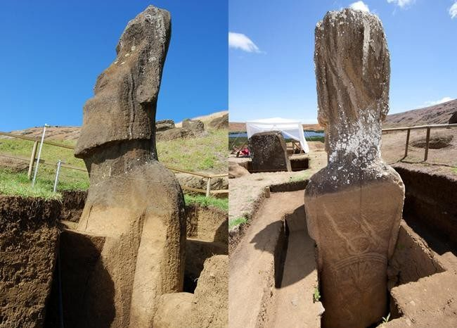
Similar, For The Most Part
So what are the definitive features that all Moai have in common? Well one thing is certain, they are monolithic structures, meaning that each statue was carved out of one large stone. But not all of them are identical, some of them are very unique in deed. The tallest Moai statue is 33-feet tall and weighs a staggering 82-tons. From a historical standpoint, the Moai have been fixed on the Chilean Polynesian island since 1250 C.E.

Slide 16
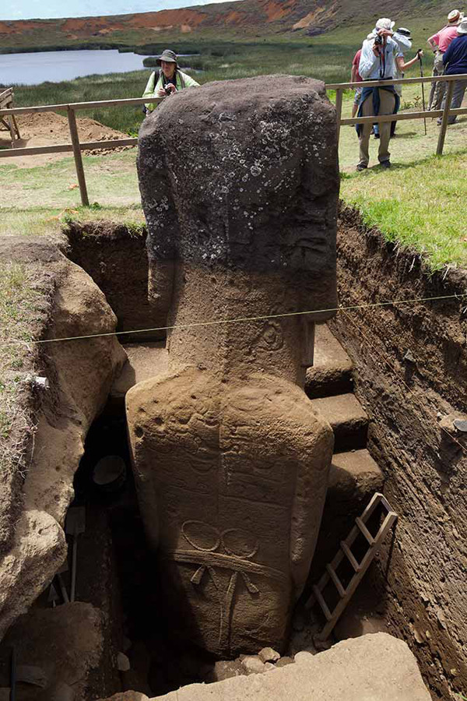
Let’s Get Spiritual
During Jacob Roggeveen’s expedition to Easter Island in 1722, he commented on the spiritual tendencies of the Rapa Nui people. He said that “they relied in case of need on their gods or idols which stand erected all along the sea shore in great numbers, before which they fall down and invoke them.” He continued, commenting how he noticed priests, who displayed much more reverence to the Moai than others, and appeared to be much more devout than the average islander.

Slide 17
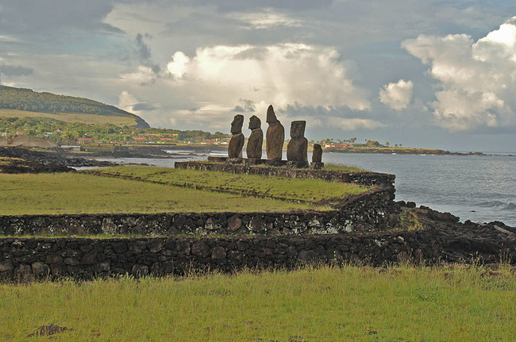
More Than Just A Pretty Face
There are many theories surrounding the symbolism of the Moai and the deeper meaning that they represent. Many archeologists believe that they were constructed to be symbols of authority and power. But to the island’s inhabitants, they were more than just symbols. The Moai were considered to be physical manifestations of sacred spirits. Another theory is that the Moai represent the ancient ancestors, who faced away from sea and towards the villages, watching over the island’s people.

Slide 18
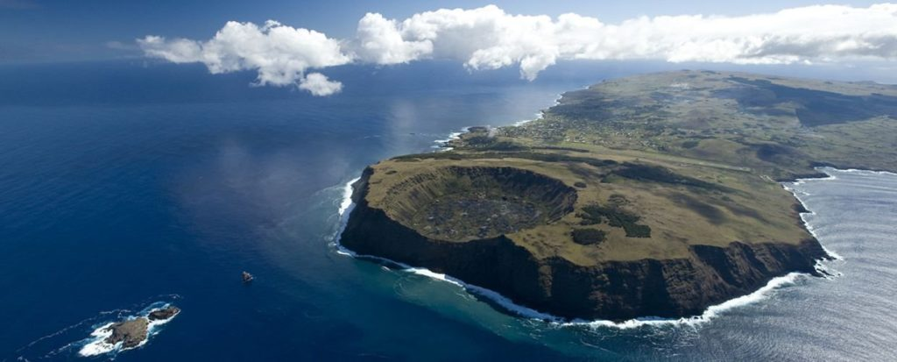
It’s Actually A Volcano
Easter Island is also home to three extinct volcanoes, the tallest standing at a staggering 1674 feet. But to be precise, Easter Island is technically one large volcano. The main volcano goes by the name of Rano Kau and is located within the UNESCO World Heritage Site of Rapa Nui National Park. And the volcano itself is actually home to the ruins of Orongo, the ceremonial village that ancient islanders travelled to and performed acts of worship.

Slide 19
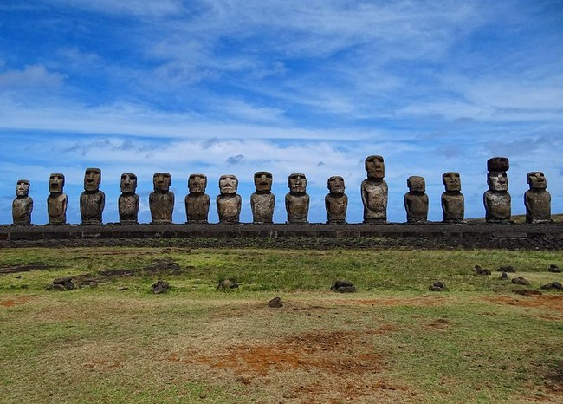
Who Were The Architects?
Despite its rich history and a myriad of theories, there is still no definitive answer as to who exactly constructed the Moai statues. One popular theory suggests that the statues were carved by the most professional carvers of the ancient Polynesians’ craft guilds. Another suggestion is that members of each clan came together to create the Moai. This would make sense because the Rano Raraku quarry was broken down into different areas for each respective clan.

Slide 20
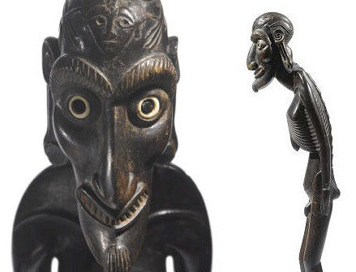
Another Breed Of Statue
A structure that is often overlooked because of the grandiose Moai is the Mo’ai Kavakava. These small wooden figures also originated from Easter Island, portraying lanky men. The word kavakava literally translates to “ribs,” which makes sense because of the gaunt appearance of the man. They are generally considered to represent starving demons, and were believed to be worn by religious men during ritual dances. They would wear the ornaments around their necks during community events.

Slide 21
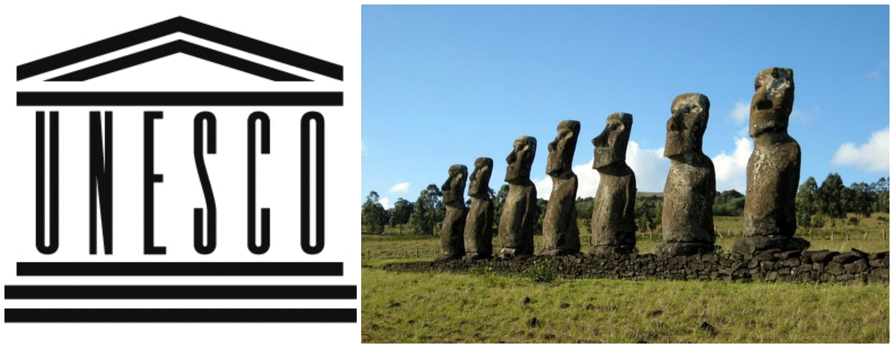
World Heritage Status
Easter Island is home to the Rapa Nui National Park, which was added to UNESCO’s list of World Heritage Sites over twenty years ago. The island World Heritage status was secured due to its fame around the world and the iconic Moai that grace the island. A vast majority of Easter Island has been declared as part of the Rapa Nui National Park. On March 22, 1996, UNESCO finally granted the park World Heritage status under its cultural criteria.

Slide 22
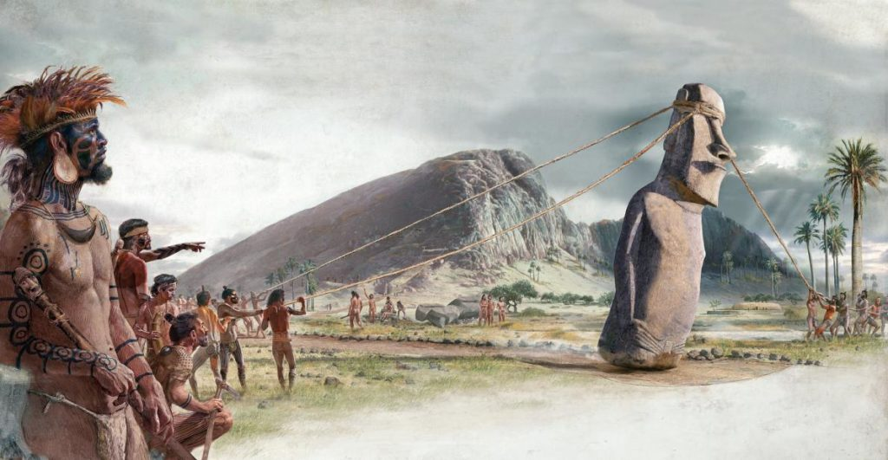
Moving Structures
Ever since the statues’ discovery, it has been a mystery as to exactly how the Moai would have been moved across Easter Island. There have been many theories how this could have been achieved. One suggested that the statues would most likely have required human labor, ropes and possibly other equipment. Other theories suggest that people may have used logs to roll the Moai to their aimed destinations. This would have meant that it would’ve taken between 50-100 people to move the structures.

Slide 23
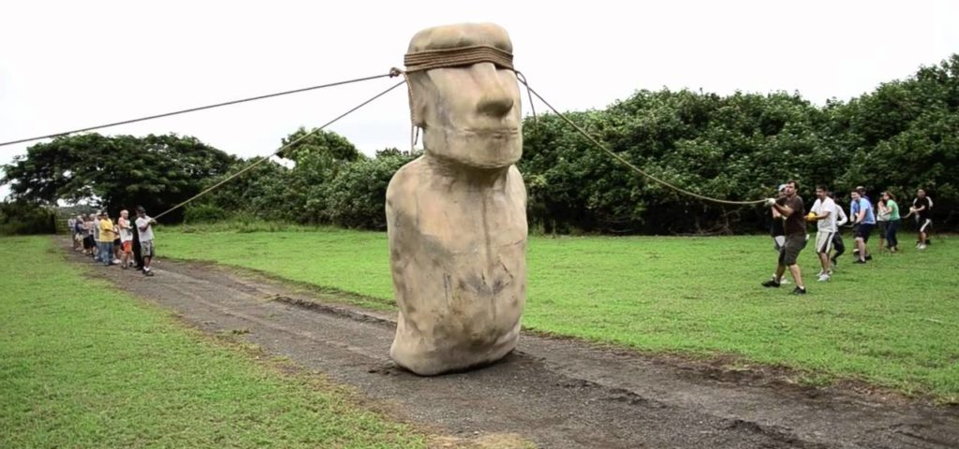
A Reconstruction
Czech engineer Pavel Pavel collaborated with Norwegian adventurer Thor Heyerdahl in order to construct their own life-size Moai statue. They took one rope, tied it around the head and then wrapped another around the base of the statue. In a team effort with 16 other people, they slowly moved the statue. However, because they were causing it slight damage, they decided to end the exercise prematurely. They predicted though that they could move the statue 330 ft per day.

Slide 24
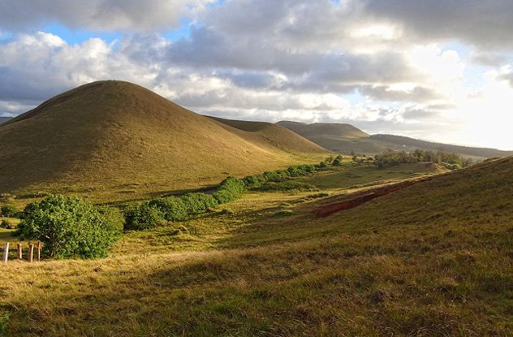
What Happened To The People?
Despite a variety of theories, it is generally agreed that the former inhabitants of Easter Island were the architects of their own destruction, at least as far as living on the island was concerned. One theory suggests inhabitants cleared the forests on the island, wrongly believing that the trees would grow back quickly. Also, the growing population on the island was a massive problem, rendering the place too small for the number of inhabitants on it.

Slide 25
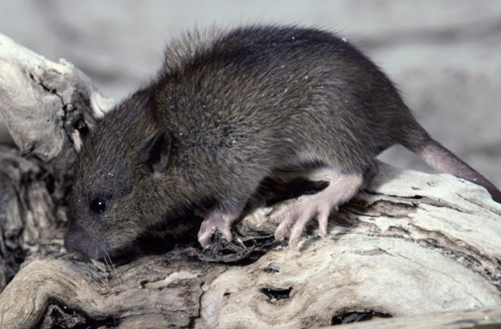
Or Could It Be…
Another theory that could explain the inhabitants’ disappearance was an infestation of rats. Some historians believe that an overflow of food could have attracted an influx of rodents that may have hid in the canoes of the people who first settled on the island. It was potentially rats that would incessantly munch away at vegetation, preventing sufficient regrowth. But despite the damage they were causing, rats became a staple of the local diet. This can be backed up by the archeological discovery of rat bones.

Slide 26
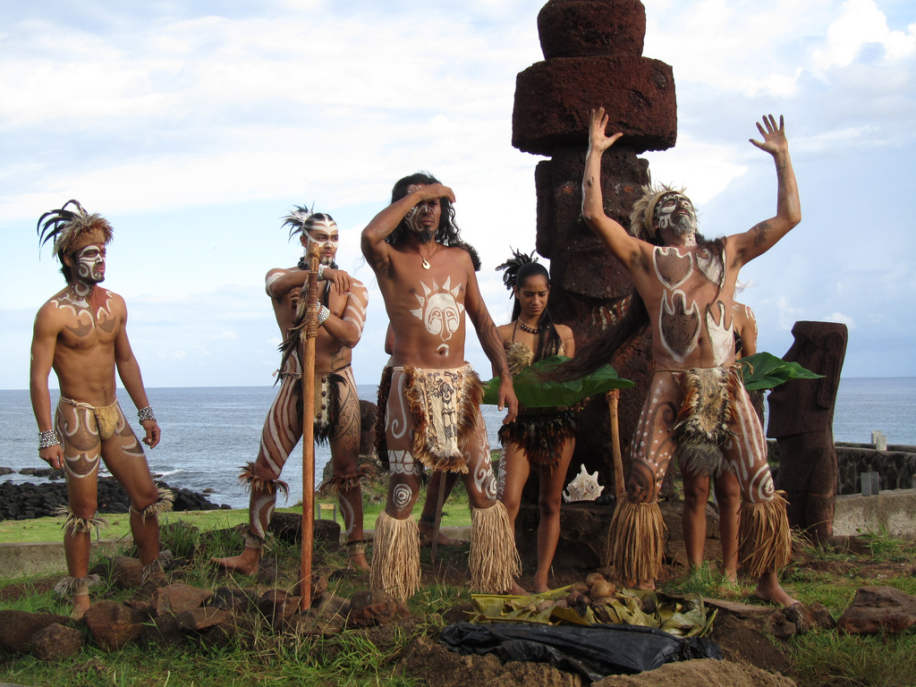
Mass Destruction
Although there are many conflicting theories surrounding the peoples’ disappearance, most anthropologists share the same opinion on one particular fact. At some point in the 18th Century, the islanders started a riot, rebelling against its leaders. As resources began to diminish, tensions rose between communities, and battles started to ensue. As a result, many Moai statues were torn down. Apparently, most of the statues lay on the ground. But of course, they have all since been re-erected.

Slide 27
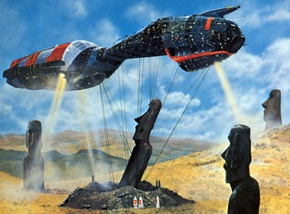
Maybe It Was The Aliens
A completely left-field theory suggests that the Moai could have been created by aliens. The idea was proposed by Erich von Daniken in his book, Chariots of the Gods?: Unsolved Mysteries of the Past. As well as his theories about the Moai, von Daniken also attributes extraterrestrial influence to the construction of the Egyptian Pyramids, as well as the Nazca line drawings. But the fact remains that the stone used to construct the statues was from the actual island.

Slide 28
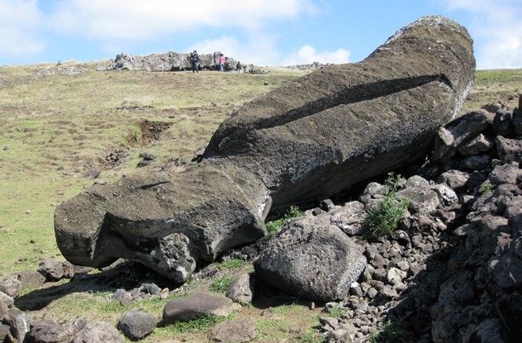
The Moai Roads
According to Thor Heyerdahl, Rapa Nui had ancient roads that were used as the main mode of transport. They were discovered along with many statues that were toppled over alongside them. Heyerdahl opposed British archeologist Katherine Routledge’s theory that the roads were actually intended for ritualistic reasons. However, there is much validity to Routledge’s theory. All the roads lead to the extinct Rano Raraku volcano, suggesting that it was a focal point of worship for the islanders.

Slide 29
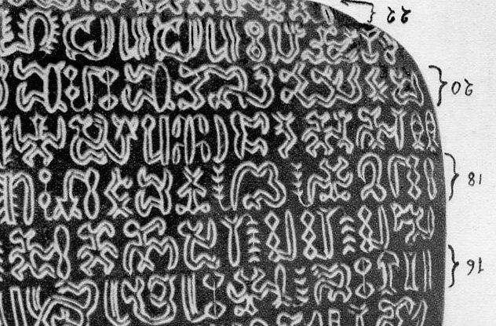
Connections Elsewhere
There has also been a mystery surrounding the writing system used on Easter Island during its inhabitance. Robert M. Schoch believed that the tablets with calligraphy could date back 10,000 years older than previously expected. And this would also make the island older. Schoch’s epiphany came after exploring the ancient Turkish ruins of Gobekli Tepe, due to seemingly feeling out of place in terms of where it is located. Schoch sees many similarities between the Moai and the pillars of Gobekli Tepe.

Slide 30
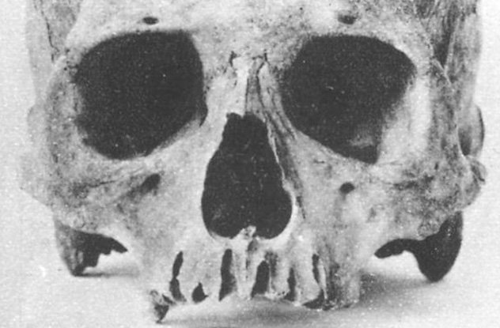
Playing The Theory By Ear
Easter Island has provided intriguing insight into the skeletal structures of the people who once lived there. Skulls that were discovered on the island appear to be long and narrow, with an indication that the Rapa Nui people may have had longer ears than the average human being. There is even documentations about supposed battles fought between short-eared and long-eared tribes. The long-ears apparently were ancient Peruvians, while the short-eared people were of Polynesian descent.

Slide 31
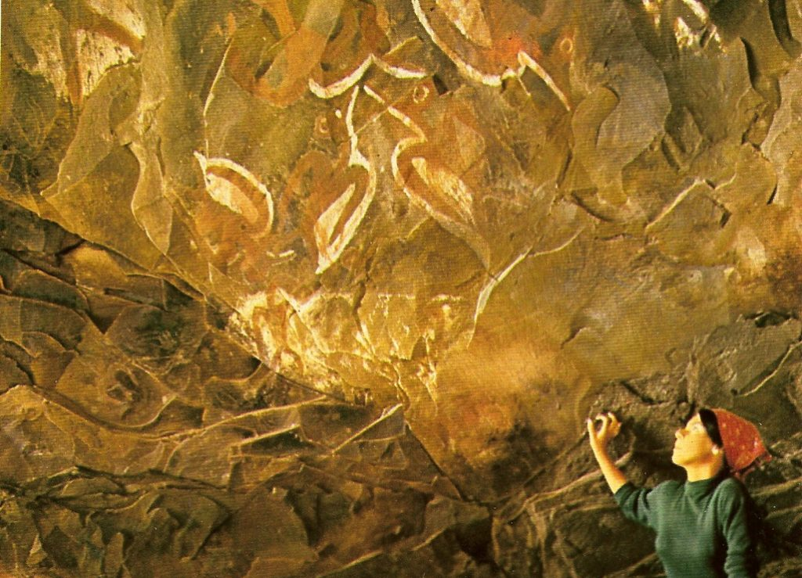
Who Will Be The Birdman?
These illustrations are taken from the “Cannibal Cave,” displaying what is widely regarded as the Tangata manu, or in English, “Birdman.” This was the winner of an annual competition on the island. Inhabitants would compete against one another to collect the first egg of the season. They would have to swim to an island close by, collect the egg and the first one to return to Rapa Nui would be hailed the Birdman, and the leader of the community for a year.

Slide 32
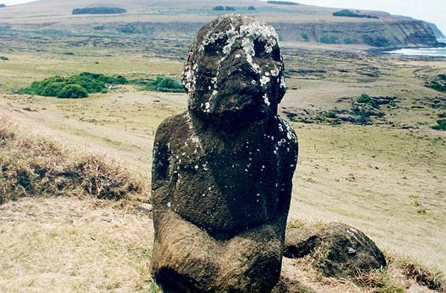
Stands Out Like A Sore Thumb
One of the most unique looking Moai statues is the Tukuturi. Believed to have been a physical manifestation of an ancient singer, the figure was found in a kneeling position, resembling the celebratory stance during the festival of rui. Sporting a beard, Tukuturi is much a smaller structure than usual Moai statues. It also was made from a different material compared to the majority of the island’s other statues. Instead, red Puna Pua stone was used to construct the statue.

Slide 33
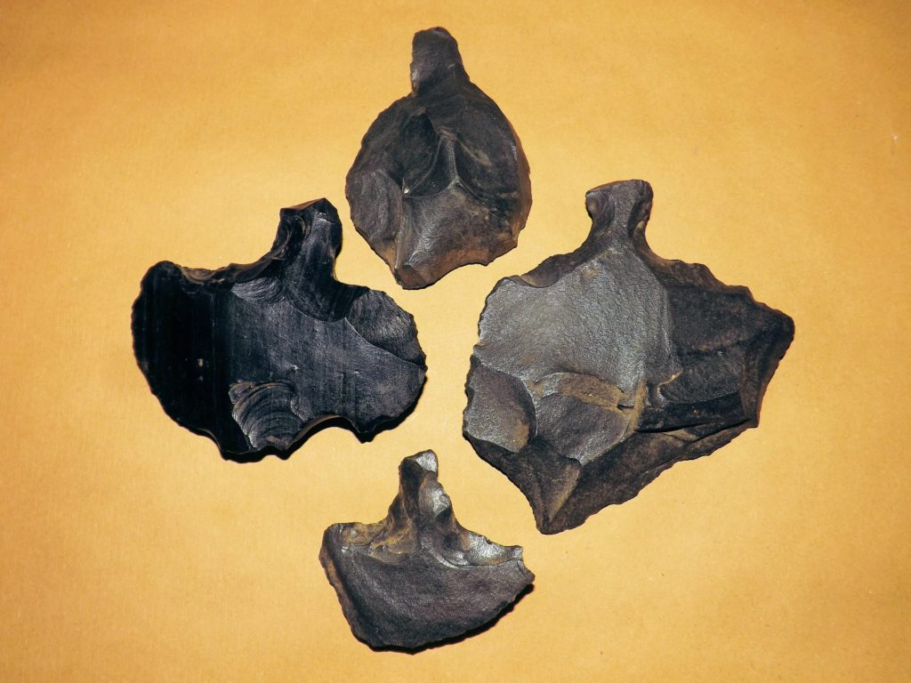
Easter Tools
One of the most distinctive archeological features that can be traced back to the Rapa Nui were the tools that the people used. Known as Mata, these tools were constructed out of volcanic glass, which the people made into a variety of shapes and sizes. Most of the tools were deliberately sharp, in order to cut fibers, carve wood and even to use for weaponry. These tools are a popular feature of many Rapa Nui exhibitions in museums around the world.

Slide 34
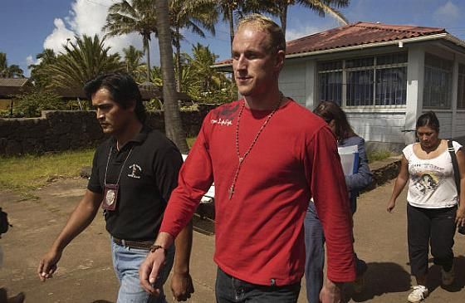
Grand Theft Moai
In an act of sheer audacity, a Finnish tourist went to Anakena beach and hacked an ear off one of the statues. Someone witnessed Marko Kulju run away with the Moai’s ear and reported him to the police. As a result, Kulju was arrested and for his crime, fined $17,000 USD. In the end, the punishment was a slap on the wrist as he could have spent seven years locked up. The incident ensured stricter security procedures for tourists at the national park.

Slide 35
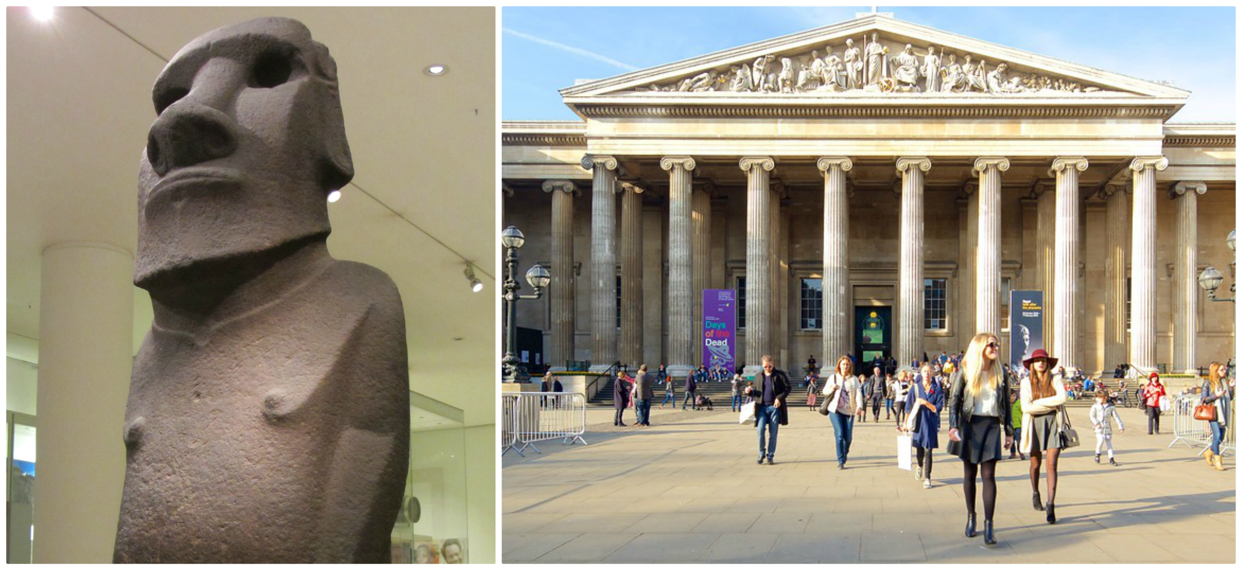
A Masterpiece
One of the most iconic of the Moai isn’t even on the island anymore. Known as Hoa Hakananai’a, this statue is on display at London’s British Museum. In November, 1868, a crew from the British ship HMS Topaze retrieved the statue from ‘Orongo, Easter Island. After a long trip, the statue finally landed in England in August, 1969. Despite being smaller than the average Moai, it is often regarded as the archetype for the Moai design and universally regarded as a masterpiece.

Slide 36
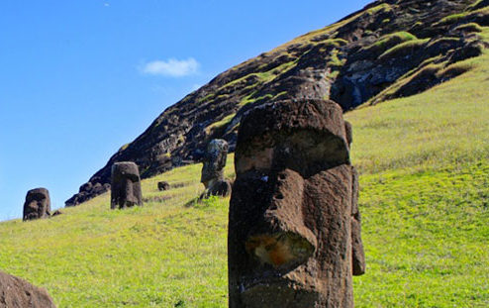
An Unexpected Cure
Another peculiar theory surrounding the Moai was developed by Dr. Anneliese Pontius. The psychiatry professor from Harvard Medical School speculated that the reason that islanders created the statues in the first place was in order to cure leprosy. Upon seeing the deformities of bodily features such as the face, hands, fingers and arms, the islanders felt compelled to create the perfect specimens in their eyes. This would help undo the damage inflicted on those struck with leprosy.

Slide 37
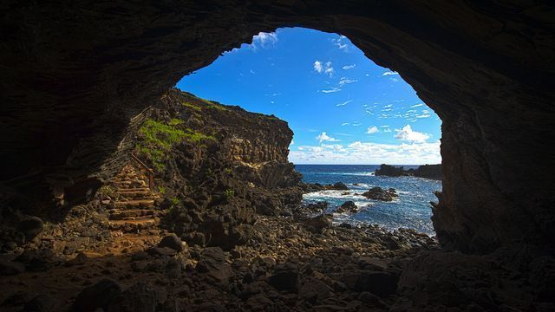
From The Old To The New
Easter Island should not be credited purely for its rich history, which spanned over thousands of years. It also has a bustling contemporary society that has seen drastic changes in just one lifetime. One tour guide commented on how his 87-year-old great-grandmother spent her childhood years growing up in a cave. For many islanders, the first time that they saw a plane fly over the island was a baffling experience to say the least.

Slide 38
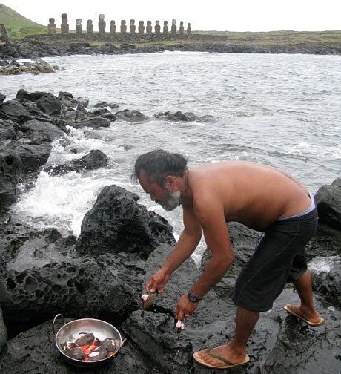
Tourism At Its Finest
There are many who provide tourists with unique insights into Rapa Nui life. Take this man for example. Moi works for a company called Ancestral Tours who show tourists how the Rapa Nui live their lives, both through water and the land. In his water-based tours, Moi takes travellers to snorkel in Ovahe Beach. After working together to retrieve fish swept up by the waves, he cooks for the tourists, while statues watch over the proceedings, like a bunch of bodyguards.

Slide 39
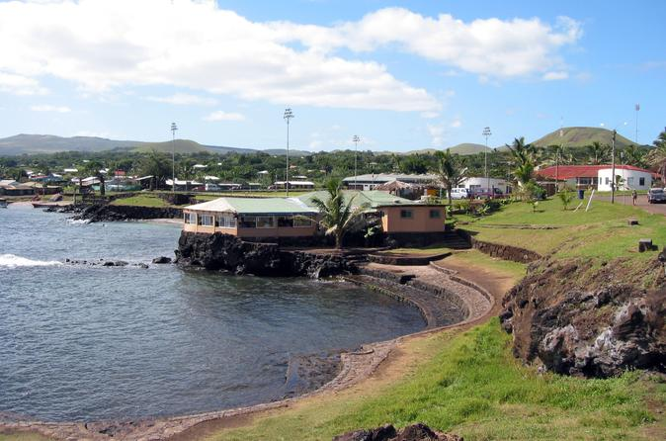
The Capital
Nowadays, Easter Island has its fair share of inhabitants who may not necessarily be originally from such parts. 90% of the population lives in the capital, Hanga Roa, which in all honesty is not the most exciting location in Rapa Nui. The town has a very basic infrastructure, having only one bank and a few private businesses. Construction laws are particularly strict, due to the tourism focused nature of the island. But there are plenty of places for tourists to stay.

Slide 40
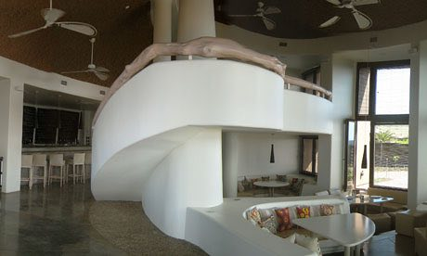
Fantastic Hospitality
One prime example of the capitalization of Easter Island’s recent boom in tourism is the Hangaroa Eco Village and Spa. It is the first high-end hotel in the island’s capital and the 75-room hotel is inspired by the original accommodations that people of Rapa Nui lived in. The hotel has solar panels and wind turbines, helping to generate energy for each room. Other unique features of the hotel include beautiful clay baths as well as furnishings made out of volcanic rock.

Slide 41
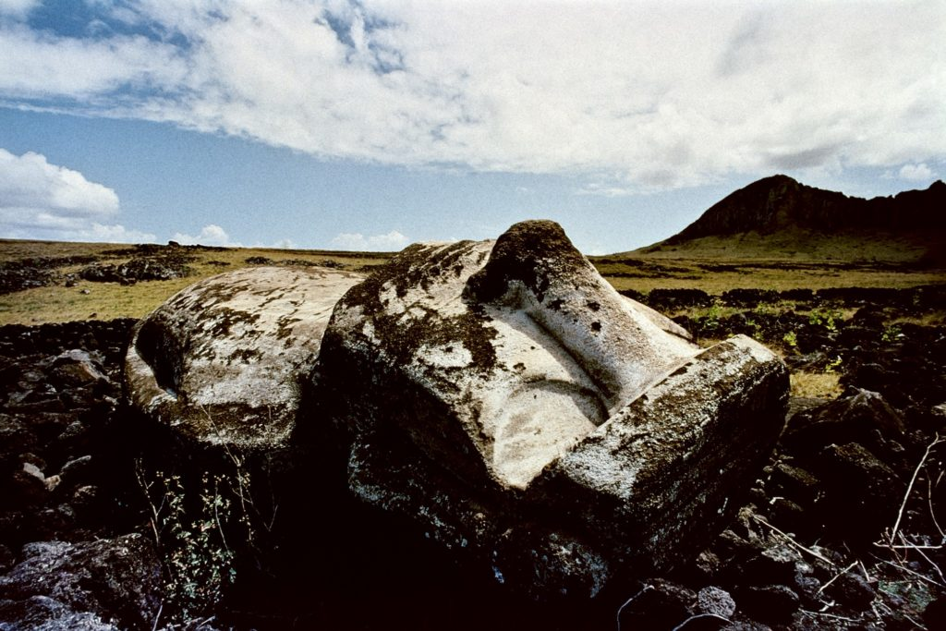
Things Have Changed
Despite the many mysteries surrounding Easter Island’s history, there is one fact that historians unanimously agree on. At one point in history, Easter Island faced extreme deforestation. It has been suggested that islanders burned most of the trees in order to make way for clear land and also to make canoes out of the wood. It’s also speculated that the people created tools to transport the Moai. At any rate, the landscape of the island is very different to how it used to be when it was inhabited.

Slide 42
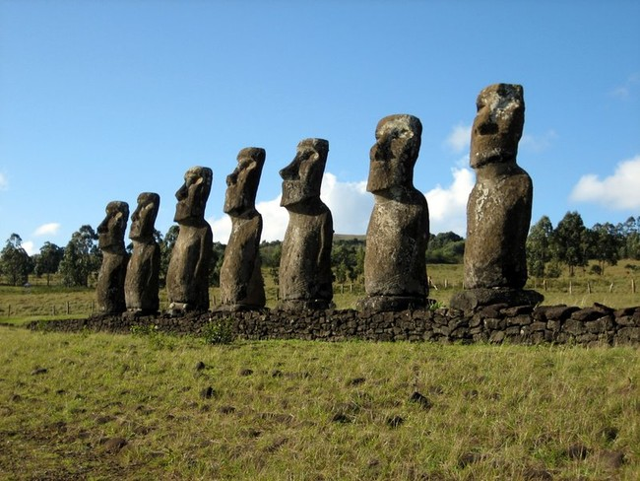
The Legend Of Ahu Akivi
The site of Ahu Akivi has a particularly special part to play in the history of Easter Island. Seven equal size Moai stand inland and face the sunset during the Spring Equinox. Then, during the Autumn Equinox, they face away from the sunrise. The seven statues represent seven protectors who in a dream, were ordered by the King’s spirit to wait for him and his other scouts to return from a trip across the Pacific Ocean.

