Slide 1
Indian Families Reflect the Great Diversity of India

Slide 2

Within India there is much diversity in: religions, language, cultures, tribes and ethnicities, etc. Among families that can afford to own and wear traditional dress, the traditional dress serves to highlight that diversity.
The drawings tha follow only scratch the surface of the diversity that exists.

Slide 3
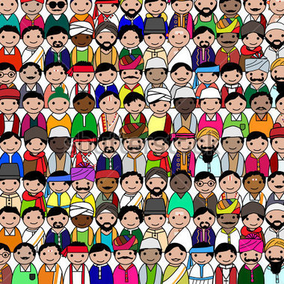
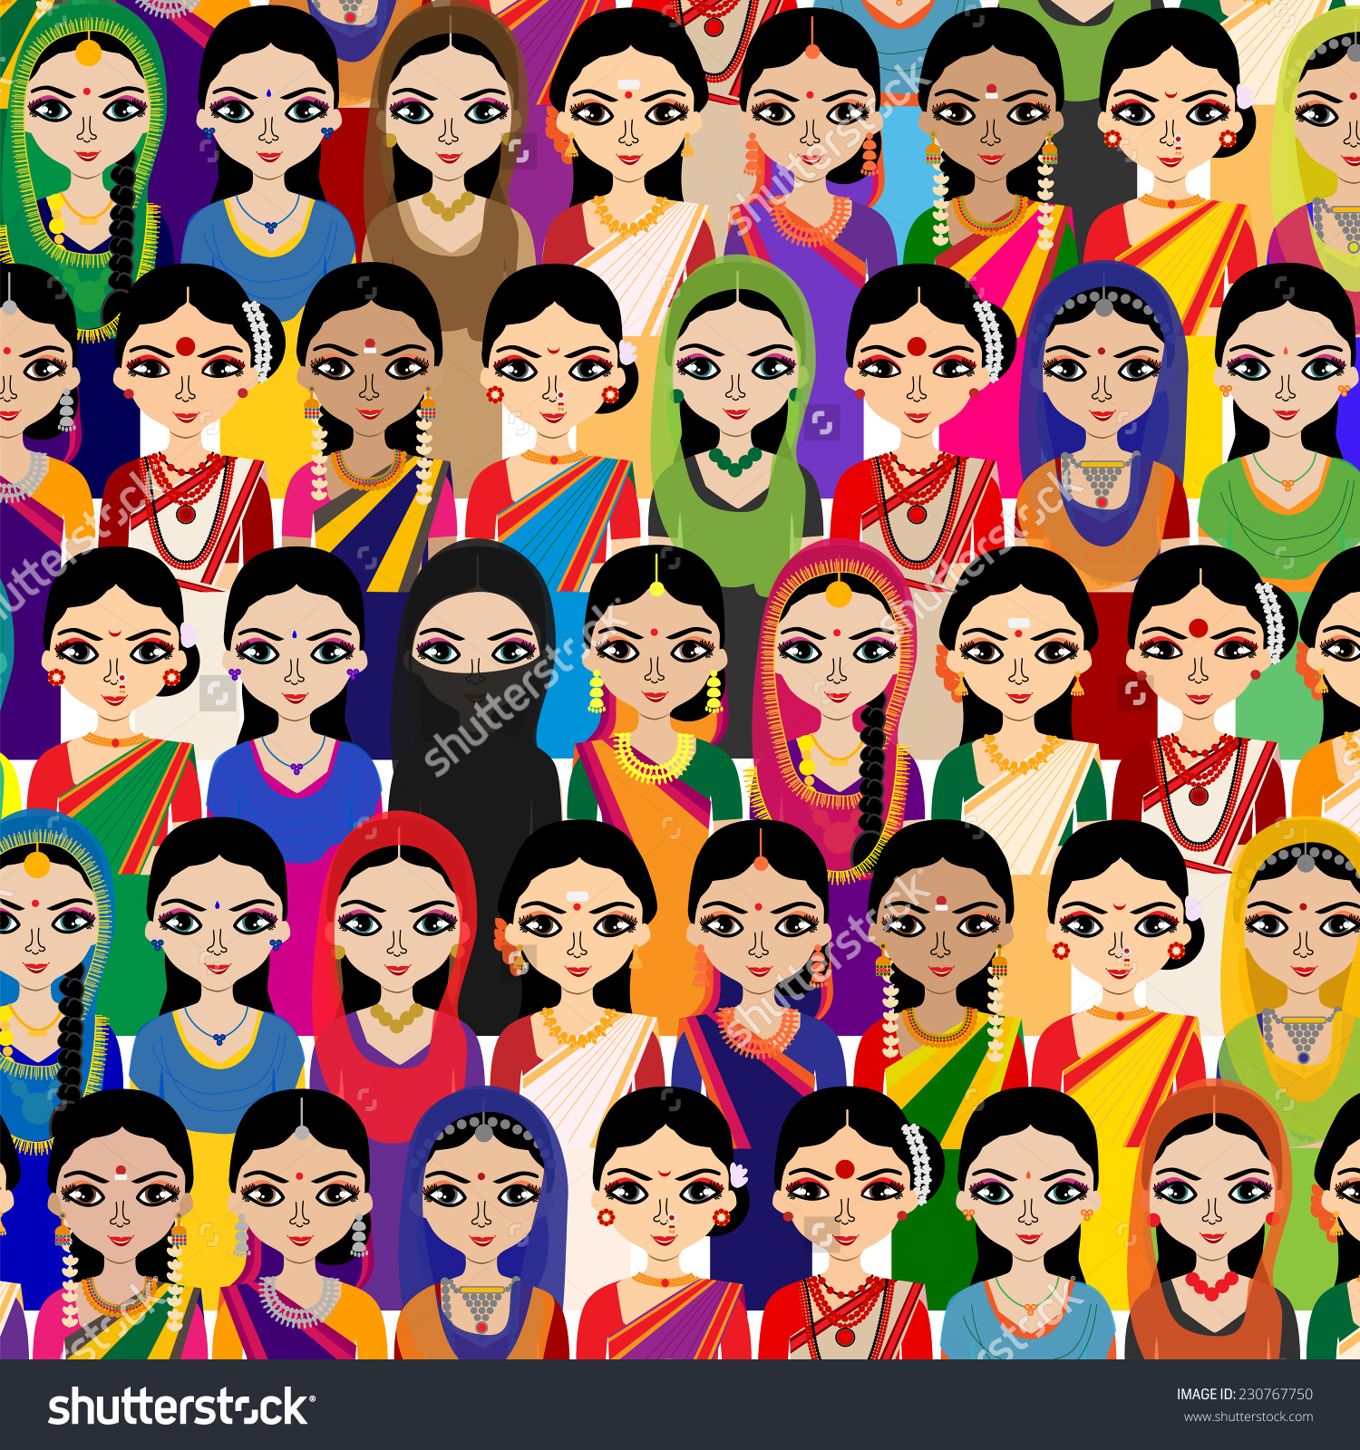
Great Diversity

Slide 4
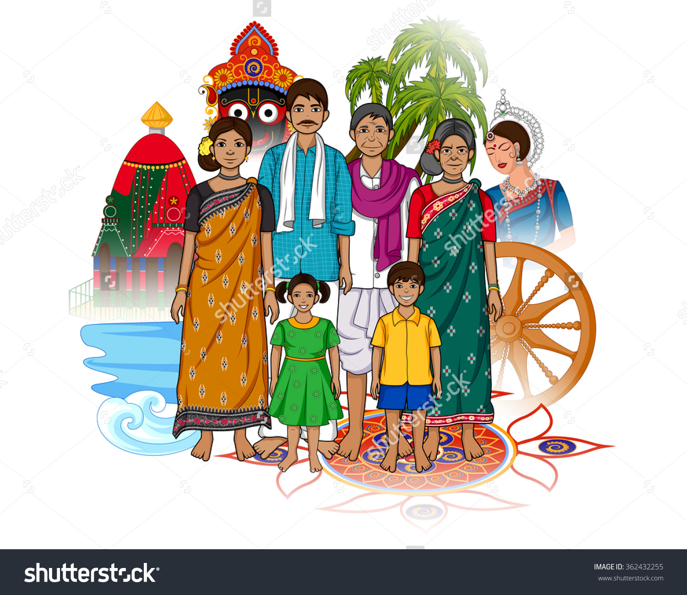

Slide 5
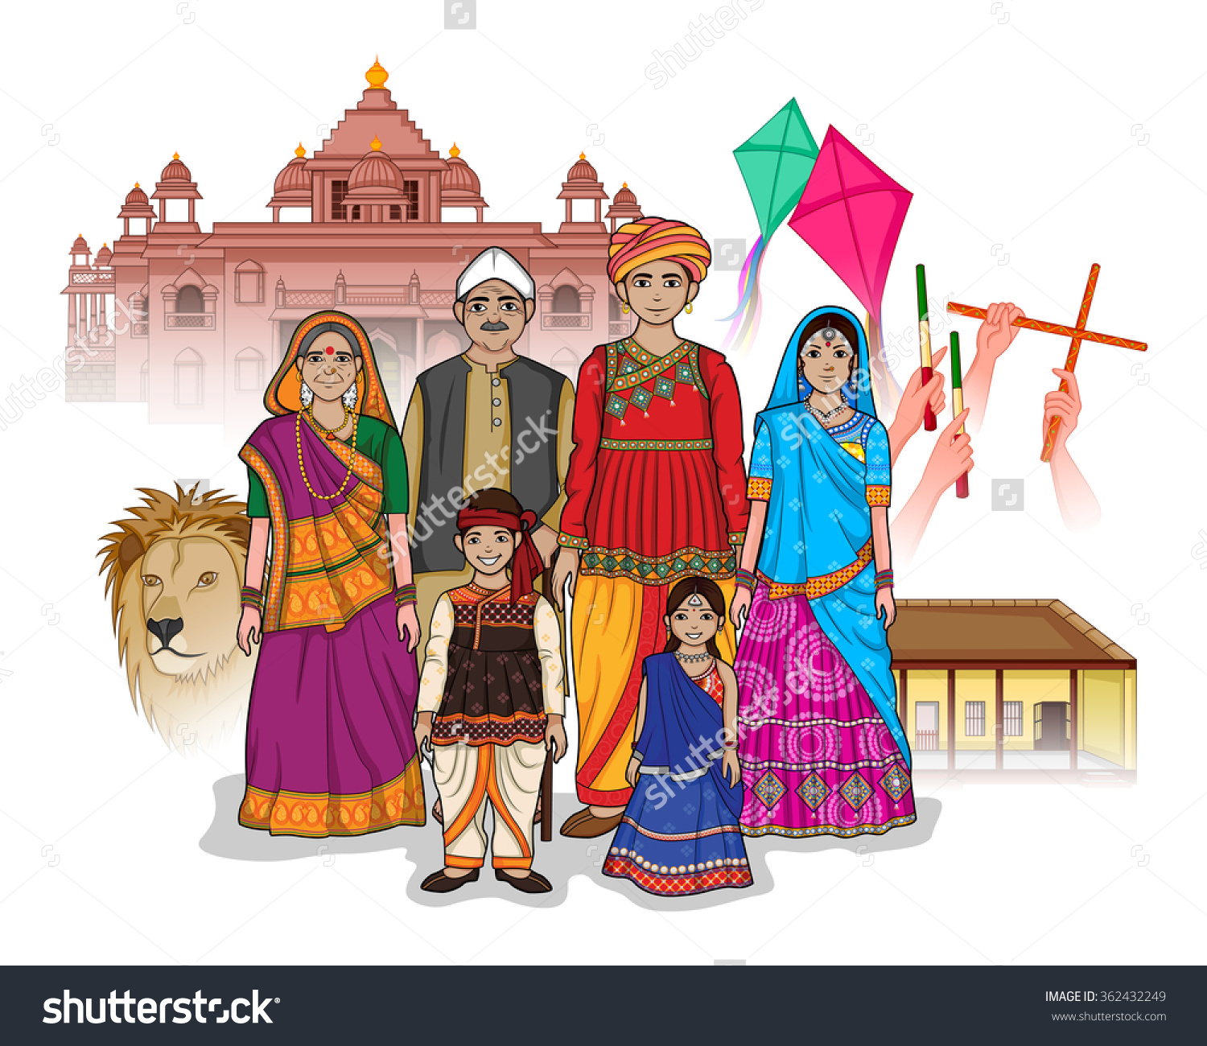

Slide 6
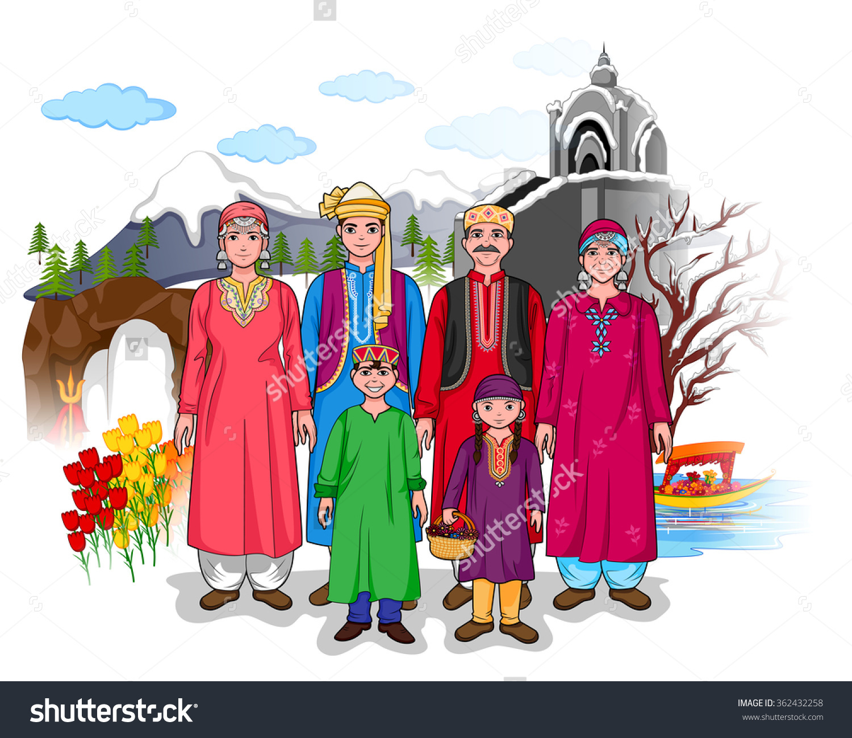

Slide 7
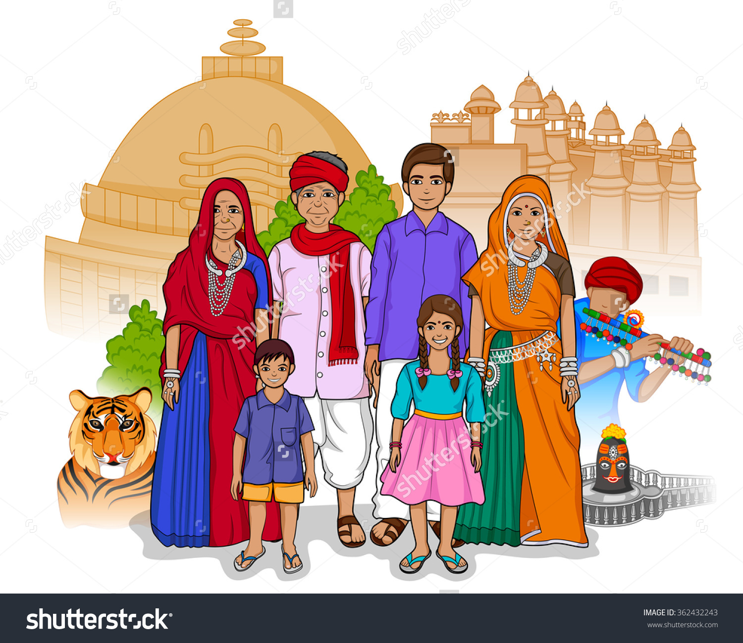

Slide 8
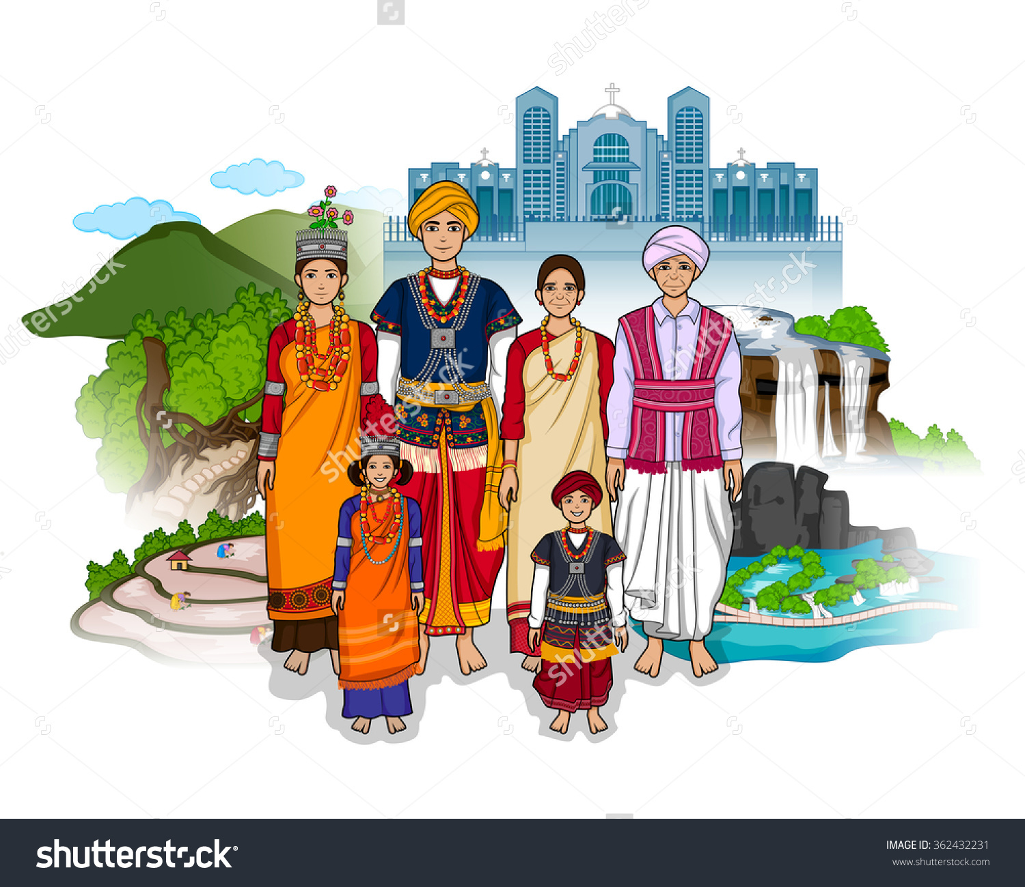

Slide 9
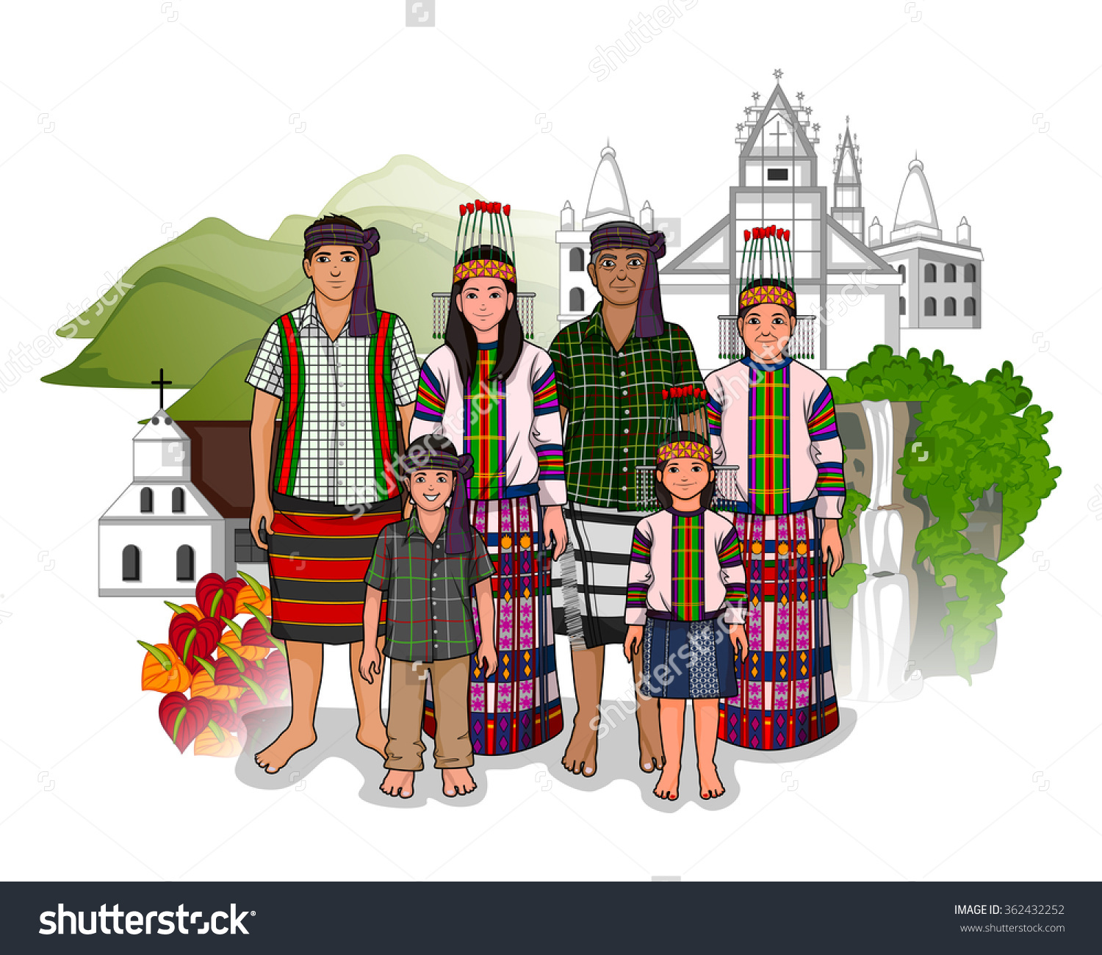

Slide 11
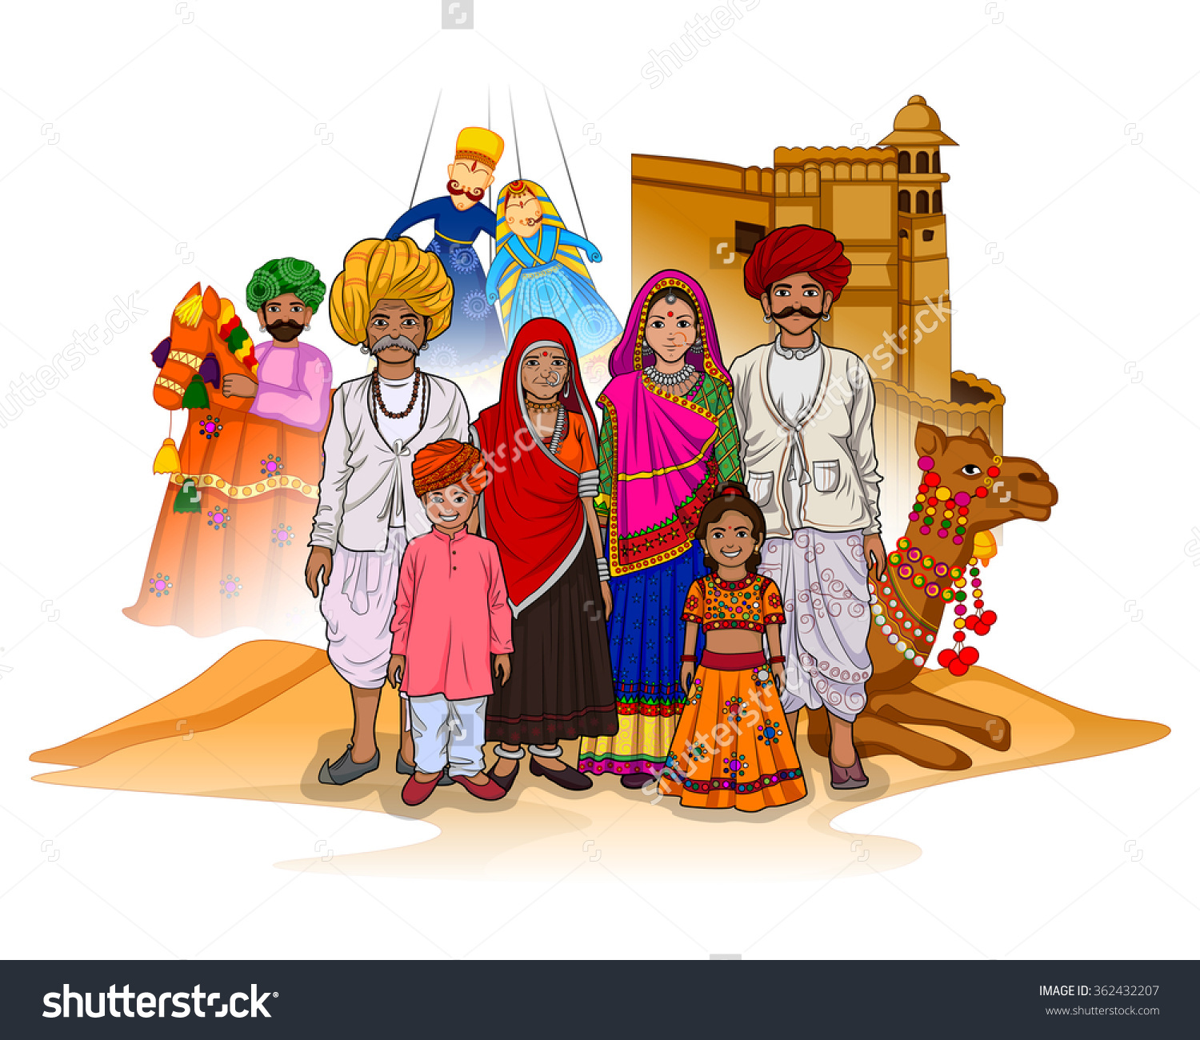

Slide 12
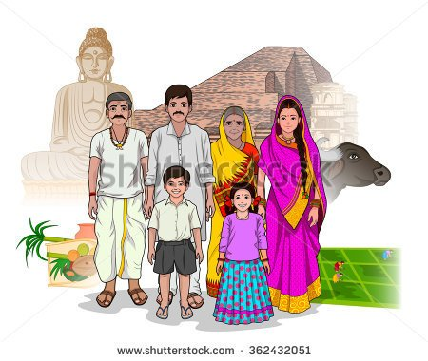

Slide 13
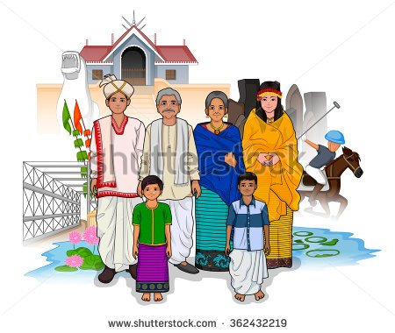

Slide 14
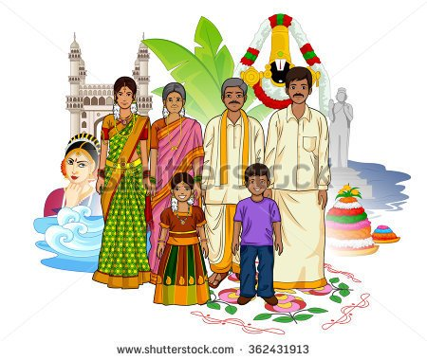

Slide 15
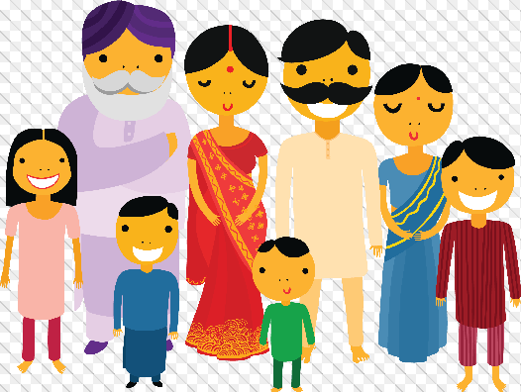

Slide 16
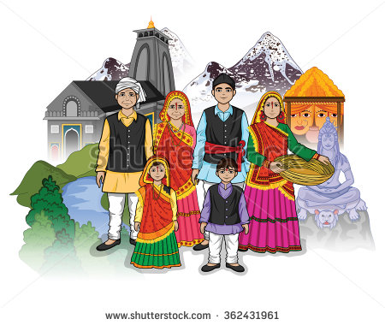

Slide 17
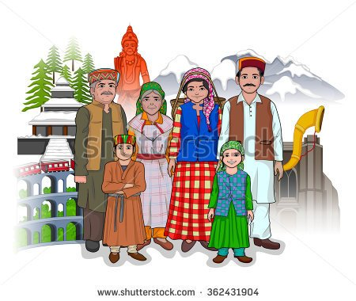

Slide 18
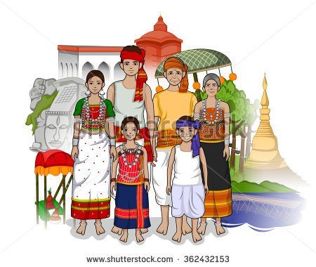

Slide 19
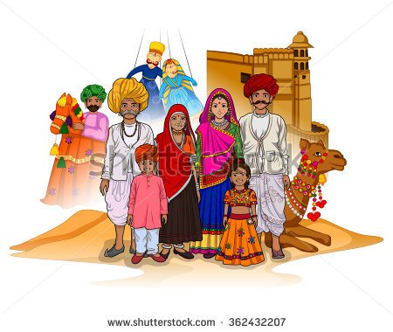

Slide 20
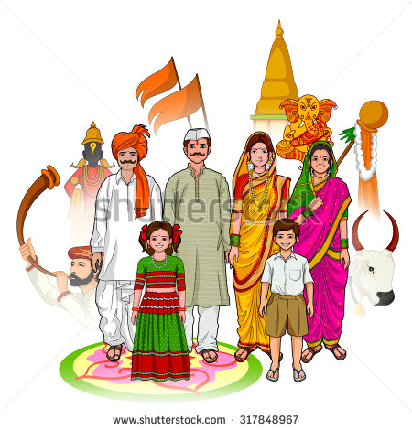

Slide 21
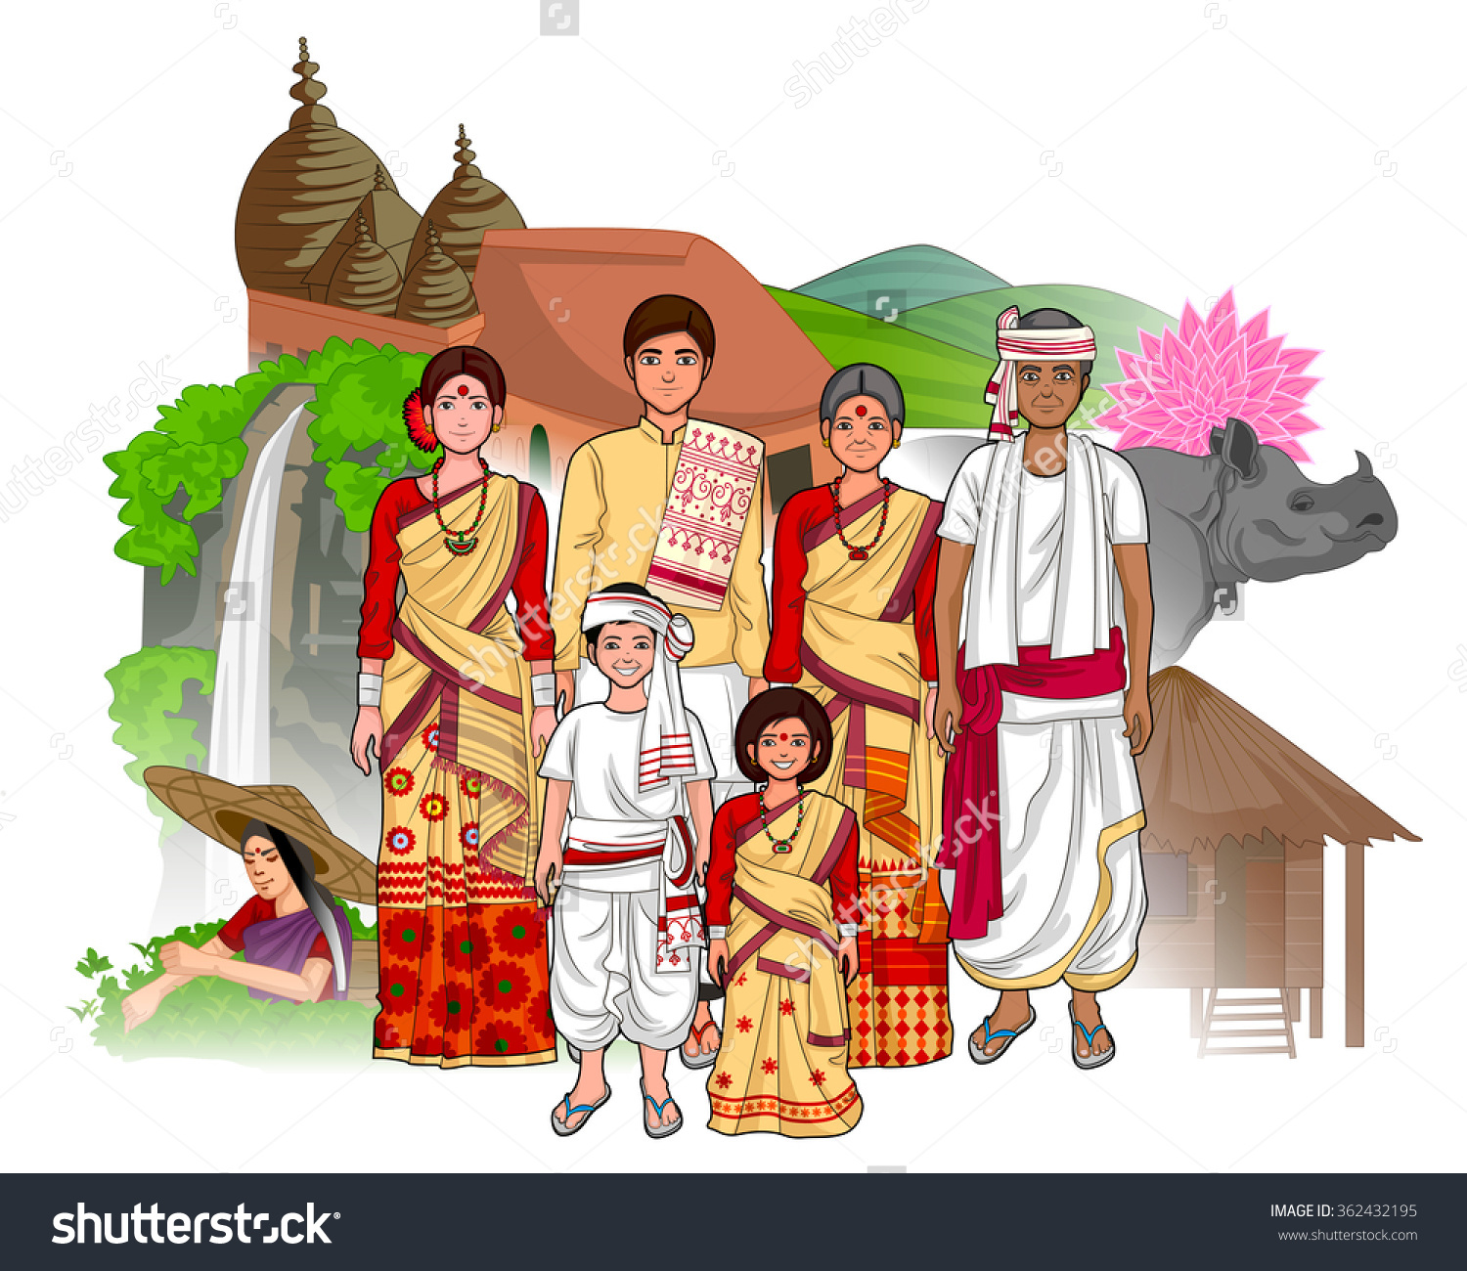

Slide 22
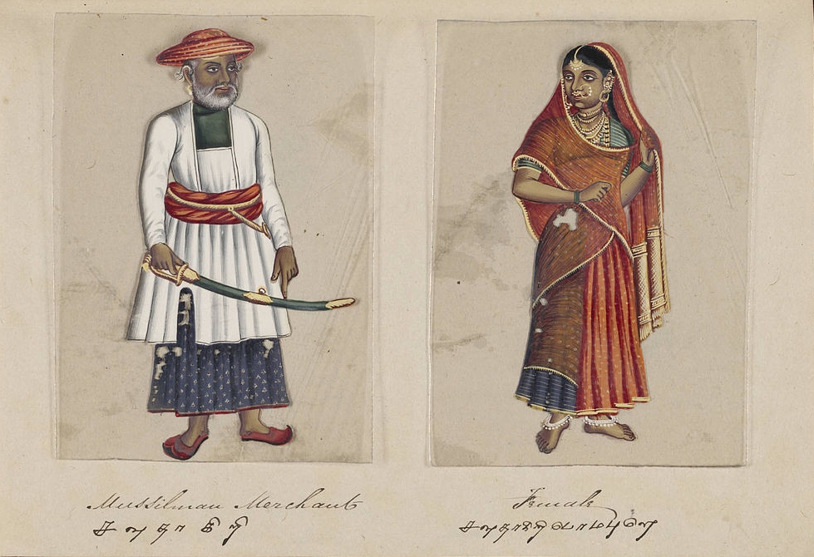
Muslim merchant

Slide 23
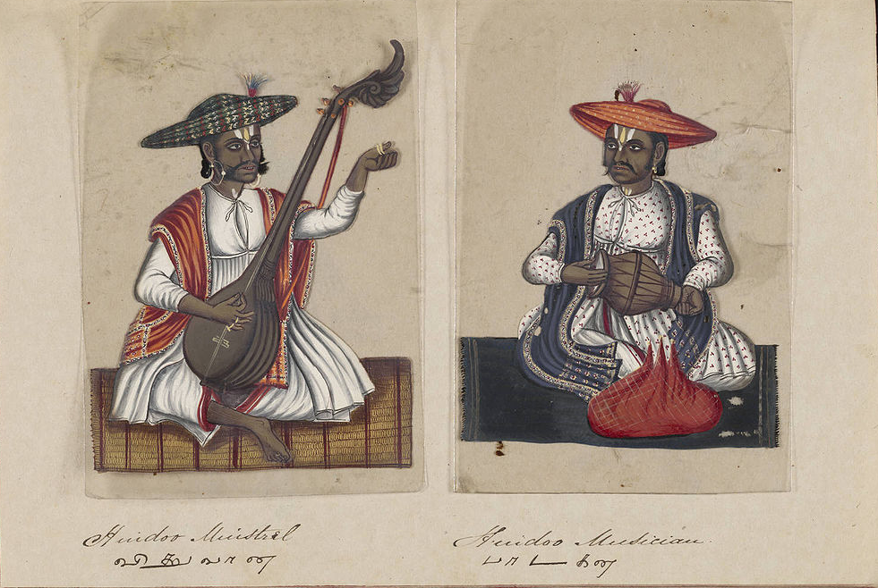
Hindu Musician

Slide 24
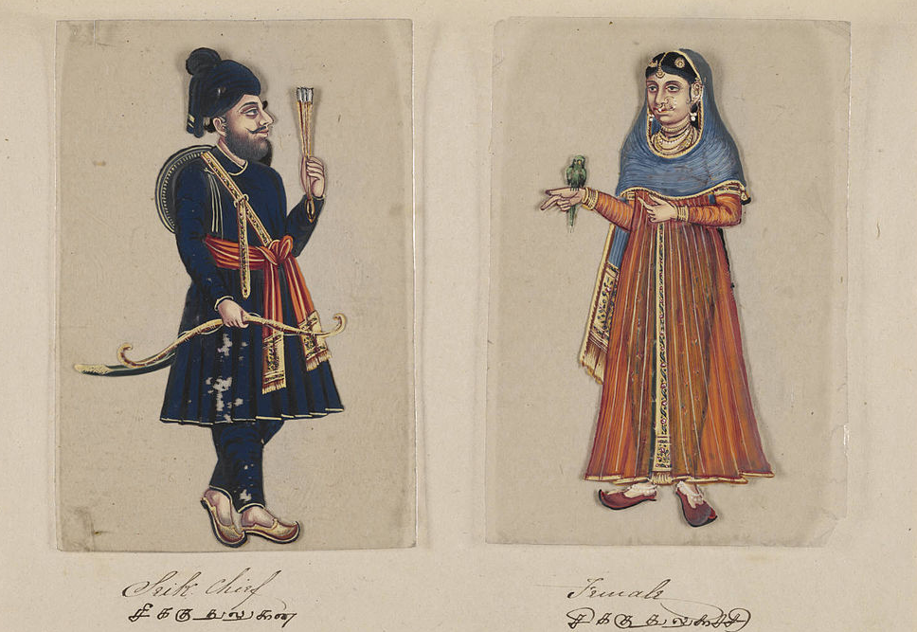
Sikh Chief

Slide 25
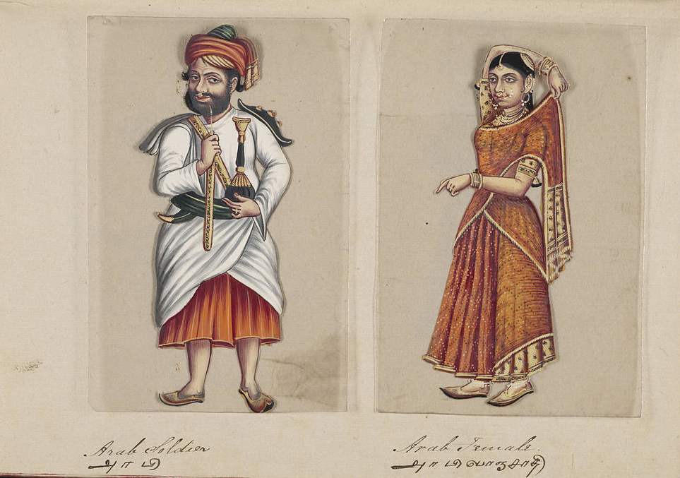
Arab Soldier

Slide 26
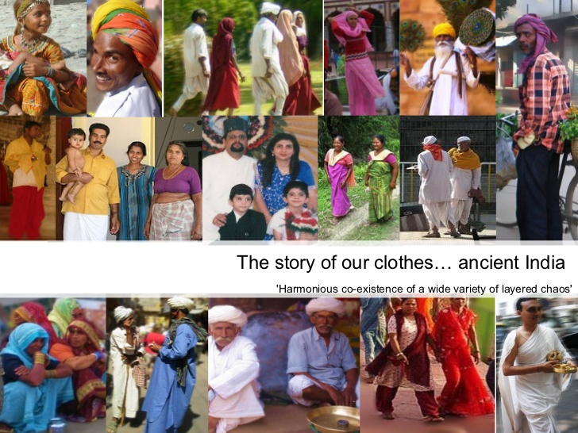

Slide 27
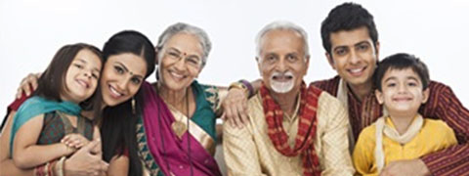
The extended family rather than the nuclear family

Slide 28
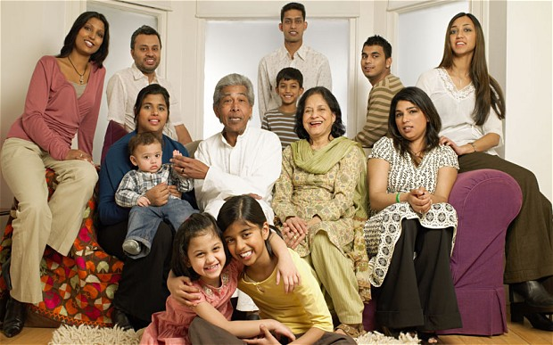
The circle of care in Indian families embraces all generations. When we speak of family

Slide 29
Religions in India

Slide 30
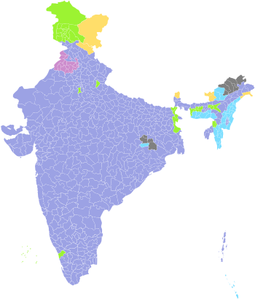
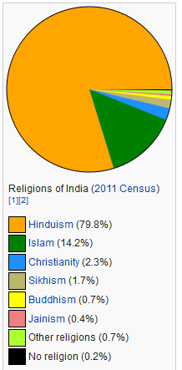
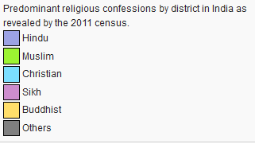

Slide 31
Languages of india

Slide 32
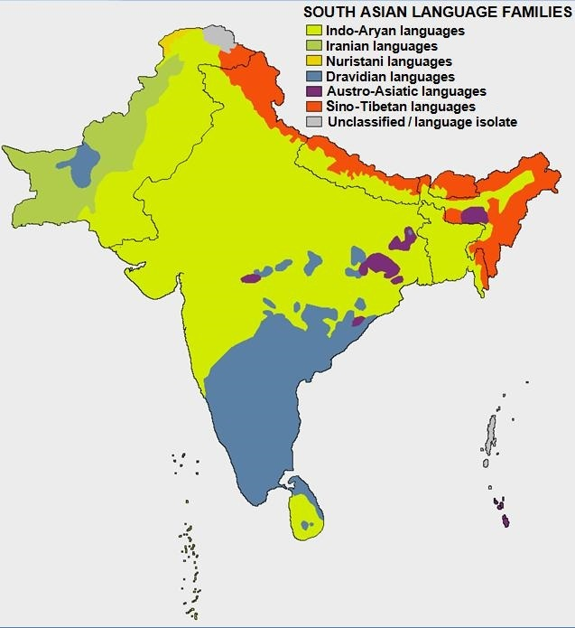
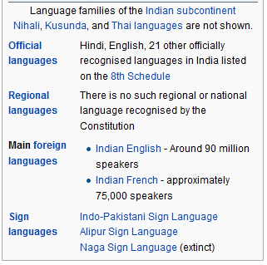
Language Families

Slide 33
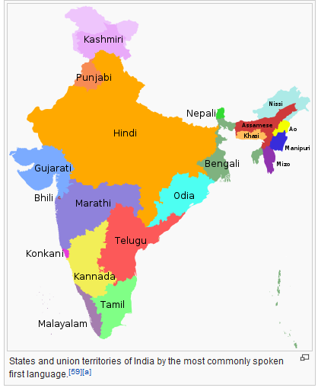

Slide 34
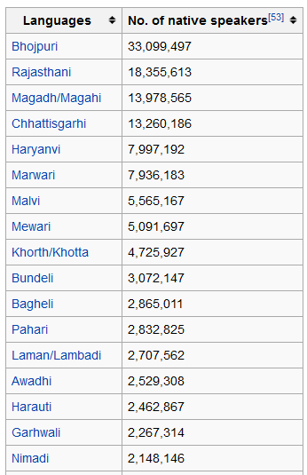
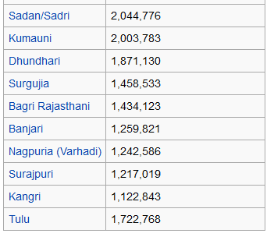
The 2001 census identified the following native languages having more than one million speakers. Most of them are dialects/variants grouped under Hindi.
The number of individual languages listed for India is 461. Of these, 447 are living and 14 are extinct. Of the living languages, 417 are indigenous and 30 are non-indigenous. Furthermore, 64 are institutional, 130 are developing, 185 are vigorous, 55 are in trouble, and 13 are dying.

Slide 35
Caste System
Castes add to the factors that divide the people of India into separate groups.

Slide 36
The caste system as it exists today is thought to be the result of developments during the collapse of the Mughal era and the British colonial regime in India. The collapse of the Mughal era saw the rise of powerful men who associated themselves with kings, priests and ascetics, affirming the regal and martial form of the caste ideal, and it also reshaped many apparently casteless social groups into differentiated caste communities. The British Raj furthered this development, making rigid caste organization a central mechanism of administration. Between 1860 and 1920, the British segregated Indians by caste, granting administrative jobs and senior appointments only to the upper castes. Social unrest during the 1920s led to a change in this policy. From then on, the colonial administration began a policy of positive discrimination by reserving a certain percentage of government jobs for the lower castes

Slide 37
New developments took place after India achieved independence, when the policy of caste-based reservation of jobs was formalised with lists of Scheduled Castes (Dalit) and Scheduled Tribes (Adivasi). Since 1950, the country has enacted many laws and social initiatives to protect and improve the socioeconomic conditions of its lower caste population. These caste classifications for college admission quotas, job reservations and other affirmative action initiatives, according to the Supreme Court of India, are based on heredity and are not changeable. Discrimination against lower castes is illegal in India under Article 15 of its constitution, and India tracks violence against Dalits nationwide.

