Slide 1
Indian Culture Handicraft 1
Traditional Handicraft – Exquisite Woodcarving

Slide 2
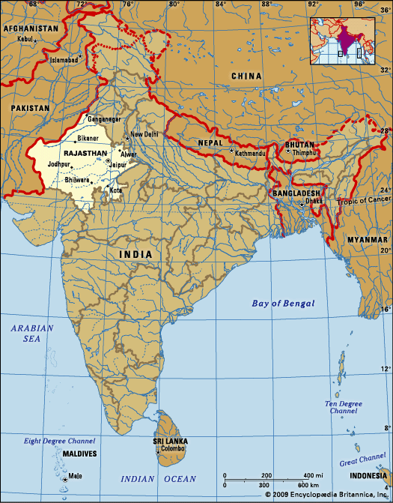
Rajasthan
Rajasthan is India's largest state by area 132,139 sq mi or 10.4% of India's total area). It is located on the western side of the country, where it comprises most of the wide and inhospitable Thar Desert (also known as the "Rajasthan Desert" and "Great Indian Desert") and shares a border with the Pakistani provinces of Punjab to the northwest and Sindh to the west, along the Sutlej-Indus river valley.
2 times the size of Missouri

Slide 3
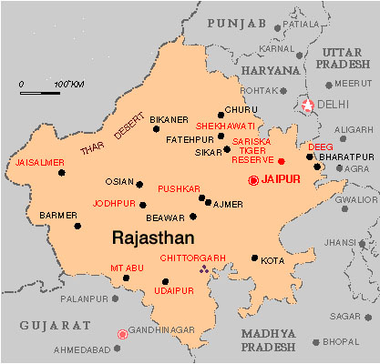

Slide 4
The World’s Most Exquisite Woodcarvings Are Being Created by This Family in Rajasthan
Meet the Jangid family – the woodcarving artists of Jaipur who specialise in sandalwood miniature carvings. Mahesh Jangid, and his sons, Rohit and Mohit Jangid, use the simplest tools like small iron sticks, knives, and chisels to carve with extreme precision on very small objects. For this family, it is a tradition that has been passed from one generation to another, and something that they deeply honour.

Slide 5
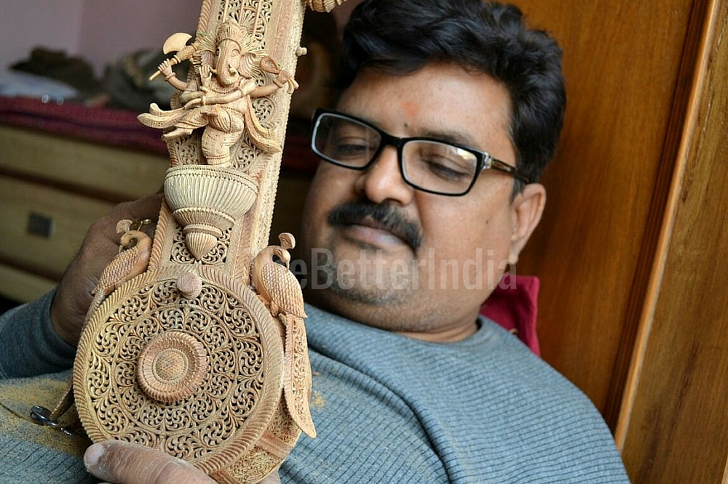
45-year-old Mahesh Jangid learned the art of woodcarving from his grandfather at the age of seven.
His grandfather, Malchand Jangid, a resident of Churu in Rajasthan, was an amazing sandalwood craftsman who won the national award in 1971 and a special award the very next year from the then Prime Minister Indira Gandhi.
Mahesh has ensured that the skill stays in the family by devoting his life to this art form.

Slide 6
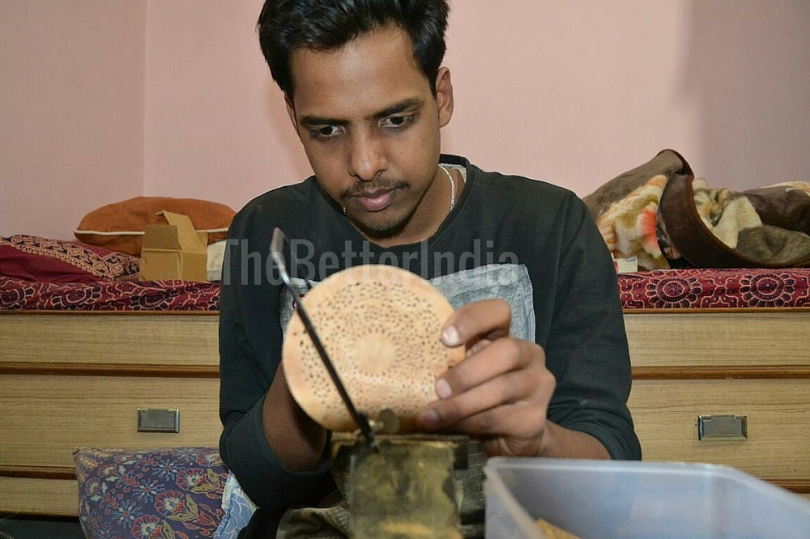
They draw inspiration for their work from history, mythology and day-to-day life in India.

Slide 7
The family works almost exclusively with sandalwood because it is very malleable and has a pleasant, natural fragrance that lasts long.
Sandalwood is the name of a class of woods from trees in the genus Santalum. The woods are heavy, yellow, and fine-grained, and unlike many other aromatic woods, they retain their fragrance for decades. Sandalwood oil is extracted from the woods for use. Both the wood and the oil produce a distinctive fragrance that has been highly valued for centuries. Consequently, species of these slow-growing trees have suffered over-harvesting in the past century.

Slide 8
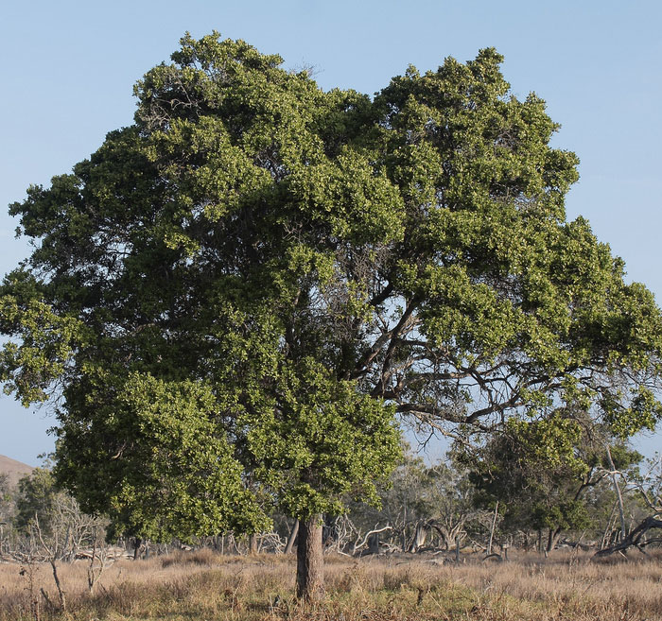
sandalwood tree

Slide 9
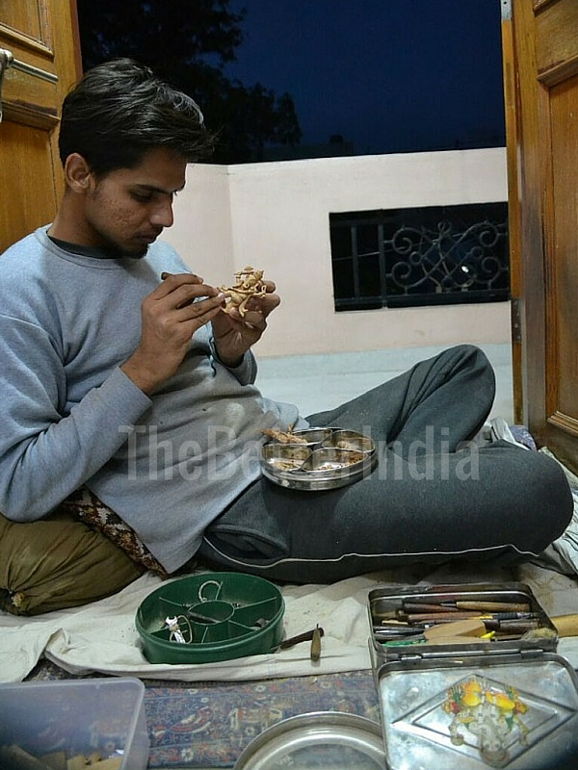
All three Jangids have got their names listed in the Limca Book of Records for their remarkable work. Mahesh’s record is for a delicate chain that he made from a solid piece of sandalwood. The chain has no joints, it weighs just 160 gm, and is 315 mm in length. Mohit has his name in the record book for the smallest playable violin, and Rohit is in there for designing the smallest carved house-fly.

Slide 10
One of the most unique aspects of their art form is that they specialize in making small pockets or compartments within the main structure. One can open the compartment with the help of a flap and it reveals some sculptures depicting a story or a scene taken from history.
  “I will continue to do this work for the rest of my life because carving has no limits. How much we do and how far we go is all up to us. I like that we always get to do new things, new designs, more miniature work, etc. I would not have this kind of freedom with any other job. I am absolutely addicted to my work and so happy that I have the talent to do this,” says Mahesh.

Slide 11
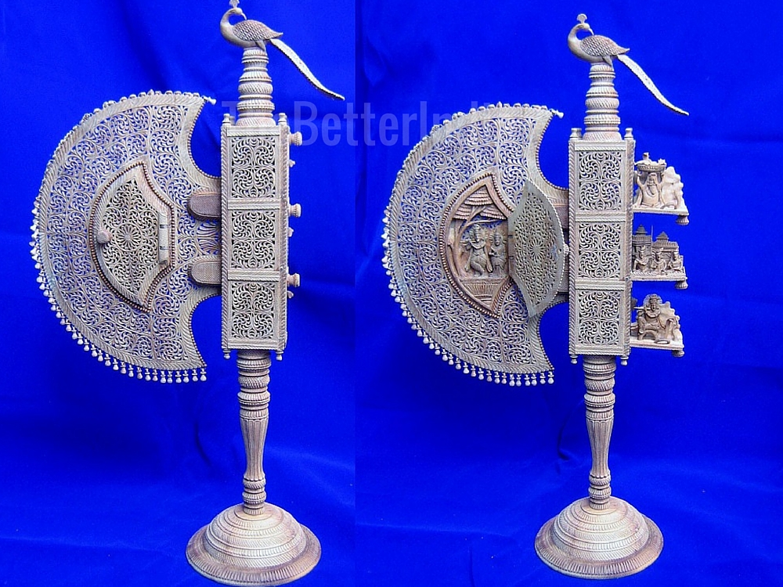
Have a look at their work:

Slide 12
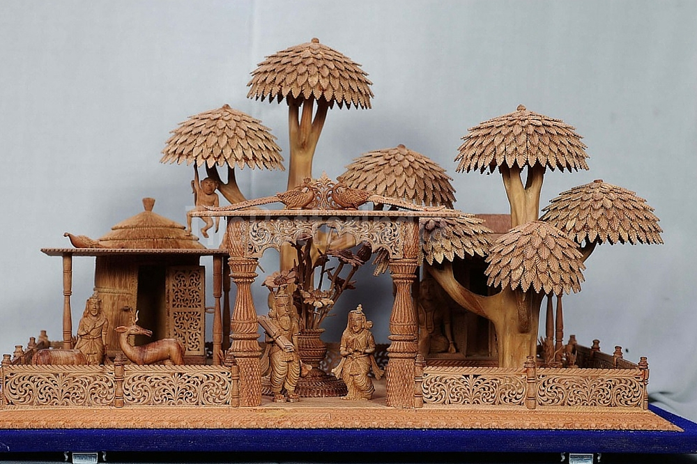

Slide 13
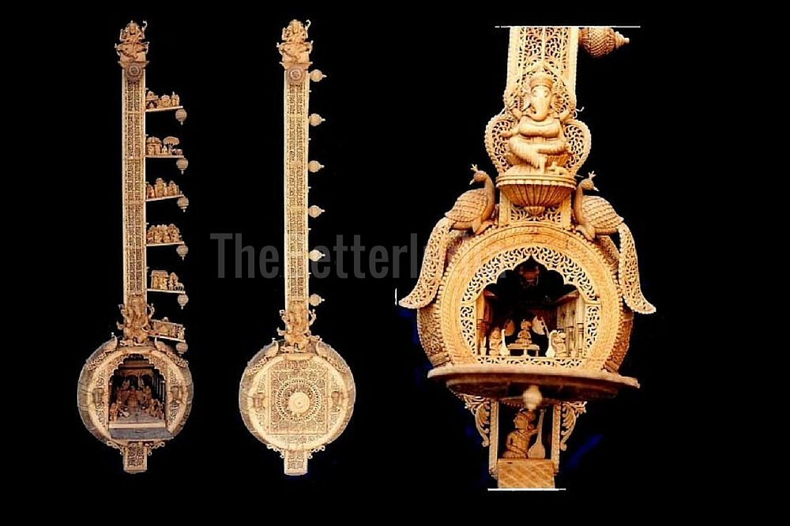

Slide 14
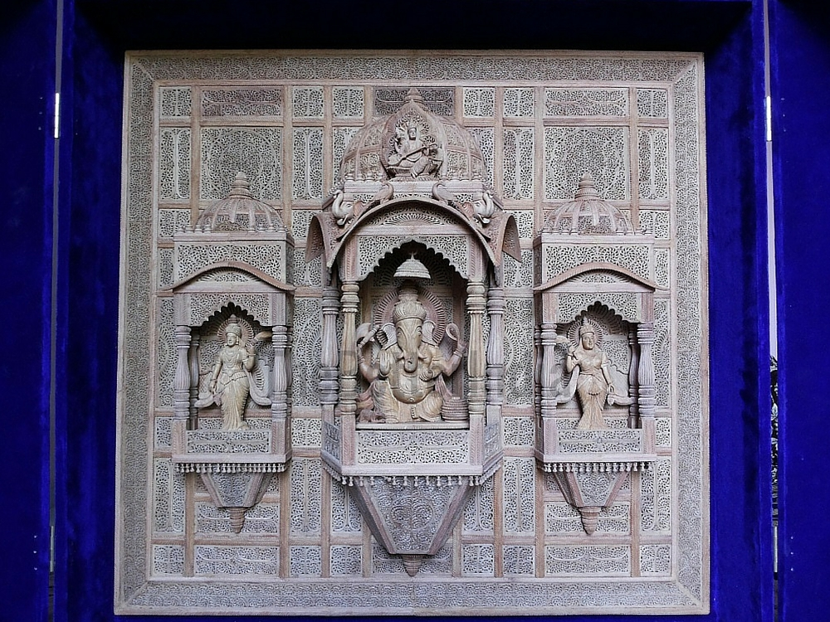

Slide 15
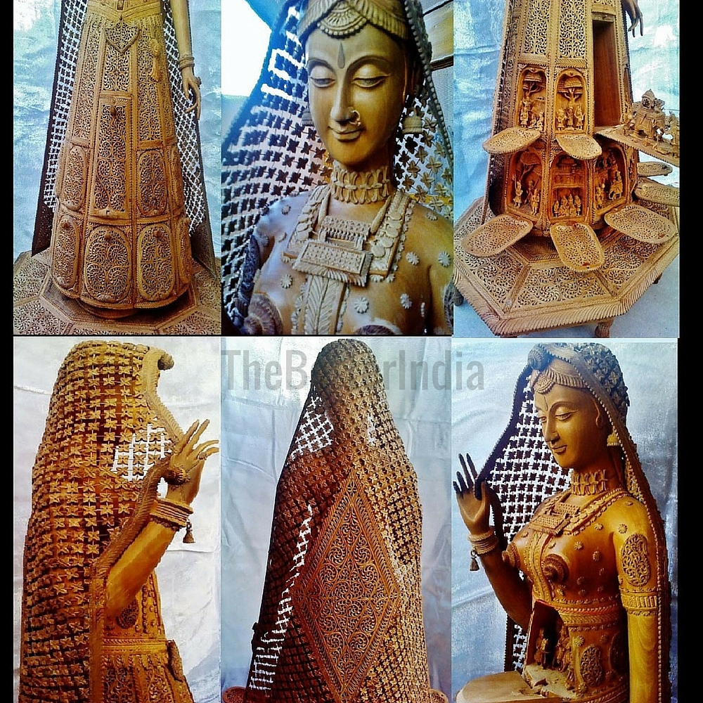

Slide 16
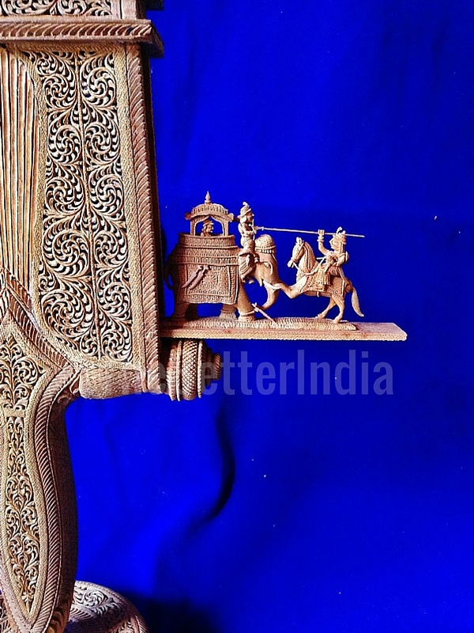

Slide 17
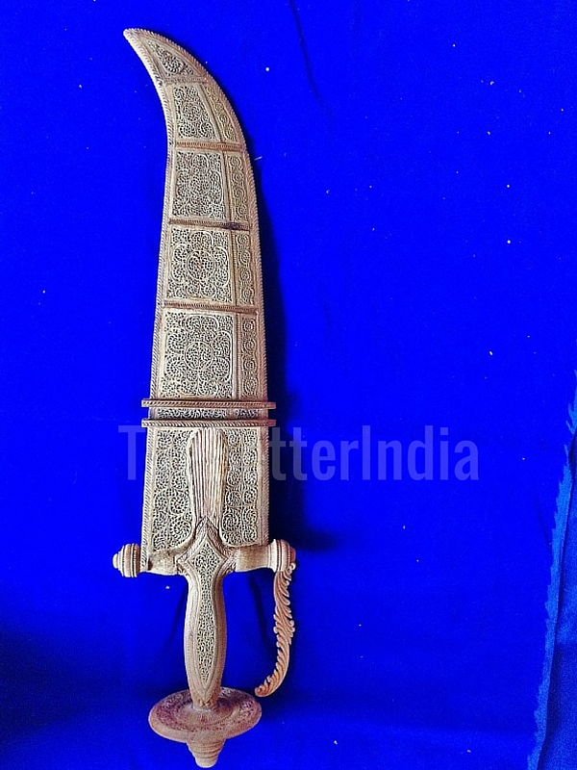
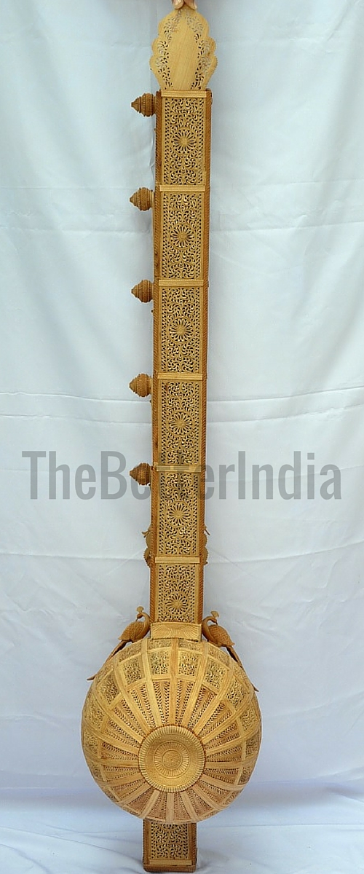

Slide 18
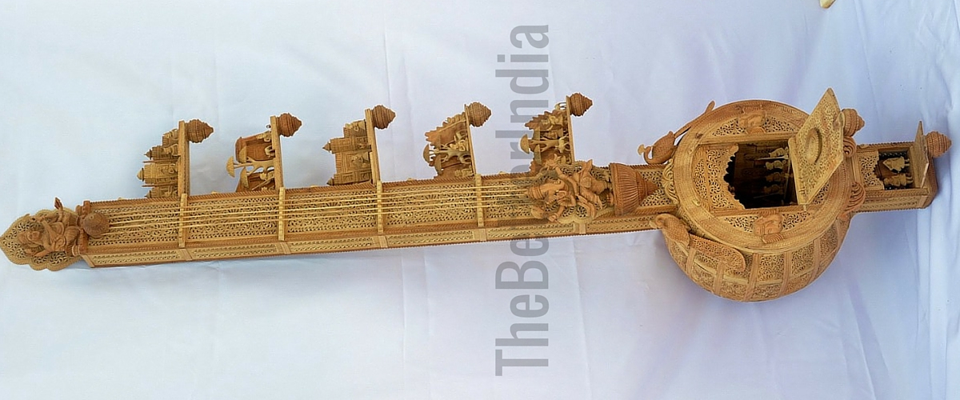

Slide 19
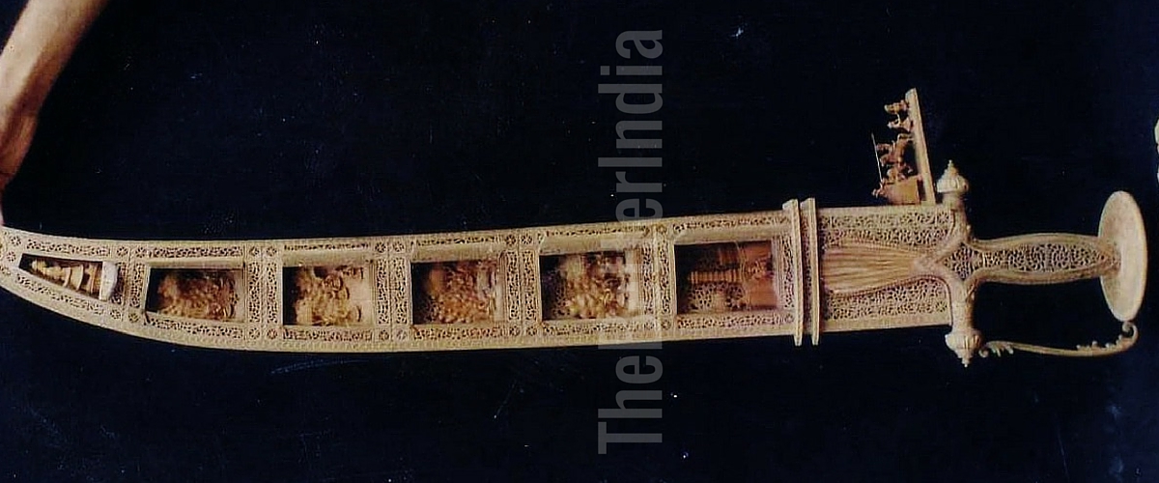
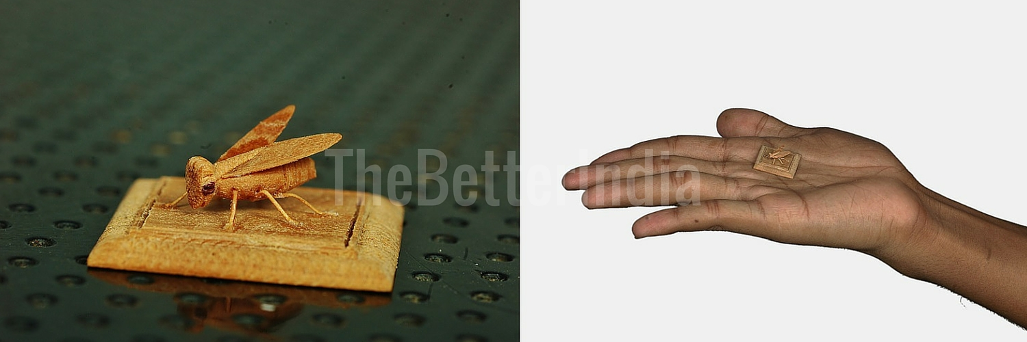

Slide 20
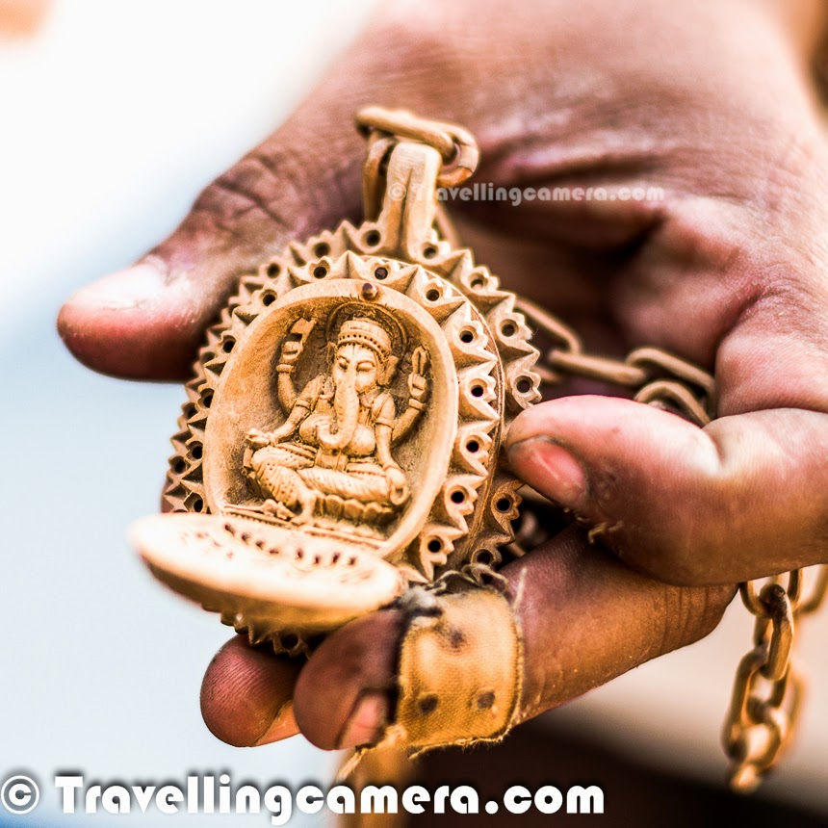

Slide 21
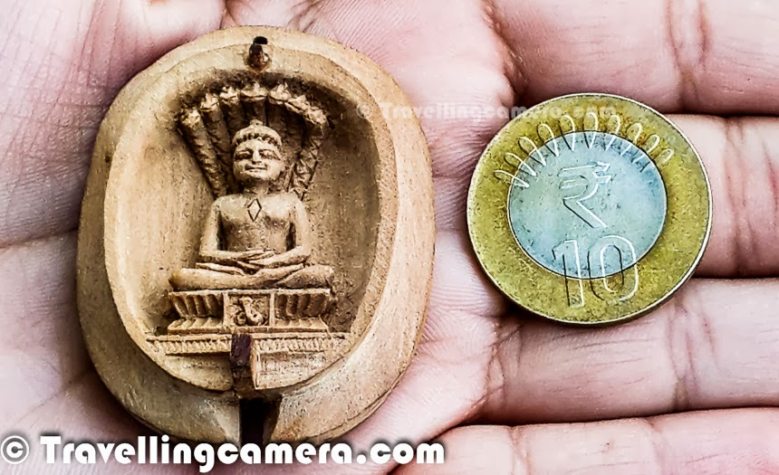

Slide 22
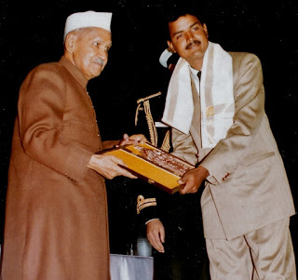
Receiving an award for his fine craftsmanship
Mahesh was born in Churu District, Rajasthan. He learned the art of woodcarving at the age of seven, under the tutelage of his grandfather, Malchand Jangid.

Slide 23
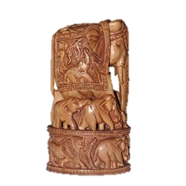
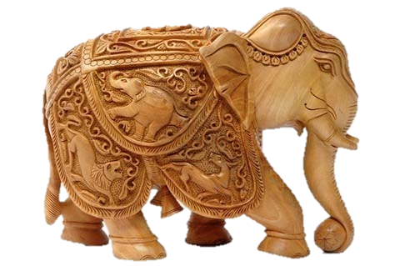
Other Wood Sculptures in Jaipur, Rajasthan

Slide 24
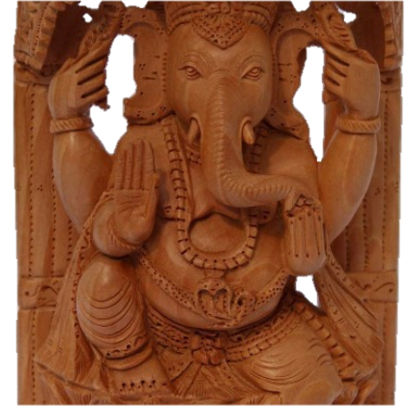

Slide 25
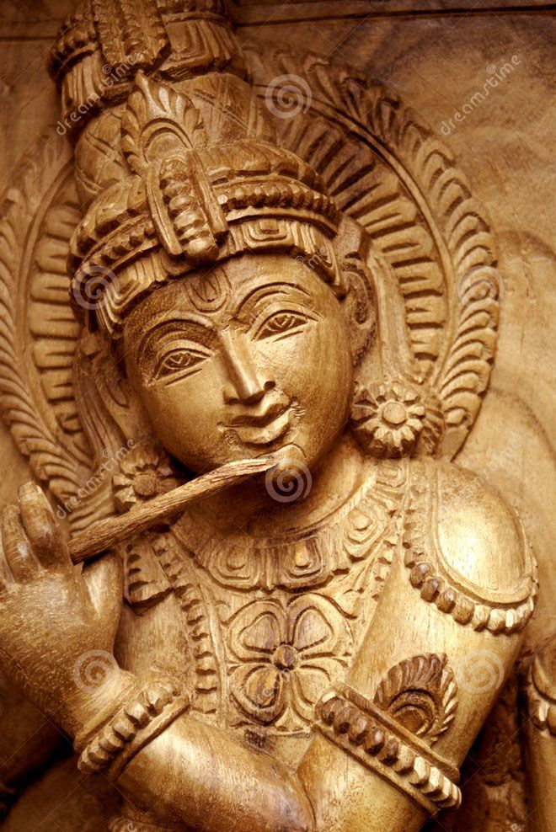

Slide 26
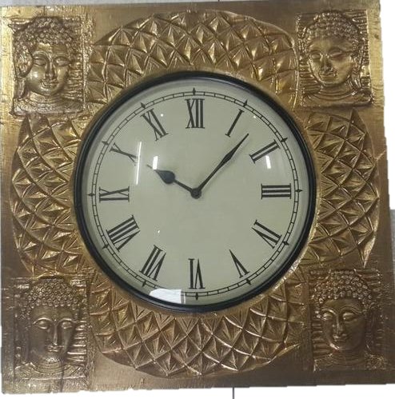

Slide 27
the state of the arts
Handicraft Artisans: The struggle for survival

Slide 28
Handicrafts and Traditional arts define the true identity of a civilization. The artisans of these crafts carry the legacy of their land and its culture, myth, and religion in their art practices from generation to generation. In India handicraft and its artisans were highly regarded and duly rewarded until the outbreak of the 19th century industrialisation.Although the Indian Govt.since independence implemented many comprehensive plans to secure this sector,the threat of industrialisation continued affecting this art and artisans. Today technological advancement has systematically reduced handicrafts into machine made cheap and popular products, bringing most of the traditional handicrafts to the verge of extinction and reduced the dexterity of the artisans into daily waged factory work.These artisans live in unhealthy clusters, deprived of basic amenities and denied of basic human rights.
Dr. Badar Jahan

