Slide 1
India - Scenes from a Wedding
Traditional Hindu Wedding

Slide 2
Photographer Sephi Bergerson always wanted to shoot and edit an entire wedding using only his iPhone but he couldn’t find a couple brave enough to let him do it. Then, he came across Ayushi and Abhishek with their big fat 3-day Indian wedding in Udaipur in Rajasthan.
NOTE: This isn’t a wedding from a poor Indian farm village. This is an upper economic class wedding.

Slide 3
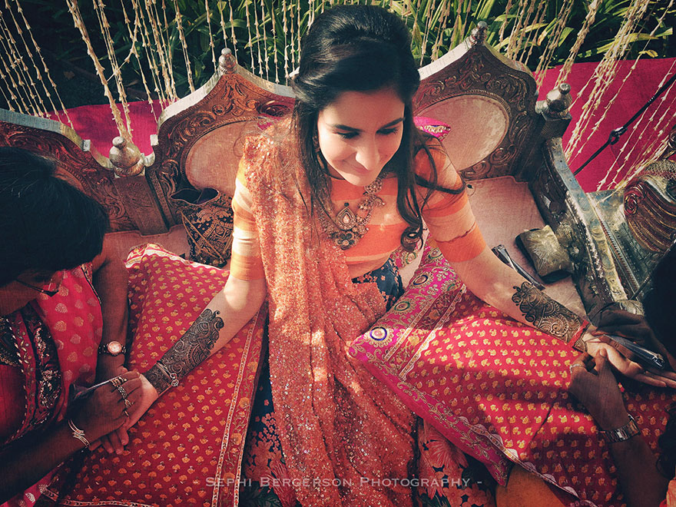

Slide 4
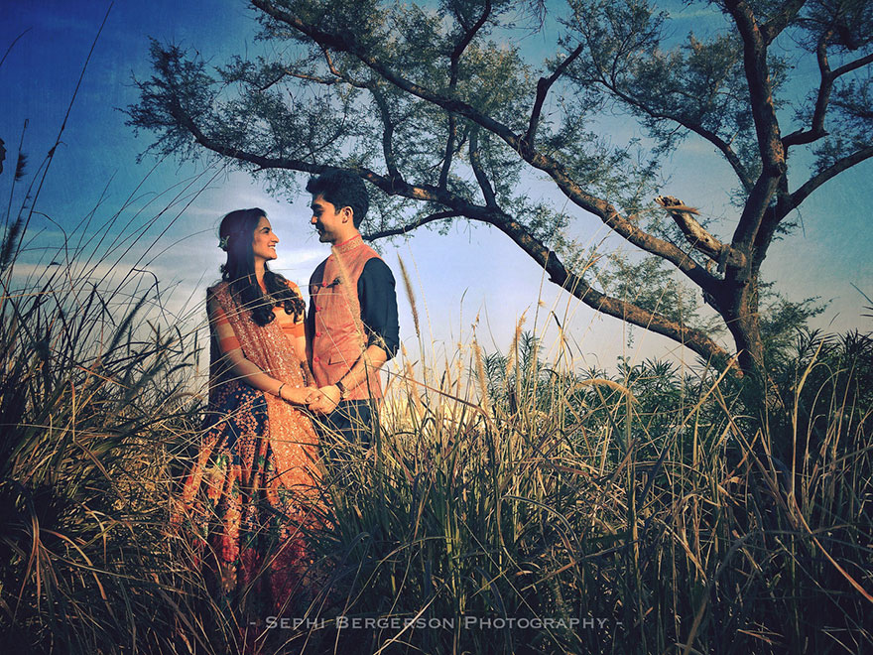

Slide 5
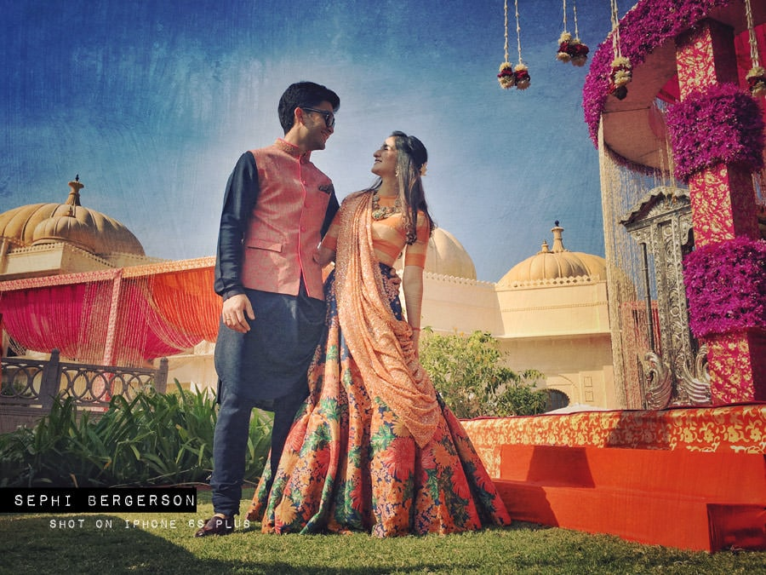

Slide 6
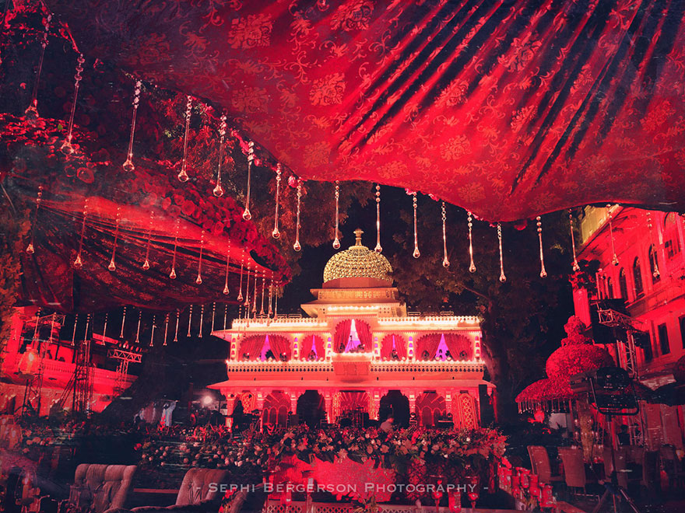
“I was not trying to document everything but rather focus on images that would later translate to the artistic vision that I had” “The images that come out are somewhere between documentary or photo journalism and what I would call fine art, closer to paintings”

Slide 7
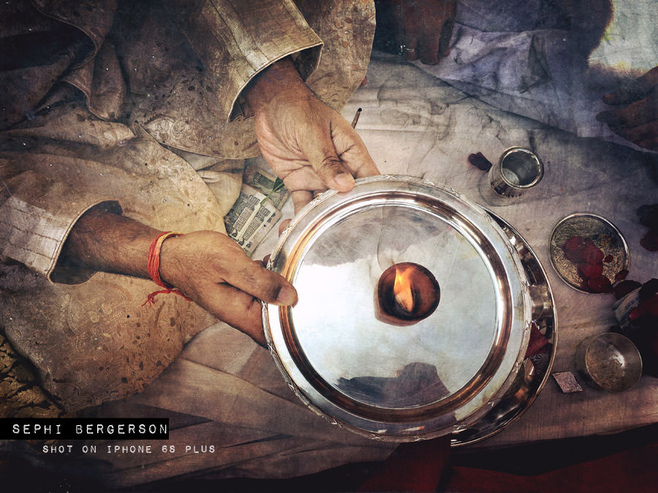

Slide 8
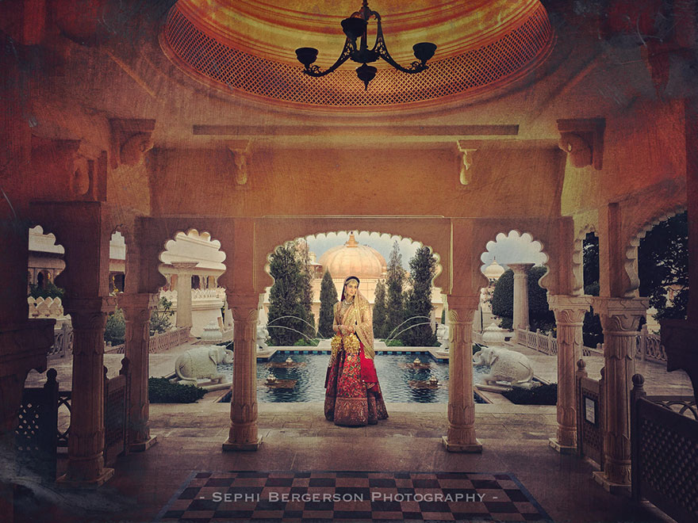

Slide 9
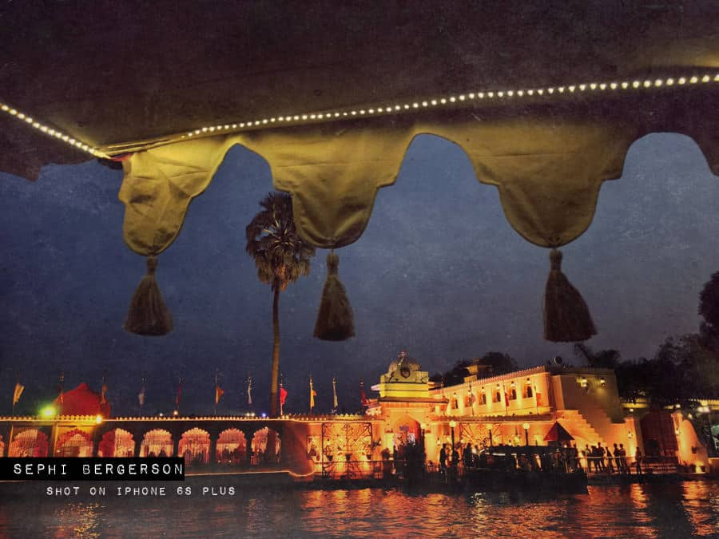

Slide 10
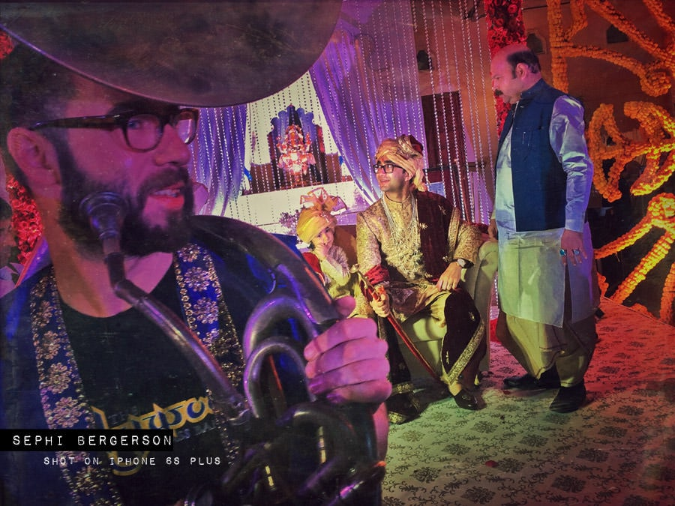

Slide 11
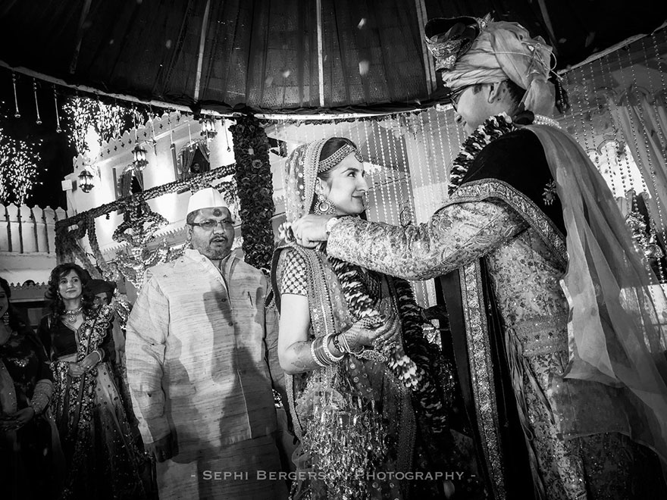

Slide 12
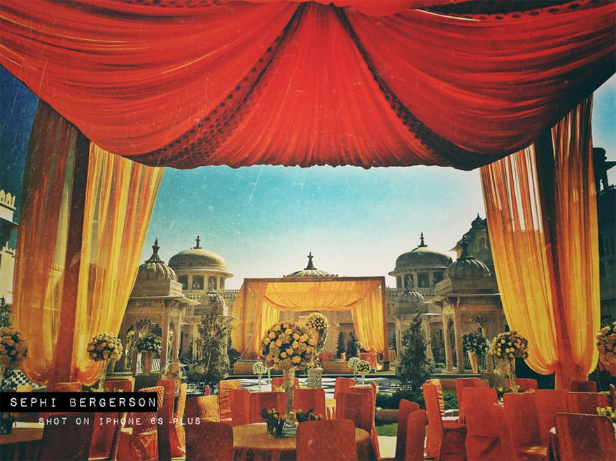

Slide 13
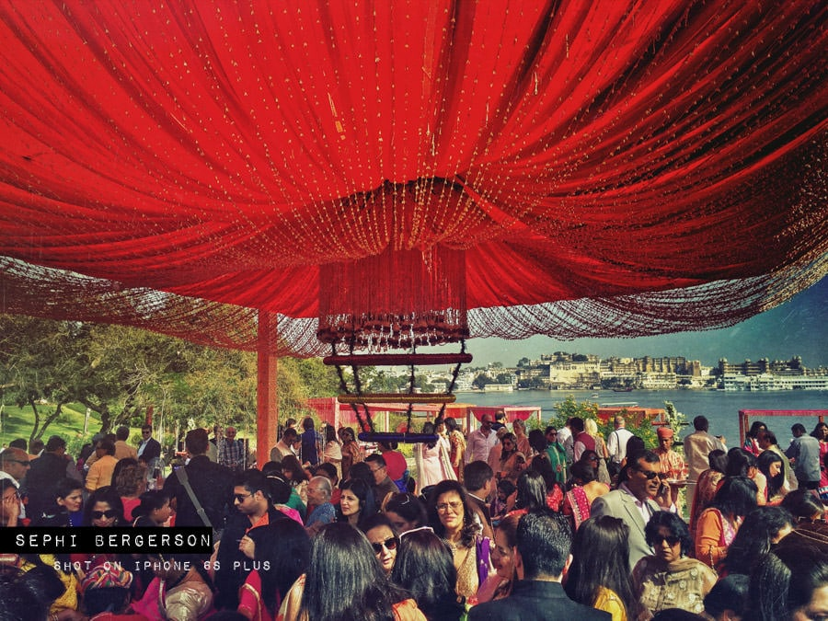

Slide 14
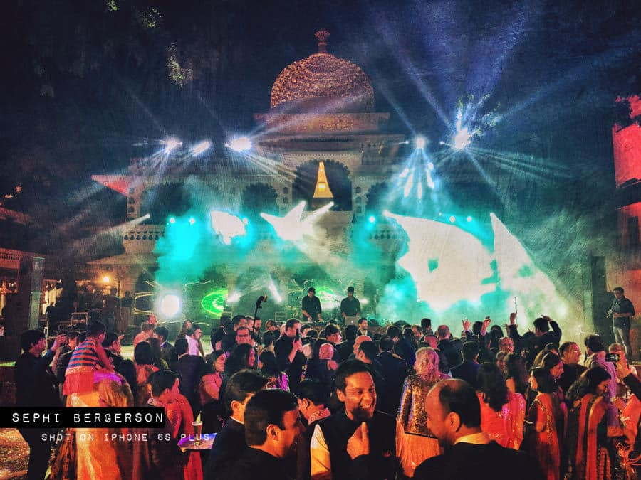

Slide 15
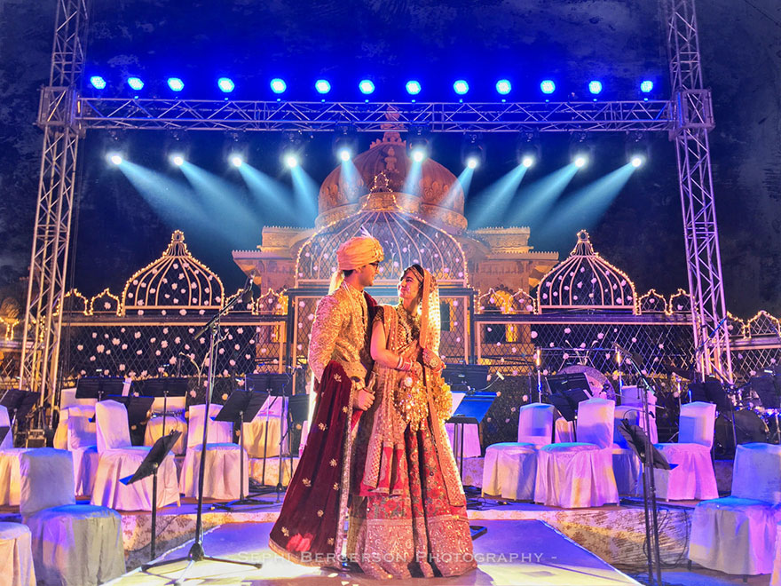

Slide 16
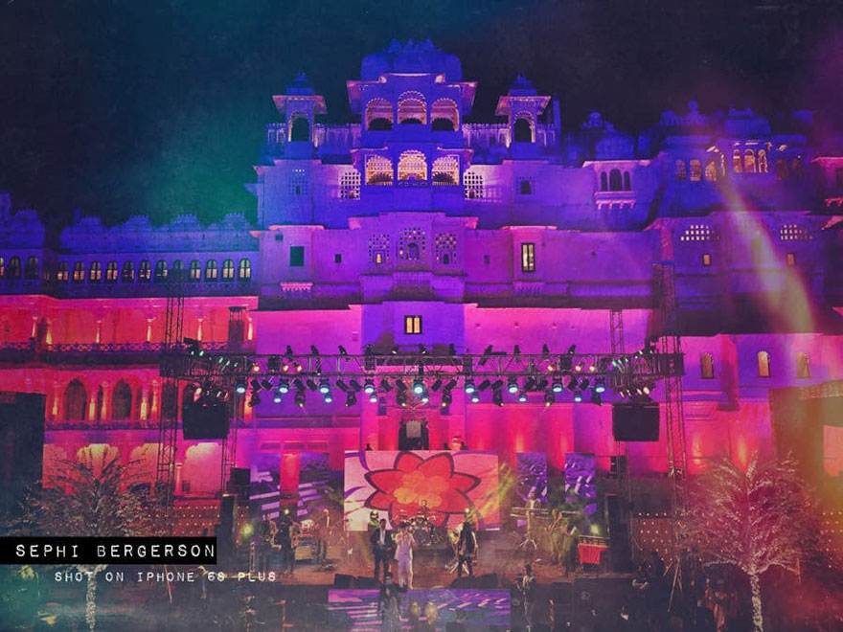

Slide 17
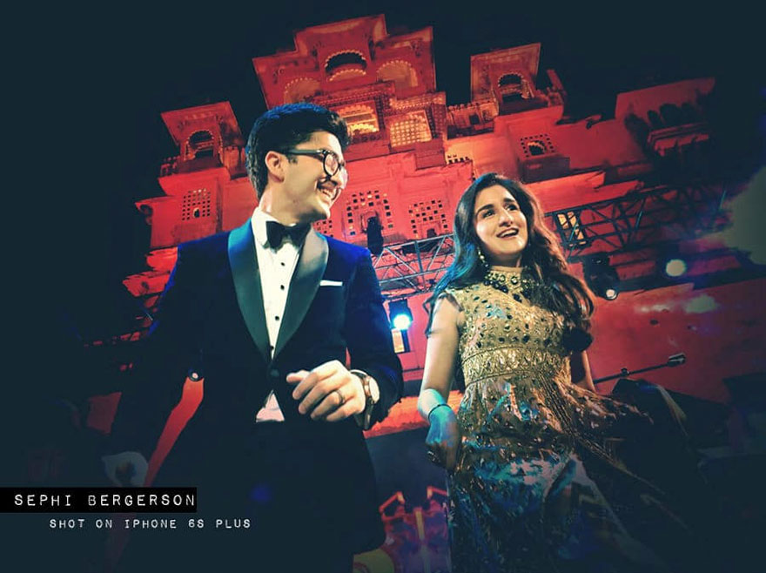

Slide 18
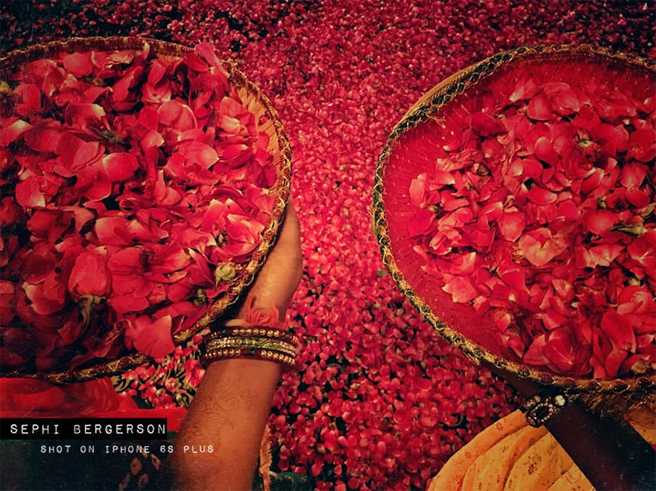

Slide 19
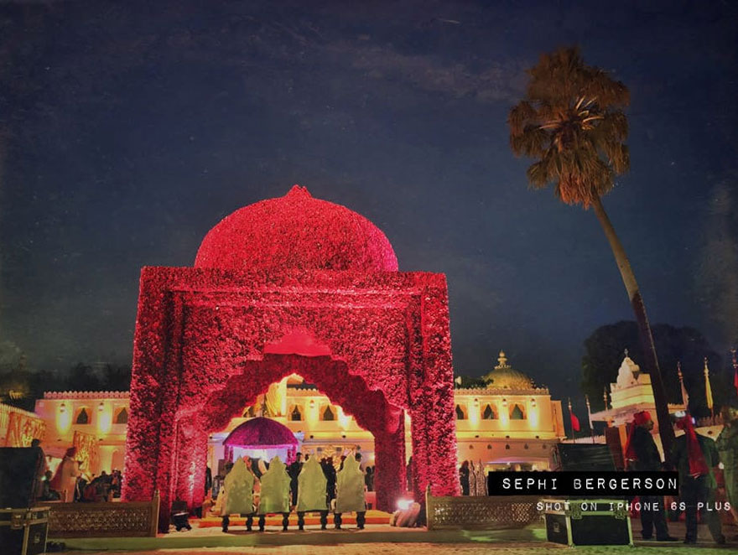

Slide 20
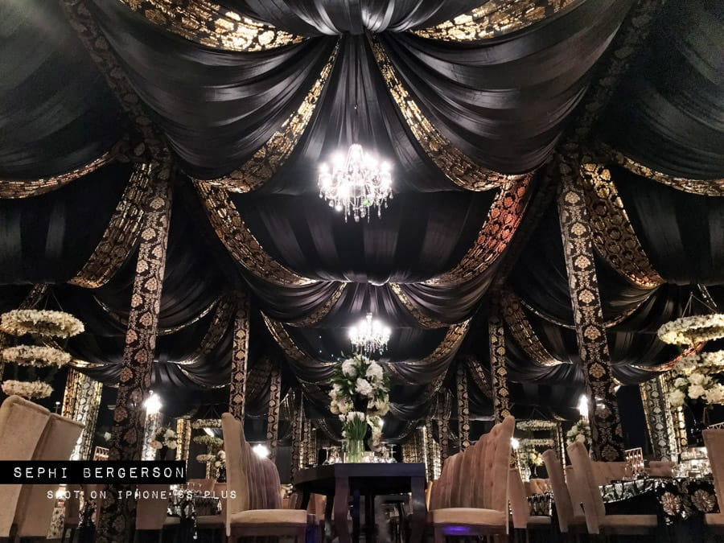

Slide 21
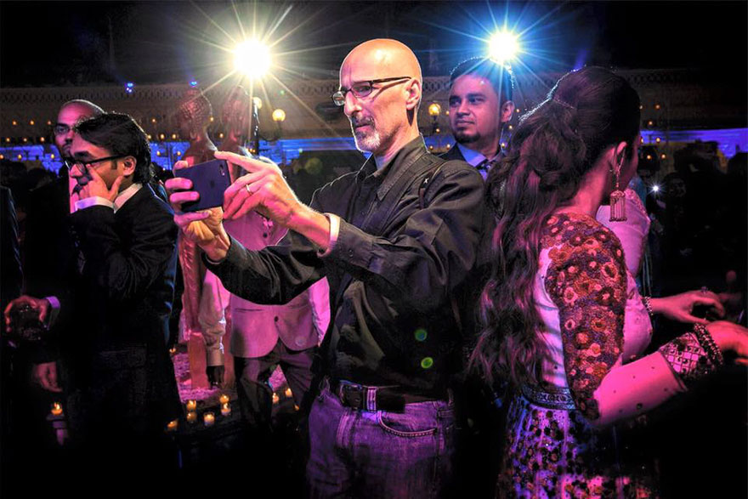
The photographer himself

