Slide 1
I Volunteered For 6 Weeks In Sri Lanka And It Changed My View Of The World Completely

Slide 2
This is not a story about spiritual journeys and finding inner peace. No, this is about realizing how harsh reality is for some people and how we are choosing to look the other way. Everything looks better on Instagram, right? But perfect lighting or filters cannot change reality. I went on a 6 week trip to Kandy, Sri Lanka. There I worked as a volunteer with orphan children who suffered from different illnesses. Before I went there, I thought of Sri Lanka as a tropical paradise. Reality hit me hard. Yes, there were beautiful beaches, breathtaking sceneries, and luxury resorts, but that was not the everyday life. There is great poverty. People live in miserable conditions. Food is prepared in highly unhygienic environments (but it tastes fantastic!!) The traffic is absolutely chaotic (a 40km journey with the bus takes about 4-5 hours). There are (BIG) spiders everywhere. I am well aware of the fact that not everywhere is the same, but in most places, this is the reality. Still, their culture is beautiful and very interesting. People seem happy and content. They are kind and helpful. That kept me going on. Sometimes the conditions I lived and worked in (with other several volunteers from around the world) were unbearable. Knowing that the locals live like this every day gave me courage, but it still seemed impossible. So next time you visit a country, take time and try to experience it’s reality, it’s everyday life, not only the tourist attractions. What you will discover might surprise you and change your perspective of the world forever.

Slide 3
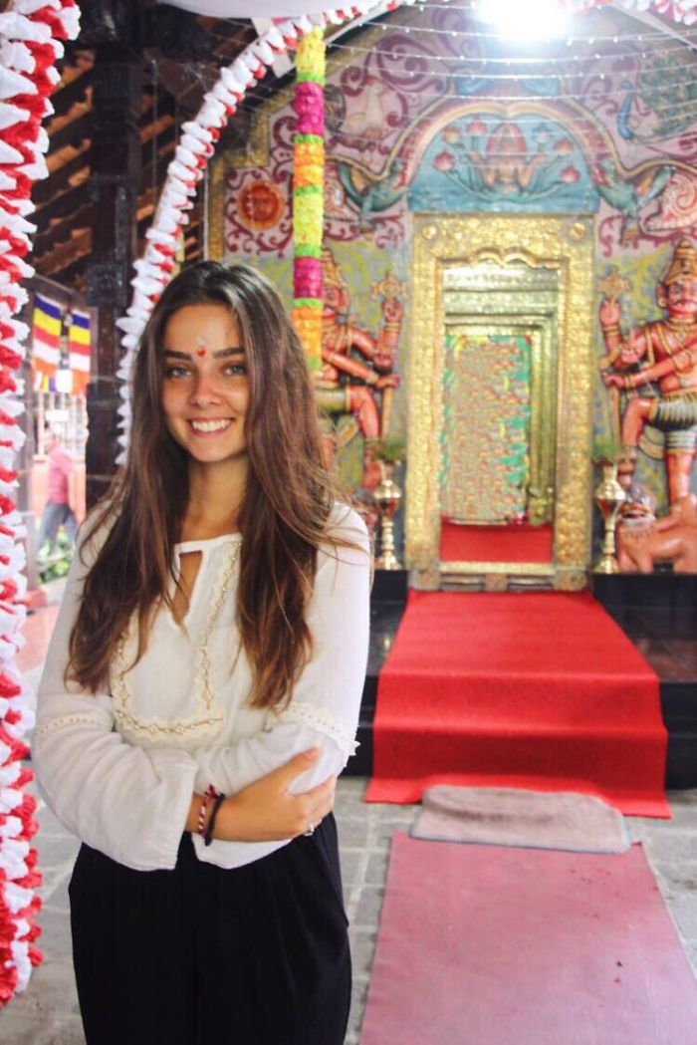
Temple

Slide 4
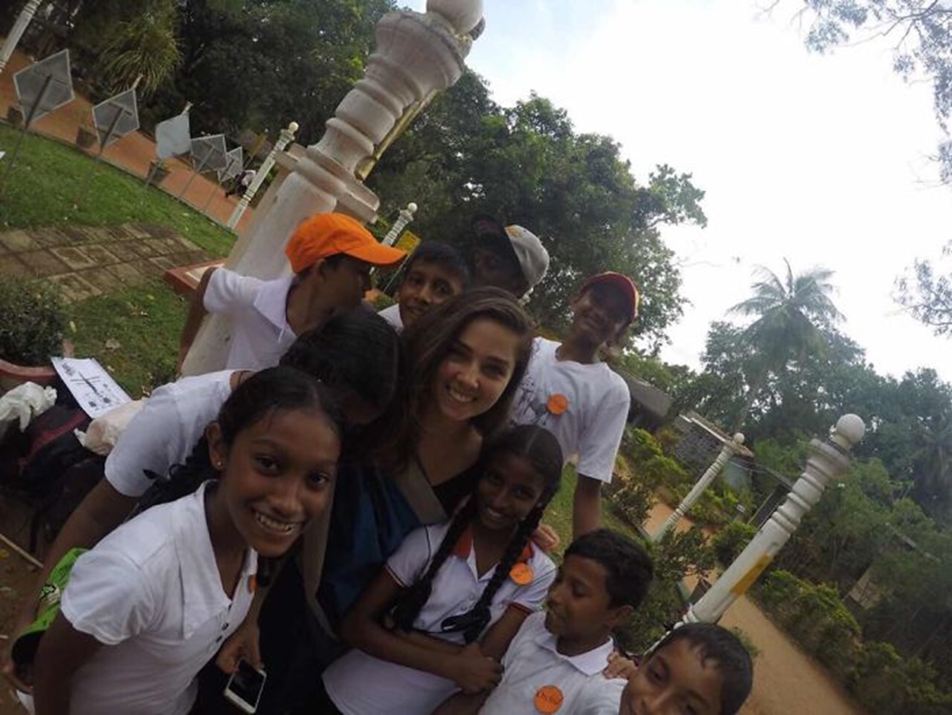
Some of the kids

Slide 5
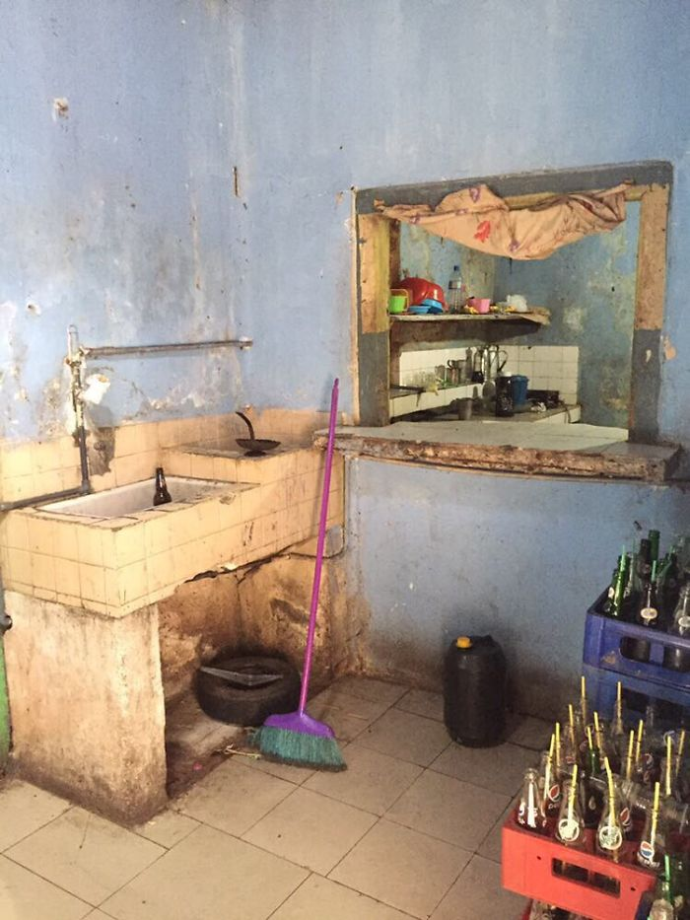
Kitchen in restaurant

Slide 6
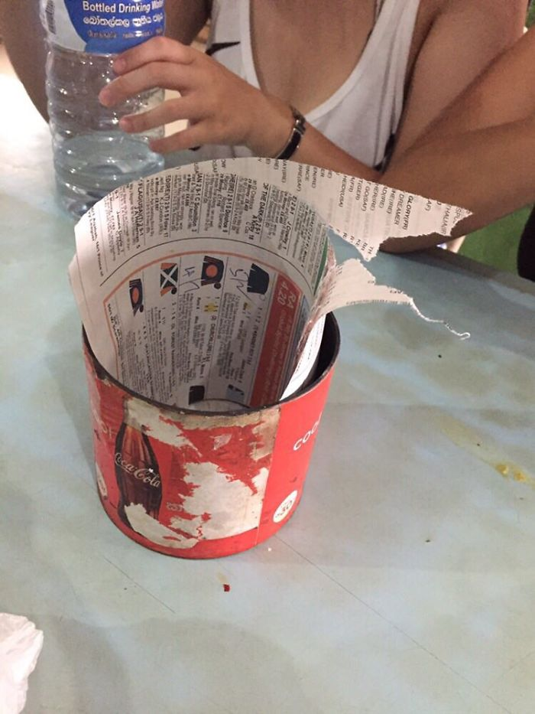
Newspaper pages instead of napkins

Slide 7
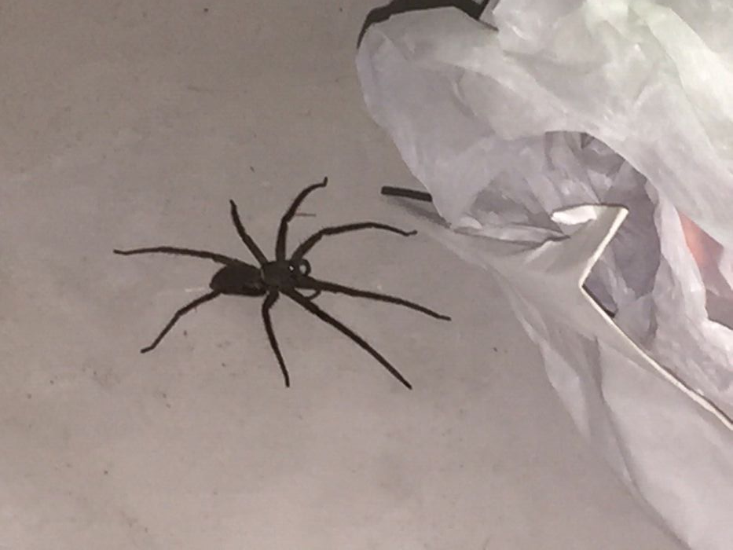
Spider in the kitchen

Slide 8
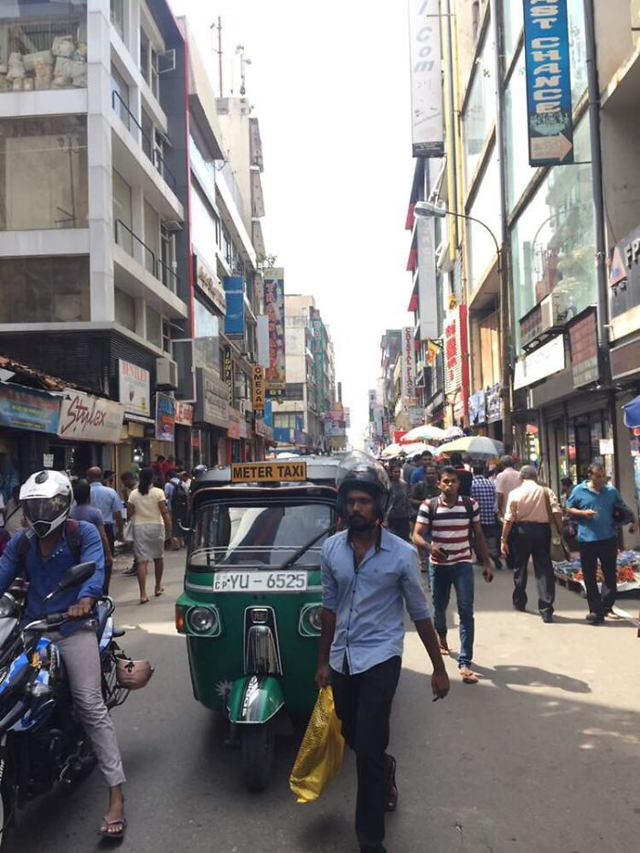
Chaos on the streets

Slide 9
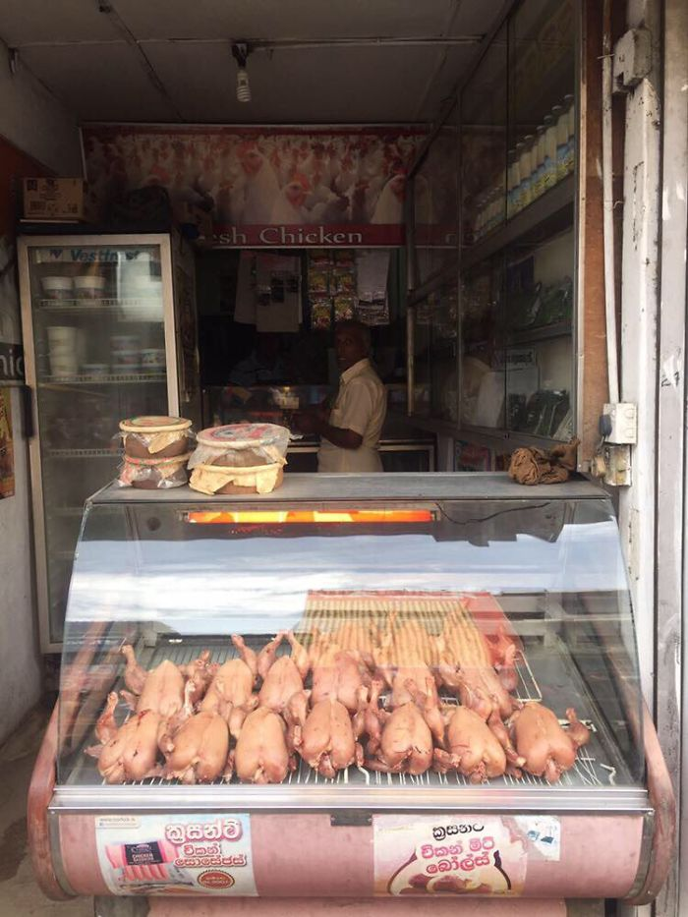
Chicken shop

Slide 10
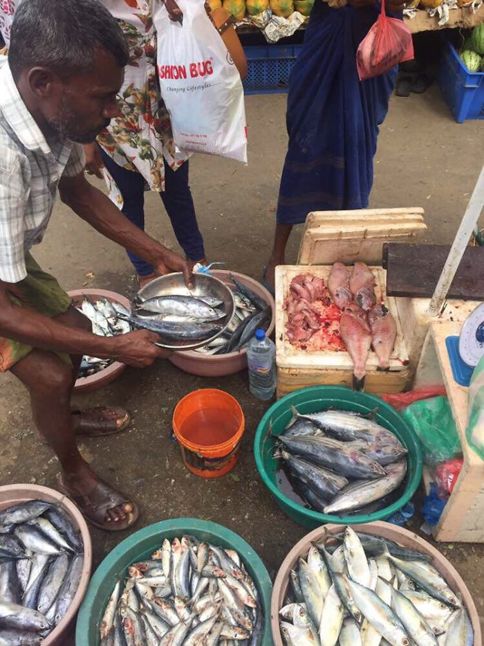
Cutting and selling fish in the street

Slide 11
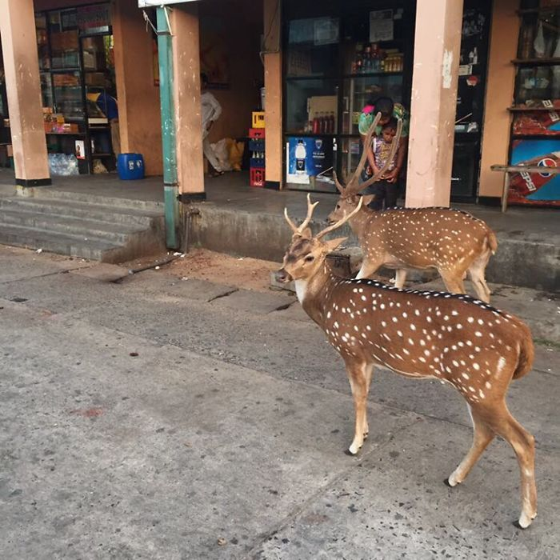
Deer taking a stroll

Slide 12
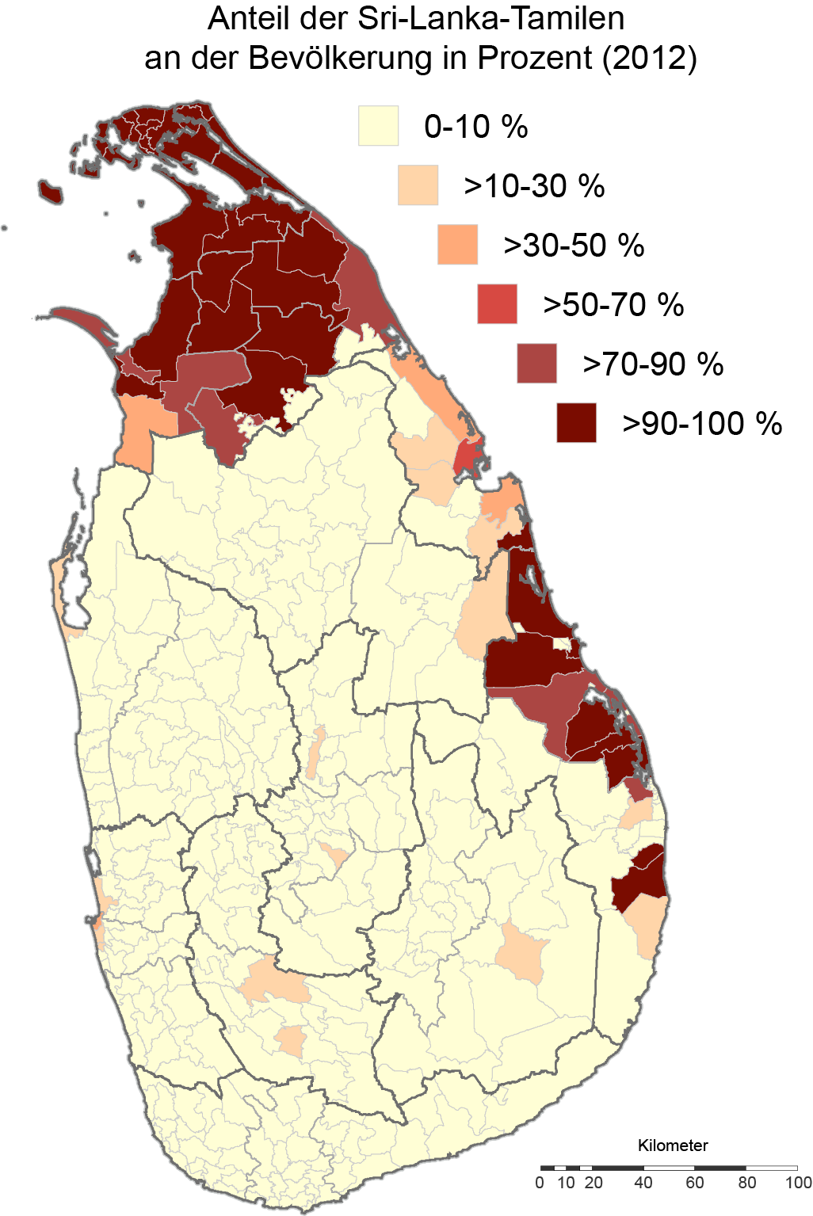
Additional Views

Slide 13
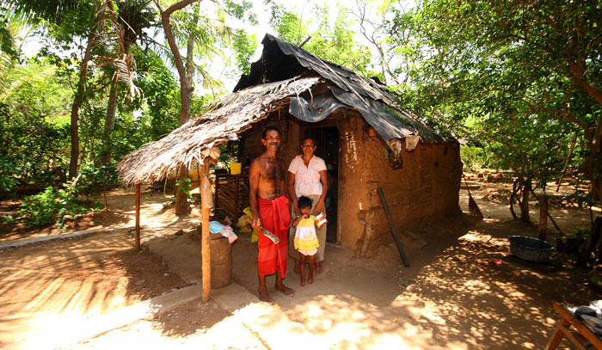

Slide 14
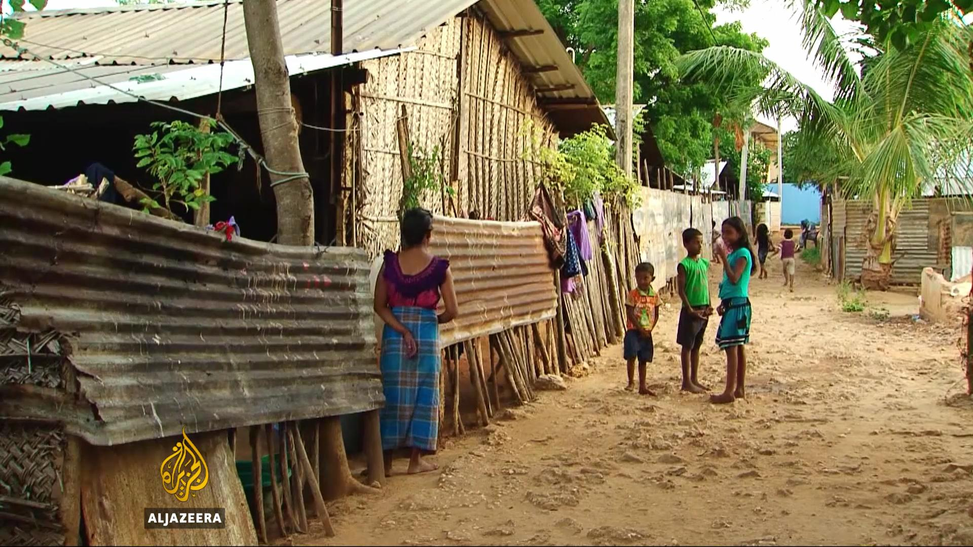

Slide 15
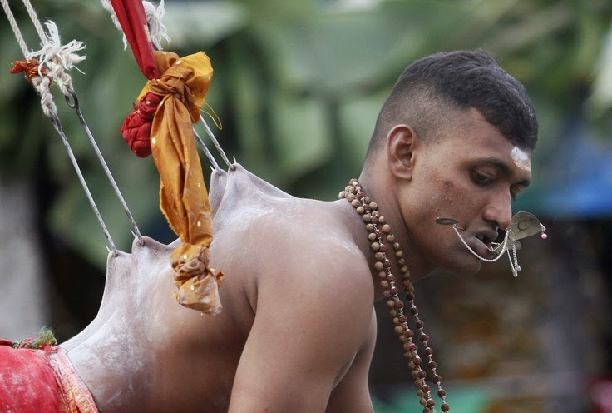

Slide 16
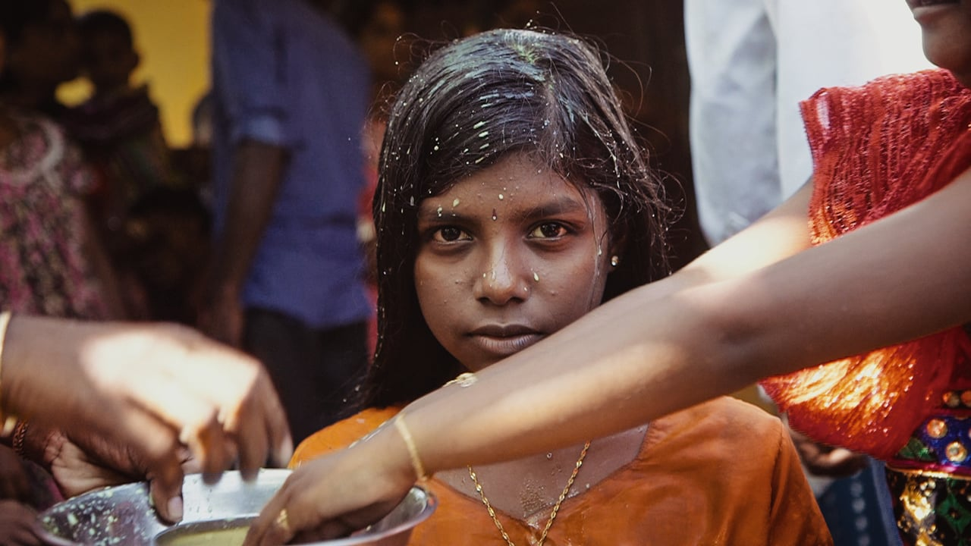

Slide 17
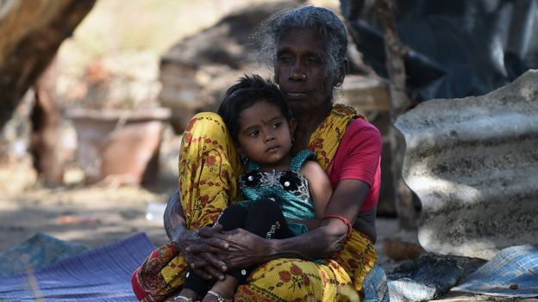

Slide 18
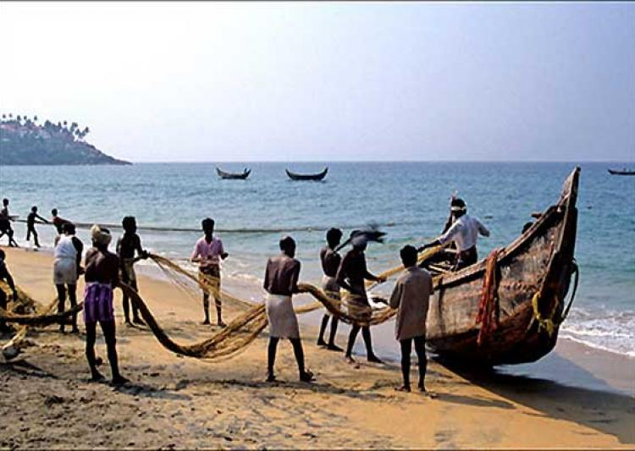

Slide 19
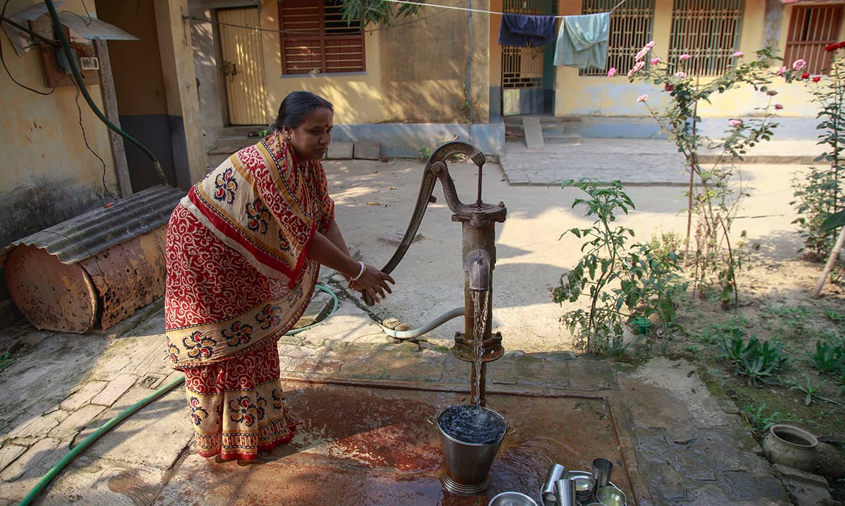

Slide 20
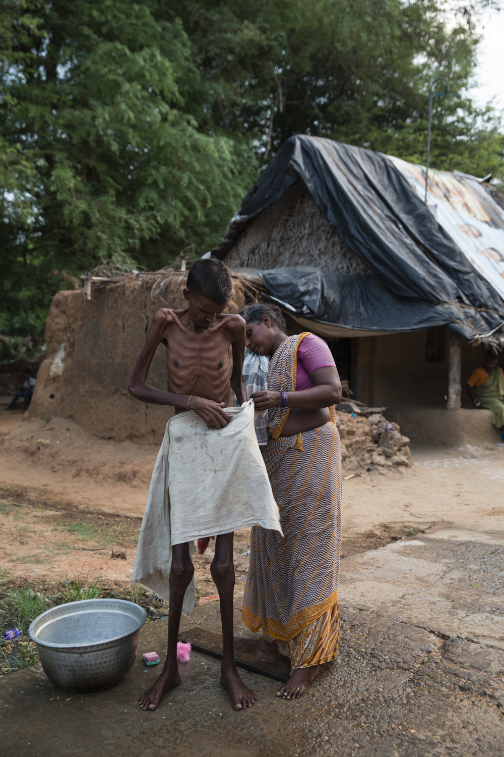
Village man suffering from tuberculosis being washed by his wife, at dusk.

Slide 21
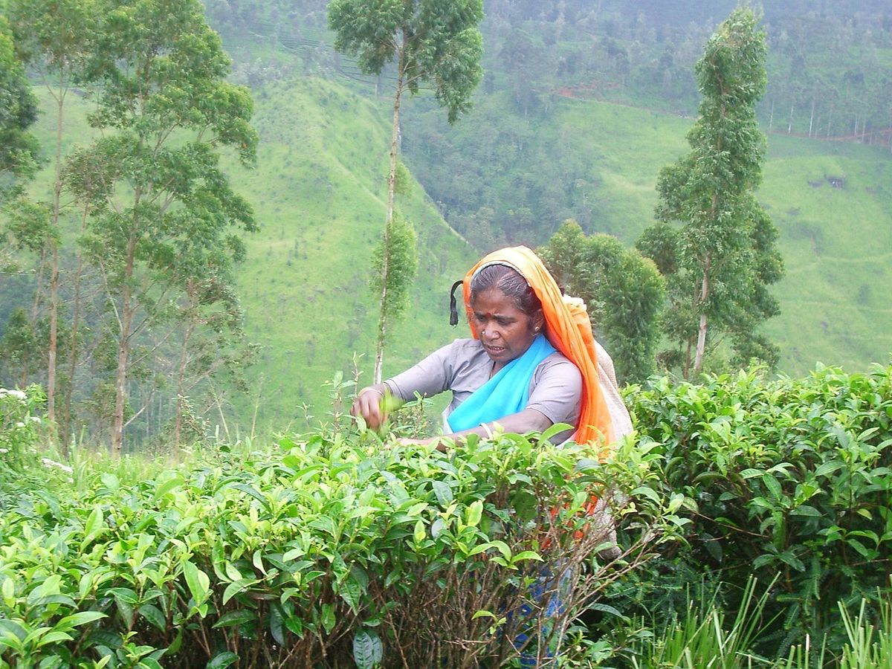
Tamil tea plucker

Slide 22
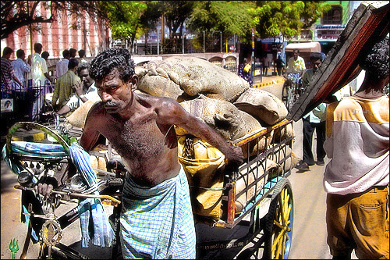

Slide 23
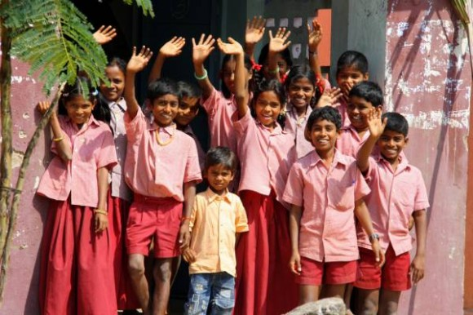

Slide 24
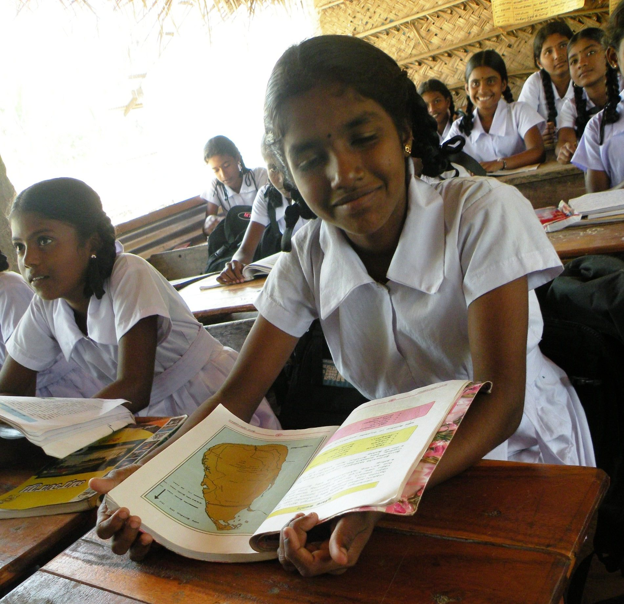

Slide 25
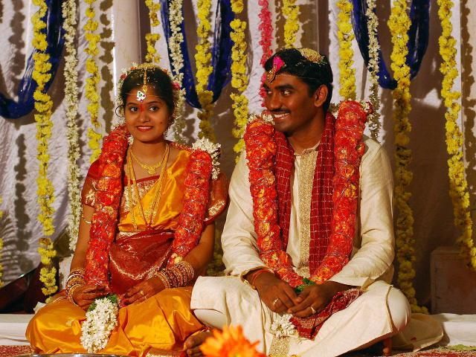
Wedding

Slide 26
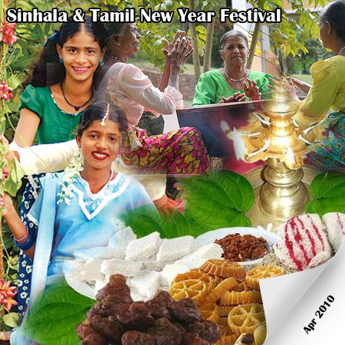

Slide 27
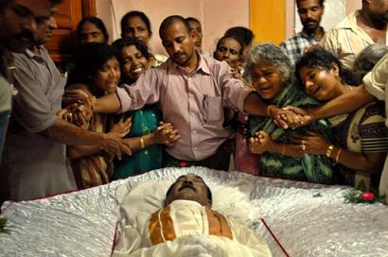
Funeral

