Slide 1
I Photographed People In Vietnam
The people where I was born and grew up. VUNG TAU-VIET NAM. Simplicity, purity and PEACE.
Photos by Việt Lê.

Slide 2
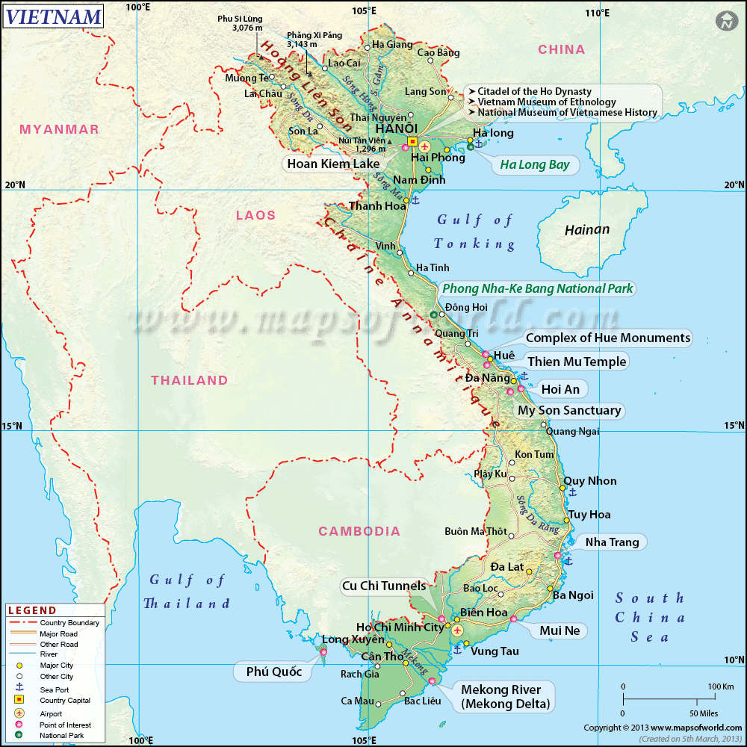
Vũng Tàu is the largest city and former capital of Bà Rịa–Vũng Tàu Province in Vietnam. The city area is 140 square kilometres (54 square miles), consists of thirteen urban wards and one commune of Long Son Islet. Vũng Tàu was the capital of the province until 2 May 2012, and is the crude oil extraction center of Vietnam.[

Slide 3
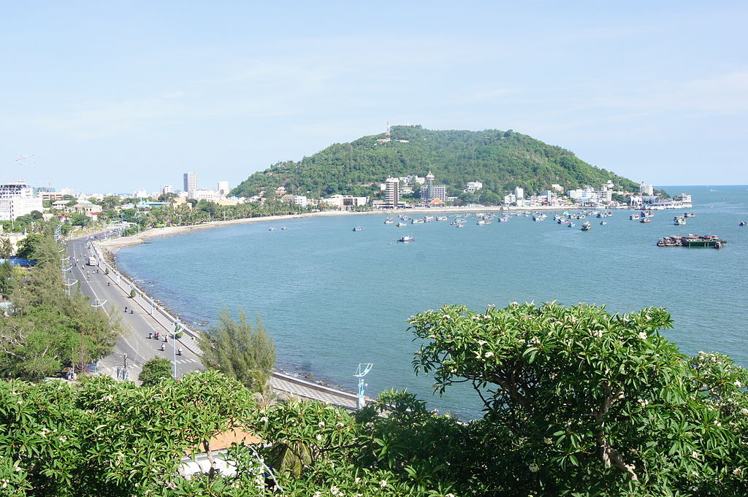

Slide 4
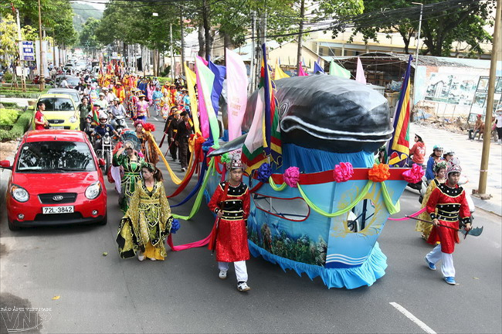
A scene of the Whale festival.

Slide 5
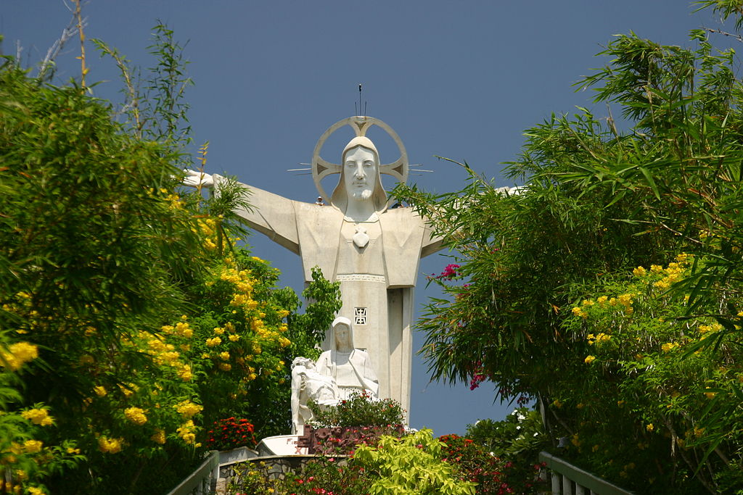
A 32m-high statue of Jesus extending his 18.3m-long arms on the top of 170m-high Nho Mount

Slide 6
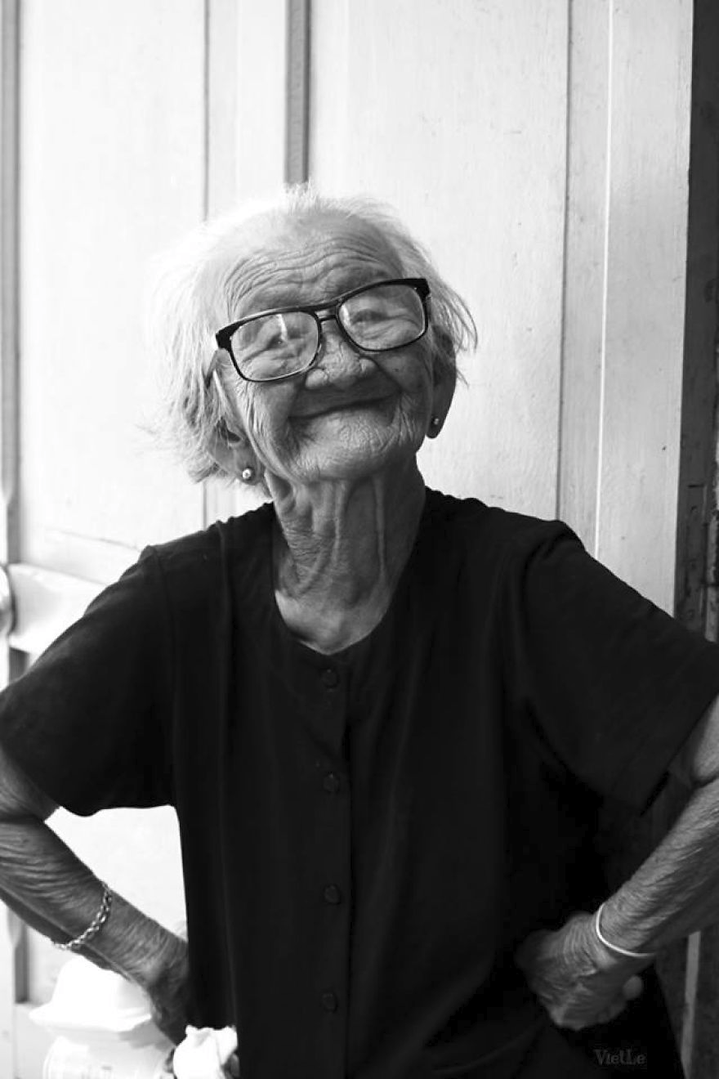
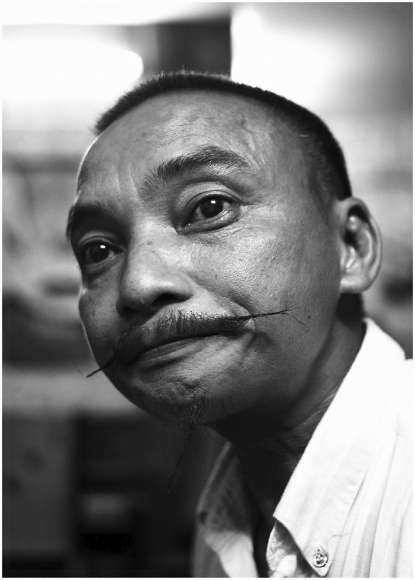

Slide 7
The People

Slide 8
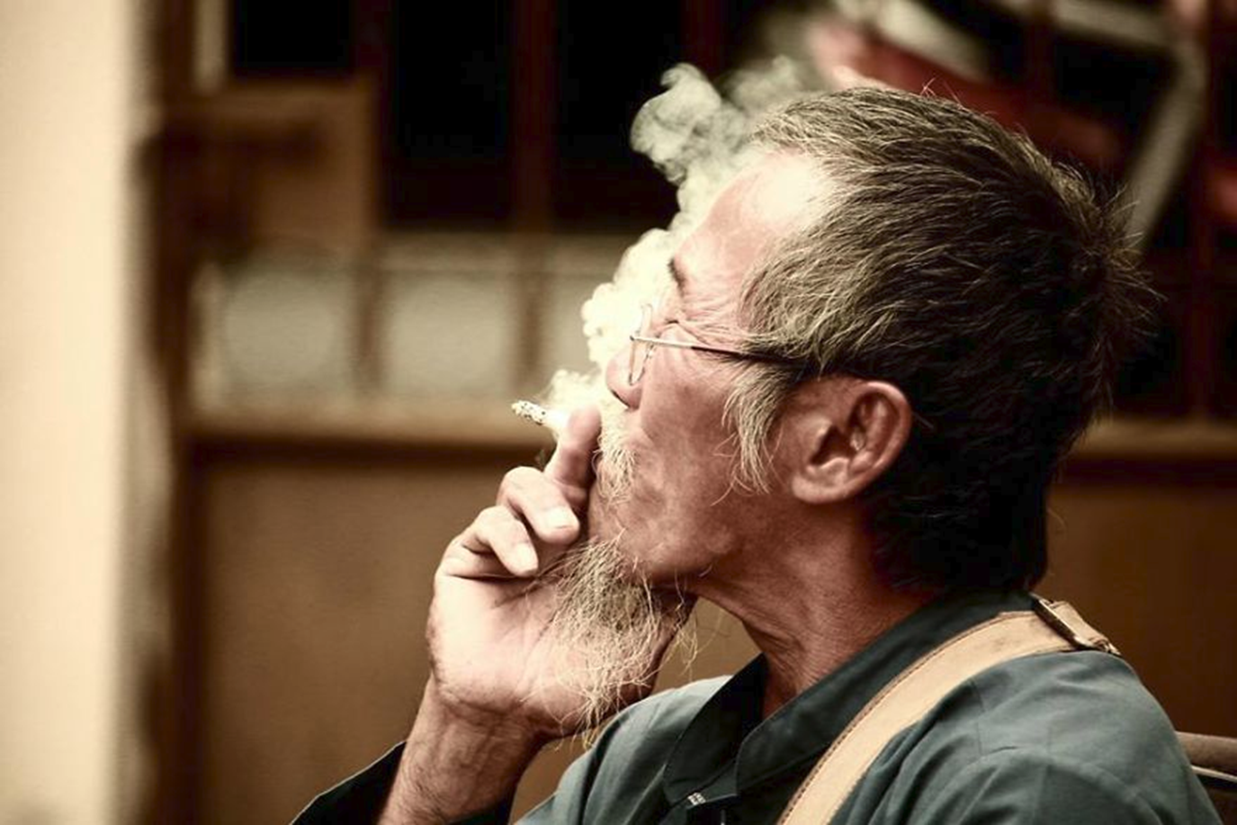

Slide 9
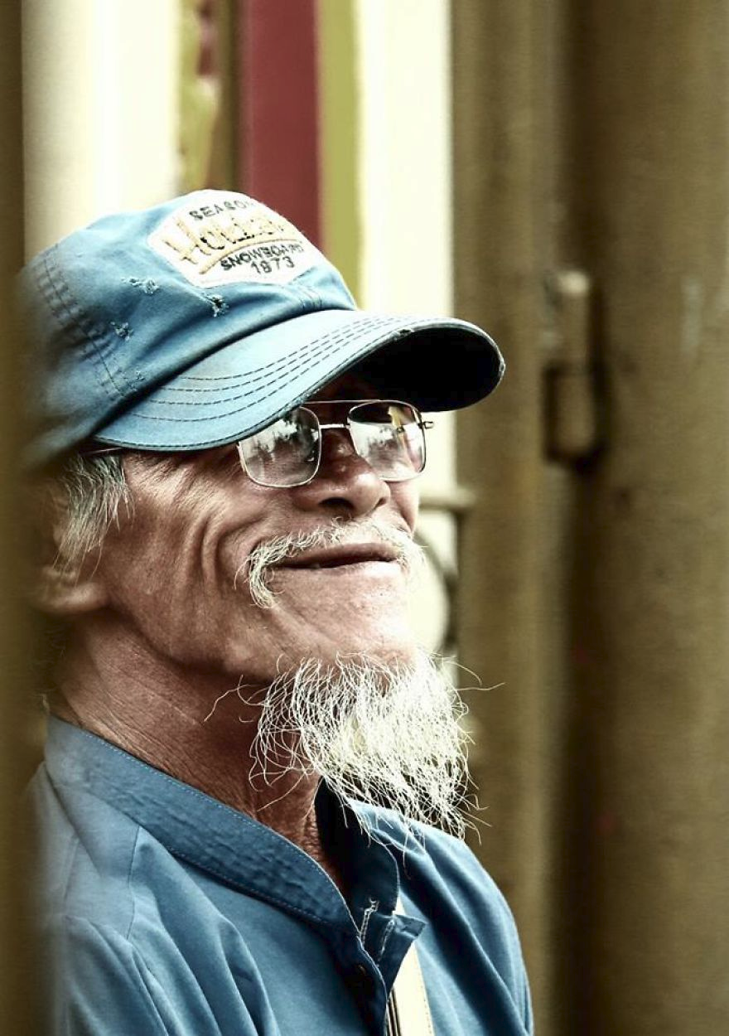
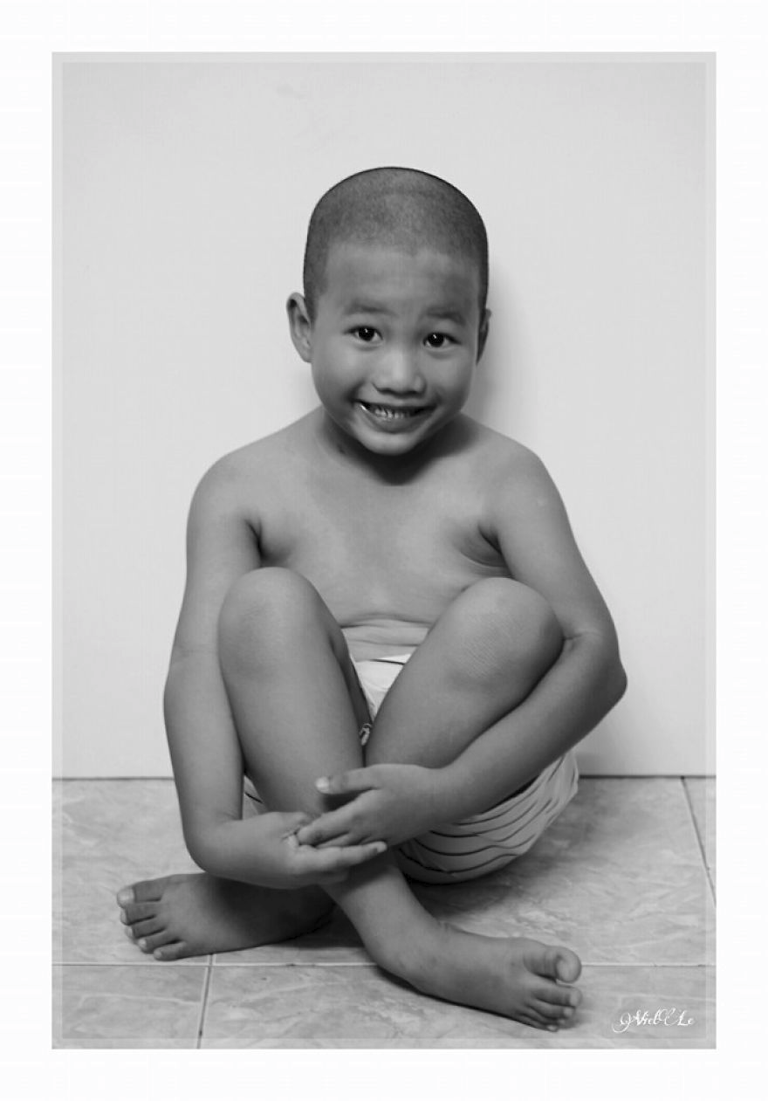

Slide 10
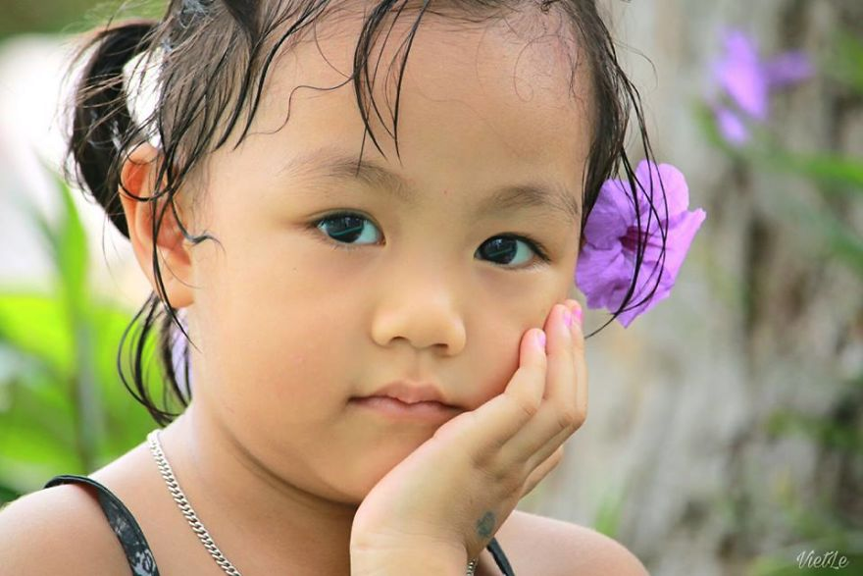

Slide 11
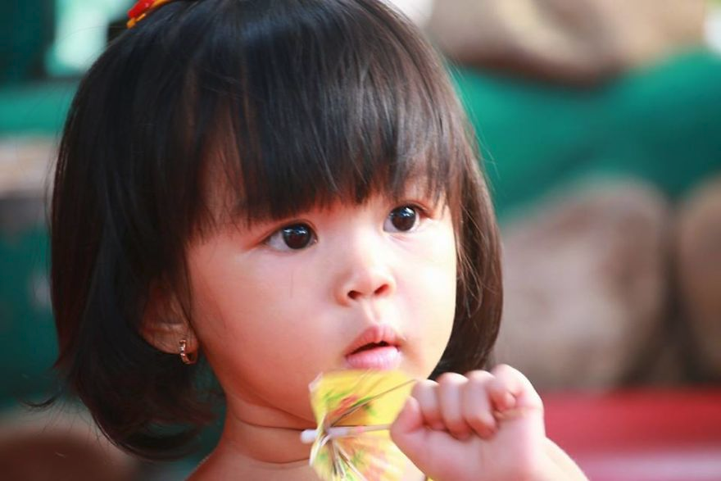

Slide 12
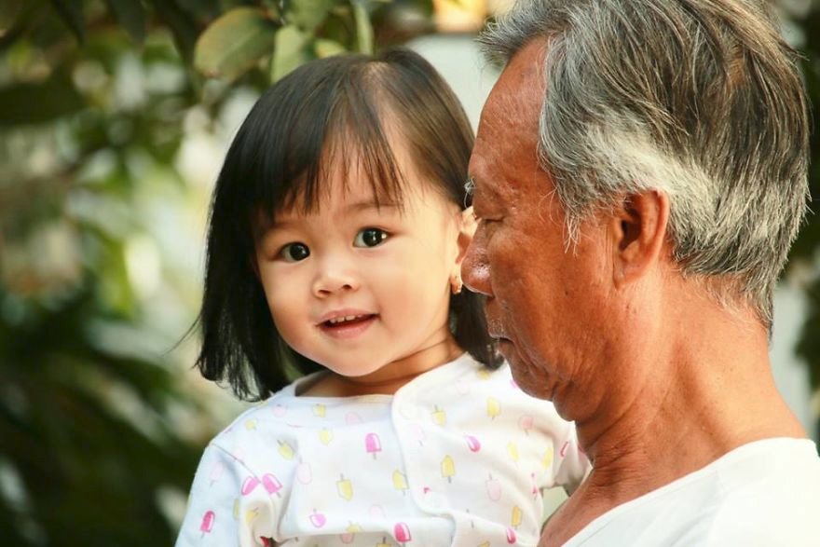

Slide 13
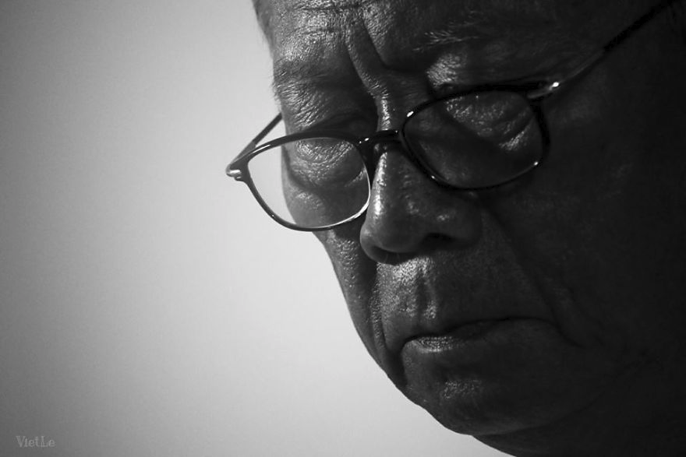

Slide 14
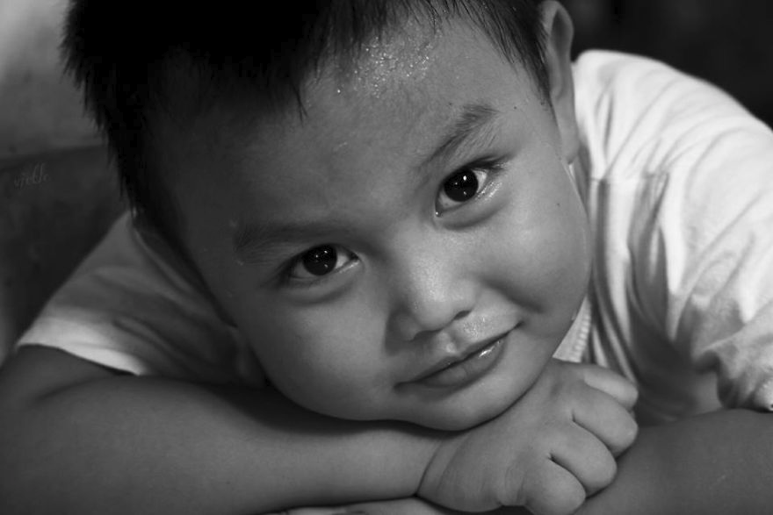

Slide 15
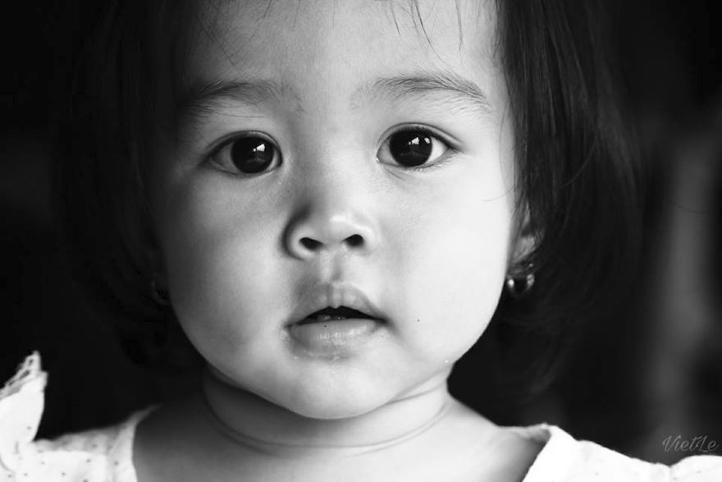

Slide 16
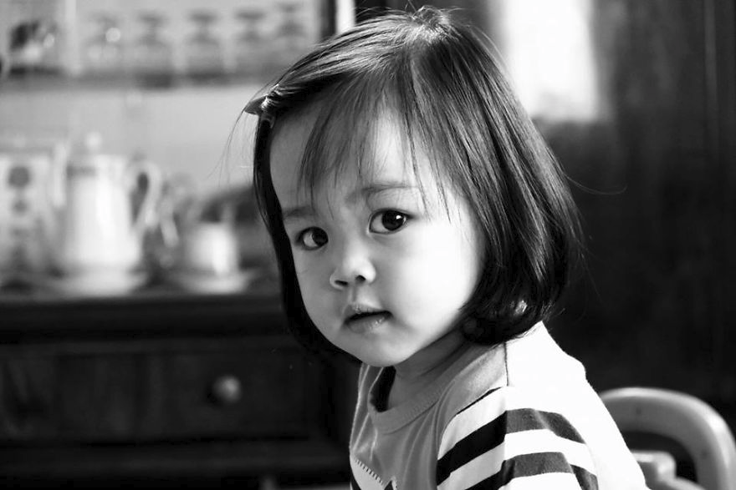

Slide 17
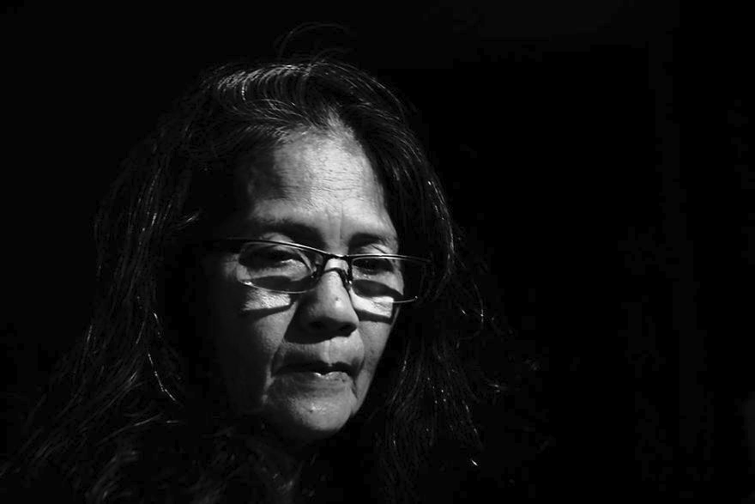

Slide 18
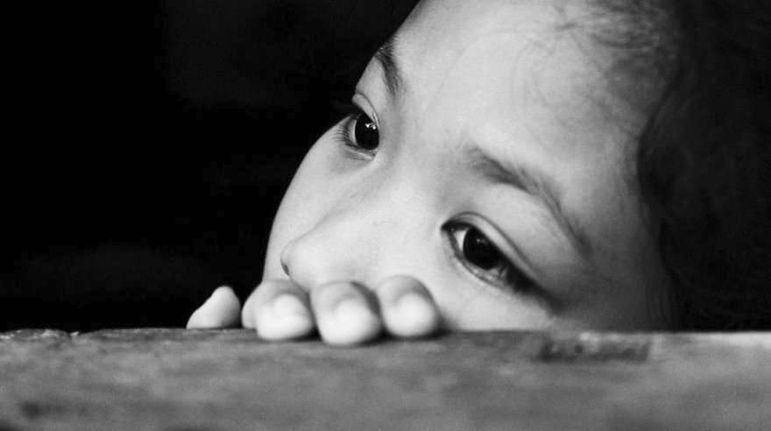

Slide 19
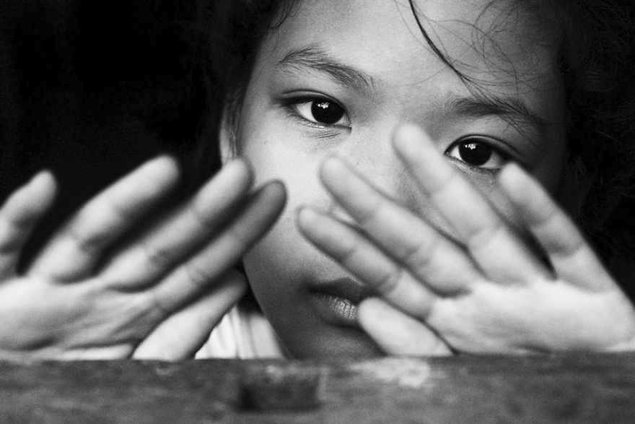

Slide 20
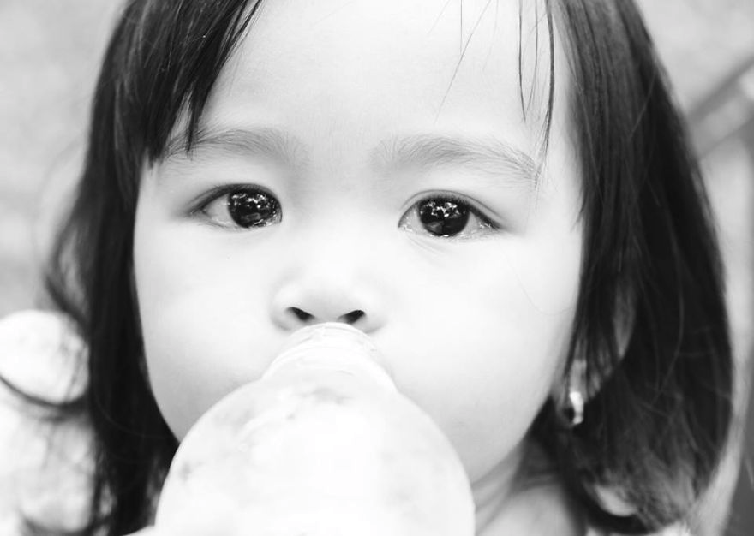

Slide 21
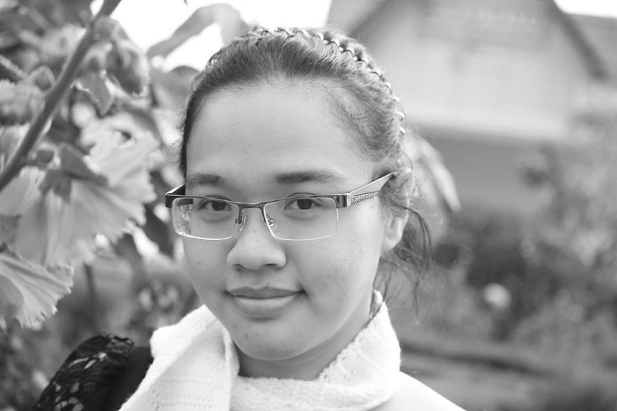

Slide 22
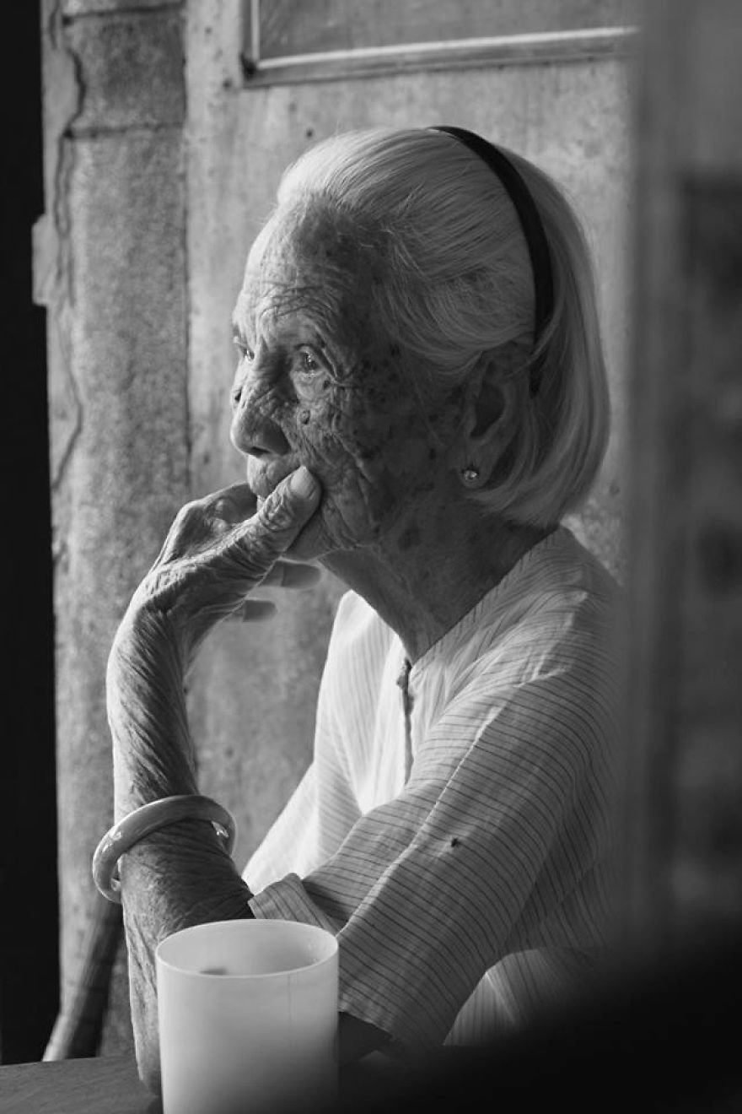
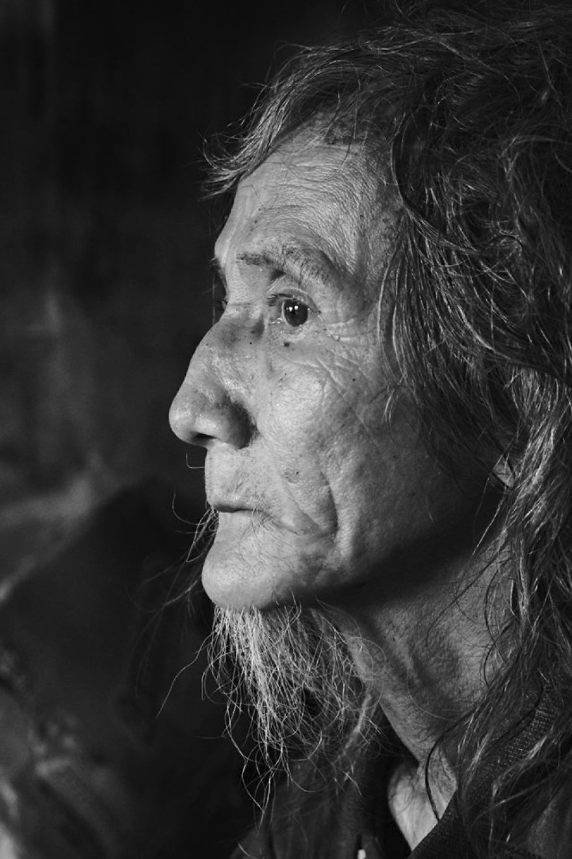

Slide 23
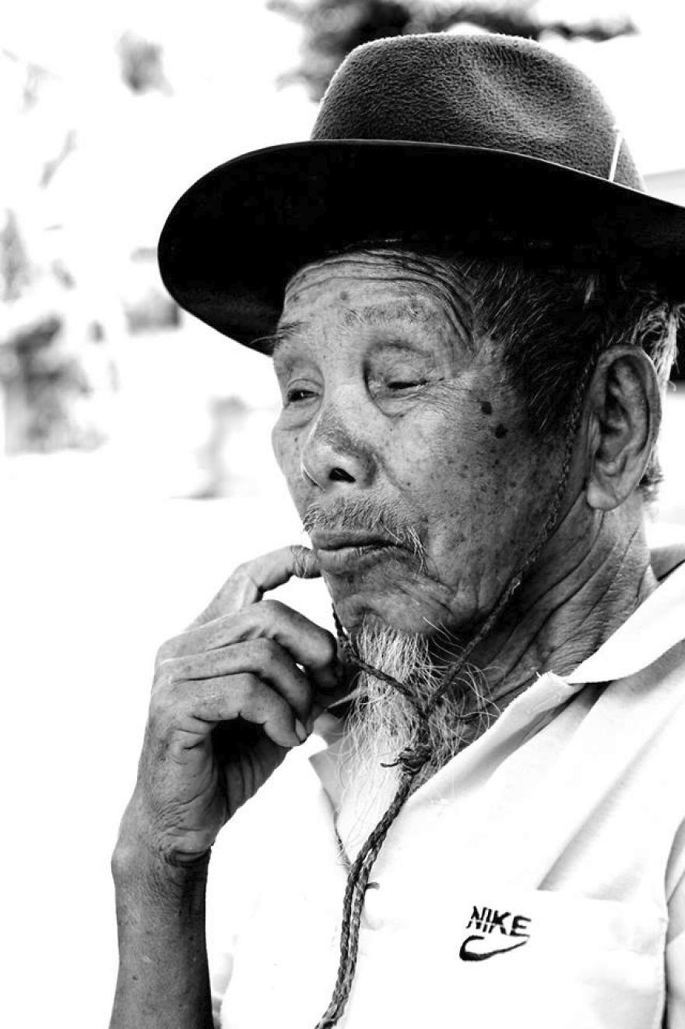

Slide 24
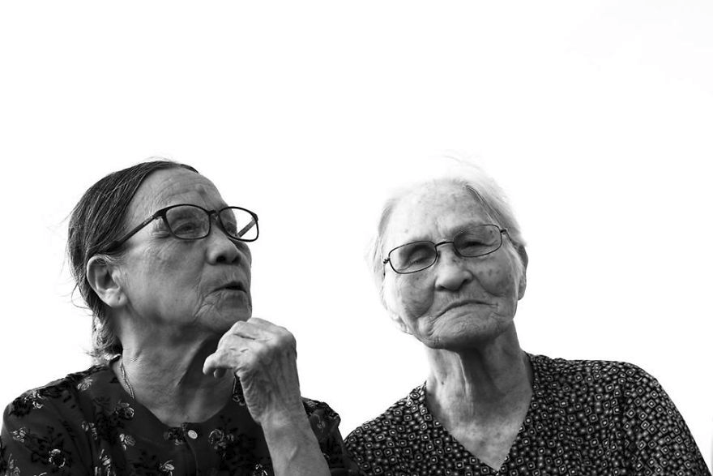

Slide 25
