Slide 1
Homes In-ground or Underground Absolutely Stunning

Slide 2
Advantages
On the plus side, an earth-sheltered home is less susceptible to the impact of extreme outdoor air temperatures than a conventional house. Earth-sheltered houses also require less outside maintenance, and the earth surrounding the house provides soundproofing. In addition, plans for most earth-sheltered houses "blend" the building into the landscape more harmoniously than a conventional home. Finally, earth-sheltered houses can cost less to insure because they offer extra protection against high winds, hailstorms, and natural disasters such as tornados and hurricanes.

Slide 3
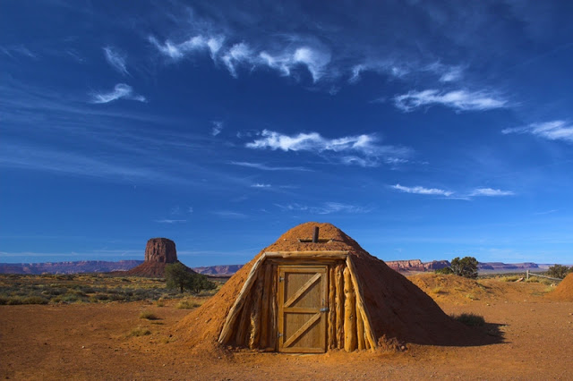
A hogan in Arizona...

Slide 4
Disadvantages
The principal downsides to earth-sheltered houses are the initial cost of construction, which can be up to 20% more than a conventional house, and the increased level of care required to avoid moisture problems, both during construction and over the life of the house. It can also take more diligence to resell an earth-sheltered home, and buyers may have more hurdles to clear in the mortgage application process.

Slide 5
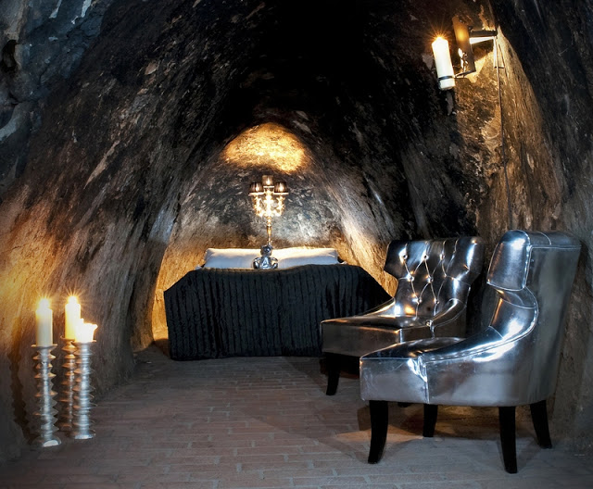
Sala Silvermine, Sweden...

Slide 6
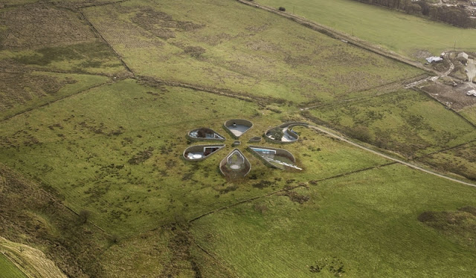
Bolton Eco House, England...

Slide 7
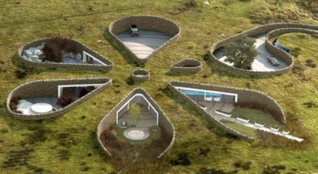

Slide 8
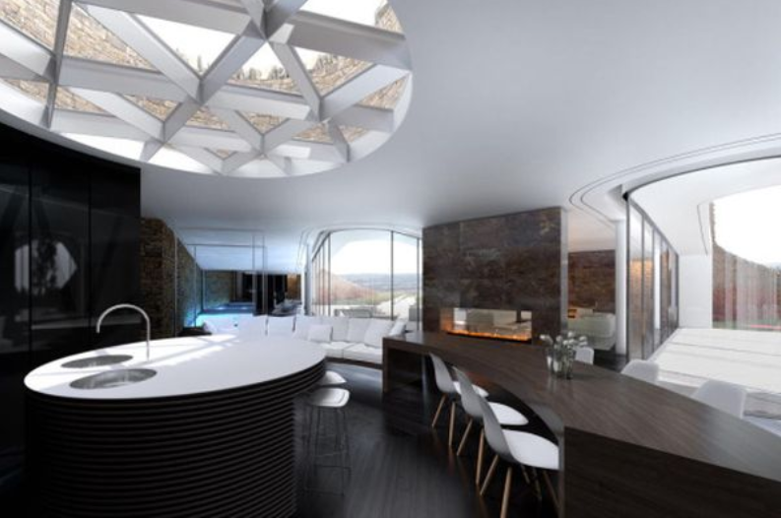

Slide 9
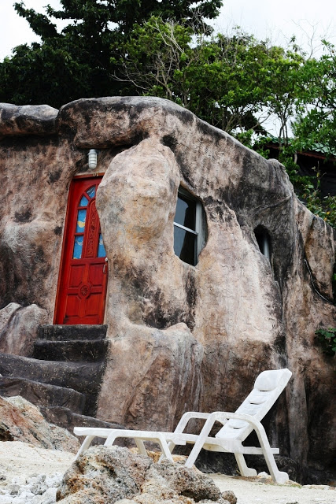
Rock house...

Slide 10
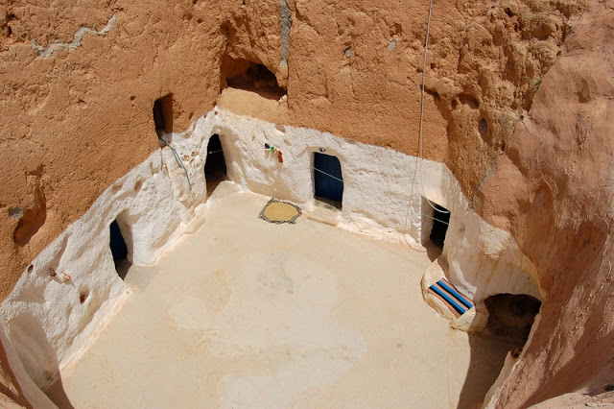
Matmata village, Tunisia...

Slide 11
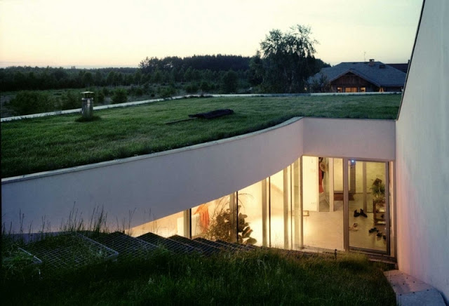
OUTrial House, Poland...

Slide 12
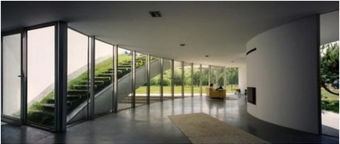

Slide 13
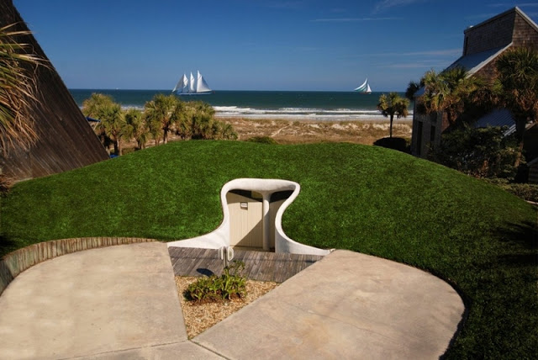
Dune House, Atlantic Beach...

Slide 14
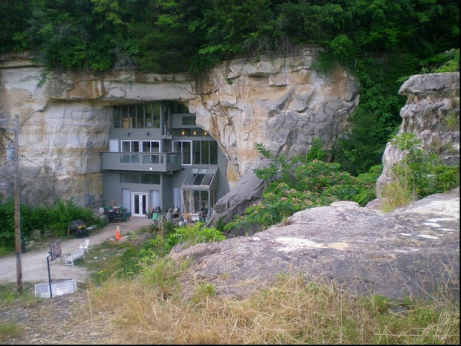
Cave House, Festus, Missouri...

Slide 15
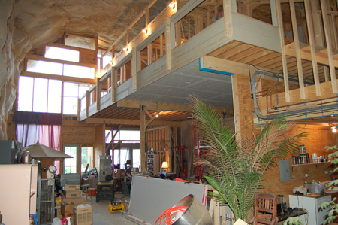

Slide 16
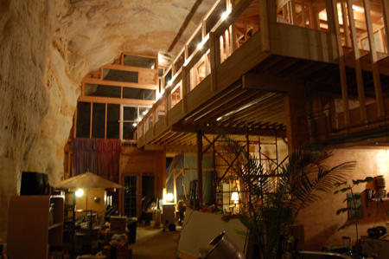

Slide 17
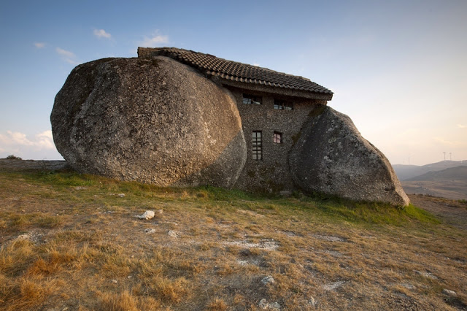
Nas montanhas de Fafe, Portugal...

Slide 18
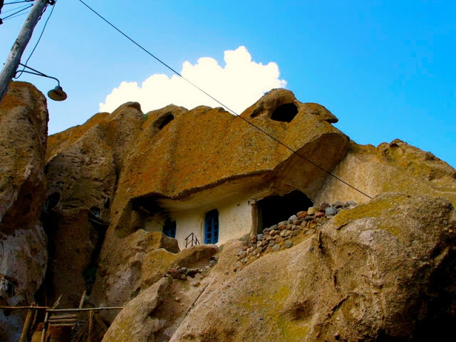
Village of Kandovan, Iran...

Slide 19
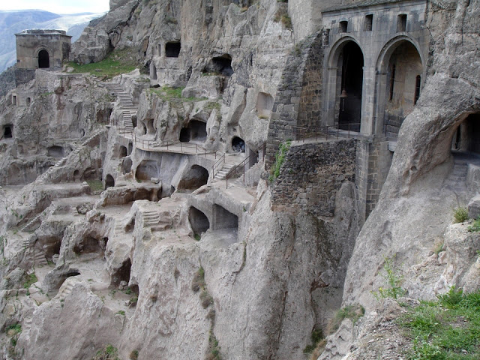
Vardezia cave city, Georgia...

Slide 20
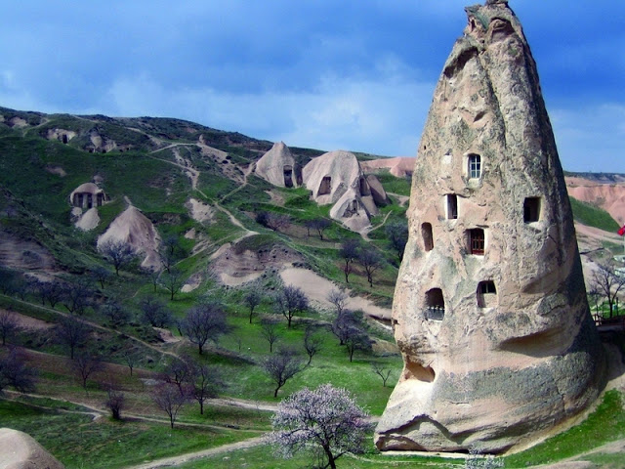
Cave homes, Cappadocia, Turkey...

Slide 21
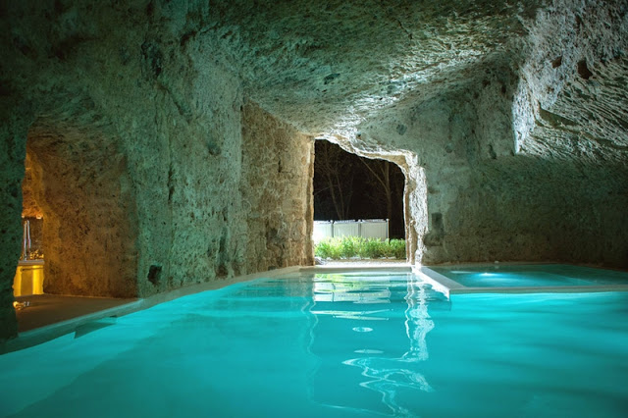
Domus Civita, Italy...

Slide 22
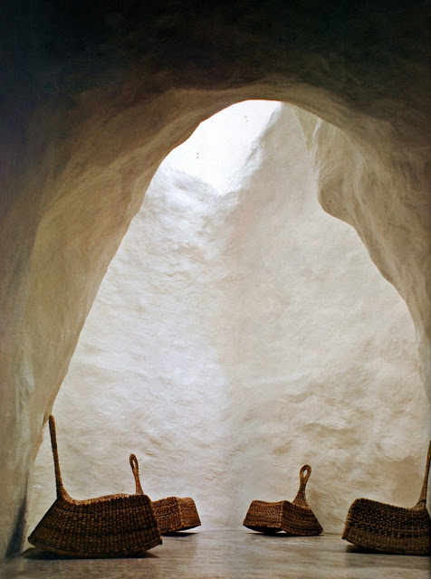
Cave dwelling, Sicily...

Slide 23
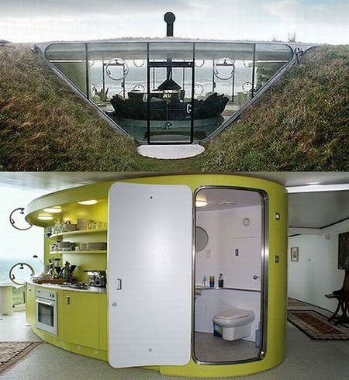
Malator in Druidstone, Wales

Slide 24
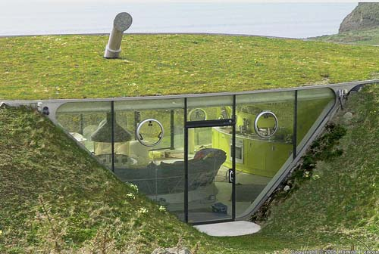

Slide 25
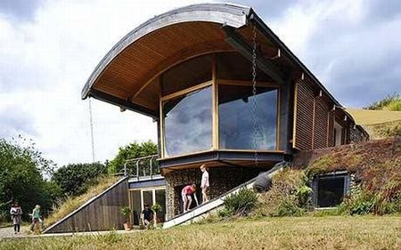
Sedum House, North Norfolk Coast, U.K

Slide 26
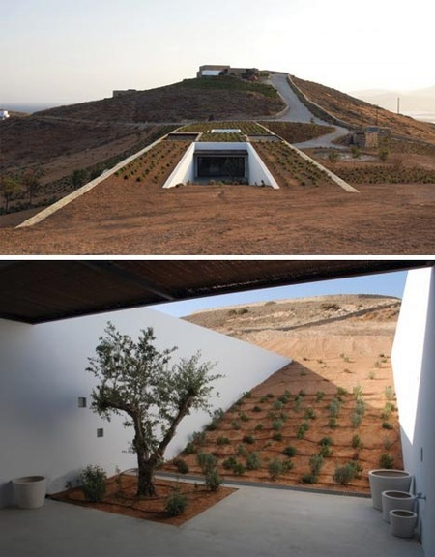
Stone Desert Home in Greece

Slide 27
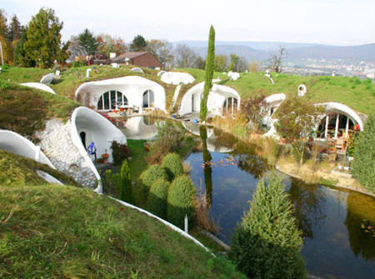
Estate Lättenstrasse, Dietikon, Switzerland

Slide 28
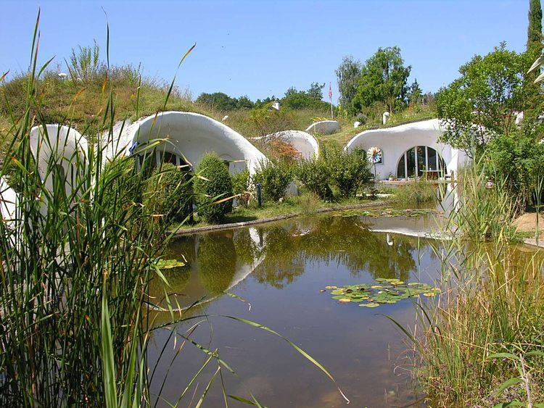

Slide 29
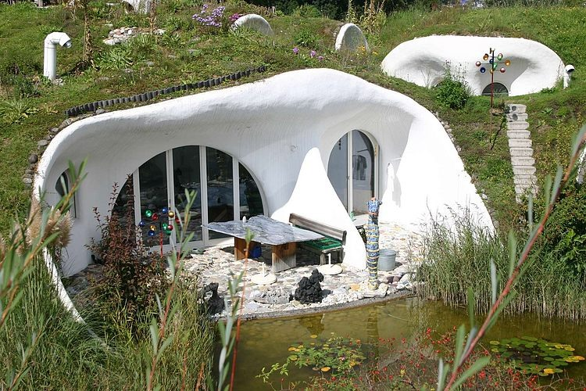

Slide 30
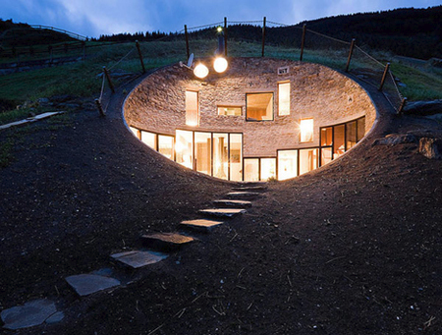
Hobbit Home in Vals, Switzerland

Slide 31
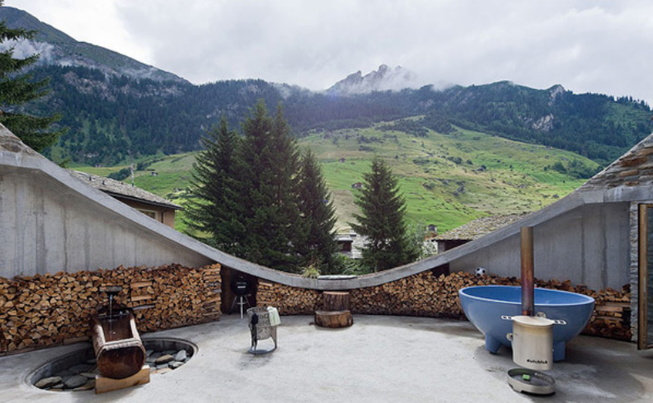

Slide 32
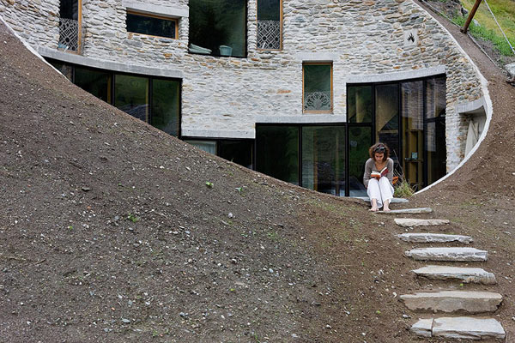

Slide 33
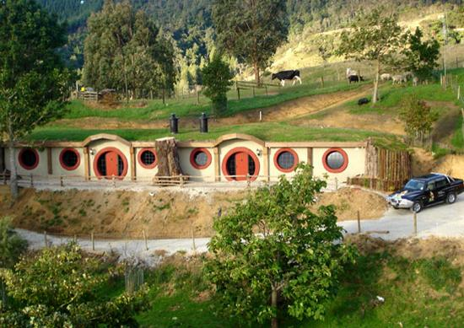
Woodlyn Park, home to the world’s first hobbit motel

Slide 34
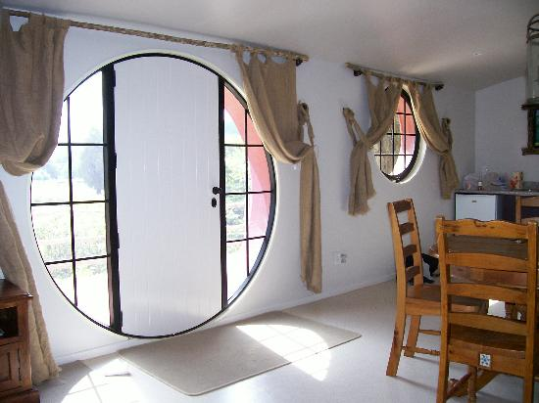

Slide 35
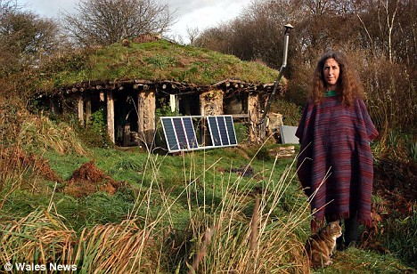
An eco-village in Preseli mountains of west Wales

Slide 36
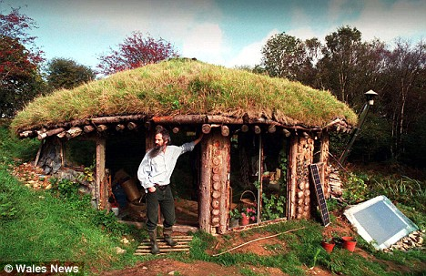

Slide 37
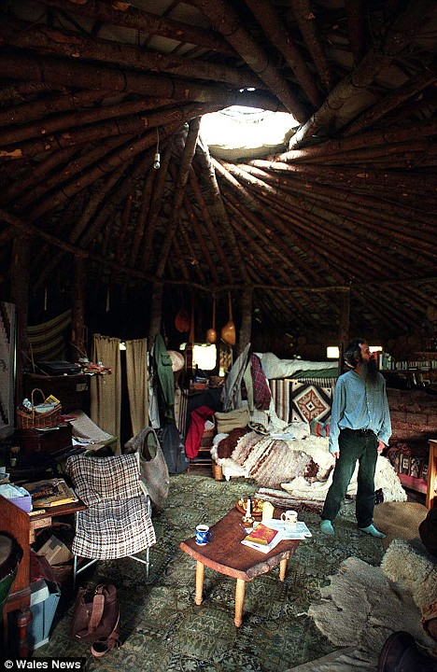

Slide 38
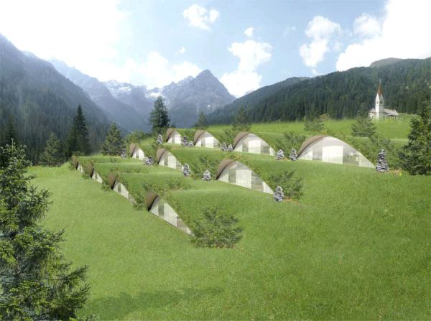
The eco-friendly Bella Vista Hotel in Italy.

Slide 39
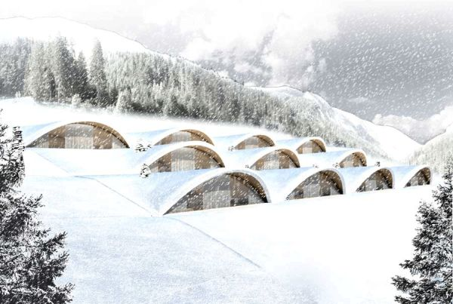

Slide 40
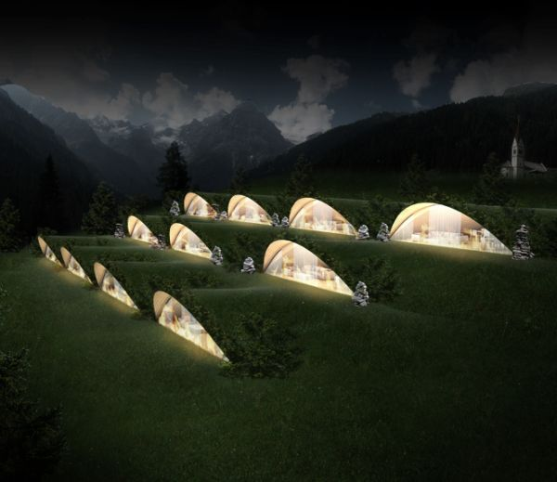

Slide 41
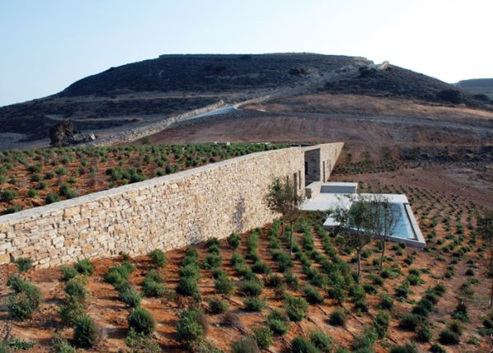
The Aloni House in the Cycladic Islands

Slide 42
Other, Unidentified, Structures

Slide 43
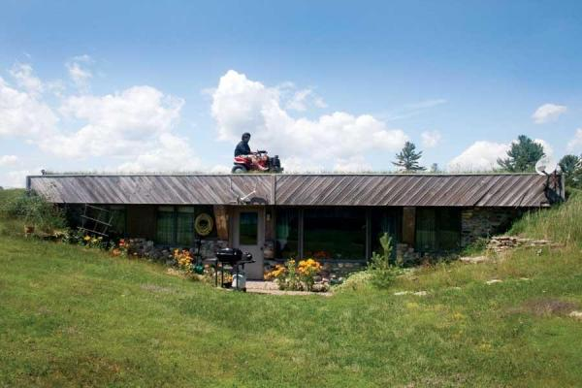

Slide 44
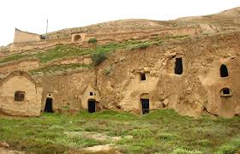

Slide 45
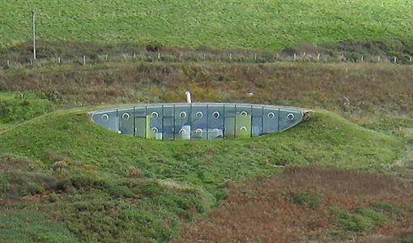

Slide 46
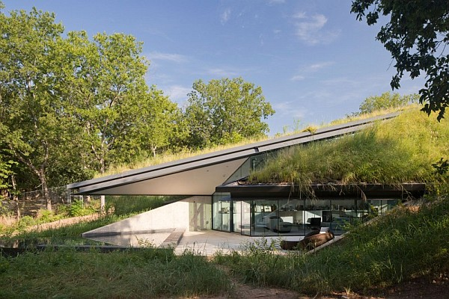

Slide 47
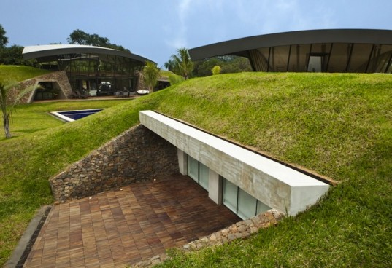

Slide 48
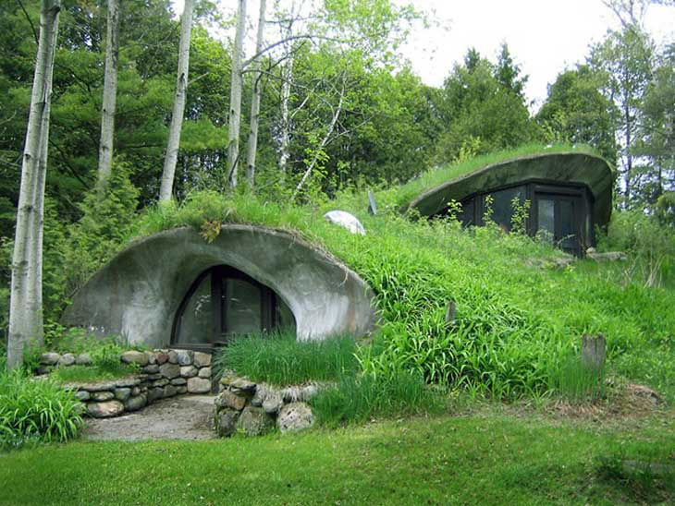

Slide 49
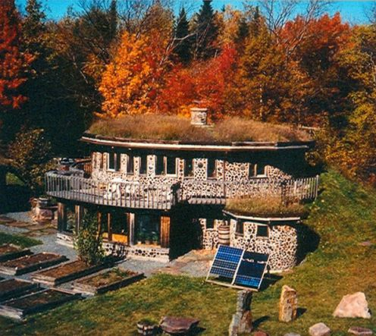

Slide 50
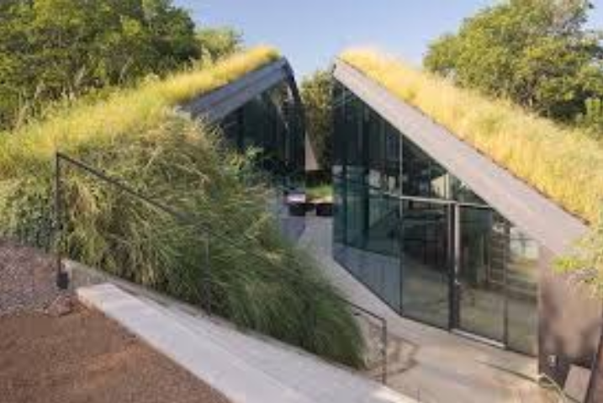

Slide 51
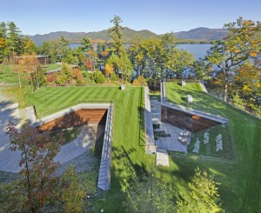

Slide 52
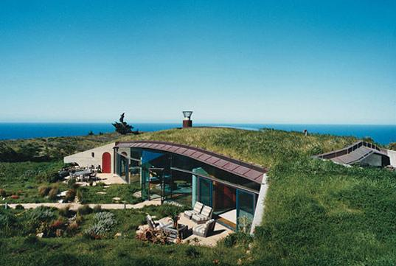

Slide 53
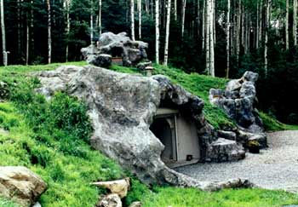

Slide 54
