Slide 1
Homemade Limousines

Slide 2
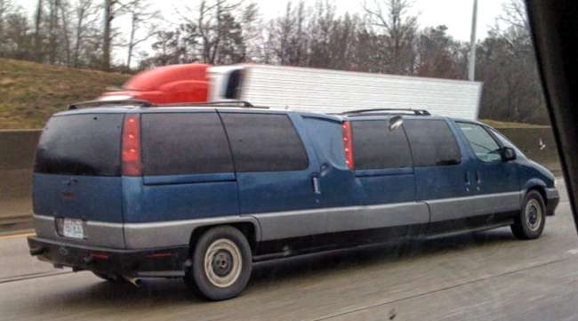
This is what happens when you have two minivans of the same type lying around.

Slide 3
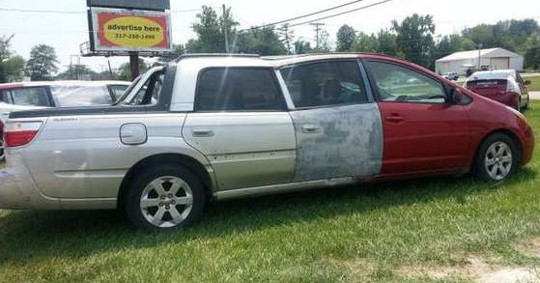

Slide 4
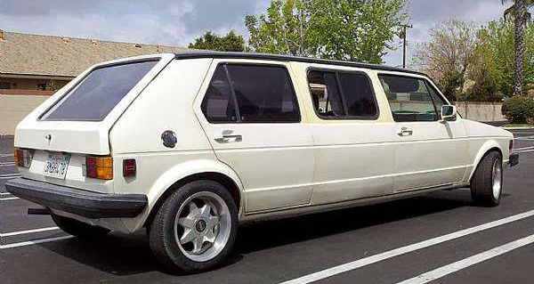
it looks like they used at least two Rabbits to make this

Slide 5
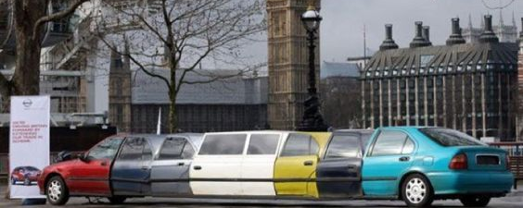
How many Honda Civics and other vehicles do you see in this picture?

Slide 6
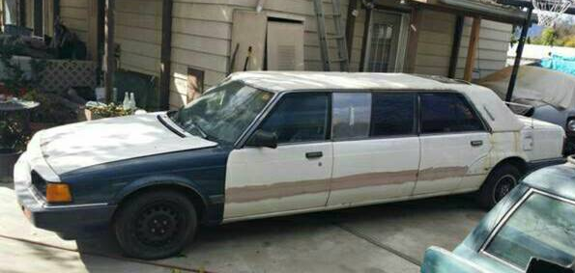
his old Marquis looks like it is straight out of the movie Shaft.

Slide 7
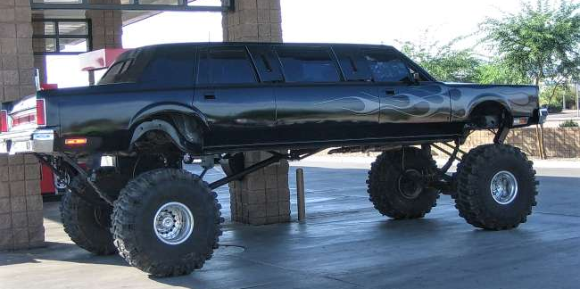
This is the Lincoln to beat all Lincolns.

Slide 8
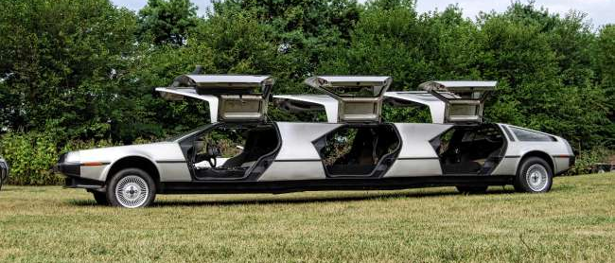
Holy DeLorean lovers, check this out!

Slide 9
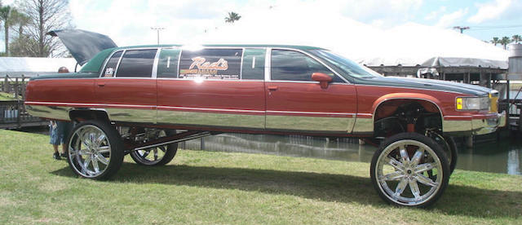

Slide 10
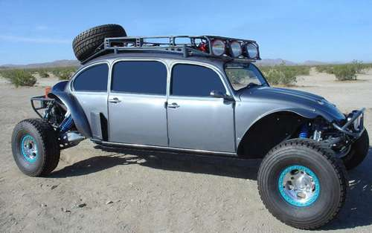
It’s funny when you see a Volkswagen Beetle that’s been modified.

Slide 11
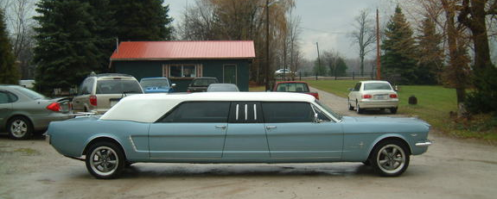
The classic Ford Mustang limousine looks to be solid and well built.

Slide 12
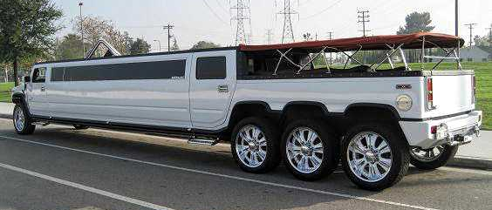
Sometimes you want the look of the Hummer, with the feel of the land yacht/pontoon boat.

Slide 13
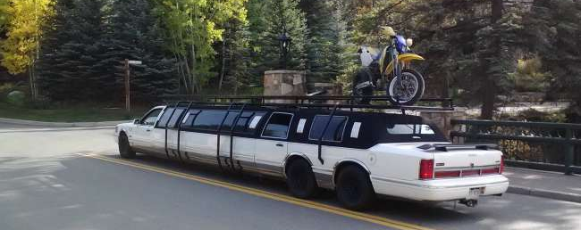
Here’s another homemade limo that rivals the last one we saw.

Slide 14
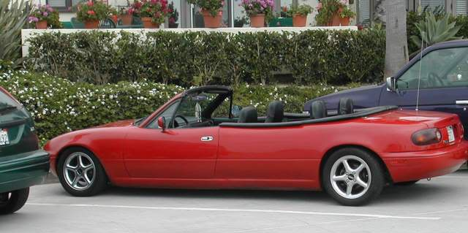
this is a custom stretch limo convertible job.

Slide 15
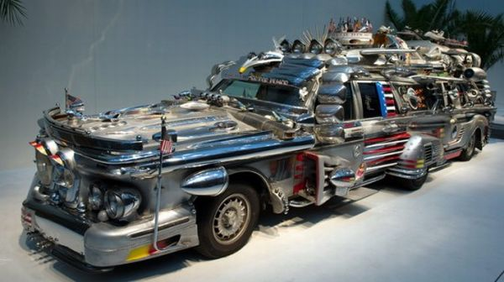
You are looking at a one million-dollar junk limousine

Slide 16

This Boeing limousine is pretty spectacular.

Slide 17
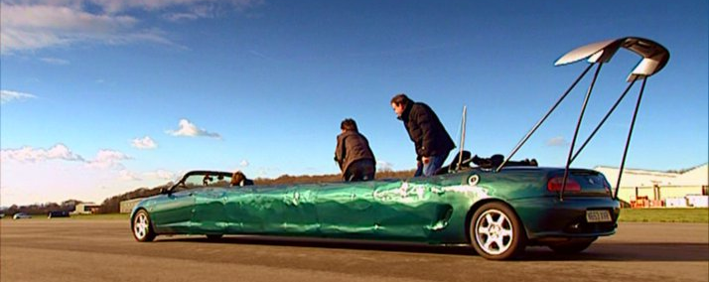

Slide 18

Here’s another homemade limousine made from two vans.

Slide 19

There are some things in life that should not be done. This Yugo has obviously seen better days.

Slide 20
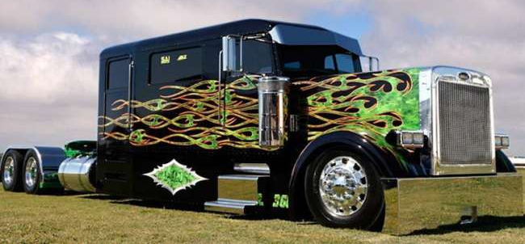
Forget team driving, this can be family driving.

Slide 21

This is a Ford with four doors on each side.

Slide 22
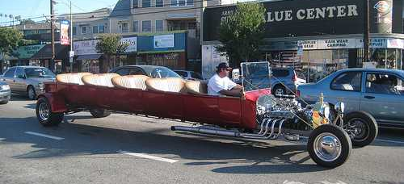
Rat rods are nice.

Slide 23
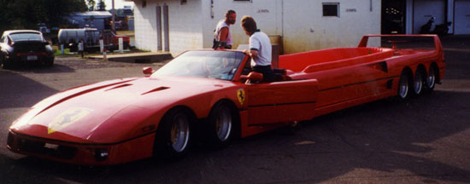
I don’t know why on earth you would want to turn a Ferrari into a limousine.

Slide 24
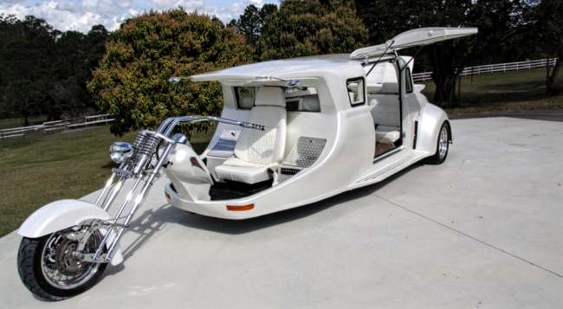
look at what has to be the baddest Harley stretch limousine

