Slide 1
Here Are some Absurd Signs That People Actually Created

Slide 2
Few things are as important in this world as a sign. After all, they tell us what we can and cannot do, where to go, and what to expect. If it weren’t for signs, the world might be in complete chaos.
But these signs may cause more chaos than they’re preventing. Come to think of it, maybe we’d be a bit better off without them.

Slide 3
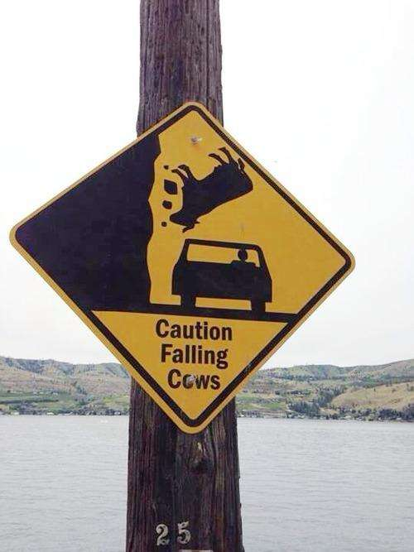
Those poor little moo cows!

Slide 4
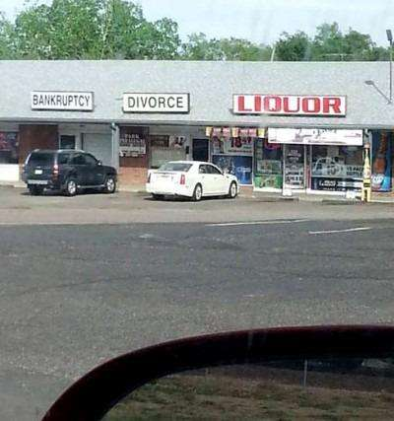
The most convenient mini-mall ever.

Slide 5
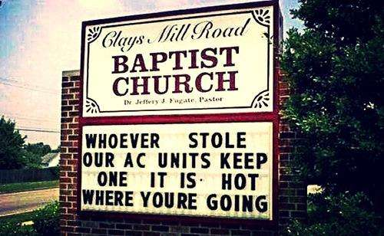
They’re gonna need a heckuva lot more than an A/C.

Slide 6
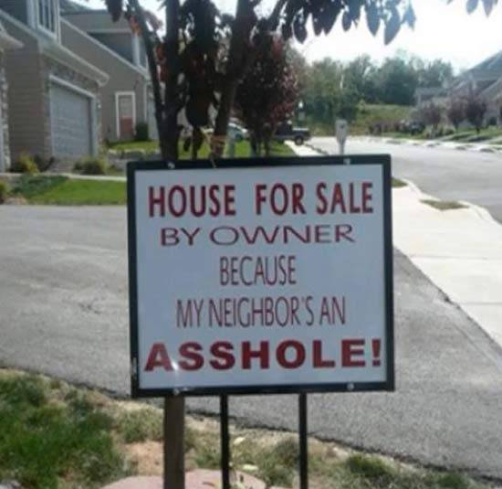
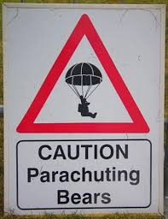
Someone has had enough

Slide 7
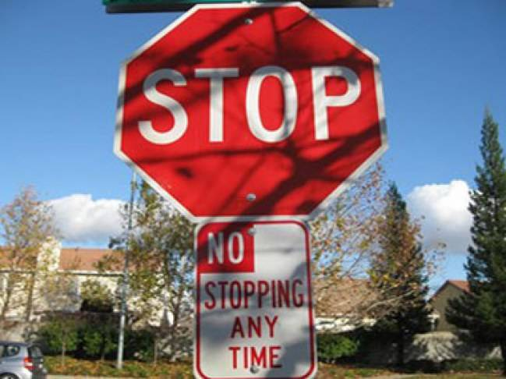
Which sign do I follow!?

Slide 8
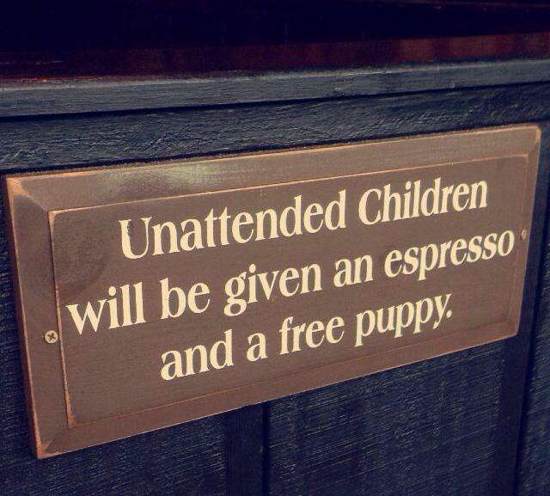
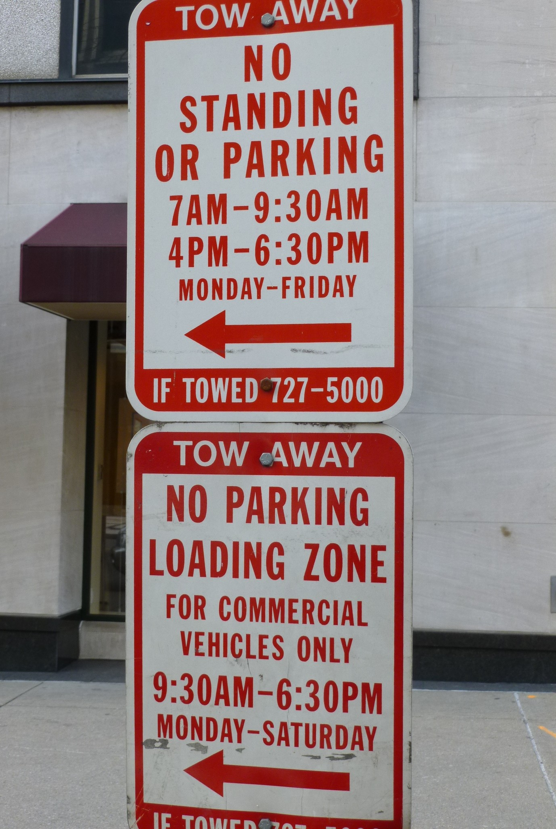
And the award for most random sign ever goes to…

Slide 9
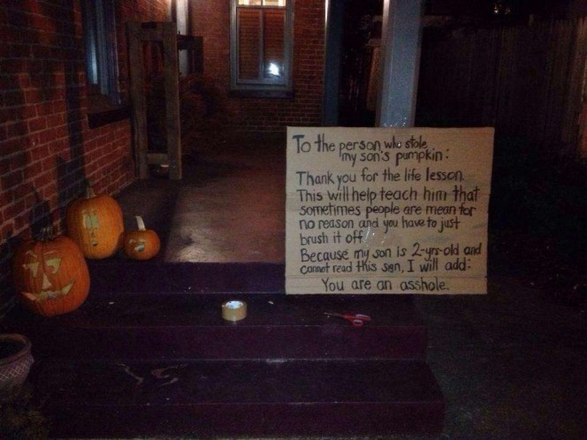
Ouch. Right to the bone!

Slide 10
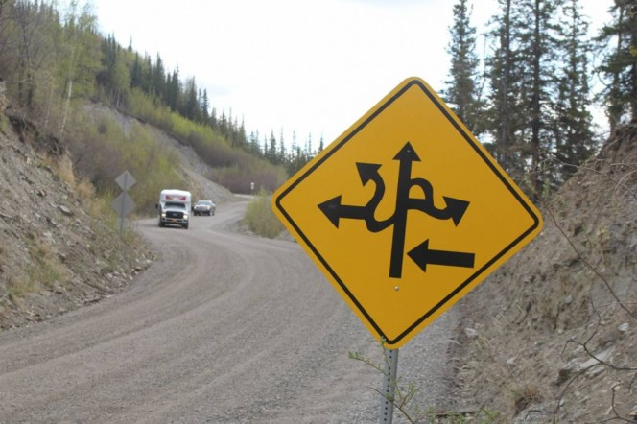
Good luck using a GPS.

Slide 11
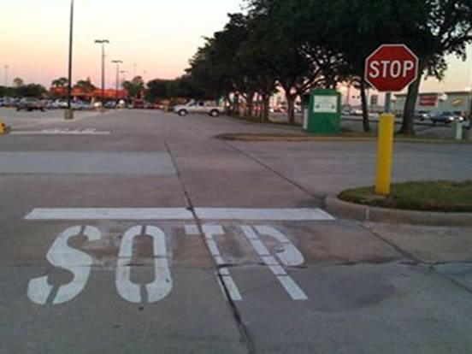
“Quality control? Who needs that!?”

Slide 12
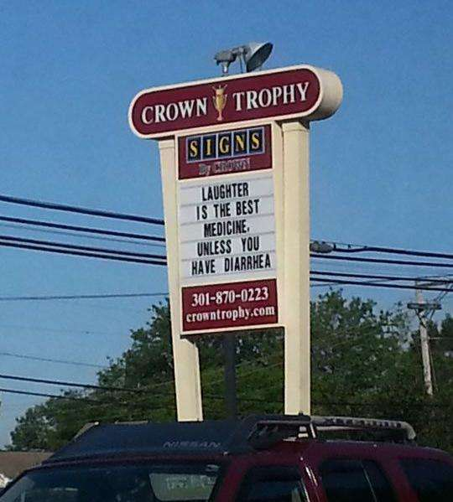
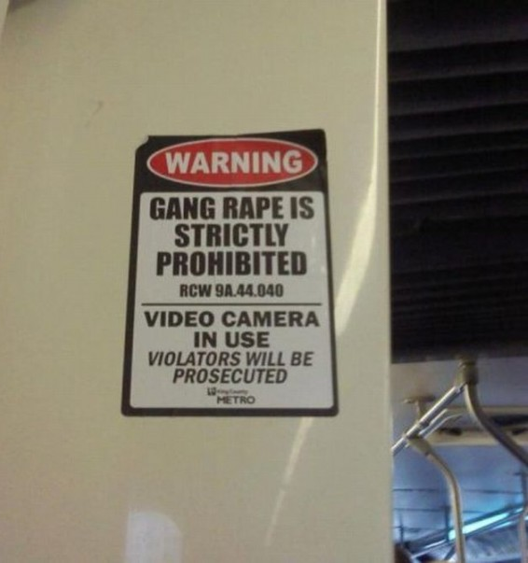
Then nobody’s laughing.

Slide 13
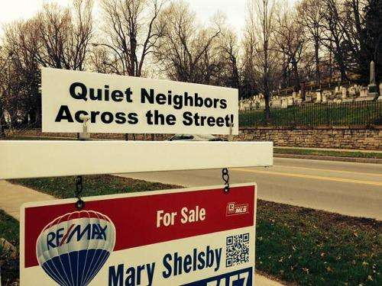
Almost too quiet…

Slide 14
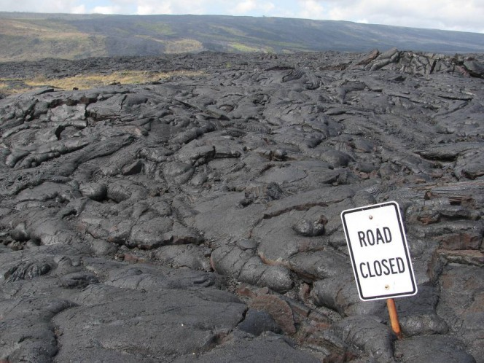
A road, you say?

Slide 15
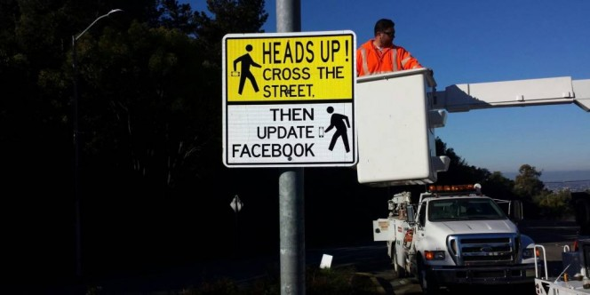
Soon, we’ll need this for Pokemon Go.

Slide 16
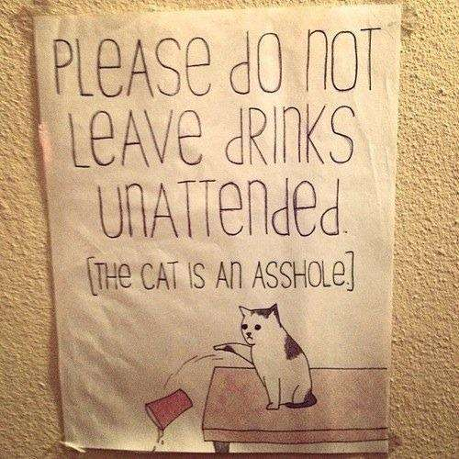
To hell with that blasted cat!

Slide 17
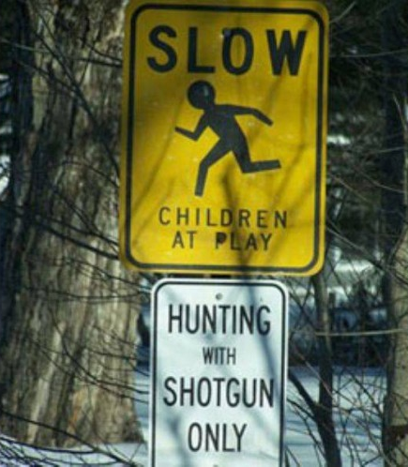
Hunting the most dangerous animal of all: children.

Slide 18
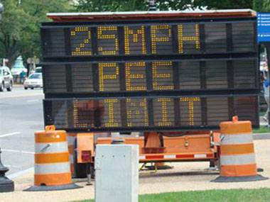

Slide 19
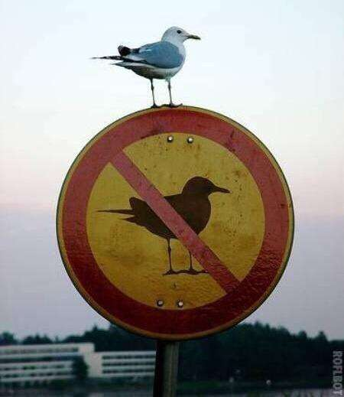
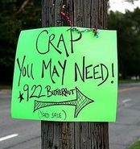
What a smug jerk

Slide 20
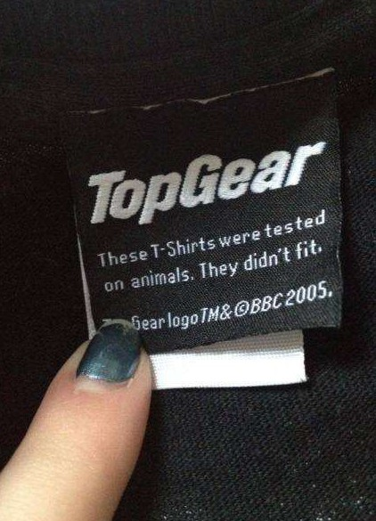
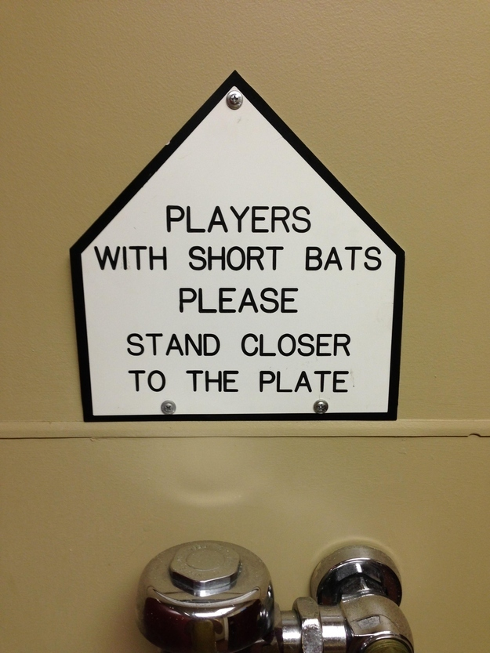
At least they tried

Slide 21
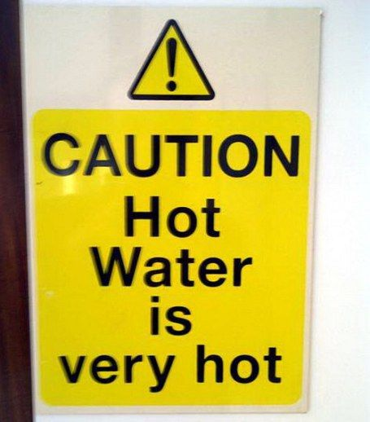
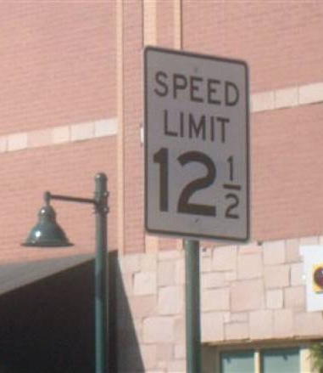

Slide 22
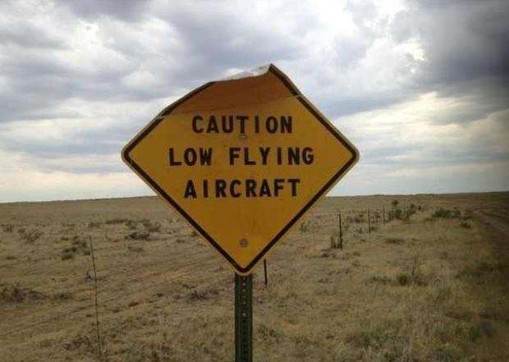
At least you know how low they fly

Slide 23
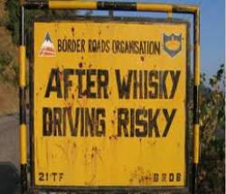
After wine, listen to this sign!

Slide 24
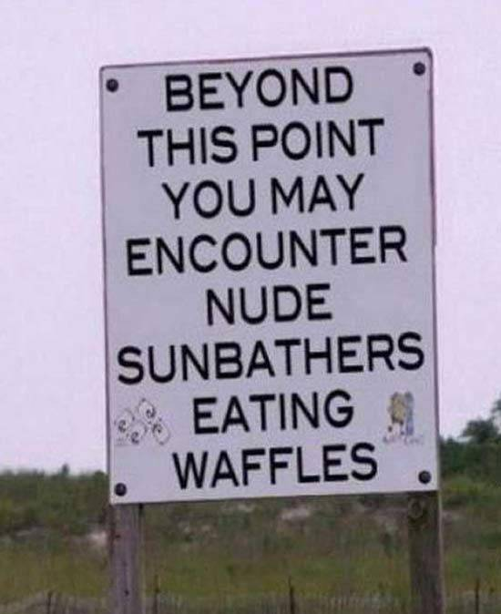
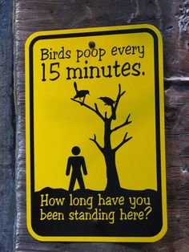

Slide 25

A free ride? Sign me up!

Slide 26
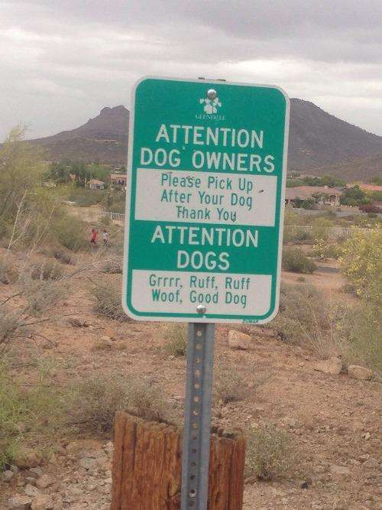
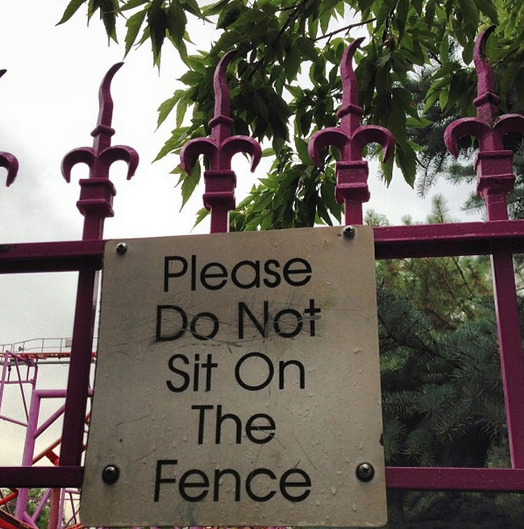

Slide 27
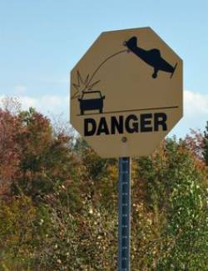
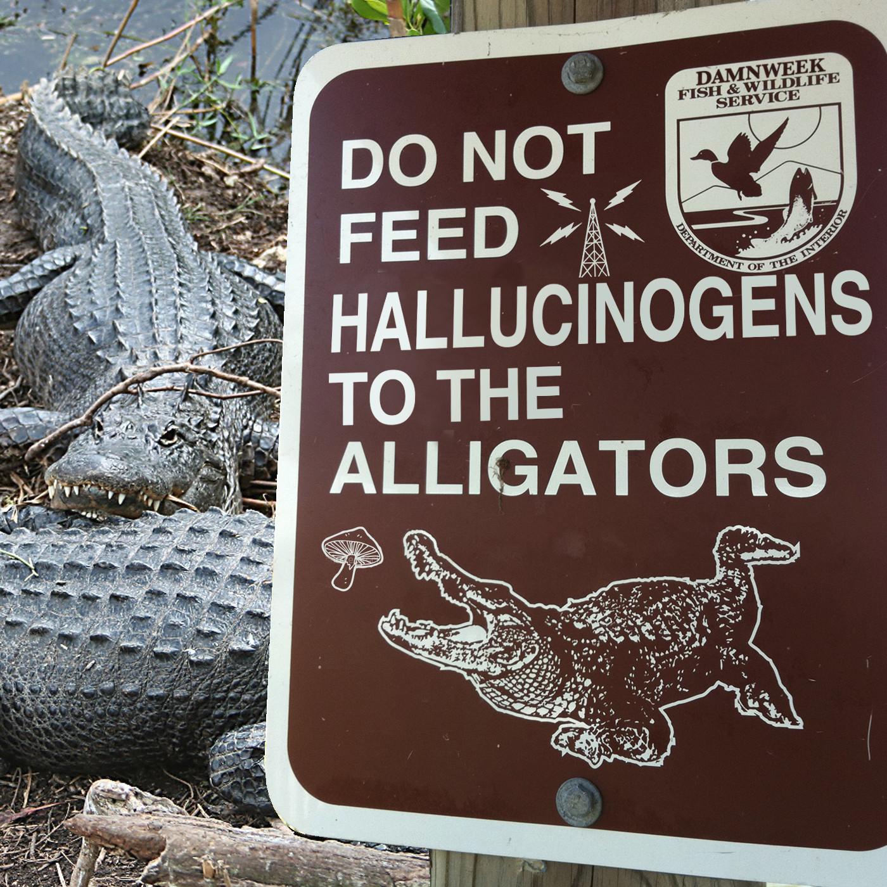
Or just stay off the road.

Slide 28
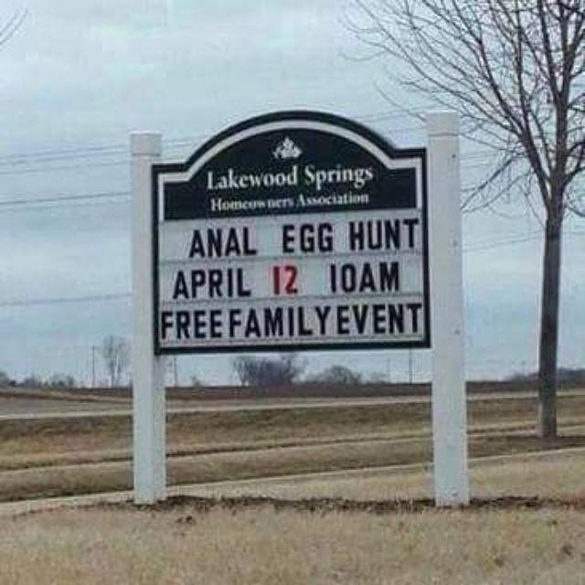
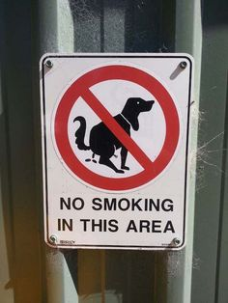

Slide 29
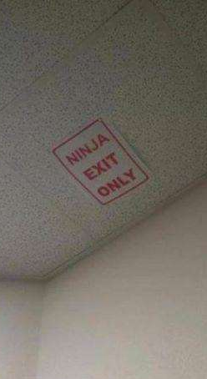
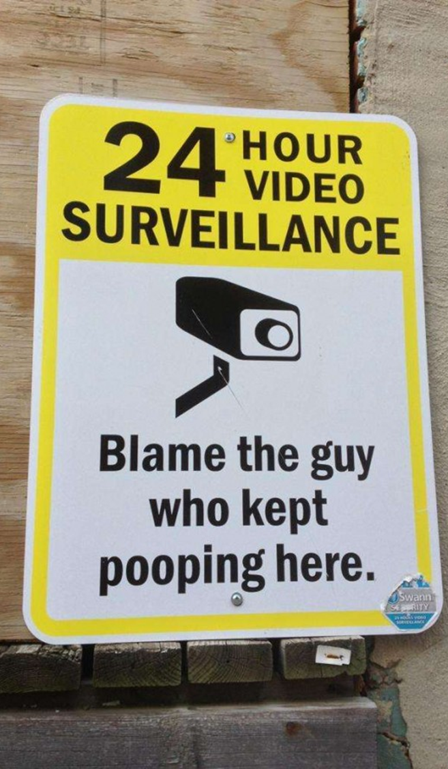
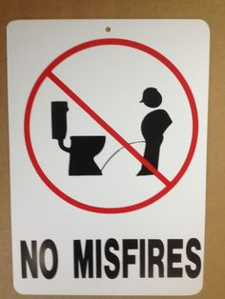

Slide 30
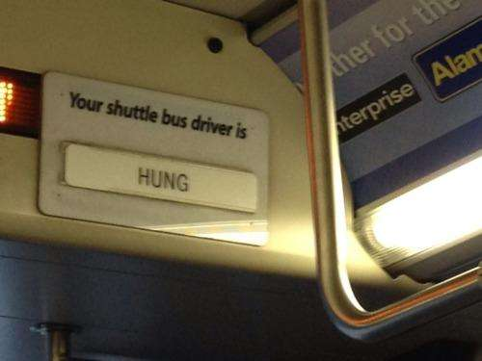
Single folks, take note.

Slide 31
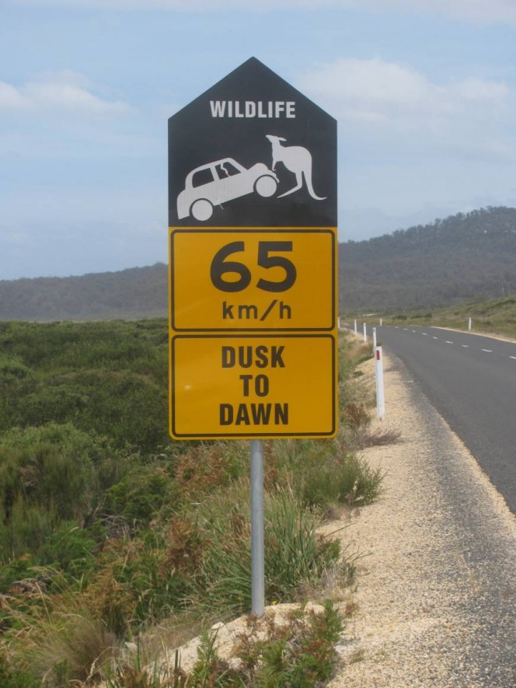
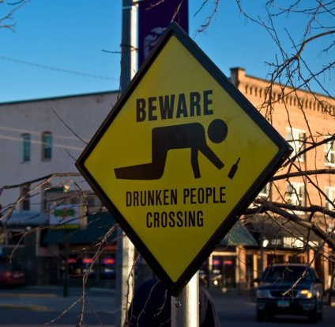
Watch out for those rare vampire kangaroos.

Slide 32
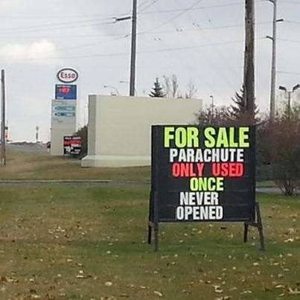
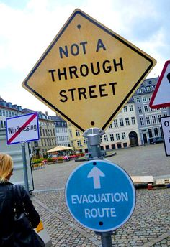
Still attached to an arm

Slide 33
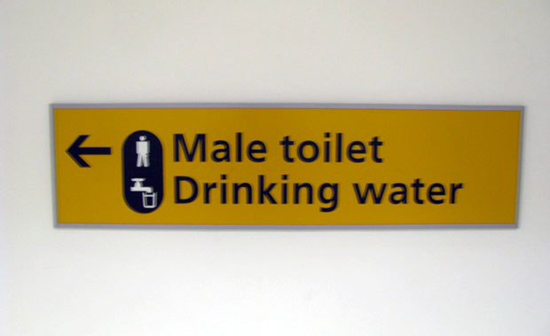
“We got excelled footage of him.”

Slide 34
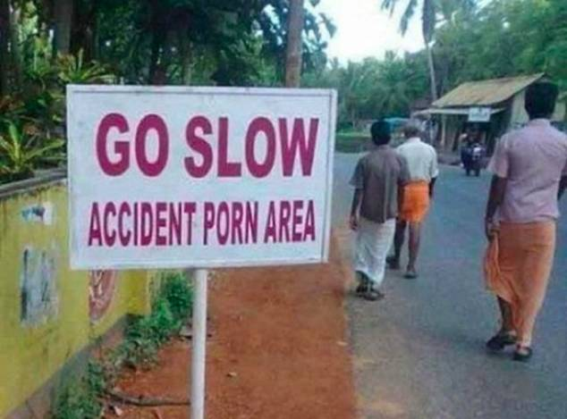
Whatever gets you through the day, I suppose.

Slide 35
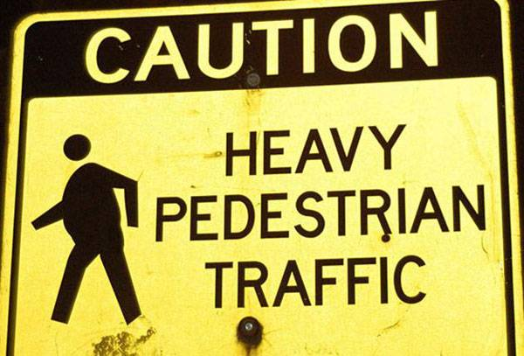

Slide 36
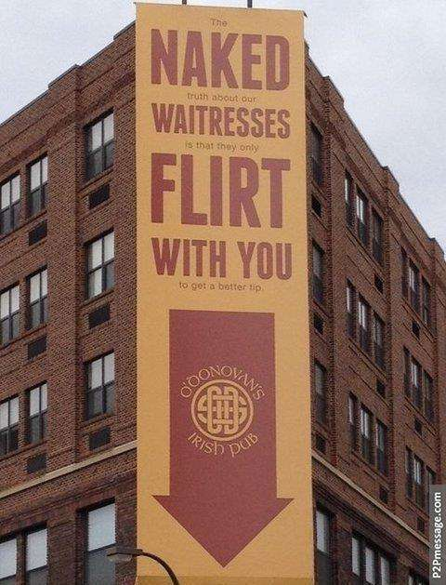
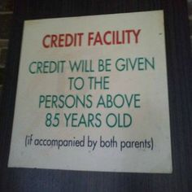
Made you look.

Slide 37
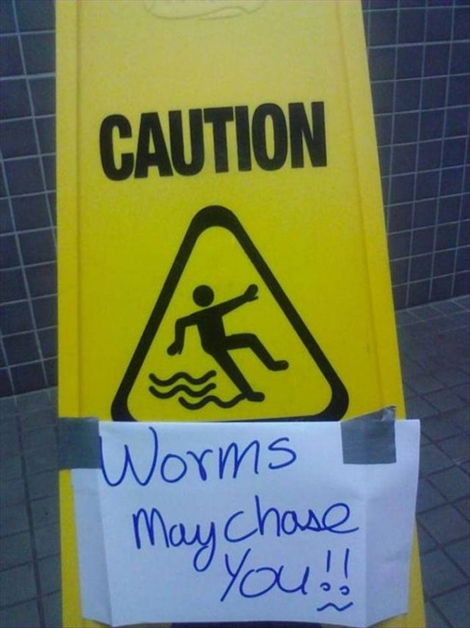
Worms! Aaah! Get them away!

Slide 38
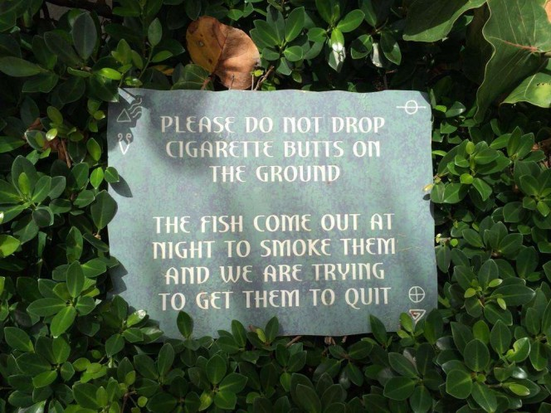
Those sure are some nasty fish!

Slide 39


Slide 40



Slide 41


Slide 42



Slide 43


Slide 44



Slide 45


Slide 46



Slide 47


Slide 48


Slide 49



Slide 50


Slide 51



Slide 52

Can one read it at 100 mph?

Slide 53


Slide 54


Slide 55


Slide 56


Slide 57


Slide 58




Slide 59


Slide 60


Slide 61


Slide 62



Slide 63


Slide 64



Slide 65


Slide 66



Slide 67



Slide 68



Slide 69


Slide 70



Slide 71


Slide 72


Slide 73


Slide 74


Slide 75



Slide 76



Slide 77


Slide 78



Slide 79


Slide 80


