Slide 1
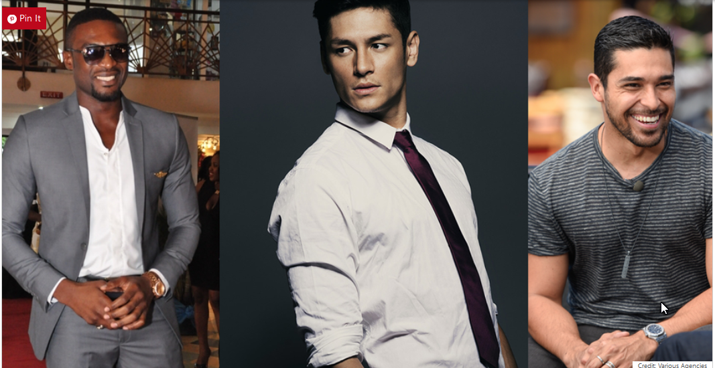
Handsome Men Around the World
Subtitle

Slide 2
Beauty (handsomeness) is a characteristic of an animal, idea, object, person or place that provides a perceptual experience of pleasure or satisfaction. Beauty is studied as part of aesthetics, culture, social psychology, philosophy and sociology. An "ideal beauty" is an entity which is admired, or possesses features widely attributed to beauty in a particular culture, for perfection.
The experience of "beauty" often involves an interpretation of some entity as being in balance and harmony with nature, which may lead to feelings of attraction and emotional well-being. Because this can be a subjective experience, it is often said that "beauty is in the eye of the beholder."
There is evidence that perceptions of beauty are evolutionary determined, that things, aspects of people and landscapes considered beautiful are typically found in situations likely to give enhanced survival of the perceiving human's genes.

Slide 3
Handsome Men
Many pictures may be of celebrities

Slide 4
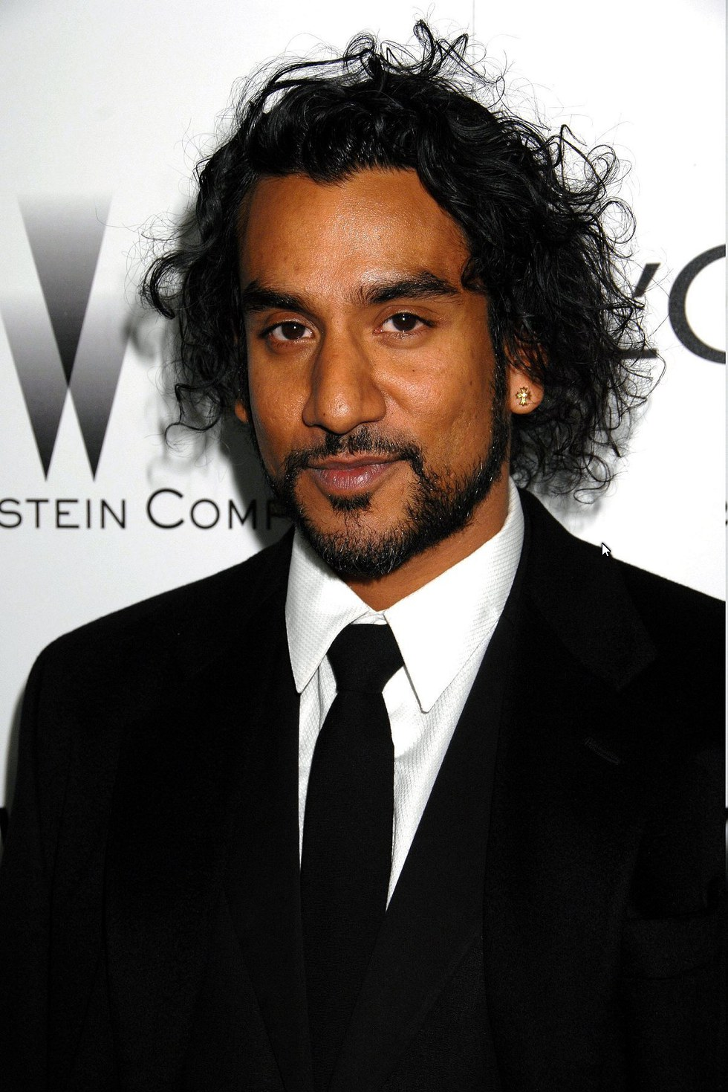
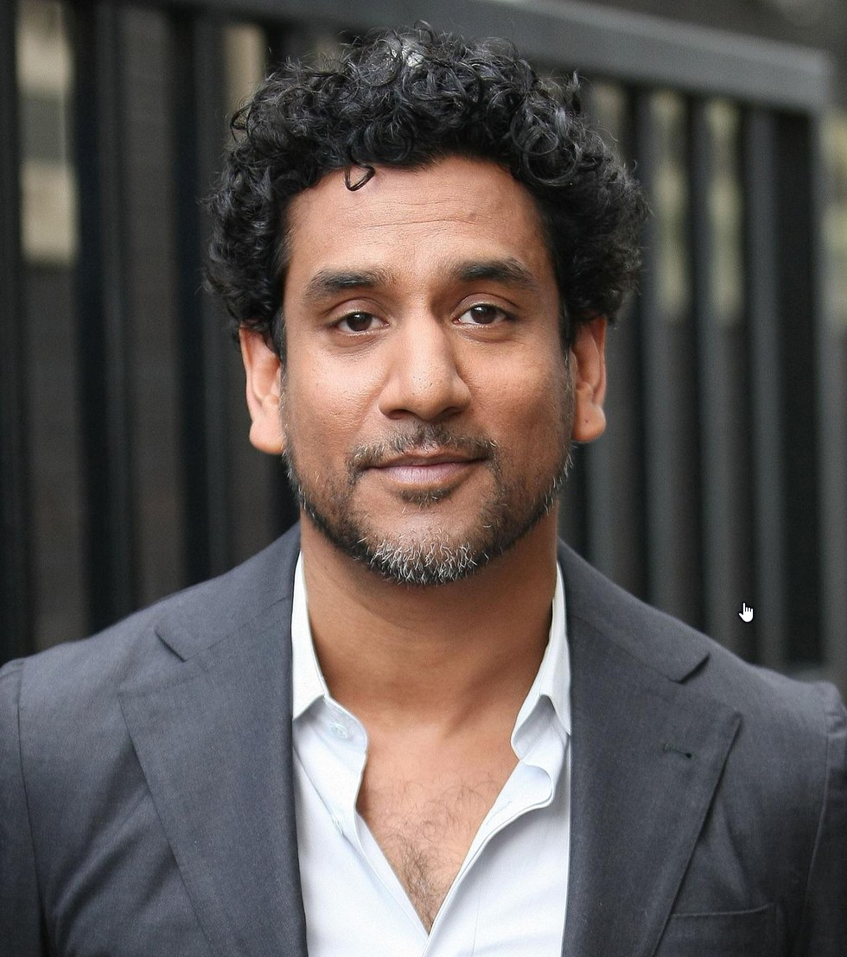
Naveen Andrews
Naveen is a British actor famous for his roles in TV shows like LOST and Sense8. His parents are Indian immigrants.

Slide 5
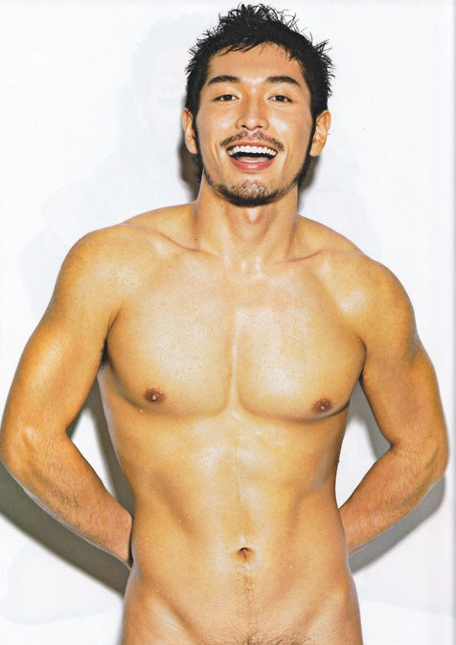
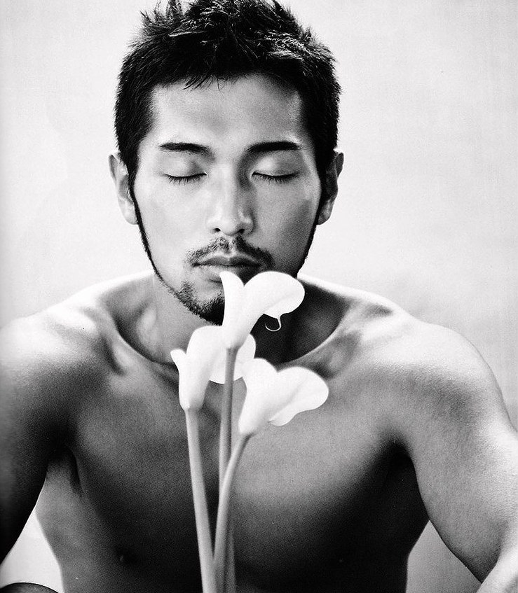
Masaki Koh
Masaki Koh was Japan's most famous gay porn star. He was openly gay, an activist and a proponent of safe sex. Koh was one of the only popular openly gay men in East Asia. He is featured on this list as an exception because of his stellar looks and importance for the Japanese queer community. He passed away on May 18, 2013 of peritonitis.

Slide 6
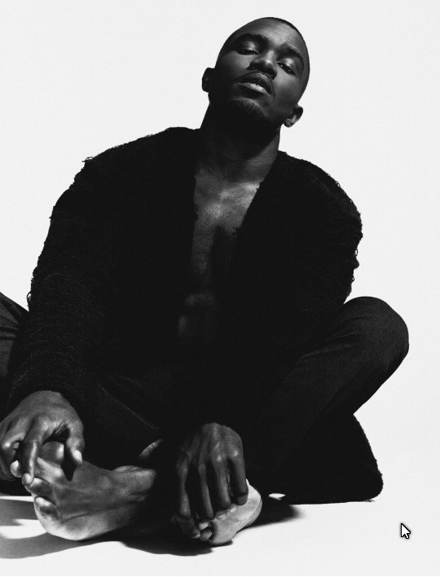
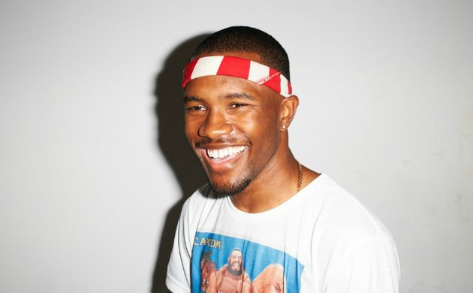
Frank Ocean
Frank Ocean is a popular American musician.

Slide 7
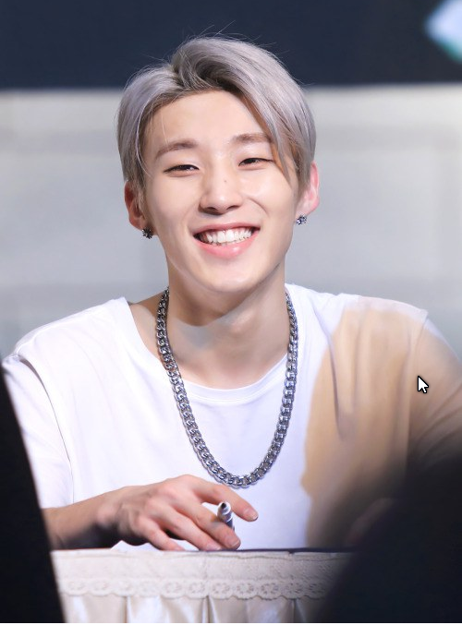
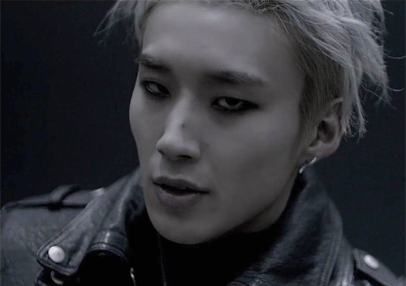
Moon Jong Up
Moon Jong Up, more commonly known by his stage name Jongup, is a member of South Korean K-Pop group B.A.P. He is the main dancer of the group.

Slide 8
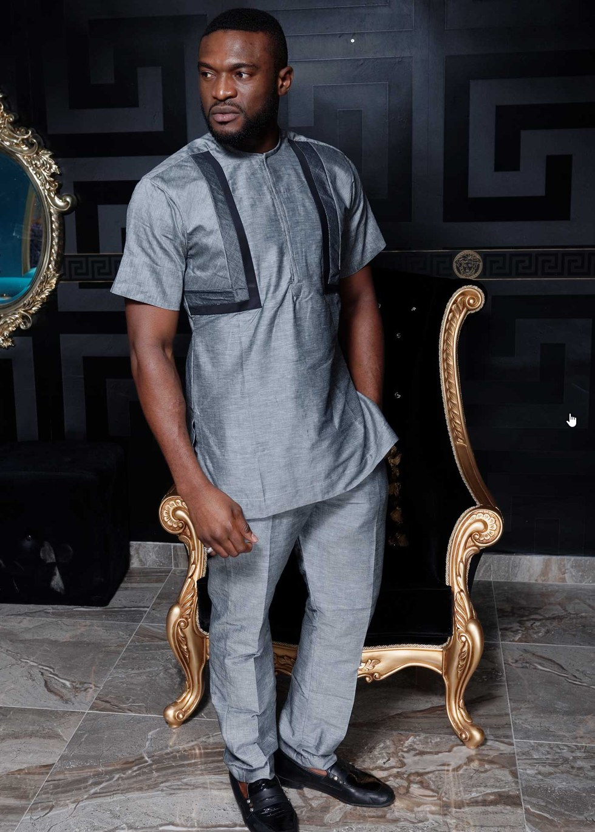
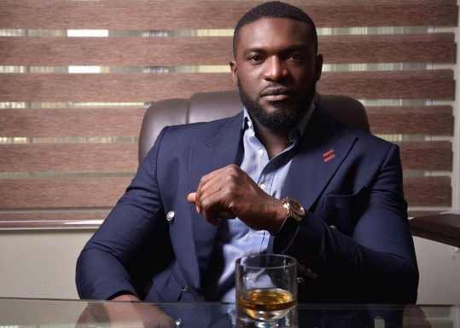
Kenneth Okolie
Kenneth Okolie is a Nigerian actor.

Slide 9
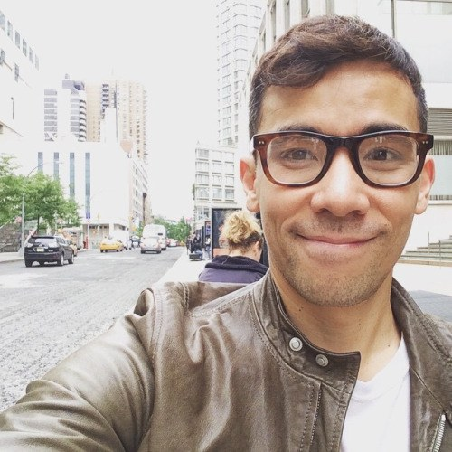
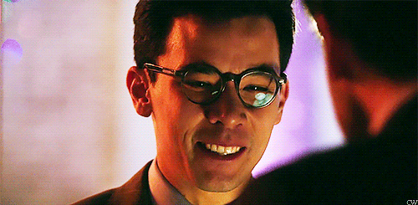
Condrad Ricamora
Conrad Ricamora is an American actor of Filipino and German descent. He is most famous for his role in the TV show How To Get Away With Murder.

Slide 10
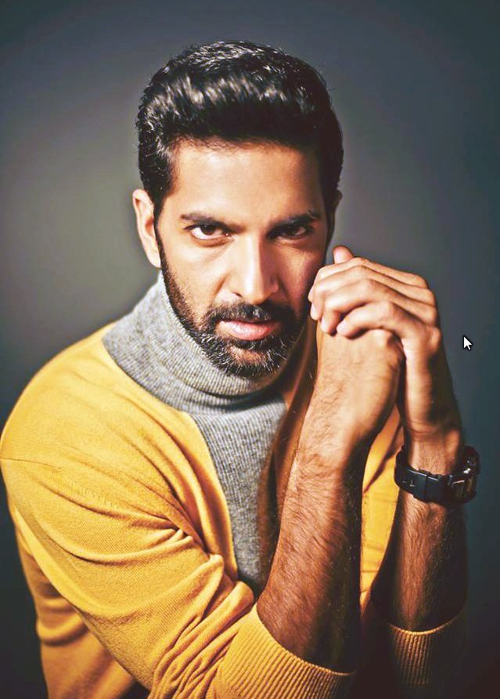
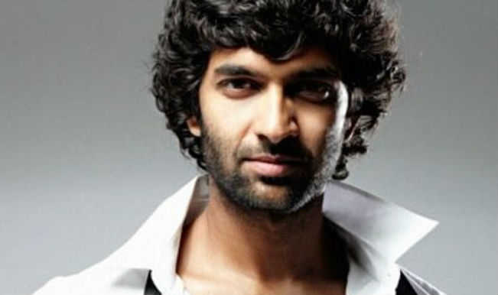
Purab Kohli
Purab Kohli is an Indian actor and celebrity. He recently starred in the Netflix show Sense8.

Slide 11
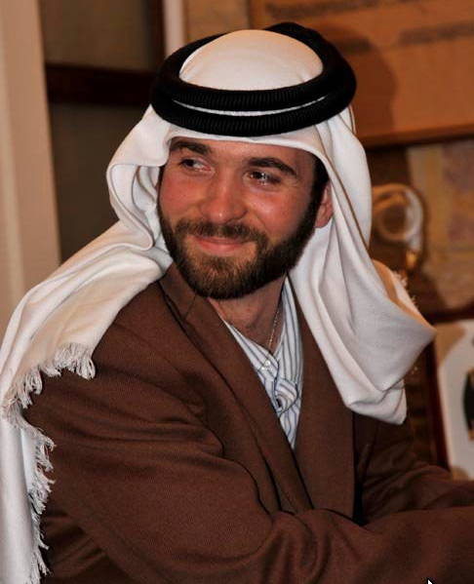
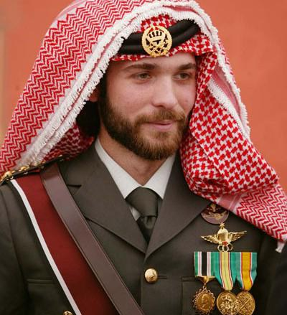
Prince Hashim bin Hussein of Jordan
Prince Hashim bin Hussein is one of the sons of Jordanian King Hussein and Queen Noor. He is in the line of succession for the throne.

Slide 12
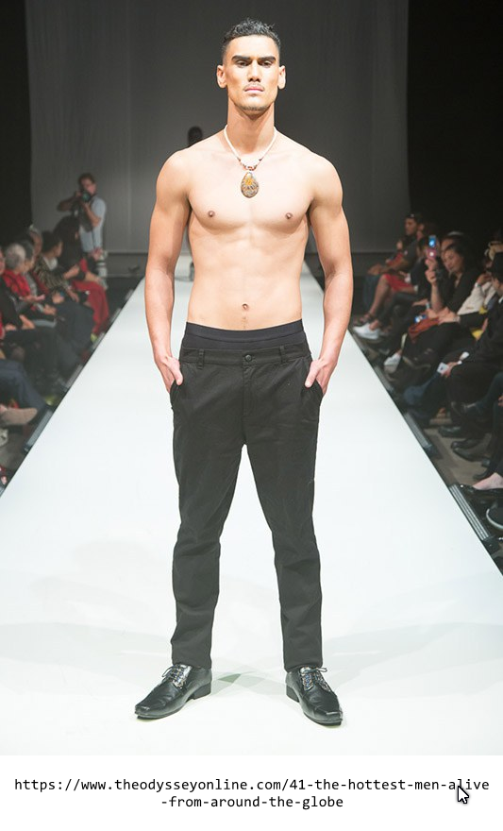
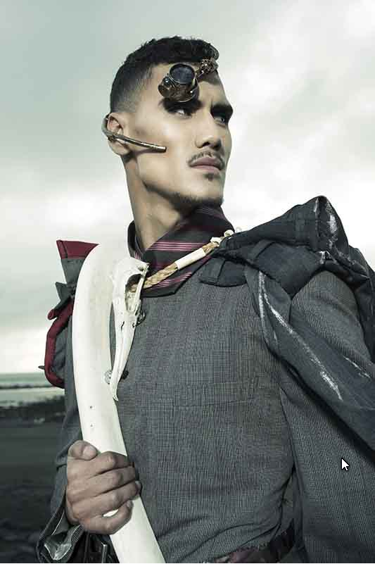
Jayden Flood
Jayden Flood is a model of Maori and Tongan descent. He and his brother model under Global Indigenous Management.

Slide 13
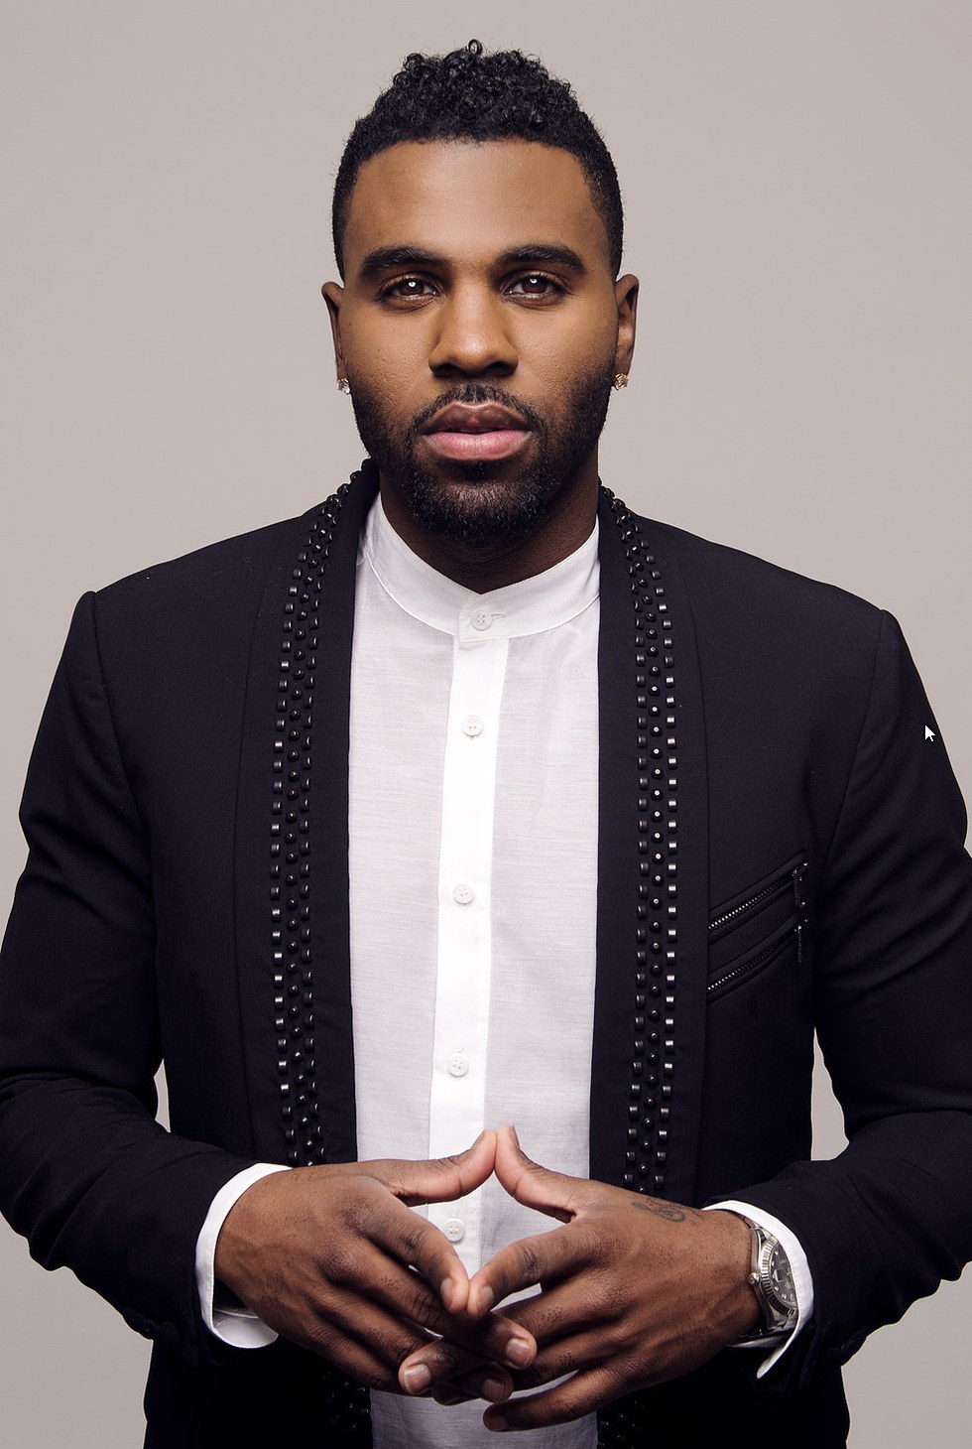
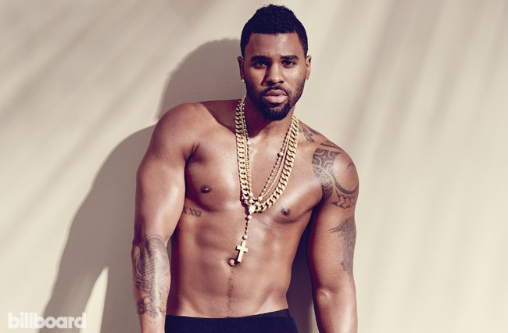
Jason Derulo
Jason Derulo is a famous American singer of Haitian descent.

Slide 14
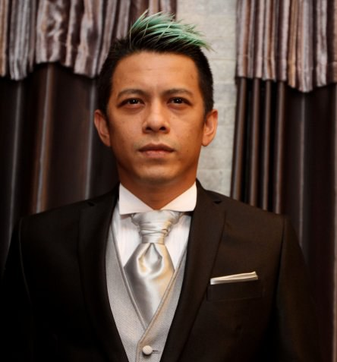
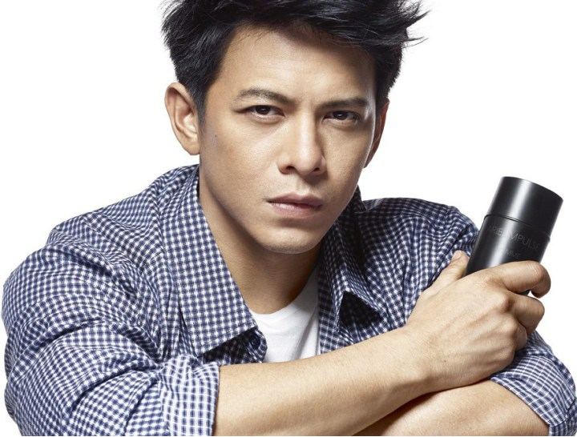
Nazril Irham
Nazril Irham, more commonly known as Ariel, is an Indonesian rock star. He is the founder of the group Noah. Ariel spent two years in prison after sex tapes with him leaked, and he was charged under Indonesian laws prohibiting pornography and adultery.

Slide 15
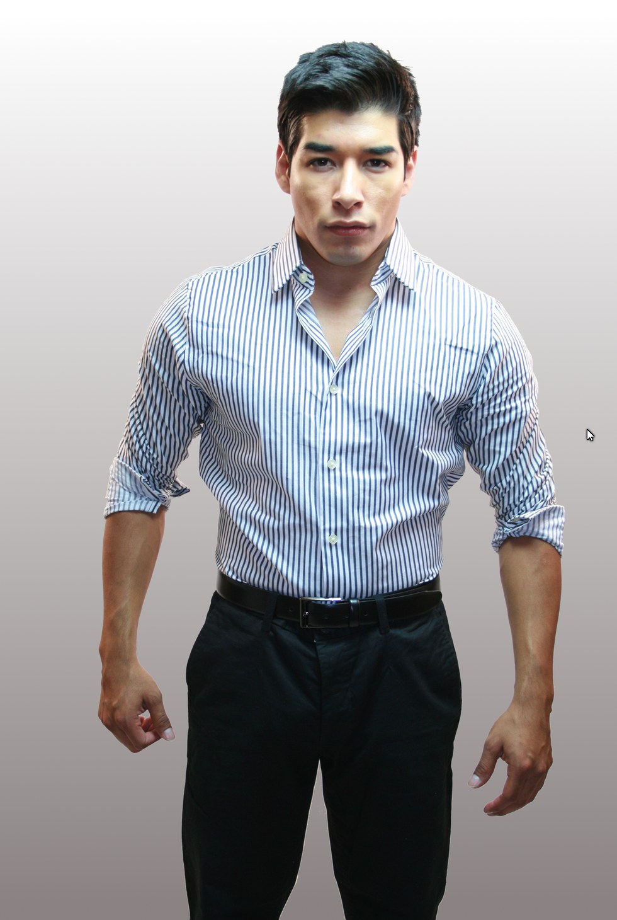
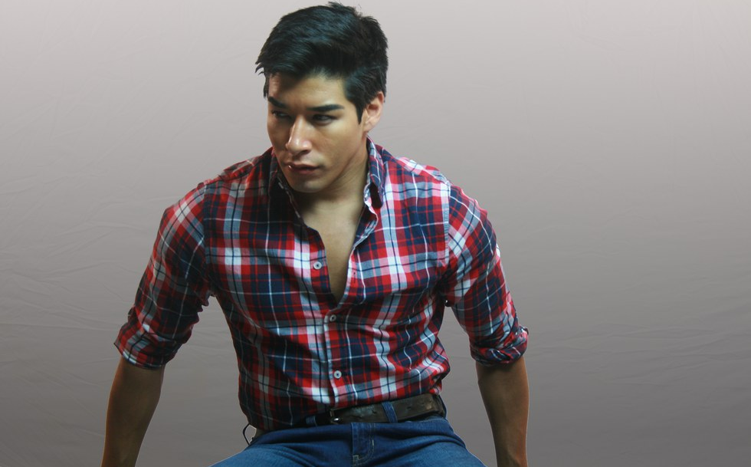
Andrew Orozco
Andrew Orozco is a Native American actor and model.

Slide 16
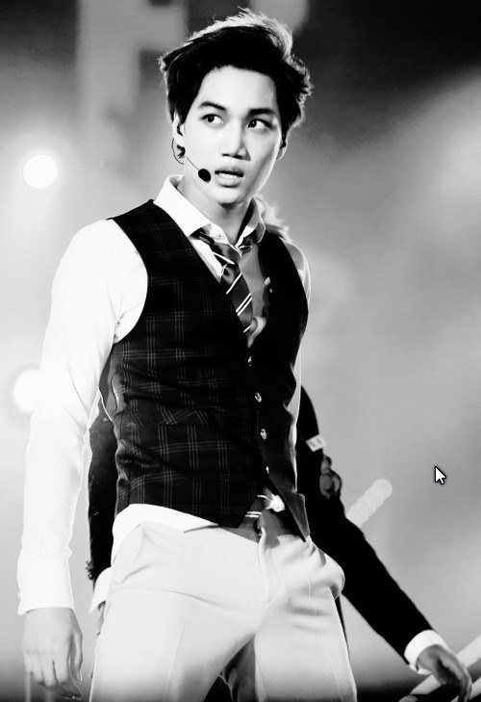
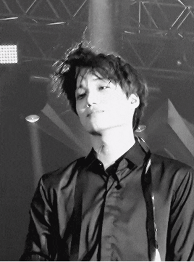
Kim Jong In
Kim Jong In, more commonly known by his stage name Kai, is the main dancer and visual of famous K-Pop group EXO. He is divine.

Slide 17
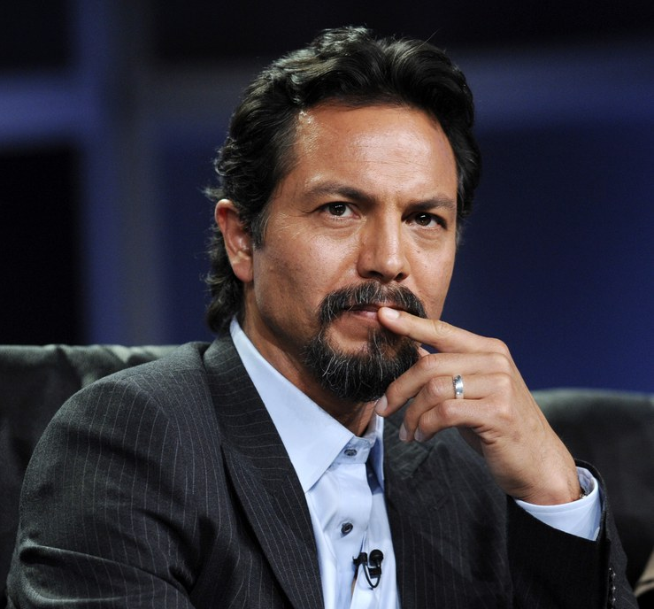
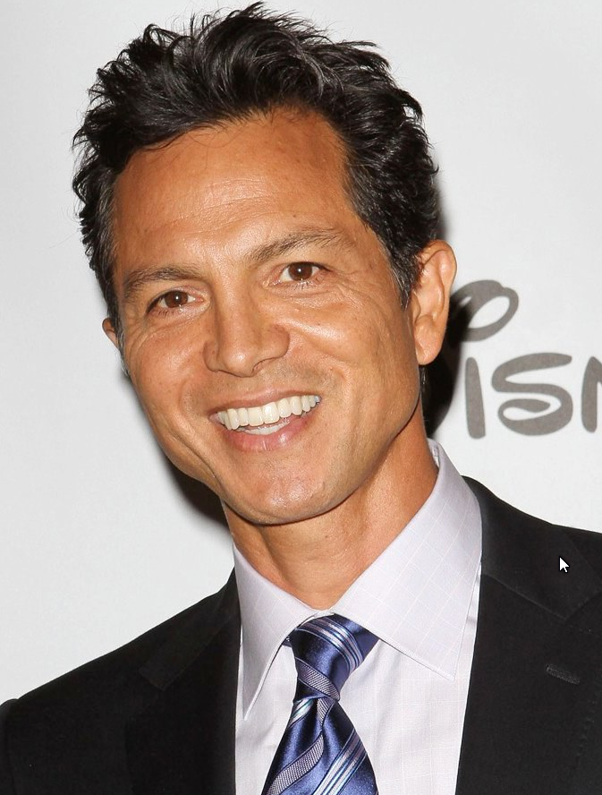
Benjamin Bratt
Benjamin Bratt is an American actor of Peruvian descent.

Slide 18
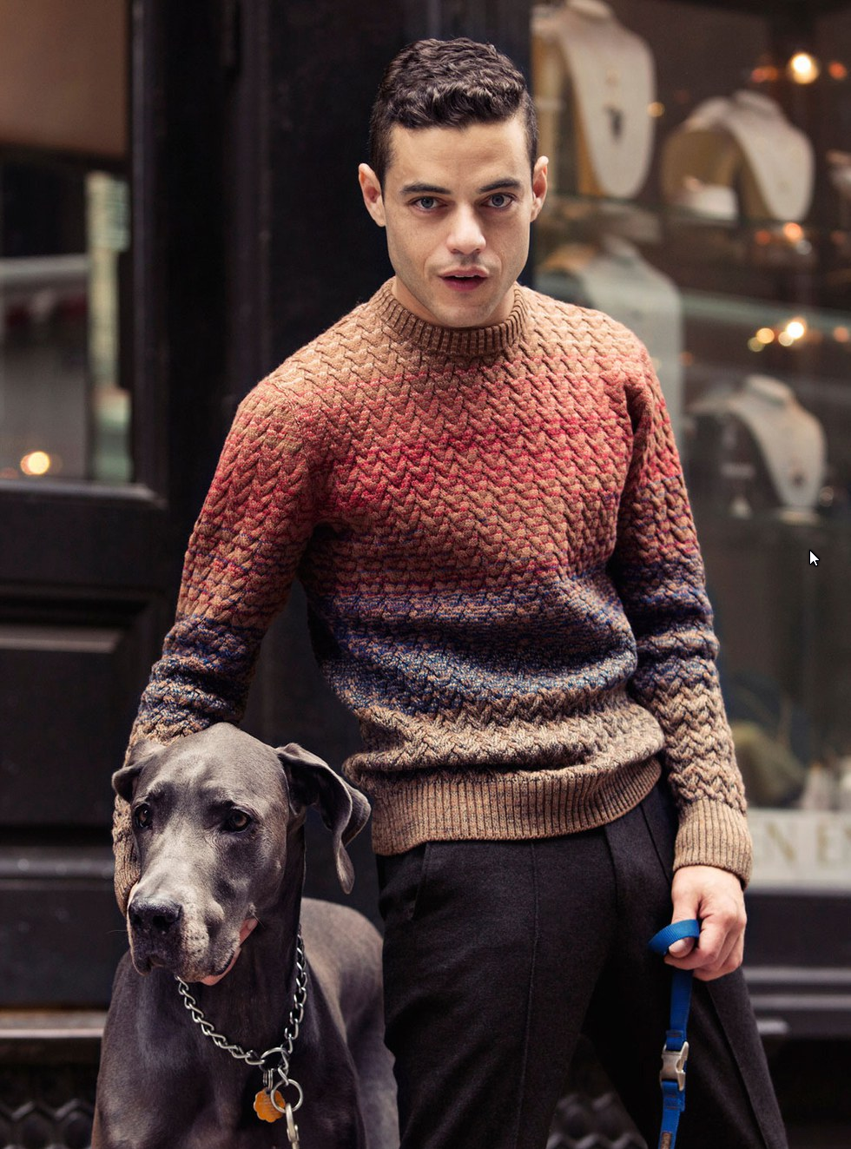
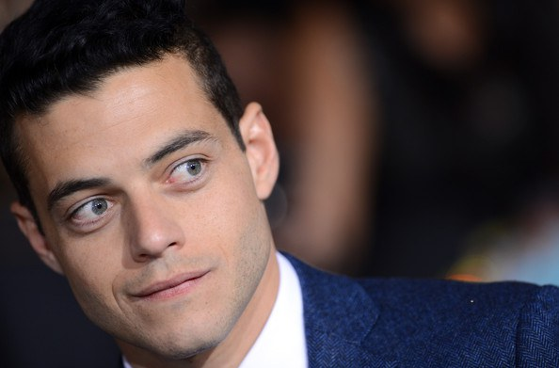
Rami Malek
Rami Malek is an American actor of Egyptian descent.

Slide 19
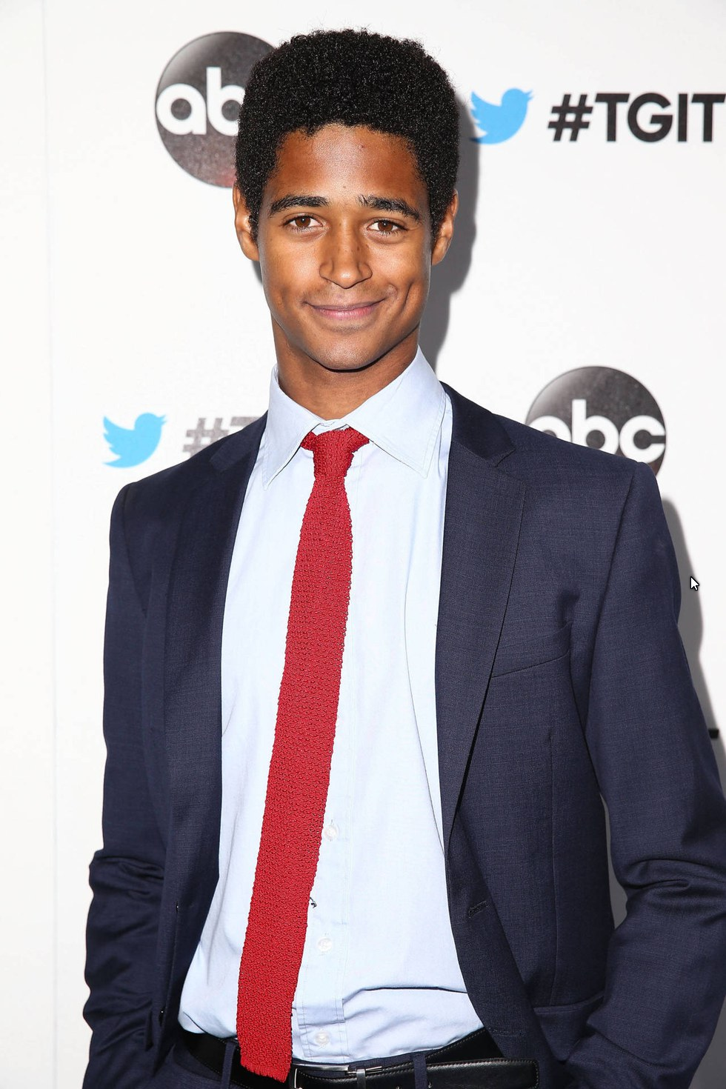
Alfred Enoch
Alfred Enoch is a British actor. He starred in the Harry Potter movies and is currently one of the leads in the TV show How To Get Away With Murder.

Slide 20
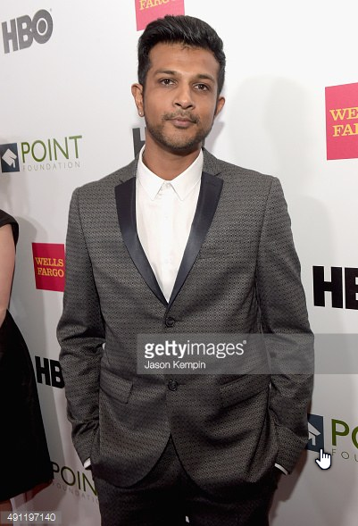
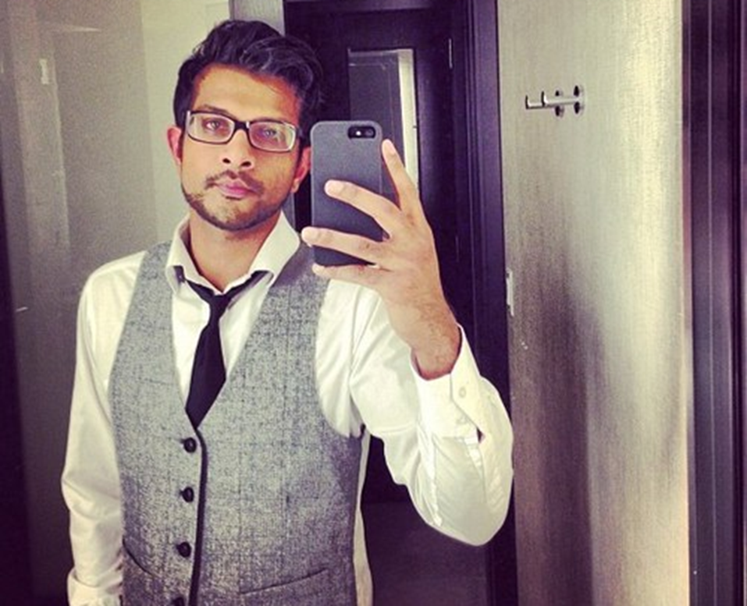
Utkarsh Ambudkar
Utkarsh Ambudkar is an American actor of Indian descent. He starred in Pitch Perfect.

Slide 21
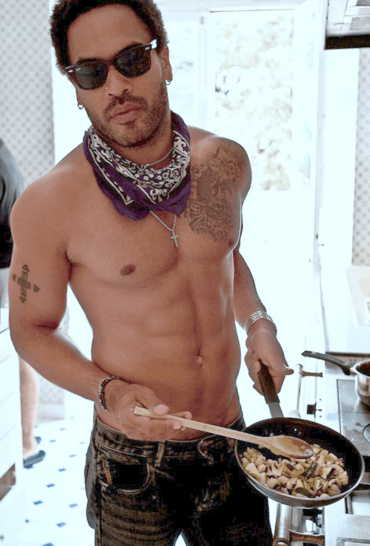
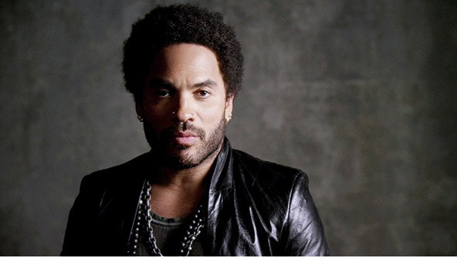
Lenny Kravitz
Lenny Kravitz is an American musician of Haitian and Ukrainian descent.

Slide 22
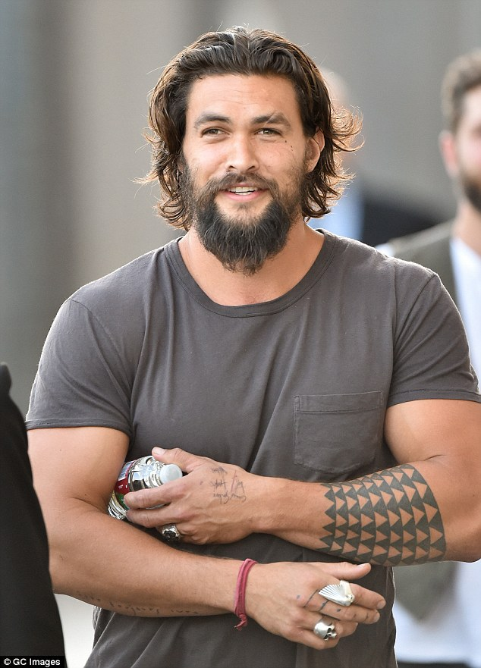
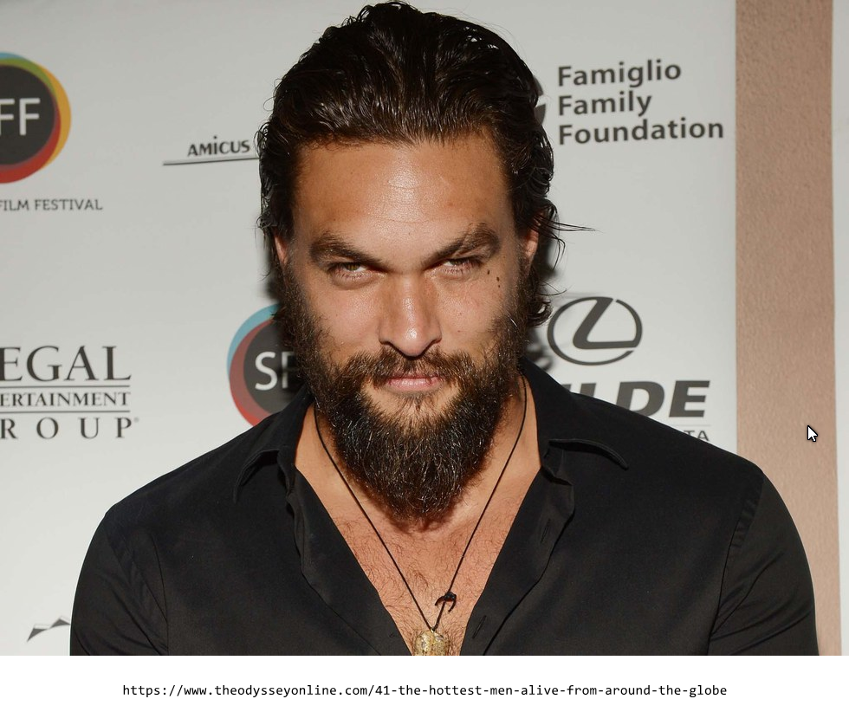
Jason Momoa
Jason Momoa is a Hawaiian actor. He is most famous for his role in Game of Thrones.

Slide 23
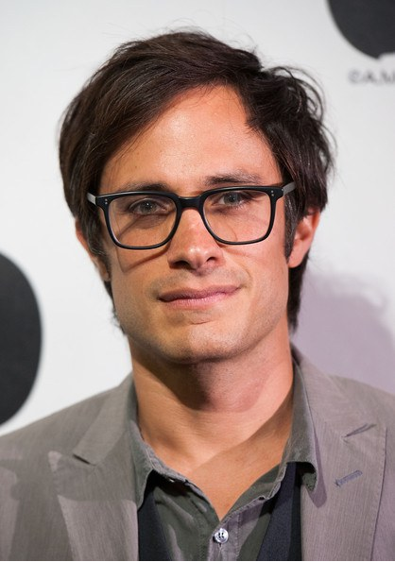
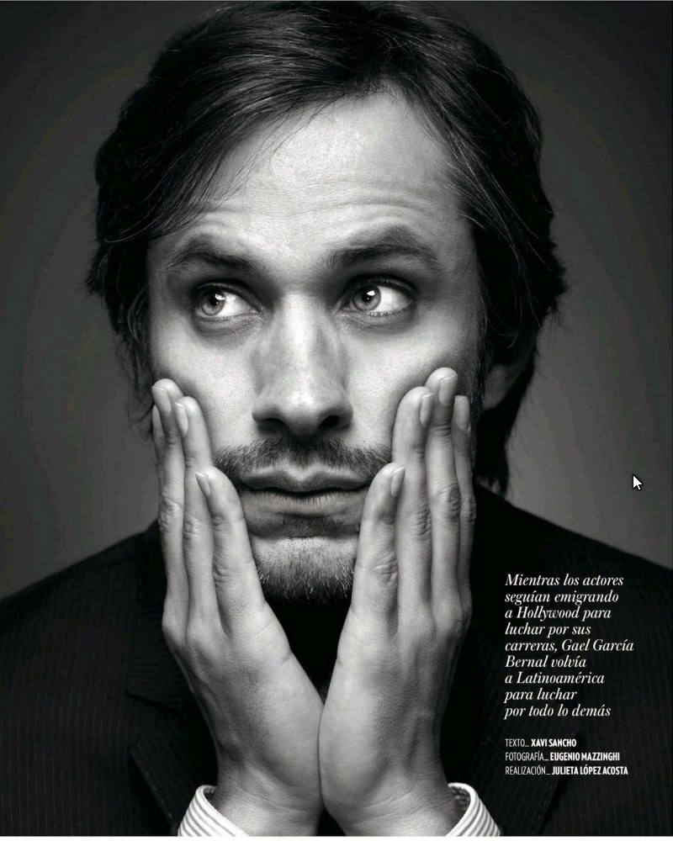
Gael Gabriel Garcia
Gael Garcia Bernal is a Mexican actor.

Slide 24
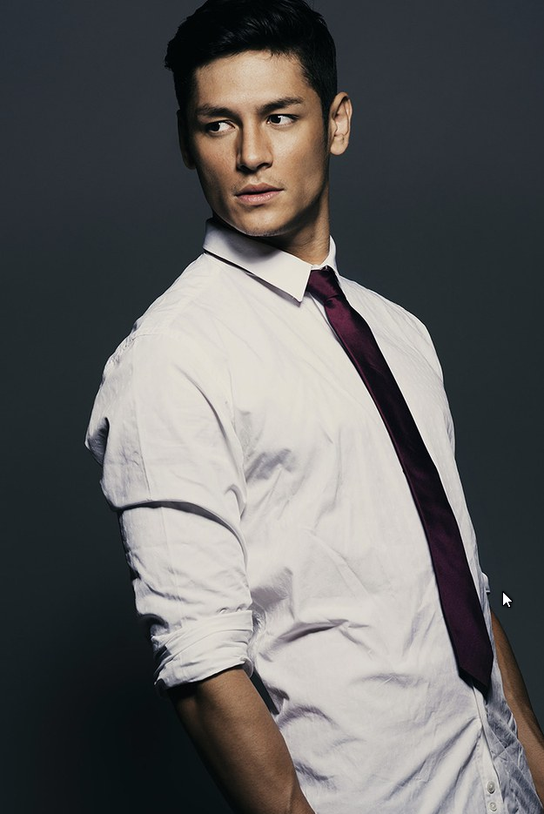
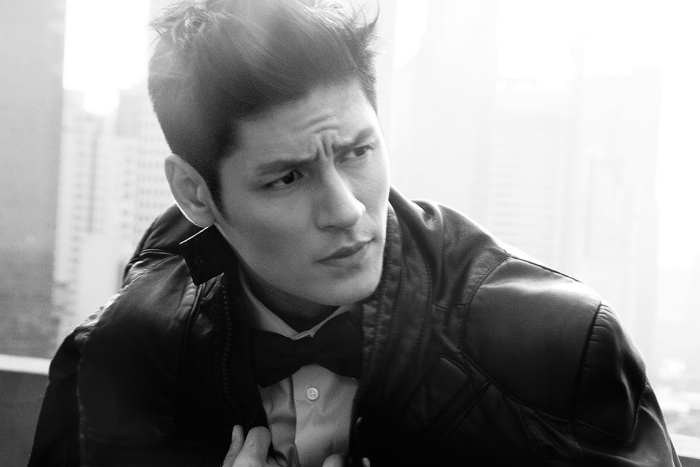
Hideo Muraoka
Hideo Muraoka is a Brazilian Japanese model.

Slide 25
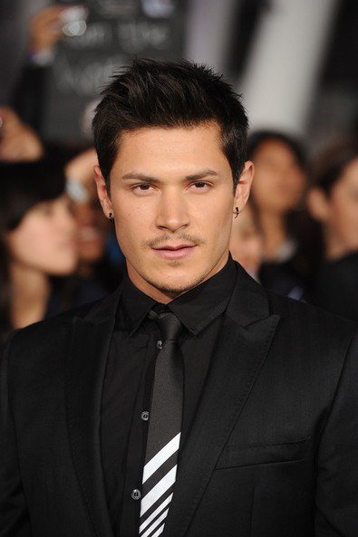
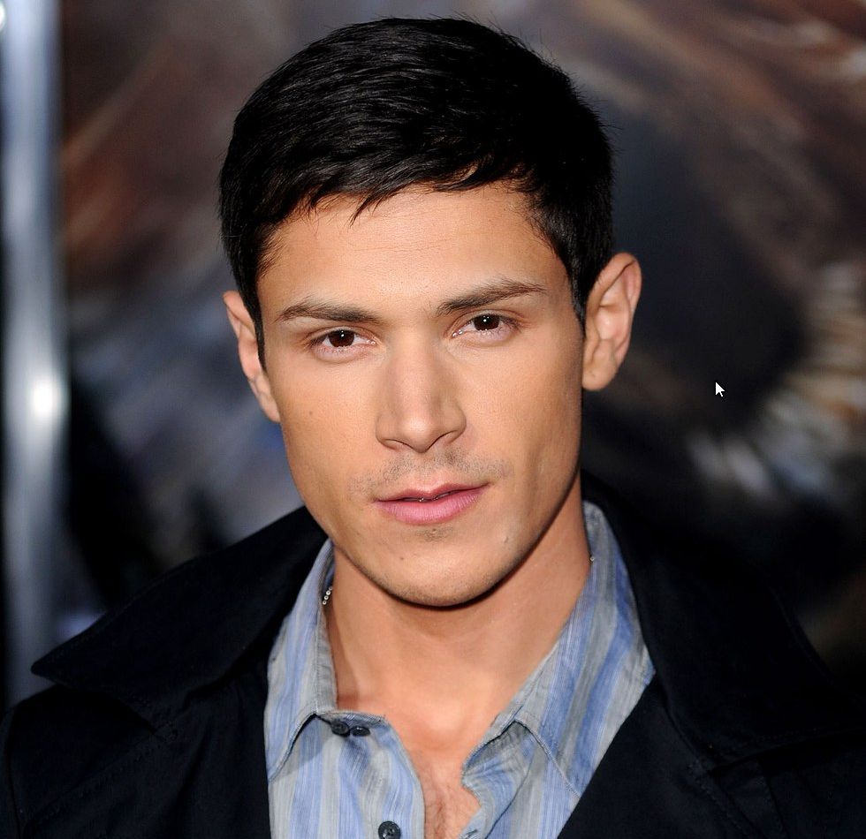
Alex Meraz
Alejandro Meraz is an American actor.

Slide 26
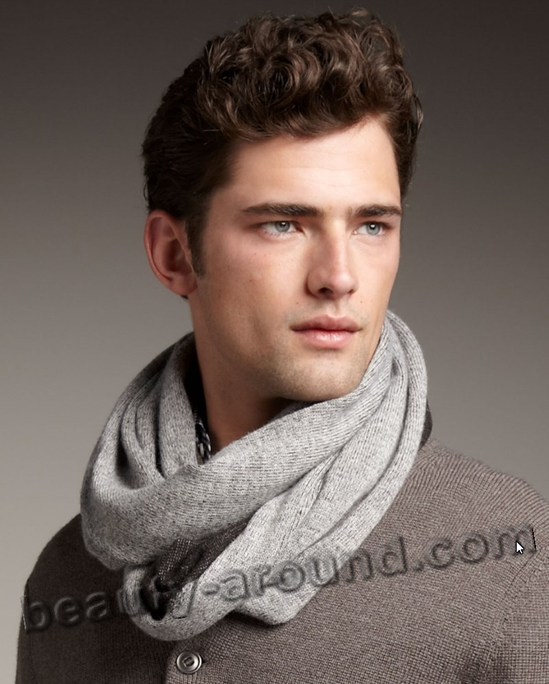
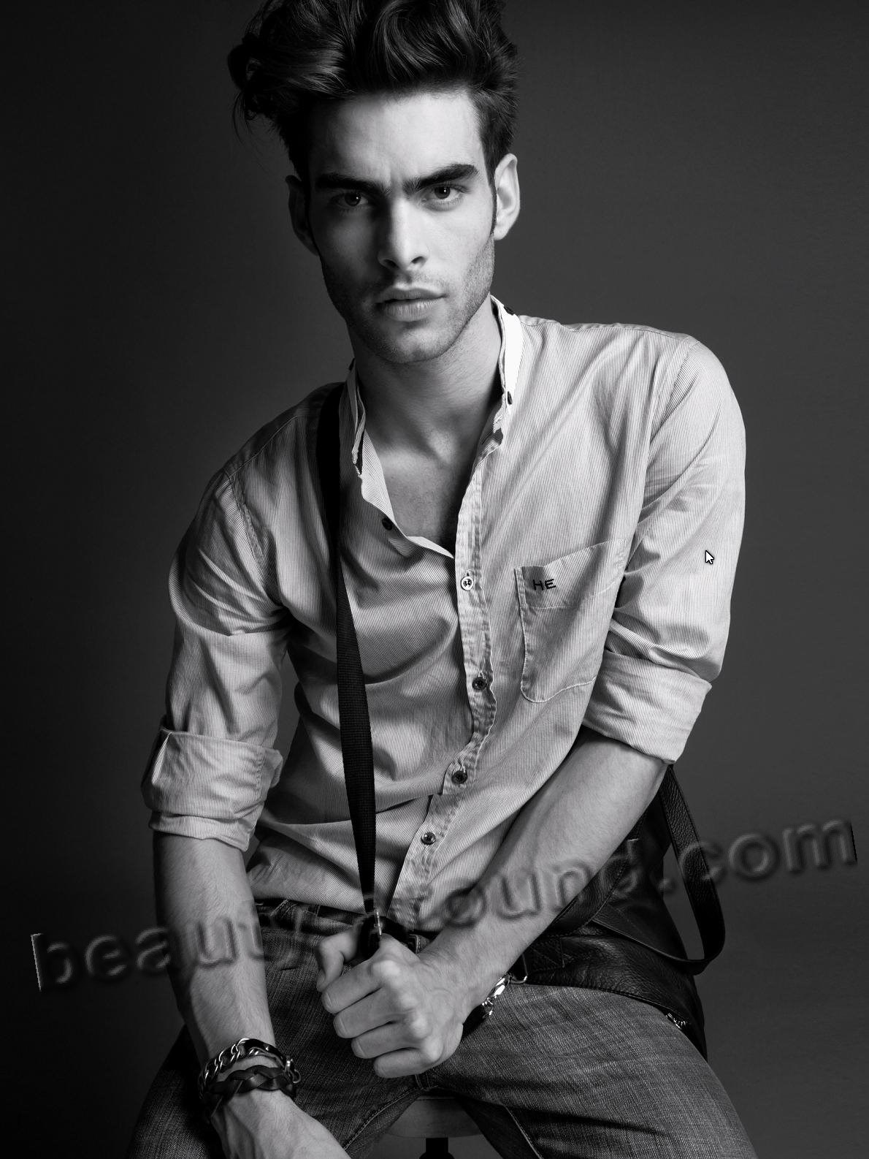
Sean O'Pry (5 July 1989) - American male model.
Jon Kortajarena (19 May 1985) - Spanish male model.

Slide 27
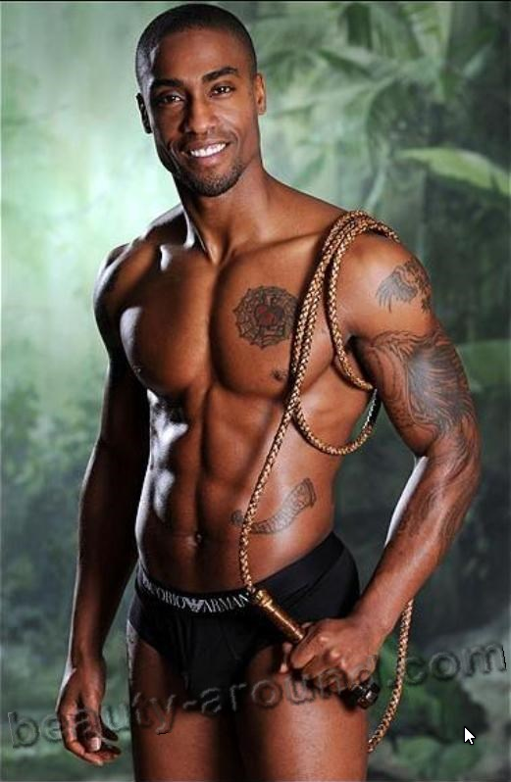
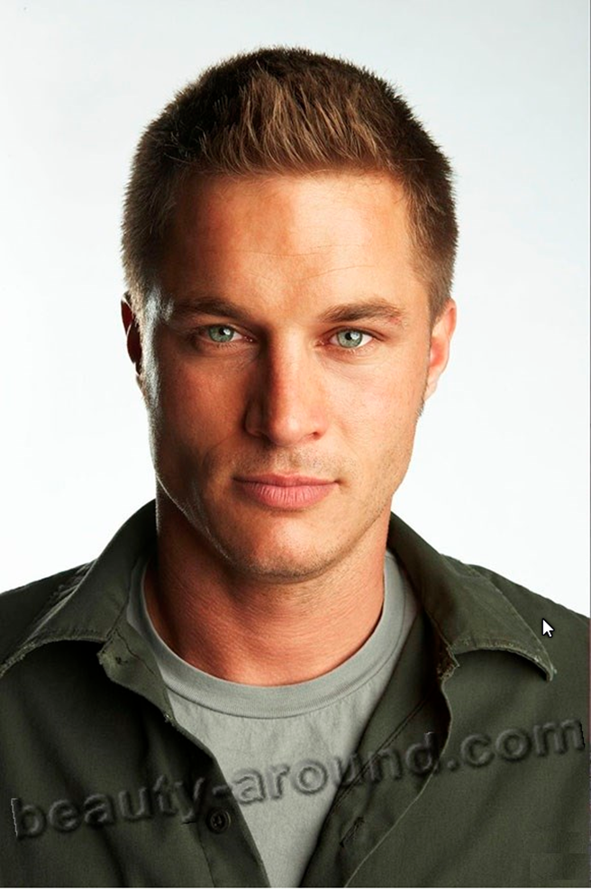
Simon Webbe (30 March 1979) - British singer.
Travis Fimmel (15 June 1979) - Australian acto

Slide 28
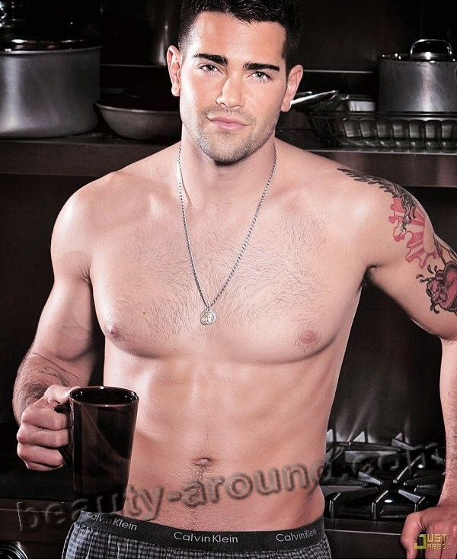
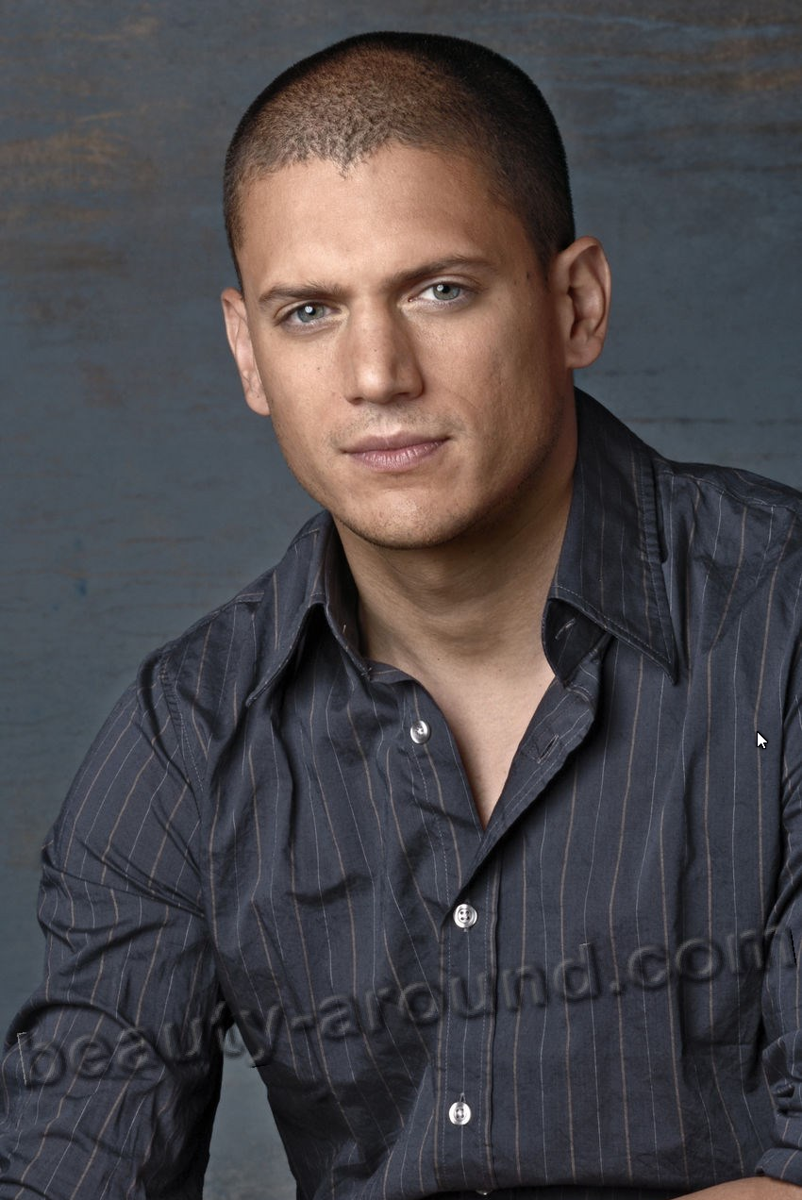
Jesse Metcalfe (9 December 1978) - American actor
Wentworth Miller (2 June 1972) - American actor.

Slide 29


Prithviraj Sukumaran (16 October 1982) - South-Indian actor.
Channing Tatum (26 April 1980) - American actor.

Slide 30


Marlon Teixeira (16 September 1991) - Brazilian model.
Maximiliano Iglesias (6 February 1991) - Spanish actor.

Slide 31


David Entinghe (1984) - male model fron USA.
Sheikh Hamdan bin Mohammed bin Rashid Al Maktoumm (13 November 1982) - Crown Prince of Dubai.

Slide 32



Slide 33



Slide 34



Slide 35


Slide 36


Slide 37



Slide 38


Slide 39


Slide 40


