Slide 1
God's Chosen People: Interesting Facts About Judaism

Slide 2
Keep this in mind . . .
There are differences among the branches of Judaism – many Jewish people may not ascribe to all of these beliefs and/or practices. In Judaism, there are different branches:
  Orthodox Judaism – the most strictly Biblical and yet there are differences among Orthodox Jews from the ultra-orthodox to the just orthodox
  Conservative Judaism
  Reformed Judaism – the most liberal Jews
There is no leader or leadership group among Rabbis who exercise authority over all Jewish branches.

Slide 3
2000 years ago there were different branches of Judaism with varying opinions on a number of beliefs, so lack of uniformity in belief isn’t something new in Judaiam.
Sadducees who were aligned with the temple hierarchy. They did not believe in the resurrection of the dead at the end of time
Pharisees who were more associated with synagogue services an did believe in the resurrection of the dead at the end of time. They were very legalistic in their approach to religion.
Zealots who wanted to drive out the Romans and their influence in the “Holy Land.I” They were looking for a militaristic type of messiah, like King David or the Maccabees, to lead rebellion.
Essenes who were a small sect of somewhat monastic Jews who lived without sexual relations near Qumran.

Slide 4
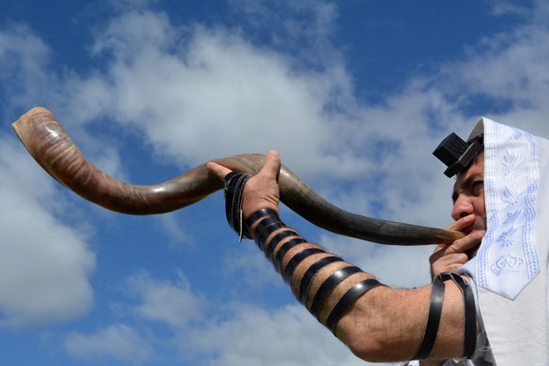
Judaism was the world's first monotheistic and Abrahamic religion. Its long history has given way to many movements and nuances within the tradition. Here we explore some of the common threads of Jewish belief and practice.

Slide 5
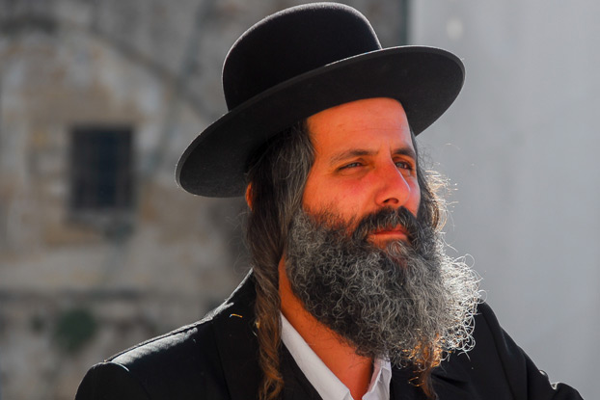
Judaism emphasizes relationships between God, humanity, and Israel.

Slide 6
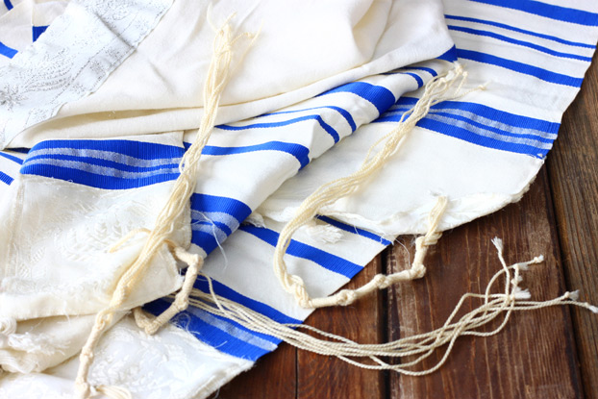
Judaism is a nearly 4,000-year-old religion that includes a wide range of theological beliefs, practices, and movements—most of which today are expressed in Rabbinic Judaism, the mainstream form of the religion since the 6th century CE.

Slide 7

Jews believe that God made a promise to Abraham: That he and his lineage would be made a sacred people and be given a Holy Land.

Slide 8
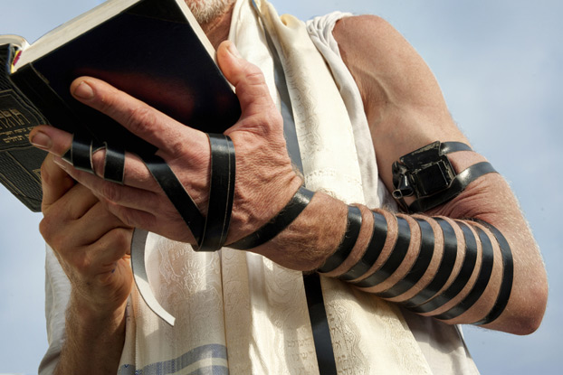
Jews believe that God appointed them to serve as the chosen people who would demonstrate an example of holiness and ethical behavior to humankind.

Slide 9
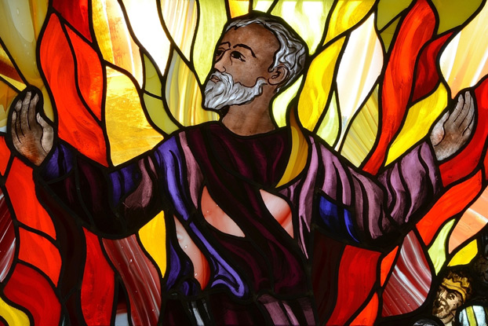
Abraham, Isaac, and Jacob are the patriarchs of Judaism and play a prominent role in scripture.

Slide 10
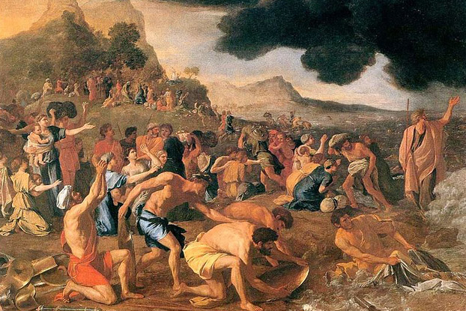
Moses is also a main figure. According to the Bible, Moses freed the Jews from Egyptian slavery, and then the people of Israel wandered in the Sinai desert for 40 years before conquering Canaan in 1400 BCE under the command of Joshua.

Slide 11
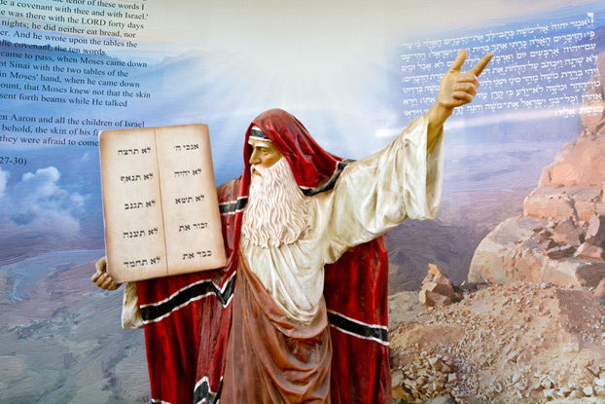
While living in the desert, Moses received the Ten Commandments at Mount Sinai from God.

Slide 12
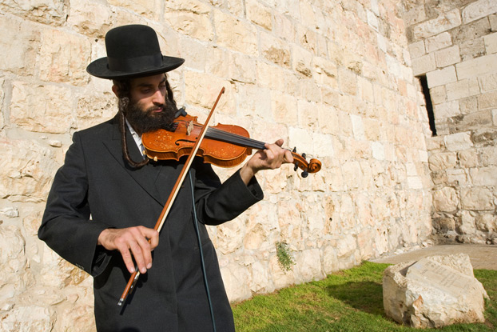
Jewish people are also considered an ethno-religious group. They descend from the Israelites, or Hebrews, of the Ancient Near East. Jewish ethnicity, culture, nationality, and religion are closely interwoven.

Slide 13
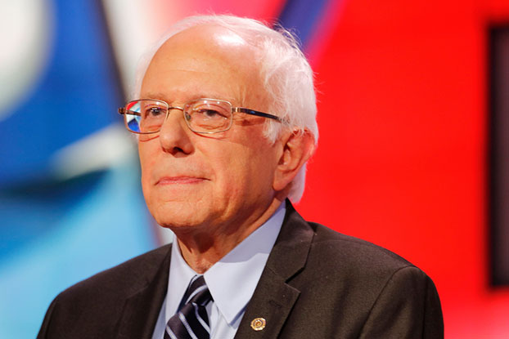
Judaism is comprised of different sects, including Conservative Judaism, Orthodox Judaism, Hasidic Judaism, and Reform Judaism. Non-religious Jews, like Bernie Sanders, sometimes identify as "secular Jews."

Slide 14
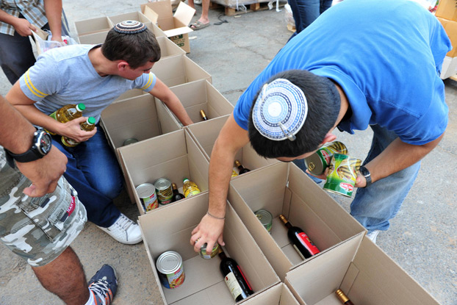
Judaism is a faith of action and Jews believe people should be judged by the way they live their faith, not by the content of their beliefs. Observant Jews strive to make every aspect of their lives holy in some way.

Slide 15
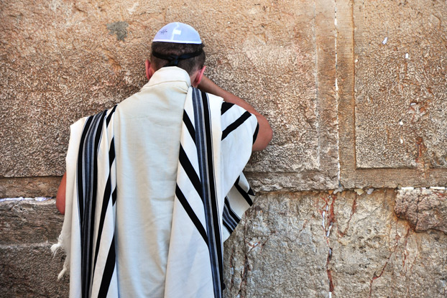
Jews believe that God is the sole creator of the universe, and that He can have an individual and personal relationship with Jews and non-Jews alike.

Slide 16
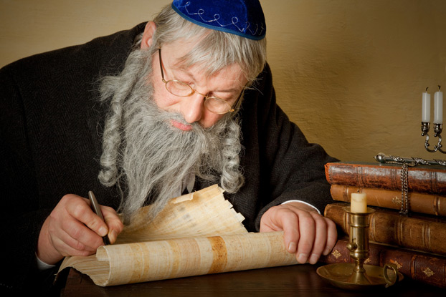
God’s name is considered holy and must be treated with the utmost respect according to Jewish law and tradition. “God” is often written as “G-d” in mediums that can be discarded, such as paper or in a computer document.

Slide 17
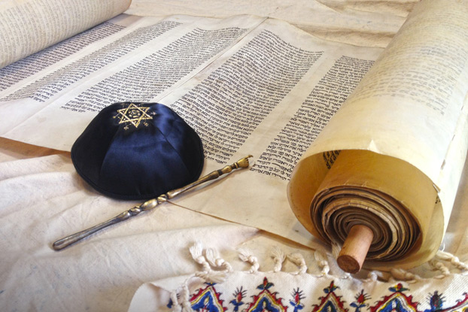
Judaism's central and most important religious document is the Torah, which contains 613 commandments. The Halakhah is the oral interpretation of the Torah. (the first five books in the Christian scriptures)

Slide 18
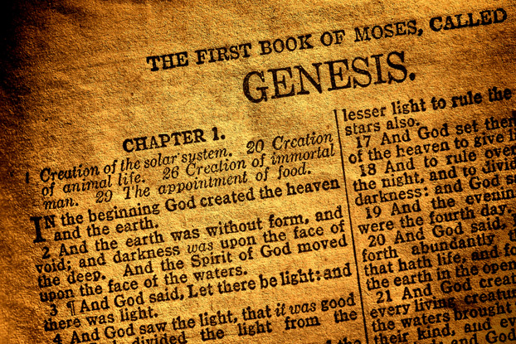
The Torah, also called the Pentateuch, consists of the first five books of the Bible: Genesis, Exodus, Leviticus, Numbers, and Deuteronomy.

Slide 19
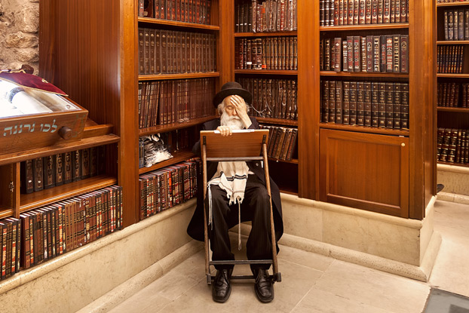
The Talmud, which often cites the Hebrew scriptures, is the basic book of Jewish law.

Slide 20

The practice of Jewish law is intended to serve as a foundation for a meaningful life and to bring a person closer to God and with their community. It guides dietary restrictions, worship practices, and more. However, adherence ranges from strict observance to not at all.

Slide 21
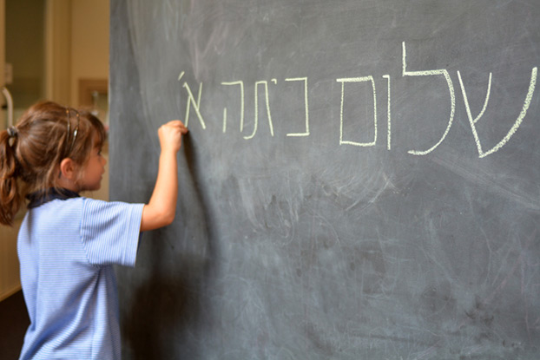
Hebrew is the liturgical language of Judaism.

Slide 22
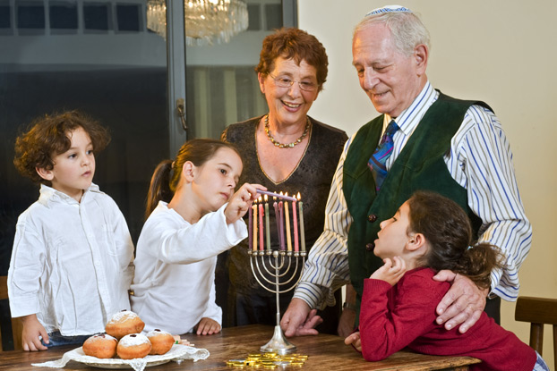
Judaism’s spiritual leaders are called Rabbis, and Jews worship in Synagogues. Many Jewish religious customs, however, take place in the home.

Slide 23
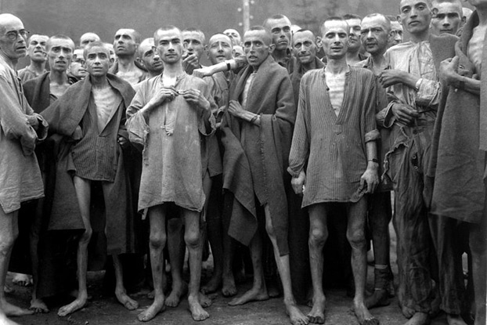
From January 30, 1933 to May 8, 1945, six million Jews were murdered in the Holocaust in Nazi Germany's systemic attempt to wipe out Judaism.

Slide 24
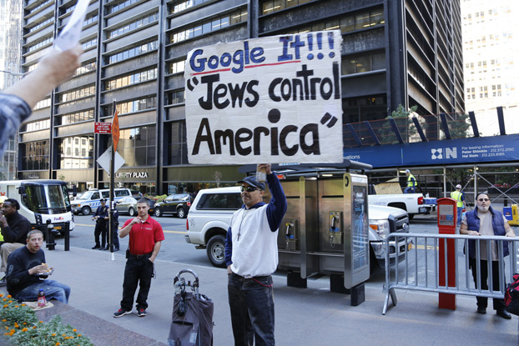
Many scholars trace the roots of modern antisemitism to both Pagan antiquity and early Christianity. Jewish religious leaders and sociologists acknowledge that Jewish identity has been profoundly influenced by antisemitism.

Slide 25
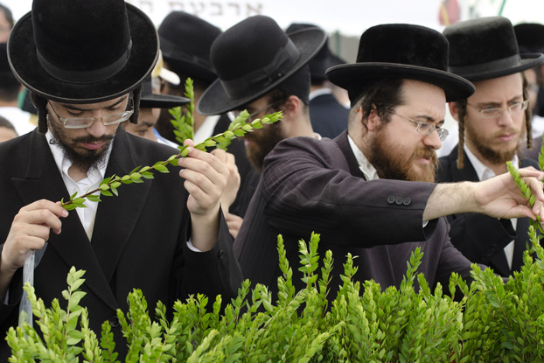
Jewish holidays recognize important events in history, important times of the year, and important times in people's lives.

Slide 26
Jewish holidays include Shabbat, Passover, the Festival of Booths, the Festival of Trees, Purim, and the Days of Awe which include 10 days beginning on Rosh Hashanah and ending on Yom Kippur (which is considered the most significant holiday).

Slide 27
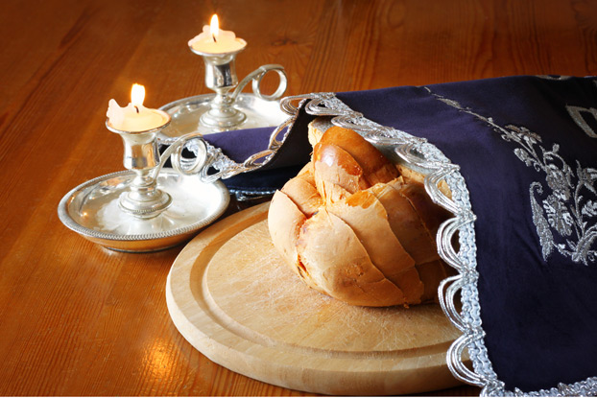
Shabbat or Sabbath is Judaism's day of rest and seventh day of the week. Shabbat begins a few minutes before sunset on Friday evening and lasts until three stars appear in the sky on Saturday night. There are 39 categories of prohibited activities on Shabbat.

Slide 28
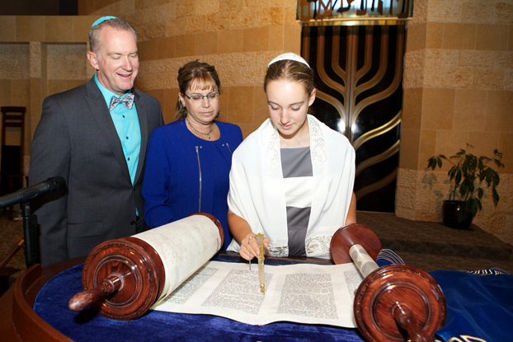
When a Jewish boy turns 13 or a Jewish girl turns 12, they celebrate their Bar or Bat Mitzvah. This is a rite of passage leading into adulthood.

Slide 29
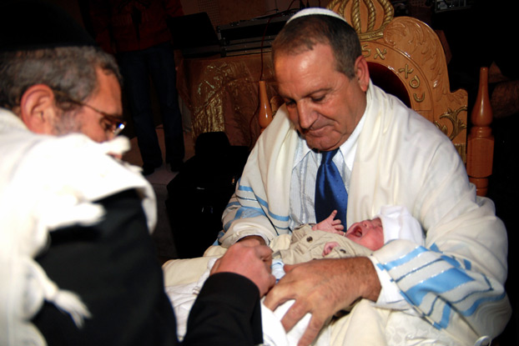
Jewish infant boys are circumcised at 8-days-old, following the instructions that God gave to Abraham.

Slide 30
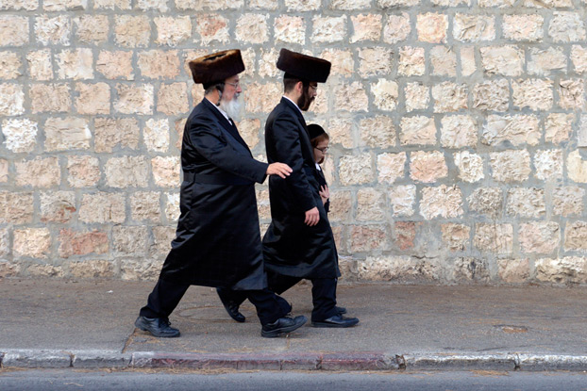
Jews do not proselytize because they do not believe that one must be a Jew to appease God. Sincere conversions to Judaism are permitted.

Slide 31
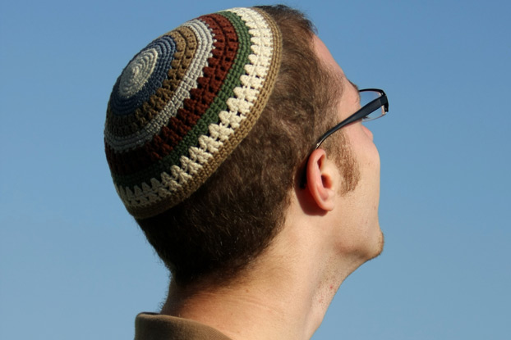
Jewish religious clothing includes the kittel (white garment worn on High Holy Days), yarmulke (brimless skullcap), tallit (prayer shawl) and tzitzit (tassels on the tallit's corners), and tefellin (leather boxes worn on the head and arms during morning prayers).

Slide 32
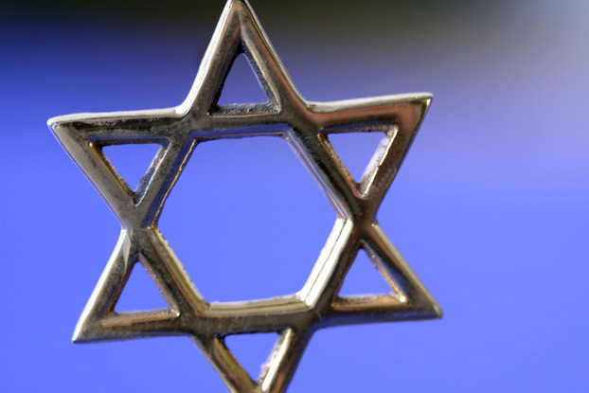
The political and religious symbol of Judaism is the Star of David. The star actually has no particular Jewish significance. The symbol's popularity grew after the First Zionist Congress in 1897, where it was chosen for the flag of the future State of Israel.

Slide 33
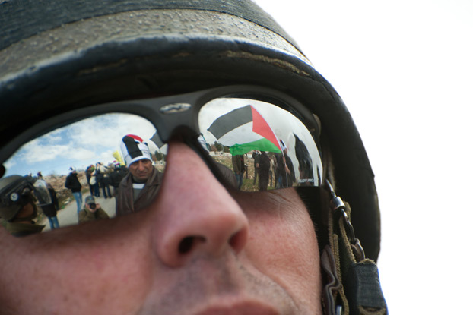
The Israeli-Palestinian conflict is rooted in a dispute over land claimed by Jews as their biblical birthright and by Palestinians, who hail from the land Israel now controls.

