Slide 1
Funny Thanksgiving Family Photos and menus

Slide 2


Slide 3
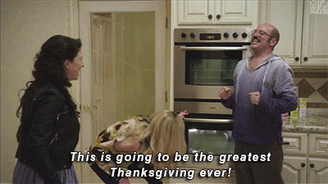

Slide 4
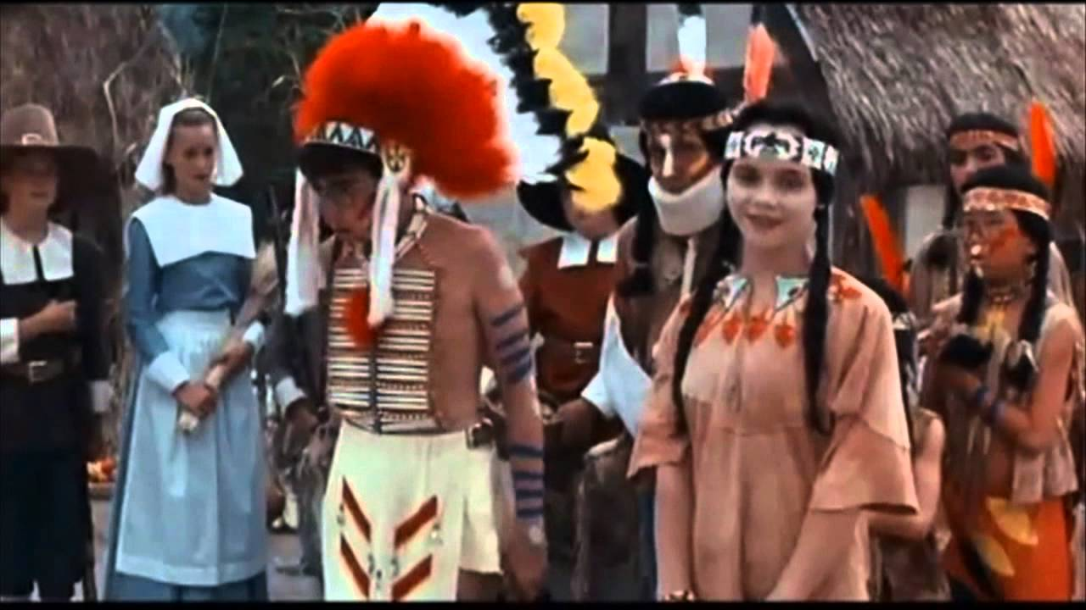

Slide 5
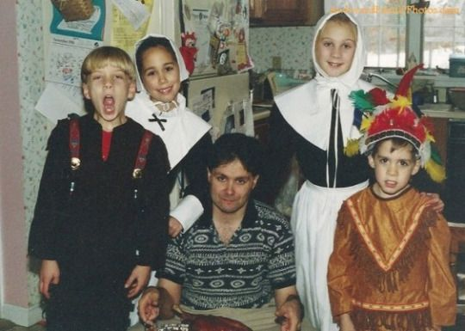

Slide 6
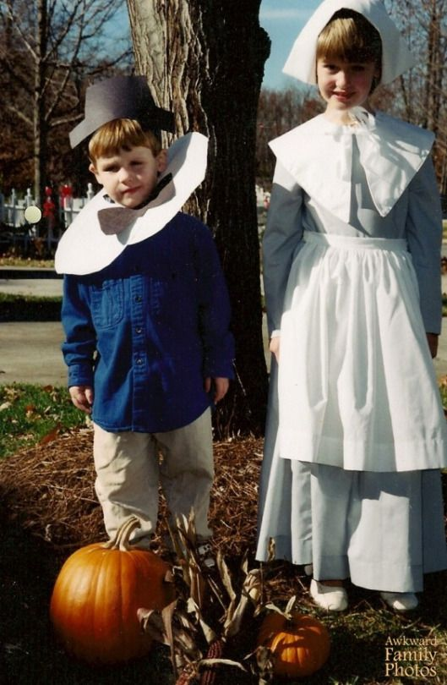

Slide 7
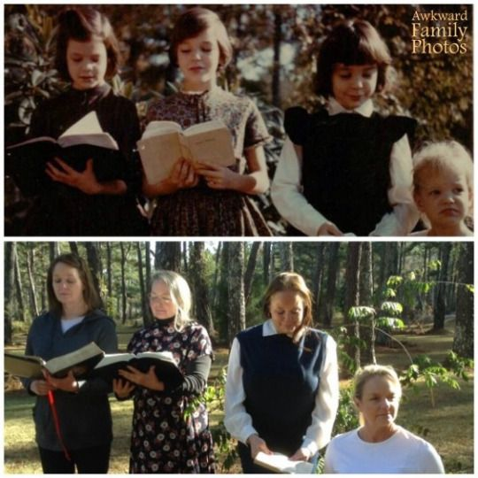

Slide 8
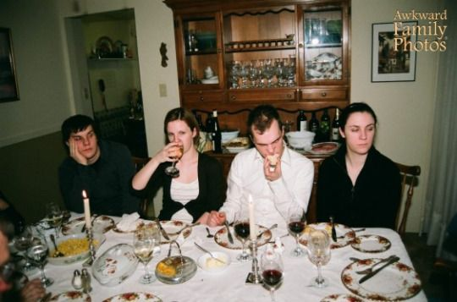

Slide 9
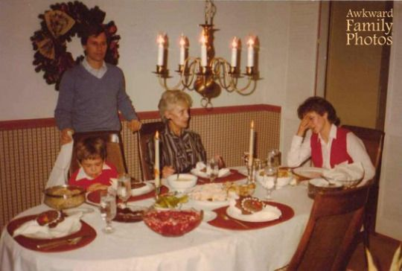

Slide 10
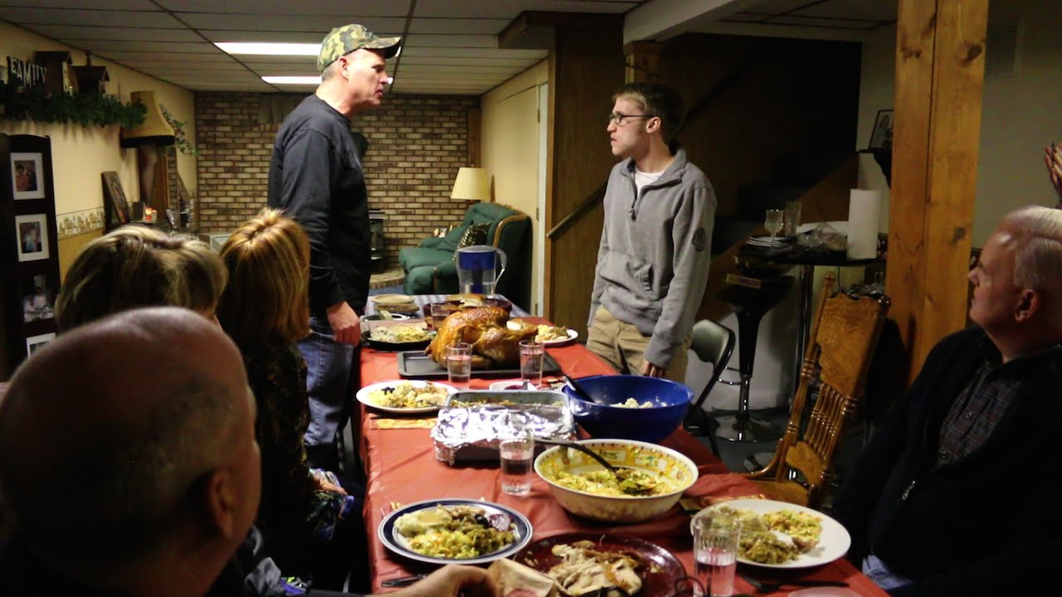

Slide 11
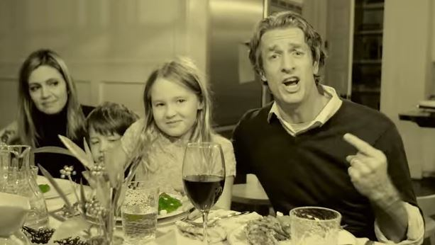

Slide 12
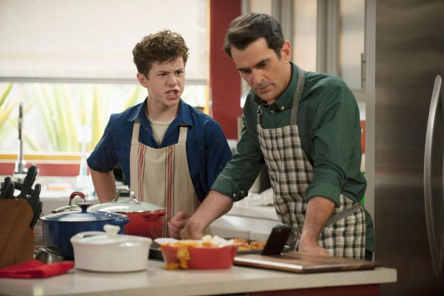

Slide 13
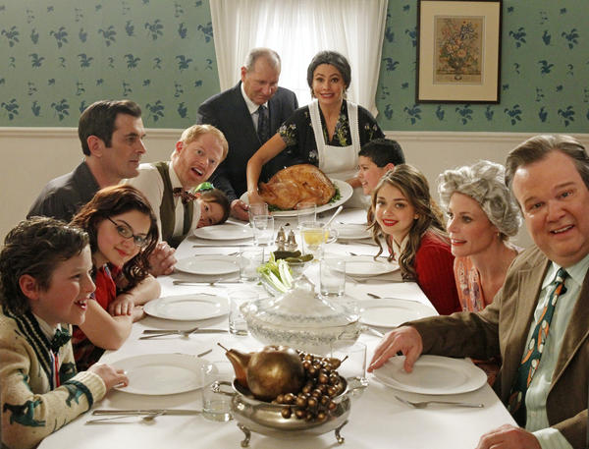

Slide 14
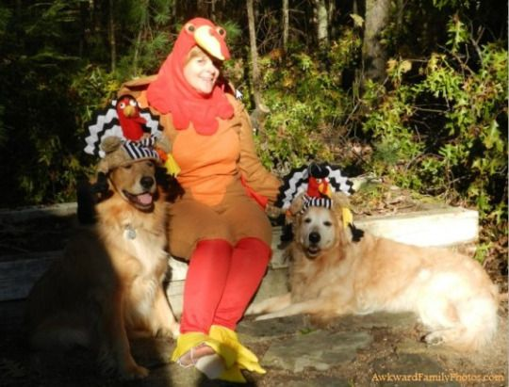

Slide 15
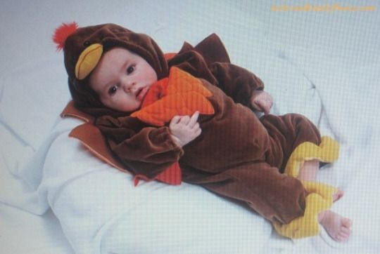

Slide 16
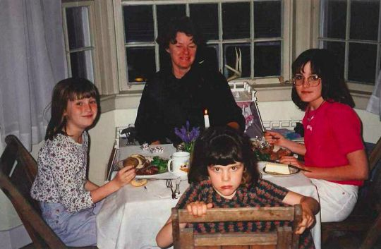

Slide 17
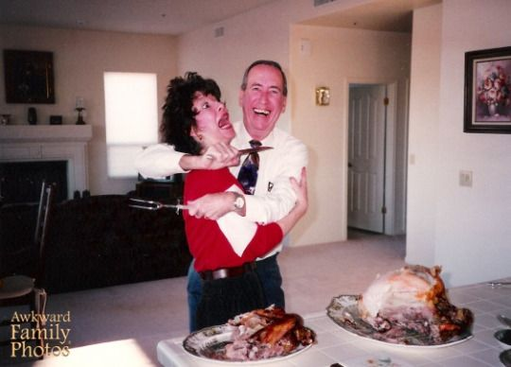

Slide 18
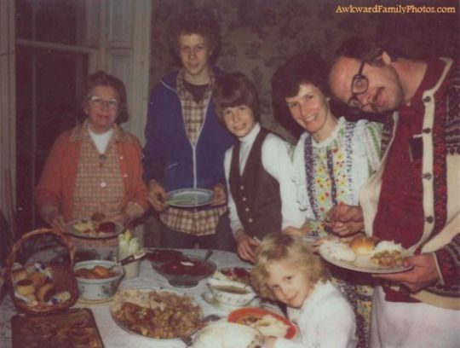

Slide 19
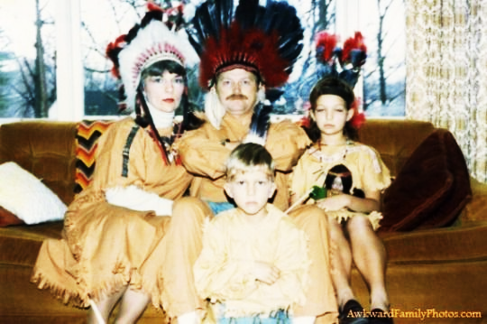

Slide 20
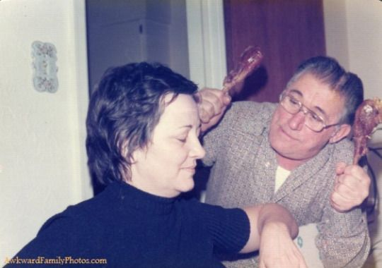

Slide 21
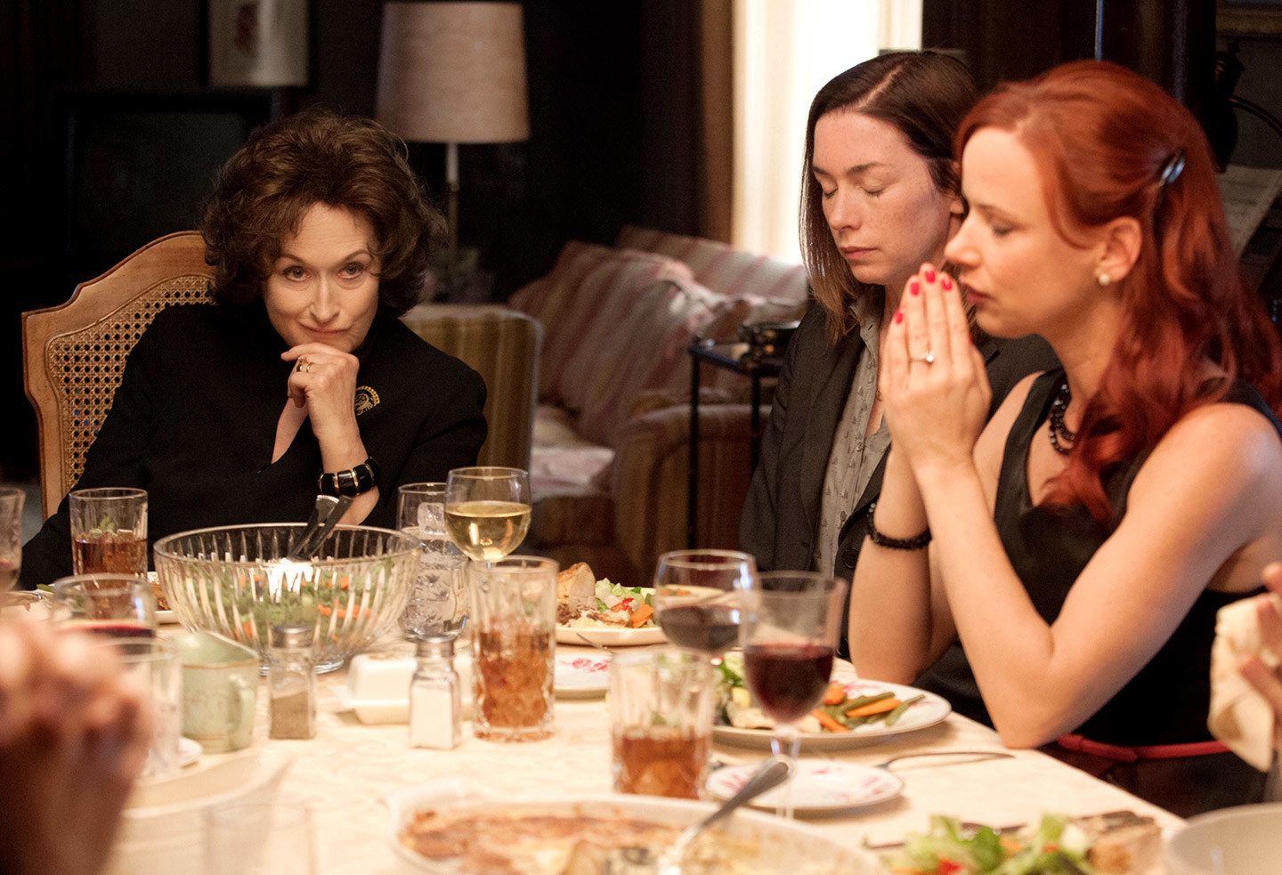

Slide 22
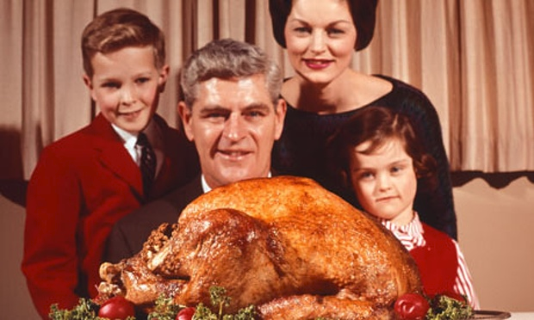

Slide 23
Failed or Strange
Thanksgiving Food

Slide 24
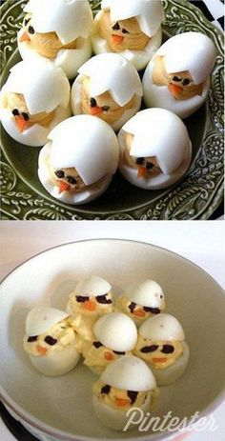
Deviled Eggs

Slide 25
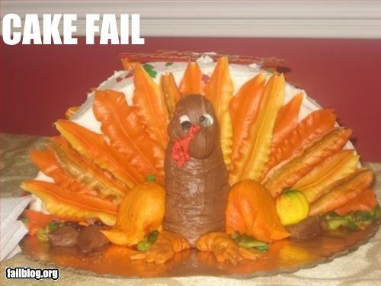

Slide 26
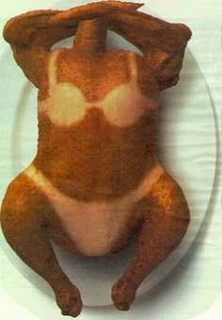

Slide 27
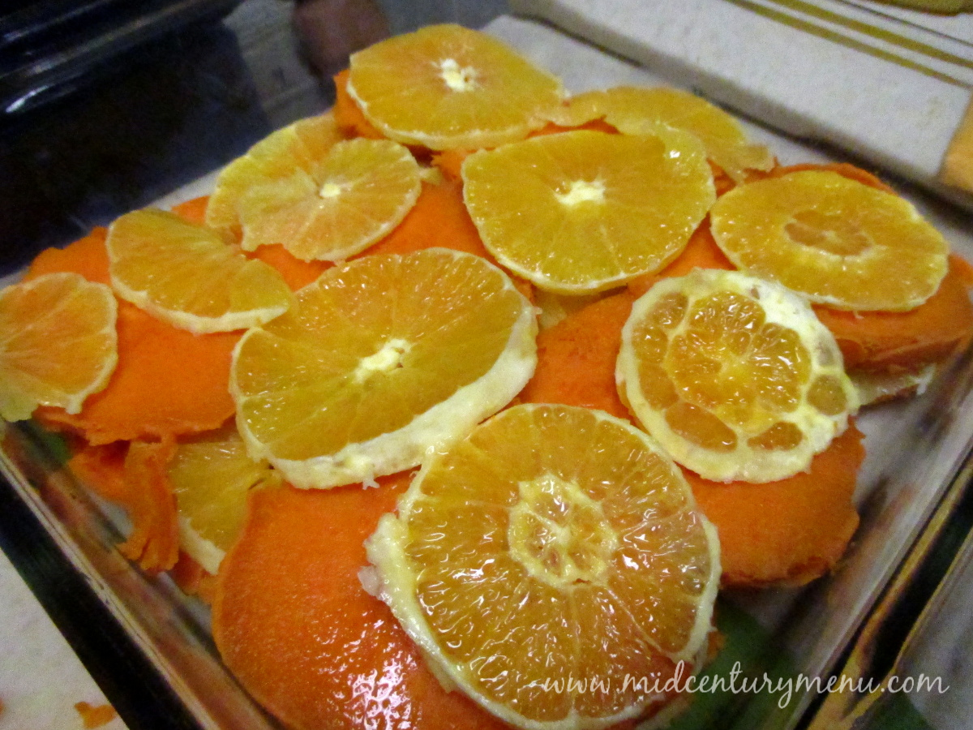
Sweet Potato Scallop

Slide 28
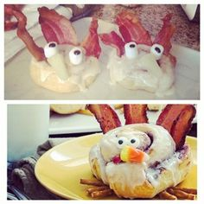
Cinnamon Rolls, Roll Turkeys,

Slide 29
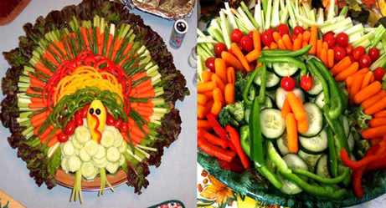

Slide 30
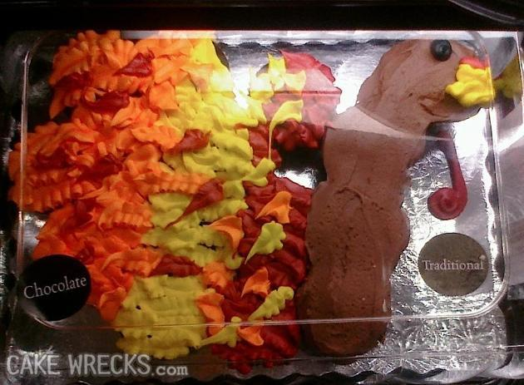

Slide 31
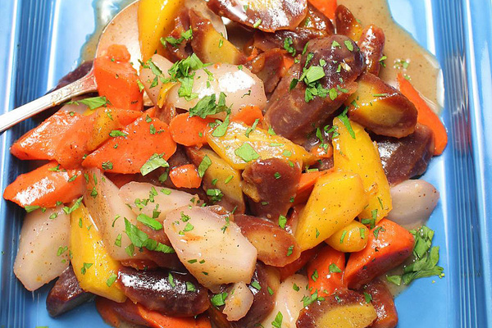
Mixed vegetables?

Slide 32
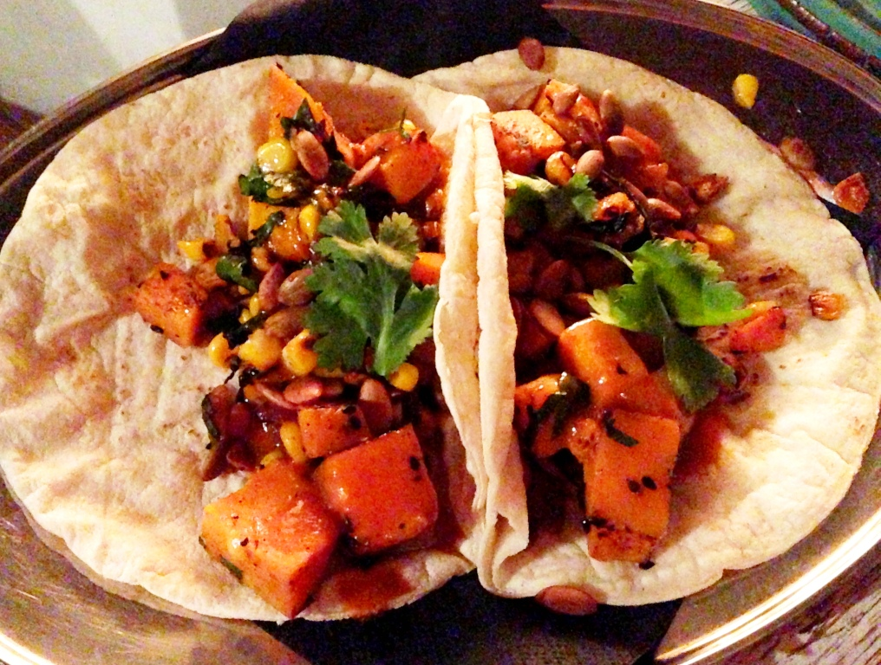
Thanksgiving tacos?

Slide 33
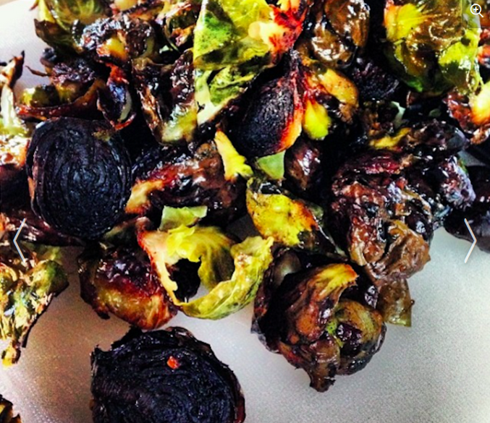
Brussels sprouts FAIL

Slide 34
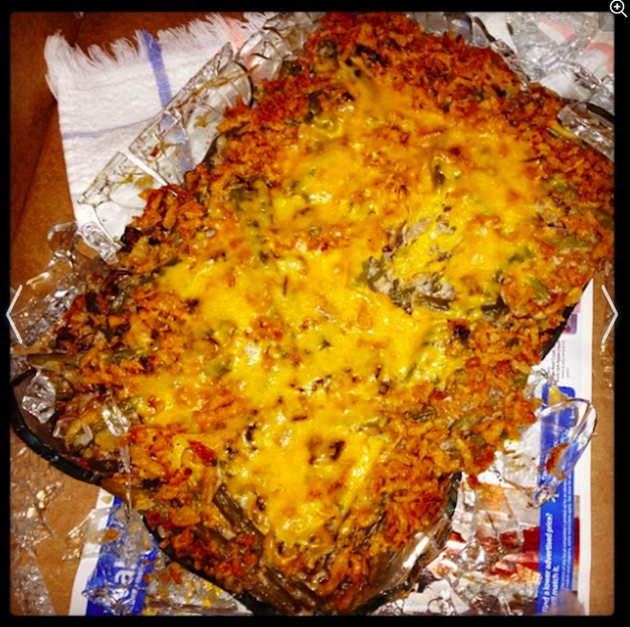
Green bean casserole FAIL

Slide 35
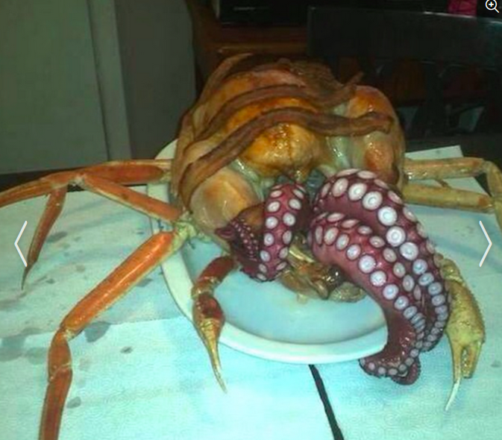
The seafood version of a turducken — aka the stuff nightmares are made of.

Slide 36
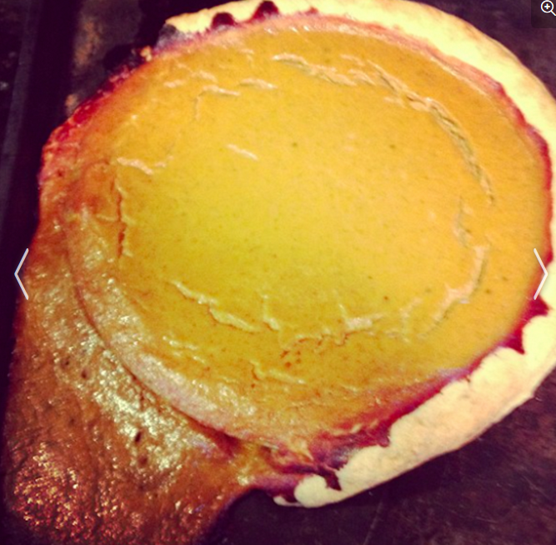
Pumpkin Pie Failed

Slide 37
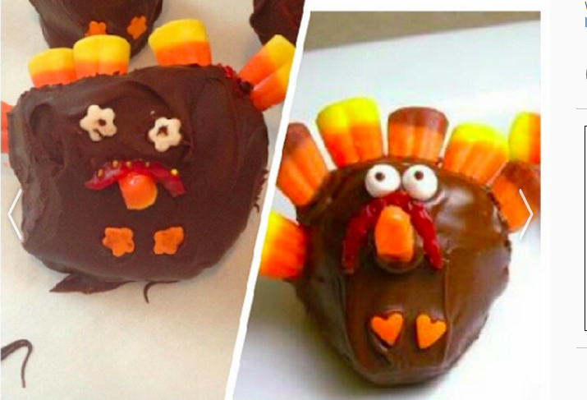
Turkey treat failed

Slide 38
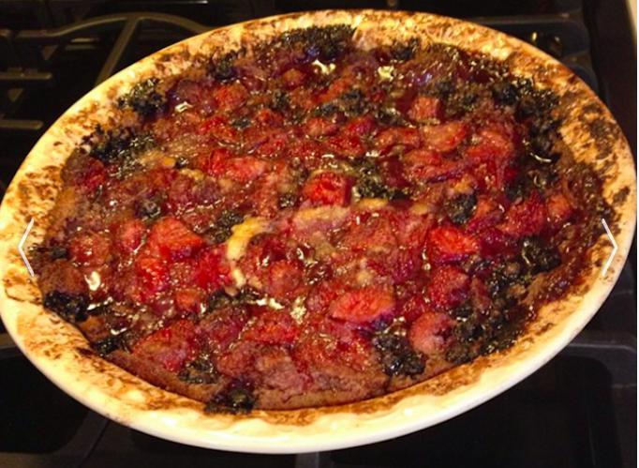
Fruit crisp FAIL

Slide 39
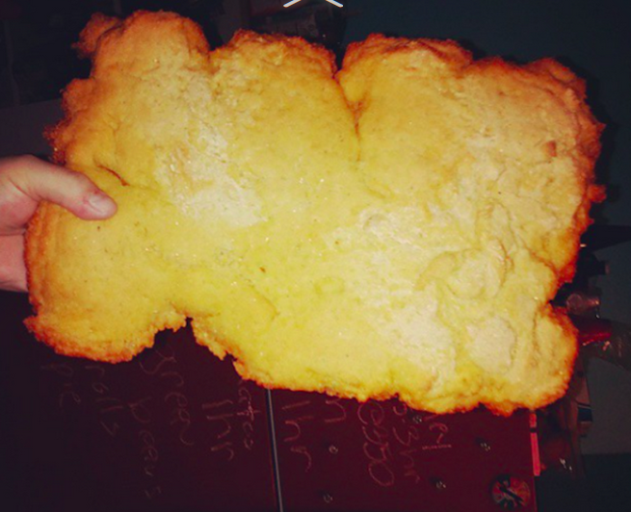
Cornbread FAI

Slide 40
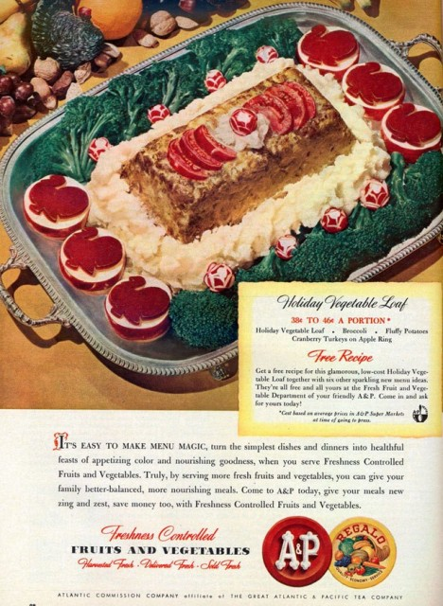
Holiday Vegetable Loaf With Apple Rings, Mashed Potatoes and “Cranberry Turkey”

Slide 41
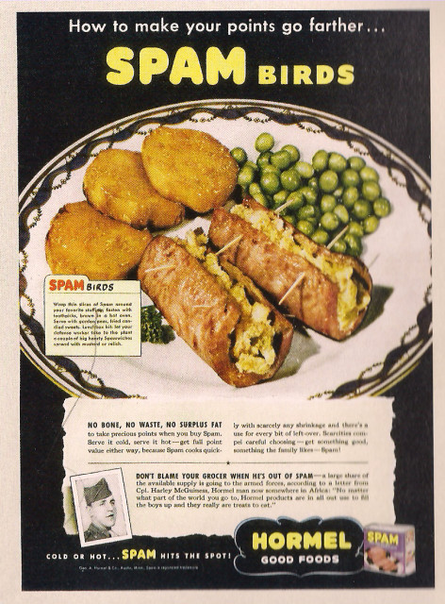
SPAM Birds

Slide 42
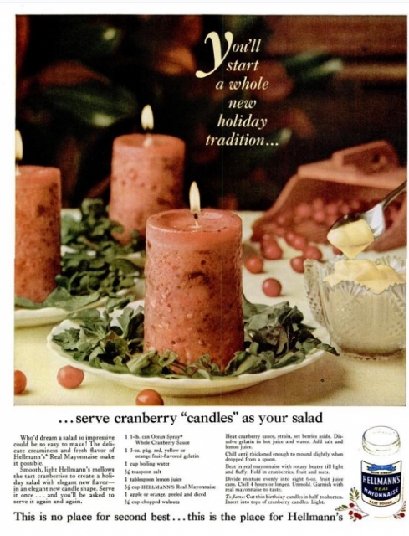
Mayonaise, Jell-O & Cranberry Sauce Candles

Slide 43
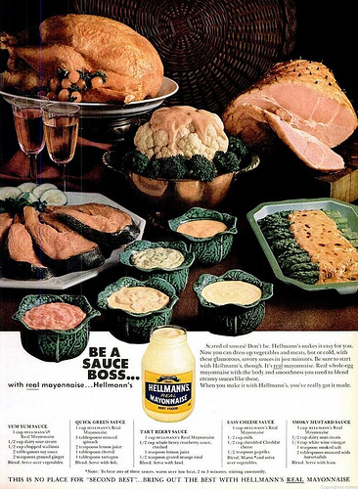
Mayonnaise On All The Things

Slide 44
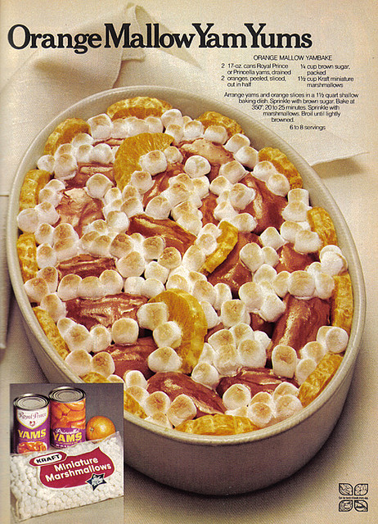
Orange Mallow Yam Yums

Slide 45
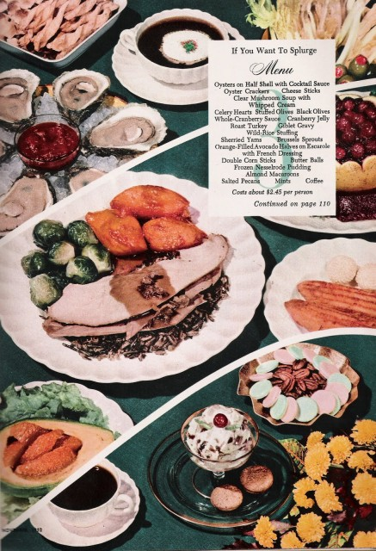
Clear Mushroom Soup With Whipped Cream

Slide 46
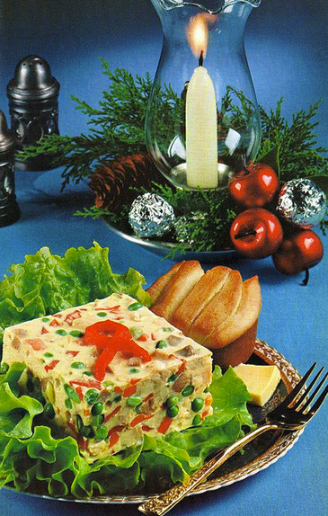
Frozen Jellied Turkey Vegetable Salad

Slide 47
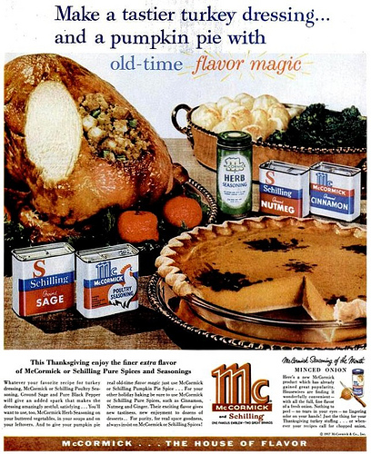
Pumpkin Pie With Black Splotches Of Flavor Magic

Slide 48
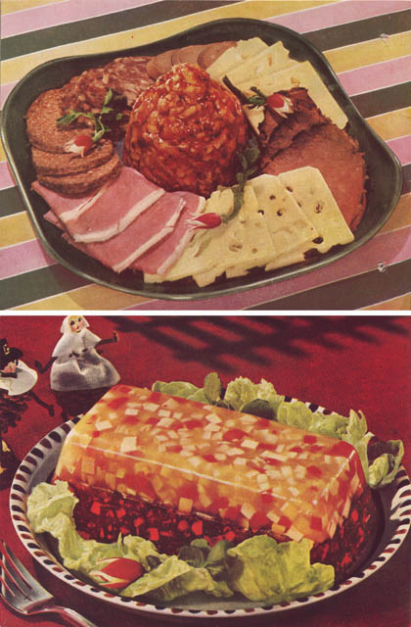
Cranberry Surprise

Slide 49
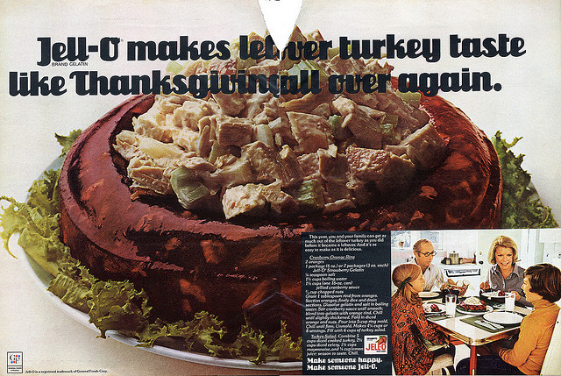
Leftover Turkey WIth Mayonaise and Jell-O

