Slide 1
Extremely Unnerving Vintage Ads
These shocking vintage ads are absolutely out of control. You won’t believe the content of these ads that were commonplace not so long ago.

Slide 2
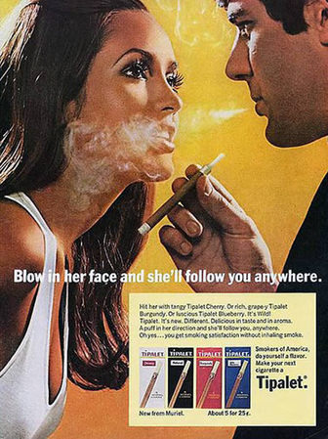
Blow In Her Face
Well, that’s one way to NOT win over a female’s heart, let alone have her “follow you anywhere”

Slide 3
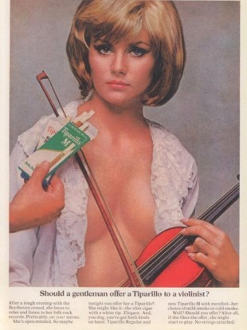
What A Gentleman Should Do
This ad is extremely misleading as a gentleman would close that lady’s blouse, not offer her a cigar!

Slide 4
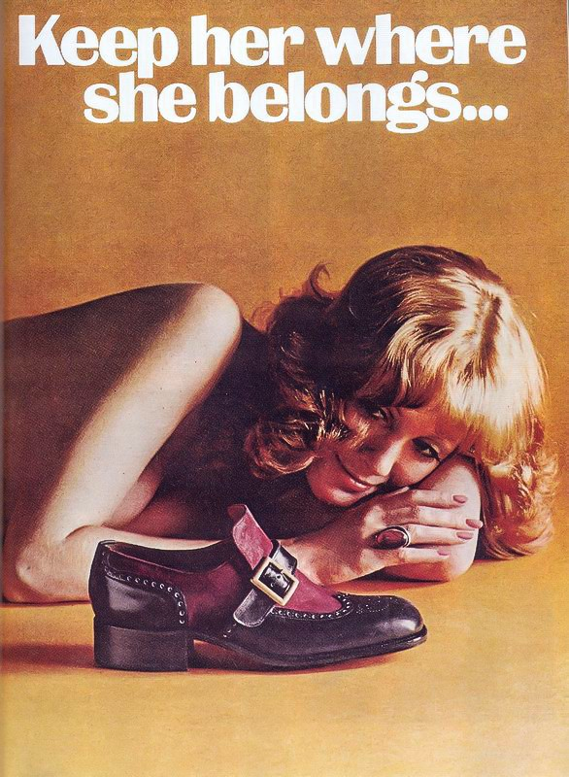
Where Women Belong
We’re unclear as to what this ad is trying to say, but let’s just be clear that women do not, and let me repeat DO NOT belong on the floor.

Slide 5
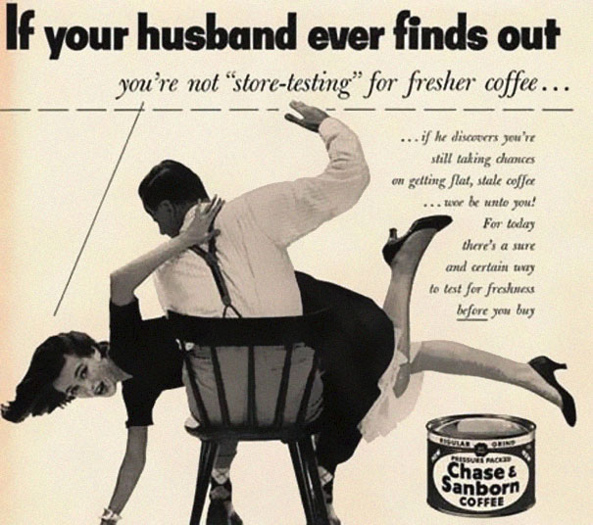
Don’t Let Your Husband Find Out
We’re pretty sure that coffee freshness isn’t this serious, domestic abuse on the other hand, certainly is.

Slide 6
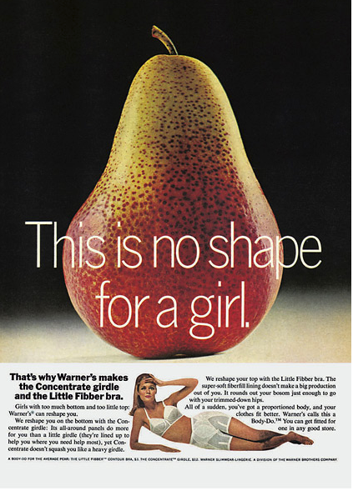
All Shapes Are Great
Warner may have tried to pull some funny business back in the day, but today women embrace all kinds of curves, and thank goodness for that.

Slide 7
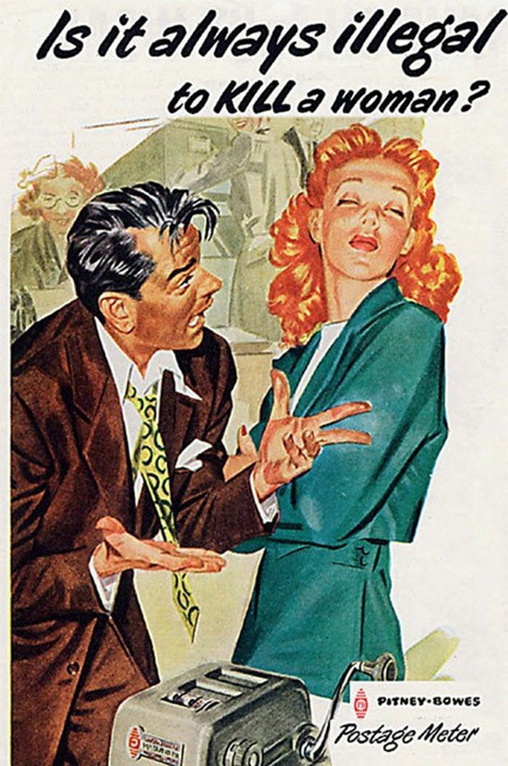
Million Dollar Question
The answer to that question would be yes…It is always very much illegal to kill a woman.

Slide 8
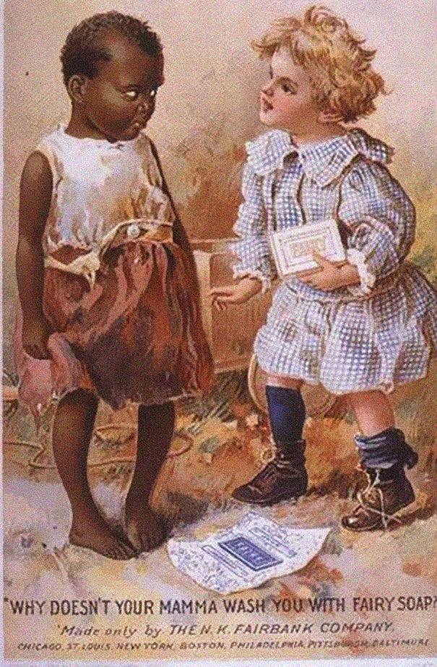
Fairy Soap
This ad is just all kinds of wrong.

Slide 9
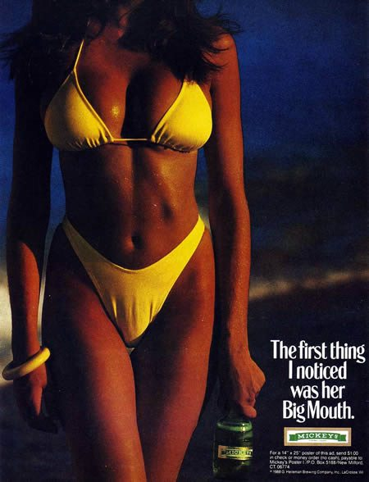
Big Mouth
Because who doesn’t love an ad with horrible humor? And sexist undertones.

Slide 10
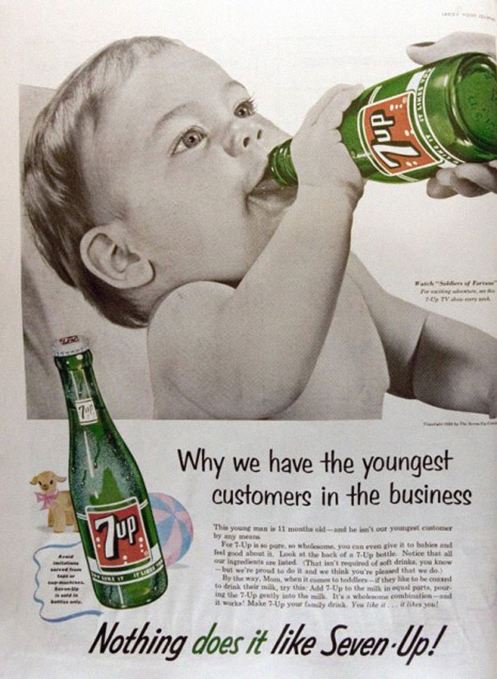
The Youngest Customers
We know this is a vintage ad but let’s just make one thing clear – giving soda to babies is definitely not okay.

Slide 11
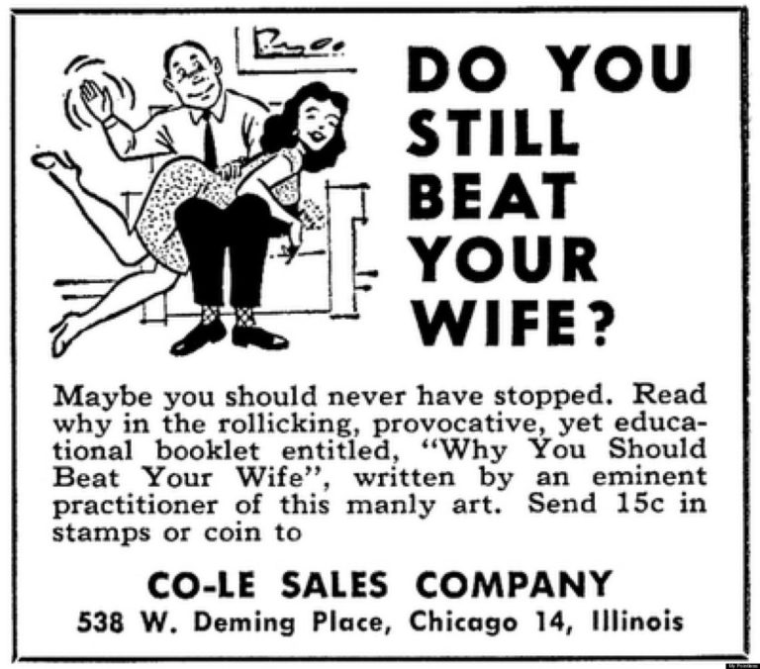
Do You Still Beat Your Wife?
We would like to know what kind of monster is behind this ad.

Slide 12
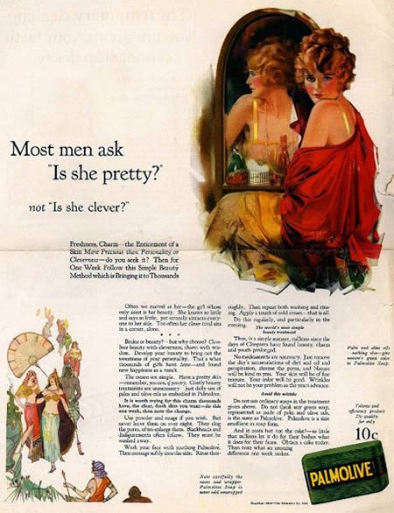
“Is She Pretty?”
Palmolive really missed the mark with this flyer.

Slide 13
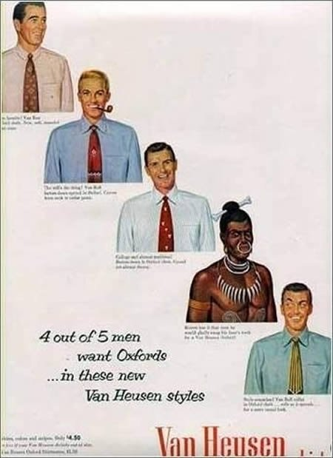
4 Out 5 Men Want Oxfords
This racially insensitive advertisement represents everything that was wrong with American advertisement in the 50’s.

Slide 14
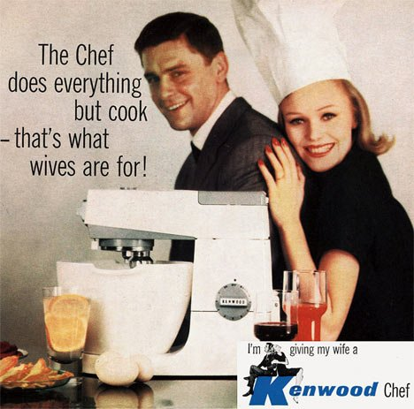
That’s What Wives Are For
Yes, Kenwood, because wives have nothing else to do with their lives then cook (eye roll).

Slide 15
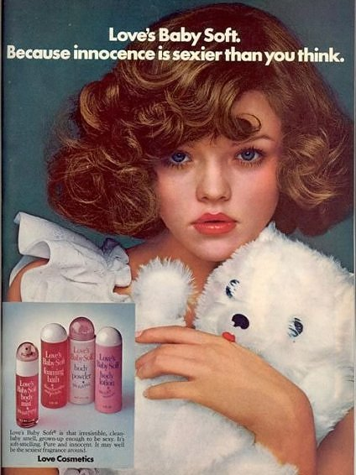
Baby Soft
The fact that this child’s innocence is being called “sexy” is a combination of horrifying and confusing.

Slide 16
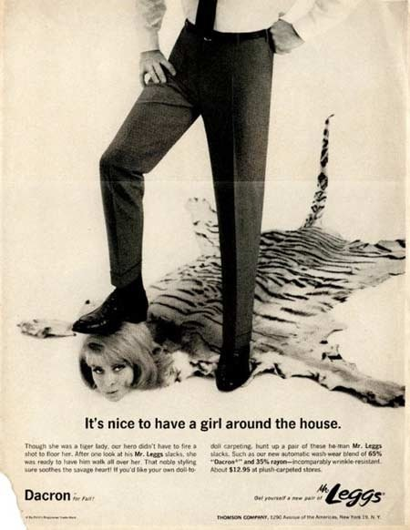
A Girl Around The House
There is no amount of explaining that will make this look okay.

Slide 17
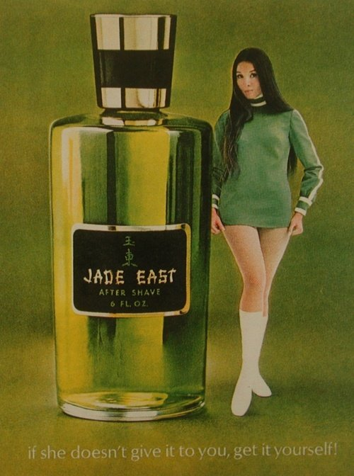
Jade East
If she doesn’t give it to you, she doesn’t want you to have it.

Slide 18
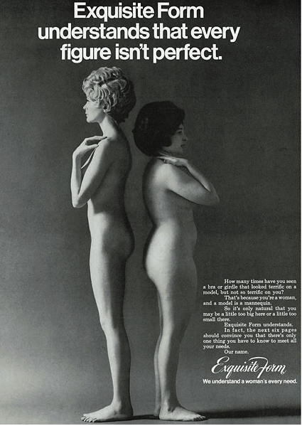
Exquisite Form Doesn’t Understand
Thank you Exquisite Form for instilling body shaming in young women so early on.

Slide 19
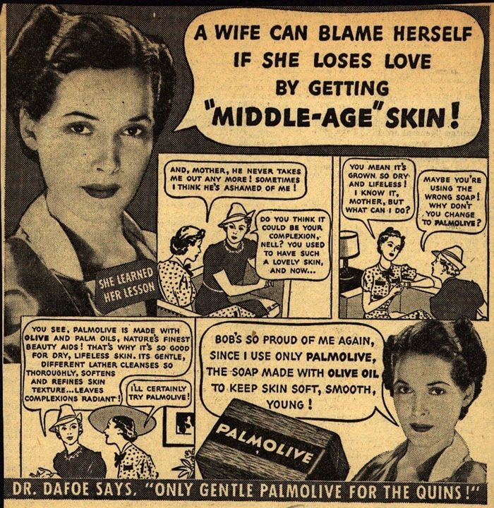
“Middle-Age” Skin
Who knew the key to a lasting marriage was great skin?

Slide 20

Gals Are Useful After All
This lady looks awfully happy for being on an ad that trashes females.

Slide 21
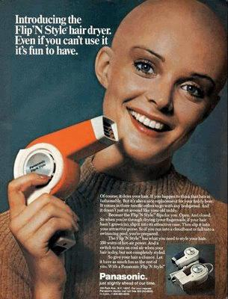
Flip’N Style Hair Dryer
This ad may hands down be th worst thing to happen to the beauty appliance world.

Slide 22
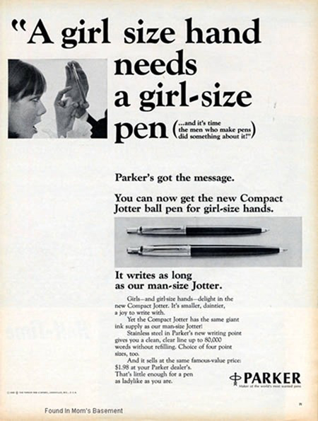
Parker Pens
We’re not sure who’s behind this realization, but it’s clear their thought process was extremely sexist.

Slide 23
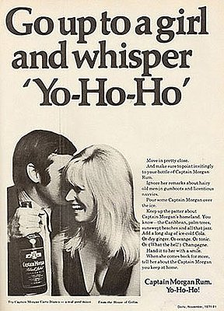
Captain Morgan Rum
Please for goodness sakes guys, do not do this to anyone!

Slide 24
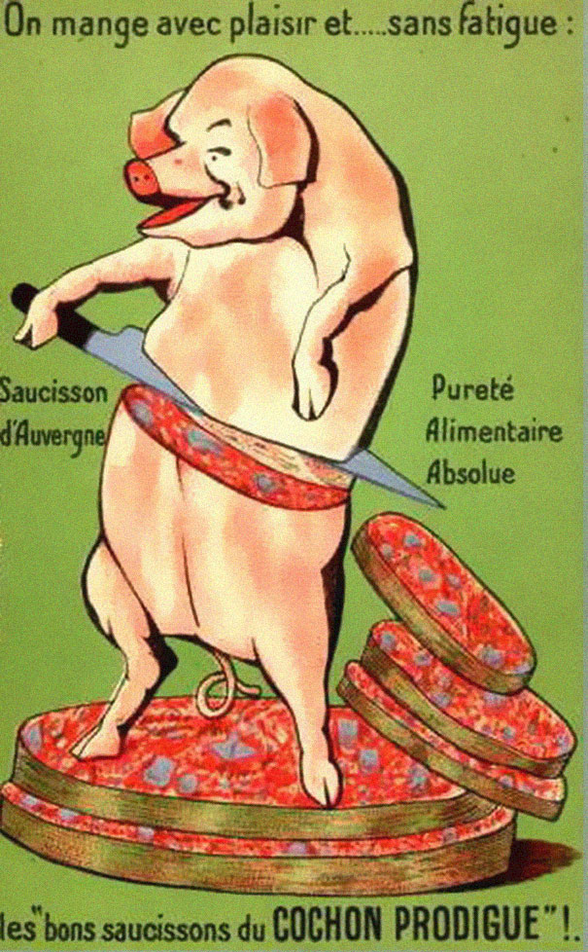
Les Bons Saucissons du Cochon Prodigue
This French poster makes an attempt to bring across the importance of meat coming from well-treated animals or what we call today “free range”, but the imagery may be just a tad too graphic.

Slide 25
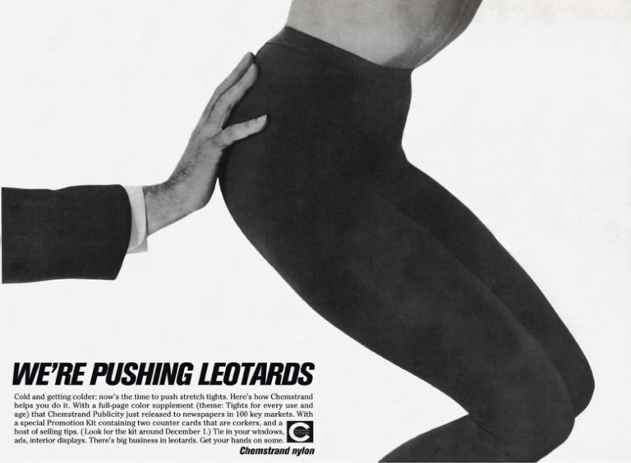
Chemstrand Nylon
I don’t know what’s going on here, but it’s not exactly making us love those tights.

Slide 26
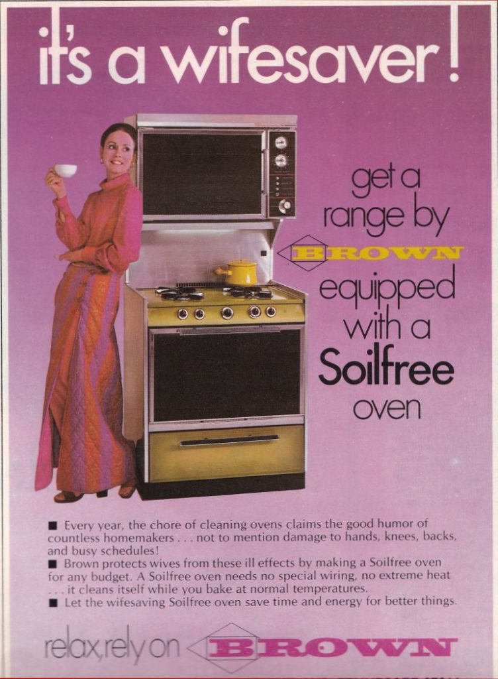
Wifesaver
A better name for this stove would be a husband-saver because men cook too!

Slide 27
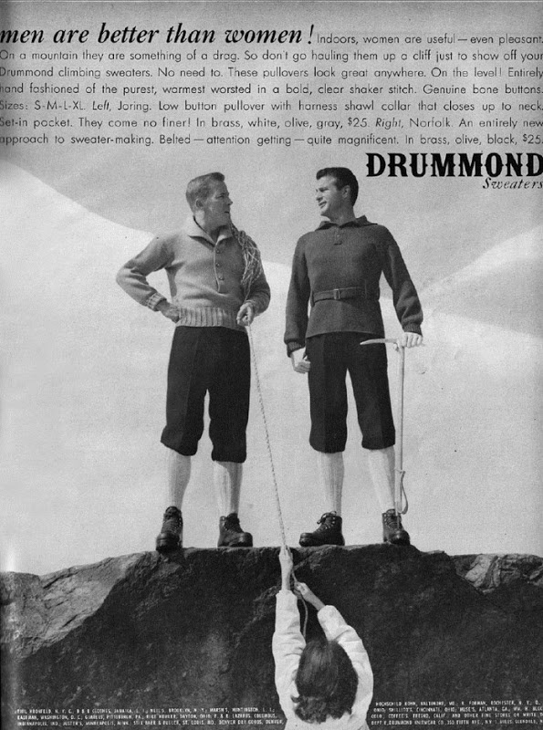
Drummond Sweaters
Excuse me while I go pick up my jaw.

Slide 28
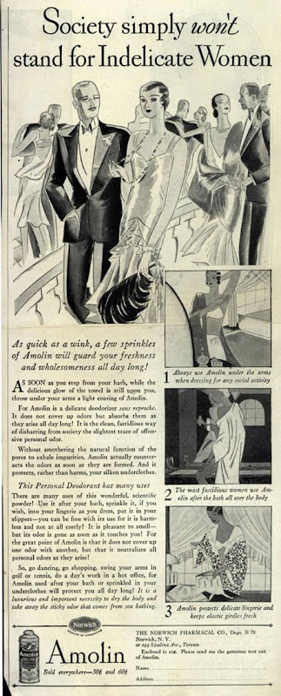
Amolin
I’m sure today’s feminist would be up in arms about this foolish ad.

Slide 29
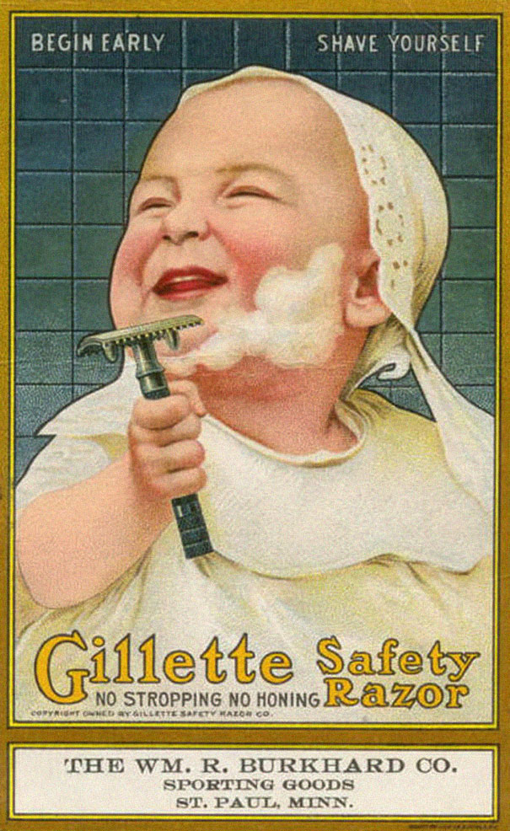
Gillette Safety Razor
Nothing says safe like an infant with a razor blade in its hand!

Slide 30
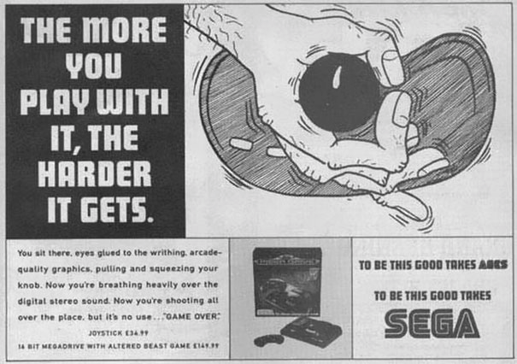
Sega Joy Stick
Good job Sega, nothing says family entertainment like an overly phallic ad.

Slide 31
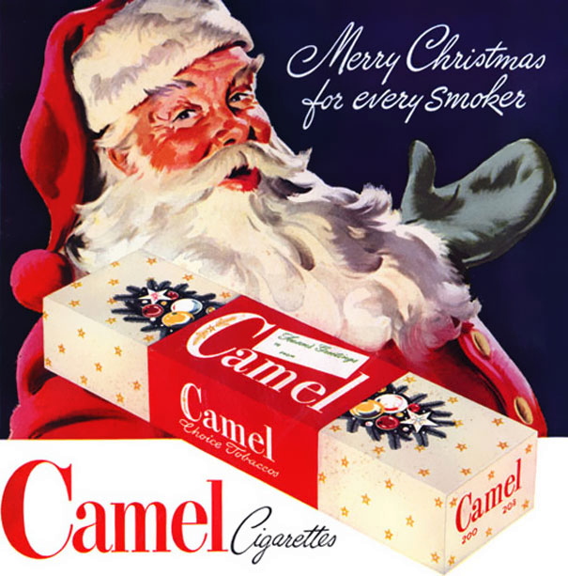
Merry Christmas From Camel
These were the days when Santa could come down your chimney with a carton of cigarettes and it was socially acceptable.

Slide 32
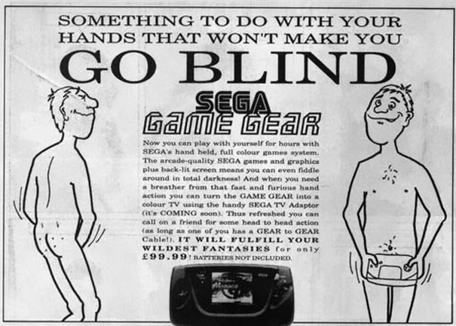
Sega Game Gear
Well look at that, Sega has again managed to put out the creepiest video game advertisements ever!

Slide 33
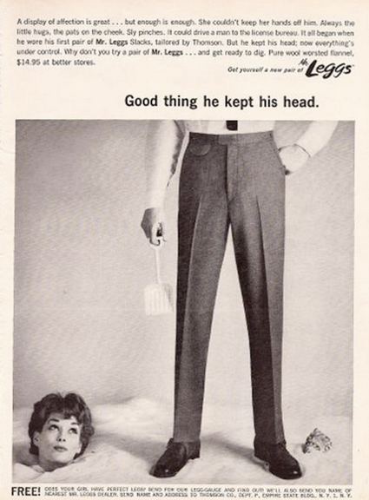
Leggs
Why is the woman buried and not the man? Leggs was up to some funny business and we’re not into it.

Slide 34

United States Navy
Don’t get us wrong, the Navy is great, but not great enough that we’d want to be a man.

Slide 35
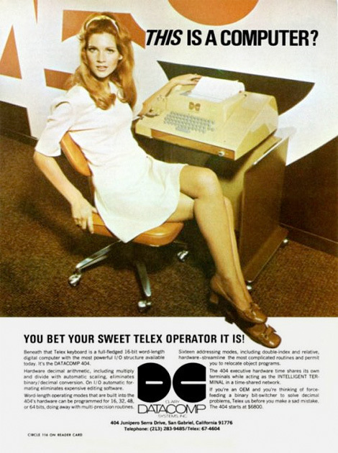
Data Comp
Glad to see that this woman has been promoted from the kitchen to the office. Slow progress, people.

Slide 36
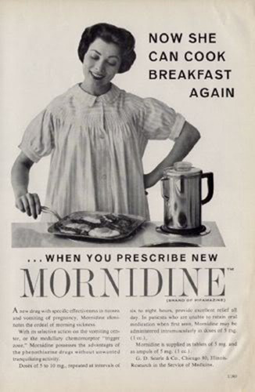
Mornidine
Not sure that cooking breakfast is exactly what this woman wants to do.

Slide 37
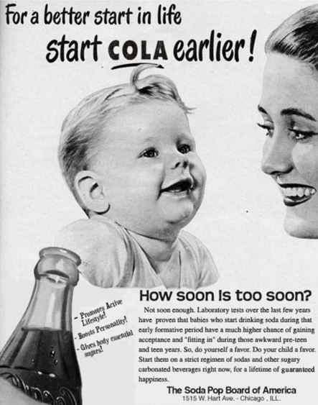
Coca Cola
We all know today that although coke tastes great, it’s really bad for you and should only be consumed, if at all, every once in a while. Imagine recommending it to babies!?

Slide 38
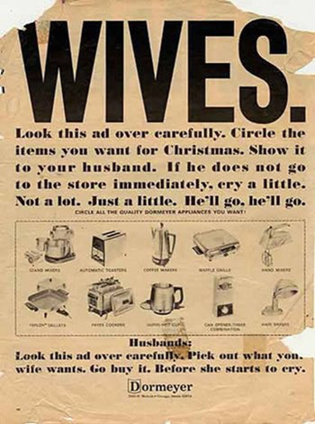
Go Buy It!
Why isn’t there jewelry or handbags on this circular?

Slide 39
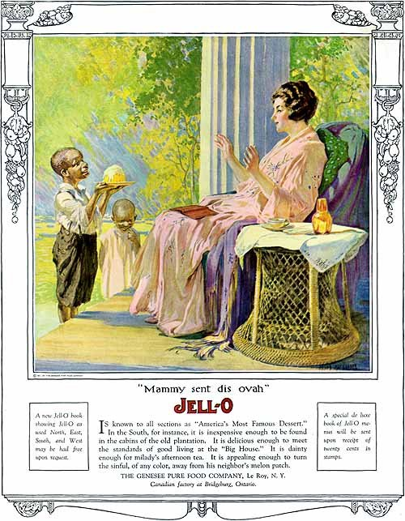
Jello Servant
This gem wins the award for least politically correct advertisement in history.

Slide 40
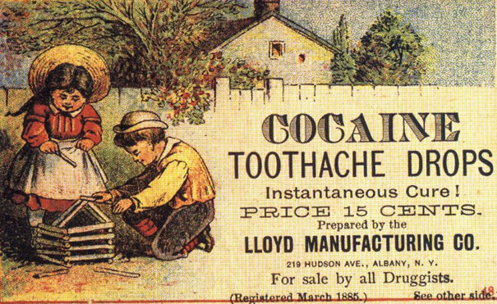
Cocaine Drops
This brand is making quite the claim with this ad. We wonder what kind of side effects these drops had.

Slide 41
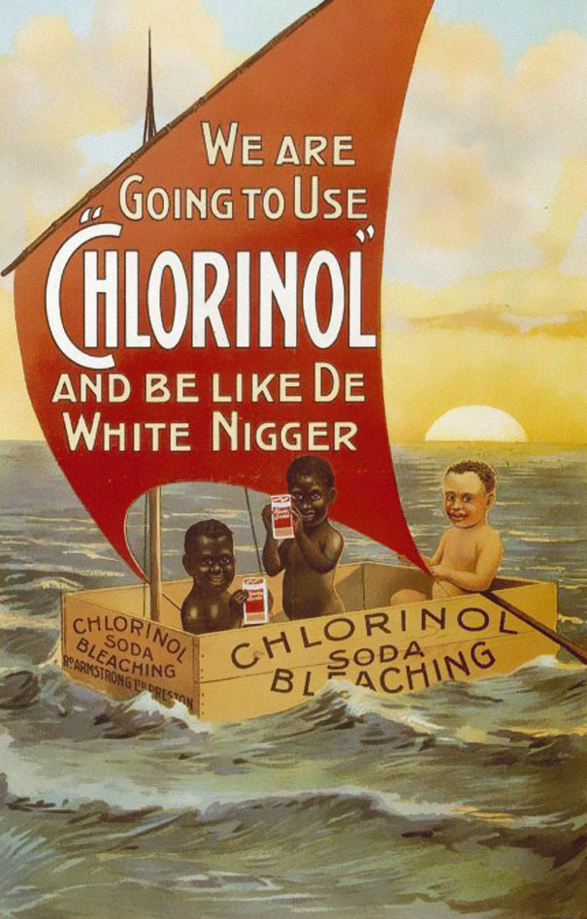
The Origins Of Skin Bleaching
Knowing an ad like this was published is extremely concerning. Let’s all take a minute to be thankful for racial equality today.

Slide 42
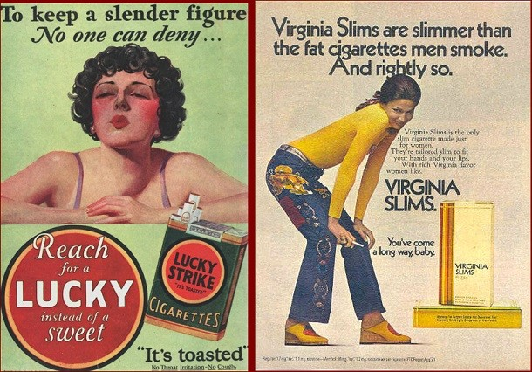
Pack of Lucky’s
There are so many healthy diets for women to follow these days, but way back when they were being recommended Lucky Strikes in order to keep their figure slim.

Slide 43
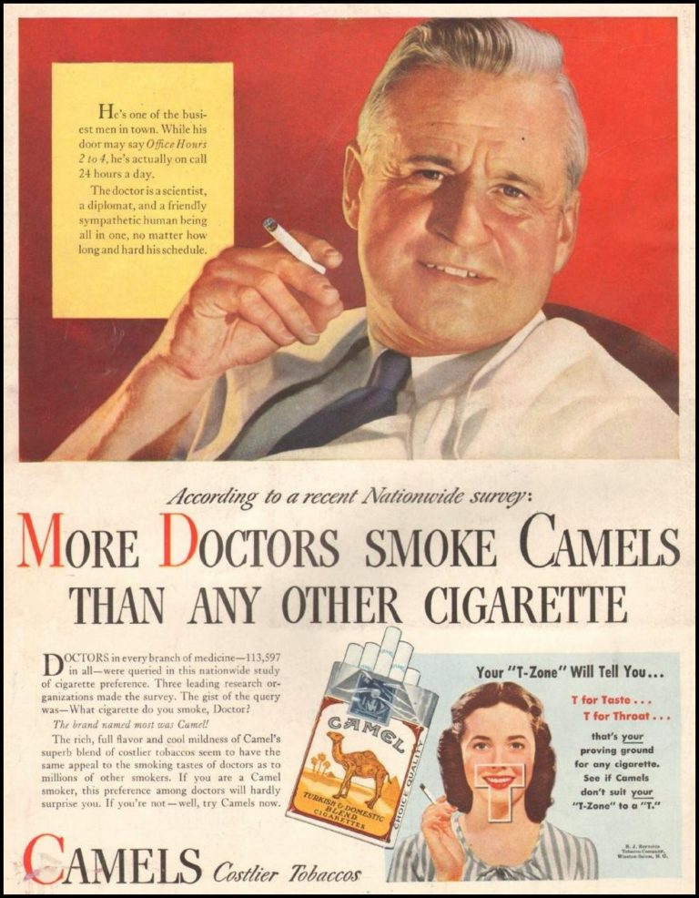
Doctors Love Camels
The fact that Camel had doctors endorse cancer sticks is absolute baboonery.

Slide 44
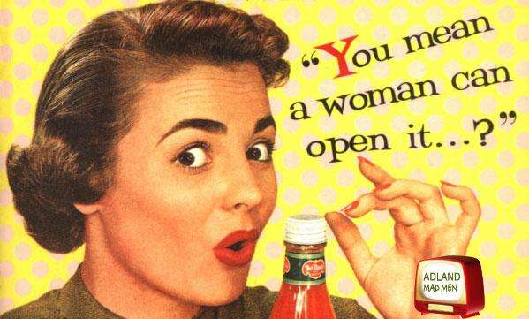
You Mean A Woman Can Open It
Del Monte’s Ketchup advertisement is a little anti-feminist. Thankfully today’s ketchup adverts have completely changed.

Slide 45
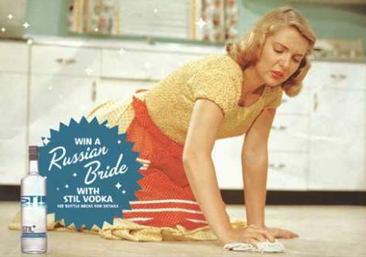
Vintage Vodka
This advert for vodka was a little tasteless.

Slide 46
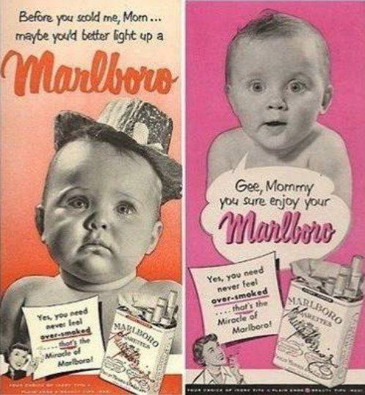
Mom Loves Cigarettes
The cigarette adverts from the past just keep getting worse.

Slide 47
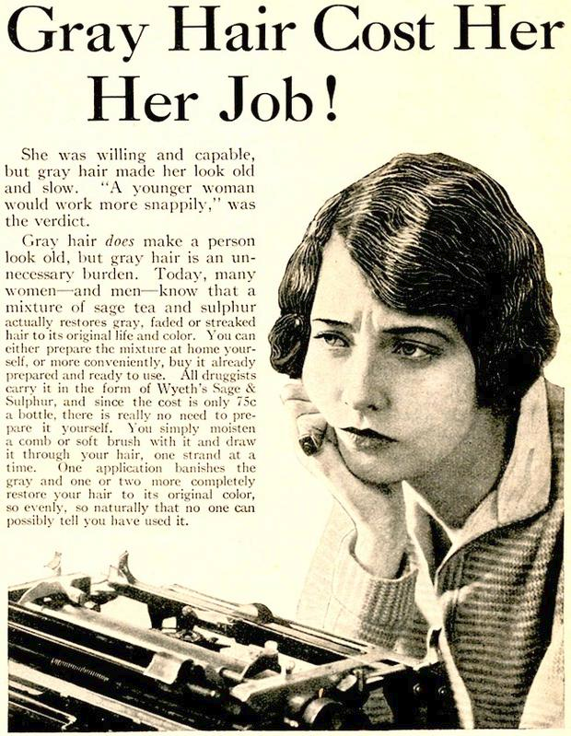
Gray Hair
Apparently women used to get fired over having gray hair.
offending_grayhair

Slide 48
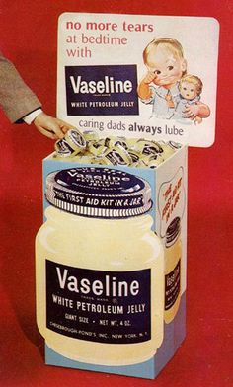
The Creepy Vaseline Ad
We hope that this ad was pure accidental, but in any case it is extremely weird.

Slide 49
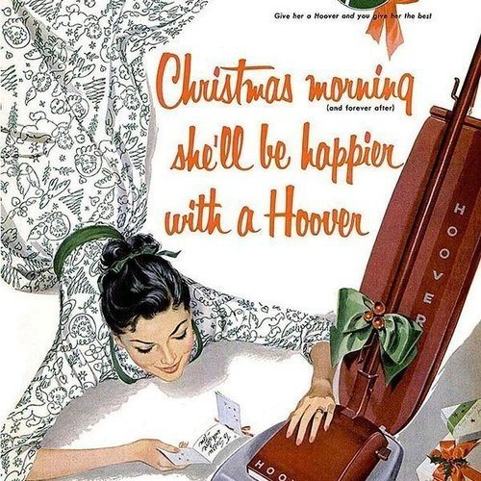
A Hoover Present
Apparently women only wanted to wake up to a hoover on Christmas morning.

Slide 50
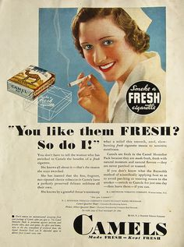
Nurses Recommend Cigarettes
Another cigarette advert, this time featuring nurses. Not sure if that is the best health recommendation.

Slide 51
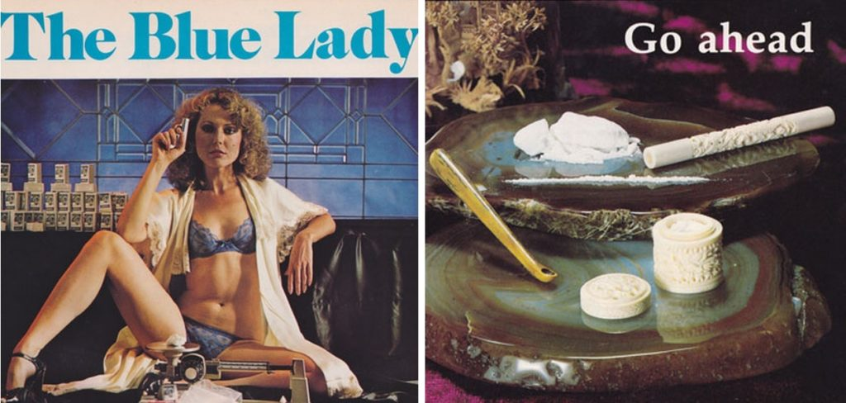
The Blue Lady
So that’s what they were calling that white stuff those days.

