Slide 1

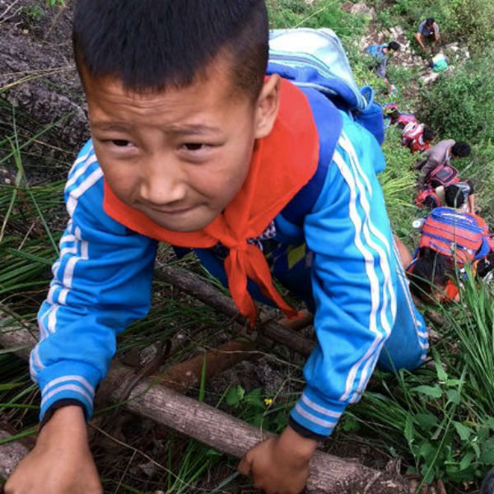
Extreme ways kids in other countries get to school. Wow.
LiveSmarter’s List of the World’s Most Extreme School Commutes: 2016

Slide 2
Education is a luxury often taken for granted in the West. Indeed, 1st world children often lament that they have to attend school, but it’s interesting to consider what happens when the convenience of a school bus is suddenly absent. Here at LiveSmarter, we feel education is central to each and every one of our lives, and we’ve put together a list of the most extreme lengths people go to get to school around the world.

Slide 3
A study conducted by UNESCO indicates that progress has slowed with respect to connecting children with schools. Dangerous commutes are one of the top reasons people choose not to attend school, so we want to take a moment to recognize those who traverse these paths in the face of mortal danger. It’s truly awe-inspiring to see these individuals overcome poverty and natural disaster to make their way to class. Read on to discover the world’s most dangerous school commute!

Slide 4
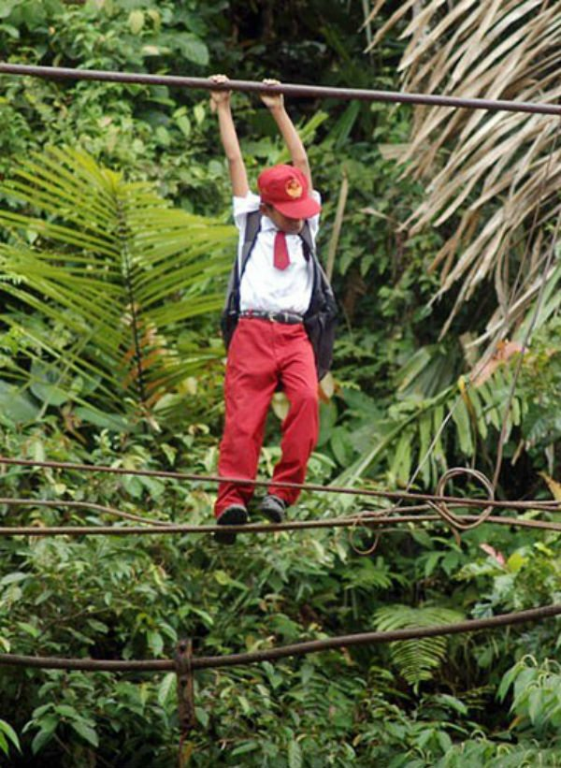
Indonesia boasts some of the most death-defying school commutes on our list, as you’ll see later on. But in the Sumatra province’s capital, Padang, this young man and his sister brave a tightrope on their way to school. The line stretches across a tributary, and hangs 30 feet above the water’s surface. One wrong move, and you might be out of school for the remainder of the season.

Slide 5
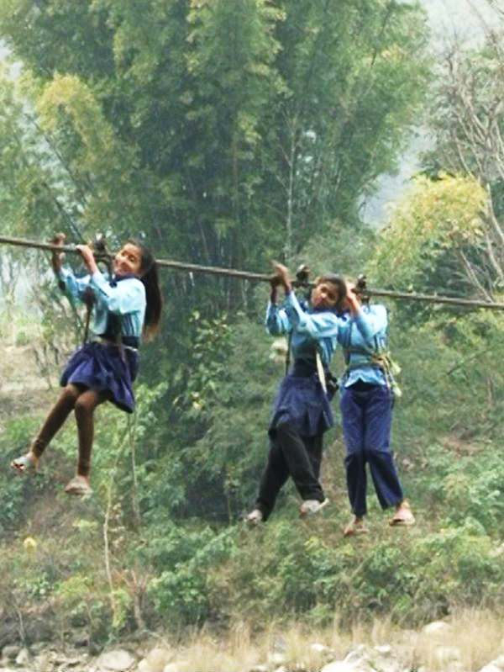
Young villagers from Dhading, Nepal have one of the most dangerous school commutes, as they are forced to use a hand-operated cable to cross the valley to their school. This line over the Trishuli river is also the village’s only route to the neighboring towns. Multiple accidents have given rise to lobbying for a proper bridge, but so far these efforts have been fruitless.

Slide 6
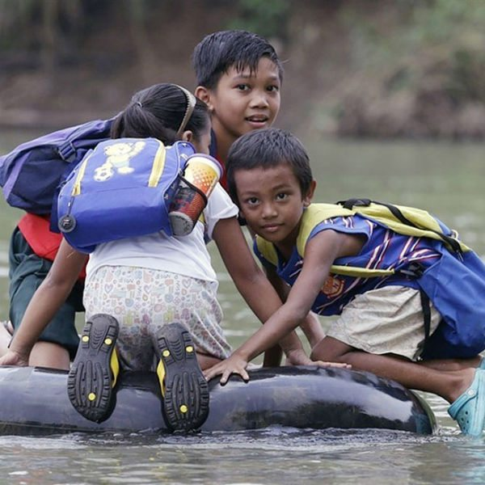
This school run is equal parts fun and danger for these little ones. Filipino schoolchildren hop an inner tube down a river in the Rizal province in order to circumvent an even longer hike through the mountains. The residents of this remote village are in the process of petitioning their local government to build a hanging bridge, to avoid this risky commute.

Slide 7
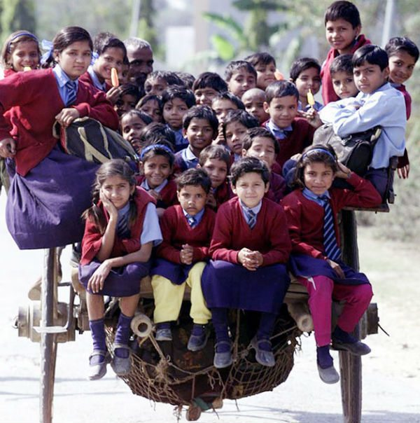
Indian ingenuity is something to behold, as is their efficiency. Delhi has long been known as a center of intellectual exchange, and as such they take their schooling very seriously. As you’ll see later on, 20+ to a vessel is about standard in this region. That must be quite a horse!

Slide 8

While he looks mighty friendly, this water buffalo still poses a risky school commute for this young girl in Myanmar. Because of early Christian and British colonialism in Burma, Myanmar was left with a school system closely resembling western education organizations. They also boast a pretty high literacy rate, hovering around 90%

Slide 9
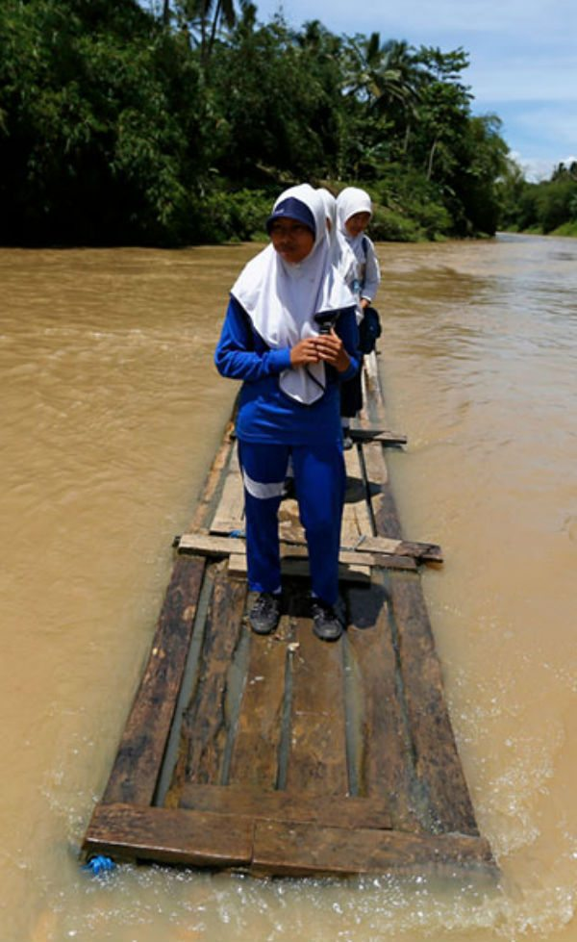
This may look like a scene out of a Southeast Asian version of Titanic, but this is yet another look into how the people of the world get to school. These young men have fashioned a makeshift raft to make their way to school down the Ciherang River in Indonesia. Ever since their bridge went down, this is how they travel across the river in Cilangkap Village.

Slide 10
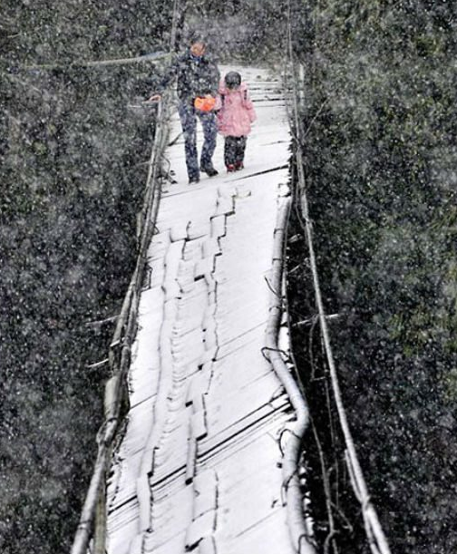
Pupils in Dujiangyan have it pretty rough, by just about any standard. Here’s a mother walking her child across a broken bridge in the snow. In recent years, the Sichuan region has had a great deal of trouble in the education department, as earthquakes destroyed several schools in the area. As if it wasn’t hard enough already!

Slide 11
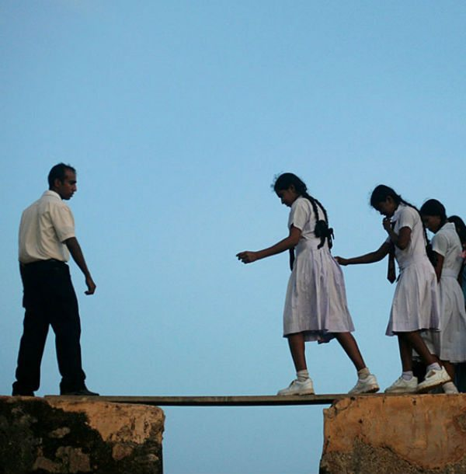
These Sri Lankan school girls are on their way to class, but to get there they must cross treacherous sections of this 16th century fort in the Bay of Galle, along the country’s southwest coast. This is a fairly common sight at the Galle Fort, since it’s home to a number of schools and religious buildings that get frequent use.

Slide 12
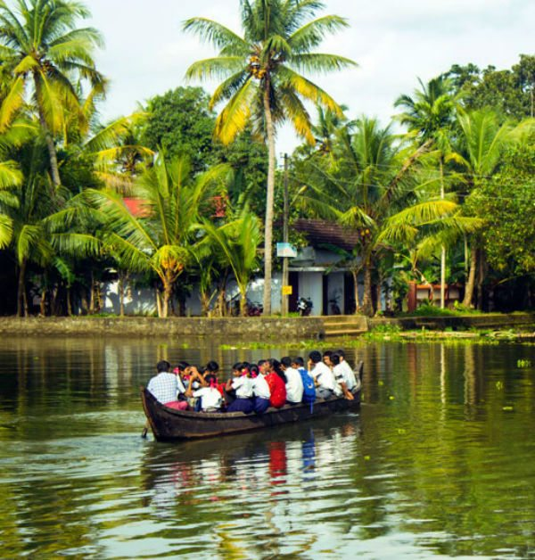
Students in Kerala, India get to school by filing onto a rowboat 20-deep. Don’t be so fast to judge their methods, however. The state of Kerala has one of the highest literacy rates in all of India, and was responsible for the creation of series expansion for trigonometric functions. Don’t knock the hustle.

Slide 13
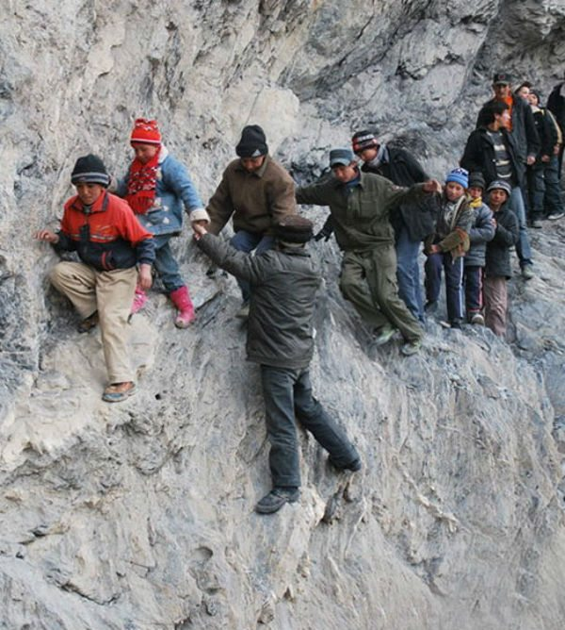
Talk about sketchy… These brave young students make a 125-mile trek to their boarding school in Pili, China. Kids aged 6 to 17 participate in the journey four times each year. Believe it or not, their passage is safer during the winter, when they can avoid this mountainous detour by traversing the frozen river below.

Slide 14
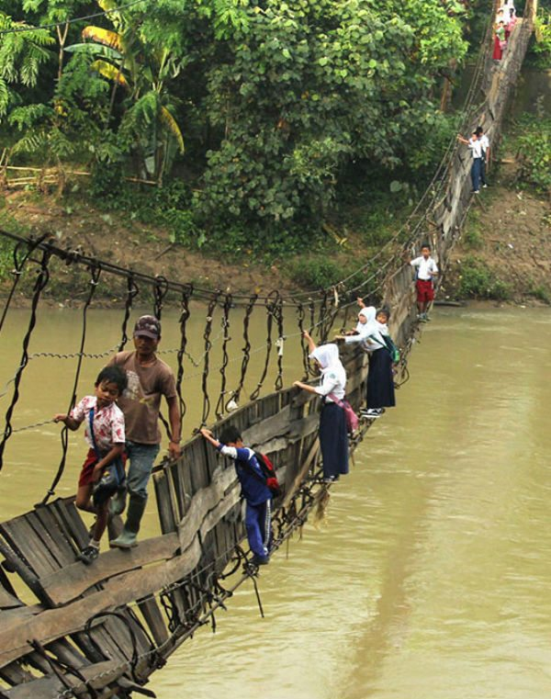
Students in the Batan province of Indonesia were forced to cross the Ciberang river on a broken suspension bridge, after flooding destroyed one of the support struts. With the nearest bridge 30 minutes away, pupils insisted that had no other choice to get to their school in Sanghiang Tanjung village.

Slide 15
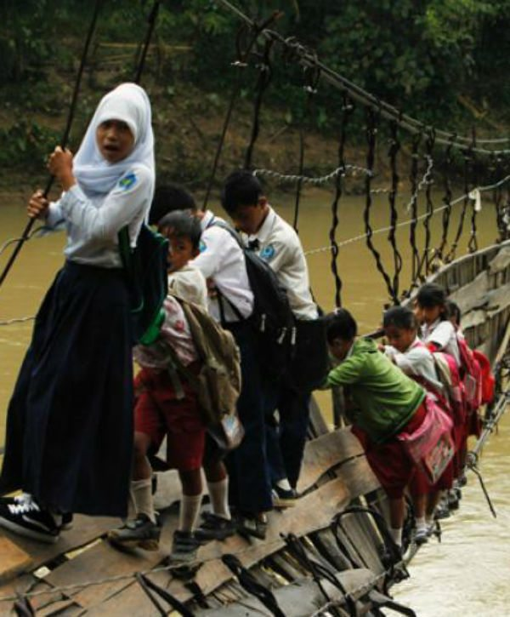
Batan Cont.
The good news? Their story got international traction, which gave rise to a movement in support of repairing this bridge, so the students no longer have to risk their lives getting to school.

Slide 16
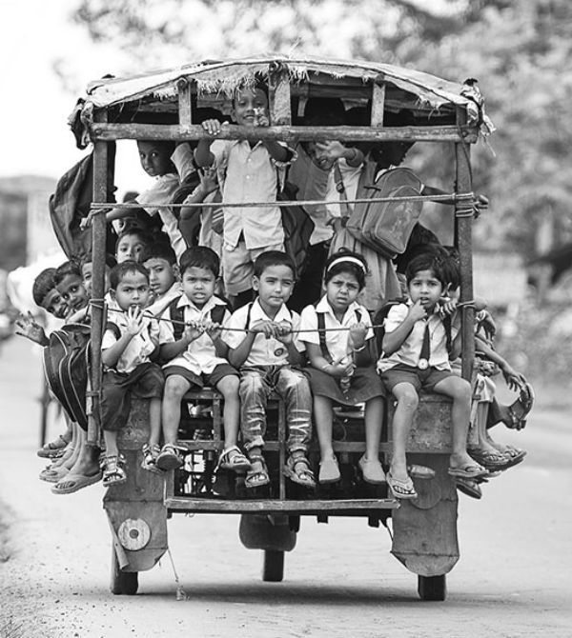
These young’ns from Beldanga ride a tuktuk to school. This auto-rickshaw putts along seemingly unburdened by the score of schoolchildren cruising on the back. Here’s to hoping the guy’s going slow, at least. There don’t appear to be any safety belts on this thing.

Slide 17
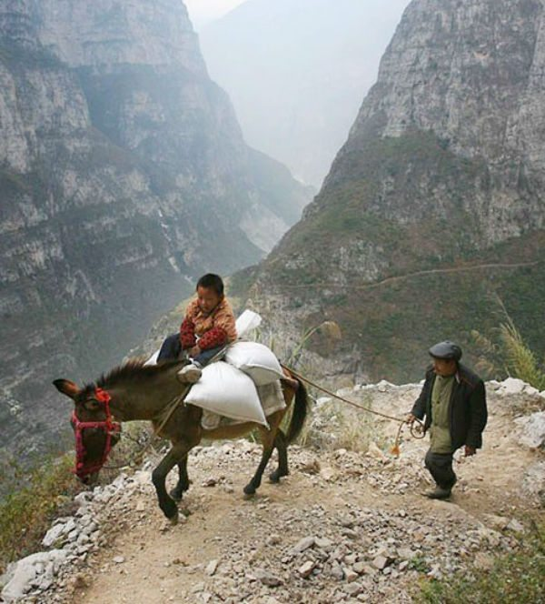
This 5-hour journey to Banpo Elementary School begins in the “nearby” village of Genguan. Students traverse a winding footpath, which narrows to ONE foot at its most treacherous. The school is stationed halfway up the mountain, and these kids make the round-trip every day.

Slide 18
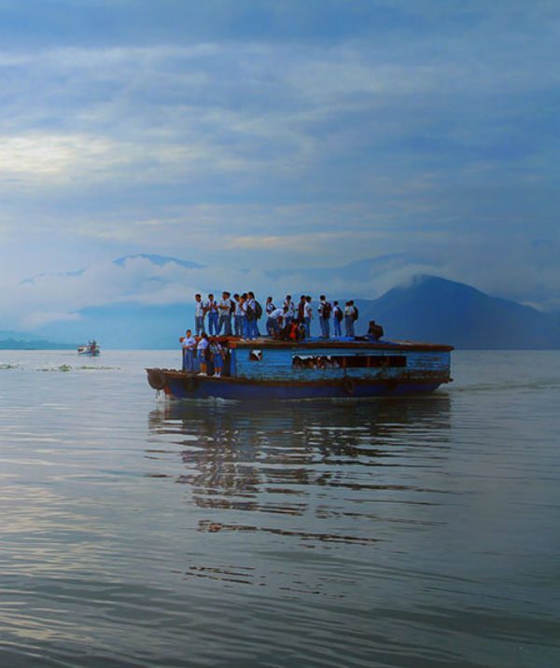
Indonesia plays home to a few of our entries for this year’s list of dangerous school commutes, as these students can be seen travelling on the roof of a wooden pontoon boat near Pangururan. Gives new meaning to being packed like sardines.

Slide 19
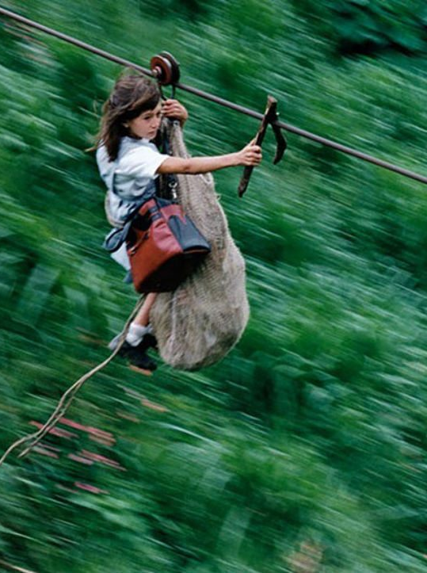
On a remote island in Colombia, children ride a 400 foot-high zipline across a canyon to reach their school in the adjacent village. Despite years of lobbying for a better solution, the cable remains the only passage between the two villages. Unfortunately, this is not the school’s only issue: they haven’t had a teacher for years, and the children receive no lessons…?

Slide 20
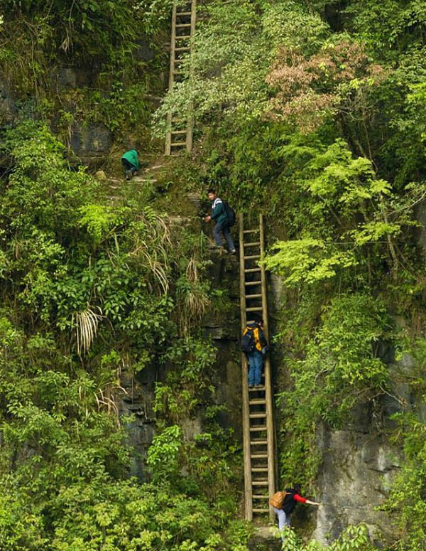
In the Hunan province of China, the children of Zhang Jiawan climb these rickety ladders to school every single day. Judging from the photos and video we’ve seen, the ladders are in no way secured to the cliffs. Fret not, for the villagers are accustomed to this mode of travel. Makeshift ladders like these provide the only expedient passage to the valley below.

Slide 21
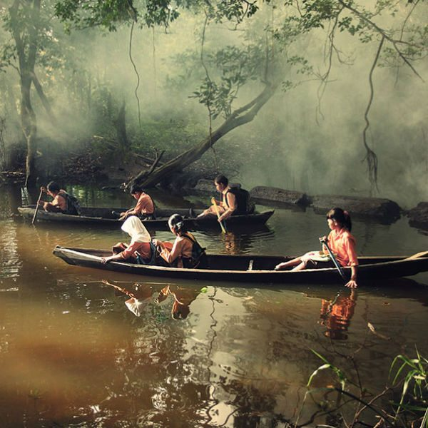
This one actually seems like a pleasant experience. Villagers in Riau, Indonesia take to the canoe in order to reach school each day. Apart from the odd splash and a soggy lunch bag, we at LiveSmarter can honestly say we wouldn’t mind the school run so much as the others.

Slide 22
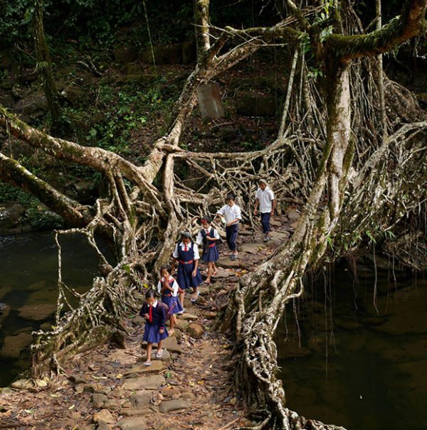
This looks like a pleasant stroll through the woods: Indian school children traverse the forest using bridges anchored by tree roots. Some of these structures are believed to be over 500 years old, and generally take about 15 years to grow. That requires some serious patience! The technique is said to have originated in Meghalaya, India, and the tensile strength of these living structures can support up to 50 people at once.

Slide 23
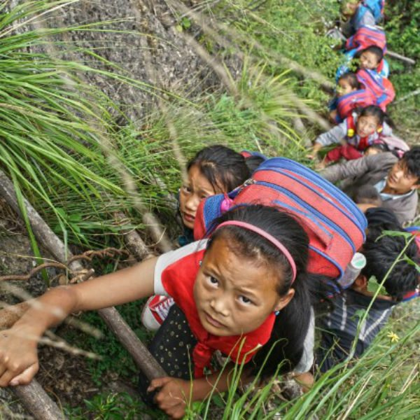
In southwest China, children of the Sichuan province climb an 800-meter cliff using “sky ladders” fashioned from vines (yes, VINES) to reach their school. Kids as young as 6 go up and down this thing without batting an eye, though there are parents who volunteer to supervise the journey. The climb in and out of Atule’er is so demanding, the students only return home twice each month.

Slide 24

Not all of the world’s extreme commutes are so exotic. Meet Nikita Rodriguez of New Haven, Connecticut. She and her mother Paris make the commute to Nikita’s school in Bridgeport, travelling 4 hours each day (at minimum). In an interview, they reported that delays sometimes push their bus ride to as long as 3 and 1/2 hours each way!

Slide 25
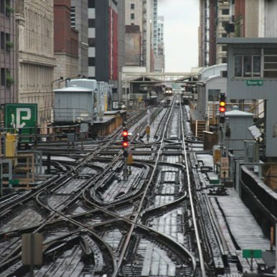
In Chicago, the school choice movement has proven to be a double-edged sword. On one hand, it gives impoverished students a chance to attend better schools. While urban schoolchildren are typically found to be highly mobile, the problem remains that the distances some of these kids travel (often by themselves) is troubling, to say the least.

Slide 26

Check this out: Leila Lashley of Knightdale, North Carolina rides the bus a total of 5 hours each day, just to get back and forth to Ligon GT Magnet Middle School in Raleigh. The worst part? It’s only because of her position in the pickup line. Her mother claims the school is a 20 minute drive by car, would that they had one!

Slide 27
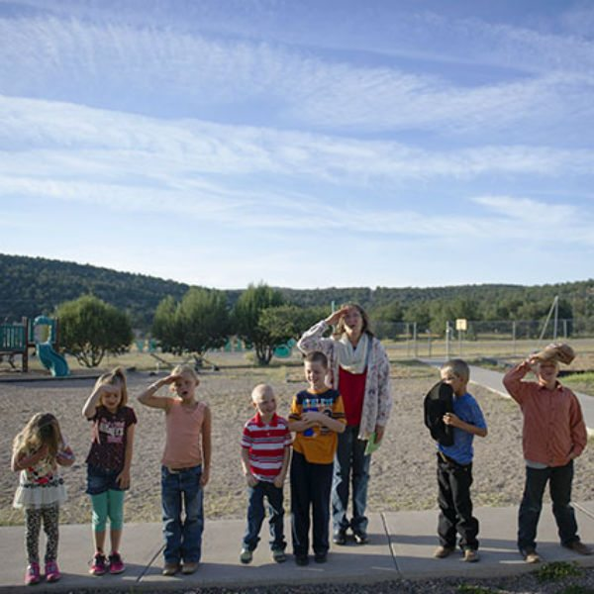
In even more sparsely populated states like New Mexico, rural schoolchildren are faced with unreasonably long commutes, like that of Nikita. In addition, low enrollment has an effect on funding, which means these remote schools are behind the tech curve, a benchmark for the modern campus. With little recourse for this under-served population, groups like the Consortium for School Networking are lobbying for advancements in online access.

Slide 28
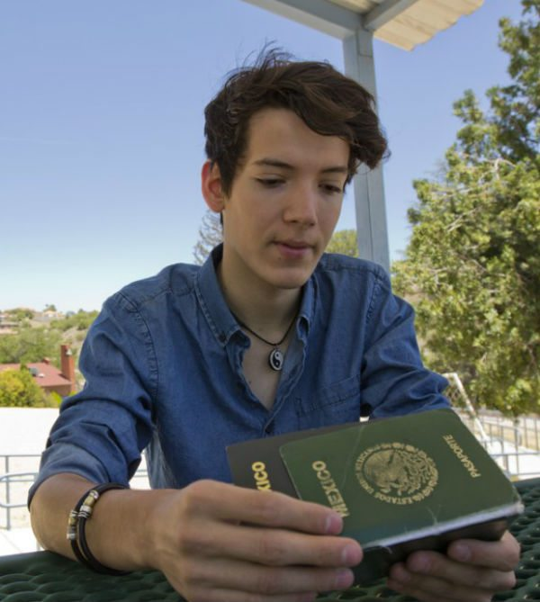
Education without borders! For the entirety of his K-12 education, Jesús Alejandro Espinosa of Nogales, Mexico, would travel across the line of demarcation to Lourdes Catholic School in Tuscon, Arizona. According to figures amassed by a local community organization, more than half of the private school’s student body makes the same commute each day.

Slide 29
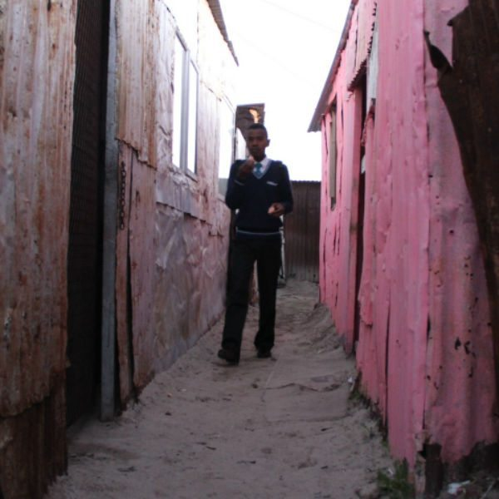
Lukhanyo is a junior at the Center of Science and Technology in Cape Town, South Africa. The walk to school from his family’s three-room metal shack is dangerous, to say the least. The commute takes him through unfamiliar neighborhoods, and the local police are of little help in dealing with gang members along the way. Some taxi drivers honor a tenuous protection agreement with local parents, but transportation remains the central issue for Cape Town’s young students.

Slide 30

This first grader is the model for juvenile independence. Ryuhei Sato swipes his transit card like a public transit regular when he leaves for school in the morning, and get this: he makes the hour-long commute to school by himself every day. In Japan, it is widely believed that a child should be functionally self-reliant by the time he or she reaches grade school.

Slide 31
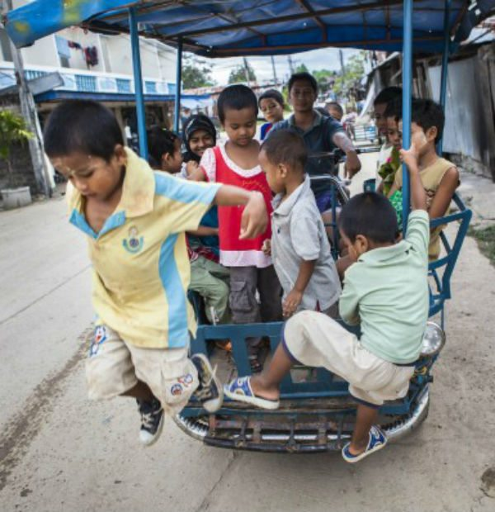
Try this on for size: this motorcyclist is also the teacher! He claims that if he didn’t come around with his som lot (motorcycle rickshaw), his attendance would only be about 50% what it is now. Just in case you were wondering how they do it Mae Sot, Thailand.

Slide 32
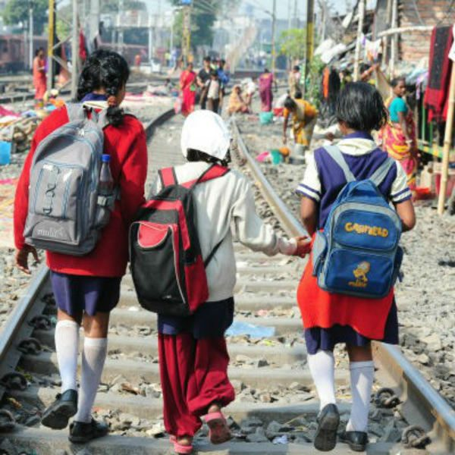
Just a walk in the park. Young lads walking to school in Calcutta, India. Again, we’re looking at boldness in the face of adversity, but when you live it there’s no hesitation. Everyone has to start somewhere, but this city boasts an impressive selection of engineering schools.

Slide 33
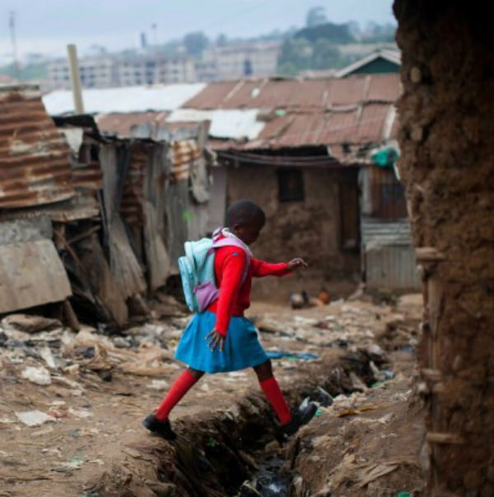
At the Kibera School for Girls in Nairobi, Kenya, there’s no one with the means to transport pupils to and fro. Elizabeth Atenio, age 6, walks an hour each way to get to class, and you can probably tell from the scenery this isn’t the most charming of neighborhoods. We stand in awe of anyone who faces such difficulty and still chooses to seek an education.

Slide 34
Up next is our grand finale, the Most Extreme School Commute in the World…

Slide 35
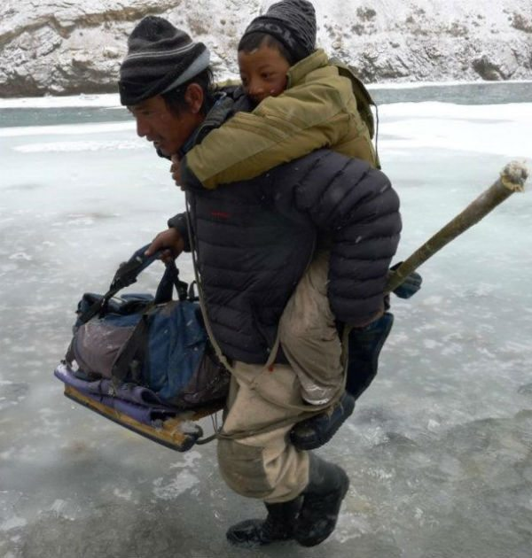
Deep in the Himalayas, one father leads his children along what has been called the most dangerous school run in the world. Trekking along the Zanskar River near Kashmir, this family contends with 100 kilometers of fluctuating conditions, treacherously thin ice, and the occasional avalanche to keep things interesting.

Slide 36
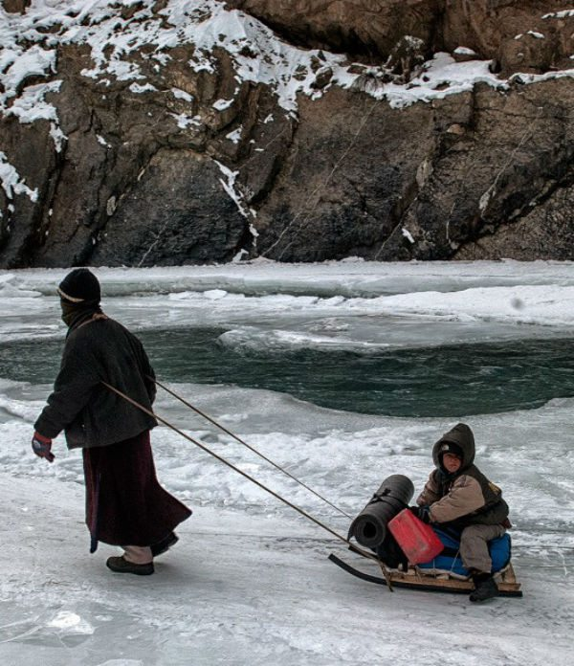
Their harrowing journey getting to and from school is a prime example of the lengths people go to ensure their children’s welfare. It warms the heart to know the desire to learn can transcend the harshest of conditions, and we look forward to finding more extreme school runs for you to read in the future.

