Slide 1
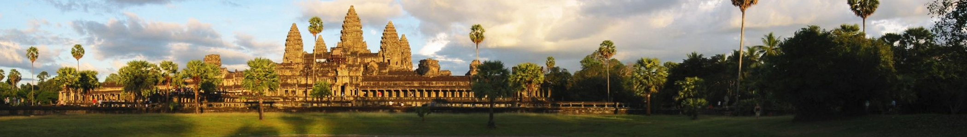
Discover the Wonders of Cambodia's Angkor!
Carmen Dragone

Slide 2
Located in a part of Cambodia that was once the seat of the mighty Khmer Empire, Angkor (meaning 'capital city' in Khmer) was the heart of a civilization that thrived from the 9th to 15th Centuries. There are over 1,000 different temples in Angkor ranging vastly in size, all of which have been restored due to their archaeological significance. The entire area is a UNESCO World Heritage site definitely worth visiting. Don't fret if you can't make it there though - I've put a collection of stunning images of the site just for you:
In 2007, a group of researchers concluded that Angkor had been the largest pre-industrial city in the world, with an elaborate infrastructure system that connected at least 1,000 square kilometers (390 square miles) to the temples at its center. It's estimated that the Angkor area may have supported up to a million people.

Slide 3
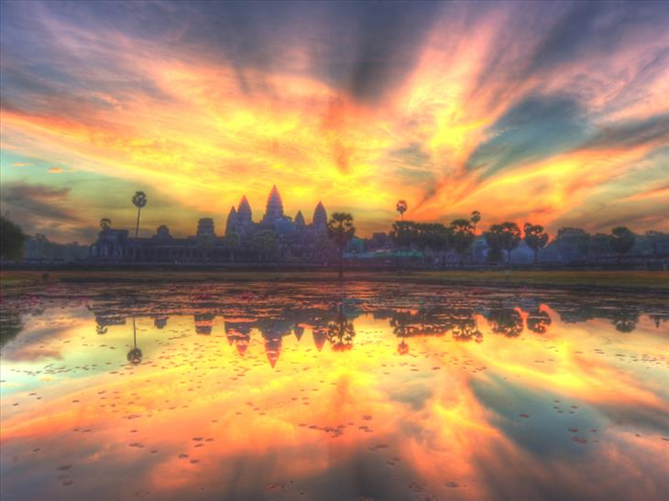

Slide 4
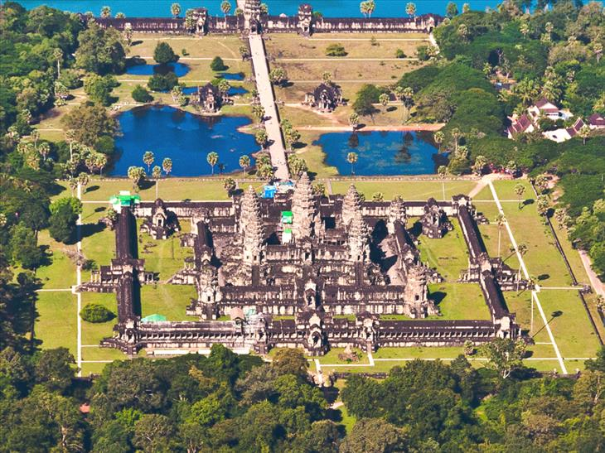
An aerial view of Angkor Wat, the temple dedicated to the Hindu god Vishnu and built as a representation of Mount Meru, the home of the gods and the center of the Hindu universe. The temple is also covered with intricate reliefs of Hindu gods and epics.

Slide 5
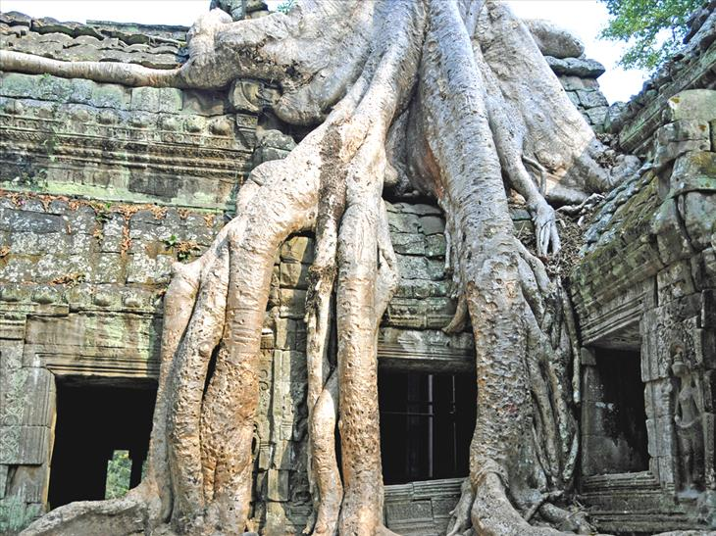
The iconic tree at Ta Prohm. This temple was built during the time of Jayavarman VII and is best known as the temple where trees have become interwoven into the stone.

Slide 6
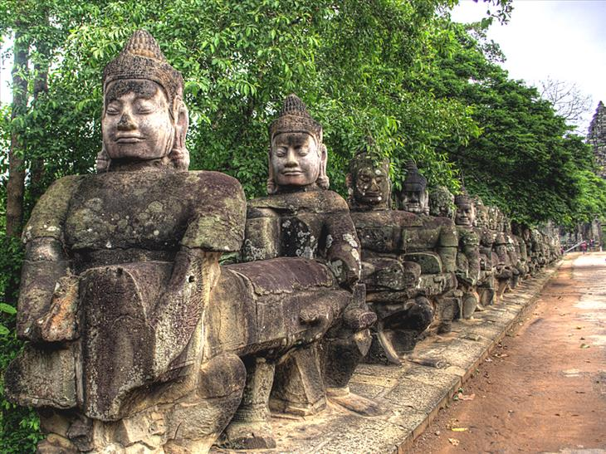
Statues at the gateway to Angkor Thom, or 'The Great City'. These images represent the Hindu myth of creation, called the Churning of the Sea of Milk. On one side of the path, there are 54 guardian gods called devas and on the other side there are 54 images of demon gods called asuras.

Slide 7
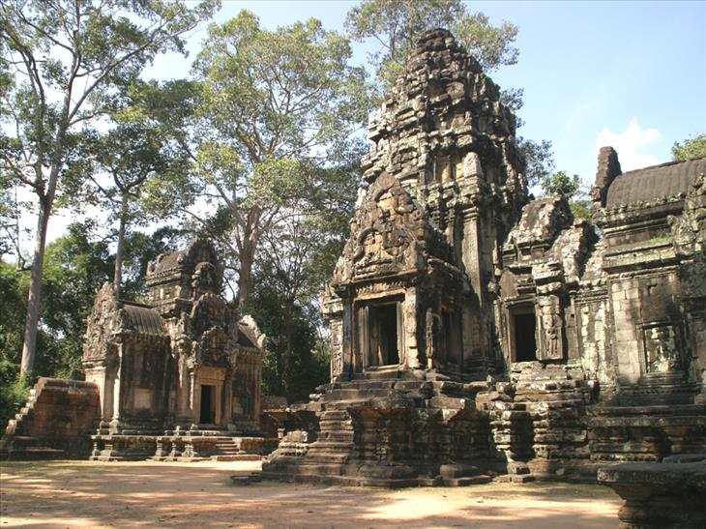
Chau Say Tevoda, another temple built in the style of Angkor Wat in the 12th Century before the construction of Angkor Thom and Victory Way.

Slide 8
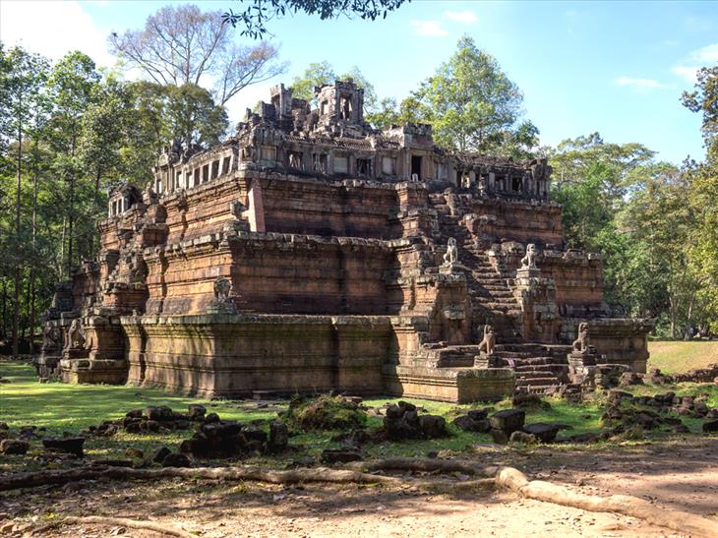
Phimeanakas was built towards the end of the 10th century during the reign of Rajendravarman and later rebuilt by Suryavarman II in the shape of a three-tiered pyramid. According to legend, there was once a tower at the top of this temple.

Slide 9
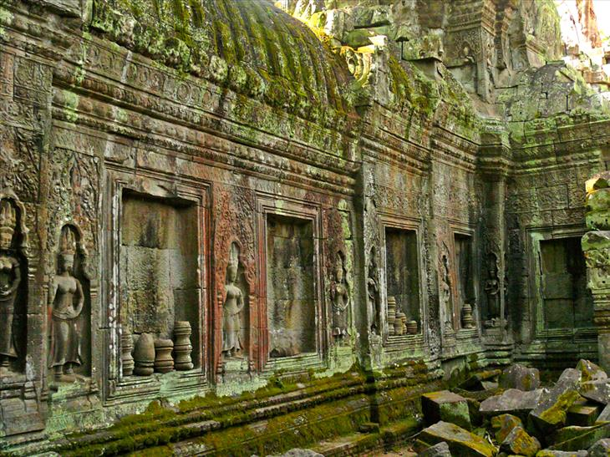
Fine carving at the ruins of the Buddhist temple of Angkor Ta Prohm. The temple dates back to the 12-13th Century and was built by the famous Jayavarman VII.

Slide 10
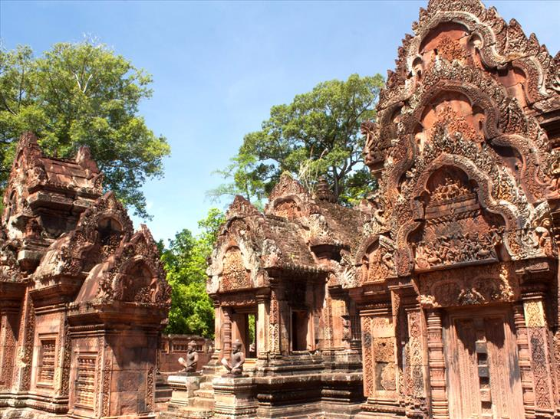
Banteay Srei was a temple built in the 10th Century that was dedicated to the Hindu god Shiva. It is the only major temple built at Angkor that was not built by a monarch, but rather a courtier is credited with the construction.

Slide 11
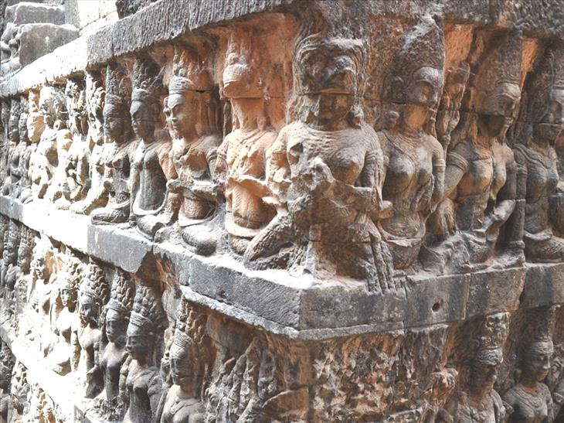
Detailed reliefs of the underworld, part of the Royal Square between the temples.

Slide 12
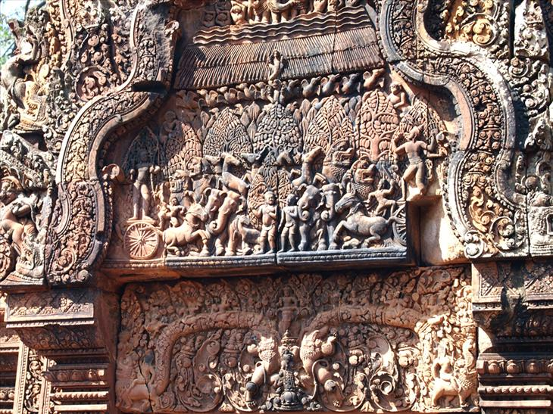
he Banteay Srey temple dedicated to Shiva is popular with tourists because it has been called 'the jewel of Khmer art', due to the atypically small size of the buildings.

Slide 13
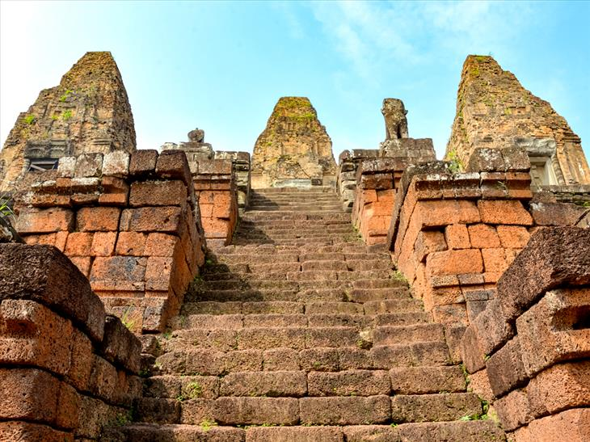
Pre Rup was originally built as the state temple of Khmer king Rajendravarman. It was finished in 961 or 962 and was built entirely of brick, laterite and sandstone.

Slide 14
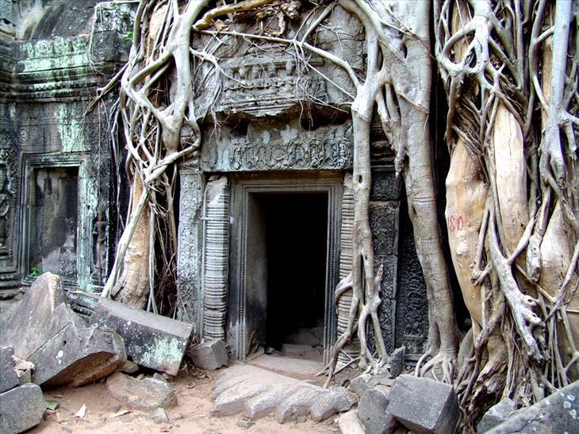
The famous empty doorway of Ta Prohm.

Slide 15
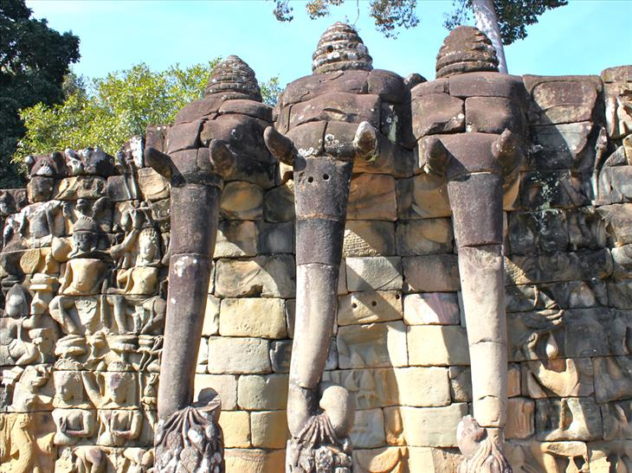
The Angkor Thom terrace of the Elephants named for the 350 meter long (1,148 ft) carvings of elephants on its face.

Slide 16
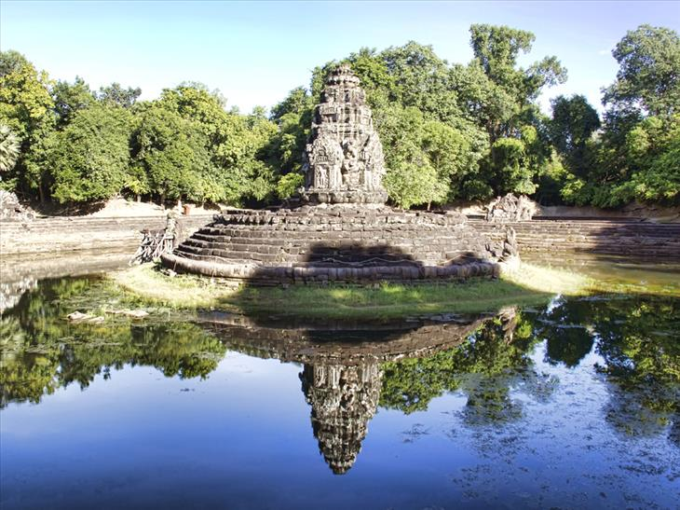
Neak Pean Temple is an artificial island with a Buddhist temple at its center. There are snakes or Naga that cover the bottom of the temple structure.

Slide 17
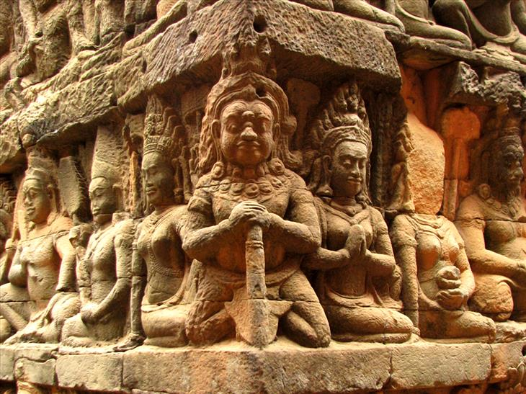
Terrace view of the Leper King in Angkor Thom.

Slide 18
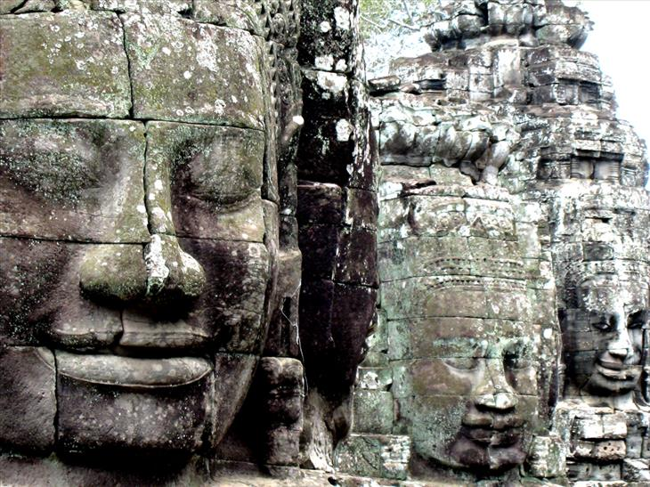
The stone faces of Bayon temple.

Slide 19
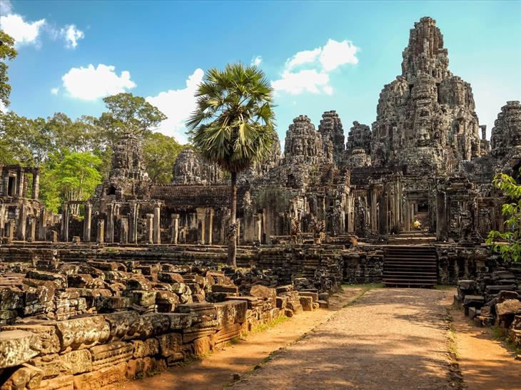
Bayon is a Khmer Buddhist temple that dates back to the 13th Century.

Slide 20
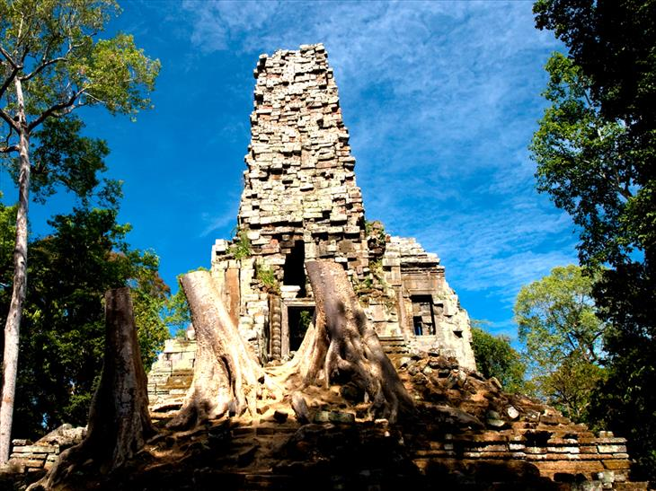
Preah Palilay. New research suggests that this entrance to a grid of canals was built as a shortcut for workers building Angkor Wat. This might explain how the temple was built in a mere 20 years.

Slide 21
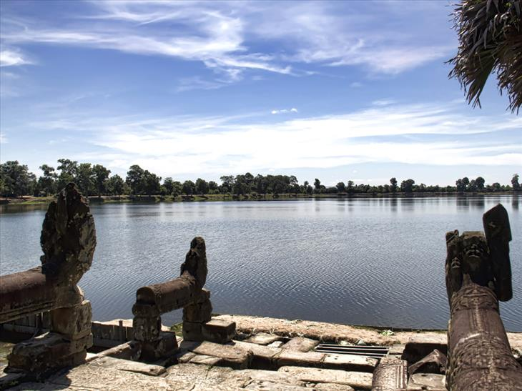
Srah Srang reservoir that was built during the mid-10th Century. There are steps that lead down to the water guarded by two lions.

Slide 22
Additional Photos

Slide 23
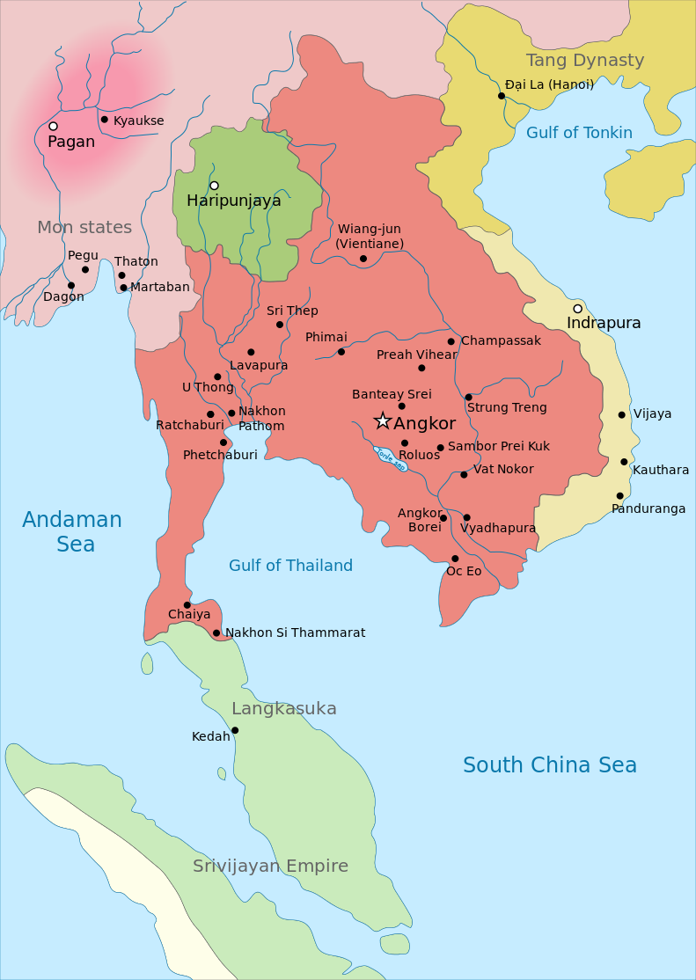
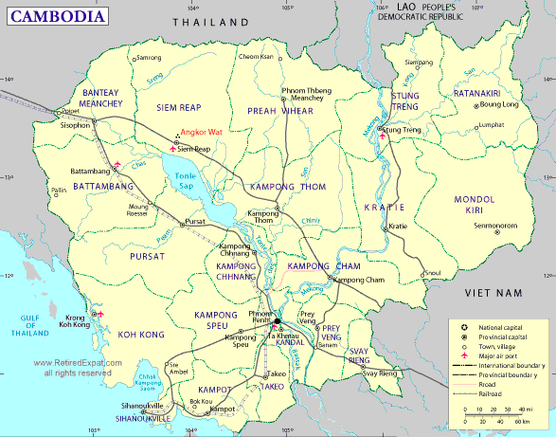

Slide 24
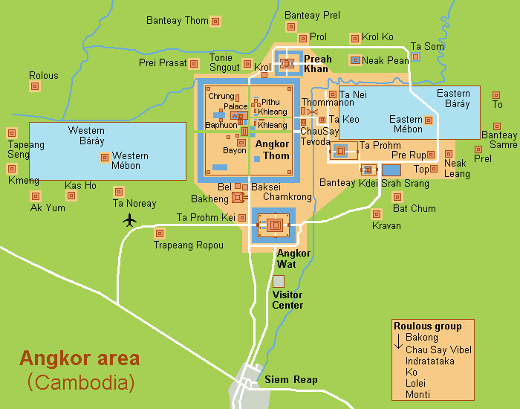

Slide 25
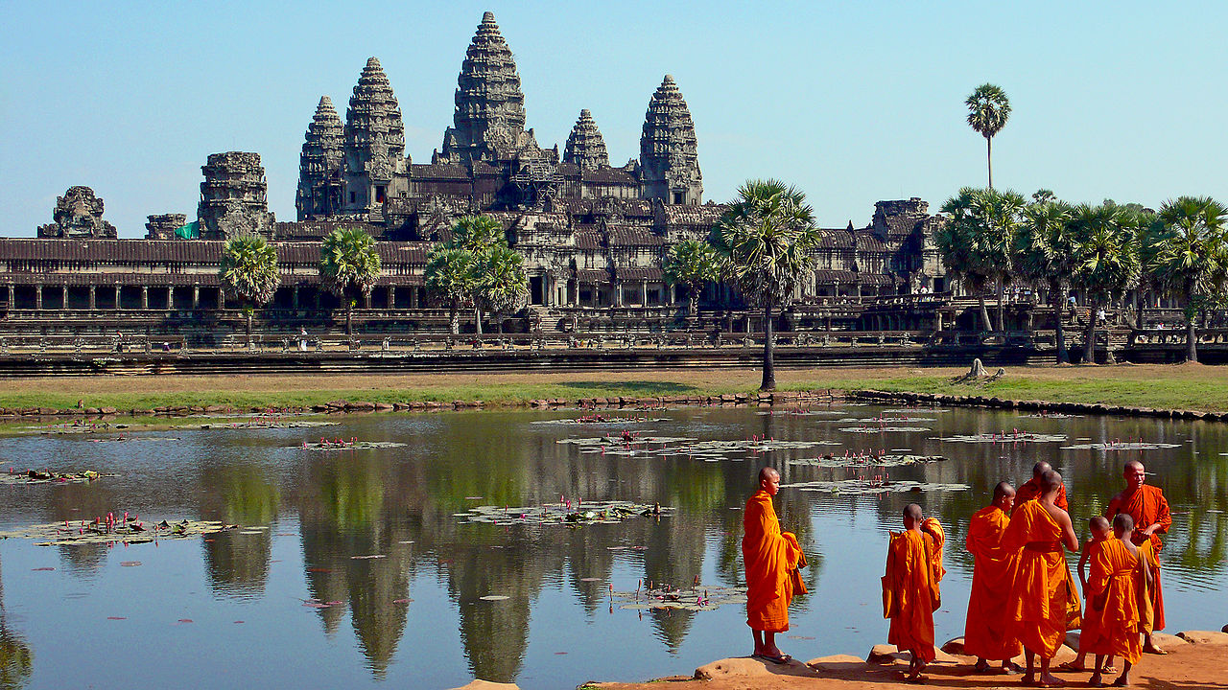

Slide 26
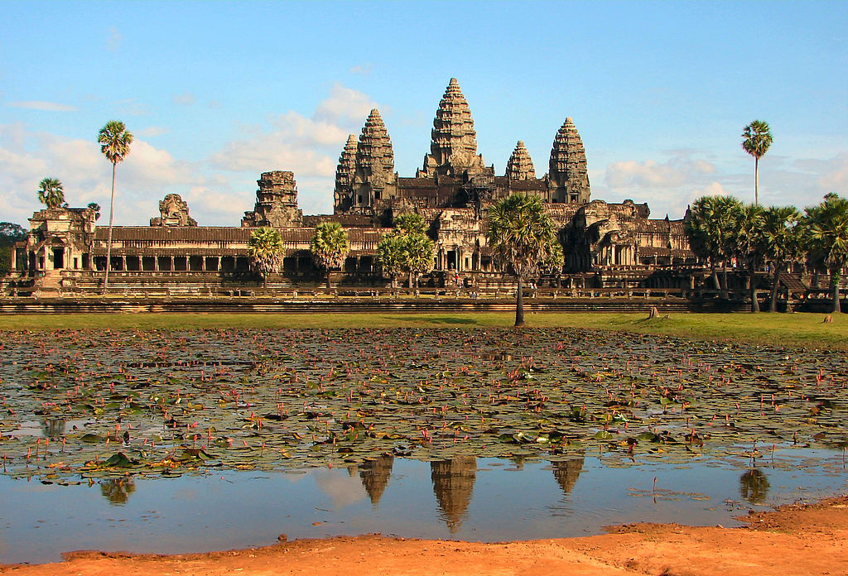
Main Complex

Slide 27
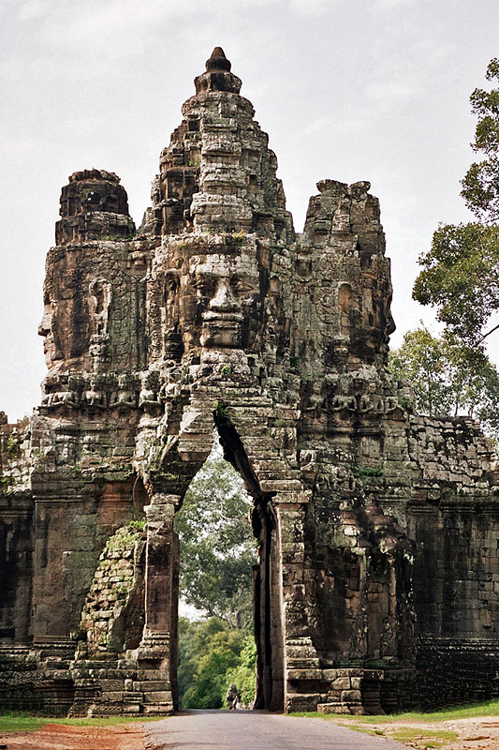
Gate into Angkor Thom

Slide 28
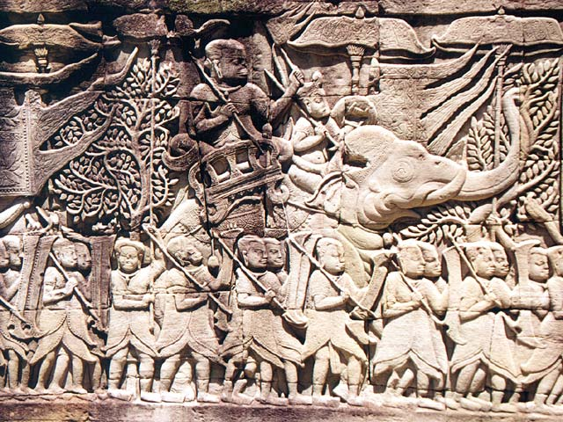
Khmer army going to war against the Cham; relief at the Bayon-temple in Angkor, Cambodia (S section, E gallery, late 12th to beginning 13th century)

Slide 29
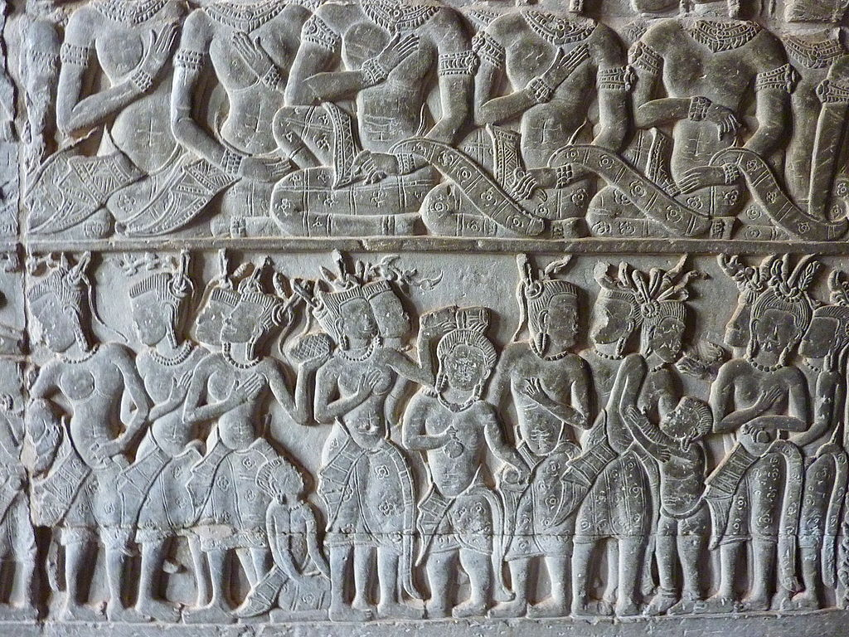
055 Frieze at Angkor Wat Photograph from Angkor Wat in Cambodia taken by Anandajoti.

Slide 30
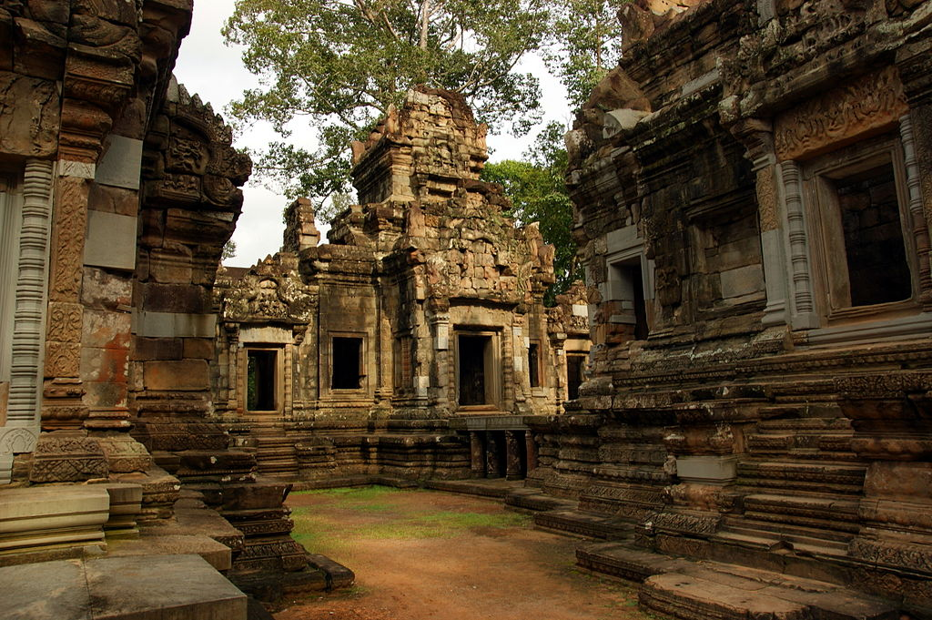
Chau Say Tevoda

Slide 31
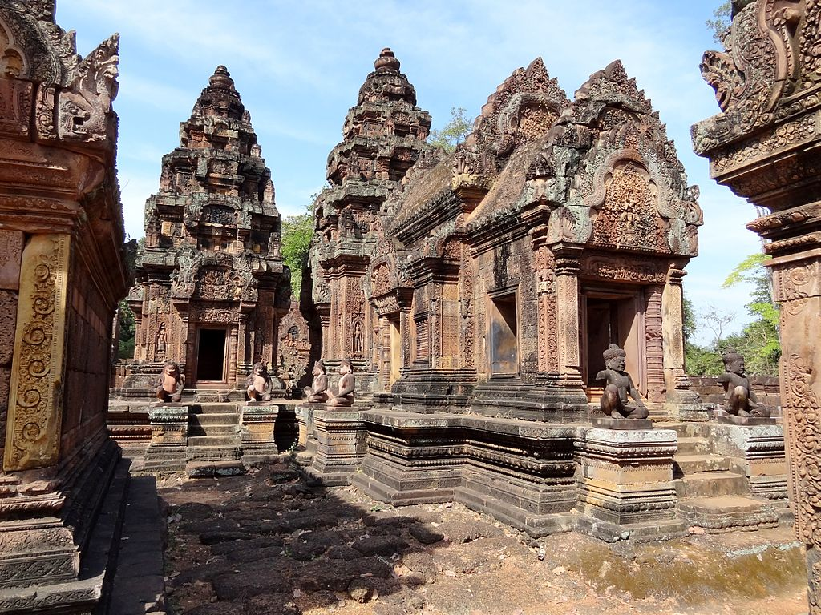
Banteay Srei

Slide 32
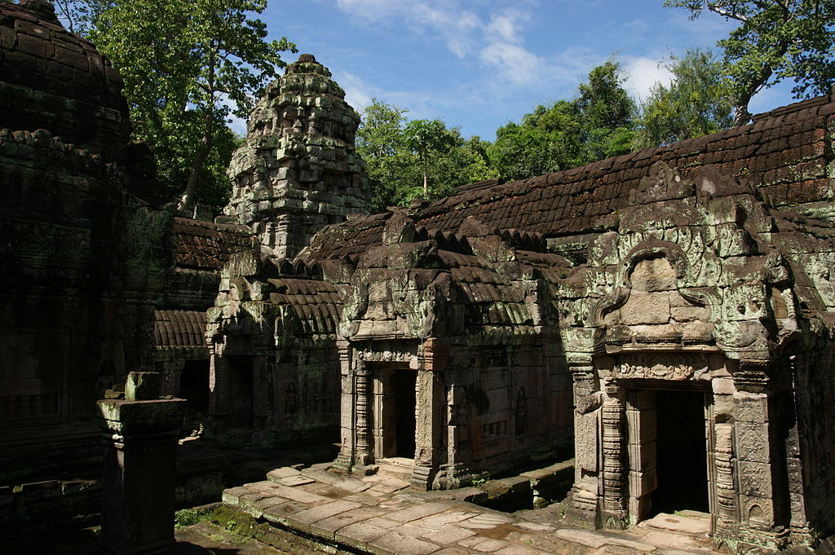
Preah Khan

Slide 33
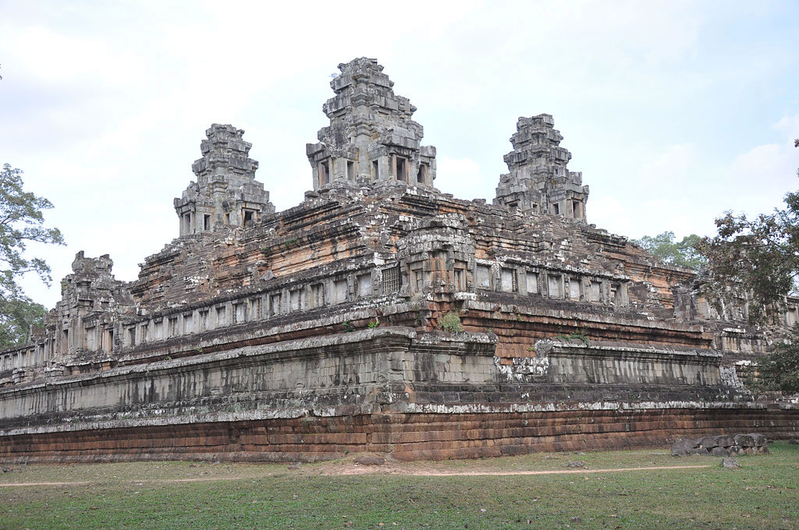
Ta Keo

Slide 34
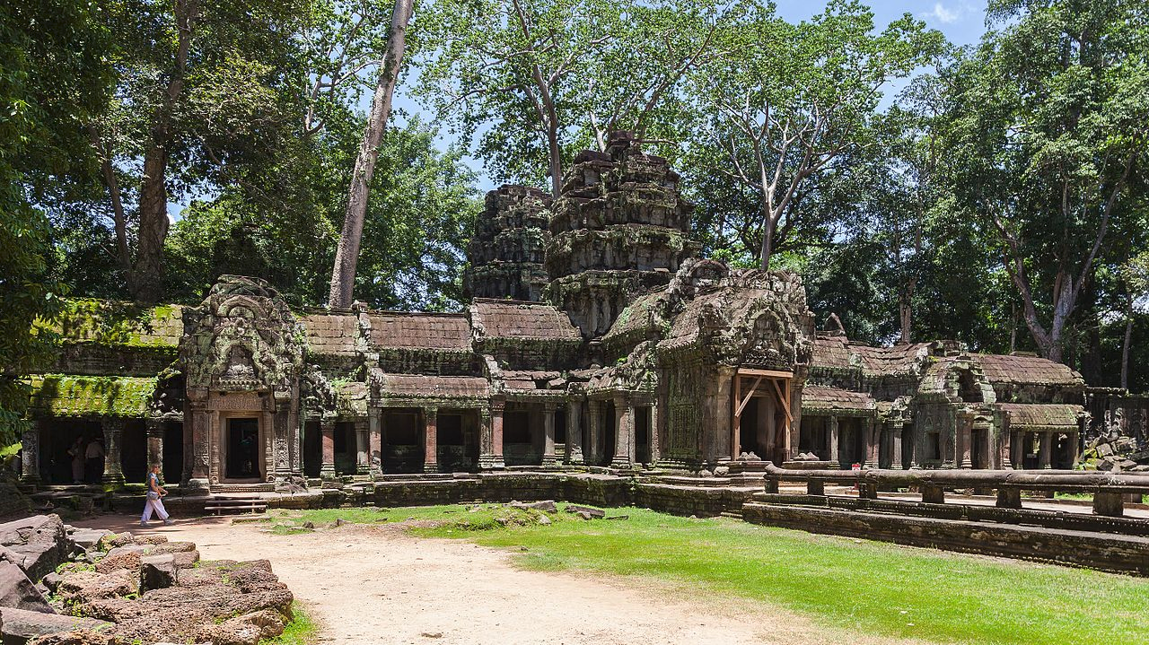
Ta Phrom

Slide 35
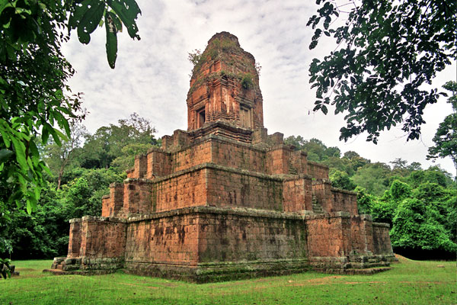
Dedicated by Rajendravarman in 948 A.D., Baksei Chamkrong is a temple-pyramid that housed a statue of Shiva

