Slide 1
Delightful Amish Proverbs
A look at Amish culture

Slide 2

“The reason some people get lost in thought … is because it is unfamiliar territory.” That’s a favorite Amish proverb of novelist Suzanne Woods Fisher, who advises “Most of us wouldn’t last a day in an Old Order Amish world. As appealing as a life ‘unplugged’ might seem, in a few hours we’d start to miss our laptop, iPhone, or car.”

Slide 3
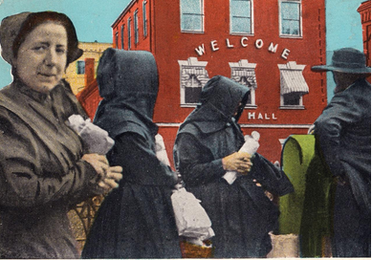
Words of simple wisdom
“But that doesn’t mean we can’t learn a few life lessons from the Plain people,” writes Fisher, author of a number of novels about the Amish, including The Letters, the first in the new The Inn at Eagle Hill series, “things that go beyond buggies, bonnets and beards.”

Slide 4
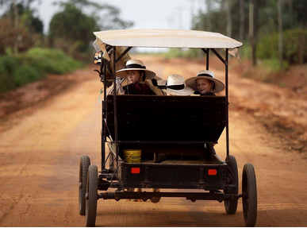
Words of simple wisdom
“Advice when most needed is least heeded” is another of her favorites. Another gem: “A woman’s work is not seen unless it’s not done.”

Slide 5
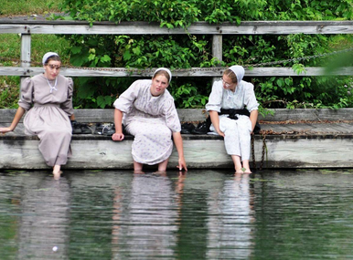
“Money is not the measure of a man, but often of finding out how small he is” is another classic Amish proverb from Fisher’s family heritage. It’s that rich background that lends such credibility to her novels.

Slide 6
“It is better to suffer wrong than to commit wrong.” The author's newest book was inspired by a true story in which a Mennonite investment fund manager mismanaged funds. Although the Amish and Mennonite investors were entitled to take him to court and make claims on the liquidated assets of the investment company, they chose not to. For biblical reasons, the Amish won’t sue anyone in a court of law. If they are wronged, so be it.

Slide 7
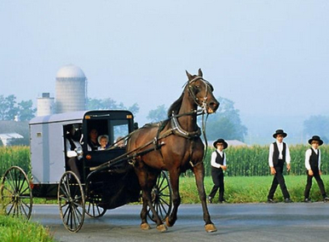
“A man is happier to be sometimes cheated than to never trust.” Instead, Plain communities across the country took up donations to help reimburse those who had lost money in the fund. To the Amish way of thinking, vengeance belongs to God. They conduct modern business the old-fashioned way – with a handshake, a word of honor, and trust.

Slide 8
“Teaching children to count is fine, but teaching what counts is better.” One storyline running through The Letters is about an oh-so-proper Amish grandmother who allows her granddaughters to keep one book in the house (beside the Holy Bible and Fox’s Book of Martyrs). The book is called A Young Woman’s Guide to Virtue and was published in 1948. The granddaughters find the book to be thoroughly old-fashioned and outdated, but surprisingly, they pull wisdom from it as they navigate their own teenaged pitfalls. In her own way, this Amish grandmother gets her message across, loud and clear.

Slide 9
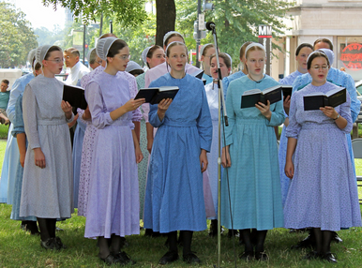
“A man is happier to be sometimes cheated than to never trust.” Instead, Plain communities across the country took up donations to help reimburse those who had lost money in the fund. To the Amish way of thinking, vengeance belongs to God. They conduct modern business the old-fashioned way – with a handshake, a word of honor, and trust.

Slide 10
“The time to make friends is before you need them.” True friendship includes to give and receive, to help and be helped.
“Experience is the great teacher.” Apprenticeships for the young are common among the Amish. It ties in with their learn-by-doing philosophy. When work is to be done, the Amish don’t exclude children or young people and keep them at home. Instead, the children are part of the work party, given age-appropriate tasks.

Slide 11
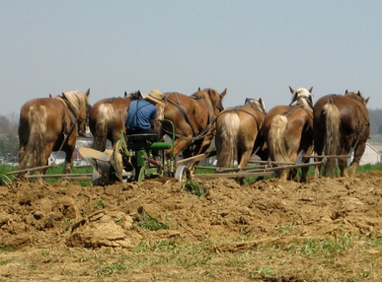
“You will always leave something behind. Your influence.” A theme in Amish life is the power of example. It’s customary to include children in all parts of life – lengthy church services, weddings, funerals, barn raisings – so they are constantly steeped in good modeling.

Slide 12
“We need old friends to help us grow old and new friends to help us stay young.” In The Letters, another storyline deals with a horse trainer who takes on an immature, impulsive, and “often wrong but never in doubt” apprentice – an exasperating personality! But both men benefit from the experience.
“If you don’t give up you haven’t lost.” Perseverance, to the Amish, is highly valued.

Slide 13
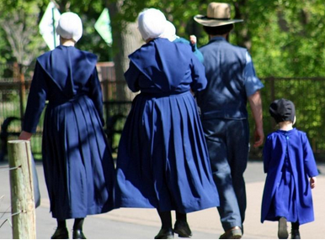
“The time to make friends is before you need them.” True friendship includes to give and receive, to help and be helped.

Slide 14
“Teaching children to count is fine, but teaching what counts is better.” One storyline running through The Letters is about an oh-so-proper Amish grandmother who allows her granddaughters to keep one book in the house (beside the Holy Bible and Fox’s Book of Martyrs). The book is called A Young Woman’s Guide to Virtue and was published in 1948. The granddaughters find the book to be thoroughly old-fashioned and outdated, but surprisingly, they pull wisdom from it as they navigate their own teenaged pitfalls. In her own way, this Amish grandmother gets her message across, loud and clear.

Slide 15
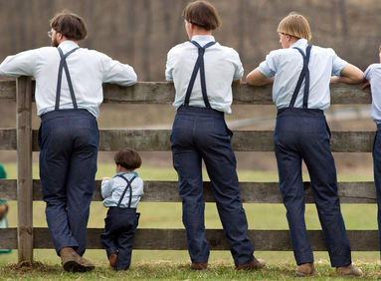

Slide 16
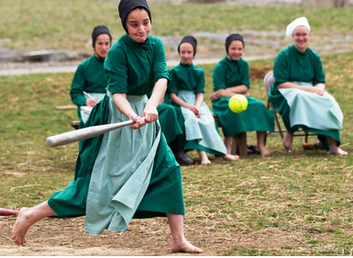
“We need old friends to help us grow old and new friends to help us stay young.” In The Letters, another storyline deals with a horse trainer who takes on an immature, impulsive, and “often wrong but never in doubt” apprentice – an exasperating personality! But both men benefit from the experience.

Slide 17
“Good deeds have echoes.” Does it seem like a stretch of fiction to read about Amish helping the non-Amish? If so, you might be surprised to learn that the Amish often come to the aid of others. Many men are volunteer fire fighters or travel with CAM (Christian Aid Ministries) to help areas hit by natural disasters. Amish women make tied quilts to send to prisoners.
“Those who had no children know best how to raise them.” Some Amish families take in foster children. They do these acts of kindness quietly, though, without drawing attention to themselves. The Amish believe that we are made in the image of a God who is by nature good. Doing good is God’s work. Think of the impact of a good deed or kind word.

Slide 18
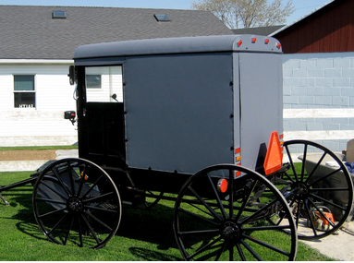

Slide 19
“You cannot do everything at once but you can do something at once.” If you are under the impression that the Amish don’t have a sense of humor, well, “have another think.”
“Raising boys is as easy as digesting iron.” Get your daily dose of Amish Wisdom by downloading Suzanne’s free app!
Here is Suzanne’s family favorite: “Every mother crow thinks her own crow is the blackest.”

Slide 20
Amish Life – Living “Plain”
Each Amish community has it’s own bishop and each community has a set of rules, or the Ordnung (The Ordnung is a set of rules for Amish, Old Order Mennonite and Conservative Mennonite living. Ordnung is the German word for order, discipline, rule, arrangement, organization, or system.) So what is allowable, particularly with technology, may differ from community to community.

Slide 21
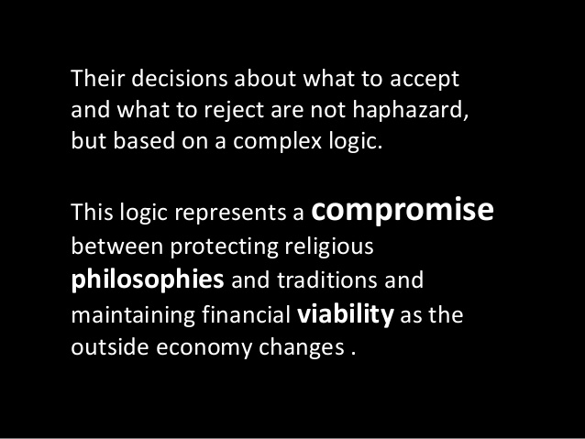

Slide 22

Where they live

Slide 23
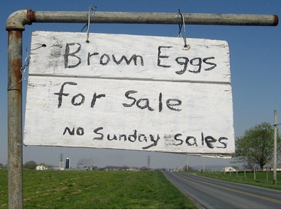

Slide 24
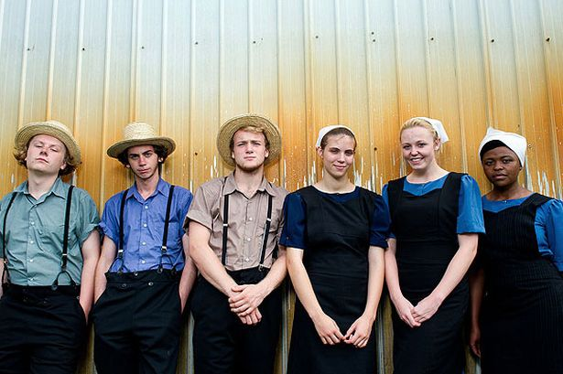
Rumspringa
Rumspringa (Pennsylvania German lit. "running around") is the period of adolescence that begins the time of serious courtship. As in non-Amish families, it is understood that there will likely be a certain amount of misbehavior, but it is neither encouraged nor overlooked. At the end of this period, Amish young adults are baptized into the church, and usually marry, with marriage permitted only among church members. A small percentage of the young people choose not to join the church, deciding to live the rest of their lives in wider society and marry someone outside the community. Since most Amish learn “Old German,” people living outside the Amish community are referred to as “Englishers.”

Slide 25
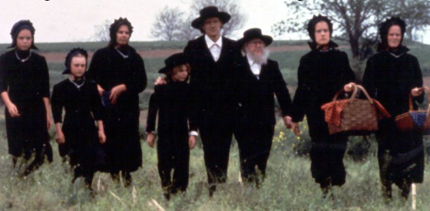
Three-generation family

Slide 26
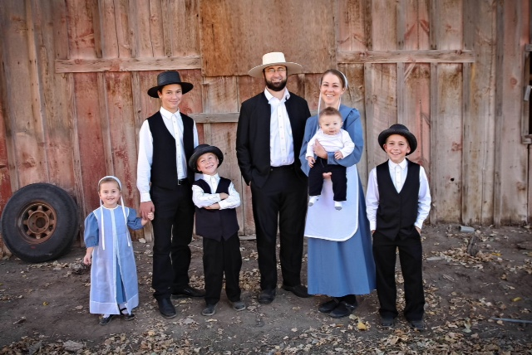
Nuclear Family

Slide 27
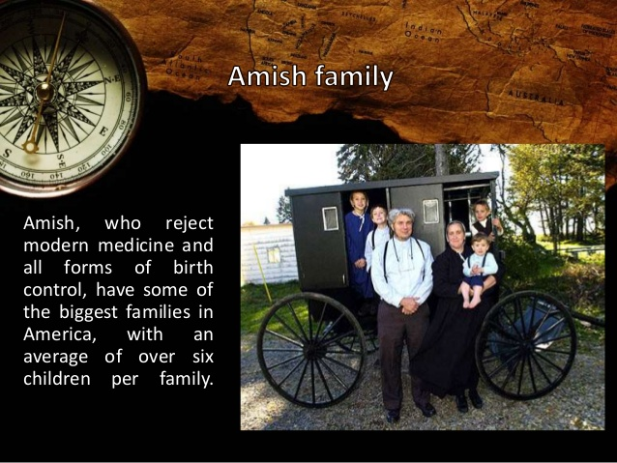

Slide 28
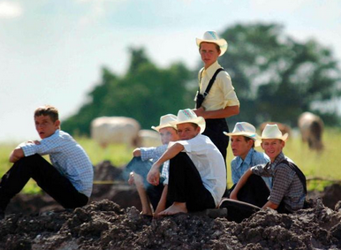

Slide 29
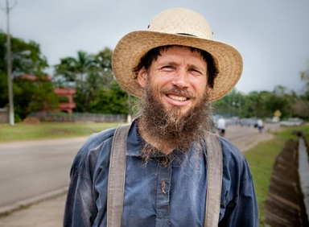

Slide 30
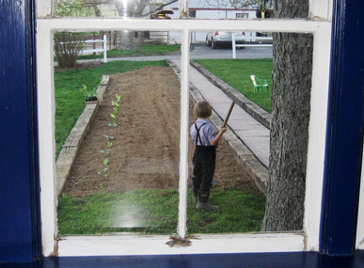

Slide 31
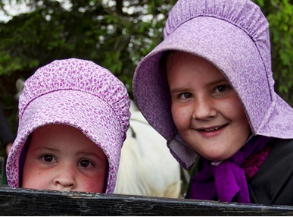

Slide 32

Barn Raising – neighbors working together

Slide 33

One-room School House

Slide 34

Basic elementary school education is provided

Slide 35
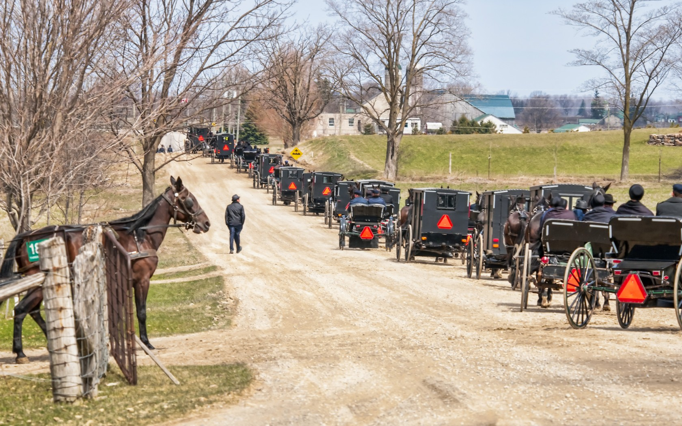
Probably going to church – services are held in private homes - everyone takes a turn.

Slide 36
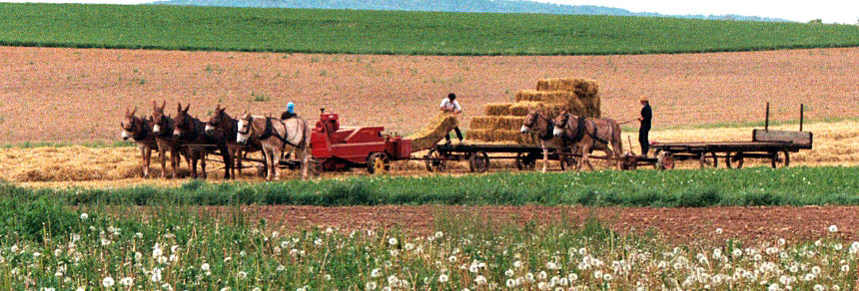
Some communities allow the use of some modern equipment

Slide 37
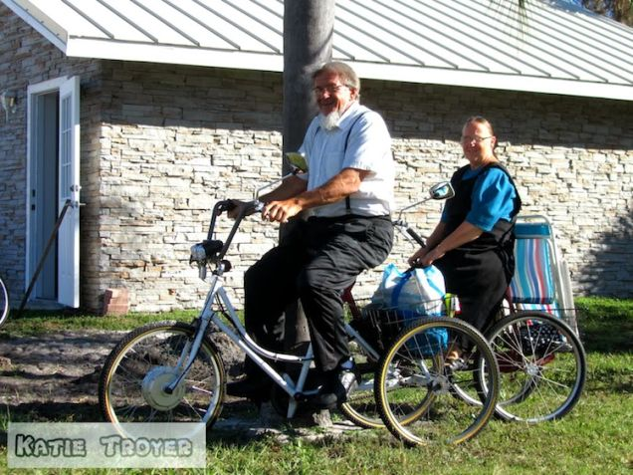

Slide 38

Going to town – autos and buggies don’t always mix well.

Slide 39
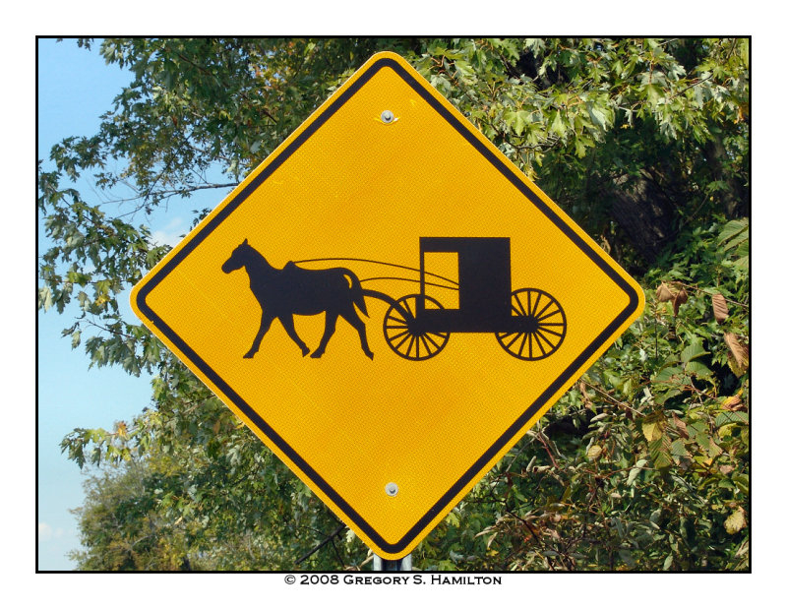

Slide 40
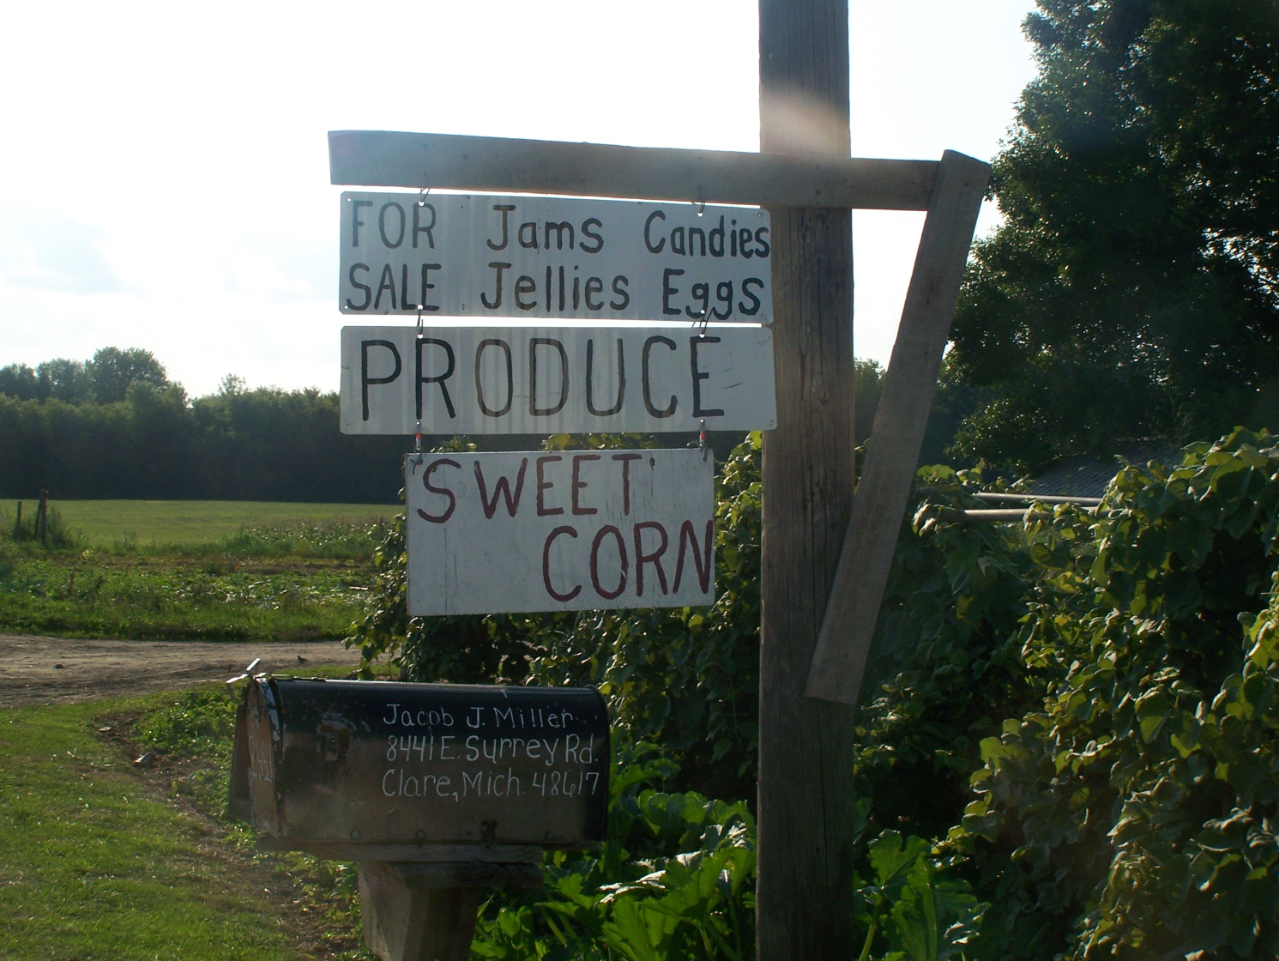
Amish Businesses
Some have opened stores in nearby towns to reach a larger market with their home-made products – food products to furniture.

Slide 41
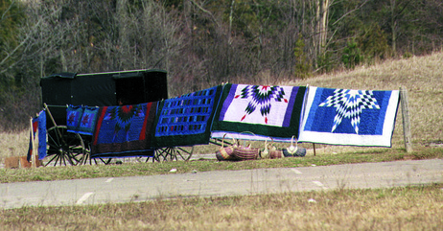
Road-side stand selling quilts and baskets

Slide 42
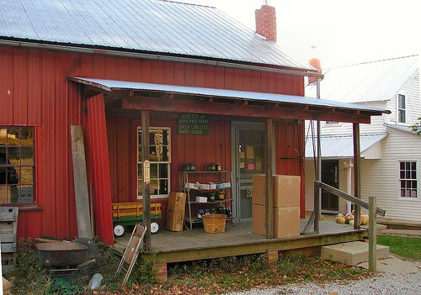

Slide 43


Slide 44
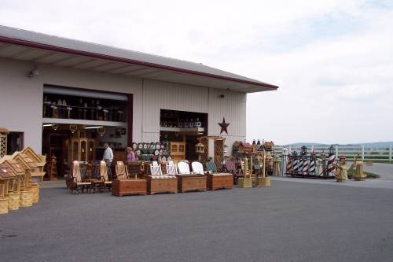

Slide 45


Slide 46
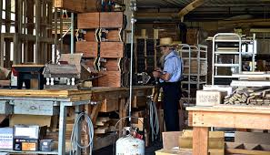
Amish business

Slide 47
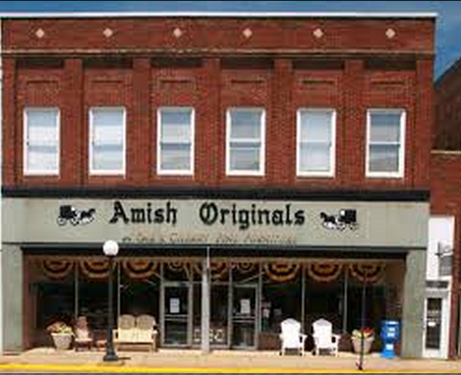

Slide 48
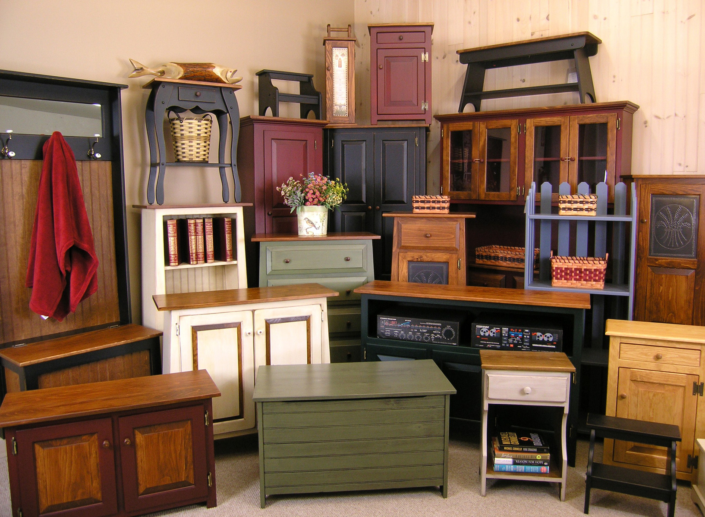

Slide 49
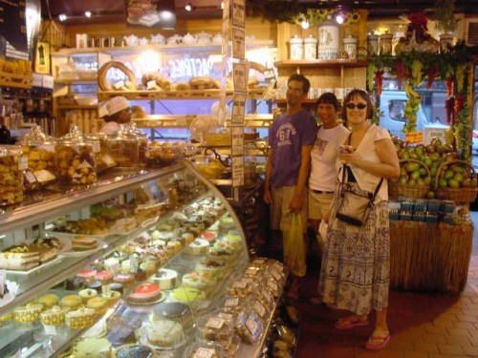

Slide 50
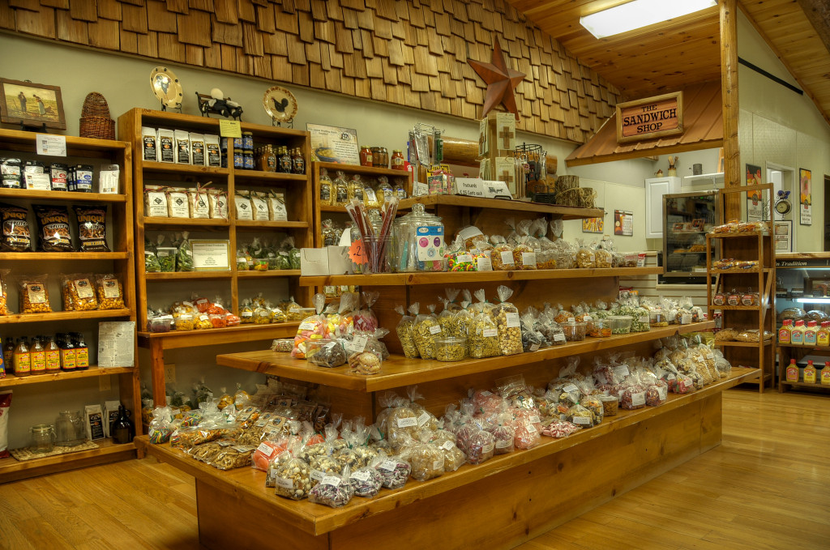
Amish General Store

