Slide 1
Child labor circa. 1900

Slide 2
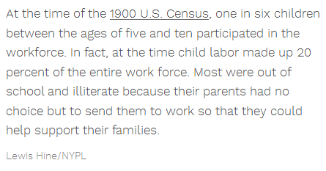

Slide 3
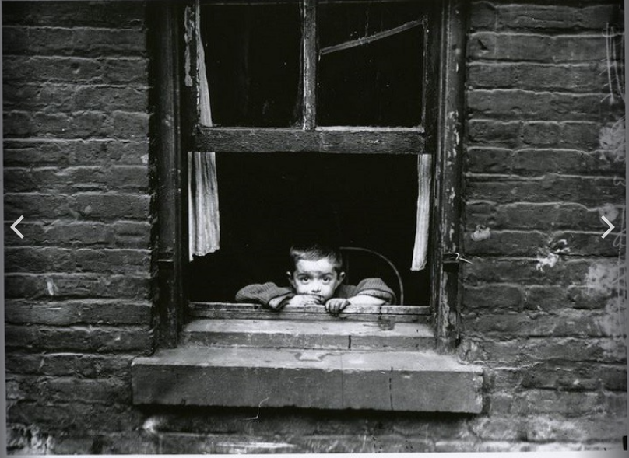

Slide 4
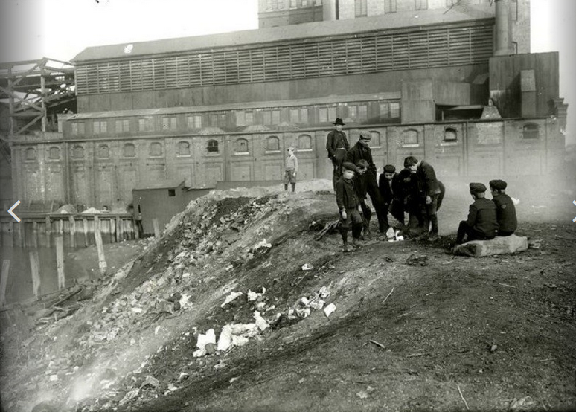

Slide 5
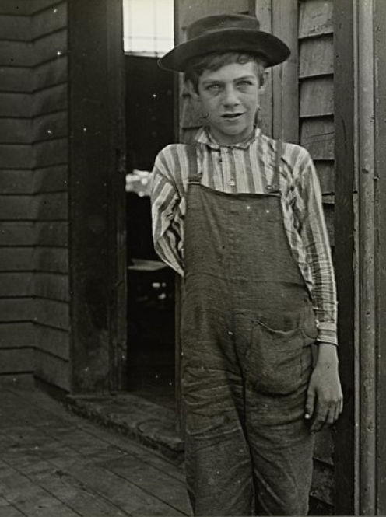
Injuries
In 1900 1million people were injured at work, many being children.

Slide 6
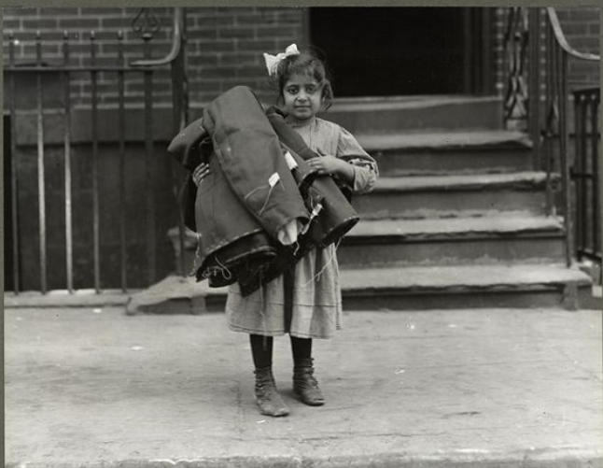
Setting up “home” sweat shops, children under the age of 14 were put to work, gertting around the child labor laws of the time.

Slide 7
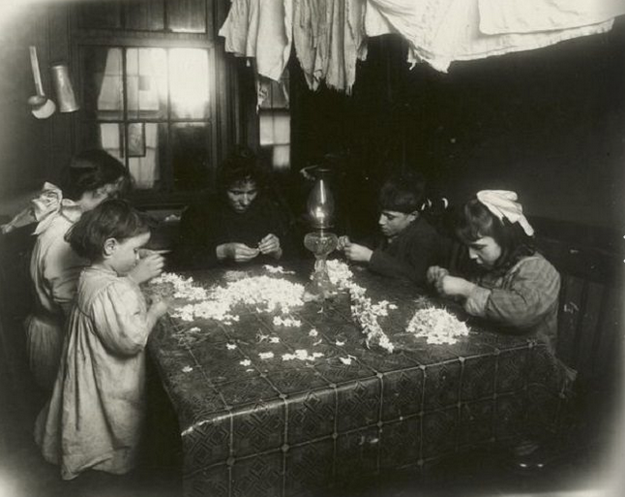

Slide 8
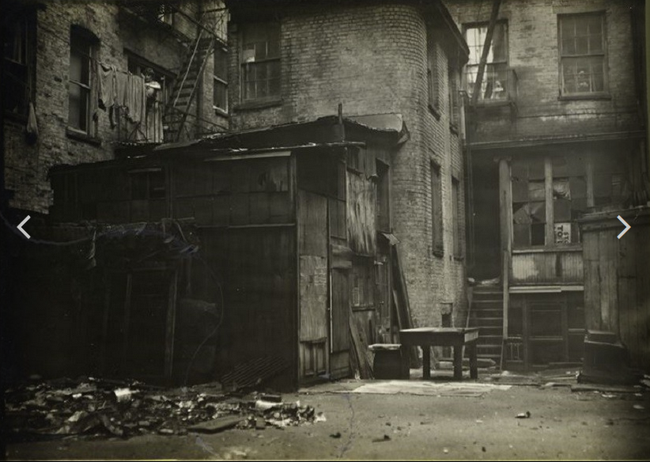
Many lived in substandard tenement housing.
Cold water flats
Heating and cooking on coal stoves
Backyard “outhouses”

Slide 9
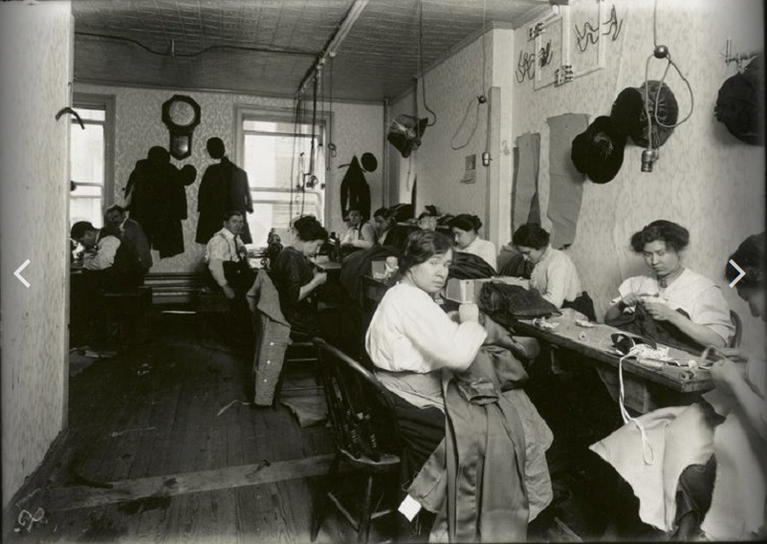
Immigrants working in a sweatshop

Slide 10
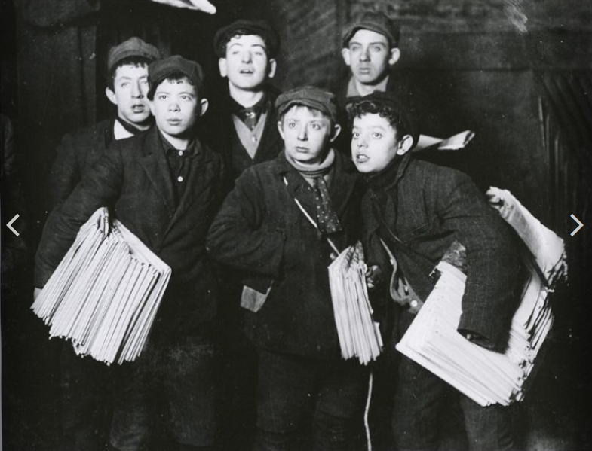

Slide 11
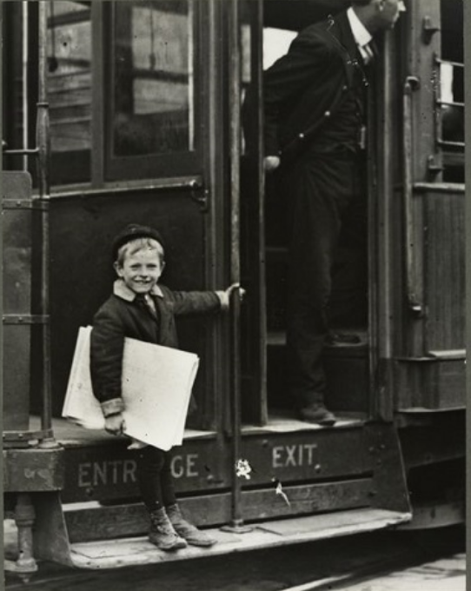
1899, news boys went on strike against Hearst and Pulitzer newspapers.

Slide 12
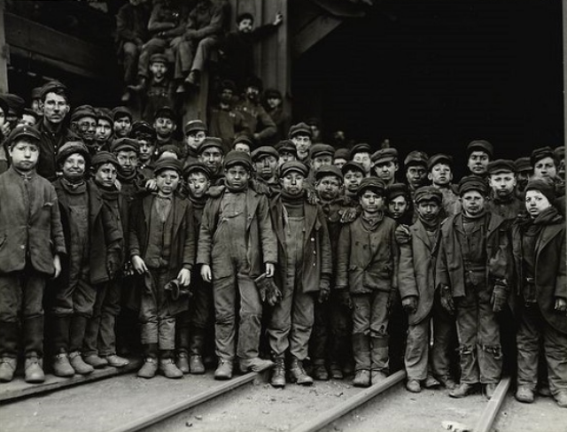
Young boys who worked in coal mines lacking any kind of reliable safety equipment.

Slide 13
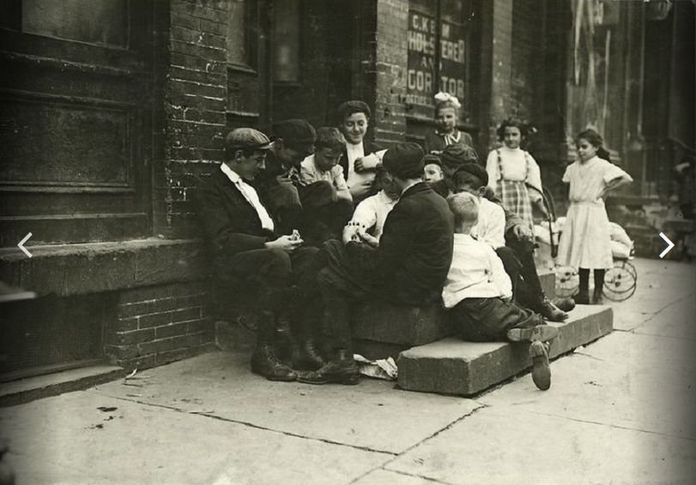
Playing cards outside of a factory.

Slide 14
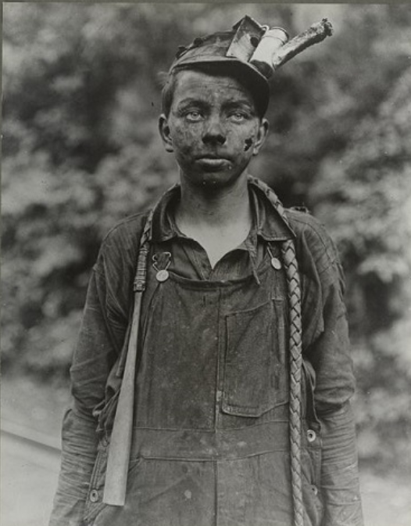
New law – boys under the age of 12 could not be employed to brake up coal. Believe it or not, this was an improvement in working conditions.

Slide 15
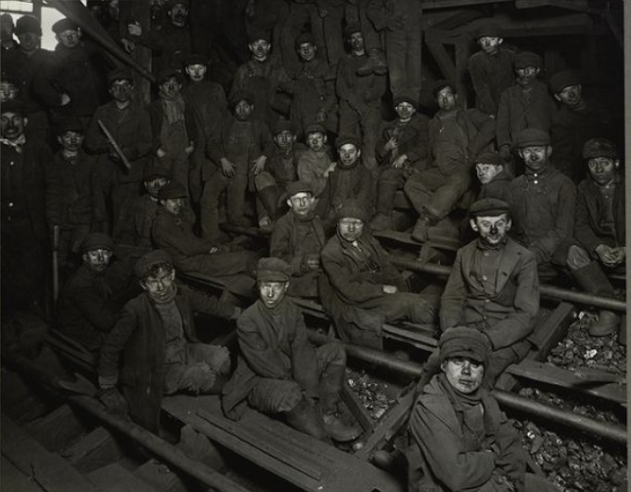

Slide 16
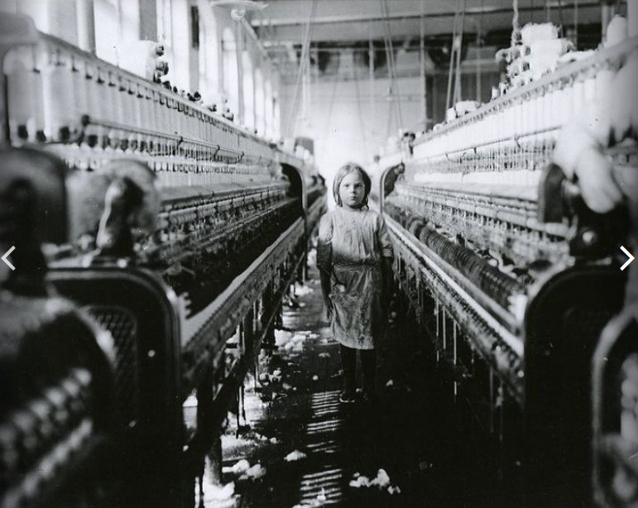
Children worked in textile mills

Slide 17
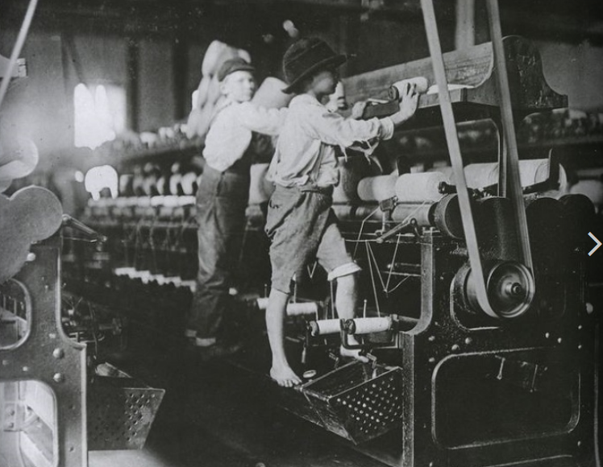

Slide 18
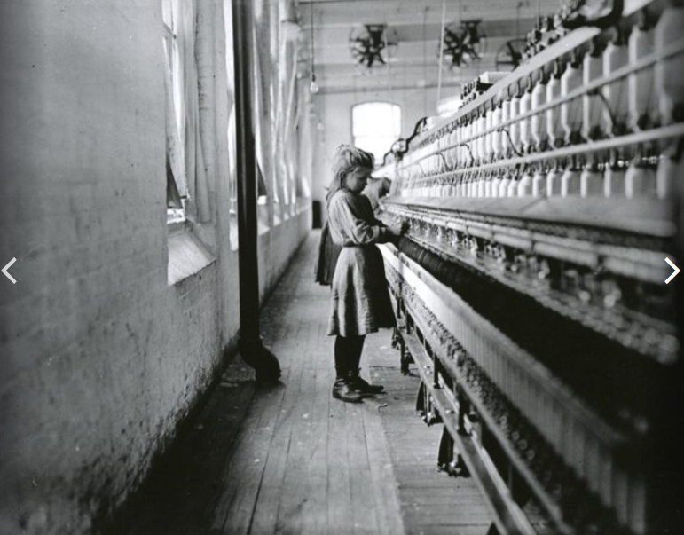

Slide 19
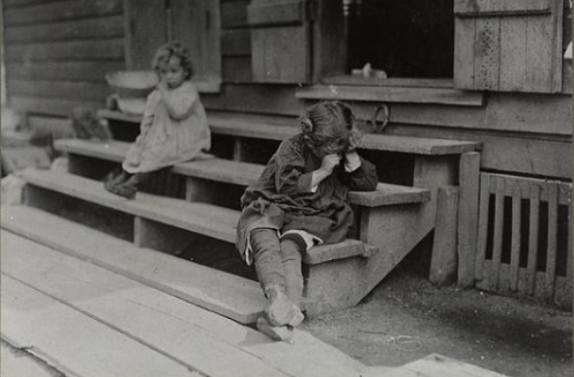
Girl resting after a long day at work.

Slide 20
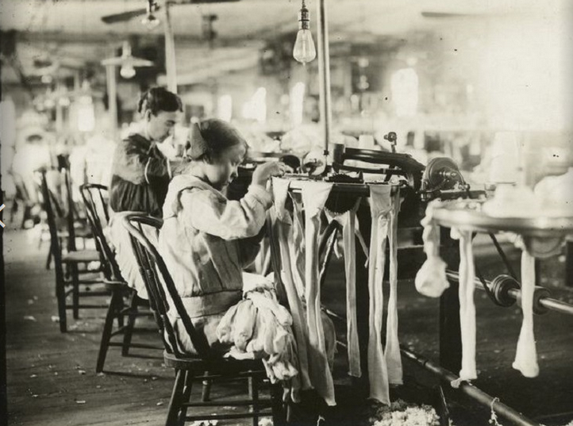

Slide 21
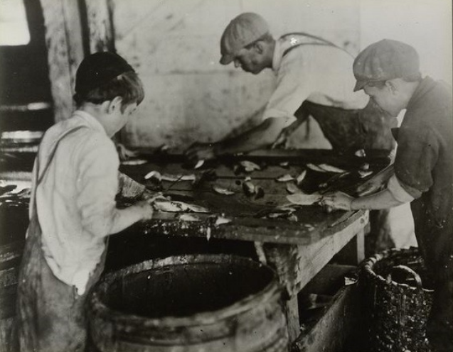
Working in a sardine cannery.

Slide 22
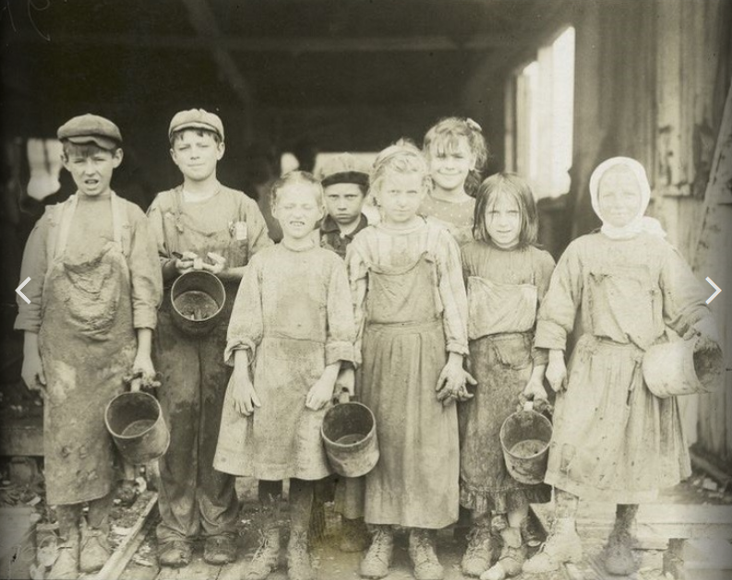
Oyster shuckers

Slide 23
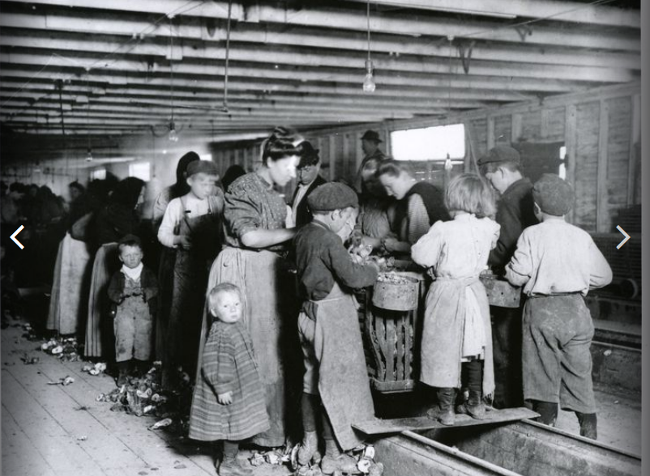
Unable to pay for childcare, women take the little ones to the cannery.

