Slide 1
About the Mayans

Slide 2
Putting in perspective
If you have a quick look at the history books, you'll find large sections devoted to Ancient Greece, The Egyptians, The Romans etc. At least, those are the periods most often taught in Western schools. But little is known about the pre-Columbus Maya peoples. And no, Mel Gibson's 2006 film 'Apocalypto' doesn't count as an accurate source of Mayan information.
Instead, let Lifehack Lane take you through some fascinating facts about the Mayans you're likely to have never come across. Some additions were made by Joe Naumann – UMSL.

Slide 3
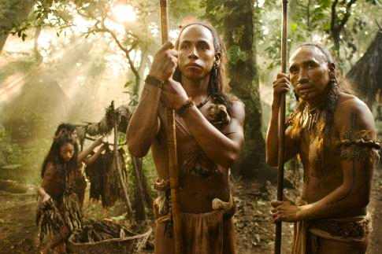

Slide 4
Written Language
The Mayans formed the first pre-Columbus writing system in the Americas, which is thought by historians to date back to as far as the 3rd century BC. Historians believe the writing used 800 different glyphs which, as you can see, appears somewhat reminiscent of the Egyptian hieroglyphs, even though the actual writings have no direct parallels. Pretty cool, right?
Well, the Spanish didn't think so, and after burning any Mayan-related documents they could get their hands on, only four books with Mayan writings are believed to be in existence. See the next slide . . .

Slide 5
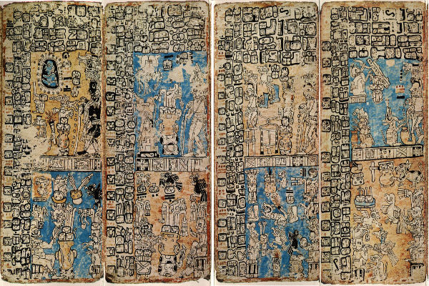

Slide 6
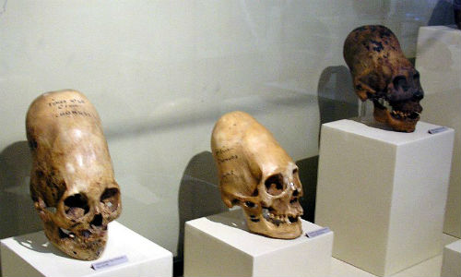
Beauty is culturally relative
If you thought the modern-day world was riddled with vanity, then wait until you read this. Believe it or not, The pre-Columbian Mayans enhanced their children's features by regularly pressing boards against their children's forehead to preserve any early onsets of wrinkling! But, as was often the case, such pressing resulted in the forehead receding.

Slide 7
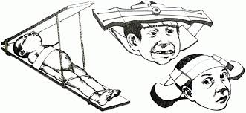
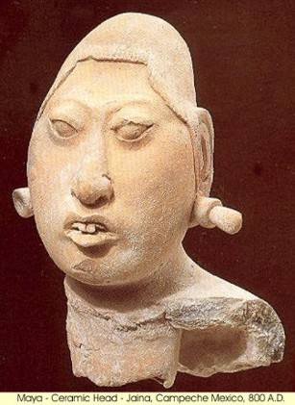
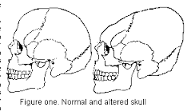

Slide 8
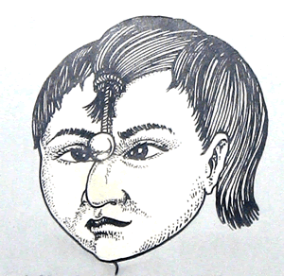
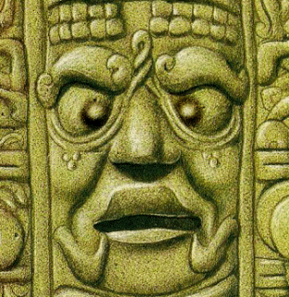
Crossed eyes?
To be deemed noble, Mayans often saw being cross-eyed as a key characteristic, which led many parents to dangle object in front of their newborns.
Mayan image of the sun god

Slide 9


Slide 10

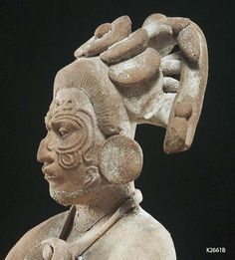
Like being cross-eyed, having a bent nose doesn't exactly scream beauty in the modern-day world. Still, the Mayans thought differently and were known for filling their noses with putty to give it a beak-like appearance.

Slide 11
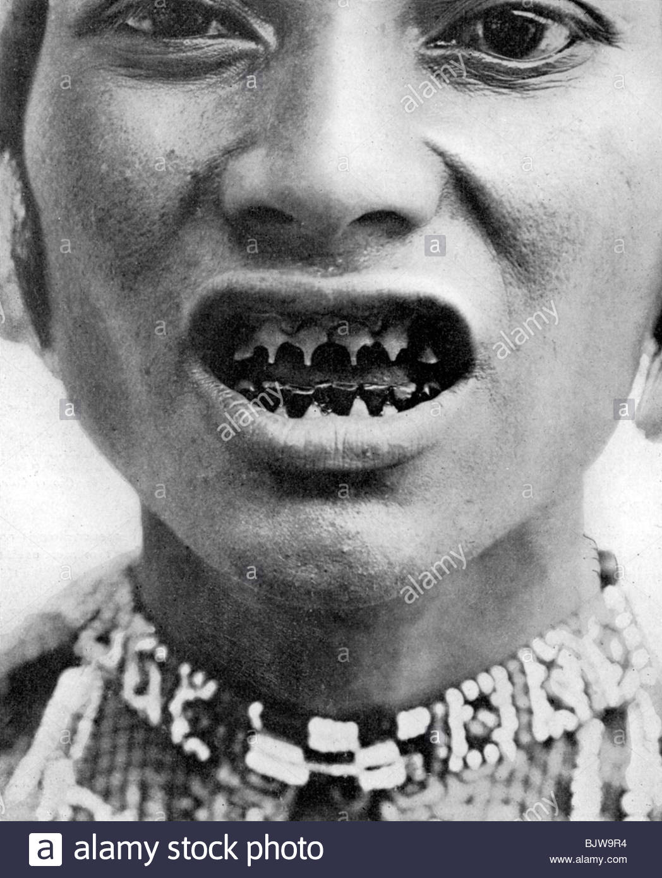
Noblewomen filed their teeth until they appeared pointy.

Slide 12
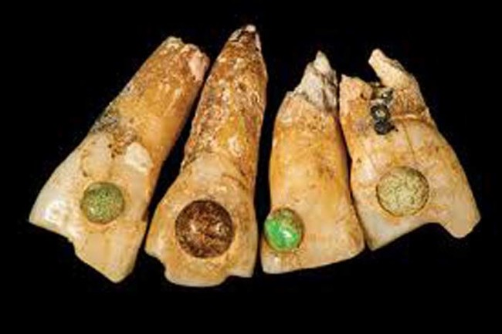
Speaking of teeth and Mayan dentistry, the ancient peoples- of all classes- implanted gems into their teeth due to the aesthetic appearance!

Slide 13

Certain linguists and scholars believe the word 'shark' derives from the Mayan language.

Slide 14


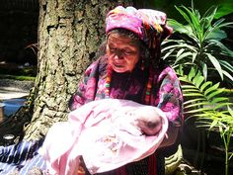
Mayans named newborns after their birthdate

Slide 15
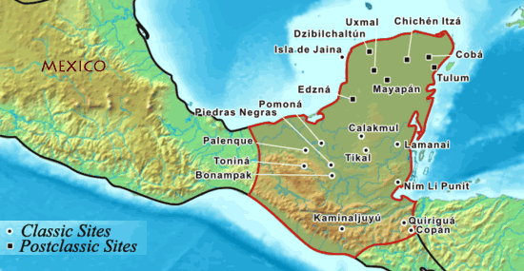
The Mayans were believed to reside in large swathes of Central America, encompassing the south of Mexico, Guatemala, Belize, Honduras and El Salvador. Their descendants still live in much of the area.

Slide 16
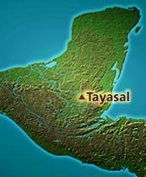
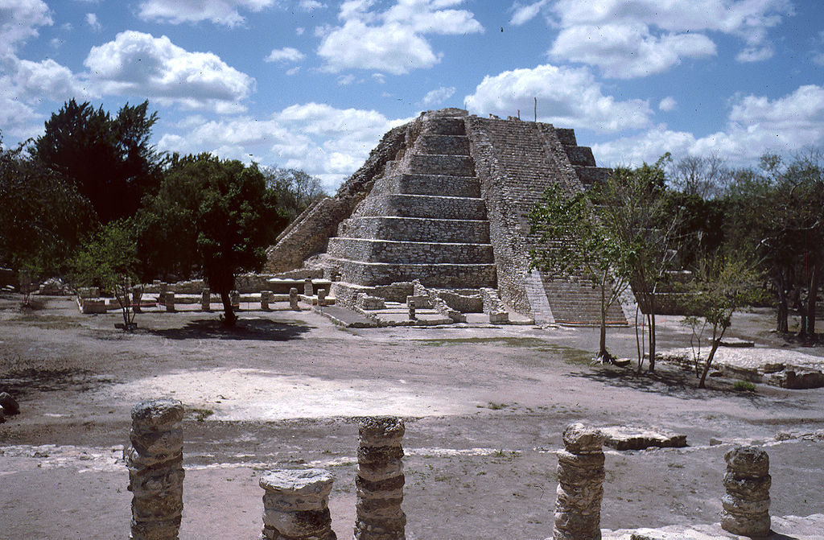
The last known Mayan government governed in the island city of Tayasal until surrendering to Spanish rule in 1697.

Slide 17
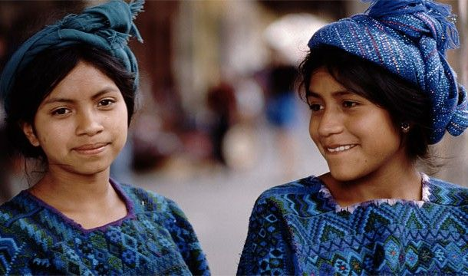
Although the Mayan civilization was entirely conquered by the latter end of 17th century, the ancient culture and Mayan language are still prevalent in some rural areas of Mexico and Guatemala.

Slide 18
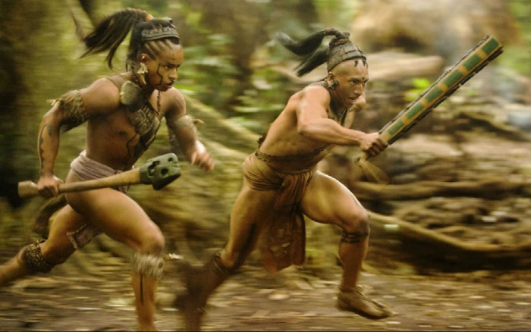
Like many ancient civilizations, Mayans never used iron or steel to make their weapons. Instead, they were formed of obsidian or volcanic rock.

Slide 19
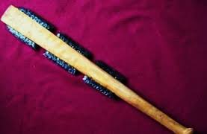
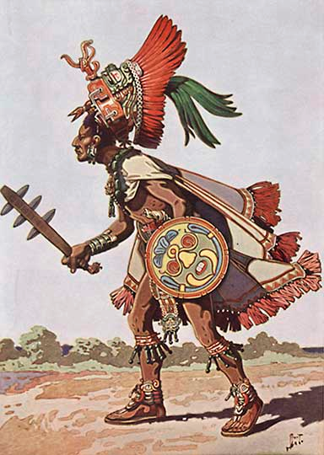
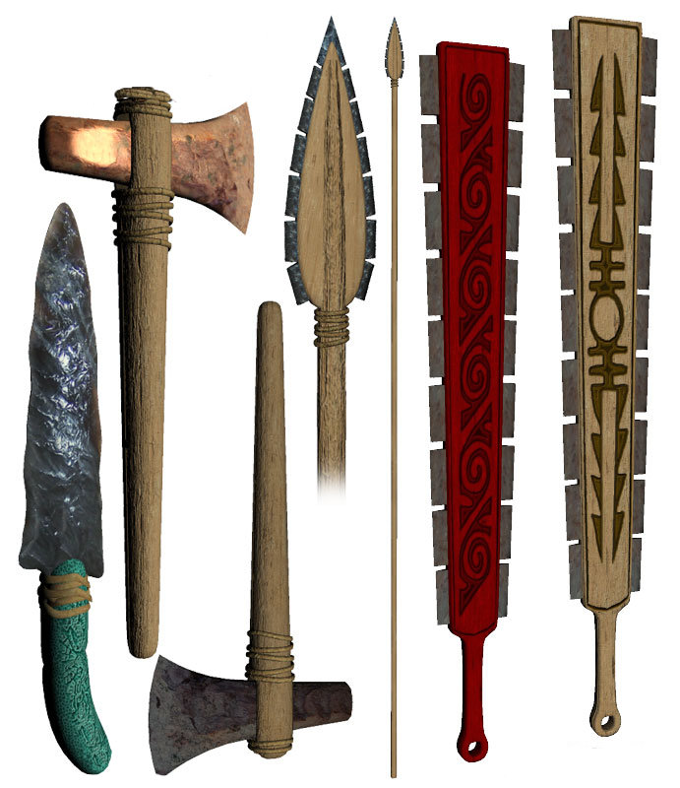

Slide 20
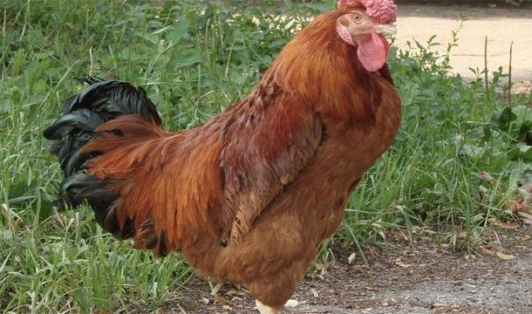
It's well documented that Mayan peoples practiced blood sacrifice in many of their rituals, but even to this day, some still do! And no, not on humans, but unsuspecting chickens should worry.

Slide 21
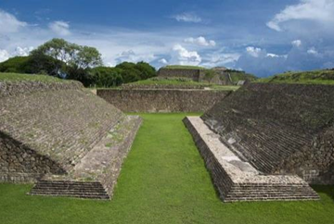
In the modern-day world, ballgames are beloved the world over, and it seems the Mayans were no different. Indeed, like the Aztecs, the Mayans were avid fans of the ballgame 'Mesoamerican Ballgame.' However, unlike popular ballgames of soccer and basketball, the Mayans game was more associated with life and death, and even involved decapitation, possibly on the losing team.
Ball court – the one I saw in Belize was not very large – it was similar to this one.

Slide 22
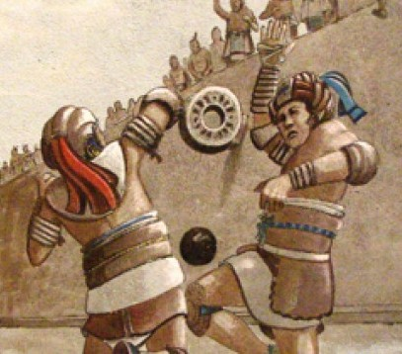
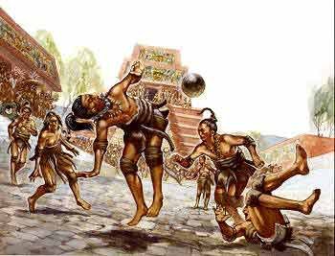

Slide 23
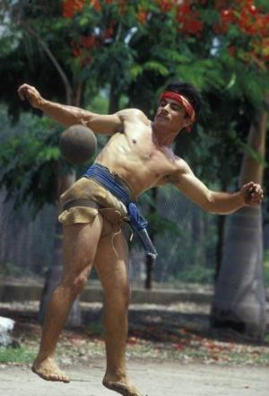
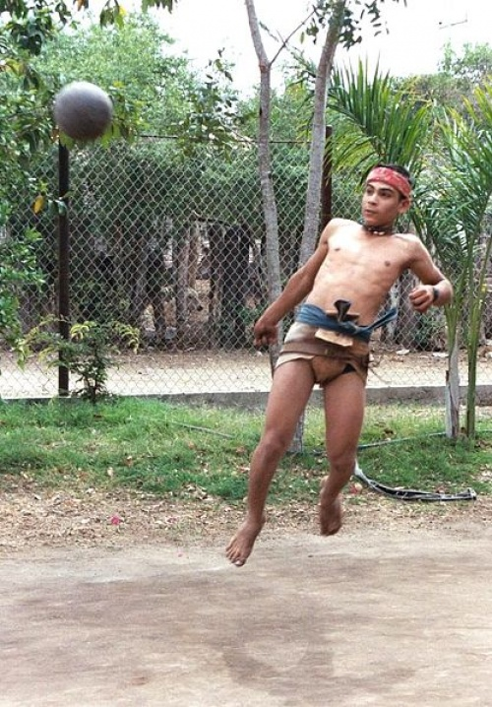
In fact, some Mayans still play the game, though human sacrifice is strictly off limits...

Slide 24
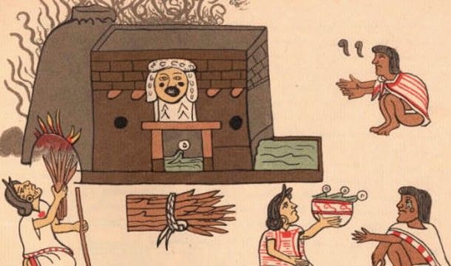
Saunas and hot baths were often used by the Mayans to rid impurities.

Slide 25
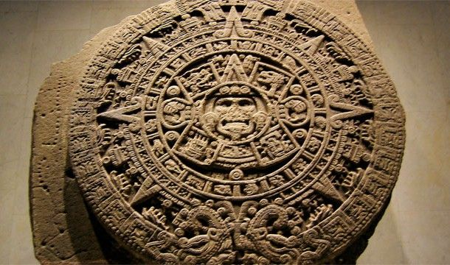
Though many will tell you the Mayan calendar predicted the fatal end of the world in 2012, none of their calendars predicted anything of the sort.

Slide 26
Had more than one calendar
The Maya calendar consists of several cycles or counts of different lengths. The 260-day count is known to scholars as the Tzolkin, or Tzolk'in. The Tzolkin was combined with a 365-day vague solar year known as the Haab' to form a synchronized cycle lasting for 52 Haab', called the Calendar Round. The Calendar Round is still in use by many groups in the Guatemalan highlands.
Less-prevalent or poorly understood cycles, combinations and calendar progressions were also tracked. An 819-day Count is attested in a few inscriptions. Repeating sets of 9 days (see below "Nine lords of the night") associated with different groups of deities, animals, and other significant concepts are also known.

Slide 27
Away from the Babylonian system, the Mayans are thought to be the first civilization to use the number zero as a placeholder. The Mayans devised a counting system that was able to represent very large numbers by using only 3 symbols, a dot, a bar, and a symbol for zero, or completion, usually a shell. The chart above shows the first complete cycle of numbers. Like our numbering system, they used place values to expand this system to allow the expression of very large values. Their system has two significant differences from the system we use: 1) the place values are arranged vertically, and 2) they use a base 20, or vigesimal, system. See the next slide . . .

Slide 28
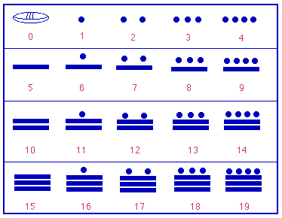

Slide 29
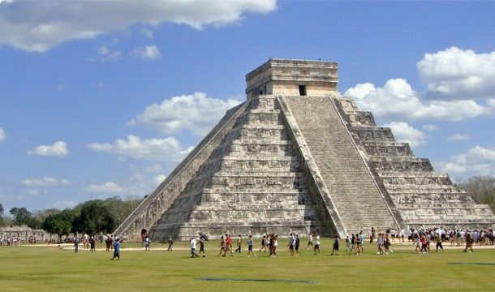
The Mayans are synonyms with many things, but it's often the ruins and pyramids in the city of Chichen Itza, the largest Mayan city that most people will recognize. Unbelievably, the government only recently purchased the historic city from a private owner!

Slide 30
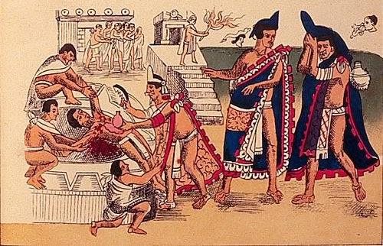
Human sacrifice played a large role in the Mayan culture, and as many historians have discovered over the years, the sacrifices were huge spectacles. Normally, prisoners and slaves were painted blue before led up the staircases of a pyramid. From that point, many would succumb to their deaths via the barrage of stabbing arrows from exuberant onlookers. If that hadn't killed them, then they'd find themselves in the more unfortunate position of being skinned alive.

Slide 31
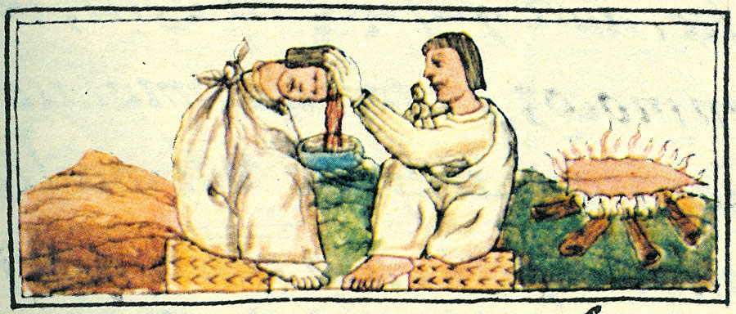
Mayan medicine was quite advanced, and though they equated sickness with the supernatural, research has shown that a high percentage of Mayan surgeries were based on rational observations via the effects of plants and the human body. Yes, many of the shamans were ahead of their time, and were known to sutured wounds with human hair, and even perform complex oral surgeries.

Slide 32
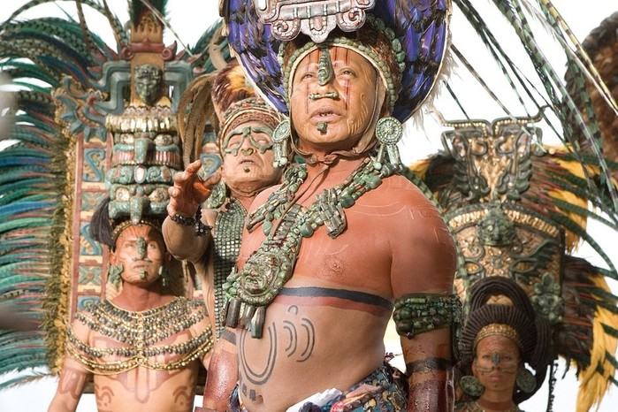
No single King ruled the Mayan Empire. Instead, rule and law was spread across 20 separate areas, each with their own ruler and noble class.

Slide 33
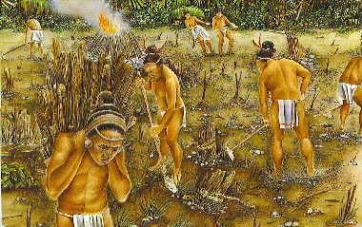
The Mayans had a penchant for farming, and although agriculture in a tropical rainforest isn't easy, the farmers overcame such obstacles by clearing large areas to create large reservoirs from which to store water.

Slide 34
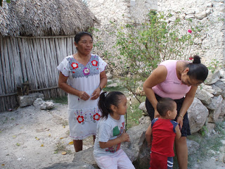
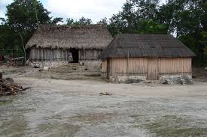
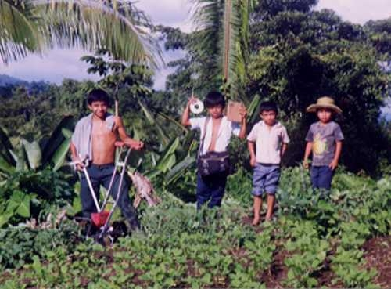
Today, Mayan farmers till the land and live in houses built the way their ancestors built them.

Slide 35
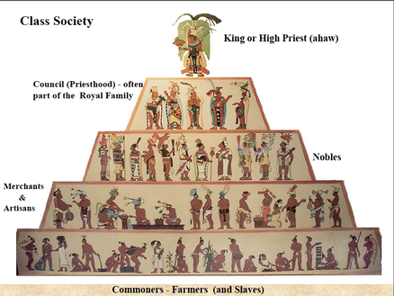
Like many cultures past and present, the Mayan society was divided into three separate groups. At the top, you had the kings and priests while the middle and lower classes comprised of artisans, tradesmen and merchants. Farmers were deemed to be of the lowest class.

Slide 36
The decline of the Mayan Empire came long before the Spanish conquest. In fact, many of the great Mayan cities such as Palenque, Tikal, and Copán had long disappeared, and even to this day, no one knows quite what happened. And though many theories have since proliferated- the most frequent being disease and invasion- there has never been any substantial evidence to prove such theories.

Slide 37
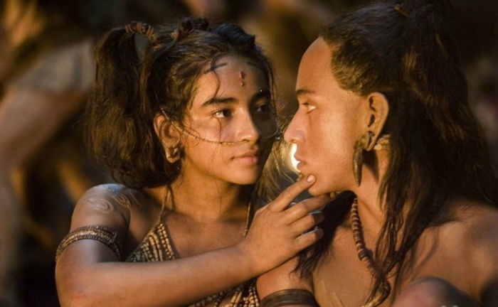
The civilization’s cities and power are gone . . .
But the people remain . . . .

Slide 38
The Maya today

Slide 39
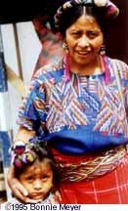
To say that the Maya civilization disappeared is not only an inaccuracy, but a great disservice to more than 6 million Maya living today in Guatemala, Mexico and Belize. While the city-states of the Classic period lowlands may have been abandoned in the tenth century, the Maya people did not disappear any more than the Italians when the Roman Empire fell.
Throughout hundreds of years of outside efforts to oppress and assimilate, the Maya people have continued to hold on to their unique way of life. Modern Maya religion is a colorful hybrid of Catholicism and ancient Maya beliefs and rituals.

Slide 40
Their ancient gods have been replaced with statues of santos (and secret Maximóns) but the stories of these saints only remotely resemble those of their European counterparts. Today, devout Maya worship at mountain and cave shrines, making offerings of chickens, candles and incense with a ritual alcoholic drink. Shaman/daykeepers keep count of the 260 day ritual calendar and provide healing by identifying curses and offended ancestors, counting seeds and crystals in their divinations, and performing curando rituals.

Slide 41
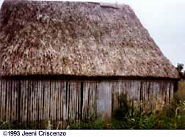
The Maya community has both secular and religious leaders. A man rises through the ranks of a confraternity by assuming increasing financial responsibilities for religious feasts and processions, often near financial ruin by the time he completes his obligations. Most Maya families are maize farmers and they still use the slash and burn method for their milpas.

Slide 42
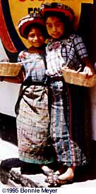
You can identify the community to which a Maya individual belongs by their dress. The women wear loose hand-woven or embroidered huipiles (blouses) with distinctive patterns and colors for each community. Few men in the Guatemala highlands wear the traditional traje as it could be dangerous to call attention to themselves as Maya

Slide 43
During the 1980's the Kekchi Maya of Guatemala found themselves in the middle of a conflict between leftist guerrillas and the government. The ladino guerrillas, based in the surrounding forests, demanded food and shelter from the Maya. In retribution, Guatemalan death squads killed 150,000 people and disappeared another 40,000. Tens of thousands of refugees fled to Mexico and the United States while those who remained were moved into "model" villages were all men were required to enlist in civil patrols.
Today, in Chiapas, Mexico, the Maya people are once again caught between the Zapatistas rebels and the Mexican government. There seems to be no end to the threats to the Maya way of life.

Slide 44
Fundamentalist missionaries are also responsible for destroying the Maya culture with a more insidious, though nonviolent, strategy. In the Lacandon forest, the harvesting of the great mahoganies is not only destroying the precious rainforest, but is also seriously jeopardizing the remote Lacandon Maya community.
Old Chan Kin, the spiritual leader of the Lancandon Maya, once predicted that when the last Maya dies, the world will end. Chan kin died in December 1996 at over 100 years old. Let us hope that his prophecy never comes to pass.

