Slide 1
About The Amish

Slide 2
The Amish community is pretty well known across America. This is thanks to documentaries and motion pictures that depict them. Although many probably think their life styles are exaggerated or that they don’t even still exist! Well, they are very real and they still have communities today that are practicing traditions from hundreds of years ago. Here are some facts about the Amish that should be known.

Slide 3
Amish church membership begins with baptism, usually between the ages of 16 and 25. It is a requirement for marriage within the Amish church. Once a person is baptized with the church, he or she may marry only within the faith. Church districts average between 20 and 40 families, and worship services are held every other Sunday in a member's home. The district is led by a bishop and several ministers and deacons. The rules of the church, the Ordnung, must be observed by every member and cover most aspects of day-to-day living, including prohibitions or limitations on the use of power-line electricity, telephones, and automobiles, as well as regulations on clothing. Most Amish do not buy commercial insurance or participate in Social Security. As present-day Anabaptists, Amish church members practice nonresistance and will not perform any type of military service. The Amish value rural life, manual labor and humility, all under the auspices of living what they interpret to be God's word.

Slide 4
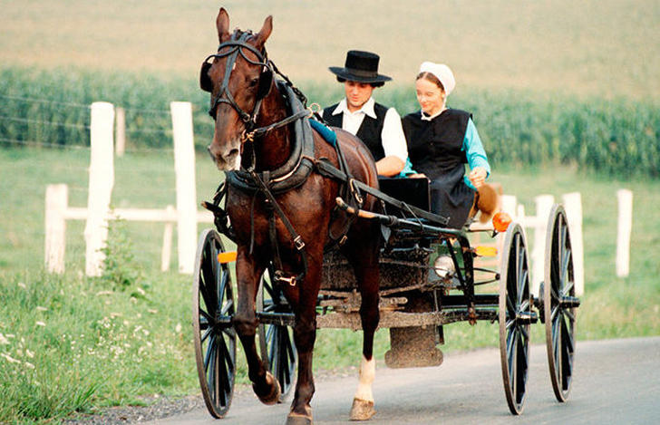
People believe that within this community that marriages must be arranged but that is not the case. They actually go about dating and marriage the same way most people do. Their dating pool though is of course limited within the Amish community. Often young people will meet in public settings and if things go well they might meet in private and have a hot cocoa. If things continue to go well they will no doubt get hitched.

Slide 5
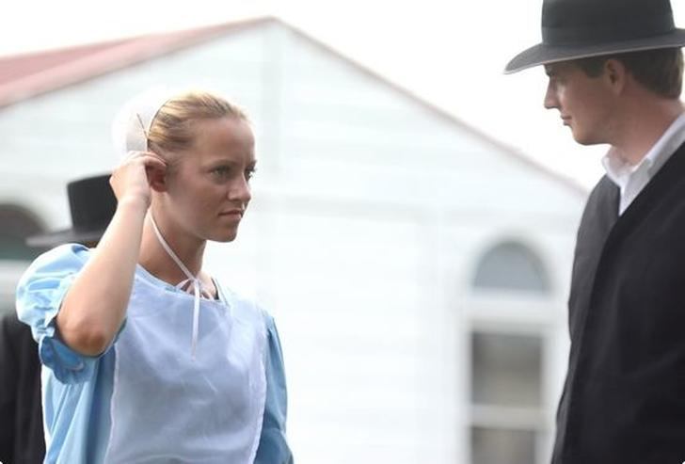
When a young couple starts dating usually marriage is not too long after. They will have a few wagon rides and lay on a bed next to each other then after that they decide they must spend the rest of their lives together. They first must get their engagement blessed by the church, which usually is not an issue. From there it becomes official when a formal declaration is put in the town newsletter.

Slide 6
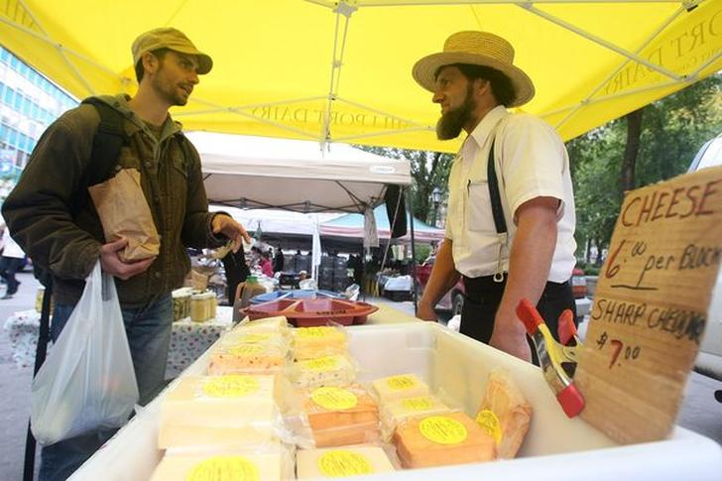
There are benefits from such a sheltered and clean culture. One thing is that they have lower cancer rates in their community. This should not be a surprise as they don’t smoke, drink and produce their own food. Most would agree that the Amish way of life is not worth the added years of life.

Slide 7
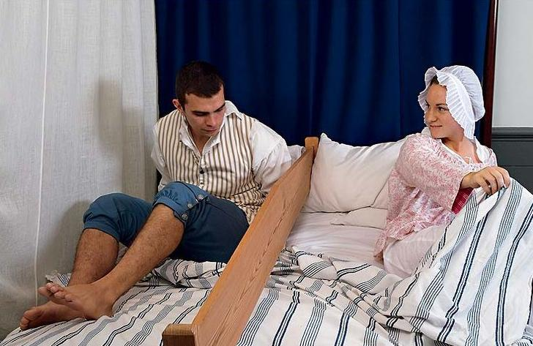
Part of having a serious relationship in the Amish community is that young couples are encouraged to share a bed together. Yes that is right! A few notes though; they are fully clothed, have a board between them and spend the whole night talking. Well, talk about safe sex!

Slide 8
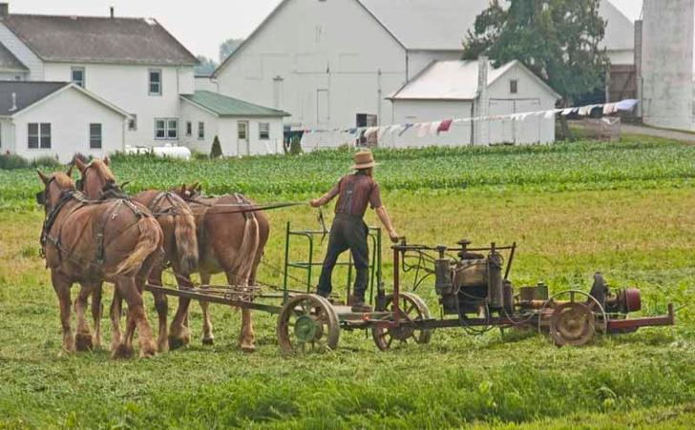
The Amish are very low-tech. I do not mean in the same way your grandma is low-tech because she does not know how to check your Snapchat I mean these folks do not even have phones let alone use electricity at all. This is not just too simply challenge themselves, there are spiritual reasons for this. They believe in “Gelassenheit” which is the concept of letting the earth be as God created it.

Slide 9
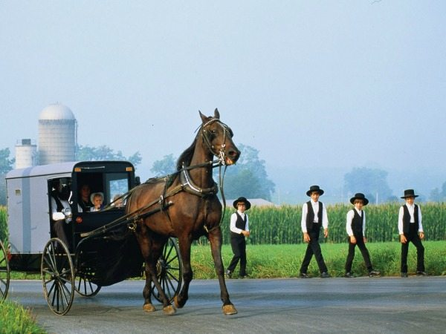
Tradition rules
They farm with traditional vehicles, refuse to use machinery and travel around in a horse and cart. The church bans them from owning or driving a car, it is thought that accessibility to vehicles may encourage individuals to leave the community and abandon their faith

Slide 10
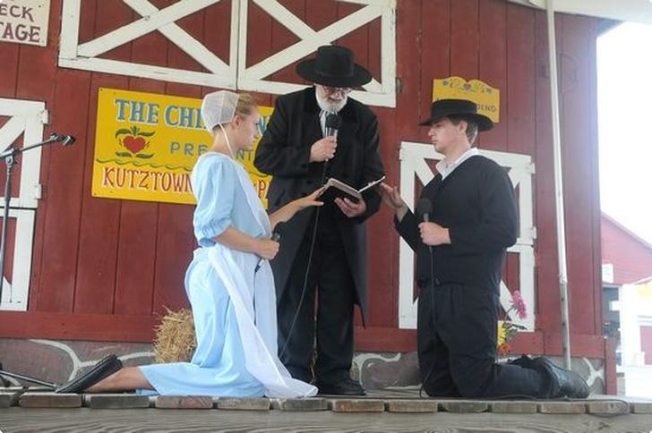
Most often Amish weddings are held not in spring or summer, but at the end of fall. The Ceremony with all its blessings and rituals could last several hours, so if you go to one, pack a lunch. The bride usually wears a simple blue-lined dress and is prohibited from wearing make up or even a ring as they both represent vanity in their eyes. Flowers are in fact too fancy and instead they use celery.

Slide 11
There is no exchange or rings at an Amish marriage and after the wedding, the groom must begin to grow his beard. Once married, the newlyweds will take a honeymoon in which they will travel around their community visiting their families, this is where they collect a majority of their wedding gifts.

Slide 12
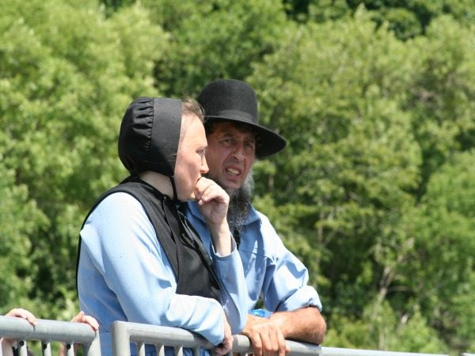
Wedding Dresses
Amish women are expected to sew their own wedding dresses, which must be blue and then continue to be worn every Sunday to church services for the rest of their lives! In another twist, there is also no exchange of rings in an Amish wedding. The Amish refuse any form of genetic tests to establish if their lover is their relative. This is because they believe it is Gods Will who you fall in love with. With the small communities that they live in, it is incredibly likely that inbreeding is rife.

Slide 13
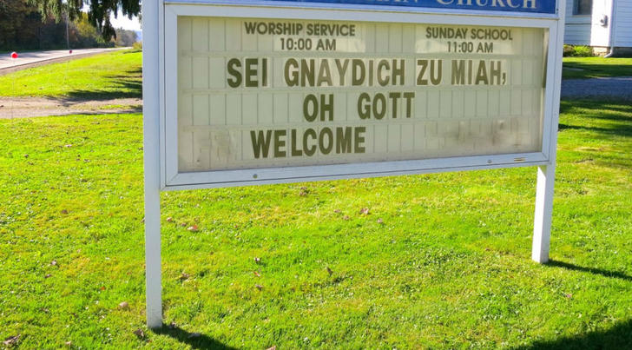
Despite being in America for many years now the Amish community actually has three languages. They speak English of course and they use English when in school or for business. Religious services are actually spoken in standard German! As far as everyday affairs go they speak in what is called Pennsylvania Dutch.

Slide 14
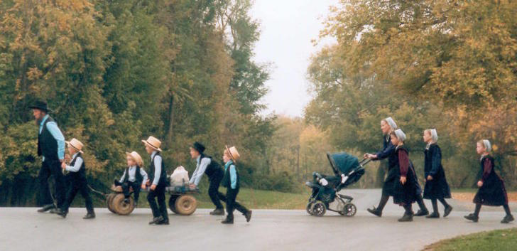
It is easy to spot the Amish, even from far away. They have worn the same clothes for years and look very old fashion. But no matter what time period you look at them from they have always looked plain. As the Ordnung says they cannot wear bright colors or jewelry.

Slide 15
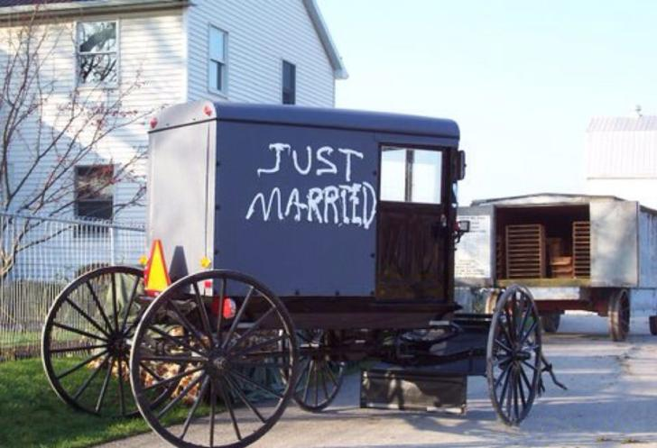
After the long ceremony there is a modest celebration where people mostly just stand around and talk or offer the new couple their blessings. Right after that the couple spends their first night together. Well, their first night where they are allowed to take their clothes off. The only problem though is the night is spent at the bride’s parent’s house.

Slide 16
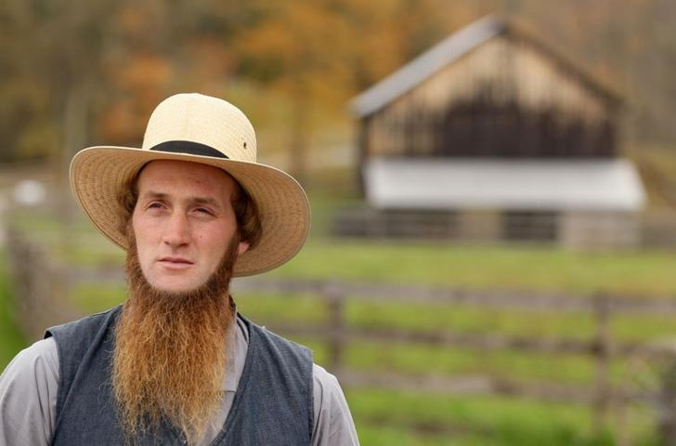
Everyone knows the Amish for their signature beards. No one else really pulls off the mustacheless long beard. It is like they are wearing a fake beard but pulled it down to their chin to enjoy their tuna fish sandwich. There is a reason for this and it dates back to the 1800’s. Back then mustaches were a signature of the wealthy and the military and the Amish wanted no part of this.

Slide 17
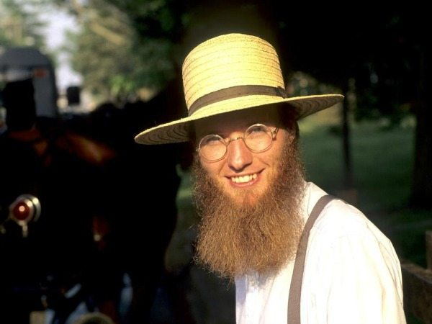
Beards
The distinctive Amish beard with no mustache is a sign of marriage. An Amish male only begins growing his beard after the day he gets married. This makes it easy to tell who’s single and who’s taken!

Slide 18
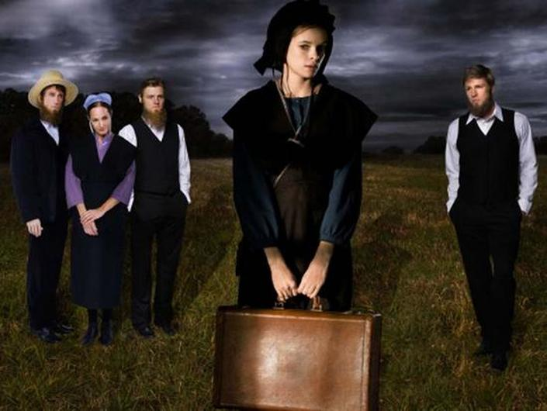
As you might already have imagined, with a community with so many rules there is the possibility to be banished. If they did not follow through with their threats no one would follow the rules. It is called Meidung when one is ordered to leave. The only way to come back is death or to beg if you can come back. Most chose the second option of the two or they choose neither, and just go and try to live a normal life.

Slide 19
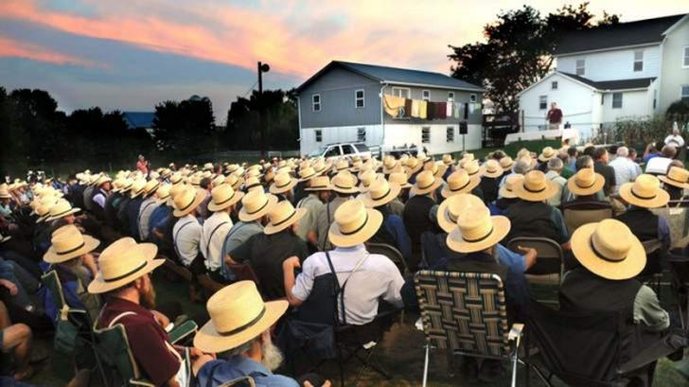
If you believe they have spiritual speaking in tongues type ceremonies, think again. Their church services are very modest. While they are of course very religious they show their faith by the way they live so they do not feel over the top worship is necessary. You will not find any mega churches in their communities. In small communities, services are held in a different family’s home every second Sunday. The alternate Sundays are reserved for visiting family.

Slide 20
Lifestyle cultivated by their religious beliefs
Two key concepts for understanding Amish practices are their rejection of Hochmut (pride, arrogance, haughtiness) and the high value they place on Demut (humility) and Gelassenheit (calmness, composure, placidity), often translated as "submission" or "letting-be". Gelassenheit is perhaps better understood as a reluctance to be forward, to be self-promoting, or to assert oneself. The Amish's willingness to submit to the "Will of Jesus", expressed through group norms, is at odds with the individualism so central to the wider American culture. The Amish anti-individualist orientation is the motive for rejecting labor-saving technologies that might make one less dependent on community. Modern innovations like electricity might spark a competition for status goods, or photographs might cultivate personal vanity.

Slide 21
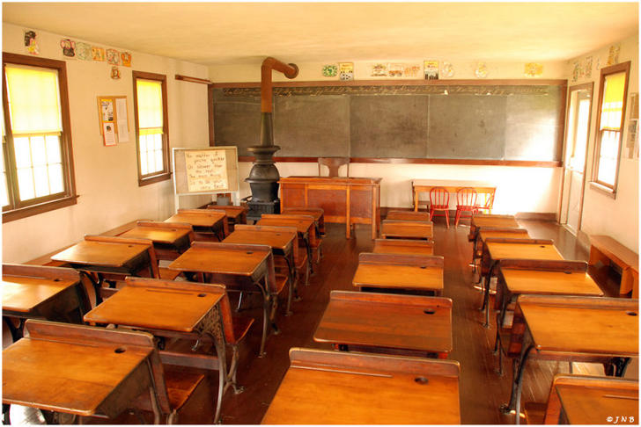
Amish believe in the simple life and part of that is keeping a simple mind. The Amish do not continue education after 8th grade. The men usually take up a trade and the women are destined to be housewives. I guess that is part of forgetting there is an outside world.

Slide 22
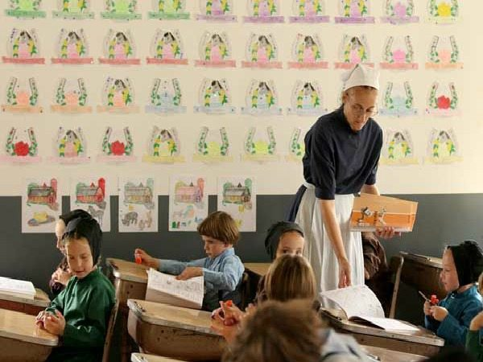
Amish children do not attend school past the eighth grade, instead, they are taught in one room in their community by a teacher with an eighth-grade education. By the time they are teens, Amish girls know how to cook a full meal and boys know how farms operate.

Slide 23
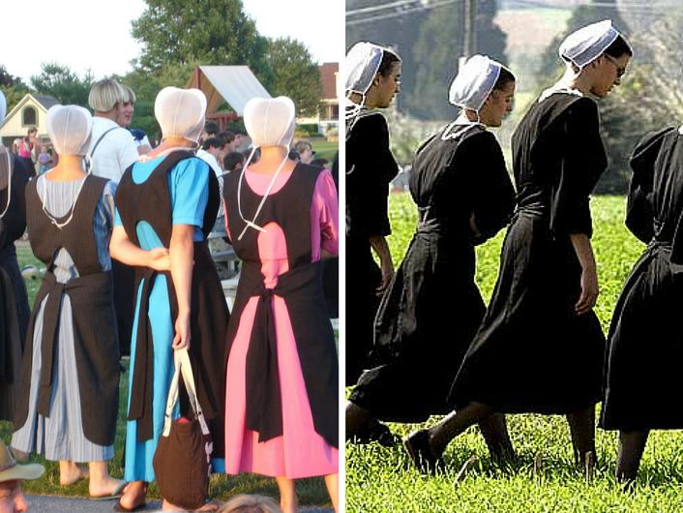
People often confuse Mennonites for the Amish, which both communities find insulting. The Amish are much more strict. Even here in this photograph you can see the difference, the Mennonites are of course sporting those bright colors on the left. The Mennonites also live in modern communities and even can own cars.

Slide 24
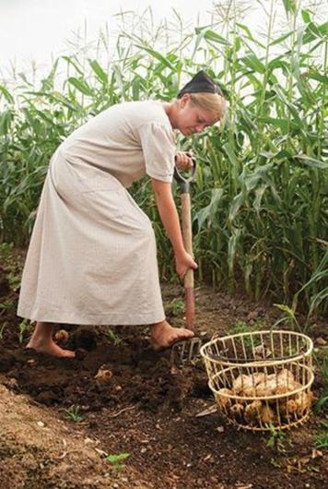
They do not believe a simple acceptance of Christ gets them everlasting life. Most people who identity as Christian think this is the case and do not practice their religion often. The Amish on the other hand are constantly focusing on helping their community. Rather than use a church they often go to each other’s homes for worship.

Slide 25
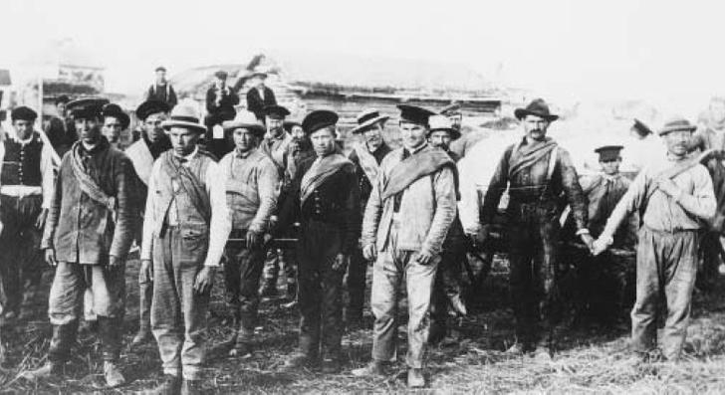
The Amish date back to the 16th century and originally came from Switzerland. One might wonder how they came all the way to North America. It was in 18th century that they came over due to persecution and other problems. In America they found a quiet home and never looked back.

Slide 26
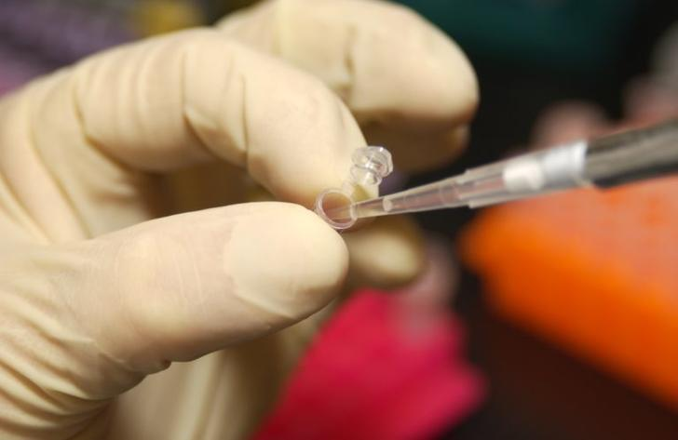
With such a tiny community there is no doubt lots of inbreeding. Often over time they might not know who is related to whom and there is many cousin hook ups. They refuse to have any tests done. They say it is because of God’s will that the tests should not be done but it might be a little bit of denial. They perhaps do not want to know how inbred they are.

Slide 27
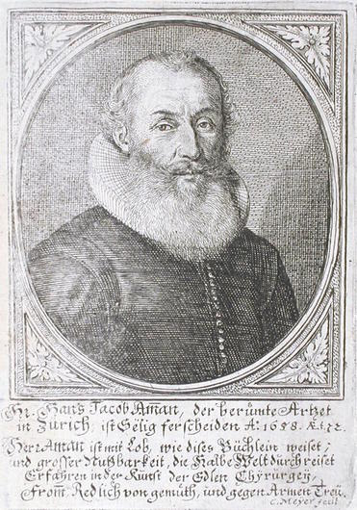
So who started it all? It was a man named Jakob Ammann who first preached for their way of life, which still holds up today. He must have been a charismatic guy. Ammann created their culture though he started as just a regular Christian. He was originally from Switzerland and was a firm believer. The name Amish of course comes from his last name and ended up being a term for the philosophy he practiced.

Slide 28
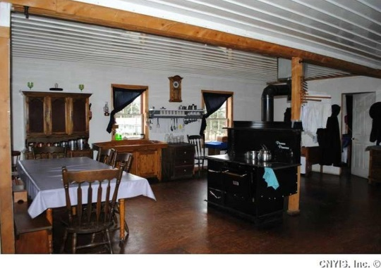
Their old fashion nature can at times be kind of charming or innocent. Unfortunately old fashion does not just mean they do things like churn their own butter. Their way of thinking is really old fashion too. Women for example are treated as 2nd class citizens. The women cannot ask questions and must remain as housewives.

Slide 29
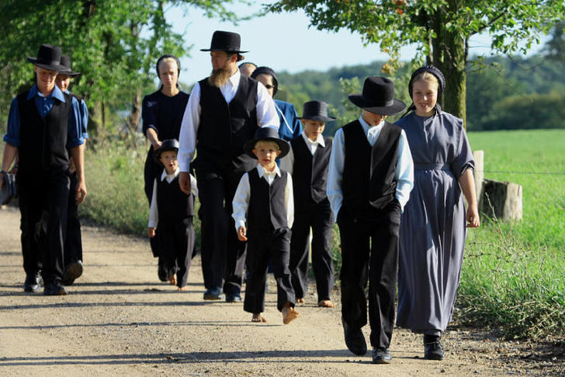
The Amish of course wait until marriage for intercourse. Once they are married it is on! They do not believe in contraceptives and actually aim to have as many kids as possible. The average couple has between 5 and 7 kids.

Slide 30
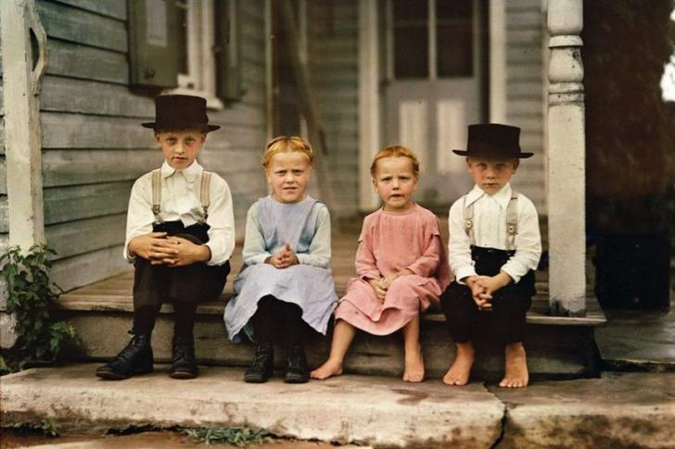
While the world evolves around them you would think that would that influence them and their numbers would be dwindling. It is actually the opposite of this. Their numbers are growing and in fact their yearly population growth rate is 3.6%. This is due to them getting married young and having so many kids.

Slide 31
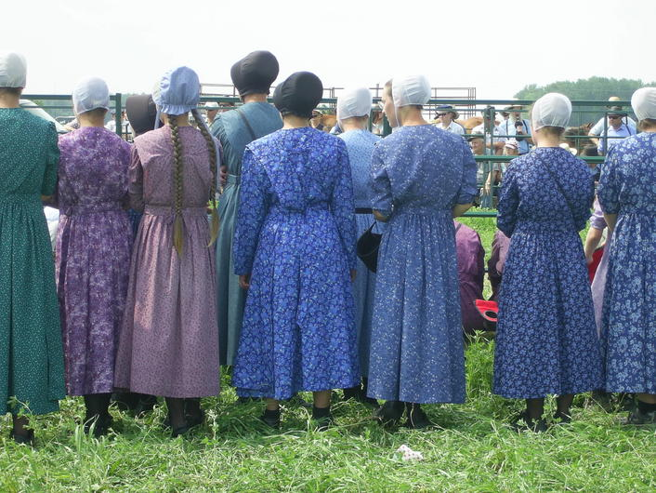
Some might assume that they are a little self-righteous but that is not the case. You will never find an Amish person judging you or condemning a person for having another religion, at least not to their face. They believe arrogance is a sin. In every aspect they are a modest bunch of folks.

Slide 32
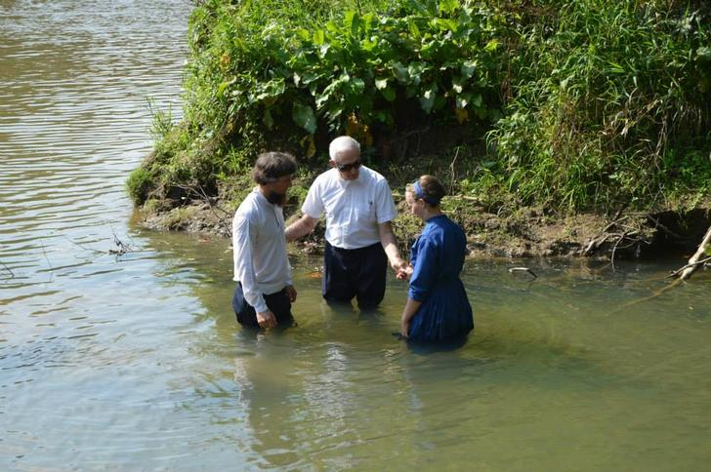
The Amish are derived from Christianity and share many of the same beliefs. The Amish community is not a blood in blood out situation, those who choose the faith make it official when they are considered old enough to make the choice. Between the ages of 16 and 24 is when they make the choice and at that point they are baptized. The Amish specifically refer to their baptism as “believers baptism.”

Slide 33
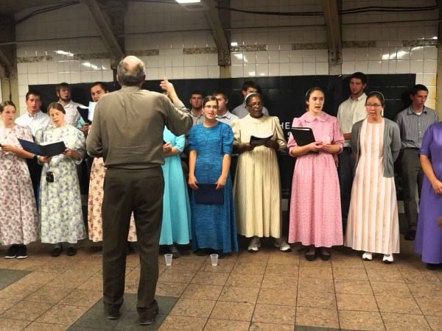
The Amish aren’t allowed to learn how to play musical instruments
The Amish aren’t allowed to learn how to play musical instruments. As with their faceless dolls, they believe playing instruments encourages feelings of superiority.

Slide 34
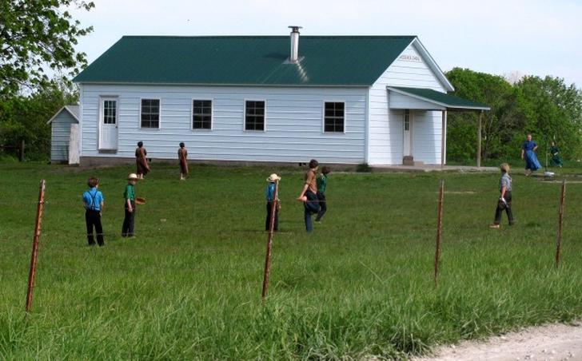
People who do not live in area near any Amish communities probably could not guess how many there might be in North America. In fact people probably assume it is just a few scattered communities here and there. There are actually more Amish than most might think. Overall there are about 300,000 Amish in the country!

Slide 35
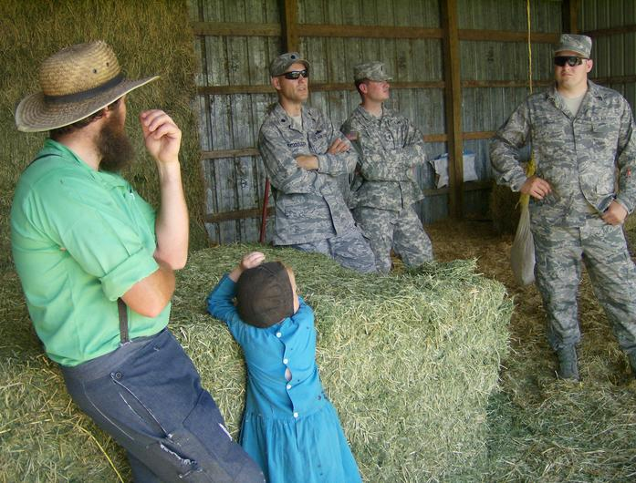
While many might not accept their sexist nature some might respect their pacifism. They are very much against violence and oppose the military. They are often soft spoken and would rather discuss matters or just look the other way. You will never see an Amish boy join the military and if he does he would be kicked out of the community.

Slide 36
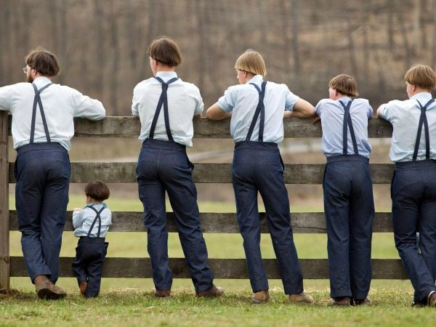
Photographs
Amish people don’t like being photographed. They believe that they are ‘graven images’, meaning that they could be used as a representation of God and worshiped. Some will allow themselves to be photographed in a natural setting as long as their faces are not shown.

Slide 37
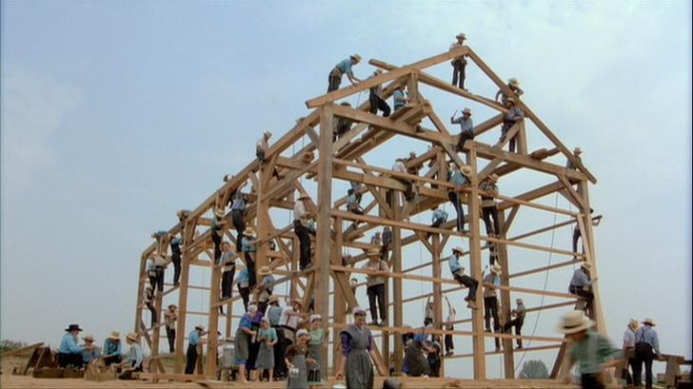
Between potlucks and house chores they must find other things to do to pass the time. One favorite pass time activity is barn building. In fact it has become another way for them to socialize. Dozens will come together and build a barn to help a neighbor. Not only is it a way to socialize but it shows selflessness too.

Slide 38
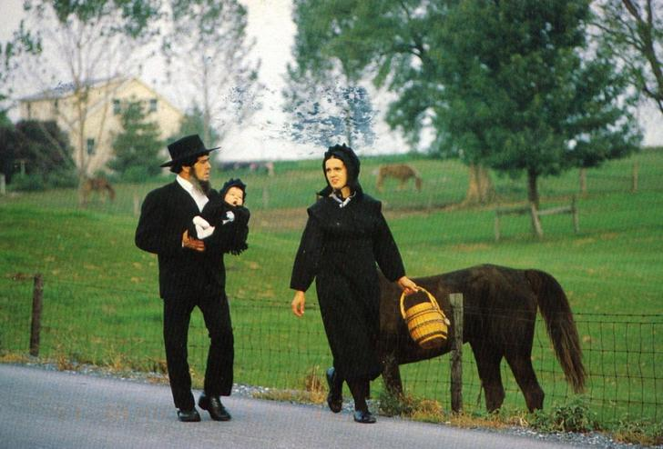
People assume the Amish do not like their pictures taken due to spiritual reasons but that is not true. When tourists come about the Amish let them snap away without much fuss, even though it must be annoying to some of them. The Amish themselves do not like taking photographs or hanging them in their homes. They believe portraits are “graven images.”

Slide 39
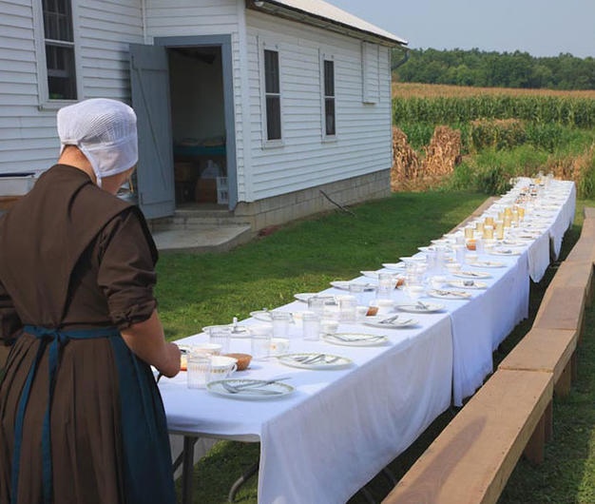
With not much else to do there is a lot of emphasis on meals. Their meals are all shared as sort of a potluck, which allows them to socialize. They often sit a long a very table and everyone discuses matters while relaxing and eating. It is often a time when young people can mingle under adult supervision.

Slide 40
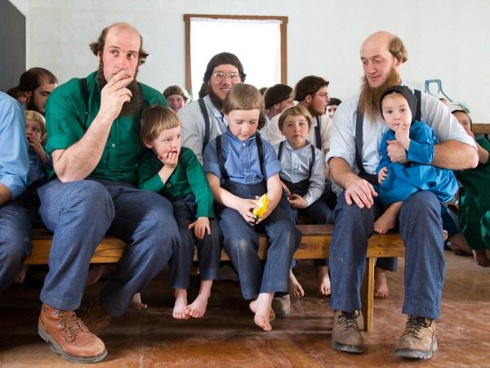
Keeping it exclusive
The Amish are generally uncomfortable around non-Amish people, therefore, they do not try to recruit new members to their faith. They will always be kind and peaceful to the non-Amish as the Bible tells them to.

Slide 41
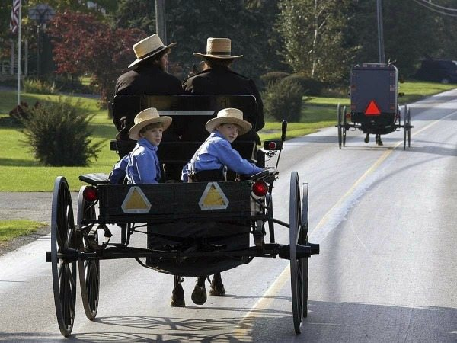
Englishers
Anyone who isn’t Amish is considered ‘English’, no matter where they are from. There are over 250,000 Amish people living in America, so they have no need to interact with anyone who isn’t from their own community.

Slide 42
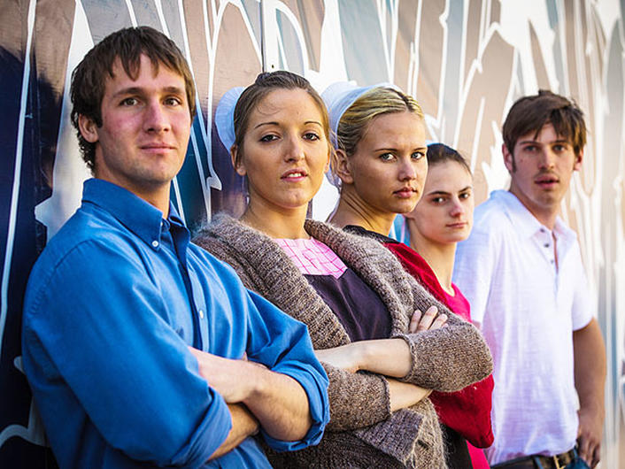
With the outside world evolving so quickly, naturally the community could be influenced. The influence is usually due to the youth bringing in things like brighter colors or even embracing branding. Though it is rare it is becoming more and more common. It is more often now you will find communities allowing these slight modernizations.

Slide 43
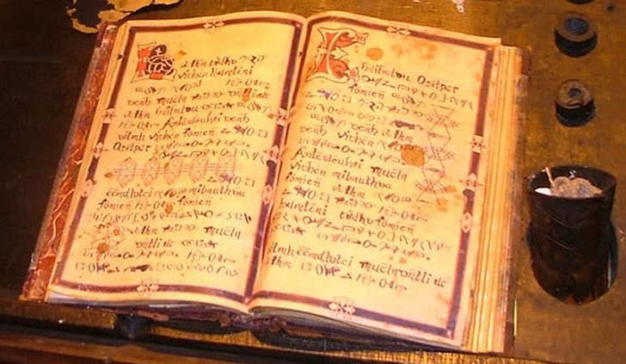
The Amish have their own book separate from the bible. Yes, they do follow the traditional bible but this other book is kind of an Amish 101 so to speak. While the bible covers their main faith this book called Ordnung covers the rules they must follow to live their lifestyle. The Ordnung must always be respected and followed and those who do not follow can get themselves into some trouble.

Slide 44
The ordnung contains may regulations, such as what is acceptable clothing
Amish clothing is plain and humble and all homemade. Men wear straight cut suits with no collars, pockets or decoration. Belt’s are not permitted. Women have to wear their hair in a braid or bun, covered by a small bonnet.

Slide 45
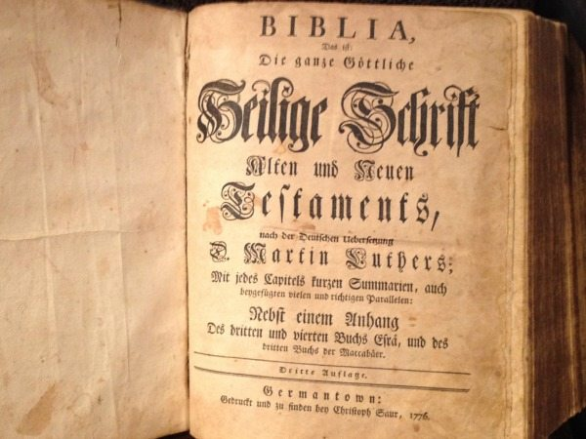
Bible in old german
The founder of the Amish believed in the importance of believing in the literal translation of the Bible.

Slide 46
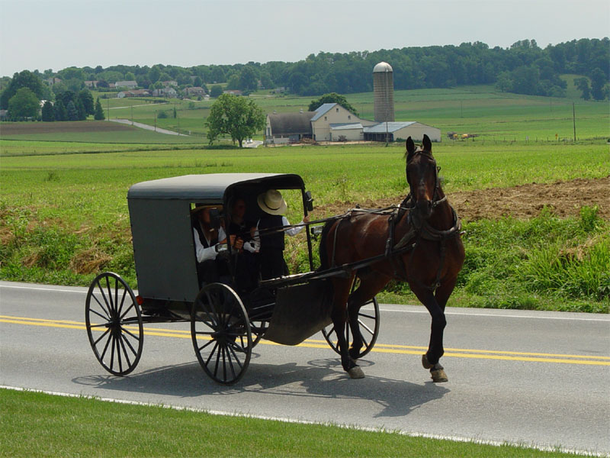
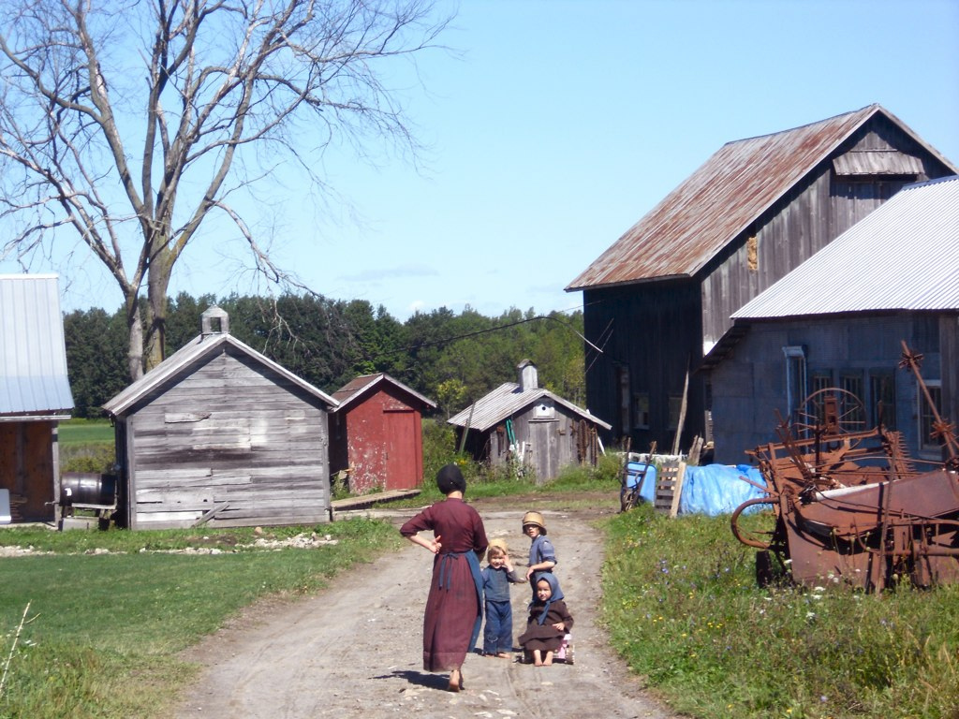
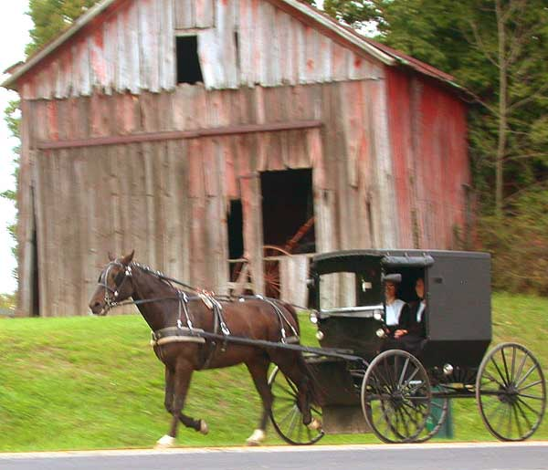
Way of life
Amish lifestyle is regulated by the Ordnung (German, meaning: order), which differs slightly from community to community, and, within a community, from district to district. What is acceptable in one community may not be acceptable in another. Bearing children, raising them, and socializing with neighbors and relatives are the greatest functions of the Amish family. All Amish believe large families are a blessing from God.

Slide 47
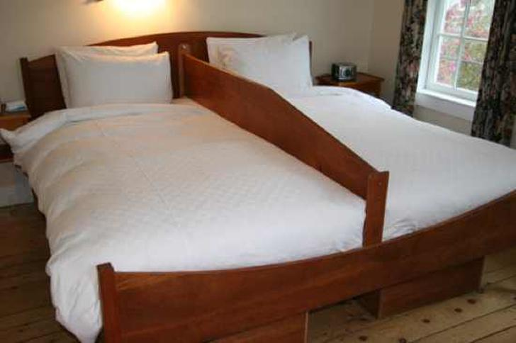
Even after marriage couples will sleep with a board between them. For anyone outside the Amish community this could be very strange, even to the devoutly religious. I kind of like this idea, no one rolling over me in the middle of the night. When they do decide to attempt to procreate I wonder if they board is removed or if one partner climbs over the board to get to the other side. Perhaps they simply carve a hole in the board.

Slide 48
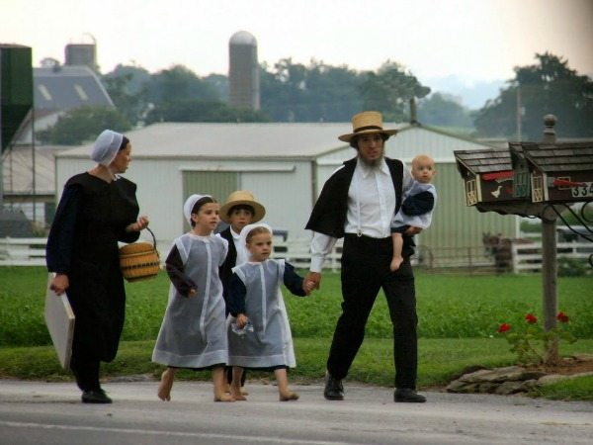
inheritance
Traditionally, it is the eldest son who inherits the family silver, but not if you’re Amish. In an Amish family, the youngest son is the most privileged for he is the one who will inherit everything.

Slide 49
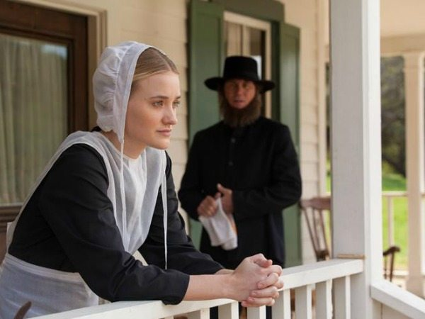
Amish women
Amish women are expected to make family, church and community needs a priority, even before their own. They are in charge of managing the home, cooking, sewing and helping neighbors. They cannot serve as bishops or preachers, and must follow their husband’s rules.

Slide 50
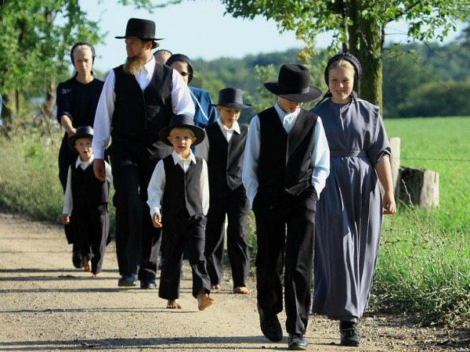
Law and order
They believe in the separation of the church and the state, and will always prioritize the Word of God over the rule of the government. This has caused controversy, most notably in 2009, when the Amish community in Missouri failed to report child abuse to the authorities. They may not report a theft or vandalism but handle it within the community. Foremost in their minds is the importance of forgiveness.

Slide 51
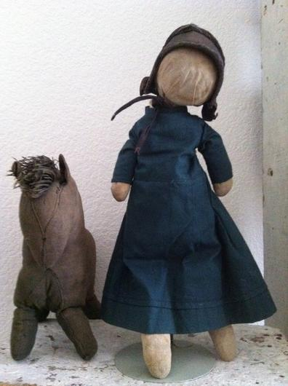
This faceless doll might be creepy to most but to the Amish it is how all their children’s toys look. While kids do not enjoy barn building or potlucks so much they must have something to ease the boredom, so toys are permitted. There is a reason for them not having faces; it is to show that a good person should be valued for who they are, not how they look.

Slide 52
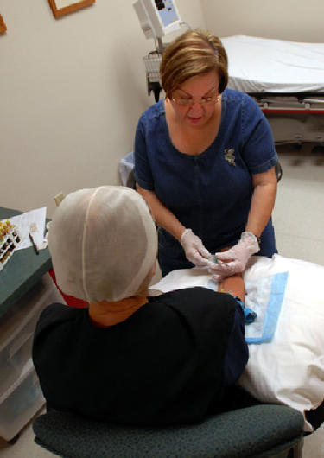
While they fight hard to stay in the 1800’s they do occasionally cave for certain things. They want to remain healthy and so they do accept modern medicine. If anyone gets sick in the community they are always very supportive. While this all makes sense to me at the same time it seems to contradict their belief system.
Most Amish groups welcome the use of modern medicine, as nothing in the Bible states that they cannot take advantage of modern medical services. However, this varies from family to family. Nobody in the Amish community has medical insurance and should they need emergency care, the community come together to donate money.

Slide 53
Health issues
While the Amish are at an increased risk for some genetic disorders, researchers have found their tendency for clean living can lead to better health. Overall cancer rates in the Amish are reduced and tobacco-related cancers in Amish adults are 37 percent and non-tobacco-related cancers are 72 percent of the rate for Ohio adults. The Amish are protected against many types of cancer both through their lifestyle and through genes that may reduce their susceptibility to cancer. Even skin cancer rates are lower for Amish, despite the fact many Amish make their living working outdoors where they are exposed to sunlight. They are typically covered and dressed by wearing wide-brimmed hats and long sleeves which protect their skin.

Slide 54
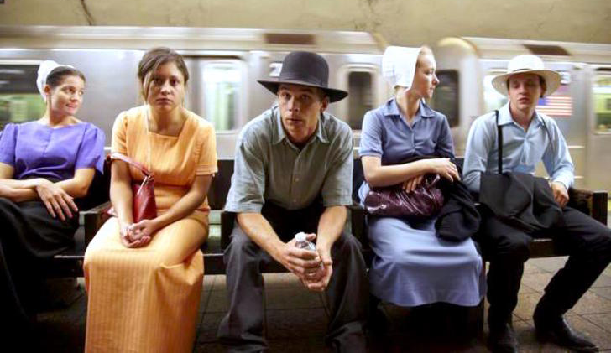
This photograph shows some young adults venturing out into the real world and boy do they look like fish out of water. They are practicing a custom called “Rumschpringa” which is translated to “running around.” When Amish kids reach the ages 14-18 they are allowed to experience life outside the community. This is to make sure that they truly want this lifestyle and to choose it for themselves.

Slide 55
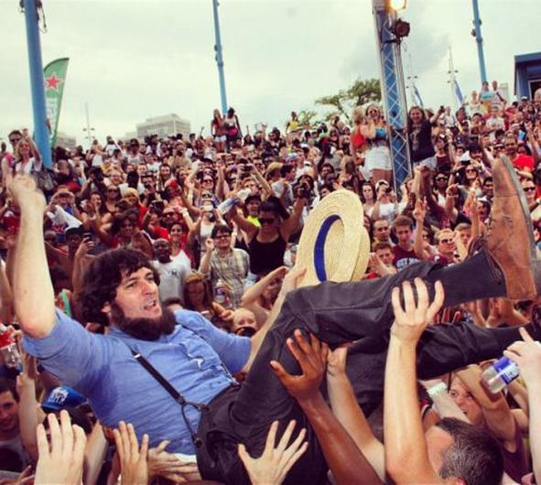
During this period of Rumschpringa the Amish get a pass to take part in anything the world has to offer. Some might just simply have a beer and go home while some might drop acid and go to a music festival. The choices are up to them. Needless to say some will not come back for years or even at all.

Slide 56

Some do actually leave the church after their Rumschpringa but most return. Even if some enjoy the “English” way of life they just can’t give up the simple comforts of the lifestyle they’ve known their whole lives. As soon as they come back things become official right away; they get baptized and then are married almost immediately after that.

Slide 57

Teenagers are teenagers whether they are Amish or not and the elders know this. Teenage rebellion is just part of growing up and being human. Because of this many teenagers get a “free pass” which means they will not be punished too terribly if a rule is broken. They feel they must do this if they want to keep them in the community.

Slide 58
Members who do not conform to these community expectations and who cannot be convinced to repent are excommunicated. In addition to excommunication, members may be shunned, a practice that limits social contacts to shame the wayward member into returning to the church. Almost 90 percent of Amish teenagers choose to be baptized and join the church. During adolescence rumspringa ("running around") in some communities, nonconforming behavior that would result in the shunning of an adult who had made the permanent commitment of baptism, may meet with a degree of forbearance. Amish church groups seek to maintain a degree of separation from the non-Amish world, i.e. American and Canadian society. There is generally a heavy emphasis on church and family relationships. They typically operate their own one-room schools and discontinue formal education after grade eight, at age 13/14. Until the children turn 16, they have vocational training under the tutelage of their parents, community, and the school teacher.

Slide 59

Use of technology by different Amish affiliations
The decision as to which kinds of technology may or may not be used in a community is made by the bishop of that community. Each bishop is independent and free to make whatever decisions he deems are correct for that time and place. The table below indicates the use of certain technologies by different Amish affiliations. The use of cars is not allowed by any Old and New Order Amish, nor are radio, television or in most cases the use of the Internet.

Slide 60

population
from 1992 to 2008, population growth among the Amish in North America was 84 percent (3.6 percent per year). During that time they established 184 new settlements and moved into six new states. In 2000, about 165,620 Old Order Amish resided in the United States, of whom 73,609 were church members. The Amish are among the fastest-growing populations in the world, with an average of seven children per family. In 2010, a few religious bodies, including the Amish, changed the way their adherents were reported to better match the standards of the Association of Statisticians of American Religious Bodies (ASARB). When looking at all Amish adherents and not solely Old Order Amish, there were about 241,000 Amish adherents in 28 states in 2010.

Slide 61


Slide 62
Seekers and Joiners
Only a few outsiders have ever joined the Amish. Since 1950 only some 75 people have joined and remained members of the Amish. Since 1990 some twenty people of Russian Mennonite background have joined the Amish in Aylmer, Ontario. More people have tested Amish life for weeks, months or even years but in the end decided not to join. Others remain just close to the Amish and never thought of joining.
Stephen Scott, himself a convert to the Old Order River Brethren, distinguishes four types of seekers:
  Checklist seekers, who look for a couple of certain specifications.
  Cultural seekers, who are more enchanted with the lifestyle of the Amish than with their religion.
  Spiritual utopian seekers, who look for true New Testament Christianity.
  Stability seekers, who come with emotional issues, often from dysfunctional families.

Slide 63

Conversion
Converting to the Amish faith is a challenge. Firstly, a would-be convert is placed within an Amish family to enable them to participate in daily activities. You would then have to learn the Pennsylvania German dialect. It is also important for you to abandon your old life, such as televisions, contemporary clothing, and cars. Even after all this, you still have to be voted in by the church.

Slide 64

This photograph is not from an Amish community and in fact it is a photograph from a busy metropolitan city, which shows a lot of diversity. To the Amish these people are simply referred to as “English.” To be “English” to them it just means someone who is not Amish which could mean you are any other race or religion. Whether it can be derogatory or not is another question.

Slide 65
The devil’s playground
The Amish often refer to the American way of life as the ‘Devil’s Playground’. Modern culture is prohibited for the Amish people, meaning that anything that they don’t condone is considered the scandalous and wrong. Hence, the ‘Devil’s Playground’.

Slide 66




Publishing
In 1964 Pathway Publishers was founded by two Amish farmers to print more print material about the Amish and Anabaptists in general. It is located in Lagrange, Indiana, and Aylmer, Ontario. Pathway has become the major publisher of Amish material. Pathway publishes a number of school text books, general reading books, and periodicals. There are also a number of private enterprises who publish everything from general reading to reprints of older literature that has been considered of great value to Amish families.[79] Some Amish read the Pennsylvania German newspaper Hiwwe wie Driwwe, and some of them even contribute dialect texts.

Slide 67



Variety in daily life

Slide 68




Commercial activities

Slide 69




Amish Crafts

Slide 70



