Slide 1
25 Pictures Of The Human Race That Are Simply Stunning
The world is a “mixed bag:” The beautiful, the ugly, the tragic, the brave, the courageous, the horrible, the touching, the inspiring.
By Michaela Mazur | November 10, 2015

Slide 2
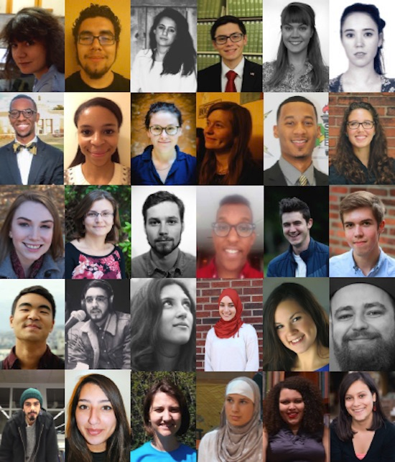
Each one is a human being.

Slide 3
The world is full of amazing people, each with their own story of love, family, or hope. Some are inspiring; some tragically sad. These heartwarming and heartbreaking photos are a reminder of the vast spectrum of emotion coursing every day through the body of the entire human race.

Slide 4
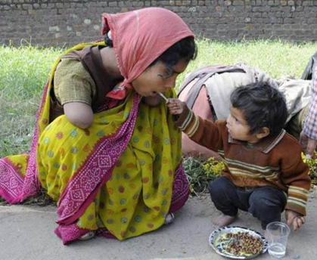
Young Boy Feeds His Mother
A young boy helps feed his mother, who has tragically lost both of her arms.

Slide 5
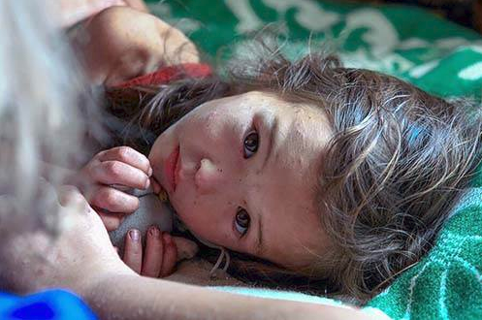
A Weary Survivor
A girl is comforted after spending 11 days alone in a Siberian forest. She suffered only a handful of scratches and insect bites.

Slide 6
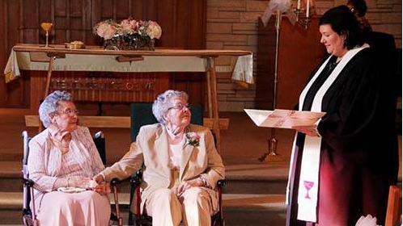
Love Is Timeless
A same-sex couple finally gets married in Iowa – at the tender age of 72 years young.

Slide 7
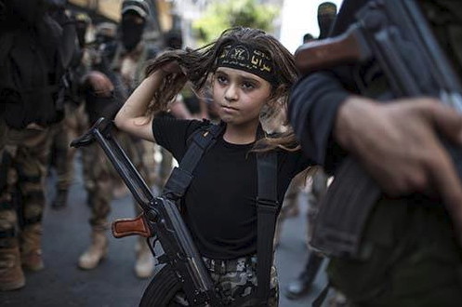
Child Militants
A young Palestinian girl strapped with a Kalashnikov rifle attends an Islamic jihad rally in Gaza City.

Slide 8
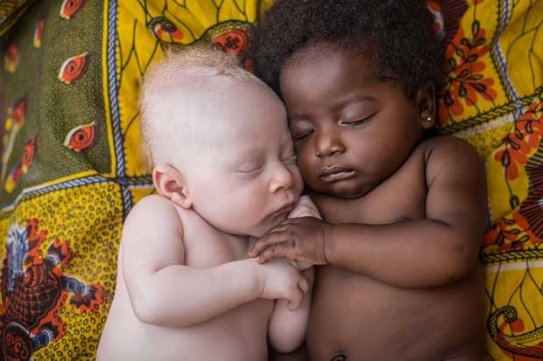
Sleeping Cousins
A 3-week old newborn with albinism sleeps beside his cousin in Kinshasa, the capital of the Democratic Republic of the Congo.

Slide 9
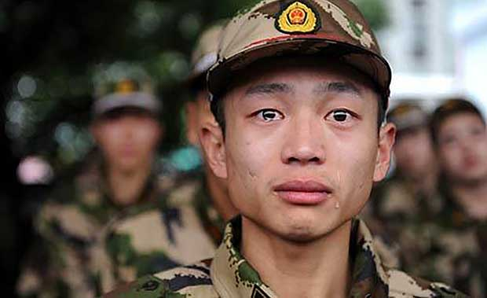
"Dreaming Up Wars...“
“I’m fed up to the ears with old men dreaming up wars for young men to die in.” ~ George S. McGovern

Slide 10
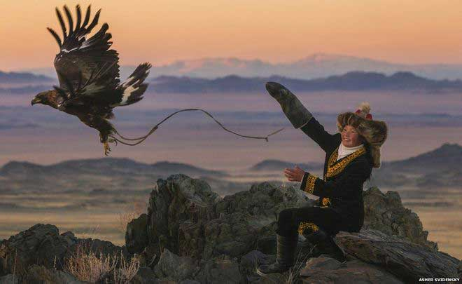
Eagle Huntress of Mongolia
Ashol-Pan is a 13-year-old eagle huntress, part of a group of young hunters – the only female of the group – who one photographer recalled, “To see her with the eagle was amazing. She was a lot more comfortable with it, a lot more powerful with it and a lot more at ease with it.”

Slide 11
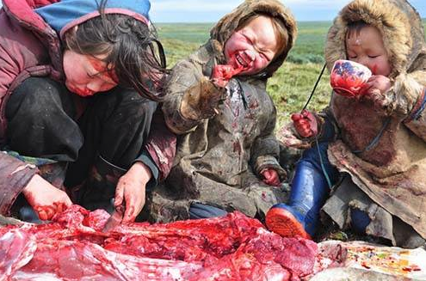
A Typical Siberian Meal
Dig in, we guess?

Slide 12
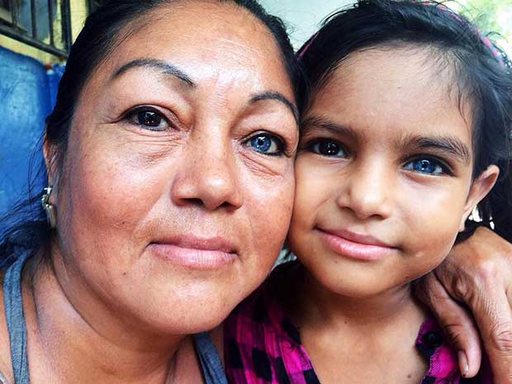
Mother and Daughter Have Similar Unusual Eyes
One dark eye and one blue runs through the generations.

Slide 13
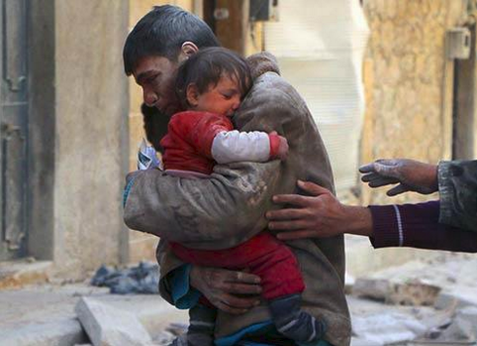
Save From Destroyed Home
A man risked his life to save his baby sister from their crumbling home in Syria.

Slide 14
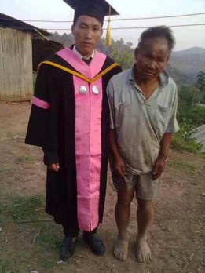
Proud Father
He has no money, but this father did everything he could to make sure his son made it through college.

Slide 15
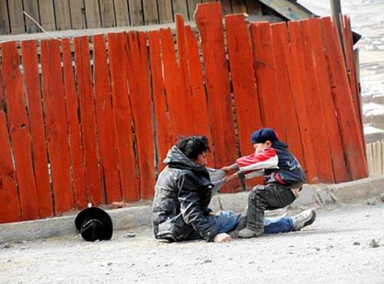
Child Dragging Home His Alcoholic Father
Heart-wrenching to witness.

Slide 16
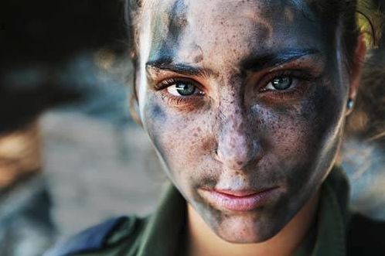
IDF Soldier Pauses After Training
Striking image of a young, 18-year-old woman in the Israeli Defense Forces.

Slide 17
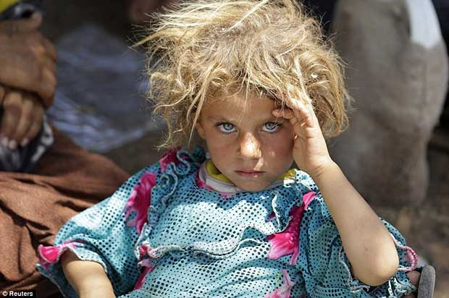
A Young Iraqi Girl
A minority girl from the Yazidi sect in Iraq watches the cameraman.

Slide 18
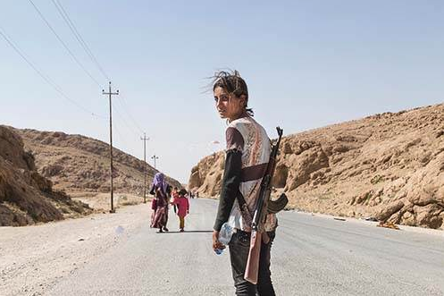
Protect Your Family
To protect her family from ISIS militants, a young Yezidi woman arms herself with an AK-47.

Slide 19
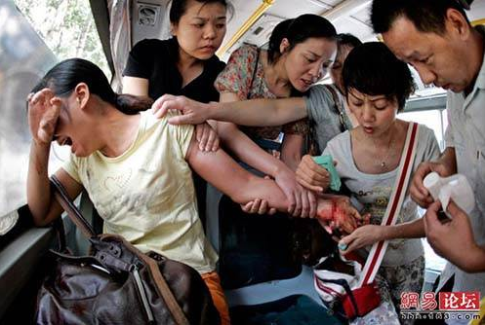
Attempted Suicide
Strangers rally to aide a woman who attempted to commit suicide on a public bus.

Slide 20
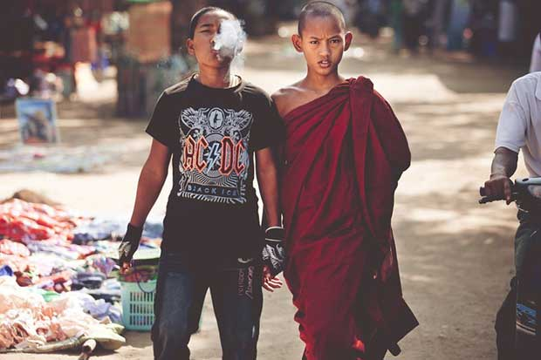
Brothers
A monk and his brother link hands.

Slide 21
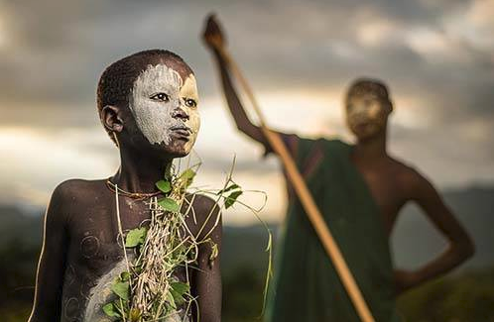
Boy From Nomadic Suri Tribe of Ethiopia
He’s dressed in traditional body paint and natural attire.

Slide 22
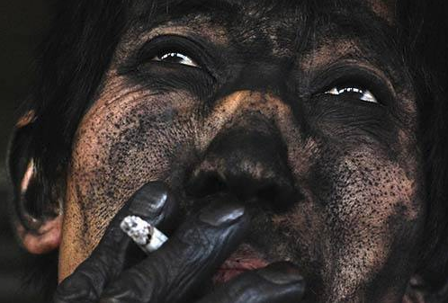
Chinese Coal Miner
There isn’t a smidge of skin on his hands that isn’t black. Crazy!

Slide 23
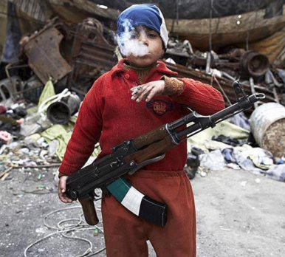
7-Year-Old Syrian Rebel
For some, they have little choice in the life they are taught.

Slide 24
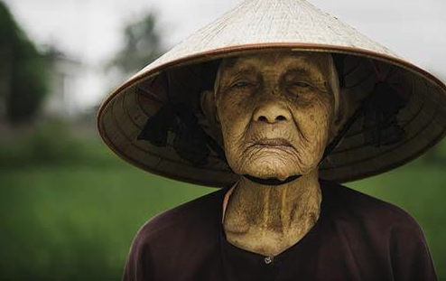
Old Rice Farmer from a Small Village in Vietnam

Slide 25
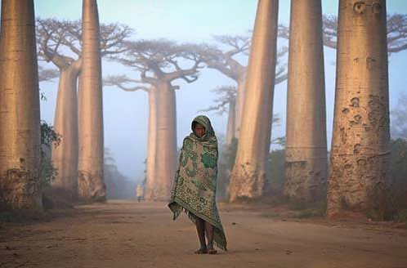
Girl Walks Between Villages Among Baobab Trees

Slide 26
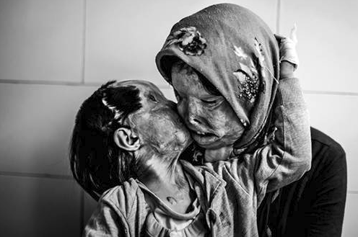
Acid Attack Victims
A 3-year-old kisses her mother. They survived an attack by the father/husband.

Slide 27
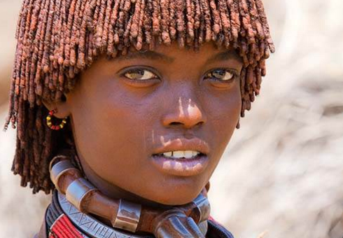
Ethiopian Girl from the Hamer Tribe

Slide 28
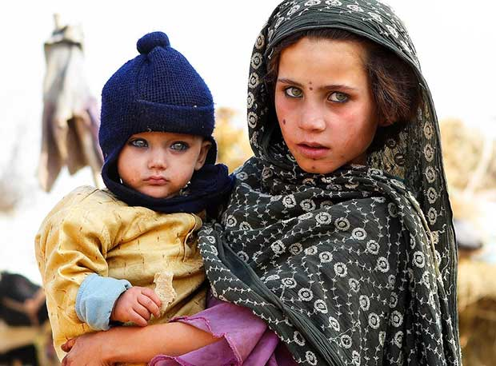
Mother & Son
The eyes are the window to the soul.

Slide 29
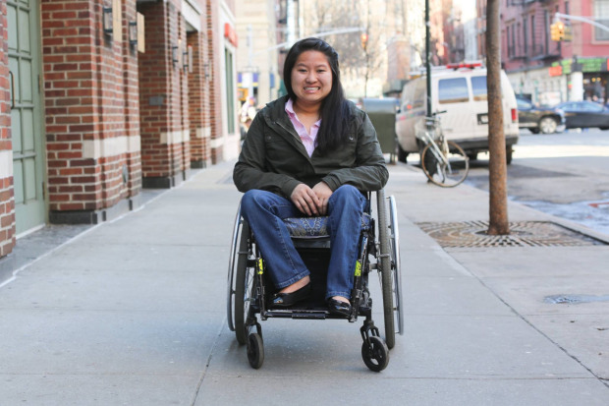
Additional ones

Slide 30
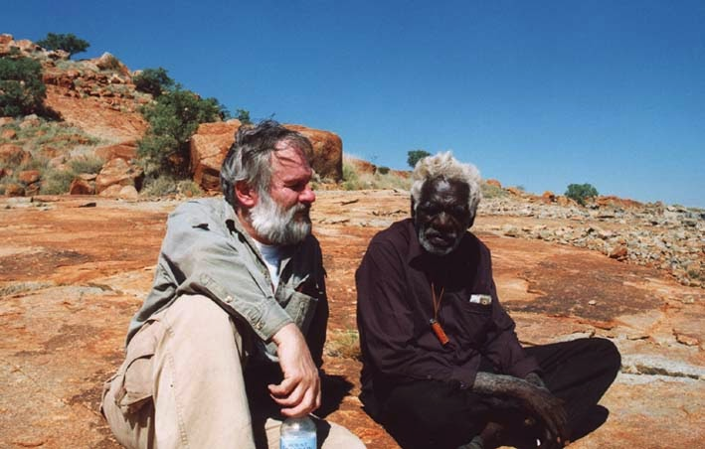

Slide 31
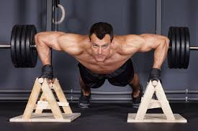

Slide 32
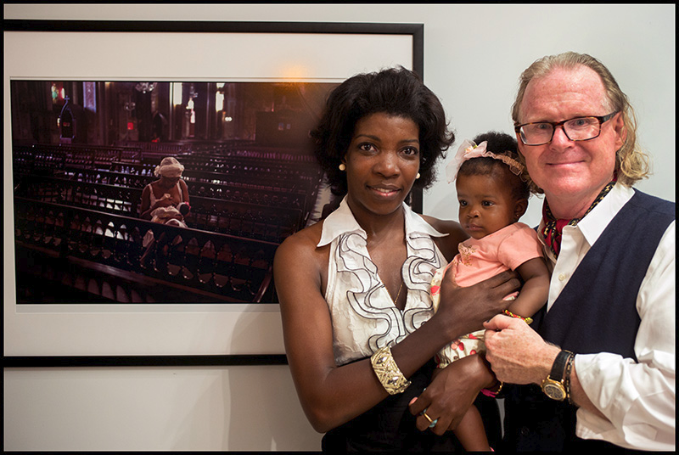

Slide 33
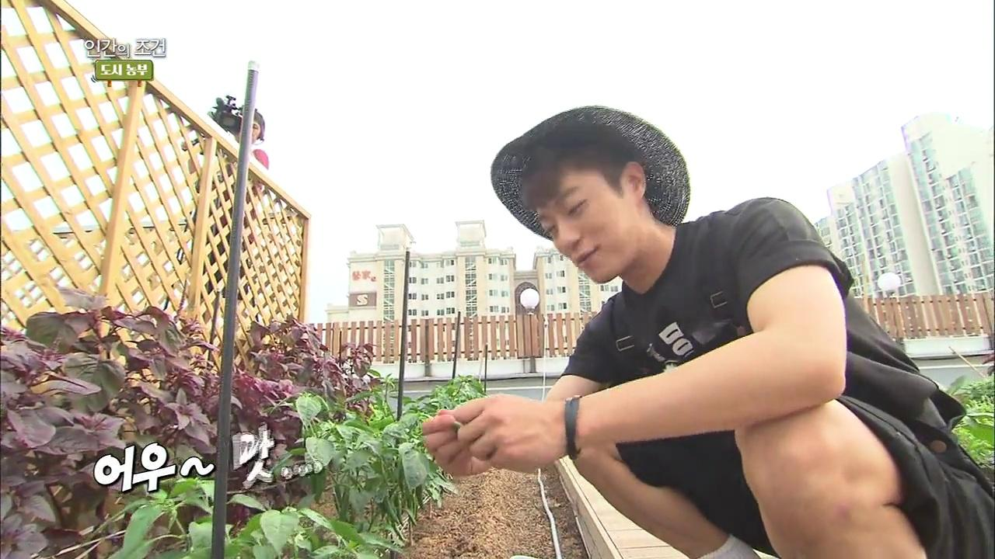

Slide 34


Slide 35
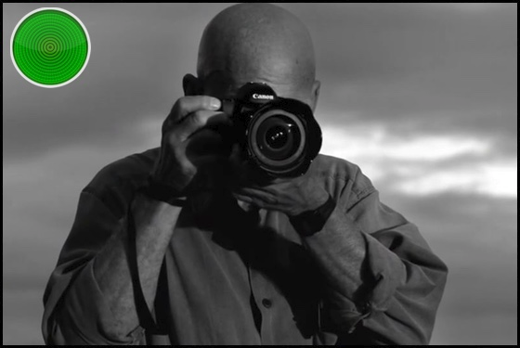

Slide 36
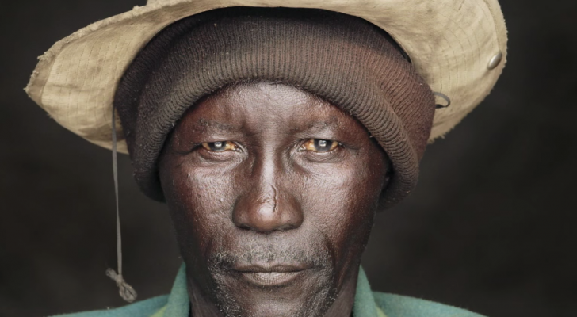

Slide 37
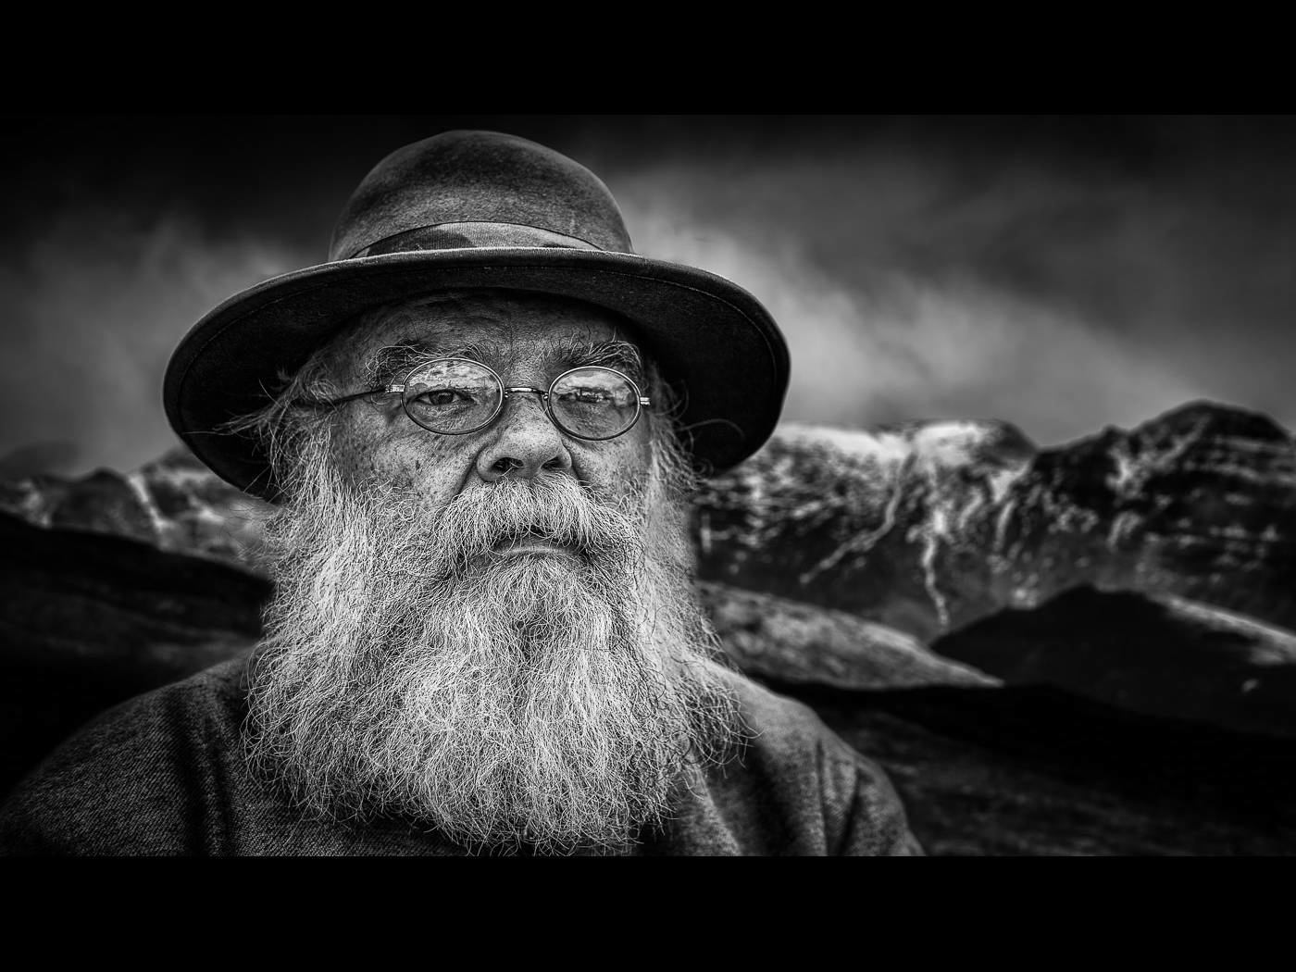

Slide 38
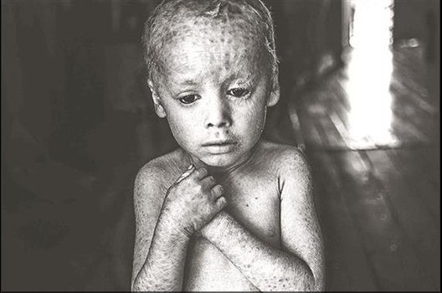

Slide 39
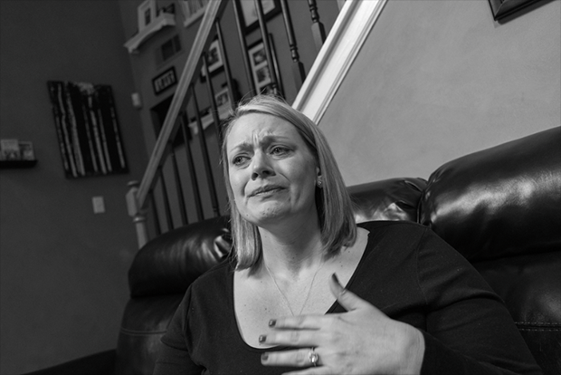

Slide 40
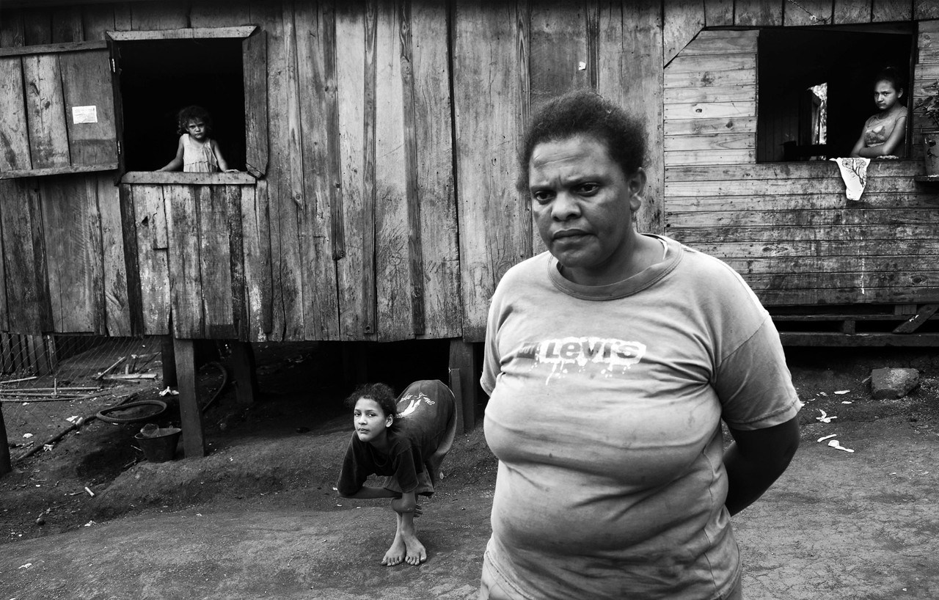
The Human Cost of Agrotoxins

Slide 41
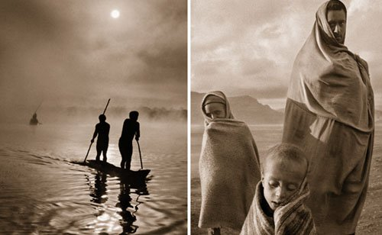

Slide 42
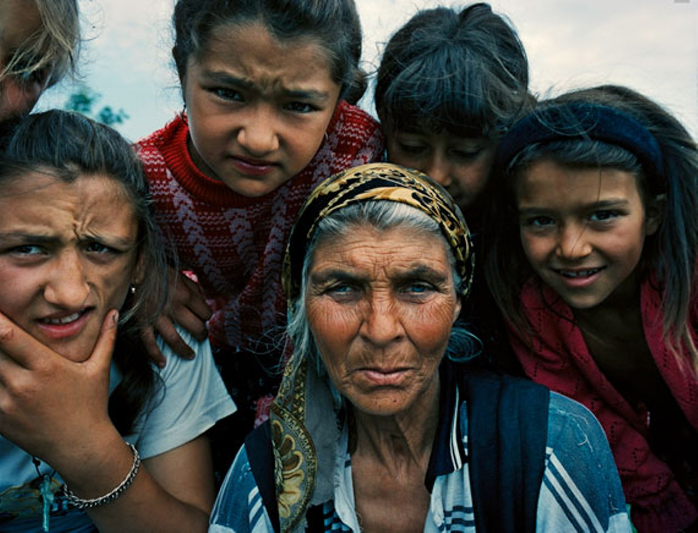
The Roma People (Gypsies)

Slide 43
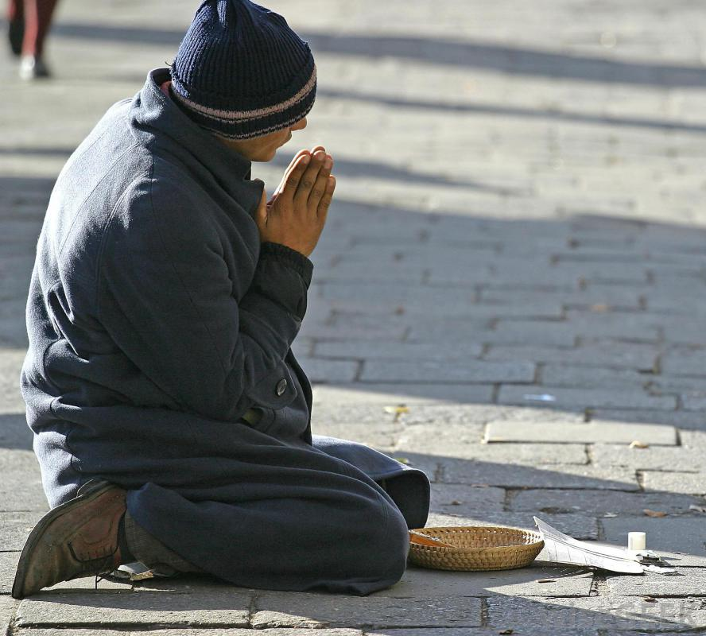

Slide 44
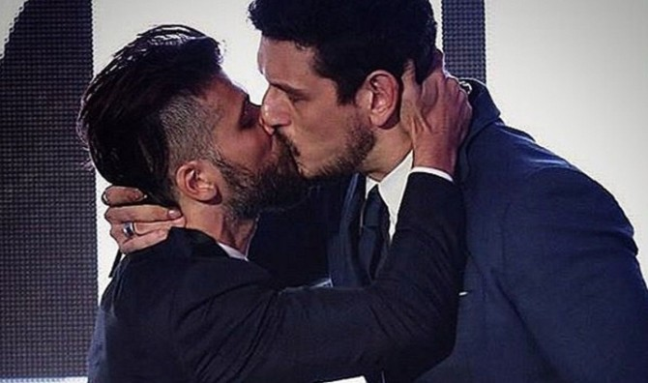

Slide 45


Slide 46
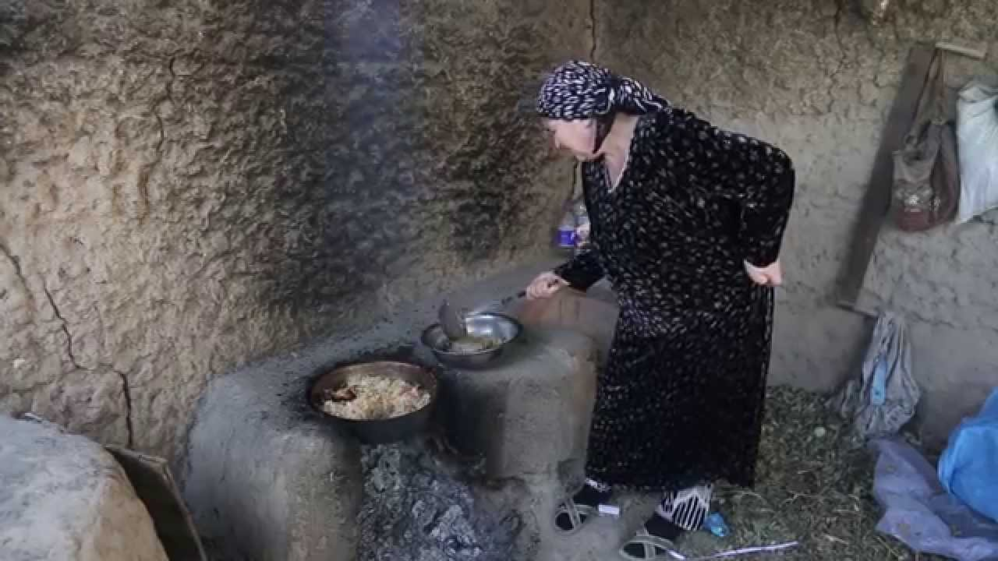

Slide 47
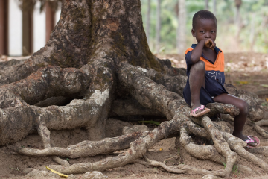

Slide 48
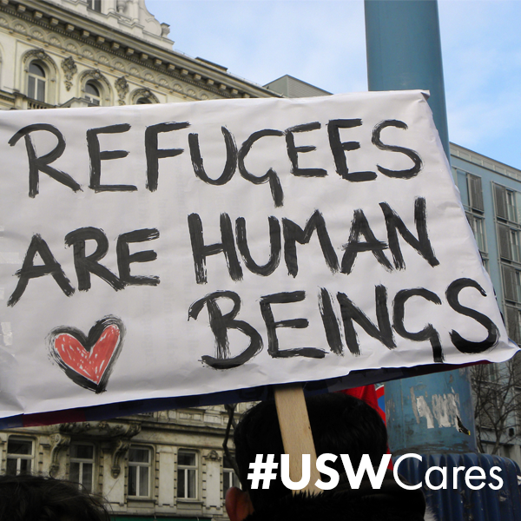

Slide 49
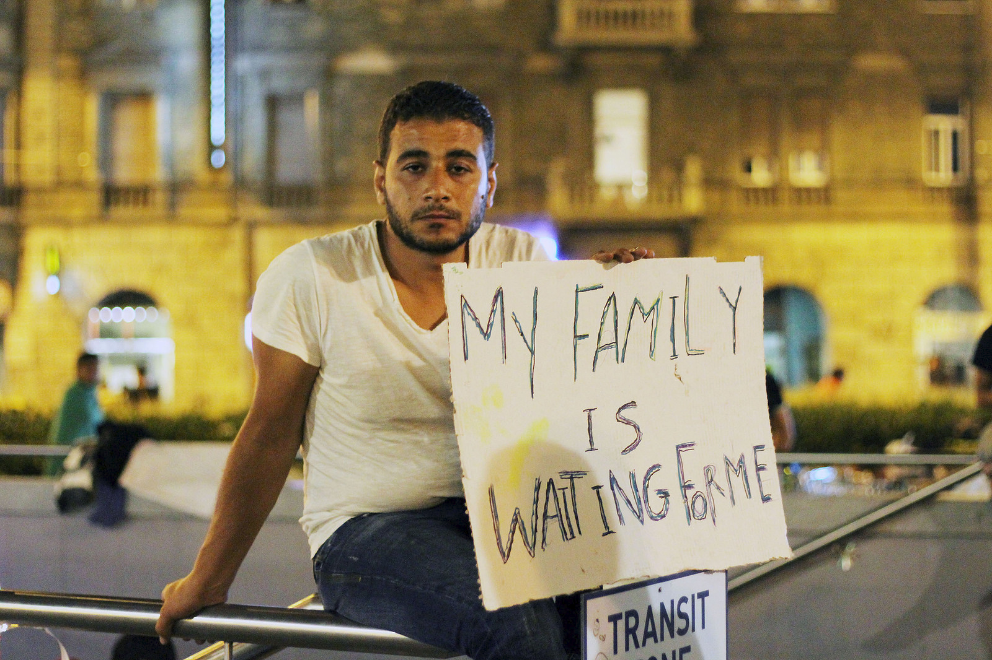

Slide 50
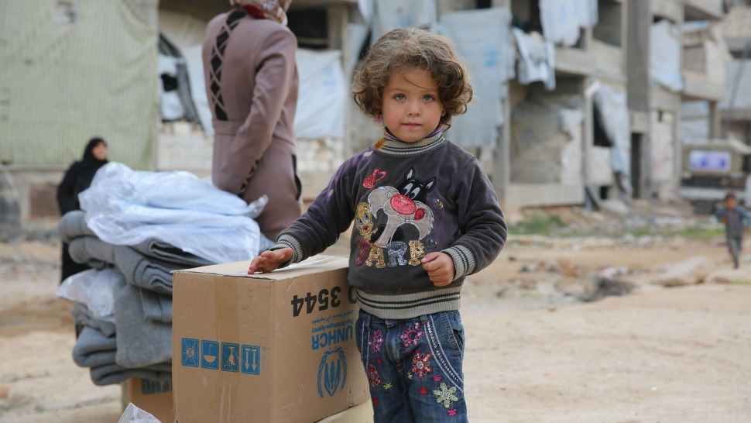

Slide 51
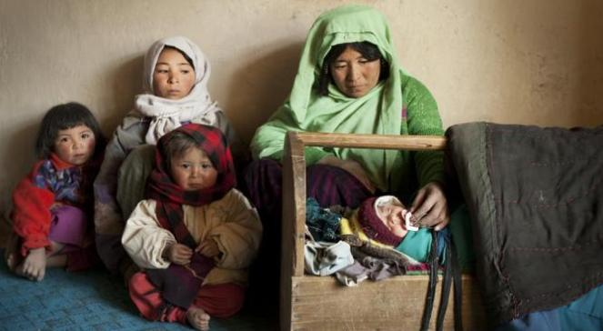

Slide 52
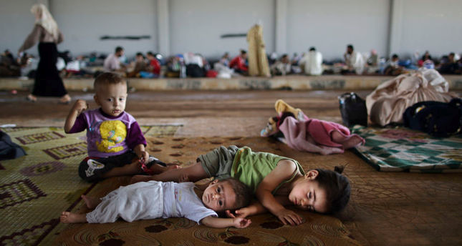

Slide 53
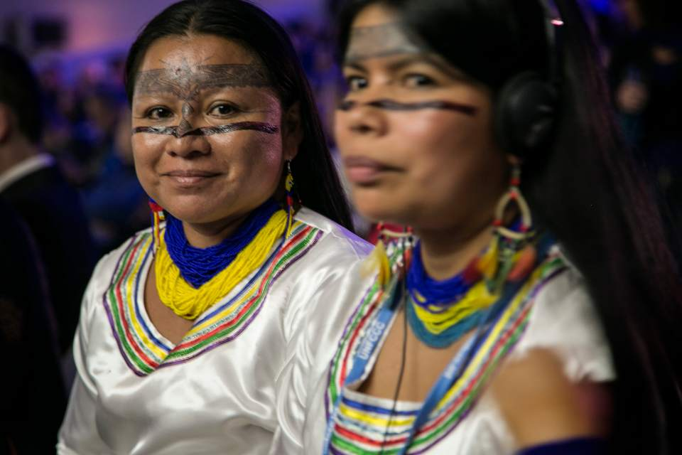

Slide 54
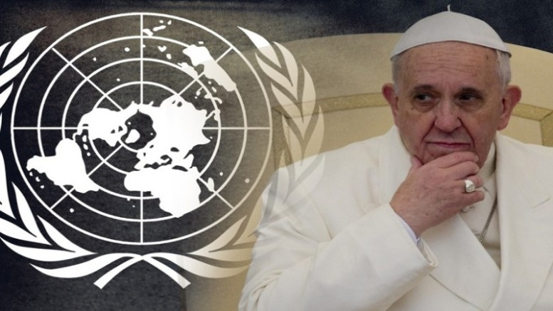

Slide 55


Slide 56


