Slide 1
10 Medicines Used Around the Year 0001 C.E. and Facts About Hygiene In Ancient Egypt
“Biblical Times” and earlier

Slide 2
Medicine in Ancient Times
It has been reported that medicine around the first century was strongly influenced by Greek medicinal standards. The Greeks had revolutionized the concepts and practices of medicine and these new practices were adopted by the Romans of Jesus’ time. Because much of the Greek medicine revolved around the four fluids, or ‘humors’, of the human body (blood, phlegm, black bile, and yellow bile), much of the medicine practiced at the time involved altering the levels of these fluids. Therefore, medical practices such as bloodletting, vomiting, baths, heating, cooling, and sweating were common.

Slide 3
However, these were not the only forms of medicine practiced. In addition to various traditional folk medicines and magical practices, numerous herbs were used to treat common conditions of the times. While few of these are mentioned in the Bible, descriptions of commonly used herbal medications were recorded in texts written by learned men of Jesus’ time. These include Di Medicina by Celsus and Naturalis Historia by Gaius Plinius Secundus (Pliny the Elder).

Slide 4
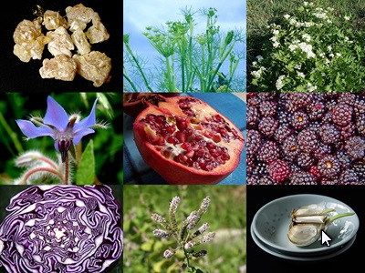

Slide 5
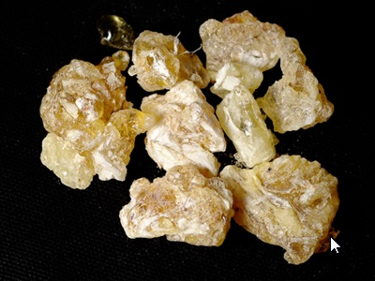
Frankincense
Frankincense has been reported to have numerous health benefits. It has been used traditionally as an antiseptic to prevent infections. It has also been suggested that frankincense helps with digestive problems, coughs, colds, and that its astringent properties helps strengthen gums, hair, and skin.

Slide 6
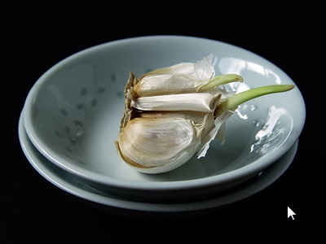
Garlic
Garlic has long been part of various traditional medicine practices due to its perceived health properties. Research over the years has confirmed that garlic has antibacterial, anti-viral, anti-parasitic, and antioxidant properties. These properties led to the use of garlic for overall health as well as digestive health.

Slide 7
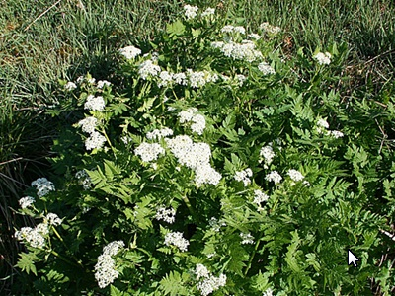
Myrrh
Myrrh also has a number of medicinal properties. Myrrh has been shown to have astringent, antibacterial, anti-fungal, and anti-inflammatory properties. This led to myrrh being traditionally used to improve circulation, boost the immune system, reduce fevers, treat digestive problems, and treat coughs and colds.

Slide 8

Borage
Best known today as an oil rich in omega-9 fatty acids with anti-inflammatory benefits, borage was often traditionally used to reduce fevers and rheumatisms and as an anti-depressant or relaxant.

Slide 9
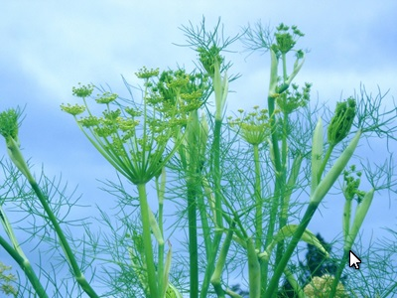
Fennel
While traditionally thought to be beneficial for eye health according to Naturalis Historia, fennel has been shown in modern times to be a rich source of vitamin C and other antioxidant and anti-inflammatory phytonutrients

Slide 10
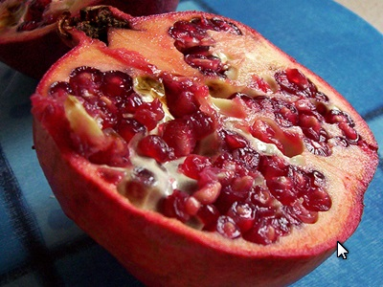
Pomegranate
Pomegranate was used for numerous remedies. The roots of the pomegranate were cooked and used to eliminate tapeworms, while the flowers were used to treat dysentery and ulcers of the mouth. Today, research has shown that pomegranates are a rich source of antioxidant phytonutrients and have a number of additional anti-cancer and anti-inflammatory health benefits

Slide 11
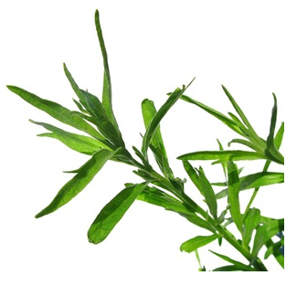
Tarragon
Probably best known as a spice for its flavor-enhancing qualities, tarragon has several uses in traditional medicine. Tarragon leaves were used to settle an upset stomach and stimulate a lost appetite. Brewed as a tea, it was reported to help sleep troubles. It was also chewed to numb a toothache.

Slide 12

Cabbage
Pliny’s Naturalis Historia indicates at least 87 remedies attributable to cabbage. Eating raw cabbage was considered beneficial for headaches, poor eyesight, and organ health. Concoctions of cabbage with warm water were used as a poultice to treat wounds, sprains, and cancers (even though not called “cancer” at the time).

Slide 13
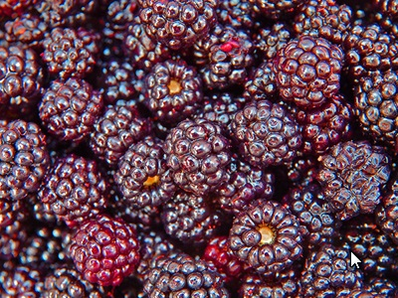
Blackberries
Referred to as mulberries of the bramble in Naturalis Historia, Pliny indicated that blackberries were useful for many remedies including maladies of the gums and tonsils and neutralization of snake venom. Extracts of the bramble shoots were supposed to have a diuretic effect, while the leaves were used to treat diseases of the mouth and skin ulcers.

Slide 14
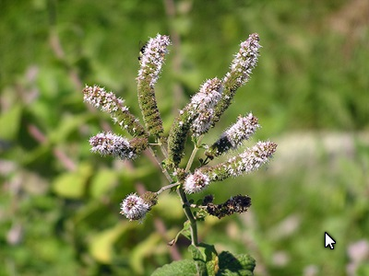
Hyssop
The hyssop is though of as “The Holy Herb” by many because it was used to sprinkle water and blood during ritualistic cleansing of lepers and to paint blood on homes of the Israelites during the Passover. From a medicinal standpoint, hyssop was commonly used in tea for coughs and shortness of breath and in plasters and chest rubs as a chest decongestant. Hyssop has also been used for the relief of arthritis and rheumatism and to treat bruises, cuts, and wounds.

Slide 15
Facts About Hygiene In Ancient Egypt
Research of ancient civilization evidently demonstrates that the Egyptians were well ahead of their time. The following cases not only demonstrate the ingenious innovations of a primordial society but their remarkably immaculate and admirable hygiene.

Slide 16
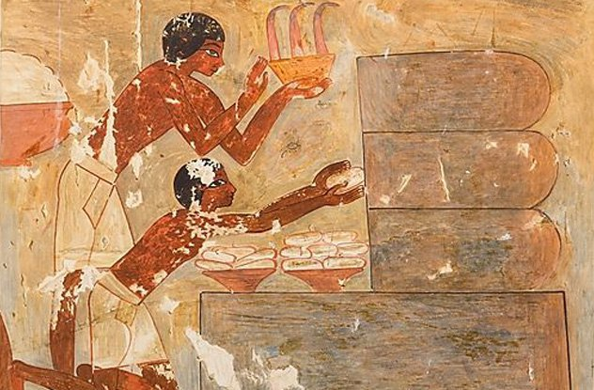
The Breath Mint
Hesi-Re is credited as being the world’s first dentist, serving under pharaoh Djoser around 1600 BC during the Third Dynasty of Egypt. However, the first evidence of dentistry dates back to 3000 BC with the Edwin Smith Surgical Papyrus, a manual with detailed instructions on how to cure wounds in the mouth. It was during this time that the dawn of minor dental surgery was performed, slowly paving a way to more complex procedures such as pulling teeth and drilling out cavities. For those whose breath smelled as bad as the armpits of the lower class, honey was combined with boiled herbs and spices, such as cinnamon and myrrh, to form pellets which were then used as breath mints.

Slide 17
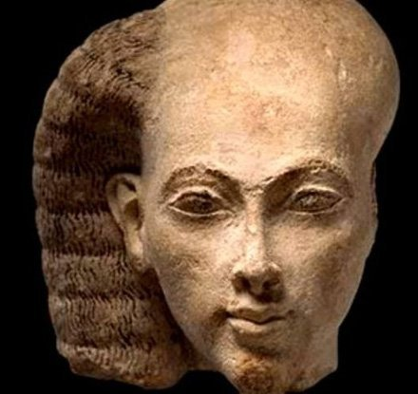
Vermin
The Egyptians had their share of struggles when it came to warding off vermin and parasites. In an effort to rid themselves of head lice, men, women and children would shave their heads, while priests would shave their entire body every other day so that “no lice or any other foul thing may come to be upon them when they minister to the gods.” While shaving would be temporarily effective, other remedies pertaining to repellents were questionable. For instance, a warm potion of date meal and water was believed to drive away fleas and lice. To keep mice from clothing, cats’ fat would be smeared “on everything possible.” One formula that perhaps was of value was sprinkling a solution of natron water, containing salt, in one’s home to eliminate and repel fleas.
Natron is a naturally occurring mixture of sodium carbonate decahydrate (Na2CO3·10H2O, a kind of soda ash) and around 17% sodium bicarbonate (also called baking soda,) along with small quantities of sodium chloride and sodium sulfate. Natron is white to colourless when pure,

Slide 18
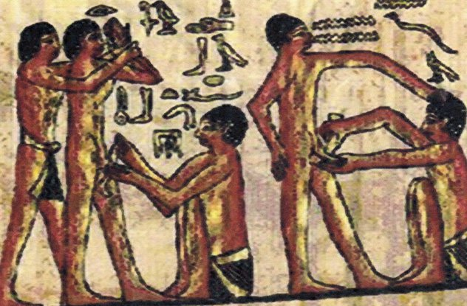
Circumcision
While anthropologists disagree on the origins of circumcision, it is certain that the ritual was practiced in Egypt as far back as 4000 BC. Mass circumcision ceremonies would take place primarily in the upper classes, being recognized as both a puberty rite as well as for the sake of cleanliness. This comes as no surprise given that circumcision has been practiced by various religions spanning thousands of years. What is surprising is that some anthropologists argue that the procedure arose as a mark of defilement or slavery. Slaves would be forced to undergo circumcision given that the procedure was viewed as sufficiently humiliating.

Slide 19
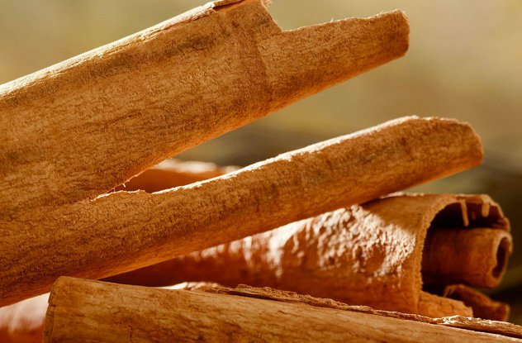
Deodorant
It’s not hard to imagine that anyone living prior to the 20th century was a tad malodorous. The Egyptians, who are often credited for developing the first deodorant, tried to find a respite from their pungent odors with the help of a variety of spices such as citrus and cinnamon. By mixing and grounding numerous fragrances, including the flowering evergreen shrubs of a carob tree, they were able to mold natural deodorant pellets that they stored in their armpits. In addition, they shaved their underarm hair upon realizing that it decreased their harsh scent. The ancient Greeks are said to have copied the Egyptians underarm application of perfume.

Slide 20
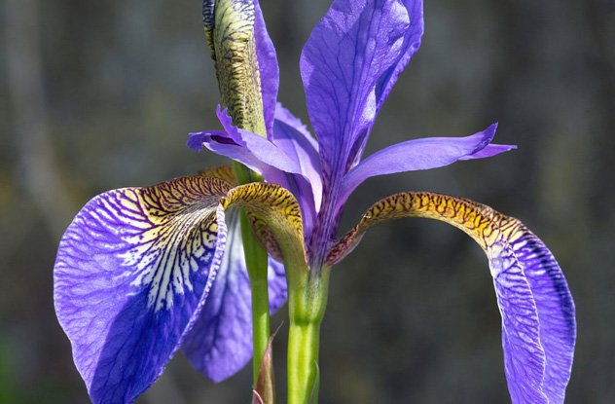
Ancient Recipes
Two thousand years before Hesi-Re was credited as being the world’s first dentist, the Egyptians as well as the Babylonians were making their own version of a toothbrush by fraying the ends of twigs. These “toothsticks” were discovered in tombs beside the mummified remains of their owners dating back to 3500 BC. What’s even more astonishing is that 1,500 years prior to this, Egyptians were using a paste to clean their teeth. In the National Library in Vienna, Austria lies a collection of papyrus documents containing the world’s oldest-known recipe for toothpaste. The formula, which consists of dried iris flower, salt, pepper, and mint, are described as being ahead of its time given that iris is an effective agent against gum disease. Surprisingly, researchers have only recently discovered iris’s beneficial properties validating the innovative brilliance of the ancient Egyptians.

Slide 21
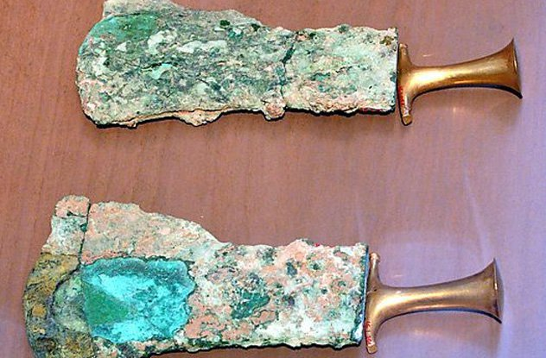
The Tombs
The attention the Egyptians devoted to their appearance is evident from the contents of their tombs. Dating as far back as the Old Kingdom to the Late Period, hair implements as well as entire cosmetic sets were buried with their rightful owner as if to serve a purpose in the afterlife. Such accessories, for example, included ornate hairpins and wide-tooth combs made of ivory and silver. Bronze tweezers to shape the eyebrows and gold razors were also found in abundance. Highly polished copper mirrors with intricate elegant handles were placed under the heads of the deceased or in front of their face.

Slide 22
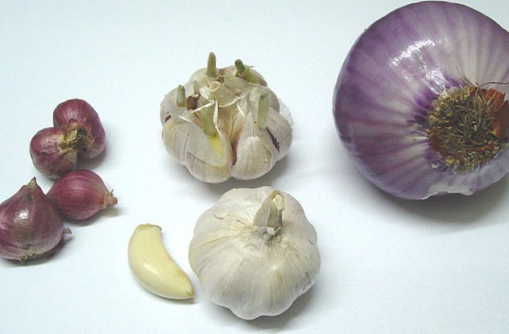
Preventative Medicine
Preventative medicine was just as important to the Egyptians as every other measure they took to maintain their health and avert the spread of disease. They primarily focused on their diet as a means to improve their wellbeing. For example, the Egyptians fed their laborers a diet rich in onion, garlic, and radish to secure the production of their magnificent monuments. The benefit is that these vegetables are extremely rich in allistatin, allicin, and raphanin which are powerful antibiotics that aided in the prevention of disease in crowded working conditions. To cure night blindness, doctors fed their patients powdered liver, which is rich in Vitamin A, a vital nutrient for vision.

Slide 23
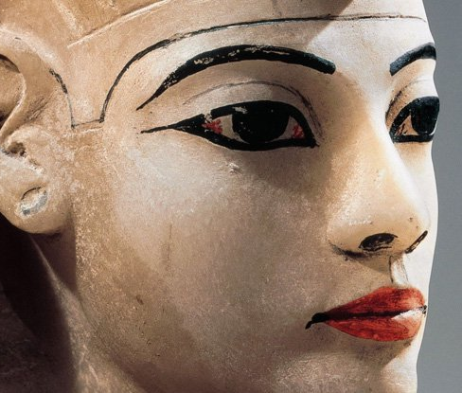
Eye Makeup
Alluring eye makeup served more of a purpose than sheer vanity. Upon analyzing 52 samples from makeup containers preserved in the Louvre museum, scientists found that much of the lead-based substances used in Egyptian cosmetics boosted nitric oxide “by up to 240% in cultured human skin cells.” The importance is that nitric oxide is a key signaling agent in the body, enhancing the immune system to help fight disease. This is of particular importance in tropical marshy areas such as the Nile where eye infections ran rampant. Research shows that two of the compounds recently discovered do not occur naturally. The Egyptians deliberately synthesized and used particular eye cosmetics to help prevent or treat diseases of the eye.

Slide 24
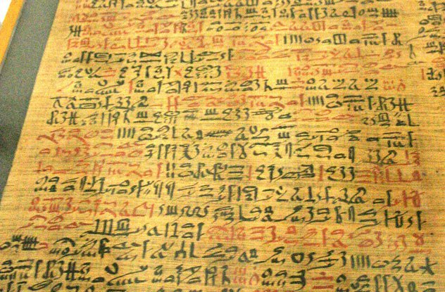
Prescriptions And Medical Knowledge
According to the Ebers Medical Papyrus, which dates back to 1500 BC, the Egyptians formed a soap-like material using alkaline salts in addition to vegetable and animals fats. This substance was not only used for washing but aided in treating skin diseases as well. In fact, the Ebers Papyrus includes 877 prescriptions as well as the earliest documented awareness of tumors. This comes as no surprise—the medicine of the ancient Egyptians has been regarded as some of the oldest documented medical records to date. As Homer who remarked in The Odyssey circa 800 BC, “The Egyptians were skilled on medicine more than any other art.”

Slide 25
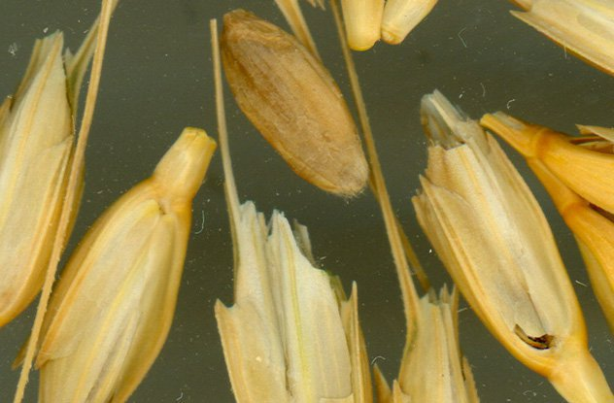
Female Physicians
In a time where women were highly objectified and limited in terms of freedom of choice, the Egyptians differed from other societies in that the educated were entitled to study any field of their choosing. Female physicians primarily pursued obstetrics, and this field, in particular, used a variety of concoctions that are not only fascinating but quite puzzling as to how they came about. For instance, the earliest-known pregnancy test was derived by the Egyptians using barley and emmer (wheat). What they would do is moisten the grains with a sample of urine each day, and if neither the barley nor emmer grew, than that indicated that the woman was not pregnant. The test was quite effective given that urine of non-pregnant women inhibited the growth, a test validated by modern science.

