Slide 1
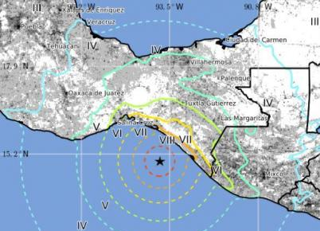
Biggest Earthquake to Hit Mexico in Over a Century Killed 58 and Moved Fault by 32 Feet
9/8/17

Slide 2
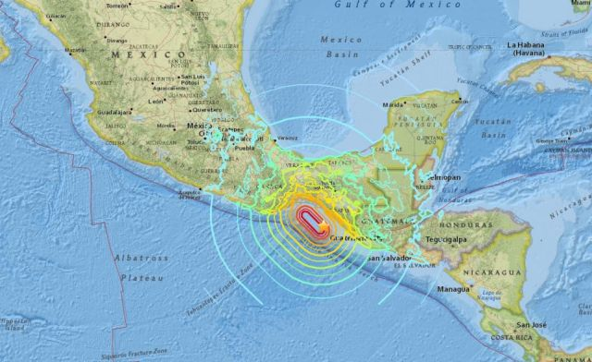

Slide 3
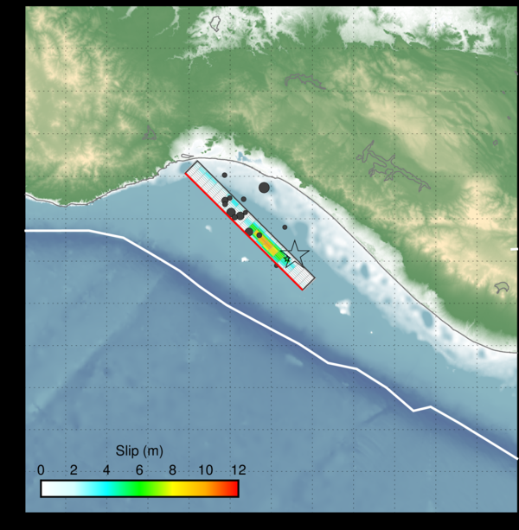
This image depicts how the fault slipped during the magnitude 8.1 earthquake off the coast of Mexico. USGS

Slide 4
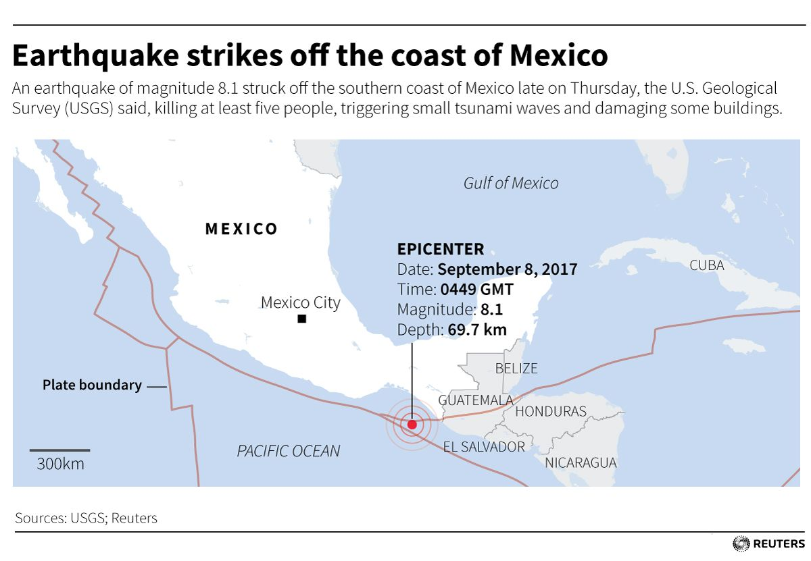

Slide 5
Police, soldiers and emergency workers raced Friday to rescue survivors from the ruins of Mexico's most powerful earthquake in a century, which killed at least 59 people.
In the southern region hit hardest by the quake, emergency workers looked for survivors -- or bodies -- in the rubble of houses, churches and schools that were split down the middle, spilling their innards onto the ground.
President Enrique Pena Nieto said 46 people were killed in Oaxaca, 10 in Chiapas and three in Tabasco.
But the death toll could be over 80, according to higher figures reported by state officials.
The hardest-hit city was Juchitan, Oaxaca, where at least 17 bodies were pulled from the ruins and where the total death toll was probably "between 30 and 40 people," according to Governor Alejandro Murat.

Slide 6
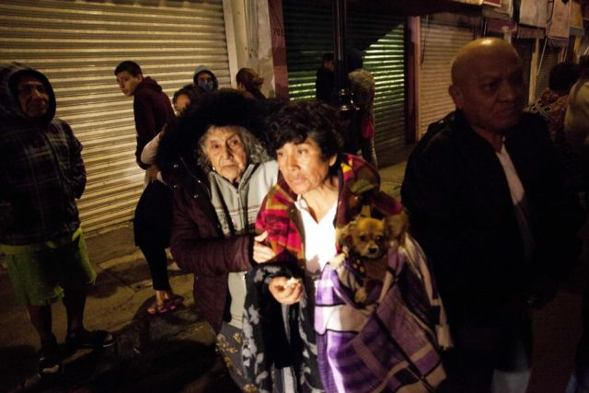

Slide 7
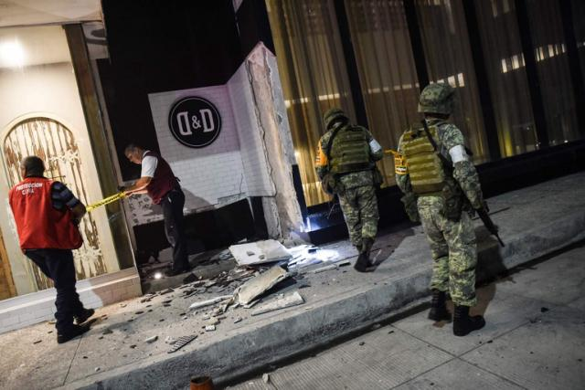

Slide 8
The quake epicenter was in the Pacific Ocean, about 100 kilometers (60 miles) off the town of Tonala, in Chiapas. It hit at 11:49 pm Thursday (0449 GMT Friday), Mexico's seismologic service said.
The US Geological Survey put the magnitude slightly lower, at 8.1 -- the same as in 1985, the quake-prone country's most destructive ever.
The quake was felt as far north as Mexico City -- some 800 kilometers from the epicenter -- where people fled their homes, many in their pajamas, after hearing sirens go off.
Officials initially issued a tsunami alert, but later lifted it. However, the quake provoked large waves that reached as far as New Zealand, more than 11,000 kilometers away, authorities there said.

Slide 9
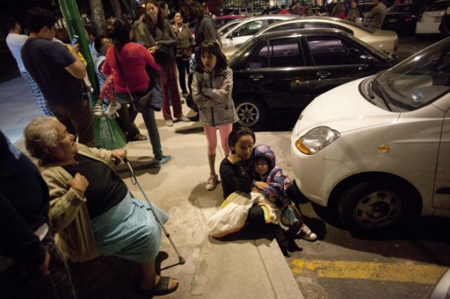
Mexico City, Sept. 7.

Slide 10
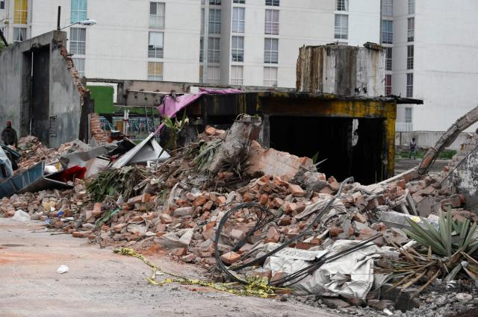
Mexico City, Sept. 8.

Slide 11
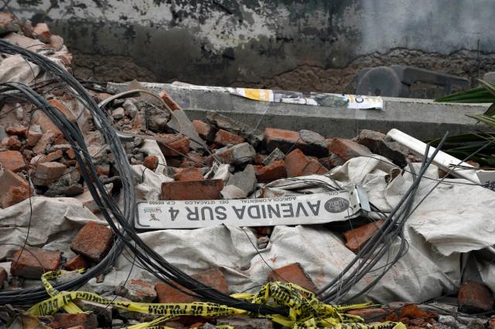
Mexico City

Slide 12
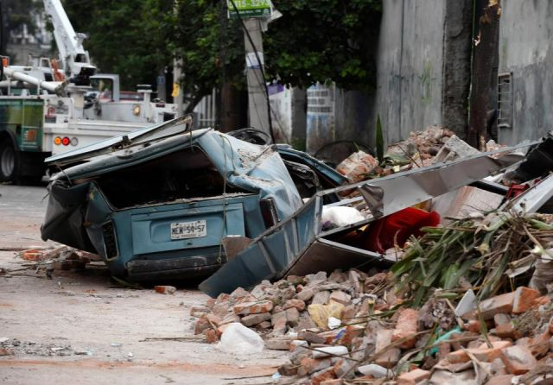
Mexico City

Slide 13
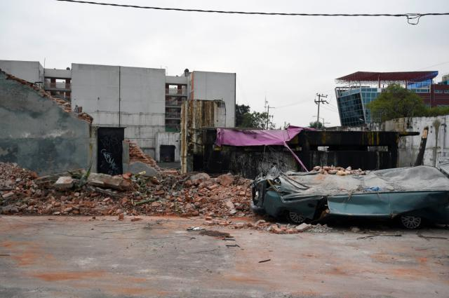
Mexico City

Slide 14
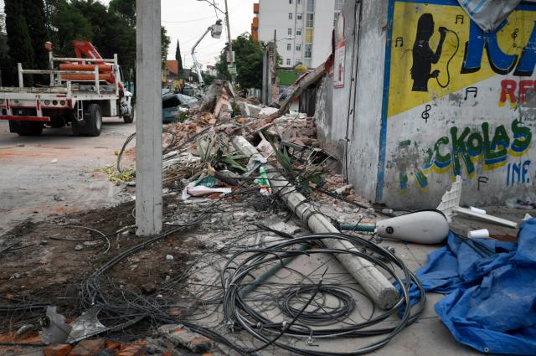
Mexico city

Slide 15
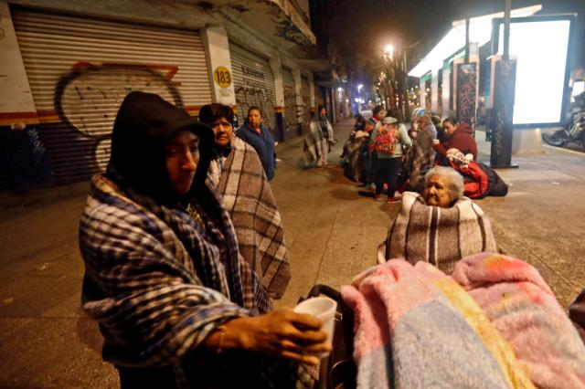
Mexico City

Slide 16
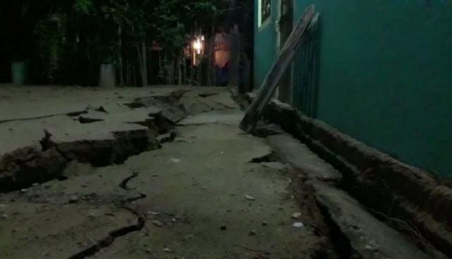
Minatitlan, Sept. 8.

Slide 17
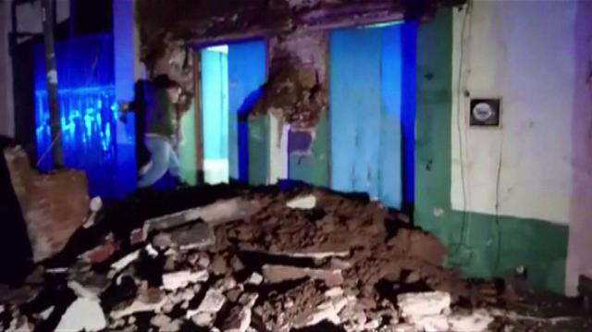
Oaxaca, Sept. 8.

Slide 18
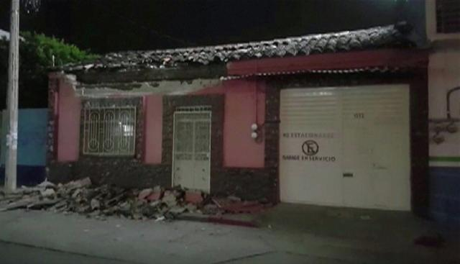
Tuxtla Gutierrez, Sept. 8.

Slide 19
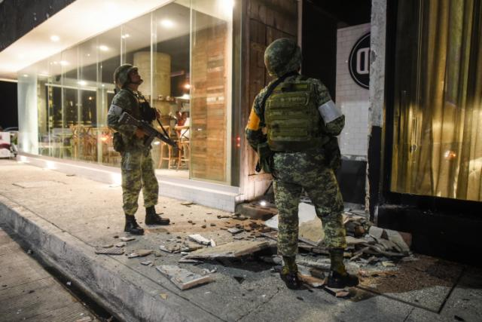
Port of Veracuz, Sept. 7.

Slide 20
